Slide 1
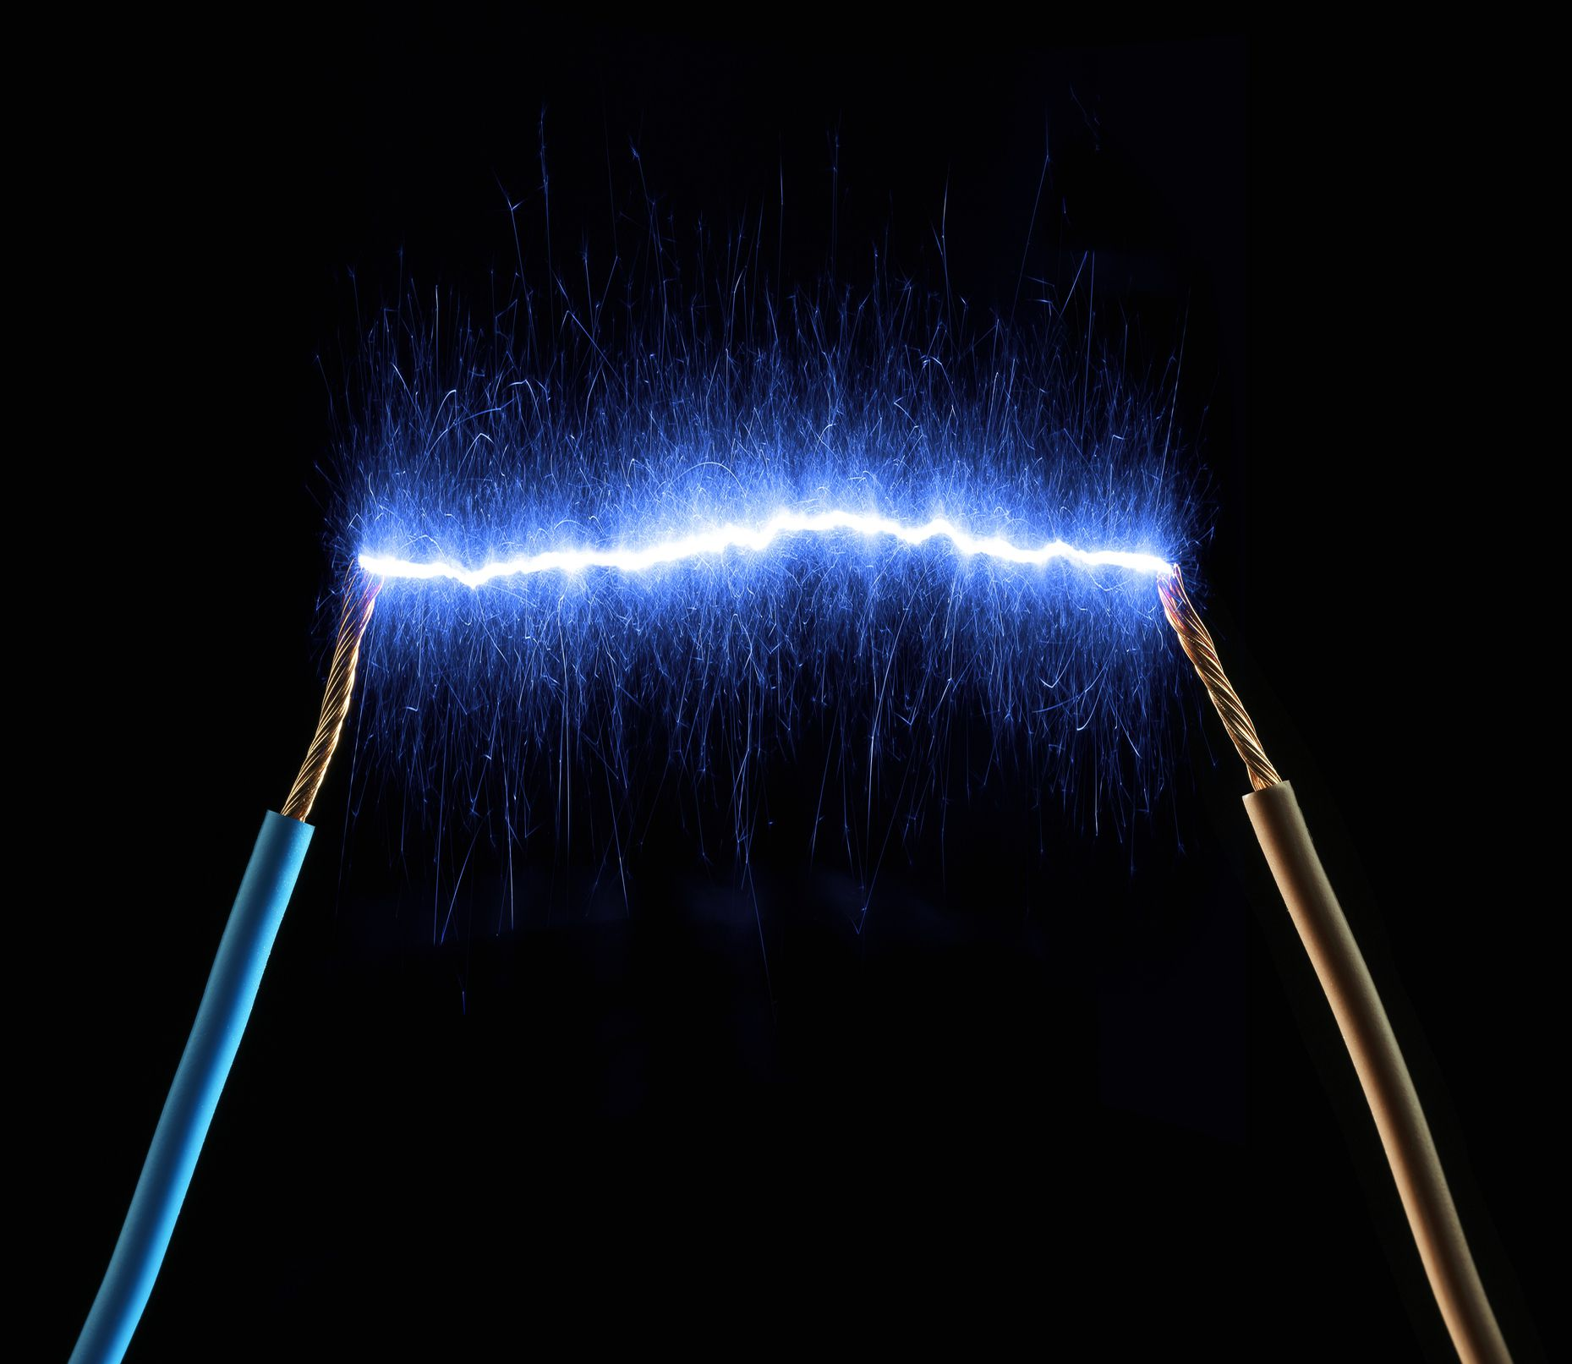

ELECTRIC CURRENT AND RESISTANCE

Slide 2
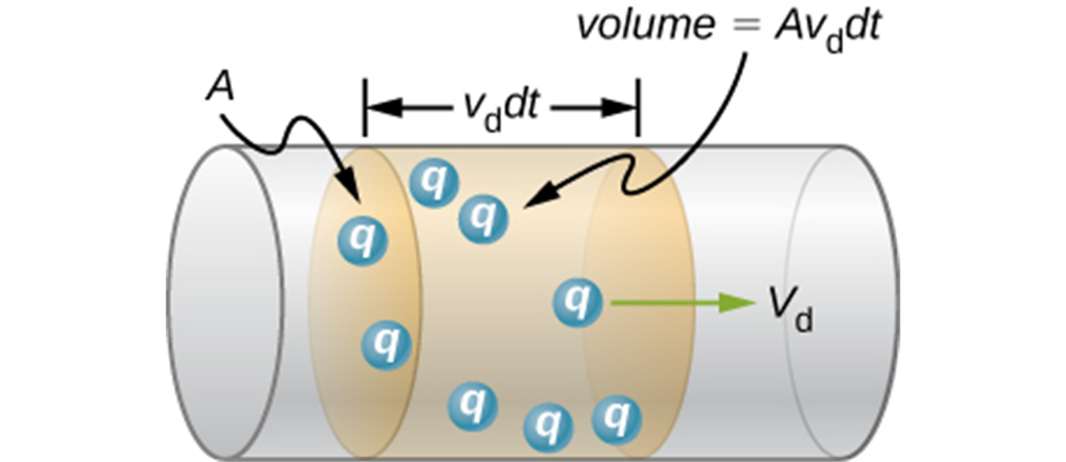
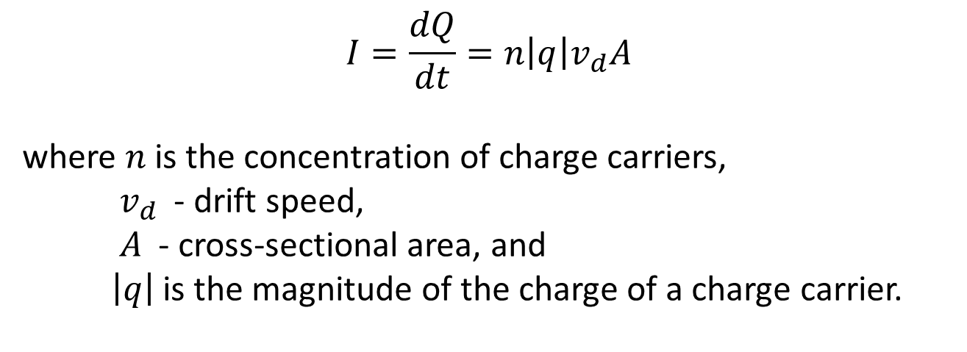
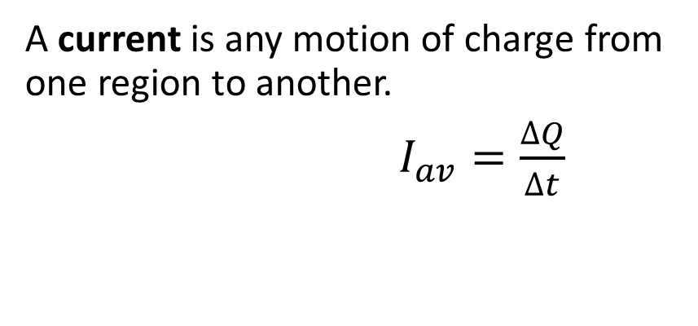
Current, the definition
A current is any motion of charge from one region to another.
$I_{av}=\frac{∆Q}{∆t}$
$$I=\frac{dQ}{dt}=n\left|q\right|v_{d}A$$
where $n$is the concentration of charge carriers,
${ v}_{d}$ - drift speed,
$A$ - cross-sectional area, and
$\left|q\right|$is the magnitude of the charge of a charge carrier.

Slide 3
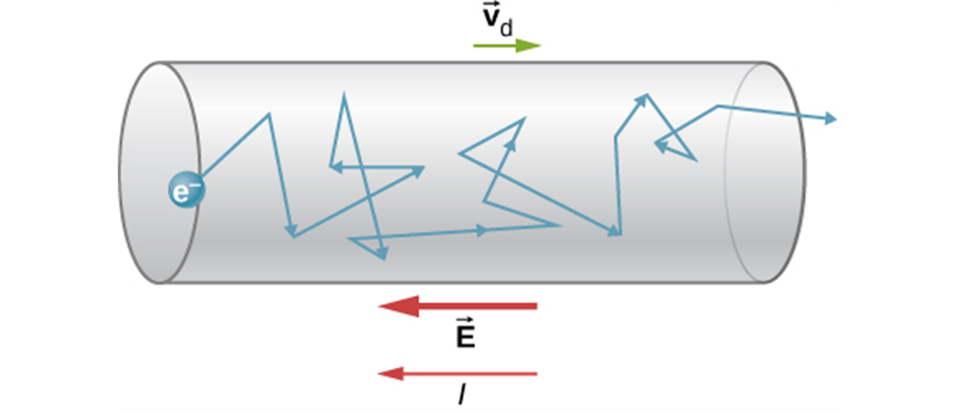
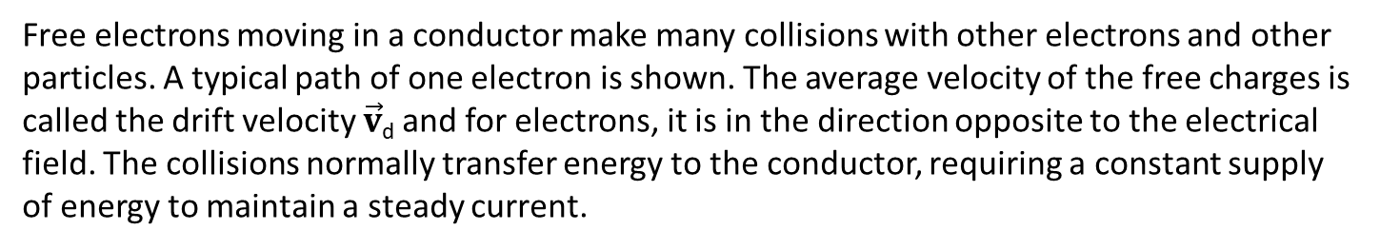
Drift speed
Free electrons moving in a conductor make many collisions with other electrons and other particles. A typical path of one electron is shown. The average velocity of the free charges is called the drift velocity $\vec{v}$_{d} and for electrons, it is in the direction opposite to the electrical field. The collisions normally transfer energy to the conductor, requiring a constant supply of energy to maintain a steady current.

Slide 4
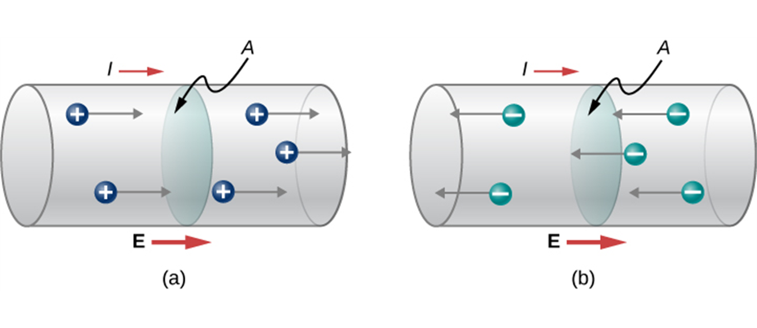
Direction of the current
Current I is the rate at which charge moves through an area A, such as the cross-section of a wire. Conventional current is defined to move in the direction of the electrical field.
Positive charges move in the direction of the electrical field, which is the same direction as conventional current.
Negative charges move in the direction opposite to the electrical field. Conventional current is in the direction opposite to the movement of negative charge. The flow of electrons is sometimes referred to as electronic flow.

Slide 5



Definition of current, details
The current direction in a wire is from higher potential to lower potential, or in the direction of the electric field.
Current is measured in coulombs/second, which we define as an ampere A.
1 ampere = 1 A = 1 coulomb/second = 1 C/s
Household currents are typically
For a steady current, the total amount of charge delivered by a current I during time interval

Slide 6
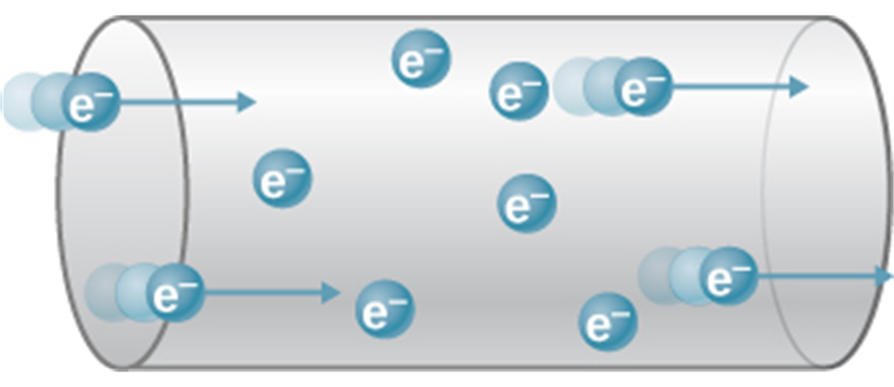
Charge carriers
The charges that move in a current are called charge carriers.
In a metal, the charge carriers are electrons.
It is the motion of the conduction electrons, which are free to move around, that forms a current in the metal.
When charged particles are forced into this volume of a conductor, an equal number are quickly forced to leave. The repulsion between like charges makes it difficult to increase the number of charges in a volume. Thus, as one charge enters, another leaves almost immediately, carrying the signal rapidly forward.

Slide 7
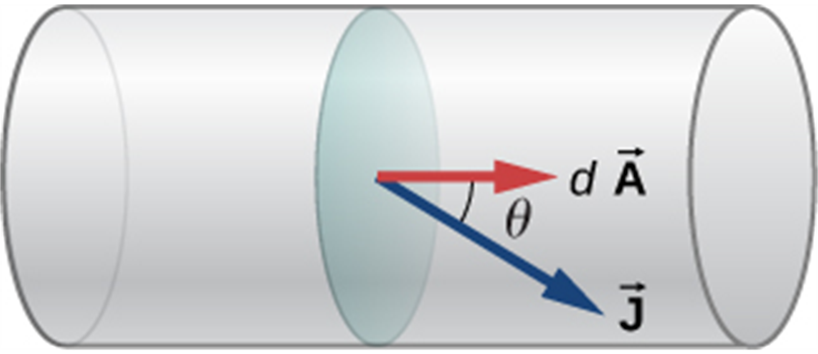
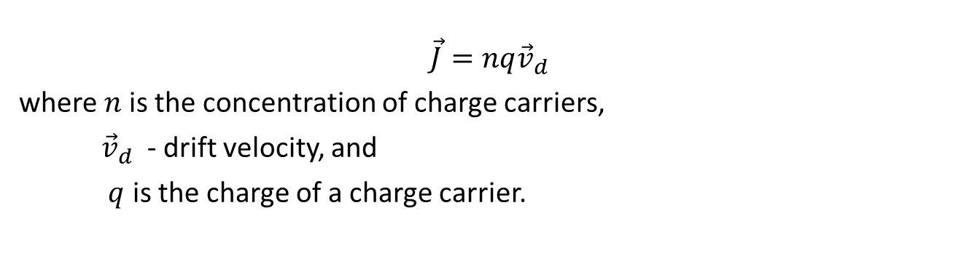
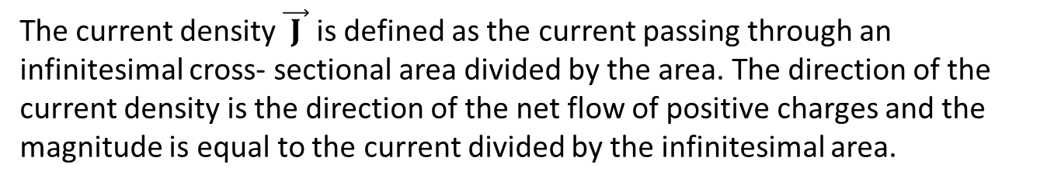
Current density
The current density $\vec{ J }$ is defined as the current passing through an infinitesimal cross- sectional area divided by the area. The direction of the current density is the direction of the net flow of positive charges and the magnitude is equal to the current divided by the infinitesimal area.
$$\vec{J}=nq{\vec{v}}_{d}$$
where $n$is the concentration of charge carriers,
${\vec{v}}_{d}$ - drift velocity, and
$q$ is the charge of a charge carrier.

Slide 8
Drift velocity, example
A wire has a cross-sectional area of 0.10 mm². If there are 4.0 × 10²⁸ atoms per cubic meter in this wire, and if each atom contributes 2 free electrons, what is the drift velocity of the electrons when the current in the wire is 6.0 A? (e = 1.60 × 10⁻¹⁹ C)
Notes:
0.0047 m/s

Slide 9
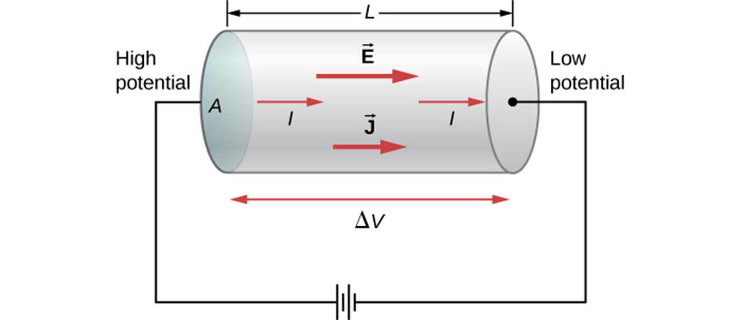
Current density and electric potential difference
A potential provided by a battery is applied to a segment of a conductor with a cross-sectional area A and a length L.

Slide 10
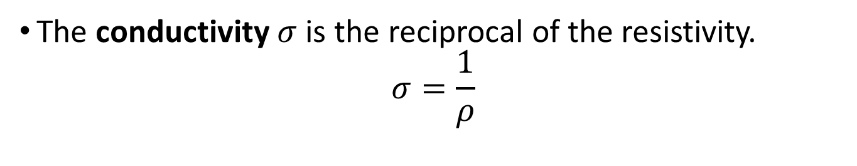
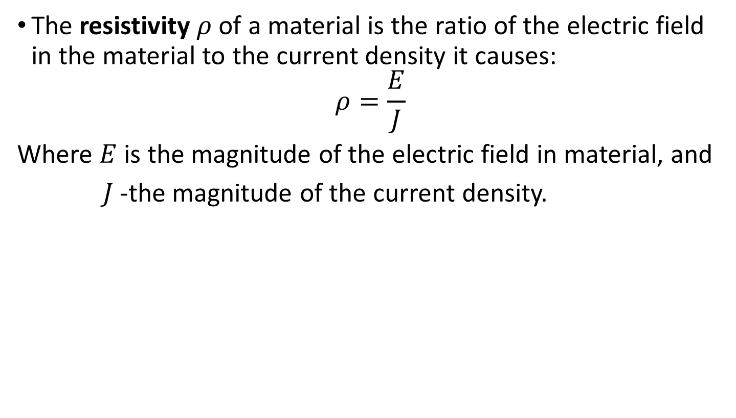
Resistivity and conductivity
The resistivity $ρ$of a material is the ratio of the electric field in the material to the current density it causes:
$$ρ=\frac{E}{J}$$
Where $E$is the magnitude of the electric field in material, and
$J$-the magnitude of the current density.
The conductivity $σ$is the reciprocal of the resistivity.
$$σ=\frac{1}{ρ}$$

Slide 11
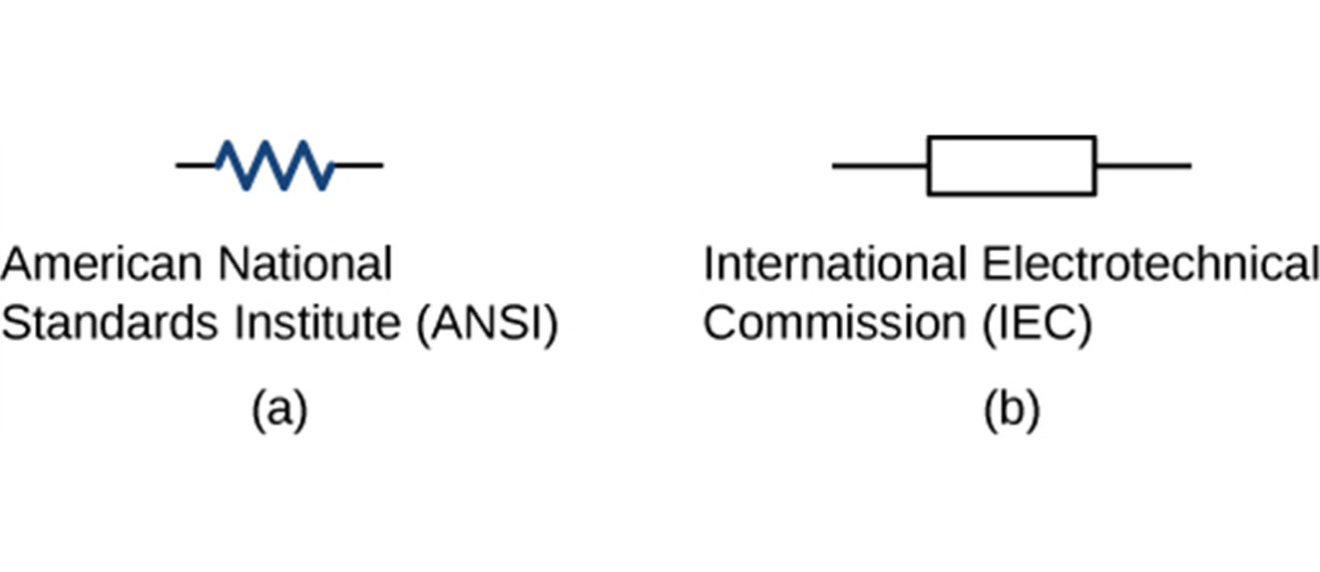
Resistors
Symbols for a resistor used in circuit diagrams. (a) The ANSI symbol; (b) the IEC symbol.

Slide 12
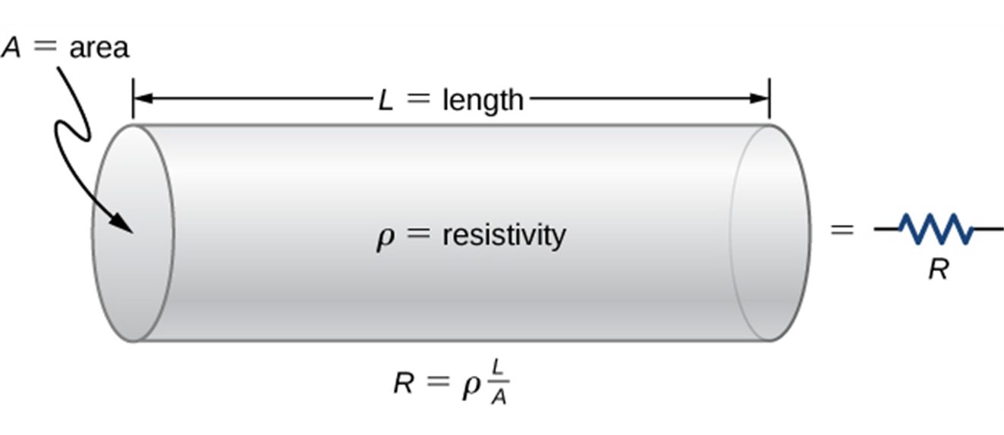
Resistance and resistivity
A model of a resistor as a uniform cylinder of length L and cross-sectional area A. Its resistance to the flow of current is analogous to the resistance posed by a pipe to fluid flow. The longer the cylinder, the greater its resistance. The larger its cross-sectional area A, the smaller its resistance.

Slide 13
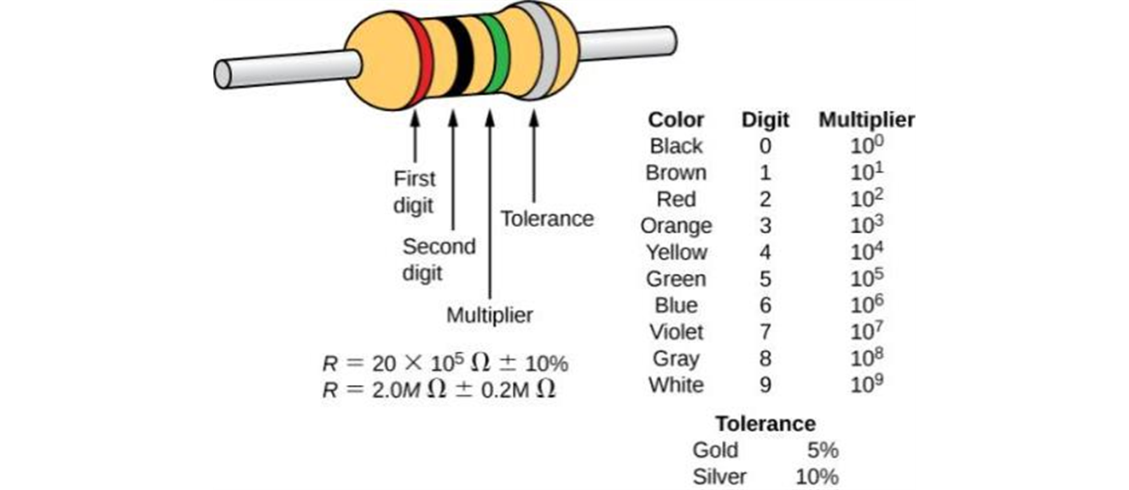
How to identify resistors
Many resistors resemble the figure shown above. The four bands are used to identify the resistor. The first two colored bands represent the first two digits of the resistance of the resistor. The third color is the multiplier. The fourth color represents the tolerance of the resistor. The resistor shown has a resistance of 20 × 10⁵ Ω ± 10%.

Slide 14
Resistivity, example
Nichrome wire, often used for heating elements, has resistivity of 1.0 × 10⁻⁶ Ω ∙ m at room temperature. What length of No. 30 wire (of diameter 0.250 mm) is needed to wind a resistor that has 50 ohms at room temperature?
Notes:
2.45 m

Slide 15
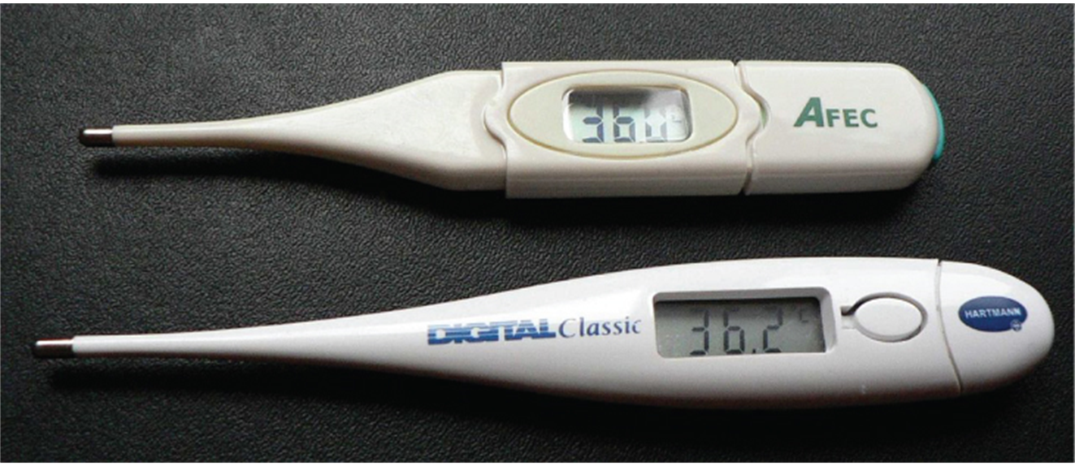
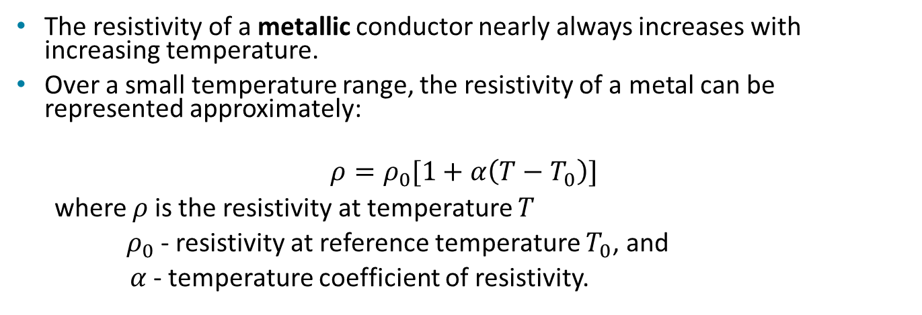
Resistivity and temperature
The resistivity of a metallic conductor nearly always increases with increasing temperature.
Over a small temperature range, the resistivity of a metal can be represented approximately:
$$ρ=ρ_{0}[1+α\left(T−T_{0}\right)]$$
where $ρ$is the resistivity at temperature $T$
${ ρ}_{0}$- resistivity at reference temperature $T_{0}$, and
$α$- temperature coefficient of resistivity.
These familiar thermometers are based on the automated measurement of a thermistor’s temperature-dependent resistance.

Slide 16
Temperature variation of resistivity, example
A platinum wire is used to determine the melting point of indium. The resistance of the platinum wire is 2.000 Ω at 20°C and increases to 3.072 Ω as the indium starts to melt. What is the melting point of indium? The temperature coefficient of resistivity for platinum is 3.9 × 10⁻³(C°)⁻¹.
Notes:
160°C

Slide 17
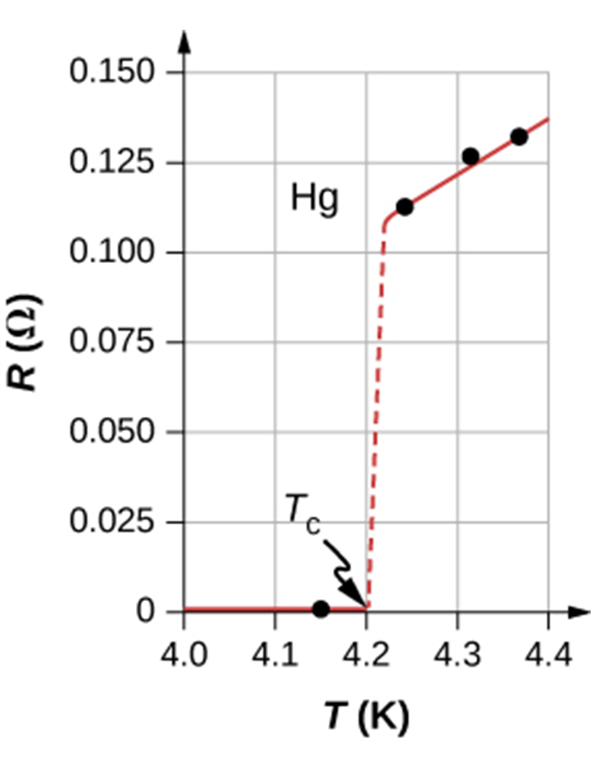
Superconductivity
Some materials show a phenomenon called superconductivity.
As the temperature decreases, the resistivity at first decreases
smoothly, like that of any metal. Below a certain critical
temperature T_{c} a phase transition occurs and the resistivity suddenly drops to zero.
Once a current has been established in a superconducting ring, it continues indefinitely without the presence of any driving field.
The resistance of a sample of mercury is zero at very low temperatures—it is a superconductor up to the temperature of about 4.2 K.

Slide 18
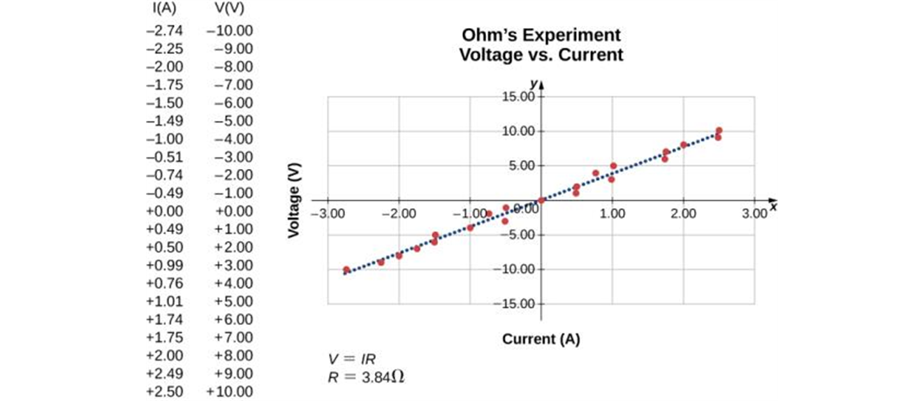
Resistance and Ohm’s law
The potential across a conductor is given by Ohm’s law:
V = IR
A resistor is placed in a circuit with a battery. The voltage applied varies from −10.00 V to +10.00 V, increased by 1.00-V increments. A plot shows values of the voltage versus the current typical of what a casual experimenter might find.

Slide 19
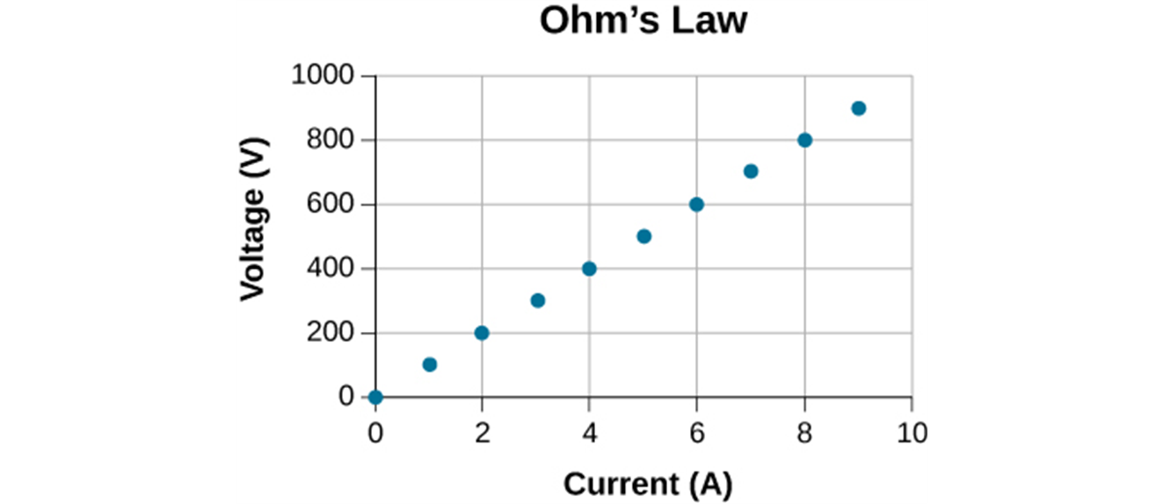
Ohmic resistors
For a resistor that obeys Ohm’s law, a graph of current as a function of potential difference (voltage) is a straight line.

Slide 20
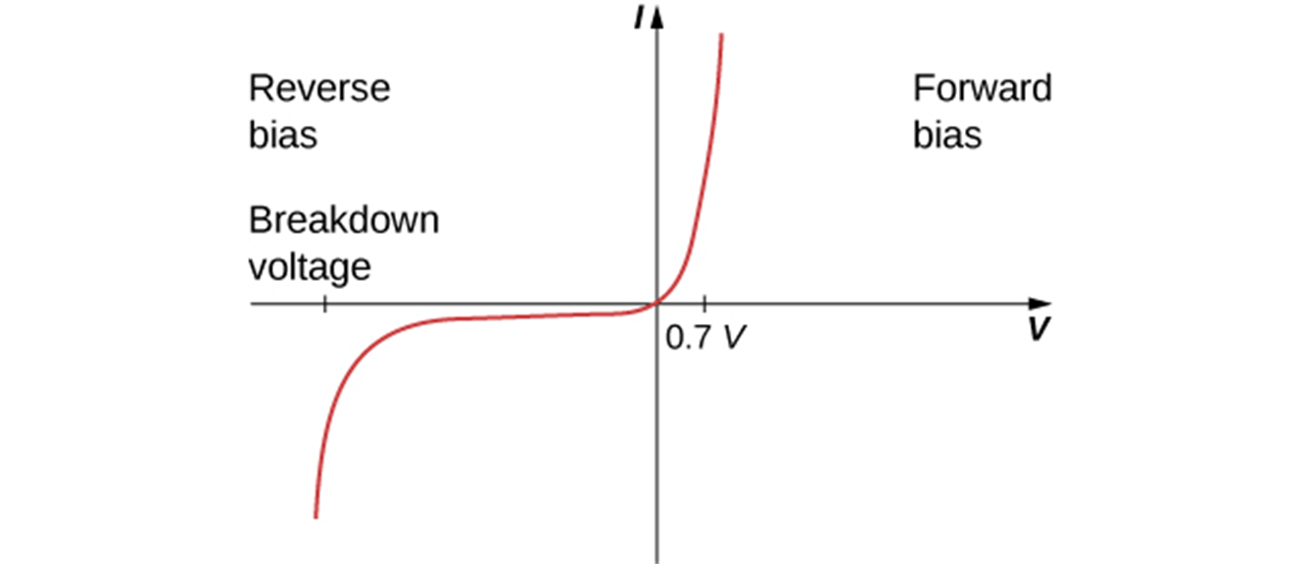
Nonohmic resistors
In devices that do not obey Ohm’s law, the relationship of voltage to current may not be a direct proportion, and it may be different for the two directions of current.
When the voltage across the diode is negative and small, there is very little current flow through the diode. As the voltage reaches the breakdown voltage, the diode conducts. When the voltage across the diode is positive and greater than 0.7 V (the actual voltage value depends on the diode), the diode conducts. As the voltage applied increases, the current through the diode increases, but the voltage across the diode remains approximately 0.7 V.

