Slide 1
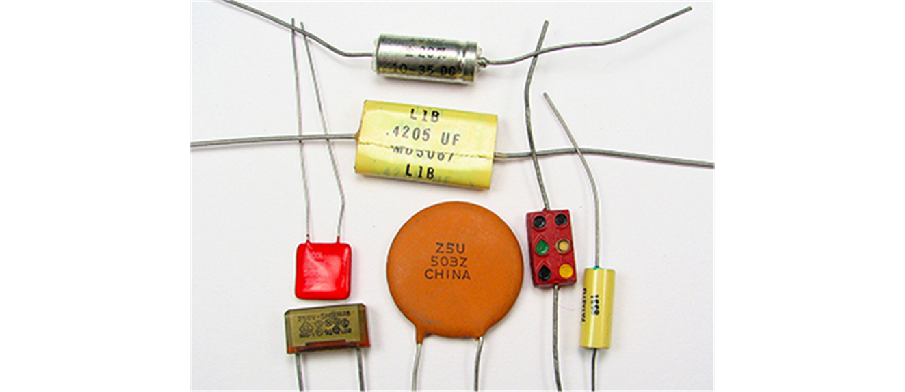


CAPACITANCE

Slide 2
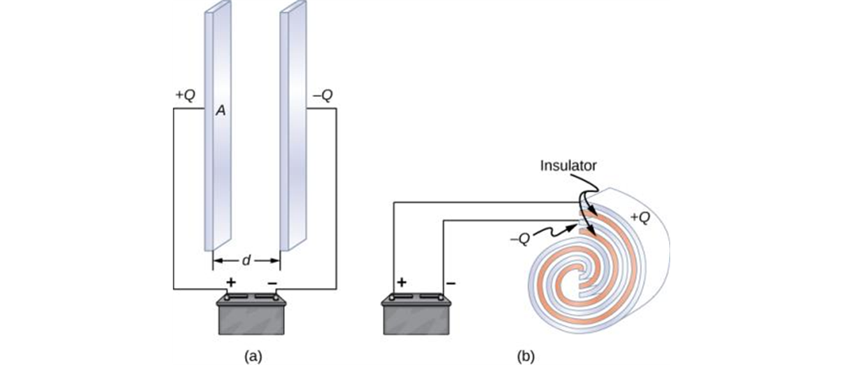
Capacitors
Any two conductors separated by an insulator (or a vacuum) form a capacitor.
When the capacitor is charged, it means the two conductors have charges with equal magnitude and opposite sign, and the net charge on the capacitor as a whole is zero.
The two conductors are called plates (or electrodes).
Both capacitors shown here were initially uncharged before being connected to a battery. They now have charges of +Q and −Q (respectively) on their plates.
A parallel-plate capacitor consists of two plates of opposite charge with area A separated by distance d.
A rolled capacitor has a dielectric material between its two conducting sheets (plates).

Slide 3
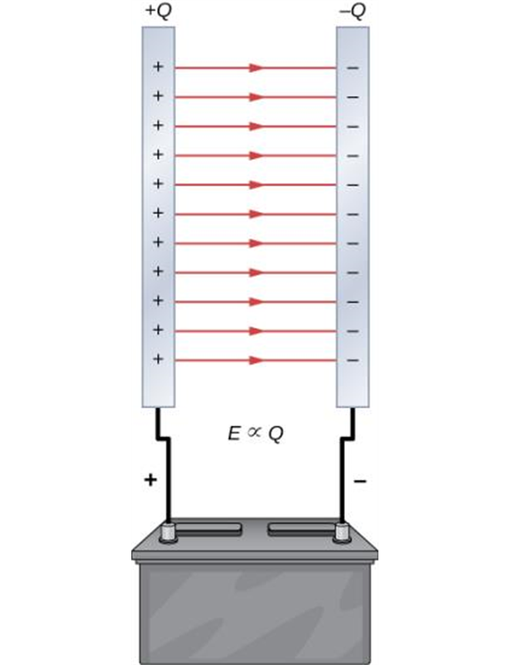
Charging a capacitor
The charge separation in a capacitor shows that the charges remain on the surfaces of the capacitor plates. Electrical field lines in a parallel-plate capacitor begin with positive charges and end with negative charges. The magnitude of the electrical field in the space between the plates is in direct proportion to the amount of charge on the capacitor.

Slide 4
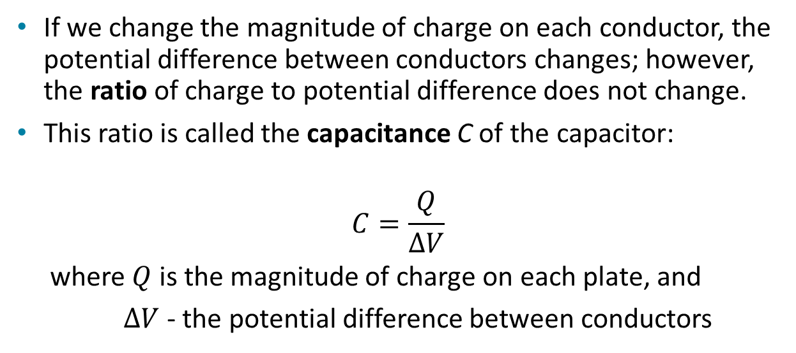
Capacitors and capacitance
If we change the magnitude of charge on each conductor, the potential difference between conductors changes; however, the ratio of charge to potential difference does not change.
This ratio is called the capacitance C of the capacitor:
$$C=\frac{Q}{∆V}$$
where $Q$ is the magnitude of charge on each plate, and
$∆V$- the potential difference between conductors

Slide 5
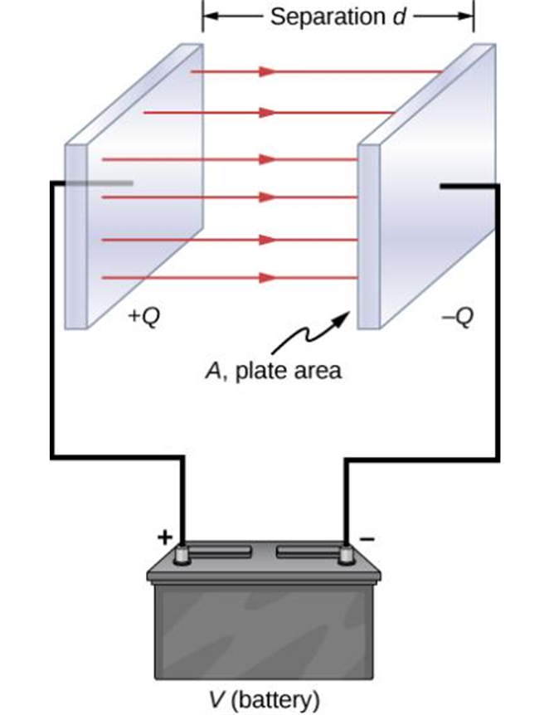
Parallel-plate capacitor
A parallel-plate capacitor consists of two parallel conducting plates separated by a distance that is small compared to their dimensions.
A parallel-plate capacitor creates a uniform electric field between its flat plates.
In a parallel-plate capacitor with plates separated by a distance d, each plate has the same surface area A.

Slide 6
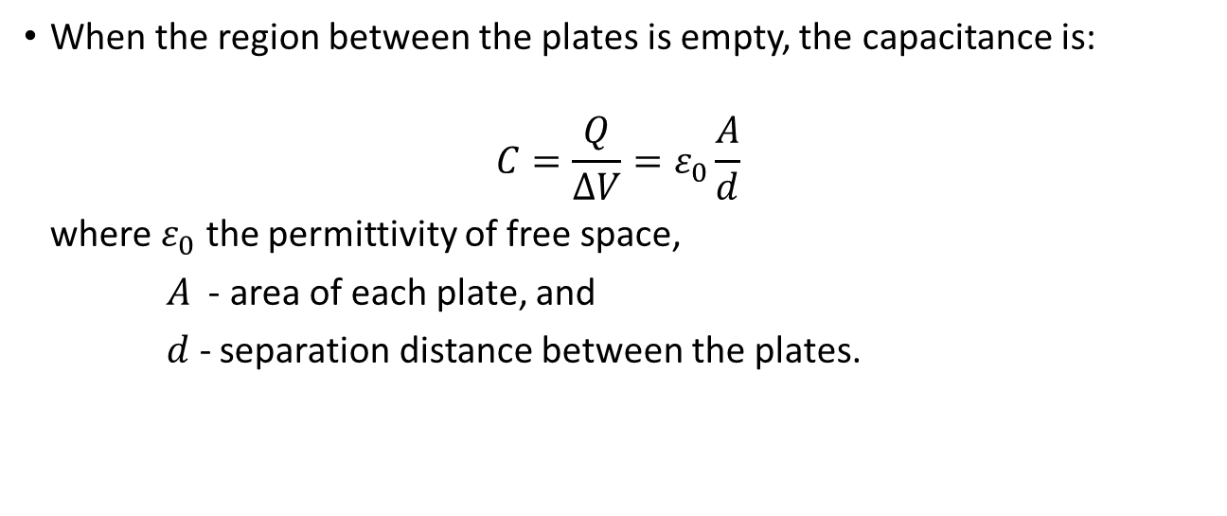
Parallel-plate capacitor, continued
When the region between the plates is empty, the capacitance is:
$$C=\frac{Q}{∆V}=ε_{0}\frac{A}{d}$$
where $ε_{0}$ the permittivity of free space,
$A$ - area of each plate, and
$d$- separation distance between the plates.
The capacitance depends on the geometry of the capacitor only.
The quantities A and d are constants for a given capacitor, and ϵ₀ is a universal constant.

Slide 7
Parallel-plate capacitor, example
A parallel-plate capacitor is constructed of two square plates, 1 m on each side, separated by a 1.0 mm gap. What is the capacitance of this capacitor? If it were charged to 100 V, how much charge would be on the capacitor?
Notes:
Answer: Equation 21.20 gives the capacitance: C = eps_0*A/d where A = 1 m^2, d = 1E-3 m, and eps_0 = 8.85E-12 (SI units). C = 8.85E-9 Farads. With 100V applied, it will accumulate a charge Q = CV = 8.85E-7 Coulombs.

Slide 8

Parallel-plate capacitor, another example
The capacitance of practical parallel-plate capacitors is quite small, in the pF range. Suppose you want to make a
capacitor using square plates separated by 1.0 mm. How large do the plates need to be?

Slide 9
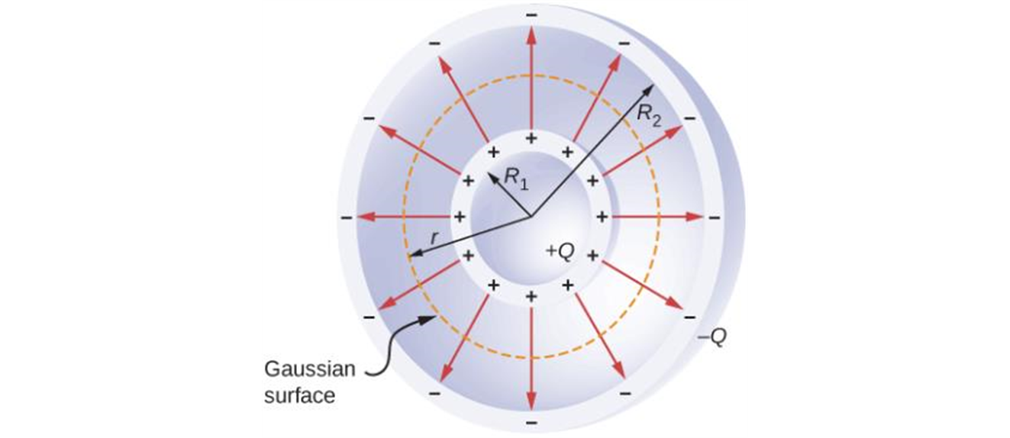
Spherical capacitor
A spherical capacitor consists of two concentric conducting spheres. Note that the charges on a conductor reside on its surface.

Slide 10
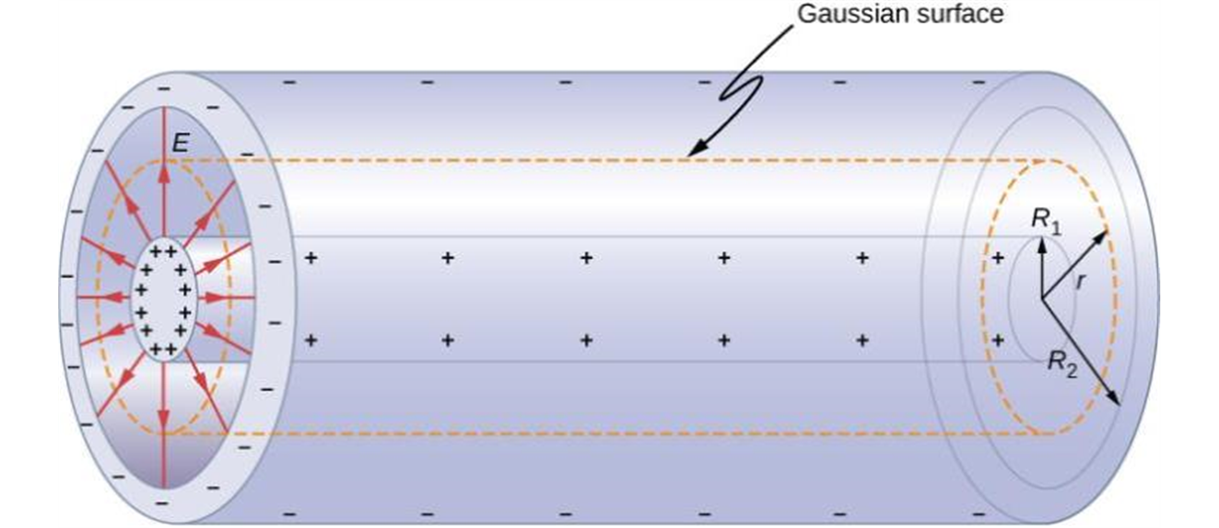
Cylindrical capacitor
A cylindrical capacitor consists of two concentric, conducting cylinders. Here, the charge on the outer surface of the inner cylinder is positive (indicated by +) and the charge on the inner surface of the outer cylinder is negative (indicated by −).

Slide 11
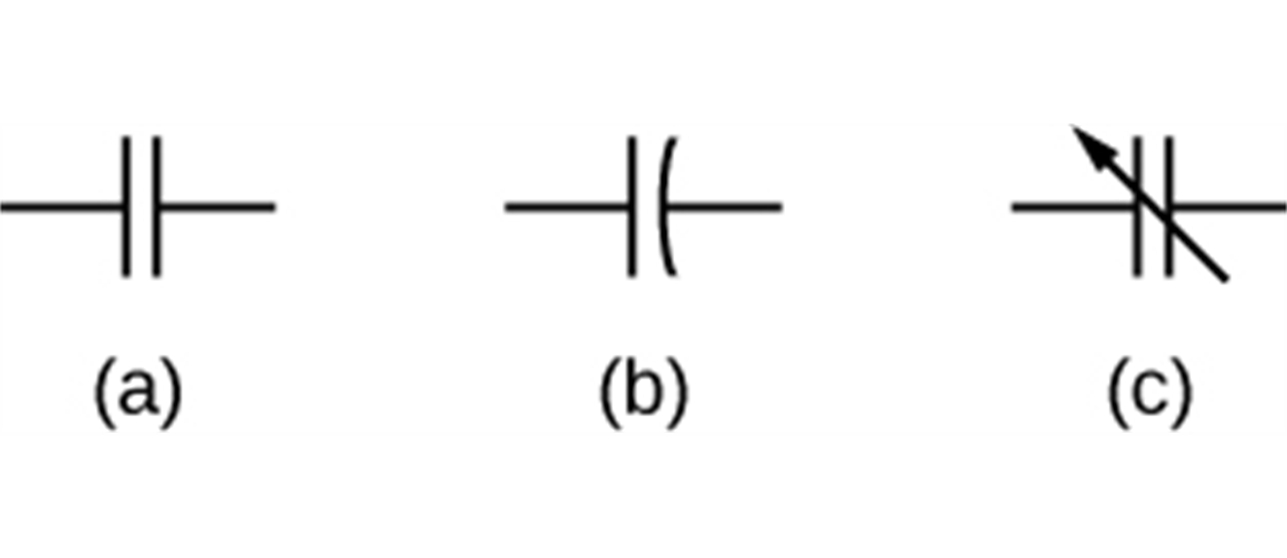
Capacitors on circuit diagrams
This shows three different circuit representations of capacitors. The symbol in (a) is the most commonly used one. The symbol in (b) represents an electrolytic capacitor. The symbol in (c) represents a variable-capacitance capacitor.

Slide 12
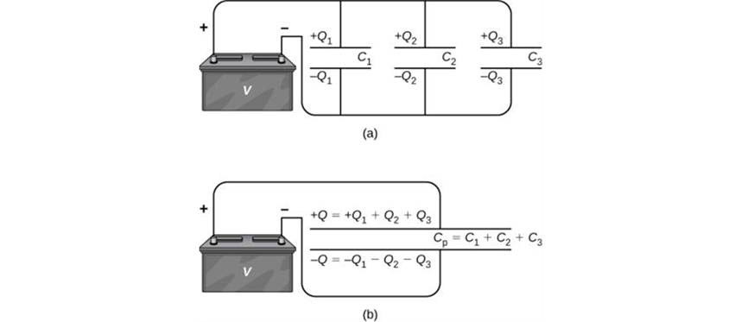
Combination of capacitors
Three capacitors are connected in parallel. Each capacitor is connected directly to the battery.
The charge on the equivalent capacitor is the sum of the charges on the individual capacitors.

Slide 13
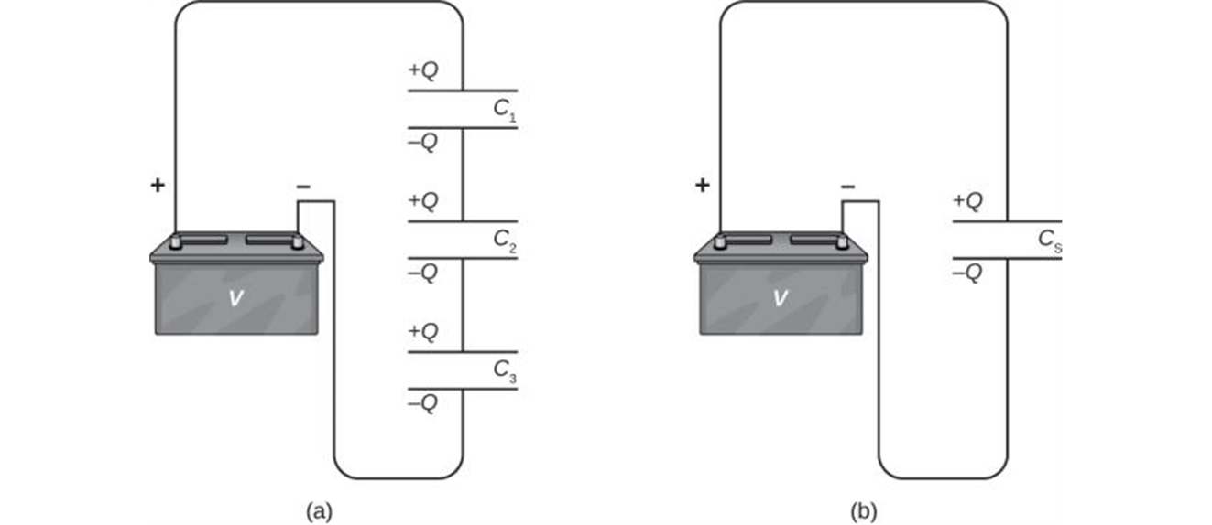
Capacitors in series
Capacitors are in series if they are connected one after the other, as illustrated (a).
The equivalent single capacitor is shown on the right (b).

Slide 14
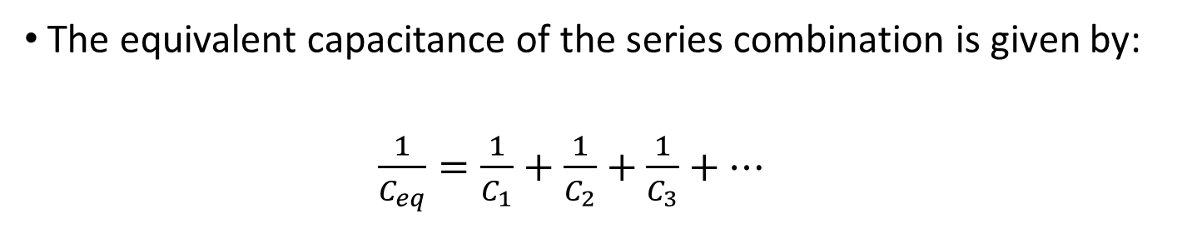
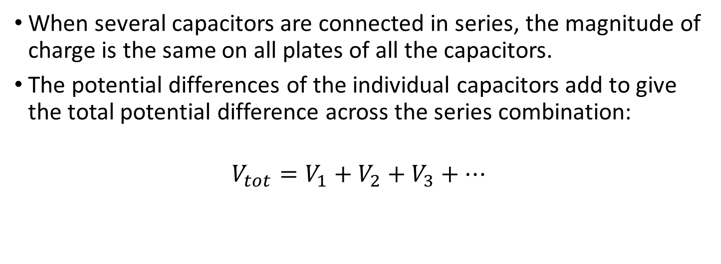
Capacitors in series, summary
When several capacitors are connected in series, the magnitude of charge is the same on all plates of all the capacitors.
The potential differences of the individual capacitors add to give the total potential difference across the series combination:
$$V_{tot}=V_{1}+V_{2}+V_{3}+⋯$$
The equivalent capacitance of the series combination is given by:
$\frac{1}{C_{eq}}=\frac{1}{C_{1}}+$ $\frac{1}{C_{2}}+$ $\frac{1}{C_{3}}+⋯$

Slide 15
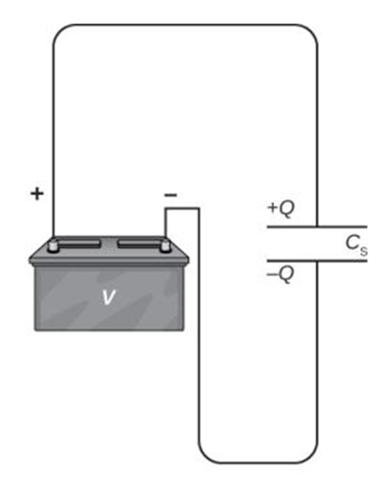
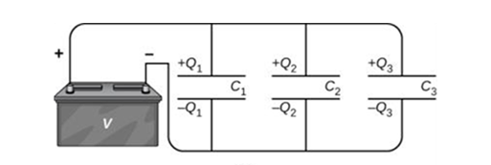
Capacitors in parallel
Capacitors are connected in parallel between a and b if the potential difference V is the same for all the capacitors.

Slide 16


Capacitors in parallel, summary
When several capacitors are connected in parallel, the potential differences are the same for all the capacitors.
The charges on the individual capacitors add to give the total charge on the parallel combination:
The equivalent capacitance of the parallel combination is given by:
$C_{eq}=C_{1}+C_{2}+$ $C_{3}+⋯$

Slide 17

Energy stored in a capacitor
The potential energy stored in a capacitor is:
$$U=\frac{1}{2}CV^{2}=\frac{1}{2}QV=\frac{Q^{2}}{2C}$$
The capacitor energy is stored in the electric field between the plates.

Slide 18
Dielectrics
Most capacitors have a nonconducting material, or dielectric, between their conducting plates.
A common type of capacitor uses long strips of metal foil for the plates, separated by strips of plastic sheet such as Mylar.
When we insert an uncharged sheet of dielectric, such as glass, paraffin, or polystyrene, between the plates, the potential difference decreases to a smaller value V.
Since Q is unchanged, the capacitance is increased with the dielectric.

Slide 19
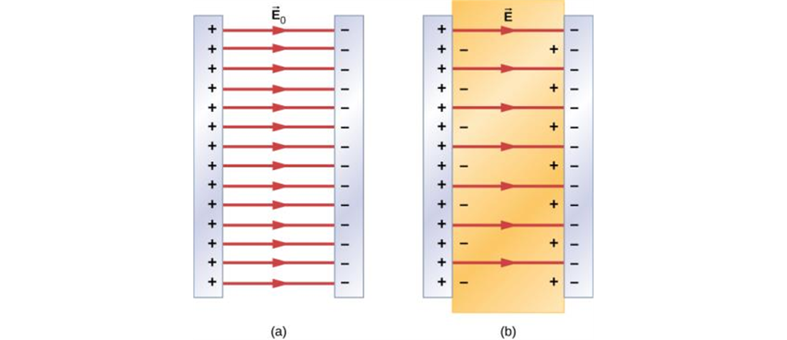
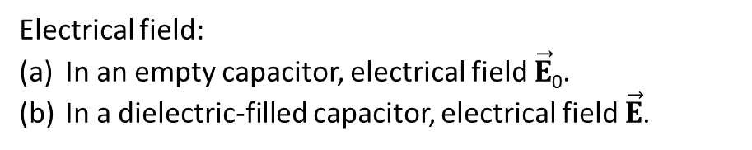
Dielectrics
When a dielectric is inserted between the plates of a capacitor, the electric field decreases.
This is due to polarization of the charge within the dielectric, which results in induced surface charges, as shown.
Electrical field:
In an empty capacitor, electrical field $\vec{E}$₀.
In a dielectric-filled capacitor, electrical field $\vec{E}$.

Slide 20
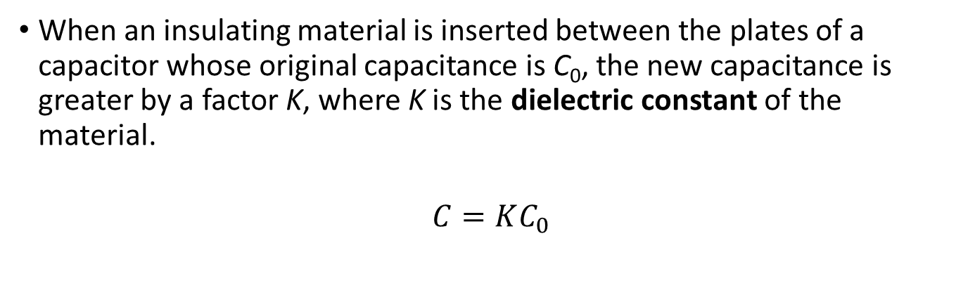
The dielectric constant
When an insulating material is inserted between the plates of a capacitor whose original capacitance is C₀, the new capacitance is greater by a factor K, where K is the dielectric constant of the material.
$$C=KC_{0}$$

