Slide 1
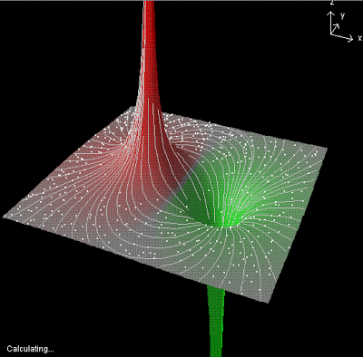


ELECTRIC POTENTIAL ENERGY

Slide 2
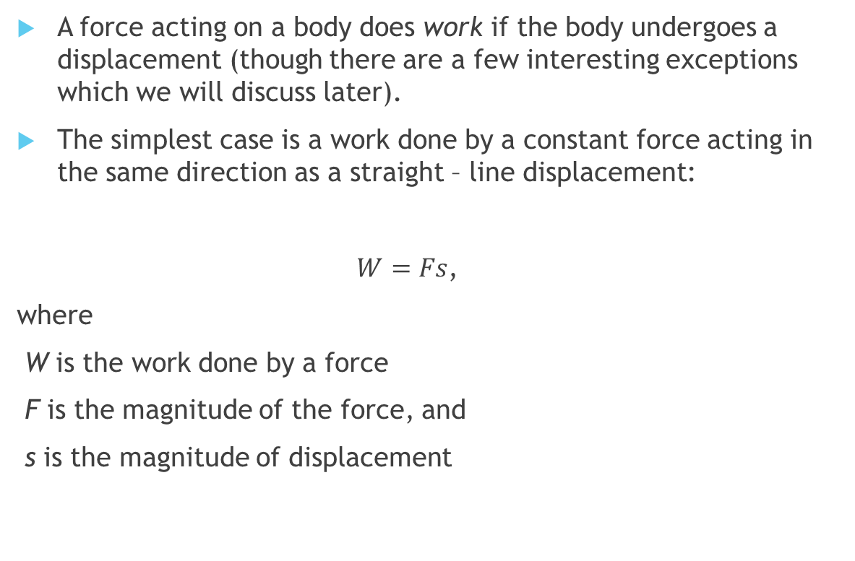
Refresher: work done by a constant force
A force acting on a body does work if the body undergoes a displacement (though there are a few interesting exceptions which we will discuss later).
The simplest case is a work done by a constant force acting in the same direction as a straight – line displacement:
$W=Fs$,
where
W is the work done by a force
F is the magnitude of the force, and
s is the magnitude of displacement

Slide 3
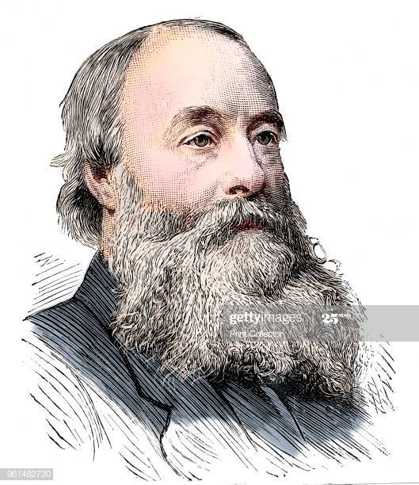
Notes on work:
Work is a scalar quantity – does not have direction
SI Units are (looking at the definition) N-m (called Joule)
1 Joule = (1 Newton)(1meter)
Work can be positive, negative,
or zero
James Prescott Joule, an English physicist who established that the various forms of energy—mechanical, electrical, and heat can be changed one into another.

Slide 4
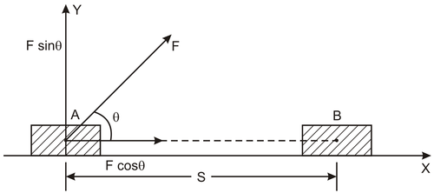
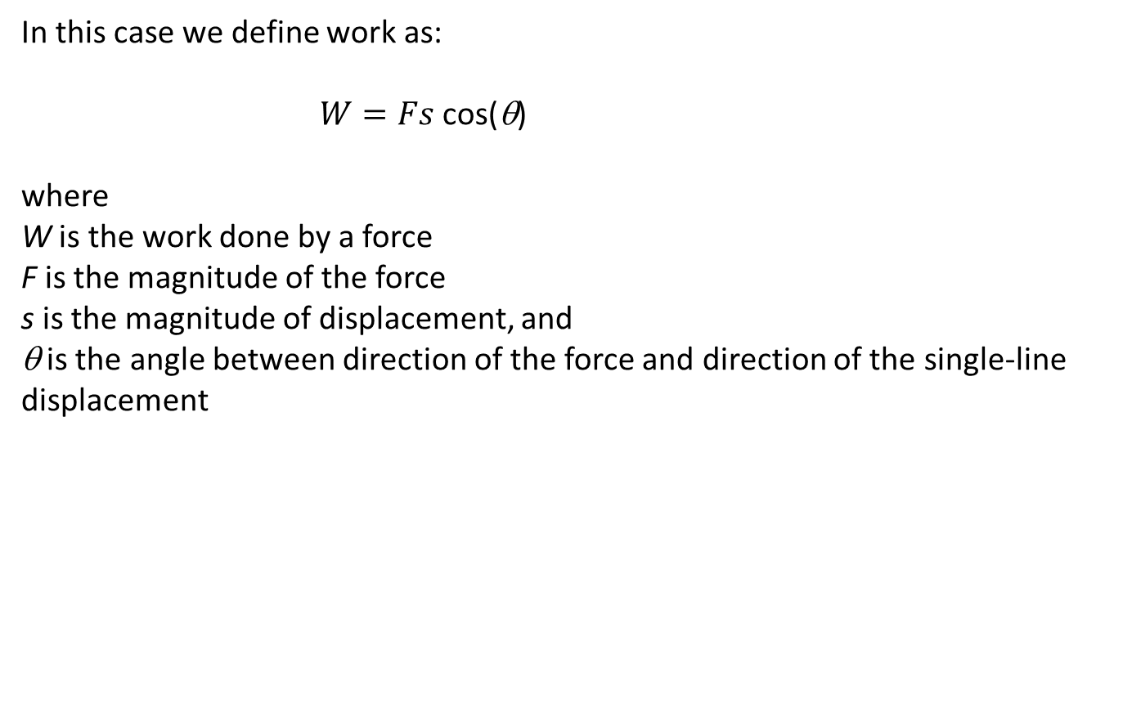
What if a constant force does NOT act along the direction of single – line displacement?
In this case we define work as:
$W=Fs$ cos(θ)
where
W is the work done by a force
F is the magnitude of the force
s is the magnitude of displacement, and
θ is the angle between direction of the force and direction of the single-line displacement

Slide 5
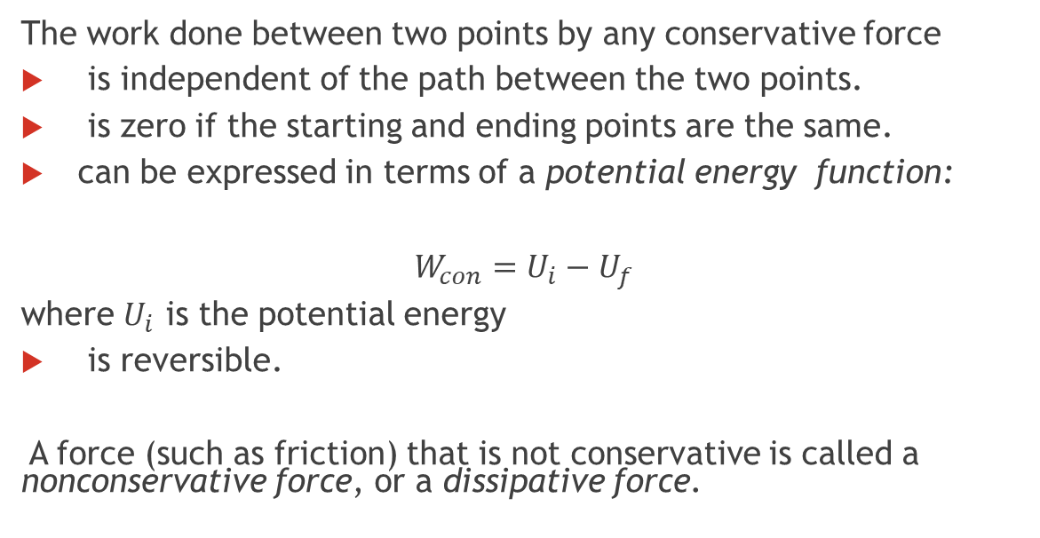
Refresher: conservative and nonconservative forces
The work done between two points by any conservative force
is independent of the path between the two points.
is zero if the starting and ending points are the same.
can be expressed in terms of a potential energy function:
$W_{con}=U_{i}−U_{f}$
where $U_{i}$ is the potential energy
is reversible.
A force (such as friction) that is not conservative is called a nonconservative force, or a dissipative force.
Examples of conservative forces: gravitational and spring

Slide 6
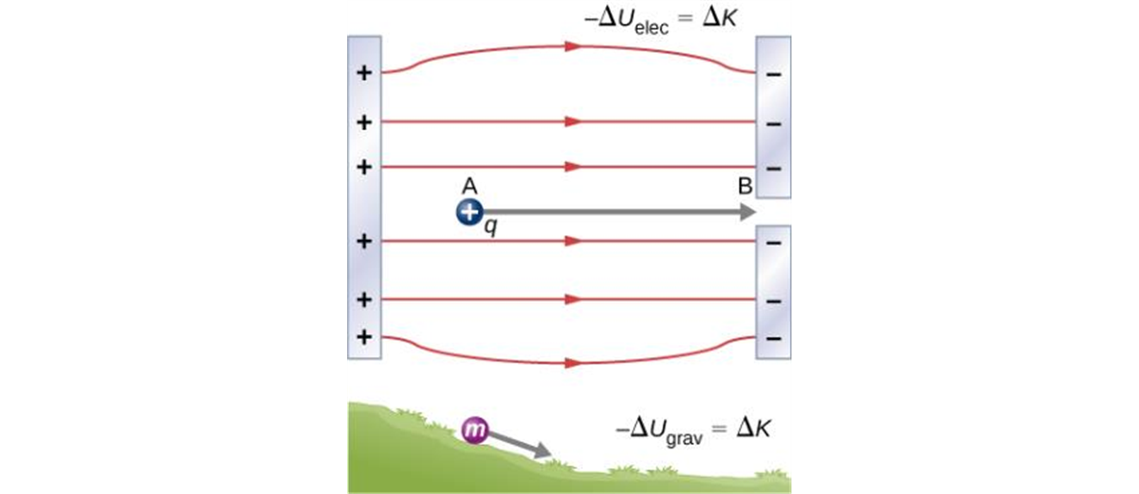
Electric potential energy in a uniform field
In the figure, a pair of charged parallel metal plates sets up a uniform electric field.
The field exerts a force on a positive test charge.
As the charge moves from point a to point b, the work done by the field is independent of the path the particle takes.
A charge accelerated by an electric field is analogous to a mass going down a hill. In both cases, potential energy decreases as kinetic energy increases, –ΔU = ΔK. Work is done by a force, but since this force is conservative, we can write W = –ΔU.

Slide 7
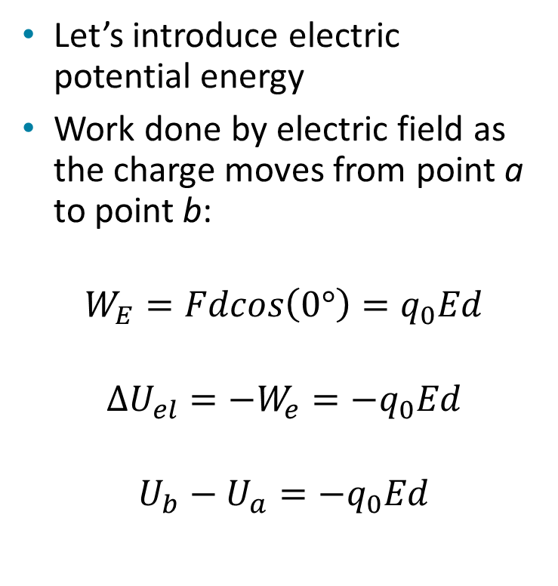
Electric potential energy in a uniform field, continued
Let’s introduce electric potential energy
Work done by electric field as the charge moves from point a to point b:
$$W_{E}=Fdcos\left(0°\right)=q_{0}Ed$$
$$∆U_{el}=−W_{e}=−q_{0}Ed$$
$$U_{b}−U_{a}=−q_{0}Ed$$

Slide 8
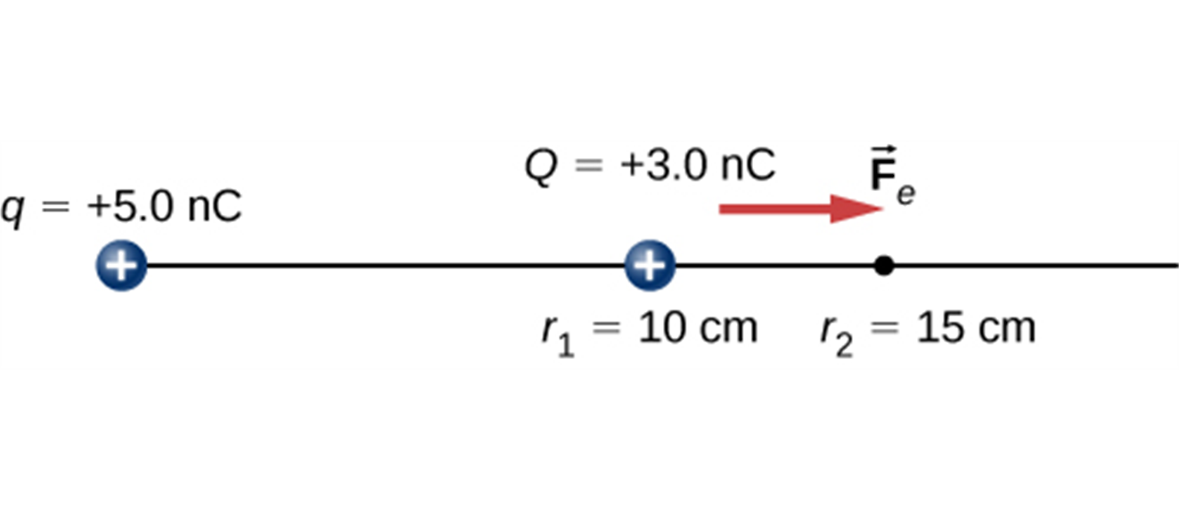
Electric potential energy of two point charges
We can introduce the idea of electric potential energy for any field.
The work done by the electric field of one point charge on another does not depend on the path taken.
Therefore, the electric potential energy only depends on the distance between the charges.
The charge Q is repelled by q, thus having work done on it and gaining kinetic energy.

Slide 9
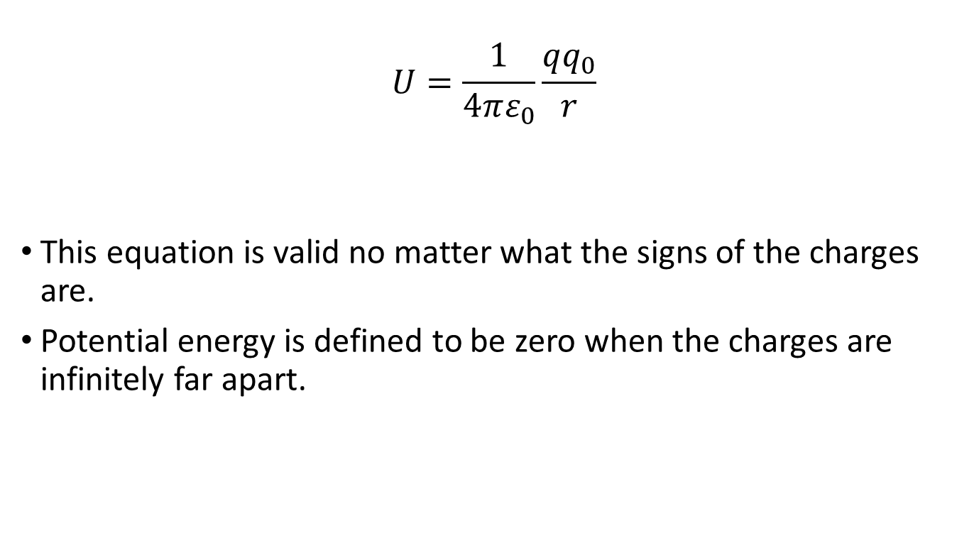
Electric potential energy of two point charges
$$U=\frac{1}{4πε_{0}}\frac{qq_{0}}{r}$$
This equation is valid no matter what the signs of the charges are.
Potential energy is defined to be zero when the charges are infinitely far apart.

Slide 10
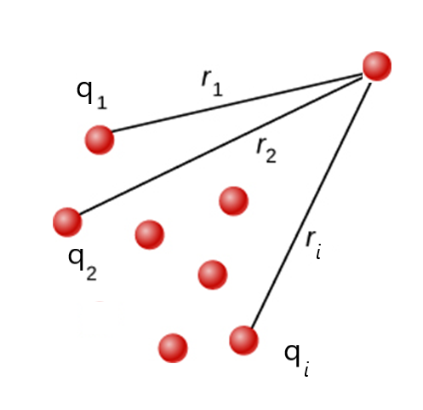
Electrical potential with several point charges
The potential energy associated with q₀ depends on the other charges and their distances from q₀.
The electric potential energy is the algebraic sum:
$U=\frac{q_{0}}{4πε_{0}}(\frac{q_{1}}{r_{1}}+\frac{q_{2}}{r_{2}}$ $+\frac{q_{3}}{r_{3}}+⋯)=\frac{q_{0}}{4πε_{0}}\sum_{i}{\frac{q_{i}}{r_{i}}}$

Slide 11
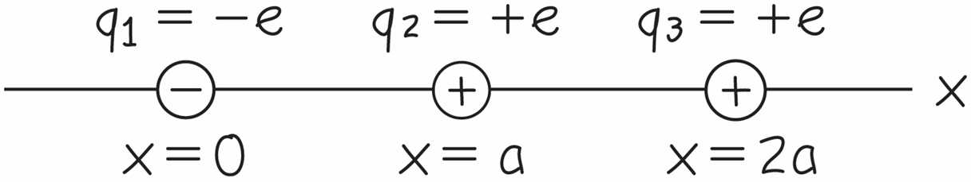
Example 1
vbv

Slide 12
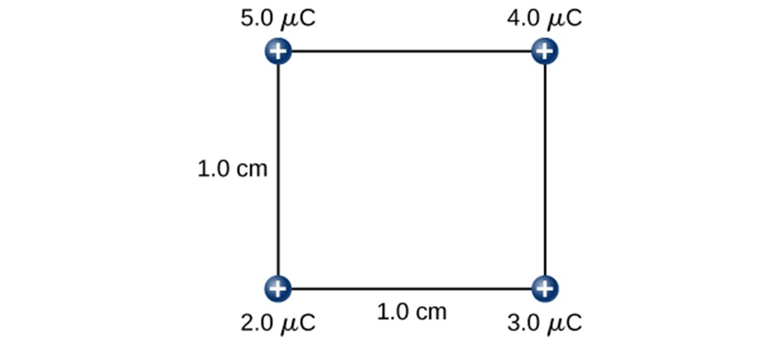
Example 2
How much work is needed to assemble this charge configuration?

