Slide 1
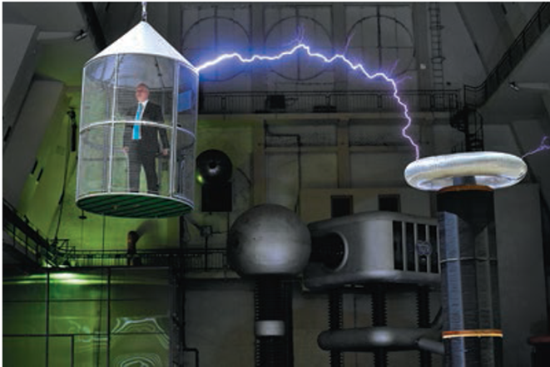


GAUSS’S LAW

Slide 2
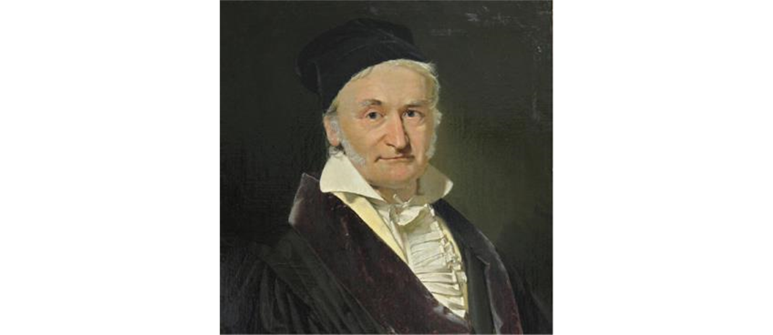
Gauss’s law
Carl Friedrich Gauss helped develop several branches of mathematics, including differential geometry, real analysis, and number theory.
The “bell curve” of statistics is one of his inventions.
Gauss also made state-of-the-art investigations of the earth’s magnetism and calculated the orbit of the first asteroid to be discovered.
While completely equivalent to Coulomb’s law, Gauss’s law provides a different way to express the relationship between electric charge and electric field.

Slide 3
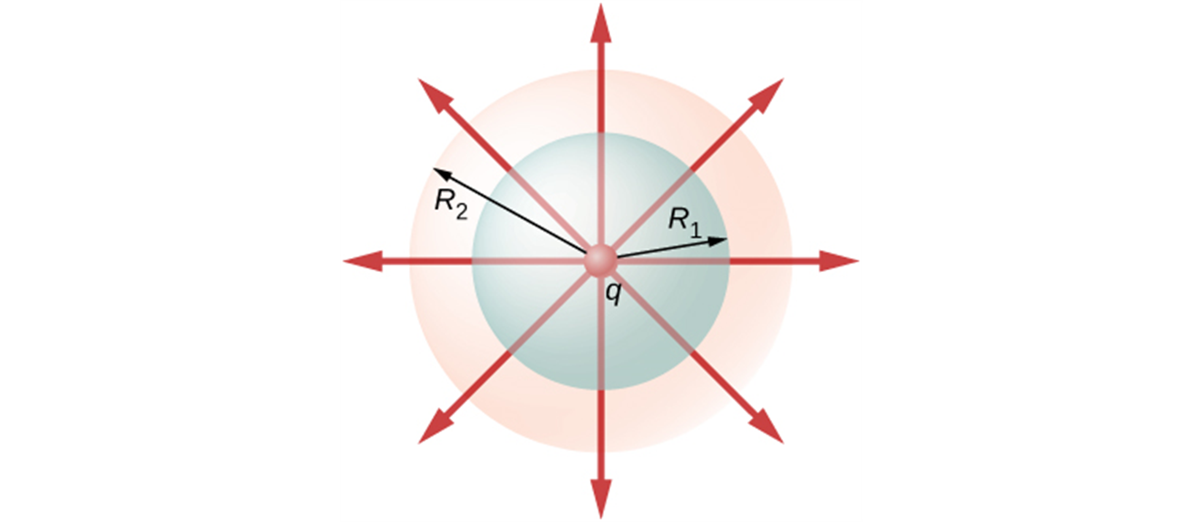
Point charge centered in a spherical surface
Flux through spherical surfaces of radii R₁ and R₂ enclosing a charge q are equal, independent of the size of the surface, since all E-field lines that pierce one surface from the inside to outside direction also pierce the other surface in the same direction.
Hence the electric flux is the same for both areas and is independent of the radius of the sphere.

Slide 4
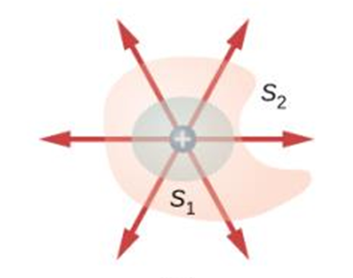
Point charge inside a non-spherical surface
As before, the flux is independent of the surface and depends only on the charge inside.
The shape and size of the surfaces that enclose a charge does not matter because all surfaces enclosing the same charge have the same flux.

Slide 5
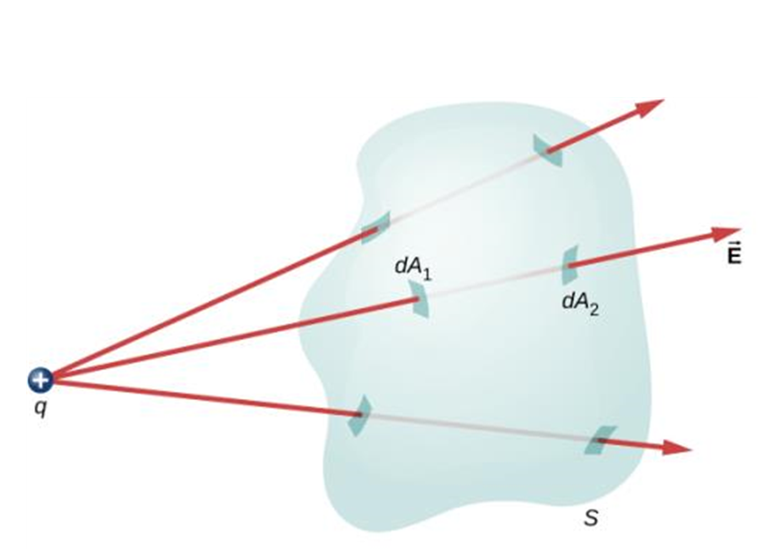

Gauss’s law in a vacuum
For a closed surface enclosing no charge:
$$Φ_{E}=\oint{\vec{E}∙d\vec{A}}=0$$
The figure shows a point charge outside a closed surface that encloses no charge.
If an electric field line from the external charge enters the surface at one point, it must leave at another.

Slide 6
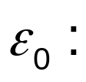
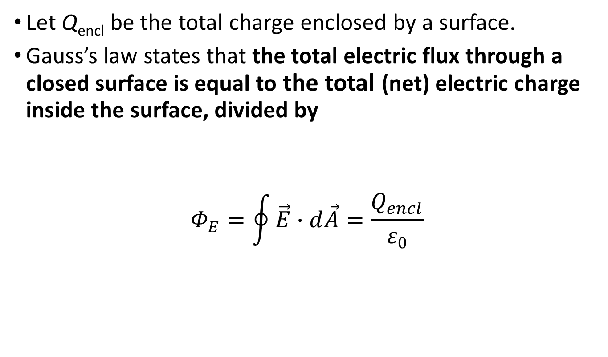
General form of Gauss’s law
Let Q_{encl} be the total charge enclosed by a surface.
Gauss’s law states that the total electric flux through a closed surface is equal to the total (net) electric charge inside the surface, divided by
$$Φ_{E}=\oint{\vec{E}∙d\vec{A}=\frac{Q_{encl}}{ε_{0}}}$$

Slide 7
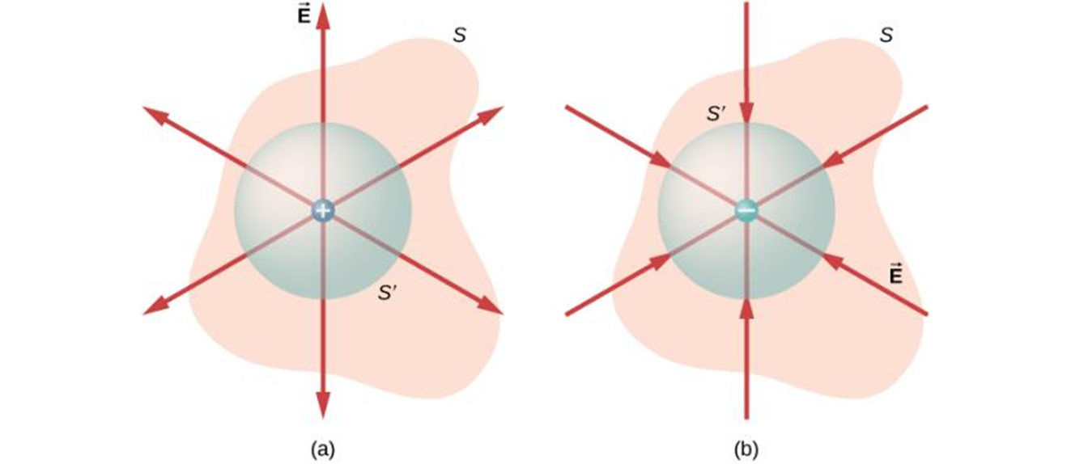
Positive and negative flux
In the case of a single point charge at the center of a spherical surface, Gauss’s law follows simply from Coulomb’s law.
A surface around a positive charge (a) has a positive (outward) flux, and a surface around a negative charge (b) has a negative (inward) flux.

Slide 8
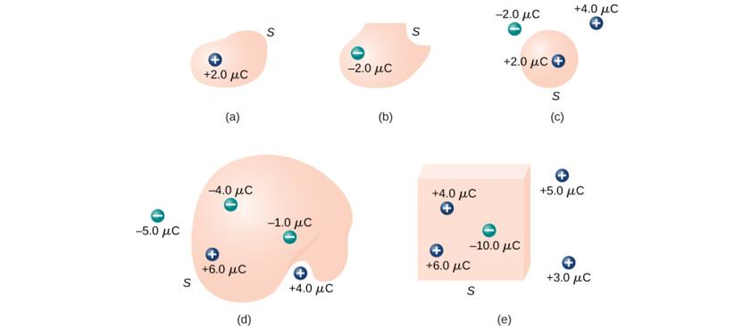
Applications of Gauss’s law
Without having to do any integration, we can use Gauss’s law to determine the electric flux through the closed surfaces in the diagram.

Slide 9
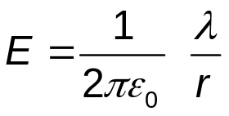
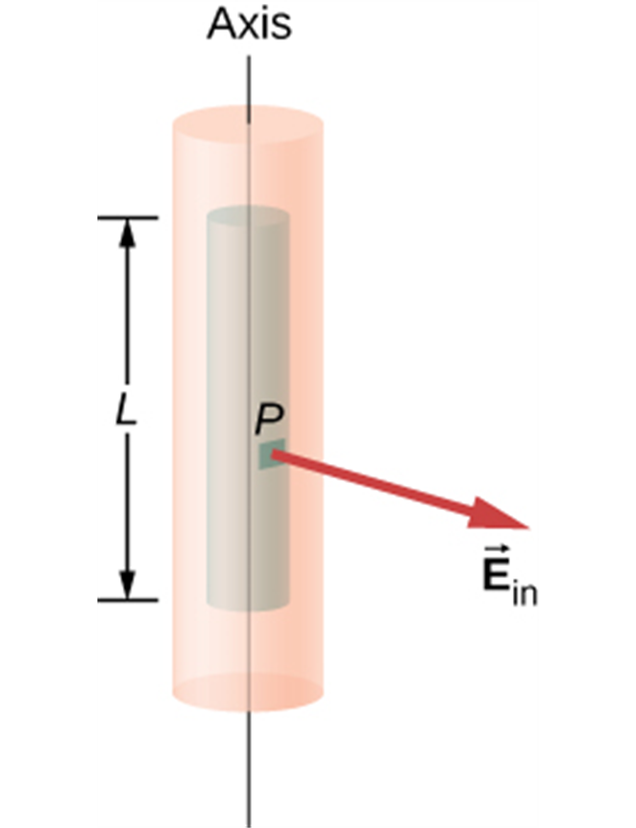
Field of a uniform line charge
Electric charge is distributed uniformly along an infinitely long, thin wire. The charge per unit length is λ (assumed positive).
Using Gauss’s law, we can find the electric field:

Slide 10
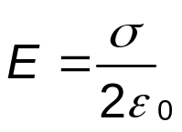
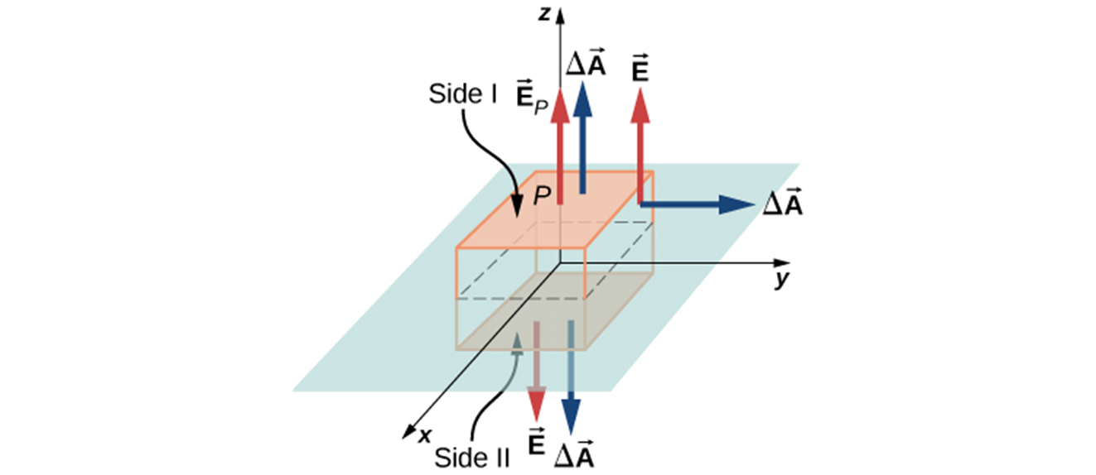
Field of an infinite plane sheet of charge
Gauss’s law can be used to find the electric field caused by a thin, flat, infinite sheet with a uniform positive surface charge density σ:
A thin charged sheet and the Gaussian box for finding the electric field at the field point P. The normal to each face of the box is from inside the box to outside. On two faces of the box, the electric fields are parallel to the area vectors, and on the other four faces, the electric fields are perpendicular to the area vectors.

Slide 11

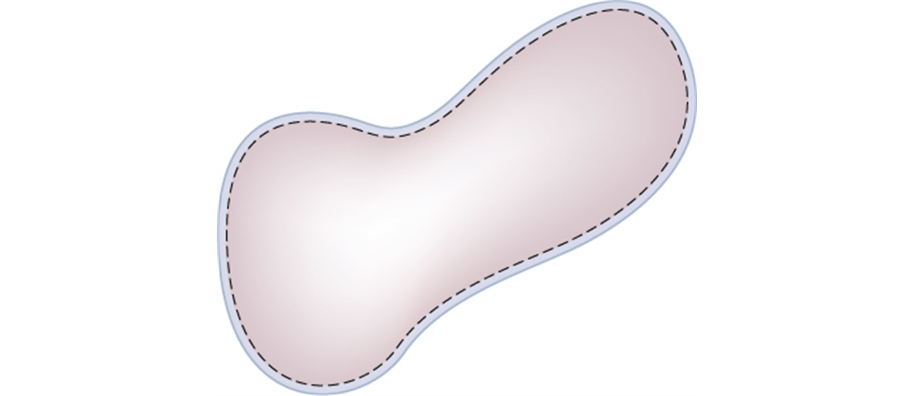
Charges on conductors
Consider a solid conductor with a hollow cavity inside.
If there is no charge within the cavity, we can use a Gaussian surface such as A to show that the net
charge on the surface of the cavity must be zero,
because
everywhere on the Gaussian surface.
The dashed line represents a Gaussian surface that is just beneath the actual surface of the conductor.

Slide 12

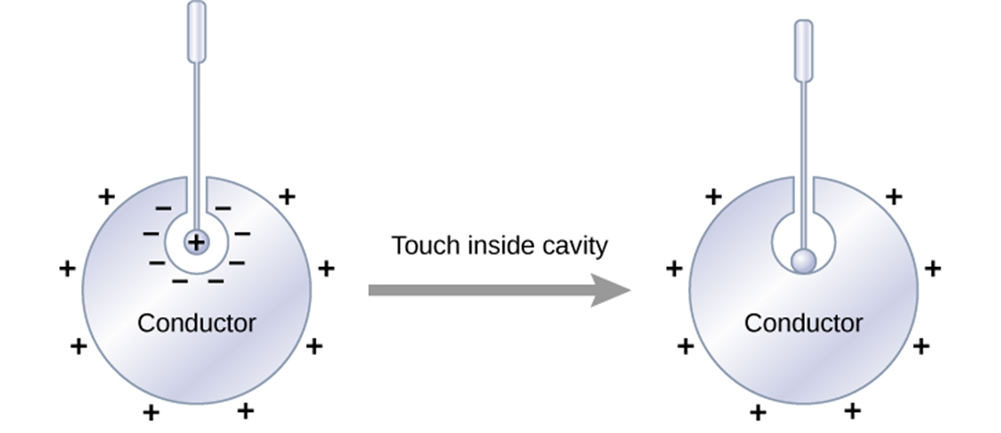

Charges on Conductors
Suppose we place a small object with a charge q inside a cavity within a conductor. The conductor is uncharged and is insulated from the charge q.
According to Gauss’s law the total there must be a
charge
distributed on the surface of the cavity,
drawn there by the charge q inside the cavity.
The total charge on the conductor must remain
zero, so a charge
must appear on its outer surface.

Slide 13

Electrostatic Shielding
Suppose we have an object that we want to protect from electric fields.
We surround the object with a conducting box, called a Faraday cage.
Little to no electric field can penetrate inside the box.
The person in the photograph is protected from the powerful electric discharge.

Slide 14
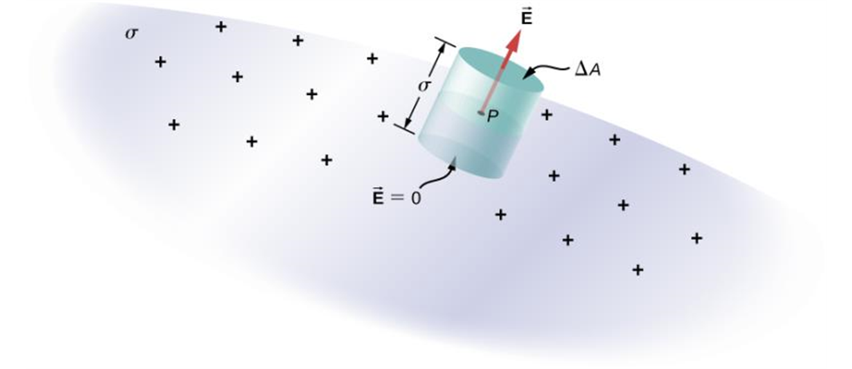
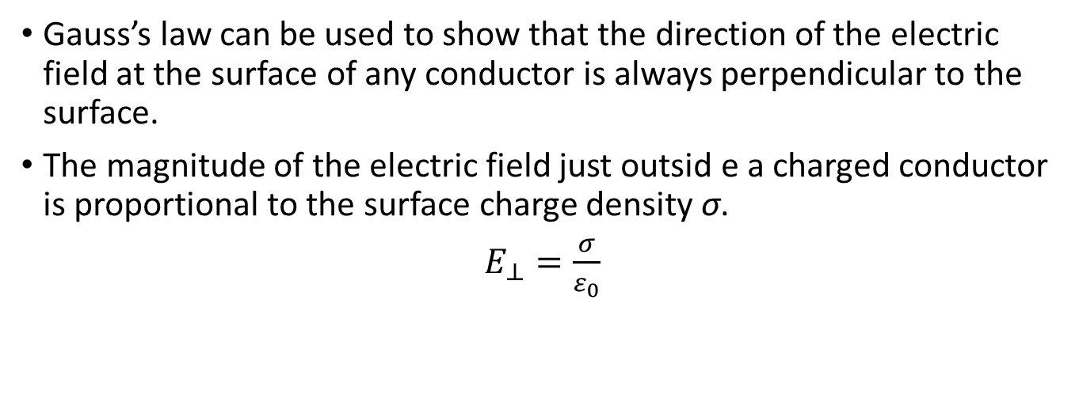
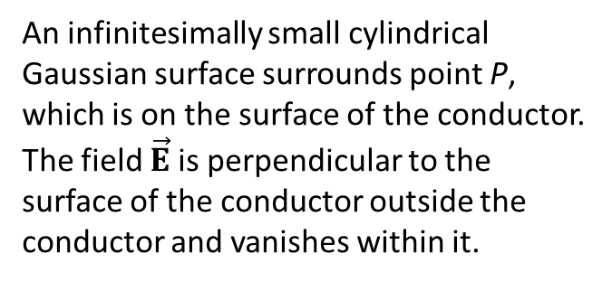
Field at the surface of a conductor
Gauss’s law can be used to show that the direction of the electric field at the surface of any conductor is always perpendicular to the surface.
The magnitude of the electric field just outsid e a charged conductor is proportional to the surface charge density σ.
$E_{⊥}=\frac{σ}{ε_{0}}$
An infinitesimally small cylindrical Gaussian surface surrounds point P, which is on the surface of the conductor. The field $\vec{E}$ is perpendicular to the surface of the conductor outside the conductor and vanishes within it.

