Slide 1
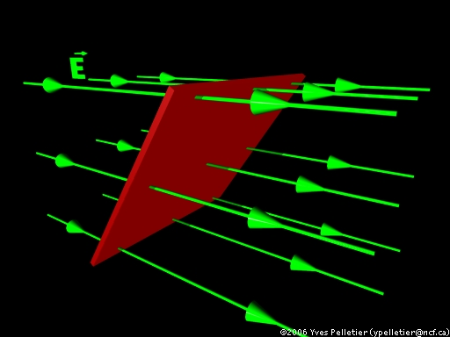


ELECTRIC FLUX

Slide 2
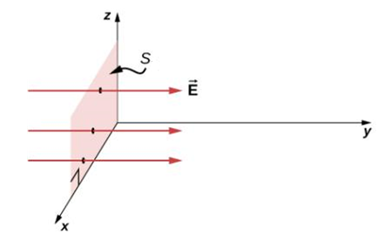
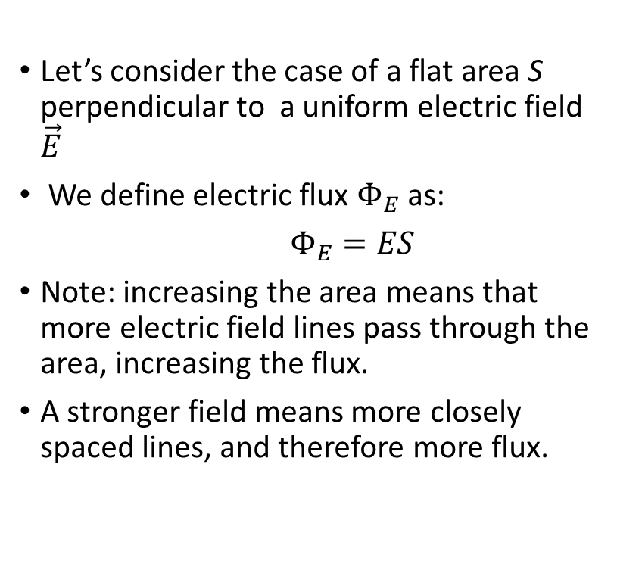
Definition of the electric flux, uniform field
Let’s consider the case of a flat area S perpendicular to a uniform electric field $\vec{E}$
We define electric flux $Φ_{E}$ as:
$Φ_{E}=ES$
Note: increasing the area means that more electric field lines pass through the area, increasing the flux.
A stronger field means more closely spaced lines, and therefore more flux.

Slide 3
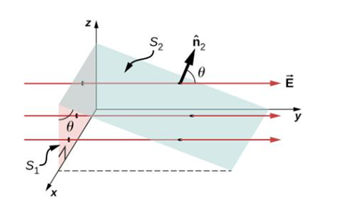
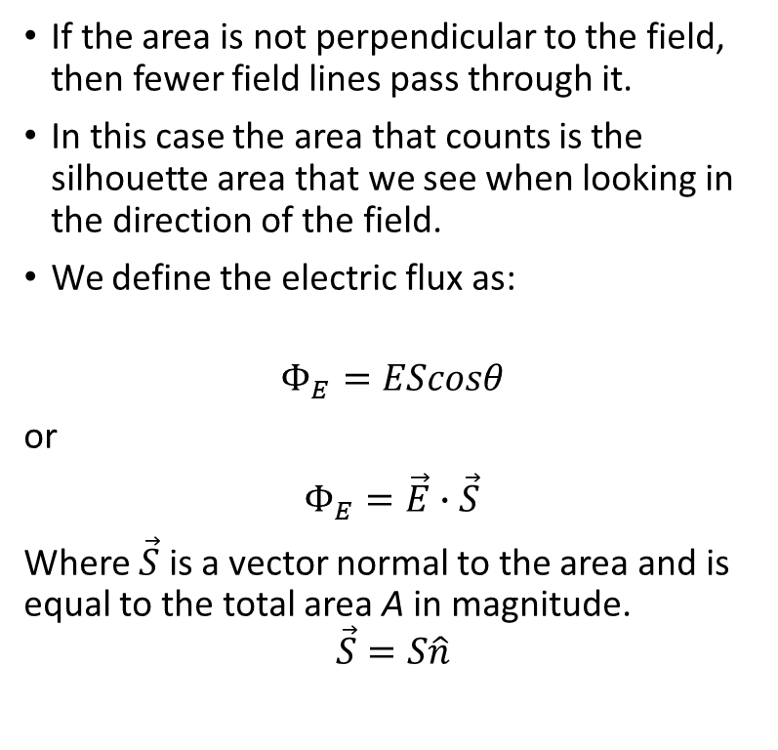
Definition of the electric flux, continued
If the area is not perpendicular to the field, then fewer field lines pass through it.
In this case the area that counts is the silhouette area that we see when looking in the direction of the field.
We define the electric flux as:
$$Φ_{E}=EScosθ$$
or
$Φ_{E}=\vec{E}∙\vec{S}$
Where $\vec{S}$ is a vector normal to the area and is equal to the total area A in magnitude.
$$\vec{S}=S\hat{n}$$

Slide 4
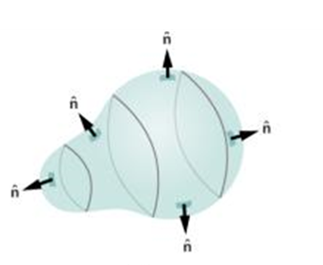
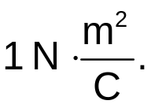
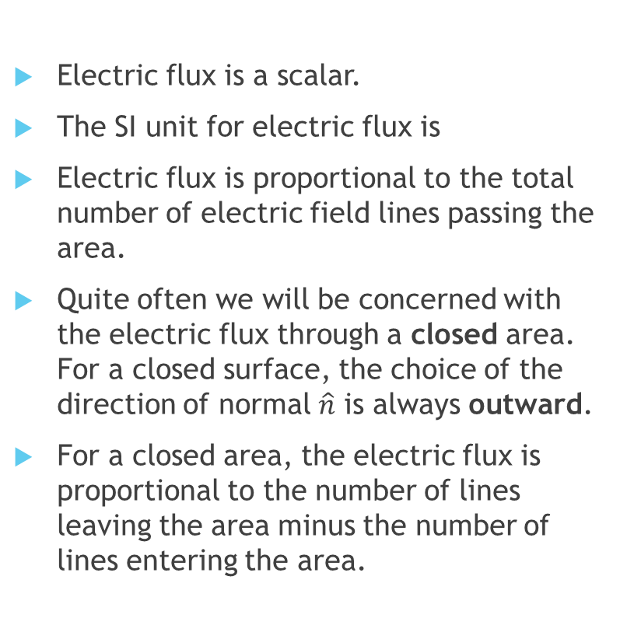
Electric flux, details
Electric flux is a scalar.
The SI unit for electric flux is
Electric flux is proportional to the total number of electric field lines passing the area.
Quite often we will be concerned with the electric flux through a closed area. For a closed surface, the choice of the direction of normal $\hat{n}$ is always outward.
For a closed area, the electric flux is proportional to the number of lines leaving the area minus the number of lines entering the area.

Slide 5
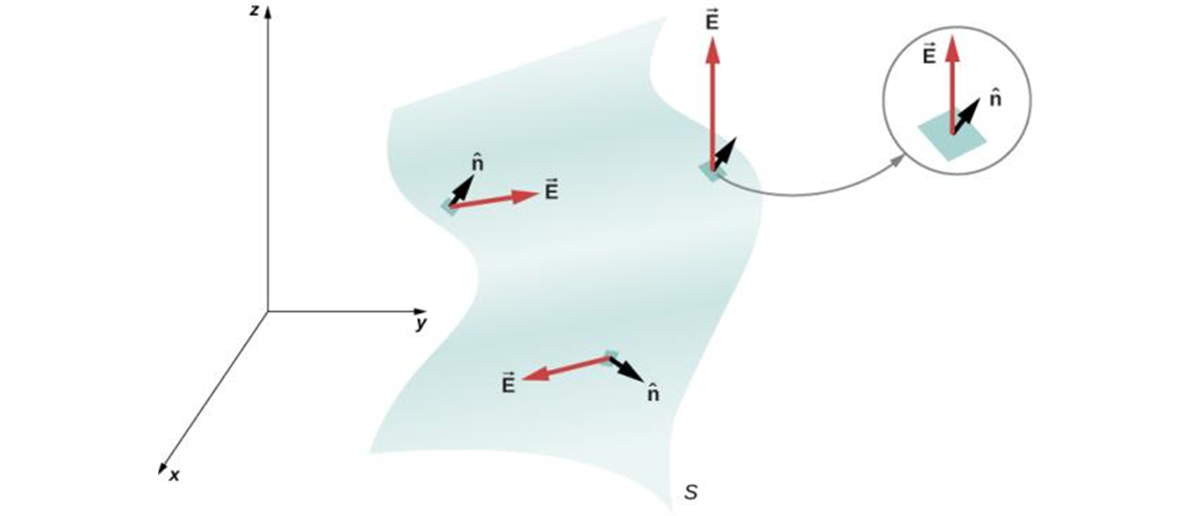
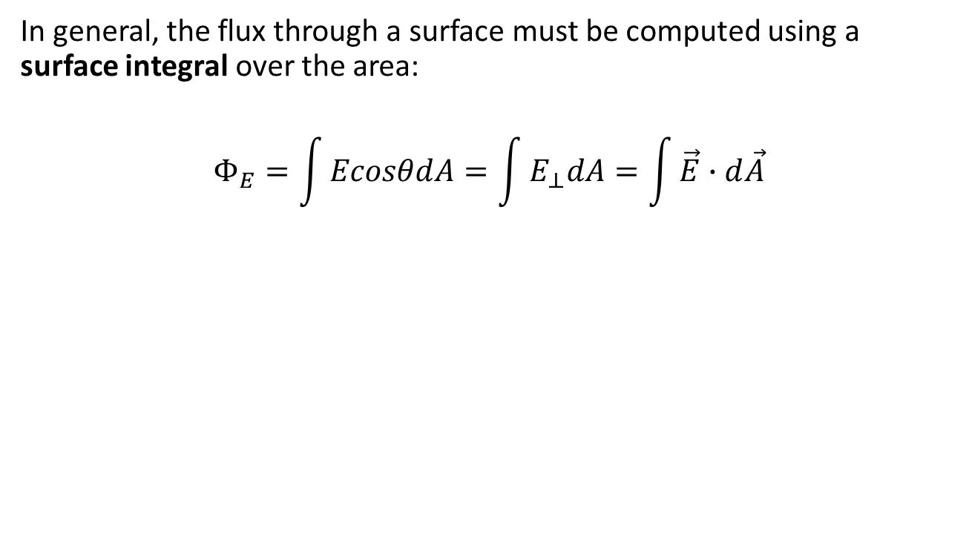
General definition of the electric flux
In general, the flux through a surface must be computed using a surface integral over the area:
$$Φ_{E}=\int{EcosθdA}=\int{E_{⊥}dA=\int{\vec{E}∙d\vec{A}}}$$
A surface is divided into patches to find the flux.

Slide 6
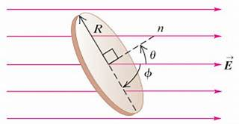
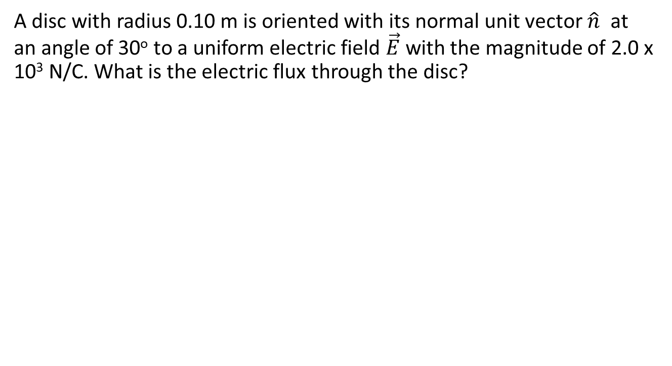
Electric flux through a disc
A disc with radius 0.10 m is oriented with its normal unit vector $\hat{n}$ at an angle of 30º to a uniform electric field $\vec{E}$with the magnitude of 2.0 x 10³ N/C. What is the electric flux through the disc?

Slide 7
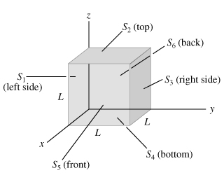
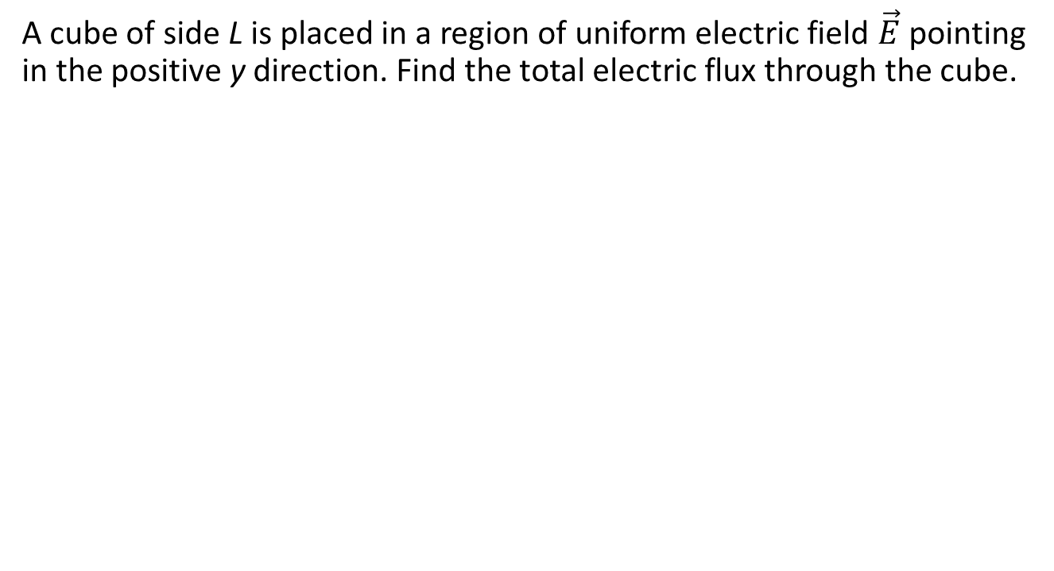
Electric flux through the cube
A cube of side L is placed in a region of uniform electric field $\vec{E}$ pointing in the positive y direction. Find the total electric flux through the cube.

Slide 8
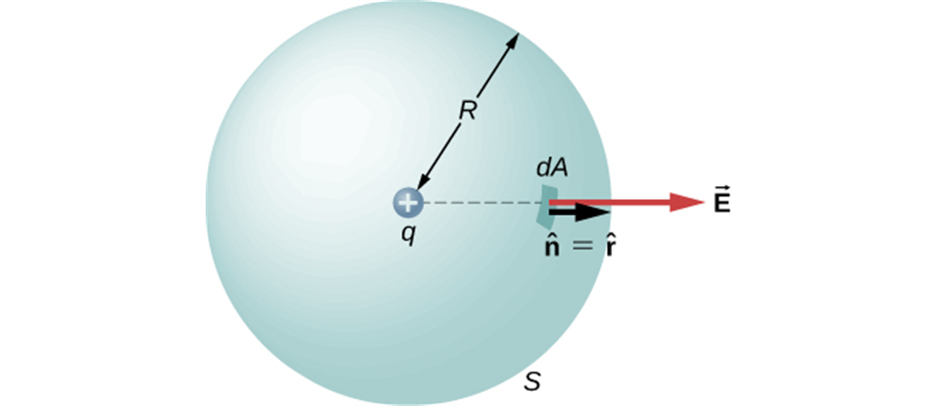
Electric flux through a sphere
A positive point charge q = 3.0 μC is surrounded by a sphere with radius 0.20 m centered on the charge. Find the electric flux through the sphere due to this charge.

