Slide 1



CHARGES AND ELECTRIC FORCES

Slide 2
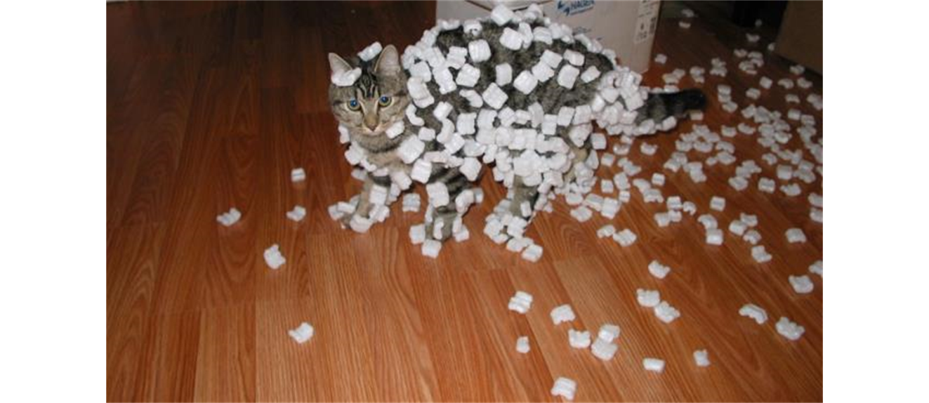
Electric charge
Plastic rods and fur (real or fake) are particularly good for demonstrating electrostatics, the interactions between electric charges that are at rest (or nearly so).
After we charge both plastic rods by rubbing them with the piece of fur, we find that the rods repel each other.

Slide 3
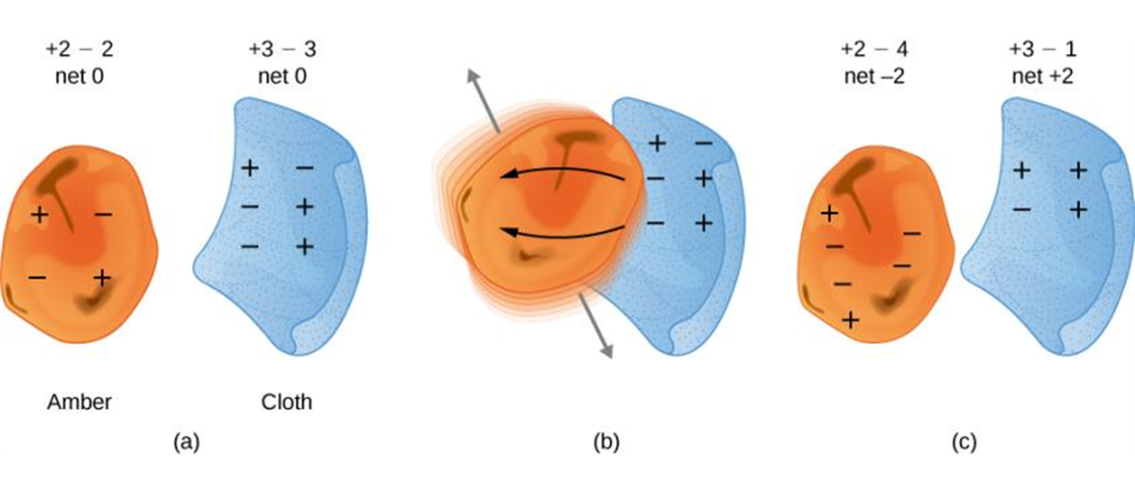
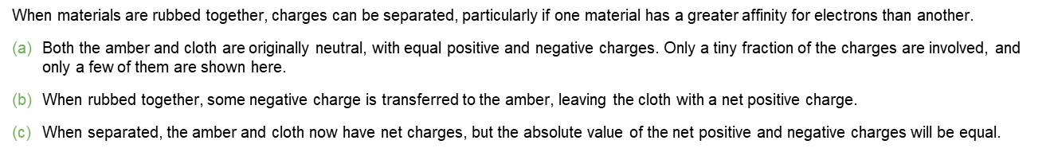
Electric charge, continued
When we rub glass rods with silk, the glass rods also become charged and repel each other.

Slide 4
Electric charge, continued
A charged plastic rod attracts a charged glass rod; furthermore, the plastic rod and the fur attract each other, and the glass rod and the silk attract each other.
These experiments and many others like them have shown that there are exactly two kinds of electric charge: The kind on the plastic rod rubbed with fur (negative) and the kind on the glass rod rubbed with silk (positive).
Similar charges repel, opposite charges attract

Slide 5
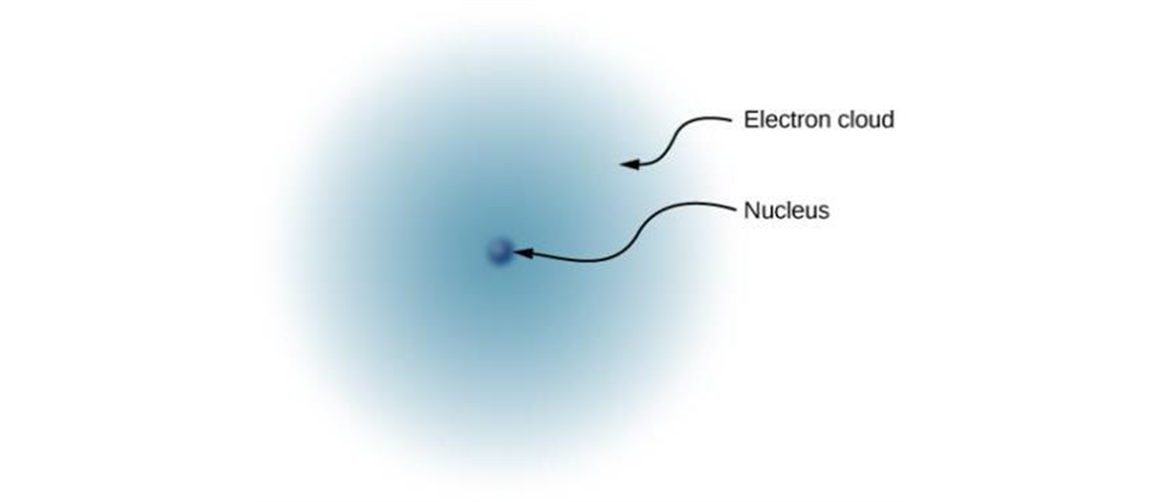
Electric charge and the structure of matter
An atom has a dense, positively charged nucleus, containing positively charged protons and neutral neutrons.
The nucleus is surrounded by the much-less-massive negatively charged electrons that form an electron cloud.
A neutral atom has the same number of protons as electrons.
Charge, like mass, is an inherent property of electrons and protons.
This simplified model of a hydrogen atom shows a positively charged nucleus (consisting, in the case of hydrogen, of a single proton), surrounded by an electron “cloud.”

Slide 6
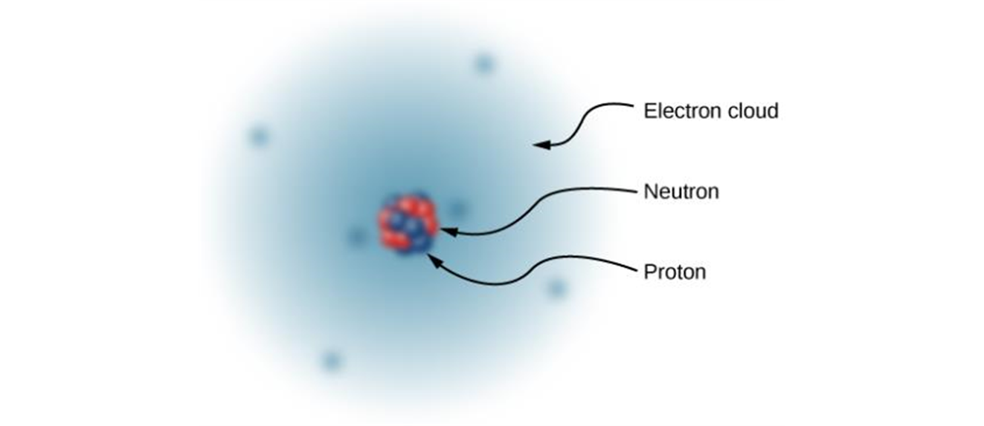
Electric charge and the structure of matter, continued
Electrons and protons are the basic charges in ordinary matter.
There are no other sources of charge.
An object is charged if it has an unequal number of protons and electrons.
Most macroscopic objects have an equal number of protons and electrons. Such objects are electrically neutral.
The nucleus of a carbon atom is composed of six protons and six neutrons.

Slide 7
Electric charge is conserved and quantized
The proton and electron have the charge of the same magnitude.
The magnitude of charge of the electron or proton is a natural unit of charge. All observable charge is quantized in this unit.
The universal principle of charge conservation states that the algebraic sum of all the electric charges in any closed system is constant.

Slide 8





Electric charge is quantized
Charge is represented by the symbol q. The S I unit is a coulomb (C).
The fundamental charge (e) is the magnitude of the charge of an electron or proton:
Particle | Mass (kg) | Charge (C)
Proton | 1.67 times 10 to the negative twenty seventh power. | Positive e = 1.60 times 10 to the negative nineteenth power.
Electron | 9.11 times 10 to the negative thirty first power. | Negative e = negative 1.60 times 10 to the negative nineteenth power.

Slide 9
Insulators and conductors
Charge can be transferred from one object to another only when the objects touch.
Discharging is removing a charge from an object, which you can do by touching it.
Conductors are those materials through or along which charge easily moves.
Insulators are materials in which charge is immobile.
Glass and plastics are insulators, metal is a conductor.

Slide 10
Charging by conduction
Copper is a good conductor of electricity; nylon is a good insulator. The copper wire shown conducts charge between the metal ball and the charged plastic rod to charge the ball negatively.
After it is negatively charged, the metal ball is repelled by a negatively charged plastic rod.
Note: the physical contact is required.
The charge on the metal ball is of the same sign as the charge on the rod.

Slide 11
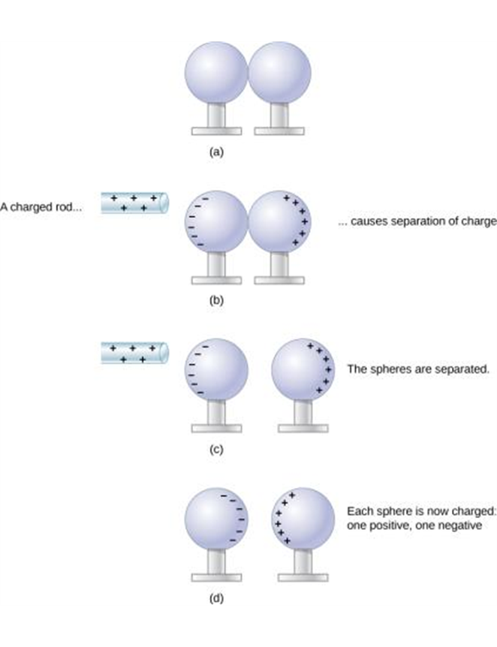
Charging by induction
Charging by induction.
Two uncharged or neutral metal spheres are in contact with each other but insulated from the rest of the world.
A positively charged glass rod is brought near the sphere on the left, attracting negative charge and leaving the other sphere positively charged.
The spheres are separated before the rod is removed, thus separating negative and positive charges.
The spheres retain net charges after the inducing rod is removed—without ever having been touched by a charged object.

Slide 12
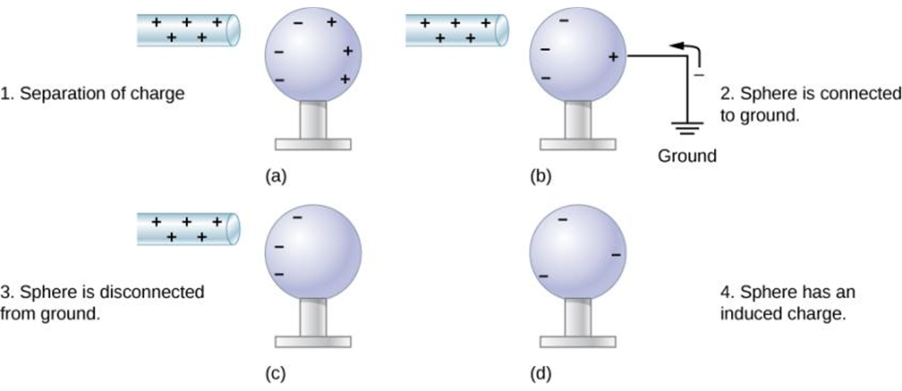
Charging by induction
Charging by induction using a ground connection.
A positively charged rod is brought near a neutral metal sphere, polarizing it.
The sphere is grounded, allowing electrons to be attracted from Earth’s ample supply.
The ground connection is broken.
The positive rod is removed, leaving the sphere with an induced negative charge.

Slide 13
Charging by induction, continued
There is NO physical contact between the ball and the rod.
The charge on the ball is of the opposite sign compared to the one on the rod.

Slide 14
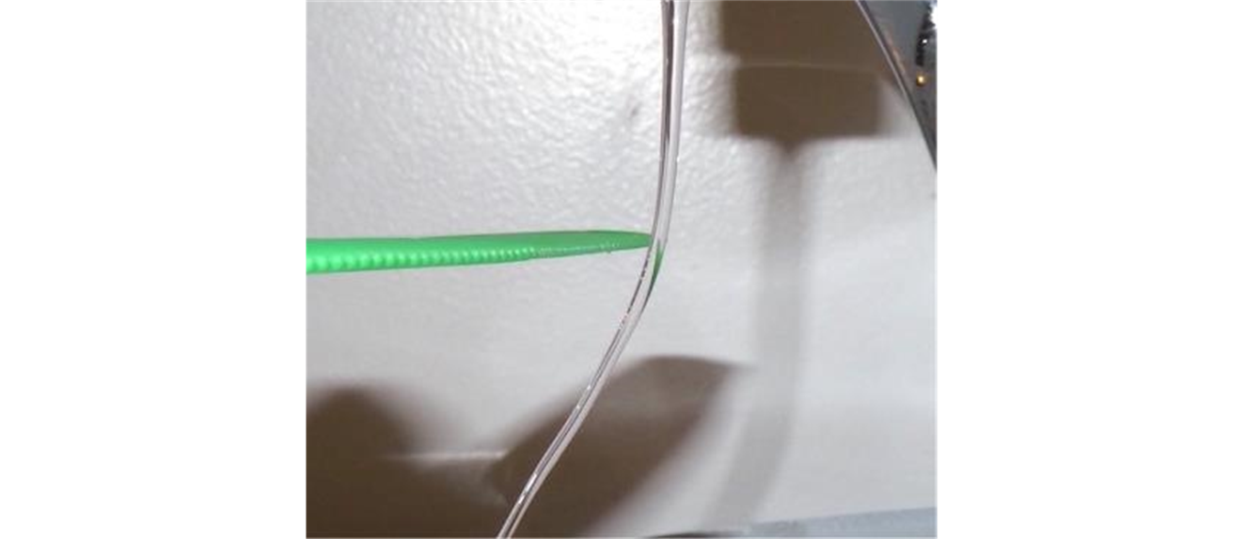
Electric forces on uncharged objects
A charged object can exert forces even on objects that are not charged themselves.
If you rub a balloon on the rug and then hold the balloon against the ceiling, it sticks, even though the ceiling has no net electric charge.
After you electrify a comb by running it through your hair, you can pick up uncharged bits of paper or plastic with it.

Slide 15
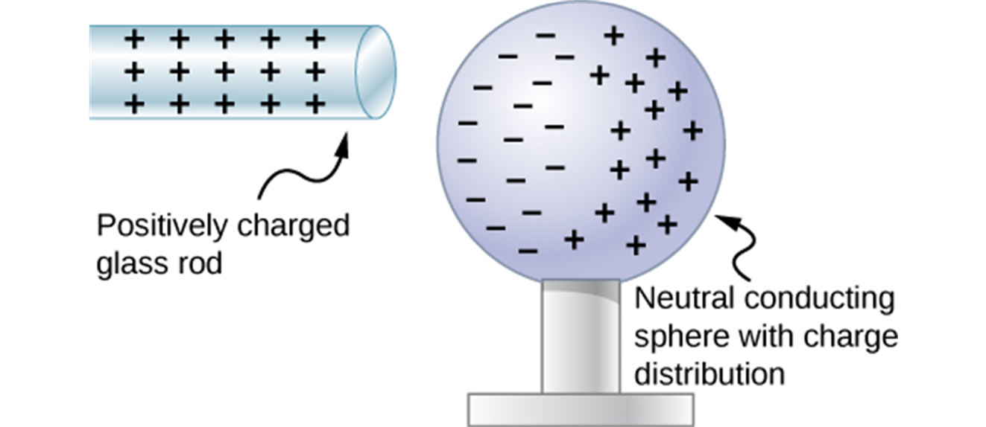
ELECTRIC FORCES ON UNCHARGED OBJECTS, CONTINUED
The negatively charged plastic comb causes a slight shifting of charge within the molecules of the neutral insulator, an effect called polarization.

Slide 16
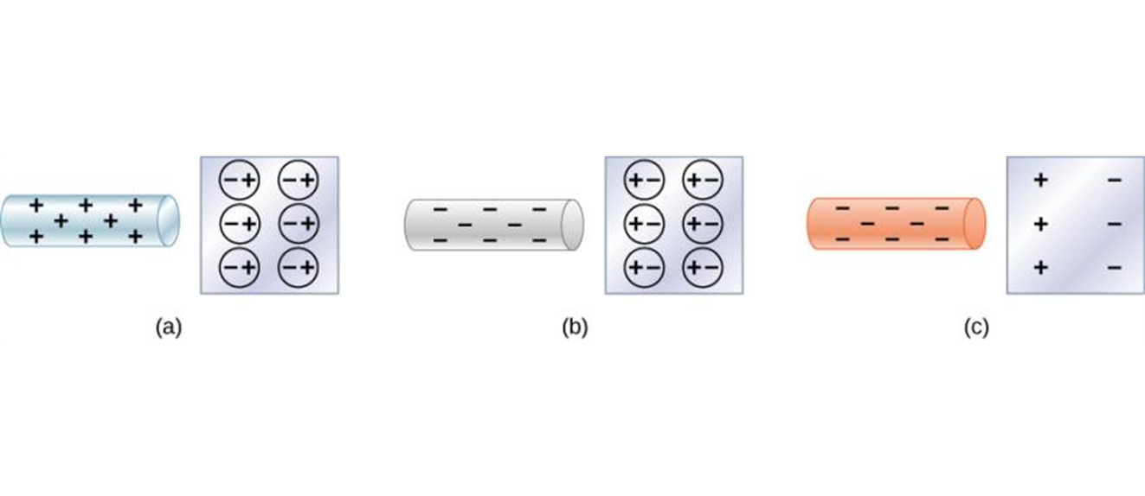
Electric forces on uncharged objects, details
Both positive and negative objects attract a neutral object by polarizing its molecules.
A positive object brought near a neutral insulator polarizes its molecules. There is a slight shift in the distribution of the electrons orbiting the molecule, with unlike charges being brought nearer and like charges moved away. Since the electrostatic force decreases with distance, there is a net attraction.
A negative object produces the opposite polarization, but again attracts the neutral object.
The same effect occurs for a conductor; since the unlike charges are closer, there is a net attraction.

Slide 17
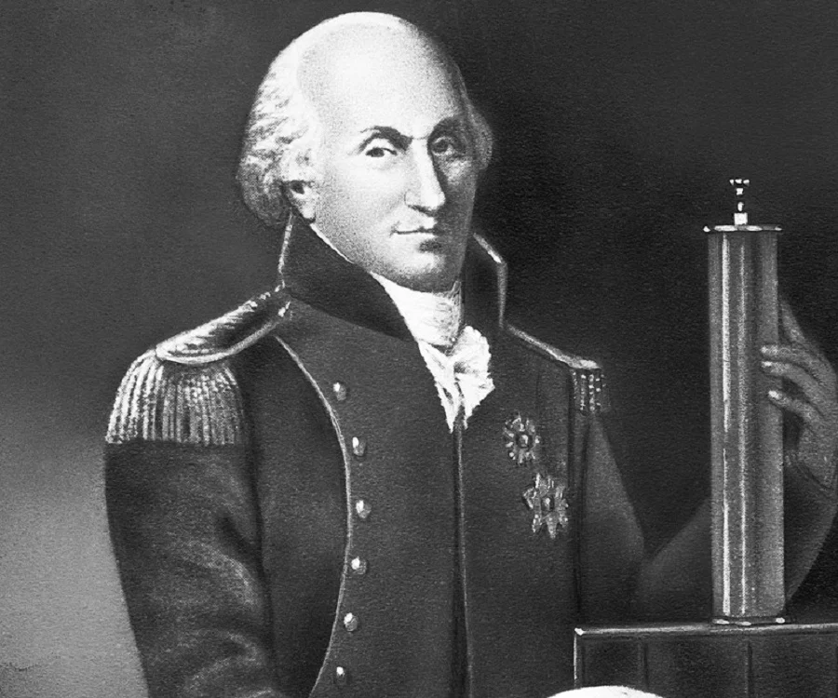
Force between point charges
Coulomb studied the interaction forces of charged particles in detail in 1784.
He used a torsion balance similar to the one used 13 years later by Cavendish to study the much weaker gravitational interaction.
For point charges, Coulomb found that the magnitude of the electric force between two point charges is directly proportional to the product of their charges and inversely proportional to the square of the distance between them.

Slide 18
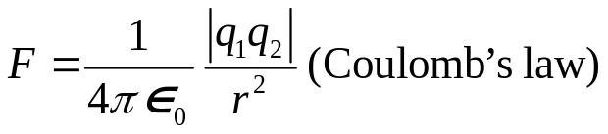
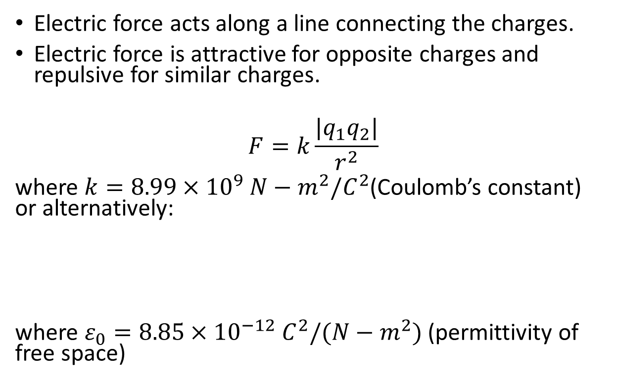
Force between point charges, continued
Electric force acts along a line connecting the charges.
Electric force is attractive for opposite charges and repulsive for similar charges.
$$F=k\frac{|q_{1}q_{2}|}{r^{2}}$$
where $k=8.99×{10}^{9} N−m^{2}/C^{2}$(Coulomb’s constant) or alternatively:
where $ε_{0}=8.85×{10}^{−12} C^{2}/(N−m^{2})$ (permittivity of free space)

Slide 19
Coulomb’s law, details
Coulomb’s law describes the force between two charged particles.
Coulomb’s law applies only to point charges and spherically symmetric charge distributions.
Objects can be considered point charges if they are much smaller than the distance between them.

Slide 20
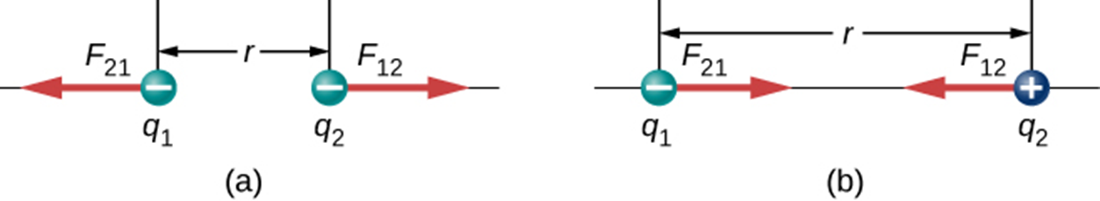
Coulomb’s law, more details
Coulomb’s law looks much like Newton’s gravity except the charge q can be positive or negative, so the force can be attractive or repulsive.
The direction of the force is determined by the second part of Coulomb’s law.

Slide 21
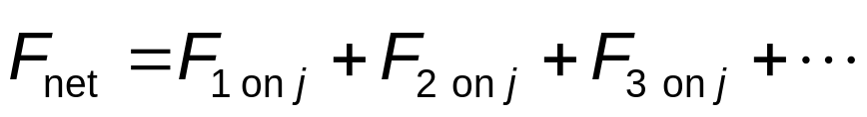
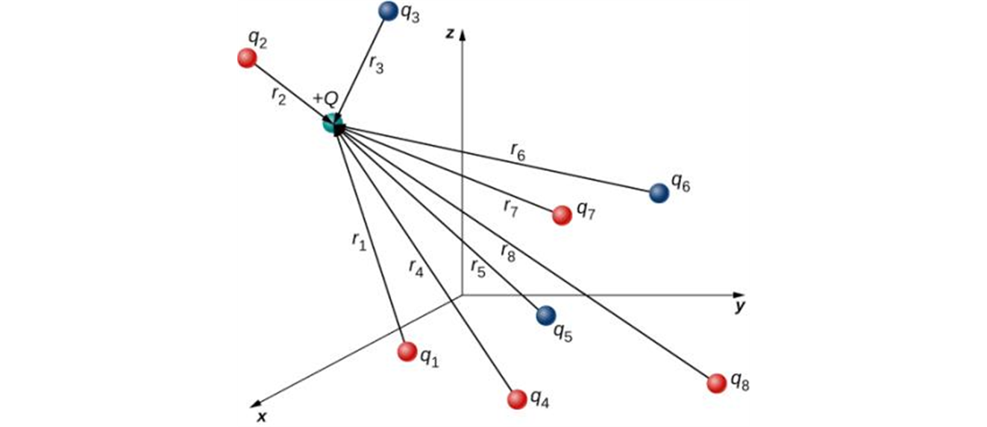
Superposition principle and other important details
Coulomb’s law is a force law, and forces are vectors.
Electric forces, like other forces, can be superimposed.
The net electric force on charge j due to all other charges is the sum of the individuals forces due to each charge:
Each force is given by Coulomb’s law.

Slide 22
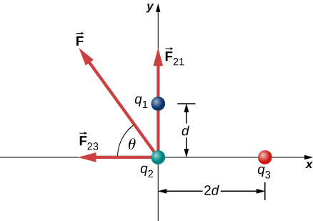
Superposition principle, example

