Slide 1

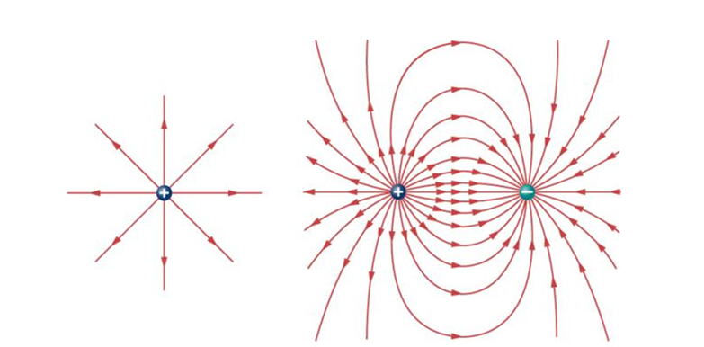

ELECTRIC FIELD LINES

Slide 2
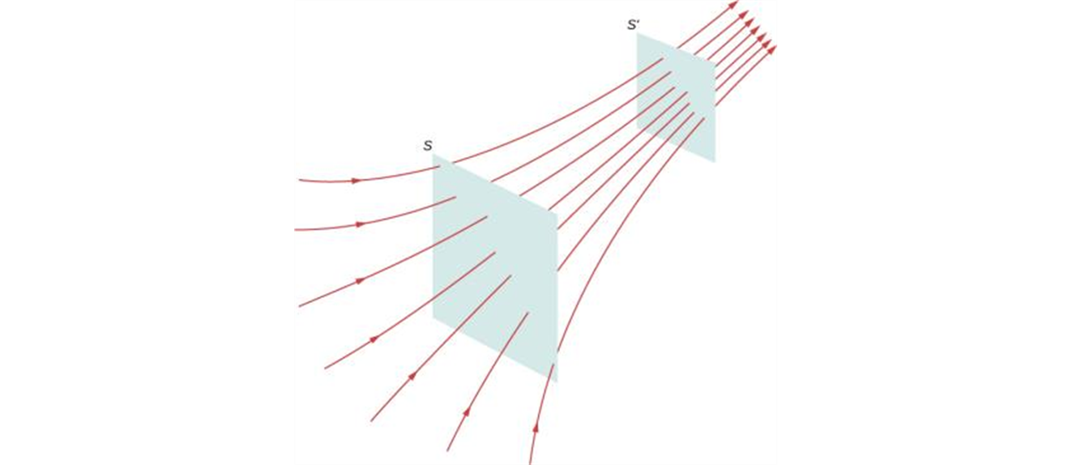
Electric Field Lines
Electric field lines are imaginary lines drawn through a region of space to help visual the electric field.
The electric field lines are drawn so that
  The electric field is tangent to the line at any point.
  The field lines are closer together where the electric field strength is greater.
If we know what the field vectors look like, we can extrapolate to the field lines.

Slide 3
Electric field lines, how to draw
The electric field is created by charges. Draw field lines starting on positive charges (or infinity) and moving toward negative charges (or infinity).
Draw the number of lines associated with a charge so it is proportional to the magnitude of the charge.
At any point, the electric field has a unique direction, so field lines never intersect.
Note: The motion of a charged particle is not necessarily along the electric field line!

Slide 4
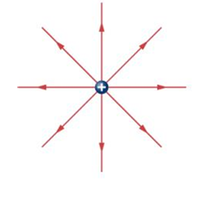
Electric field of a point charge

Slide 5
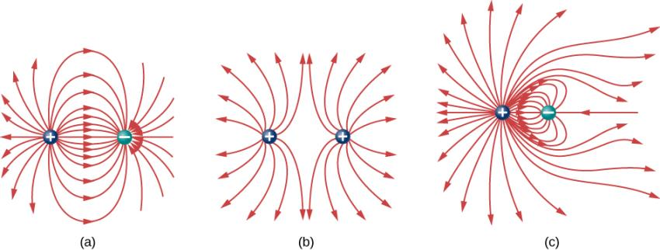
More examples
Three typical electric field diagrams.
A dipole.
Two identical charges.
Two charges with opposite signs and different magnitudes. Can you tell from the diagram which charge has the larger magnitude?

