Slide 1

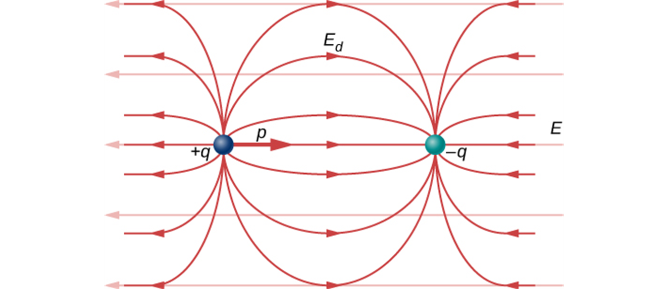

ELECTRIC DIPOLES

Slide 2
Electric dipole
An electric dipole is a pair of charges with the same magnitude but opposite signs.
Many physical systems (such as molecules) can be described as electric dipoles.
Molecule of water, for example, in many ways behaves as an electric dipole.
This is a reason water is an excellent solvent for ionic substances.

Slide 3
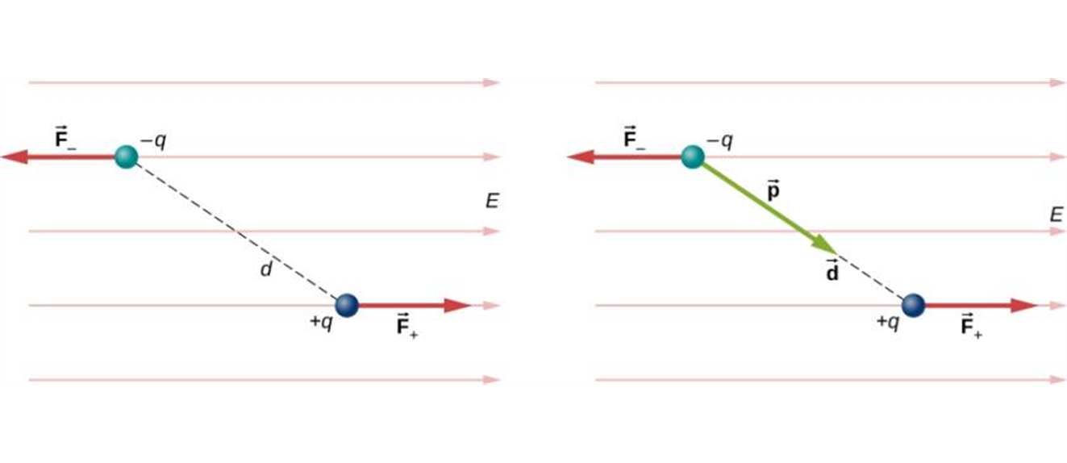
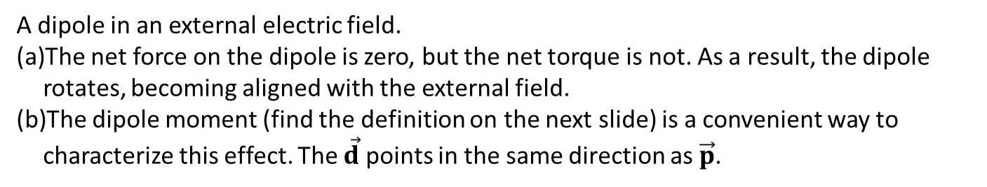
Forces and torques on electric dipole
An electric dipole in a uniform electric field experiences no net force.
There is a net torque on a dipole in a uniform electric field, which causes it to rotate.
A dipole in an external electric field.
The net force on the dipole is zero, but the net torque is not. As a result, the dipole rotates, becoming aligned with the external field.
The dipole moment (find the definition on the next slide) is a convenient way to characterize this effect. The $\vec{d}$ points in the same direction as $\vec{p}$.

Slide 4
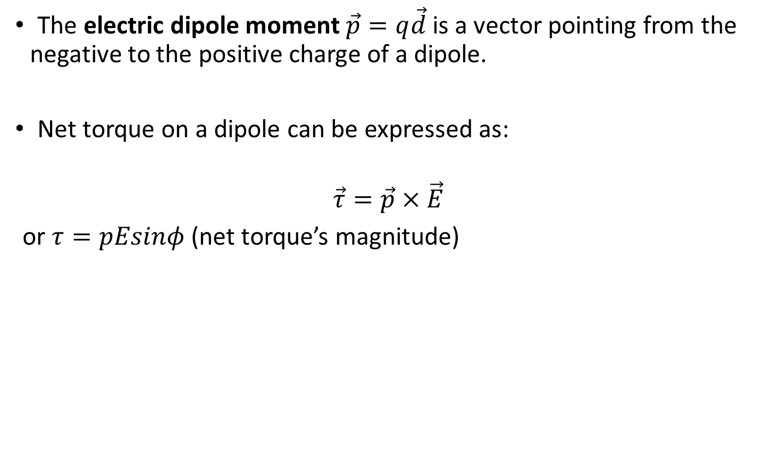
Forces and torques in an electric dipole, continued
The electric dipole moment $\vec{p}=q\vec{d}$ is a vector pointing from the negative to the positive charge of a dipole.
Net torque on a dipole can be expressed as:
$$\vec{τ}=\vec{p}×\vec{E}$$
or $τ=pEsinφ$ (net torque’s magnitude)

Slide 5
Equilibrium position of a dipole
The equilibrium position of a dipole in an electric field is with the electric dipole moment aligned with the field.

Slide 6
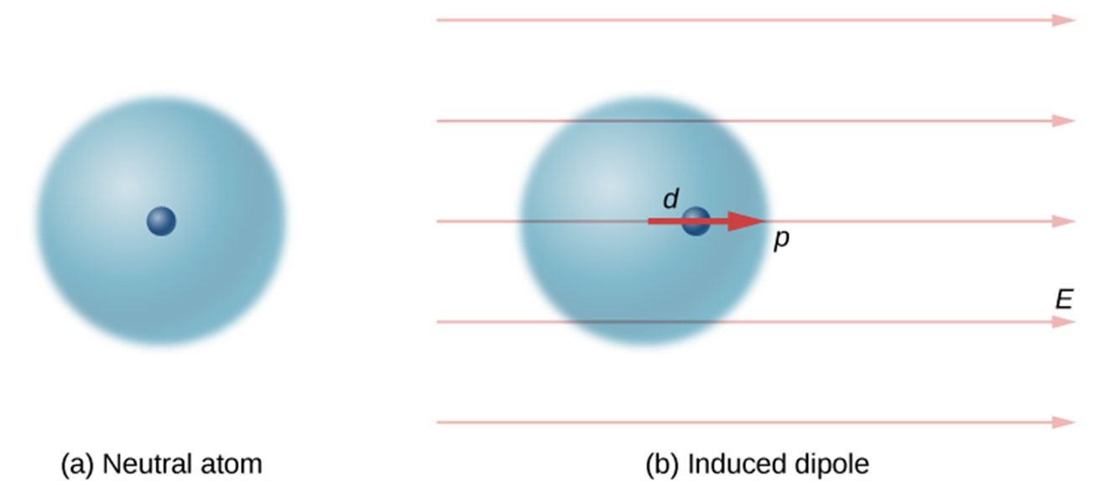
Induced dipole
A dipole is induced in a neutral atom by an external electric field. The induced dipole moment is aligned with the external field.

