Slide 1
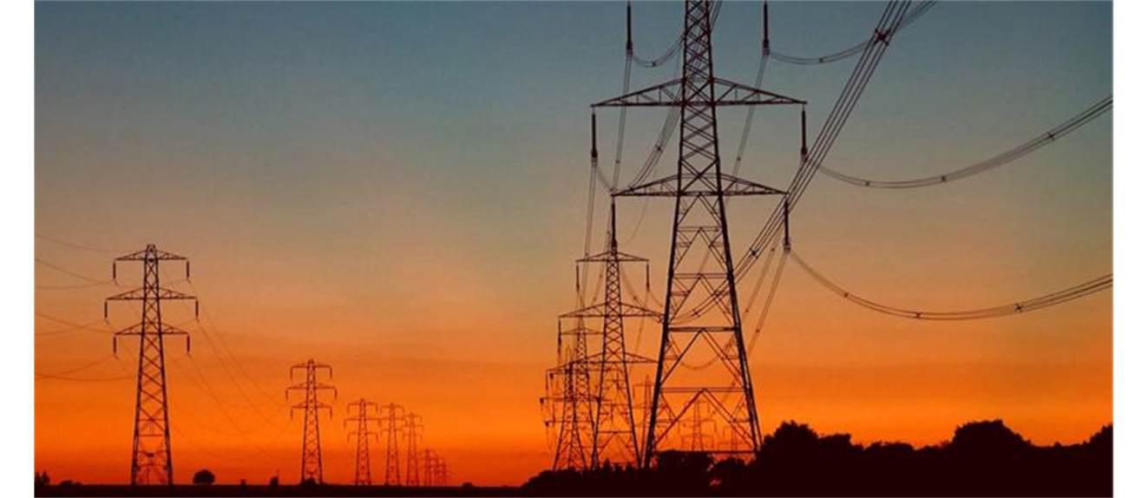


ALTERNATING CURRENTS

Slide 2
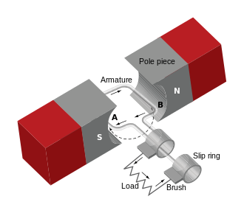
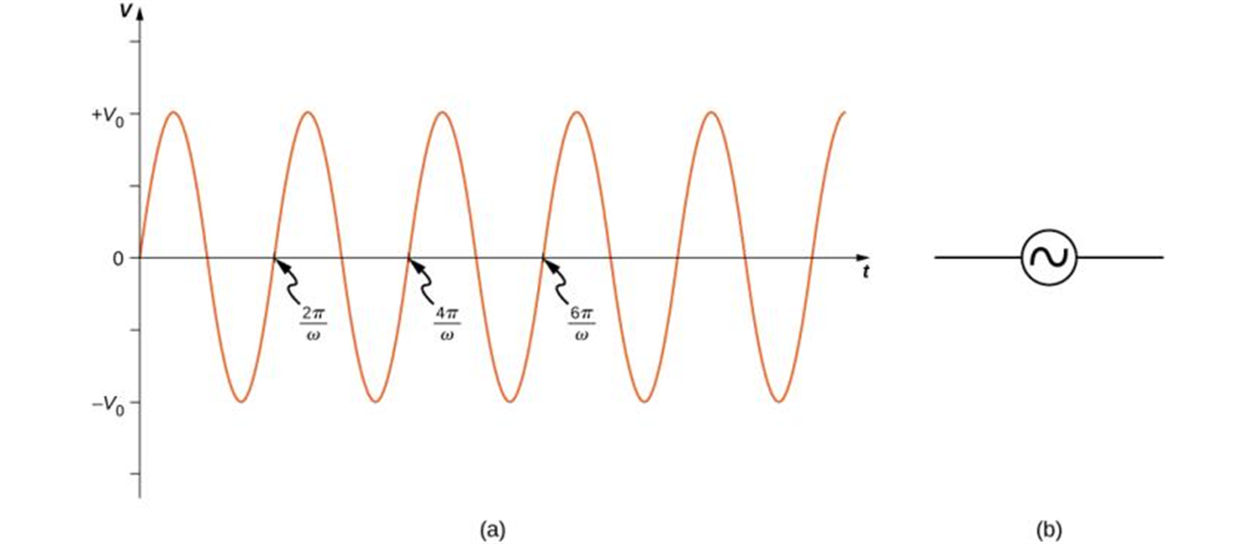
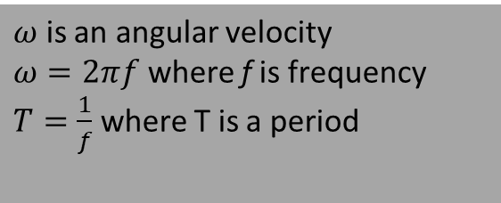
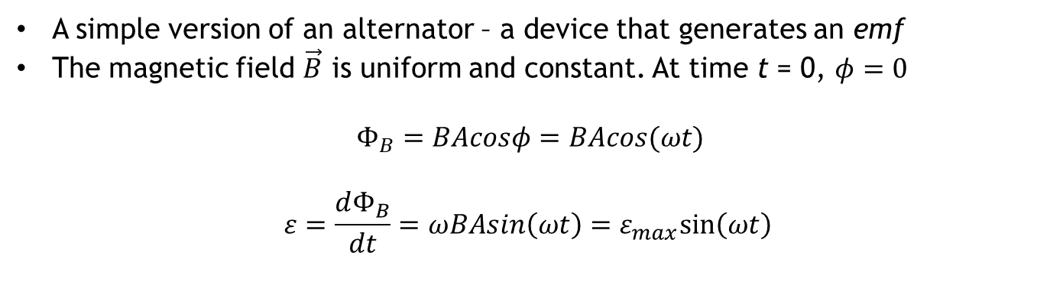
ac generator
$ω$ is an angular velocity
$ω=2πf$ where f is frequency
$T=\frac{1}{f}$ where T is a period
A simple version of an alternator – a device that generates an emf
The magnetic field $\vec{B}$ is uniform and constant. At time t = 0, $φ=0$
$$Φ_{B}=BAcosφ=BAcos(ωt)$$
$$ε=\frac{dΦ_{B}}{dt}=ωBAsin\left(ωt\right)=ε_{max}sin⁡\left(ωt\right)$$
The output v(t) = V₀ sin 𝜔t of an ac generator.
Symbol used to represent an ac voltage source in a circuit diagram.

Slide 3
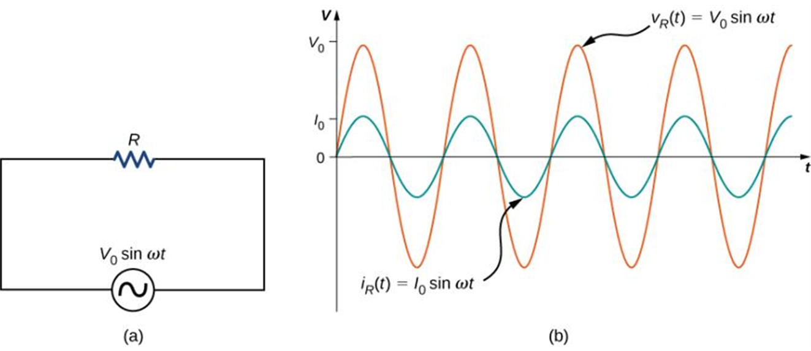
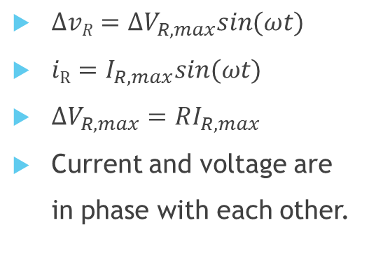
Resistor in an ac circuit
$ΔvR=ΔV_{R,max}sin(ωt)$
$iR=I_{R,max}sin(ωt)$
$ΔV_{R, max}=RI_{R, max}$
Current and voltage are
in phase with each other.
A resistor connected across an ac voltage source.
The current i_{R}(t) through the resistor and the voltage v_{R}(t) across the resistor. The two quantities are in phase.

Slide 4
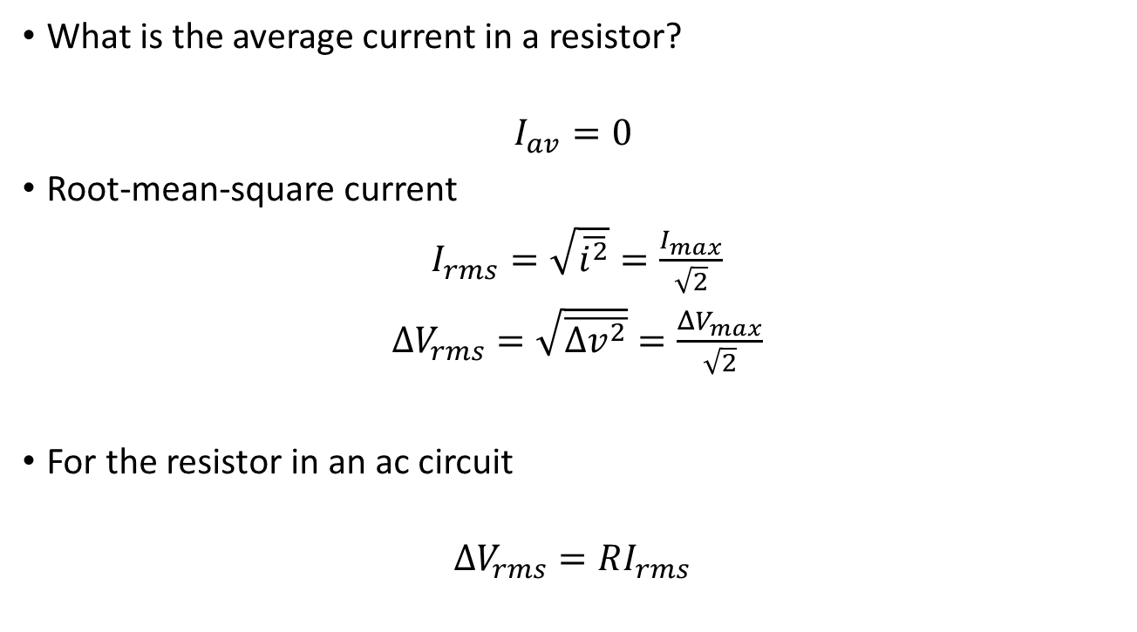
rms current
What is the average current in a resistor?
$$I_{av}=0$$
Root-mean-square current
$I_{rms}=\sqrt{\overline{i^{2}}}=\frac{I_{max}}{\sqrt{2}}$
$ΔV_{rms}=\sqrt{\overline{{Δv}^{2}}}=\frac{ΔV_{max}}{\sqrt{2}}$
For the resistor in an ac circuit
$$ΔV_{rms}=RI_{rms}$$
rms current is a dc current that would produce the same power output as the actual ac circuit!
“120-V ac” means the rms voltage, not the maximum, which is 170 V!

Slide 5
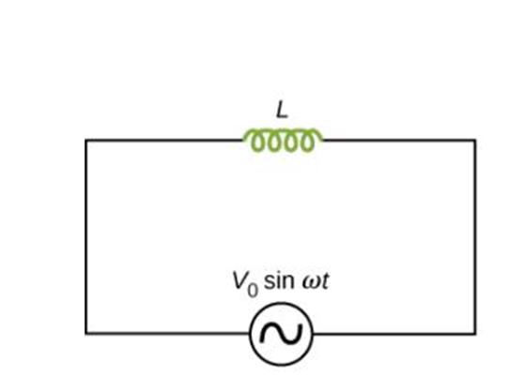
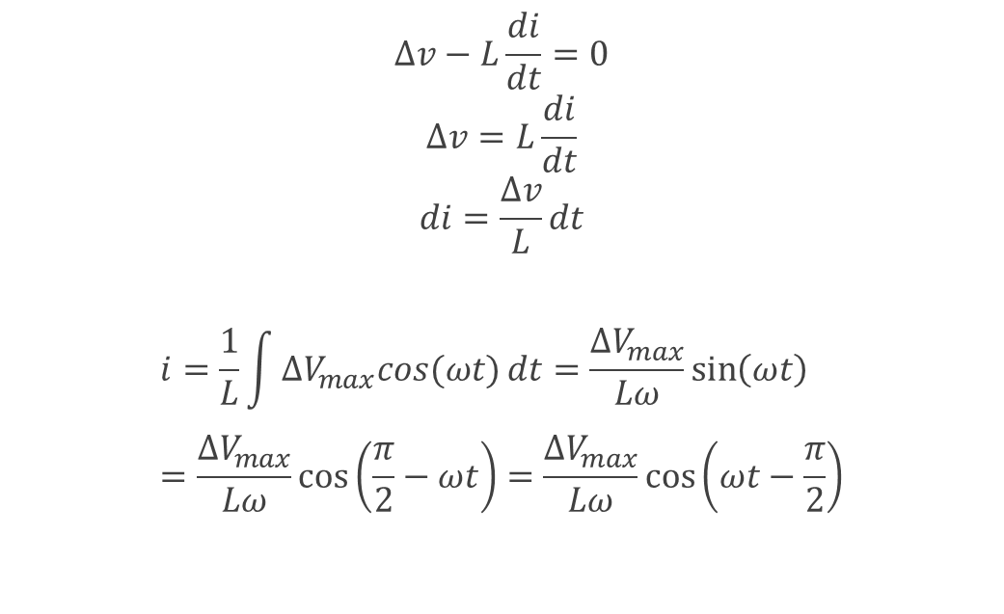
Inductor in an ac circuit
$$Δv−L\frac{di}{dt}=0$$
$$Δv=L\frac{di}{dt}$$
$$di=\frac{Δv}{L}dt$$
$$i=\frac{1}{L}\int{ΔV_{max}cos(ωt)}dt=\frac{ΔV_{max}}{Lω}\sin\left(ωt\right)=\frac{ΔV_{max}}{Lω}\cos\left(\frac{π}{2}−ωt\right)=\frac{ΔV_{max}}{Lω}\cos\left(ωt−\frac{π}{2}\right)$$

Slide 6
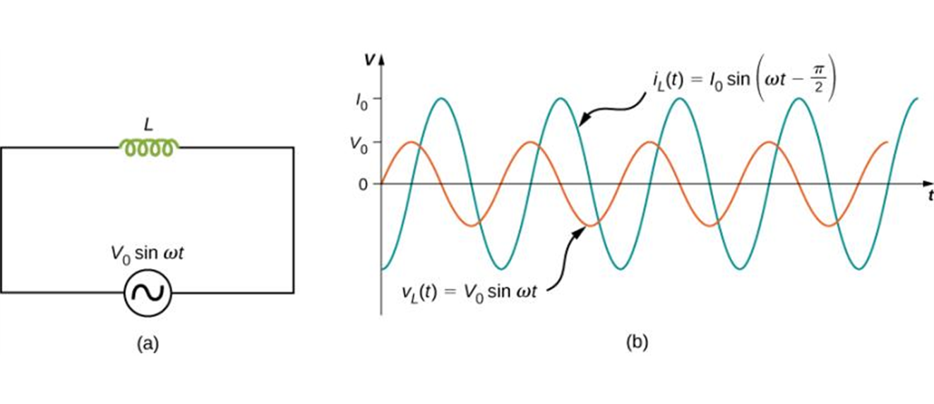
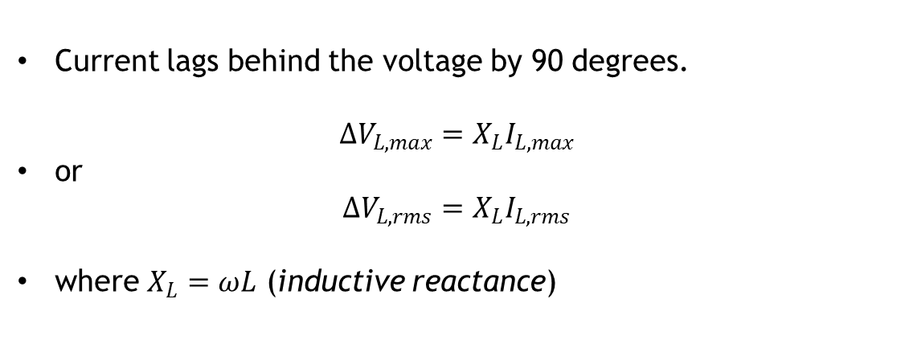
Inductor in an ac circuit, continued
Note: units of the inductive reactance are Ohms!
Current lags behind the voltage by 90 degrees.
$ΔV_{L,max}=X_{L}I_{L,max}$
or
$ΔV_{L,rms}=X_{L}I_{L,rms}$
where $X_{L}=ωL$ (inductive reactance)

Slide 7
An inductor in an ac circuit example
Suppose you want the current amplitude in a pure inductor in a radio receiver to be 250 μA when the voltage amplitude is 3.60 V at a frequency of 1.60 MHz (corresponding to the upper end of the AM broadcast band). What inductive reactance is needed? What inductance? If the voltage amplitude is kept constant, what will be the current amplitude through the inductor at 16.0 Mhz?

Slide 8
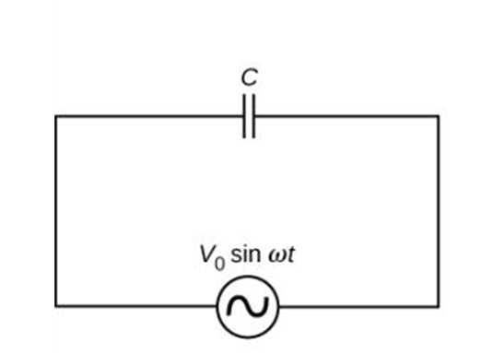
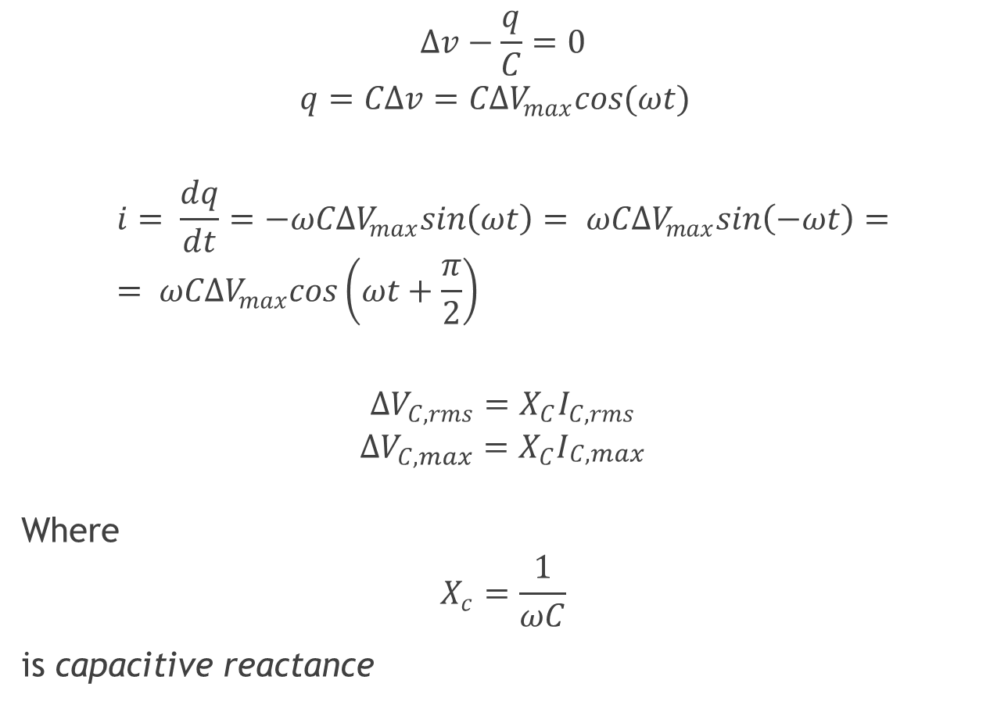
Capacitor in an ac circuit
$$Δv−\frac{q}{C}=0$$
$$q=CΔv=CΔV_{max}cos(ωt)$$
$$i= \frac{dq}{dt}=−ωCΔV_{max}sin\left(ωt\right)= ωCΔV_{max}sin\left(−ωt\right)== ωCΔV_{max}cos\left(ωt+\frac{π}{2}\right)$$
$$ΔV_{C,rms}=X_{C}I_{C,rms}$$
$$ΔV_{C,max}=X_{C}I_{\begin{aligned}C,max \\ \end{aligned}}$$
Where
$$X_{c}=\frac{1}{ωC}$$
is capacitive reactance

Slide 9
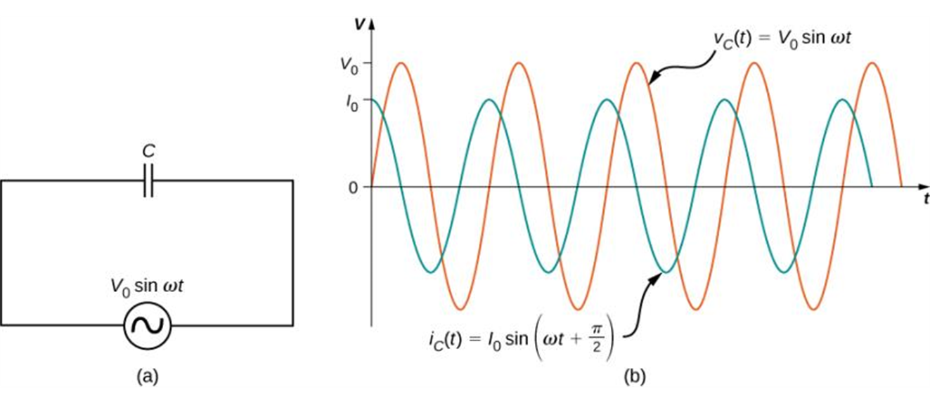
Capacitance in an ac circuit
Current leads the voltage by 90 degrees
Remember ELI the ICE man mnemonics!

Slide 10

Example: the capacitive reactance
capacitor at a 100 H z audio frequency and at a 100 M H z F M-radio frequency?
What is the capacitive reactance of a

Slide 11


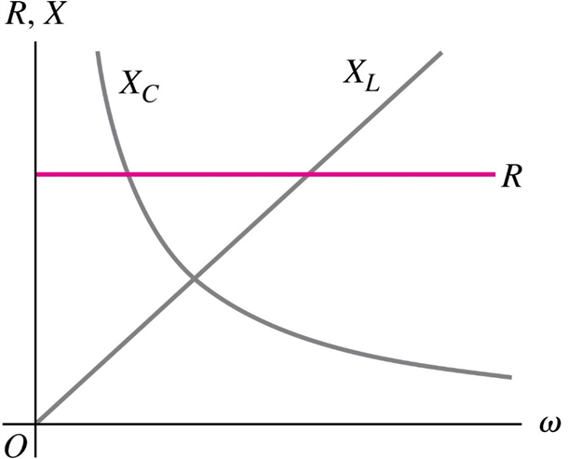

Comparing ac Circuit Elements
The graph shows how the resistance of a resistor and the reactances of an inductor and a capacitor vary with angular frequency
Resistance R is independent of frequency.
If corresponding to a dc circuit, there is no current through a capacitor because
In the limit the current through
an inductor becomes vanishingly small.

Slide 12
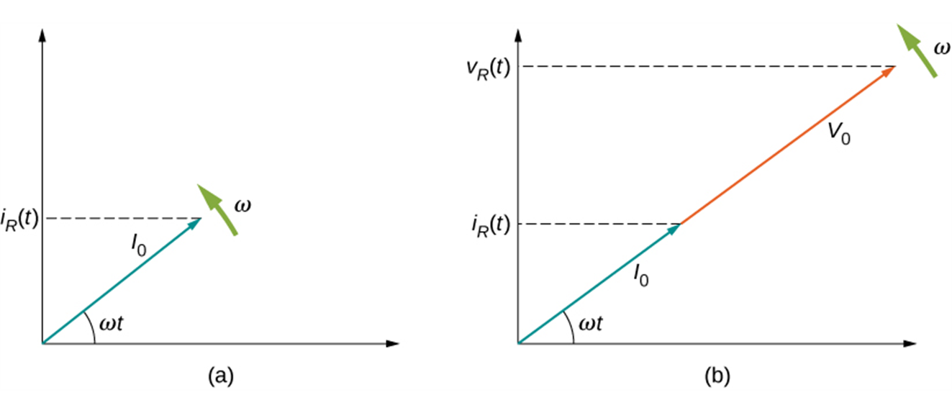
Phasors
Phasor is a vector rotating around the origin of a coordinate system
Length of the phasor corresponds to a maximum value of a current (or voltage)
Projection of a phasor onto vertical axis at
a moment t equals the instantaneous value of
a current (voltage)

Slide 13
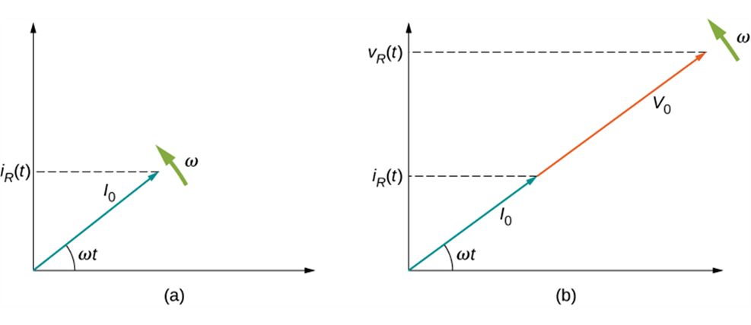
Phasor diagram for the resistor
The phasor diagram representing the current through the resistor
The phasor diagram representing both i_{R}(t) and v_{R}(t) .

Slide 14
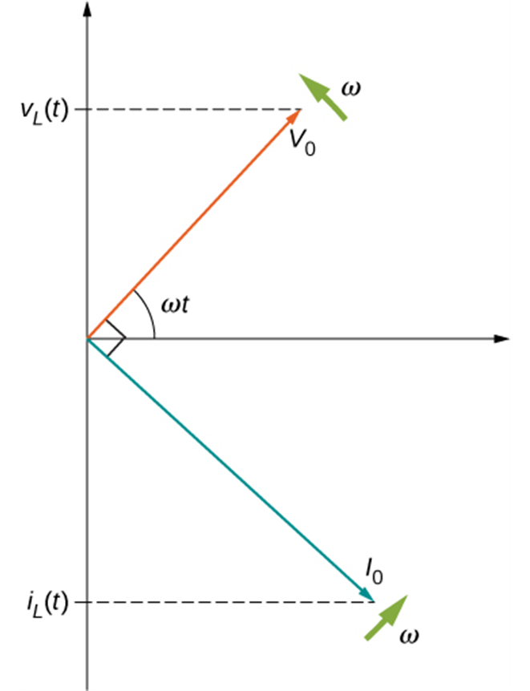
Phasor diagram for an Inductor
The phasor diagram for the inductor. The current phasor lags the voltage phasor by 𝜋/2 rad as they both rotate with the same angular frequency.

Slide 15
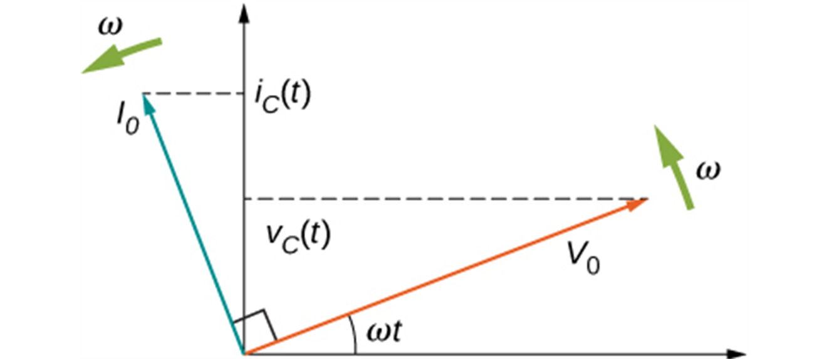
Phasor diagram for a capacitor
The phasor diagram for the capacitor. The current phasor leads the voltage phasor by 𝜋/2 rad as they both rotate with the same angular frequency.

Slide 16
The L-R-C series circuit
Many ac circuits used in practical applications involve resistance, capacitance, and inductance
Can be analyzed with phasor diagram

Slide 17
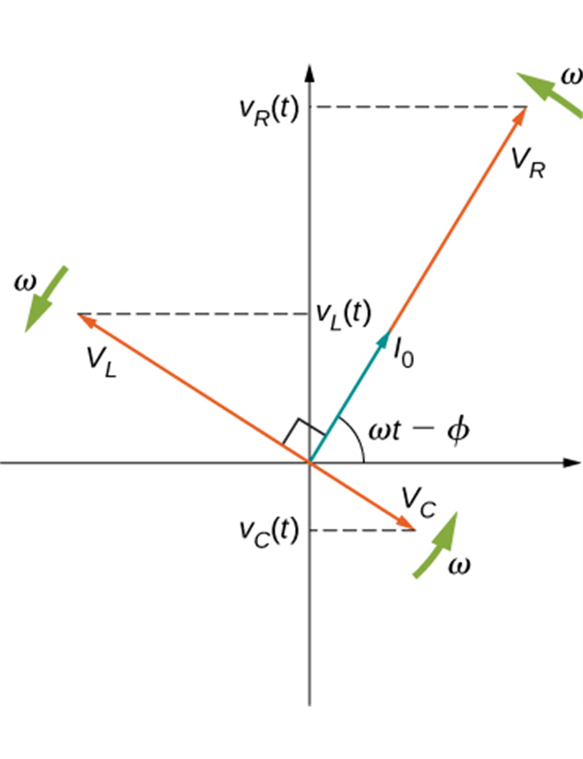
Phasor diagrams for the L-R-C series circuit
The phasor diagram for the circuit.

Slide 18
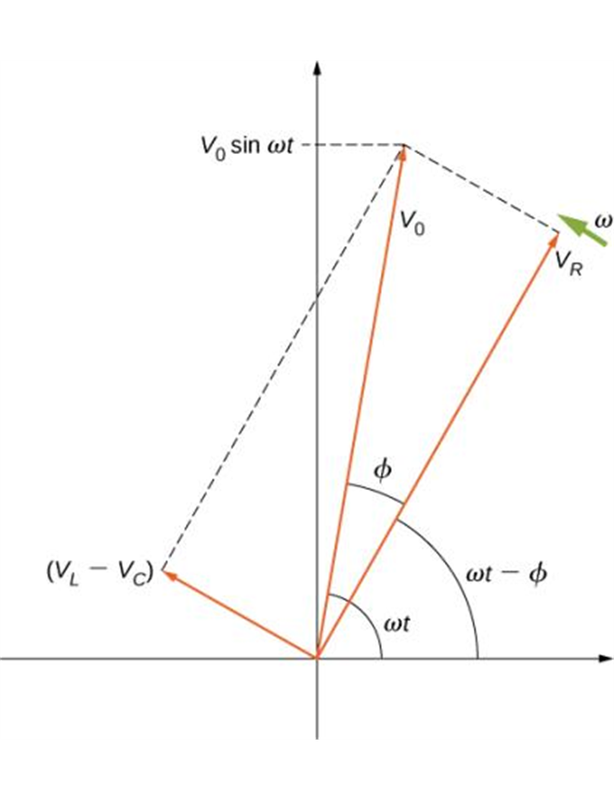
The L-R-C series circuit, continued
The resultant of the phasors for v_{L}(t) , v_{C}(t), and v_{R}(t) is equal to the phasor for v(t) = V₀ sin ωt. The i(t) phasor (not shown) is aligned with the v_{R}(t) phasor.

