Slide 1

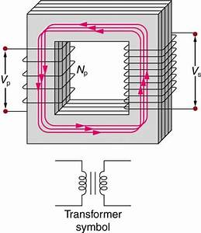

INDUCTANCE

Slide 2
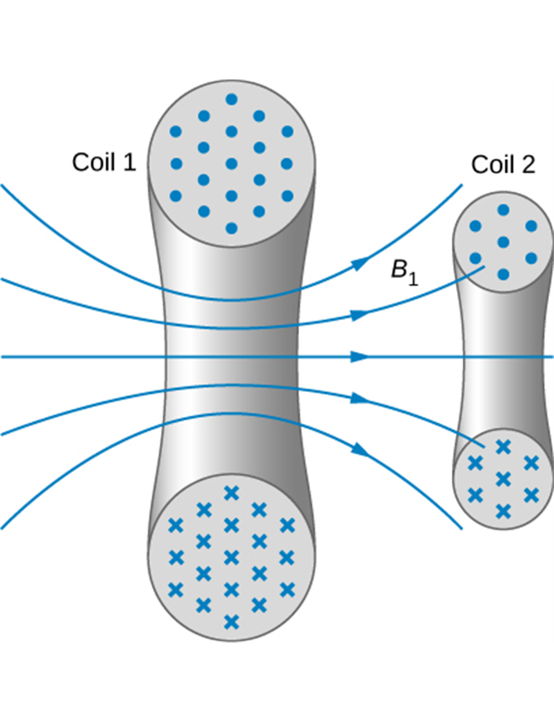
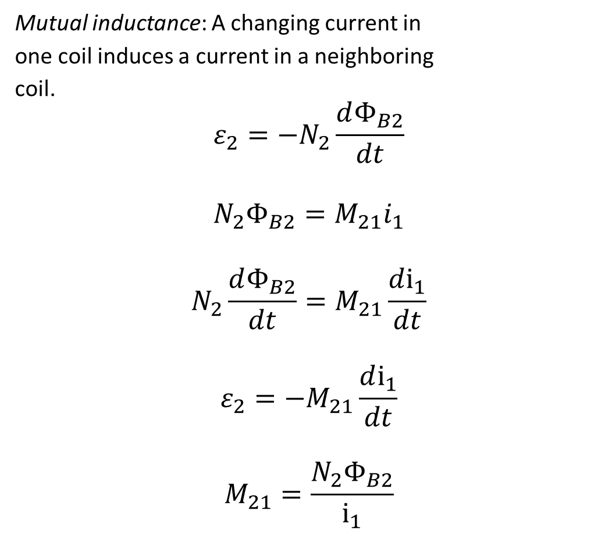
Mutual inductance
Mutual inductance: A changing current in
one coil induces a current in a neighboring
coil.
$$ε_{2}=−N_{2}\frac{dΦ_{B2}}{dt}$$
$$N_{2}Φ_{B2}=M_{21}i_{1}$$
$$N_{2}\frac{dΦ_{B2}}{dt}=M_{21}\frac{di_{1}}{dt}$$
$$ε_{2}=−M_{21}\frac{di_{1}}{dt}$$
$$M_{21}=\frac{N_{2}Φ_{B2}}{i_{1}}$$
Some of the magnetic field lines produced by the current in coil 1 pass through coil 2.

Slide 3

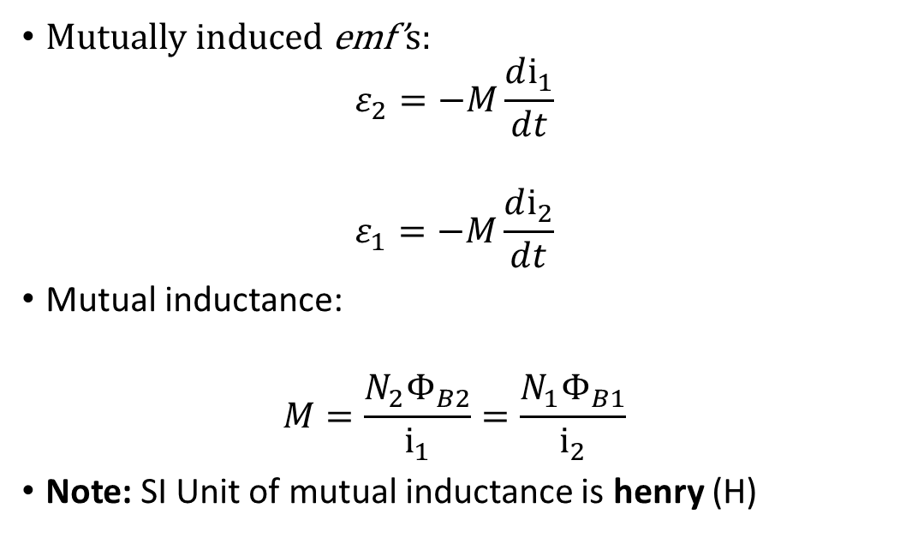
Mutual inductance
Mutually induced emf’s:
$$ε_{2}=−M\frac{di_{1}}{dt}$$
$$ε_{1}=−M\frac{di_{2}}{dt}$$
Mutual inductance:
$$M=\frac{N_{2}Φ_{B2}}{i_{1}}=\frac{N_{1}Φ_{B1}}{i_{2}}$$
Note: SI Unit of mutual inductance is henry (H)

Slide 4
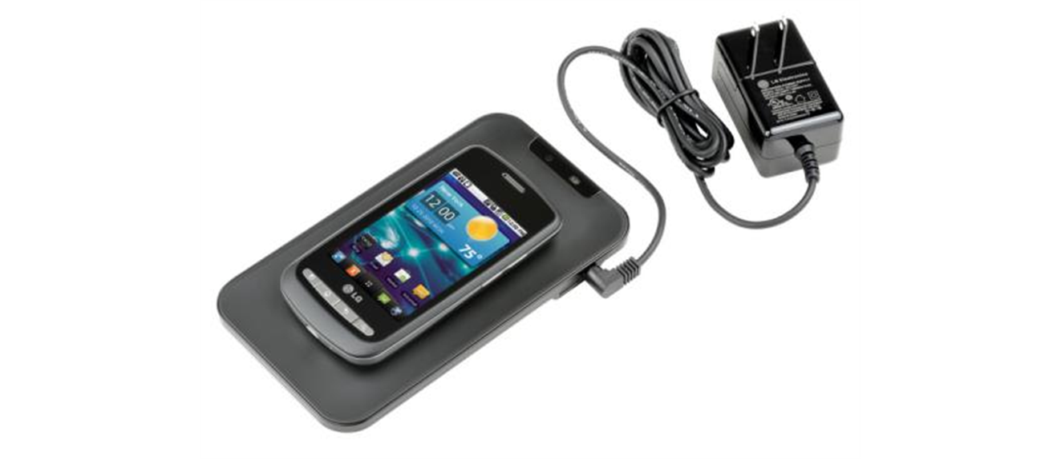
Mutual Inductance
A smartphone charging mat contains a coil that receives alternating current, or current that is constantly increasing and decreasing. The varying current induces an emf in the smartphone, which charges its battery. Note that the black box containing the electrical plug also contains a transformer that modifies the current from the outlet to suit the needs of the smartphone. (credit: modification of work by “LG”/Flickr)

Slide 5
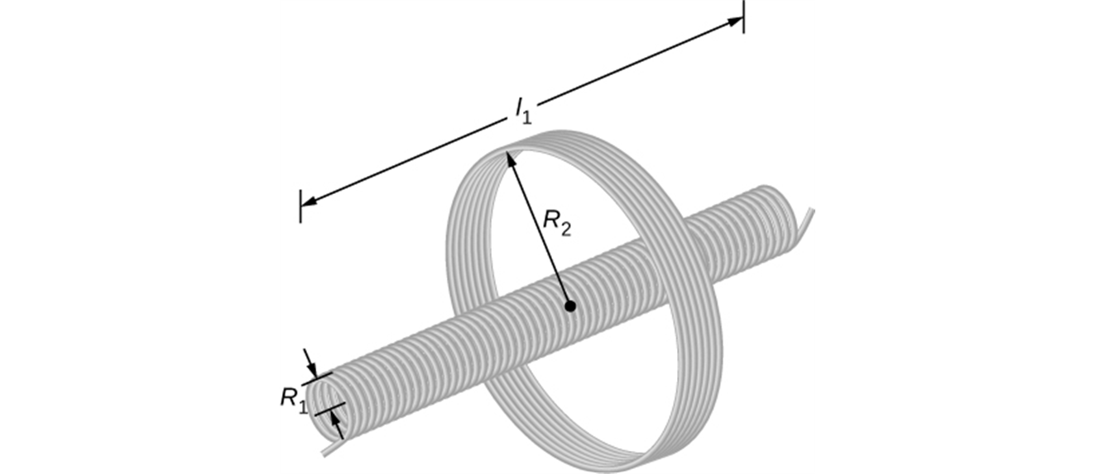
Calculating mutual inductance
In one form of Tesla coil (a high-voltage generator), a long solenoid with length l and cross sectional area A is closely wound with N₁ turns of wire. A coil with N₂ turns surrounds it at its center. Find the mutual inductance.

Slide 6
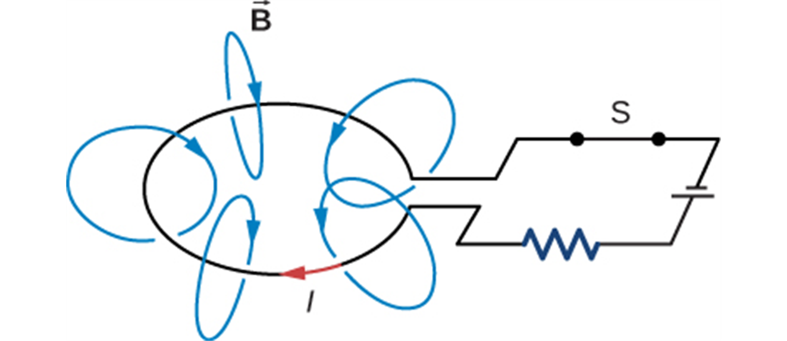
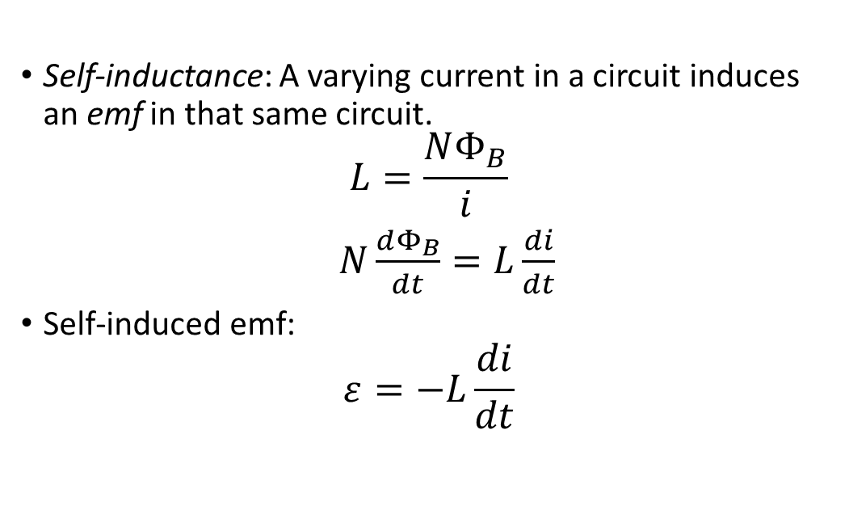
Self-inductance and inductors
Self-inductance: A varying current in a circuit induces an emf in that same circuit.
$$L=\frac{NΦ_{B}}{i}$$
$N\frac{dΦ_{B}}{dt}=L\frac{di}{dt}$
Self-induced emf:
$$ε=−L\frac{di}{dt}$$

Slide 7
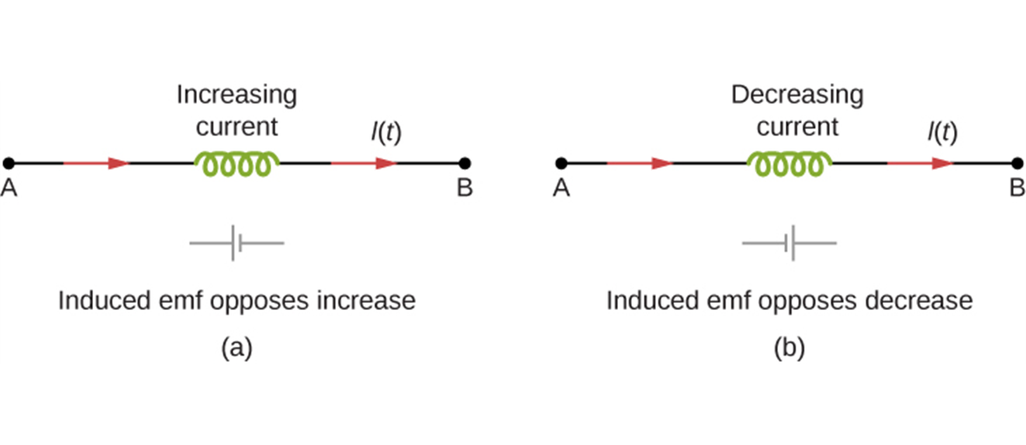
Potential across an inductor
The induced emf across an inductor always acts to oppose the change in the current. This can be visualized as an imaginary battery causing current to flow to oppose the change in (a) and reinforce the change in (b).

Slide 8
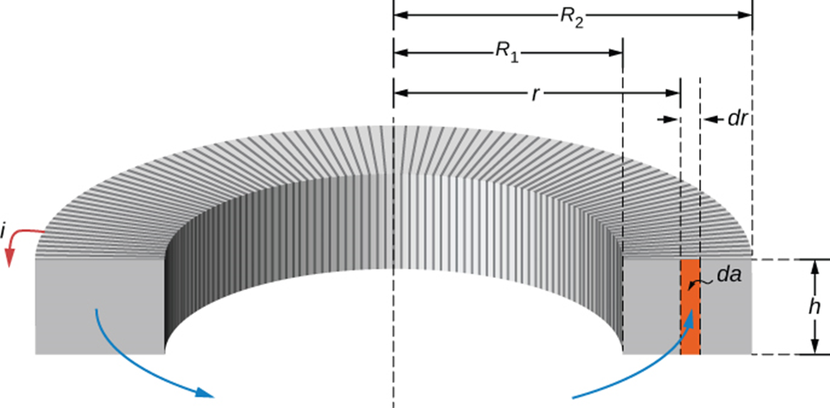
Calculating self-inductance and self-induced emf
A toroidal solenoid with cross-sectional area A and mean radius r is closely wound with N turns of wire. A toroid is wound on a nonmagnetic core. Determine its self-inductance L.

Slide 9

Calculating self-induced emf
If the current in toroidal solenoid increases uniformly from 0 to 6.0 A in 3.0 μs, find the magnitude and direction of the self-induced emf.

Slide 10
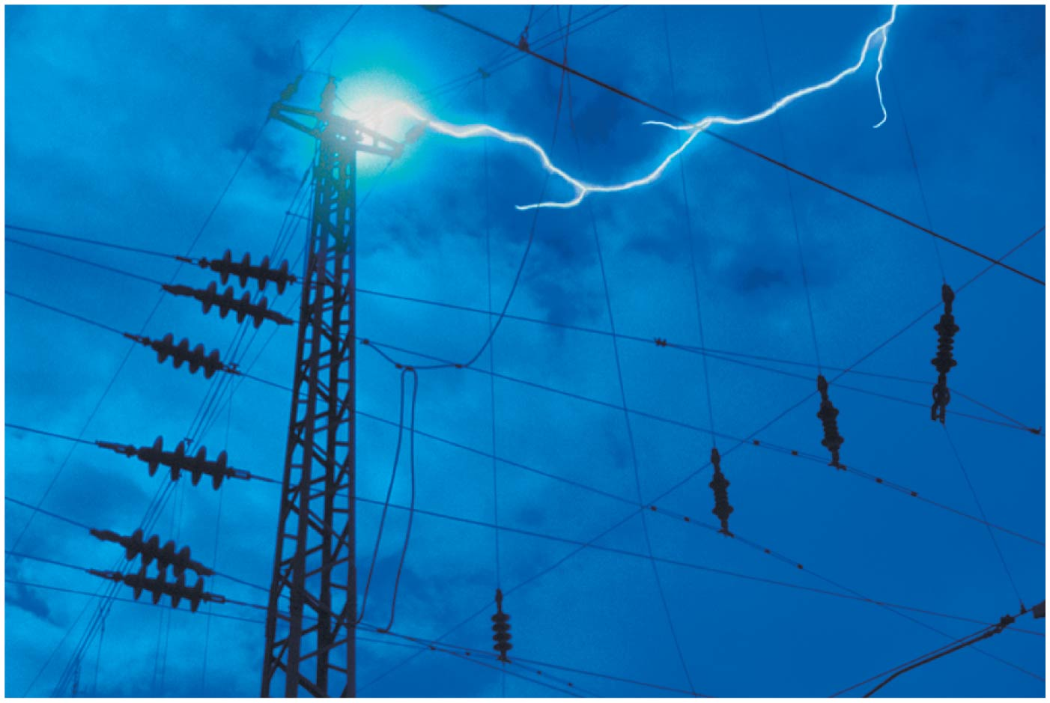
Inductors and lightning strikes
If lightning strikes part of an electrical power transmission system, it causes a sudden spike in voltage that can damage the components of the system.
To minimize these effects, large inductors are incorporated into the transmission system.
These use the principle that an inductor opposes and suppresses any rapid changes in the current.

