Slide 1

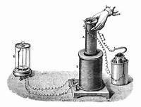
ELECTROMAGNETIC INDUCTION
Faraday's experiment showing induction between coils of wire: The liquid battery (right) provides a current which flows through the small coil (A), creating a magnetic field. When the coils are stationary, no current is induced. But when the small coil is moved in or out of the large coil (B), the magnetic flux through the large coil changes, inducing a current which is detected by the galvanometer (G).

Slide 2
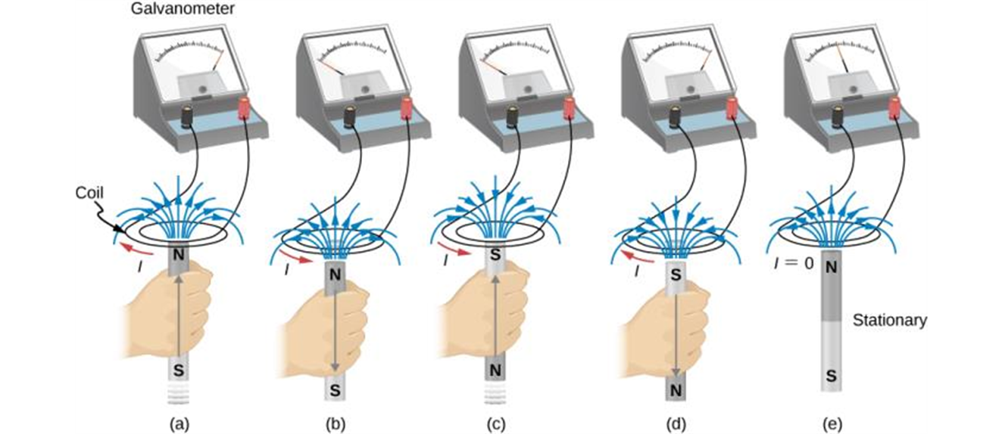
INDUCED CURRENT
Movement of a magnet relative to a coil produces emfs as shown (a–d). The same emfs are produced if the coil is moved relative to the magnet. This short-lived emf is only present during the motion. The greater the speed, the greater the magnitude of the emf, and the emf is zero when there is no motion, as shown in (e).

Slide 3
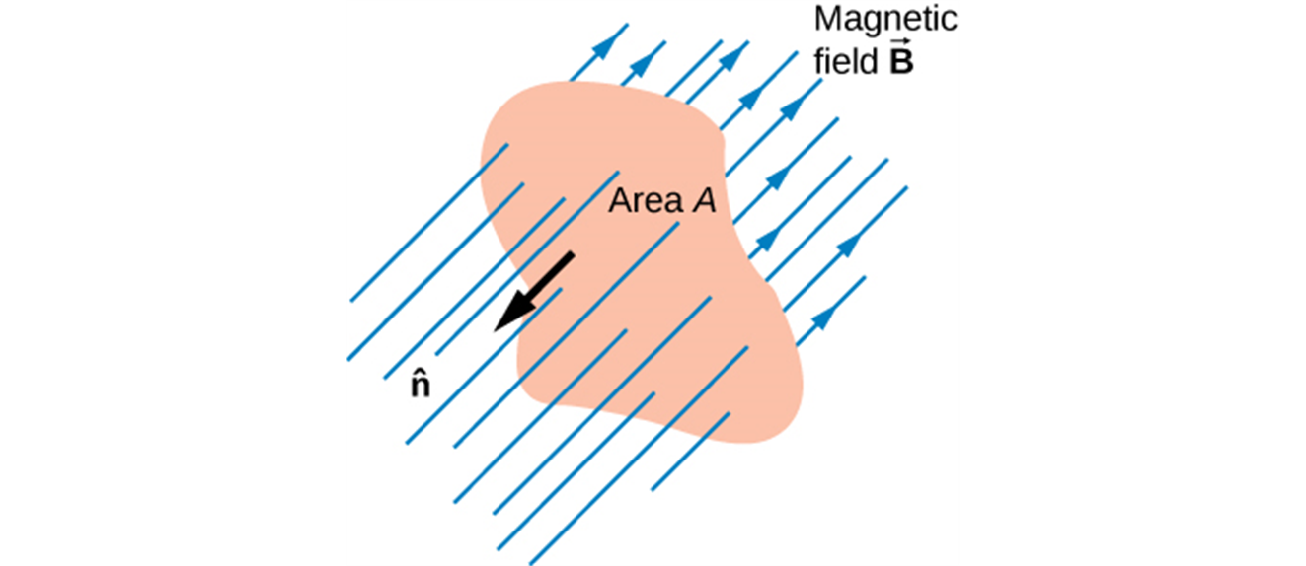
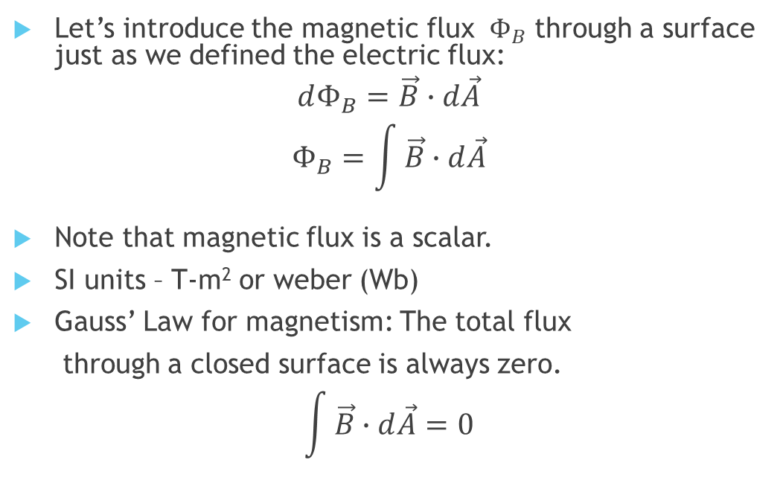
MAGNETIC FLUX definition
Let’s introduce the magnetic flux $Φ_{B}$ through a surface just as we defined the electric flux:
$$dΦ_{B}=\vec{B}∙d\vec{A}$$
$$Φ_{B}=\int{\vec{B}∙d\vec{A}}$$
Note that magnetic flux is a scalar.
SI units – T-m² or weber (Wb)
Gauss’ Law for magnetism: The total flux
through a closed surface is always zero.
$$\int{\vec{B}∙d\vec{A}}=0$$
Note: The magnetic flux is the amount of magnetic field lines cutting through a surface area A defined by the unit area vector 𝐧 ̂. If the angle between the unit area 𝐧 ̂ and magnetic field vector 𝐁 ⃗ are parallel or antiparallel, as shown in the diagram, the magnetic flux is the highest possible value given the values of area and magnetic field.

Slide 4
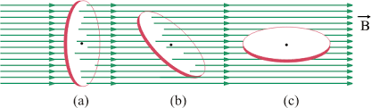
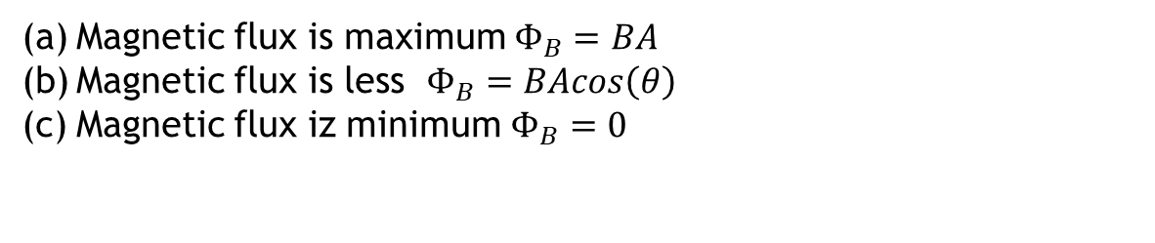
MORE ON THE MAGNETIC FLUX
Magnetic flux is proportional to the total number of magnetic field lines that cross the area.
Magnetic flux is maximum $Φ_{B}=BA$
Magnetic flux is less $Φ_{B}=BAcos\left(θ\right)$
Magnetic flux iz minimum $Φ_{B}=0$

Slide 5
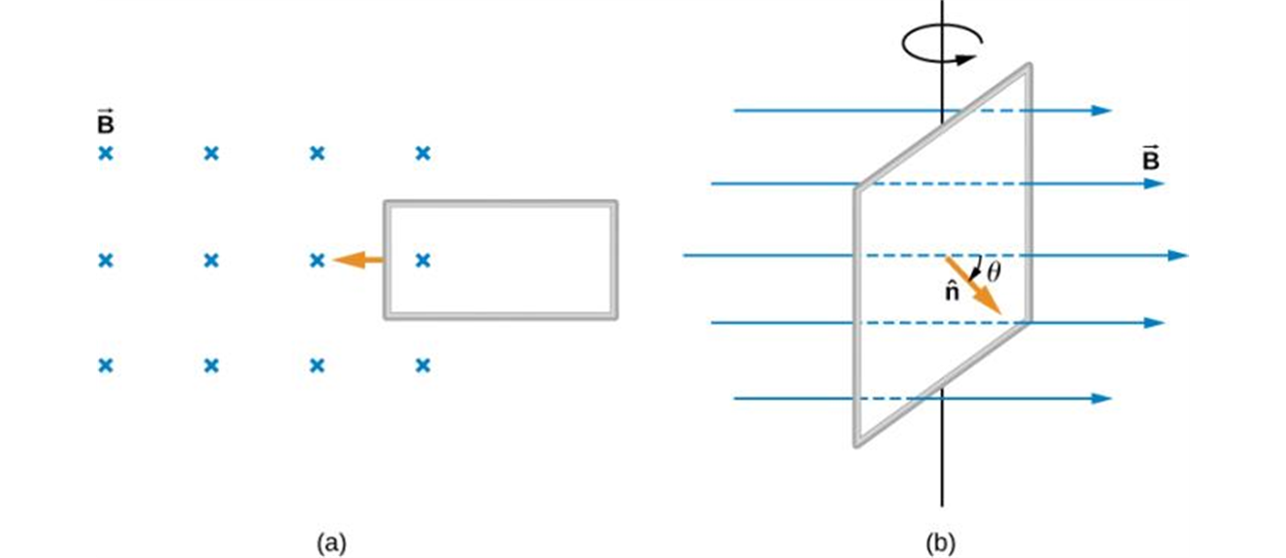
EXAMPLES OF CHANGING MAGNETIC FLUX
Magnetic flux changes as a loop moves into a magnetic field;
magnetic flux changes as a loop rotates in a magnetic field.

Slide 6
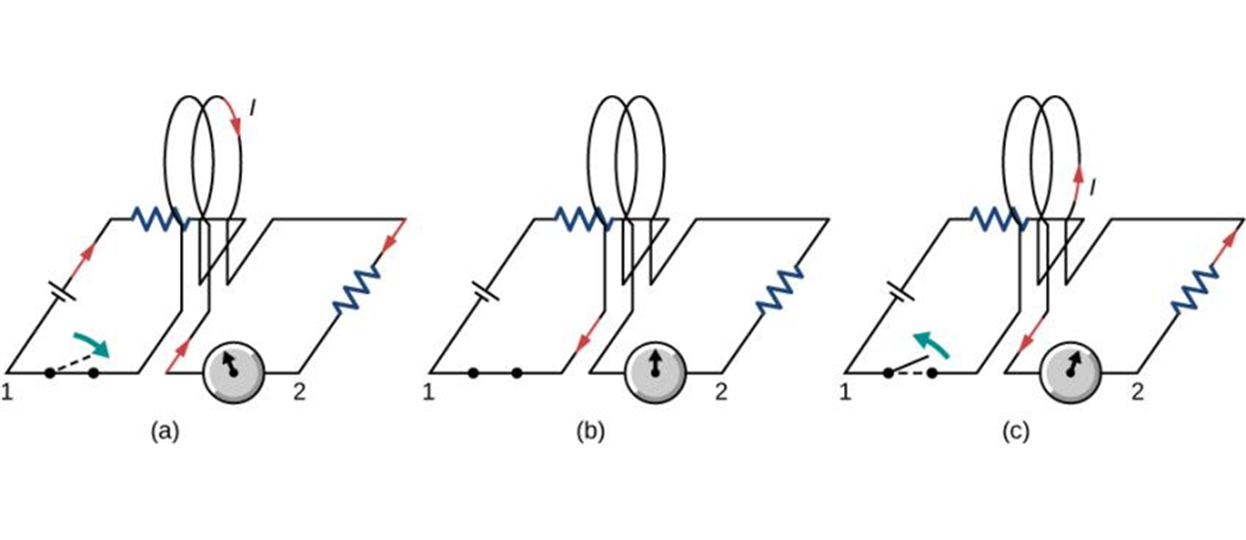
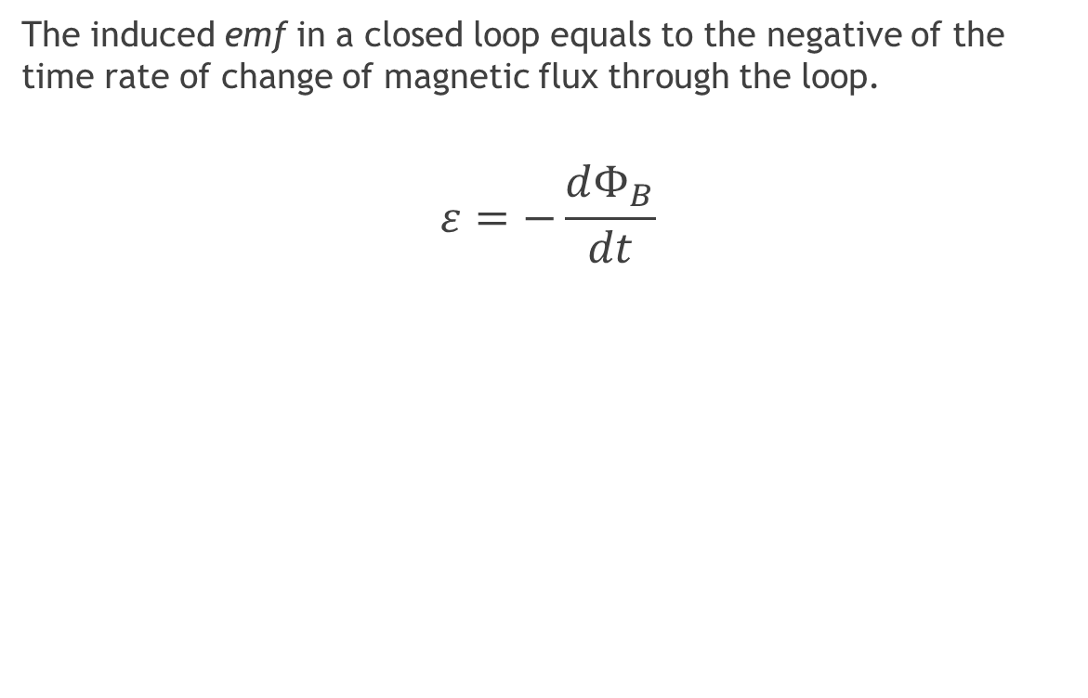
FARADAY’S LAW
The induced emf in a closed loop equals to the negative of the time rate of change of magnetic flux through the loop.
$$ε=−\frac{dΦ_{B}}{dt}$$
Closing the switch of circuit 1 produces a short-lived current surge in circuit 2.
If the switch remains closed, no current is observed in circuit 2.
Opening the switch again produces a short-lived current in circuit 2 but in the opposite direction from before.

Slide 7
DIRECTION OF THE INDUCED EMF – LENZ’S LAW
Lenz’s law is a convenient method for determining the direction of an induced current/polarity of the induced emf.
Polarity of the induces emf is such as to produce a current whose magnetic field will minimize the changes in the magnetic flux through the loop.

Slide 8
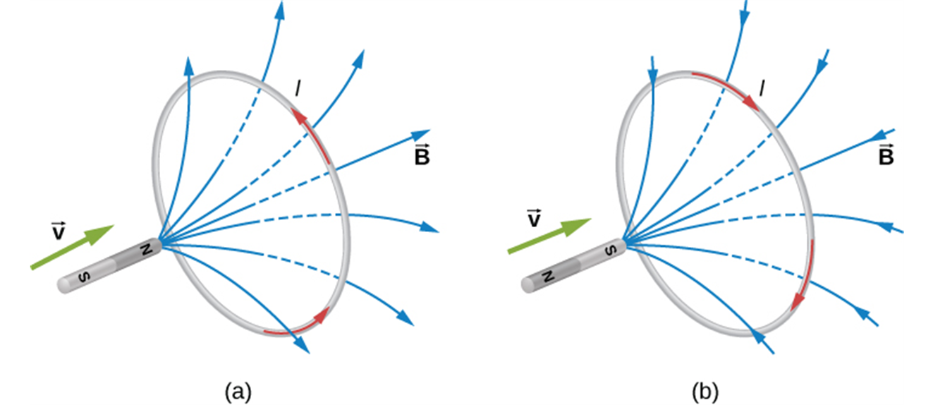
LENZ’S LAW – APPLICATION EXAMPLE
The change in magnetic flux caused by the approaching magnet induces a current in the loop.
(a) An approaching north pole induces a counterclockwise current with respect to the bar magnet.
(b) An approaching south pole induces a clockwise current with respect to the bar magnet.

Slide 9
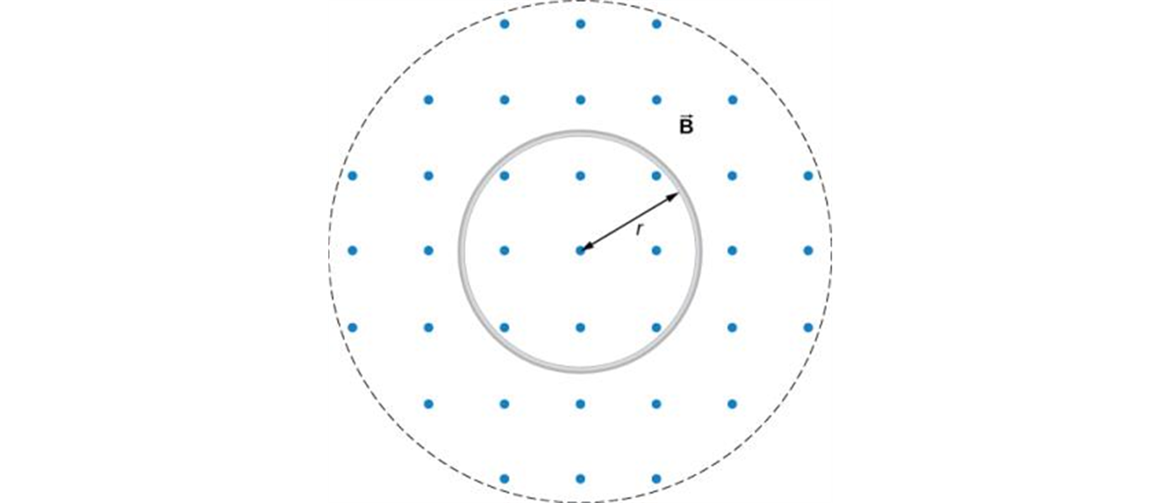
LENZ’S LAW AND THE DIRECTION OF INDUCED CURRENT
Let’s practice:
A circular coil in a decreasing magnetic field: counterclockwise induced current.
Magnetic field held constant, loop is stretched out: clockwise induced current.

Slide 10
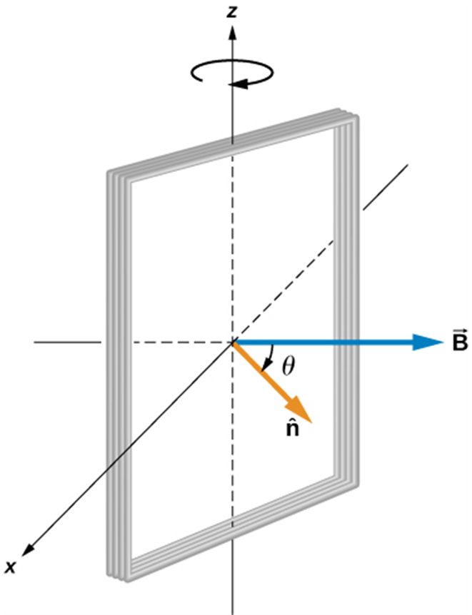
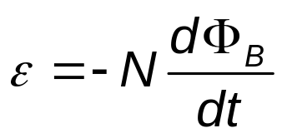
Faraday's Law for a Coil
A commercial alternator uses many loops of wire wound around a barrel-like structure called an armature.
The resulting induced emf is far larger than would be possible with a single loop of wire.
  If a coil has N identical turns and if the flux varies at the same rate through each turn, total emf is:
A rectangular coil rotating in a uniform magnetic field.

Slide 11
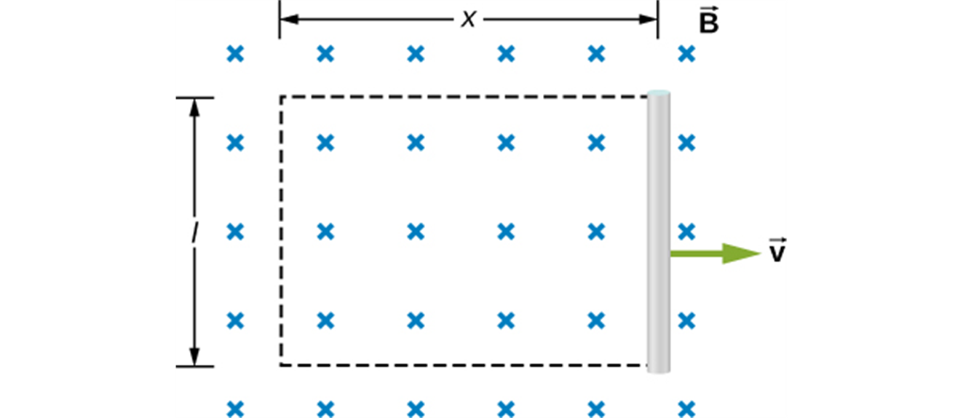
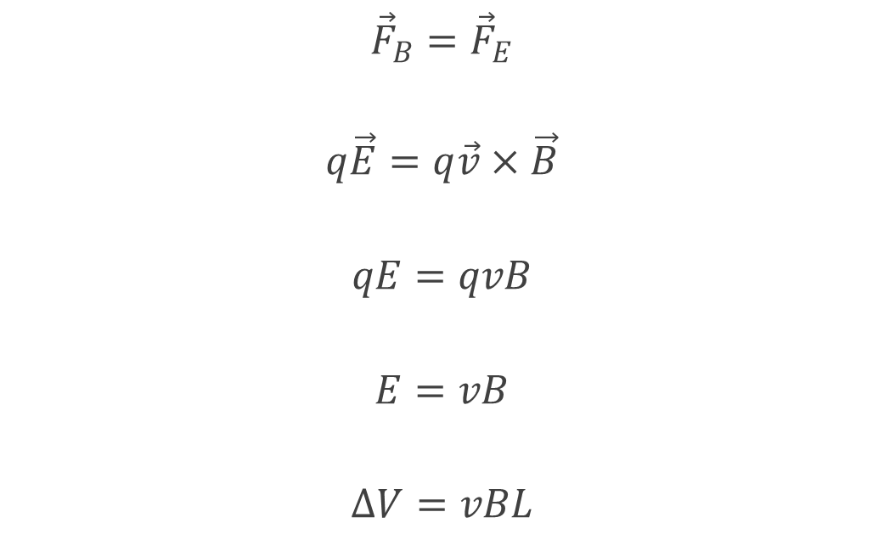
Motional electromotive force
$${\vec{F}}_{B}={\vec{F}}_{E}$$
$$q\vec{E}=q\vec{v}×\vec{B}$$
$$qE=qvB$$
$$E=vB$$
$$∆V=vBL$$
With the imaginary rectangle shown, we can also use Faraday’s law to calculate the induced emf in the moving rod.

Slide 12
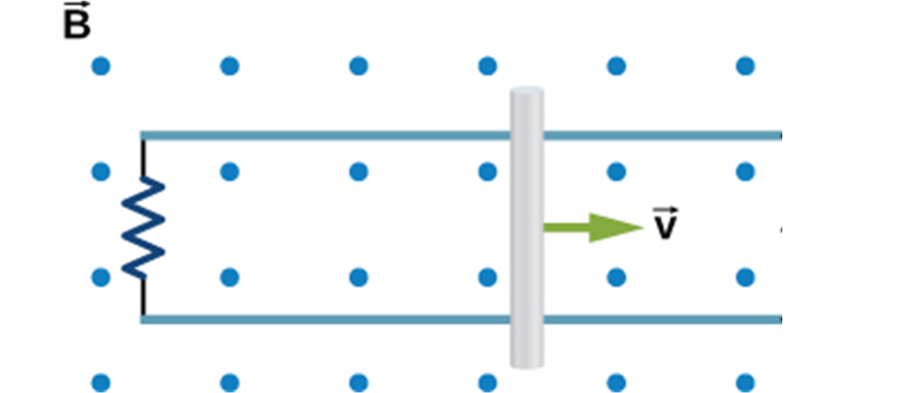

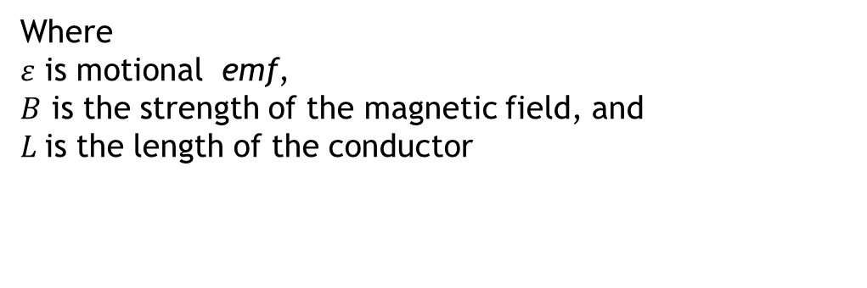
Motional Electromotive Force
When a conducting rod moves perpendicular to a uniform magnetic field, there is a motional emf induced.
$$ε=vBL$$
Where
$ε$ is motional emf,
$B$ is the strength of the magnetic field, and
$L$is the length of the conductor

Slide 13
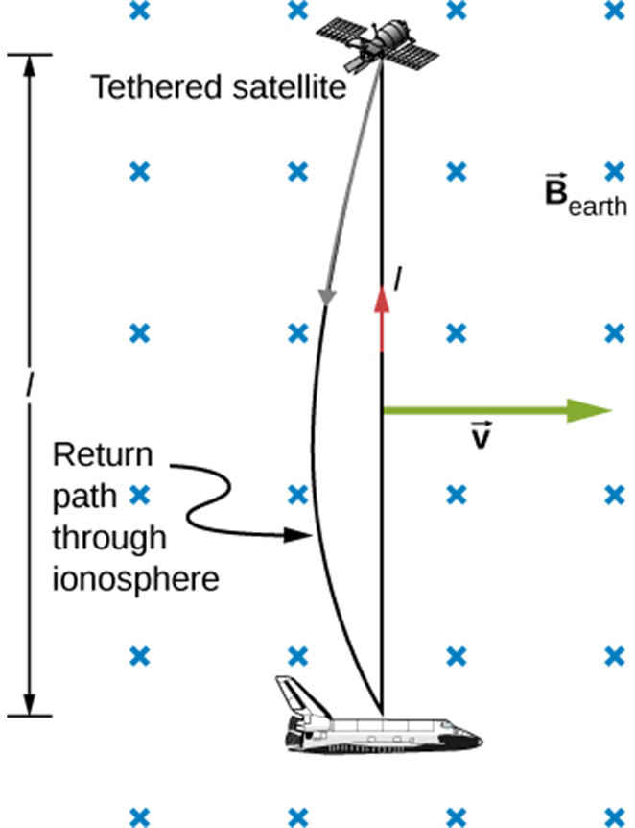
MOTIONAL EMF, CONTINUED
Motional emf as electrical power conversion for the space shuttle was the motivation for the tethered satellite experiment. A 5-kV emf was predicted to be induced in the 20-km tether while moving at orbital speed in Earth’s magnetic field. The circuit is completed by a return path through the stationary ionosphere.

Slide 14
MOTIONAL EMF, EXAMPLE
Suppose L = 0.10 m, the magnitude of the velocity v = 2.5 m/s, and the magnetic field strength B = 0.60 T. The total resistance of the loop is 0.030 Ω. Find motional emf, induced current, the force on the rod, and power dissipated in the circuit.

Slide 15
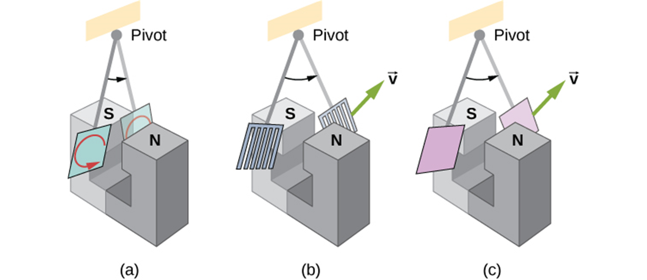
Eddy Currents
When a piece of metal moves through a magnetic field or is located in a changing magnetic field, eddy currents are induced.
A common physics demonstration device for exploring eddy currents and magnetic damping. (a) The motion of a metal pendulum bob swinging between the poles of a magnet is quickly damped by the action of eddy currents. (b) There is little effect on the motion of a slotted metal bob, implying that eddy currents are made less effective. (c) There is also no magnetic damping on a nonconducting bob, since the eddy currents are extremely small.

Slide 16
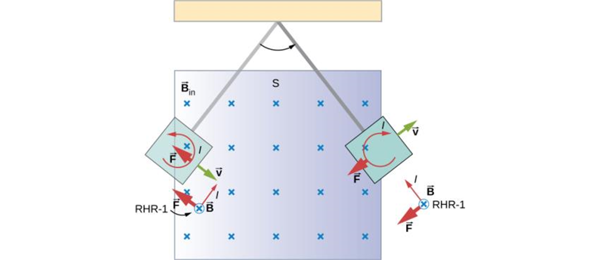
EDDY CURRENTS, CONTINUED
A more detailed look at the conducting plate passing between the poles of a magnet. As it enters and leaves the field, the change in flux produces an eddy current. Magnetic force on the current loop opposes the motion. There is no current and no magnetic drag when the plate is completely inside the uniform field.

Slide 17
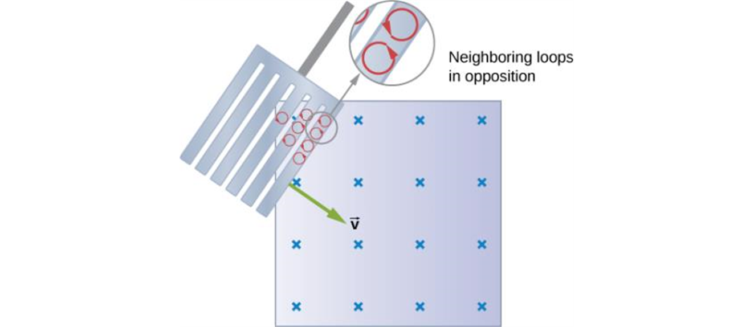
EDDY CURRENTS, CONTINUED
Eddy currents induced in a slotted metal plate entering a magnetic field form small loops, and the forces on them tend to cancel, thereby making magnetic drag almost zero.

Slide 18

WHAT’S NEXT?
Attempt the Try I Yourself Tutorials and Problems.
Get ready for the final quiz of the module.

