Slide 1
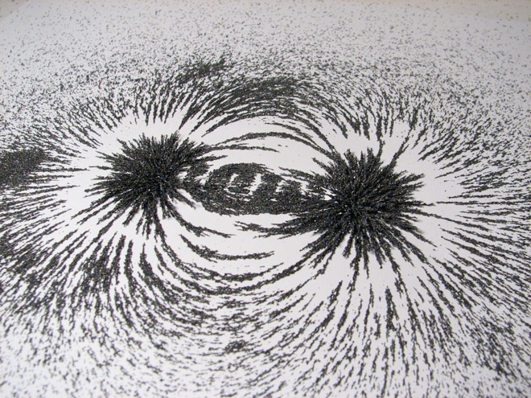


MAGNETIC FORCES AND FIELDS

Slide 2
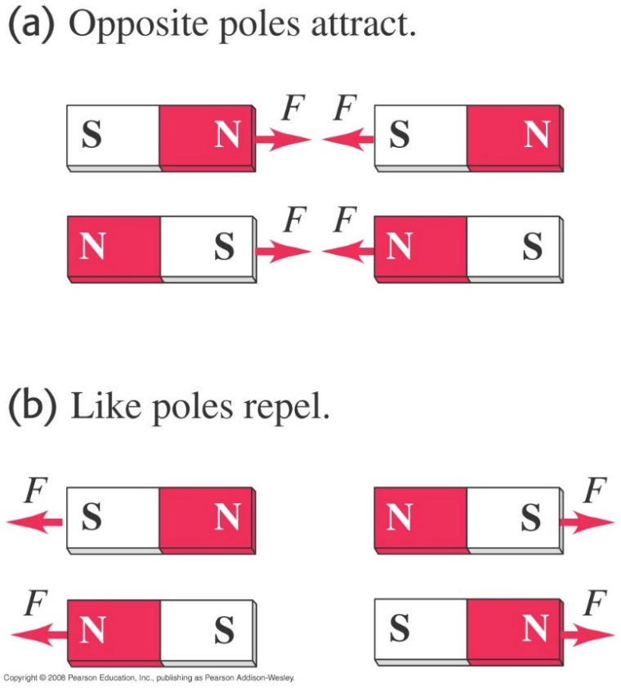
Properties of magnets
  Permanent magnets exert forces on each other.
  Magnets have two poles: north and south.
  Opposite poles attract while like poles repel.

Slide 3
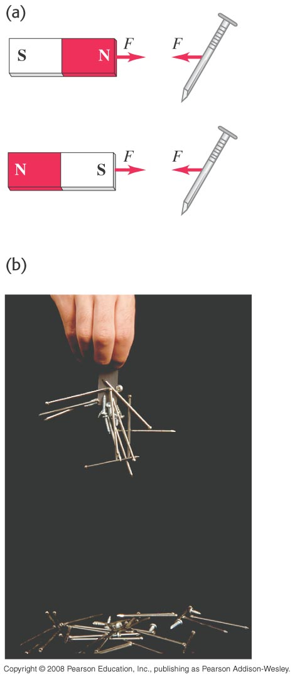
Magnetism and certain metals
  Either pole of a permanent magnet will attract a metal like iron.

Slide 4
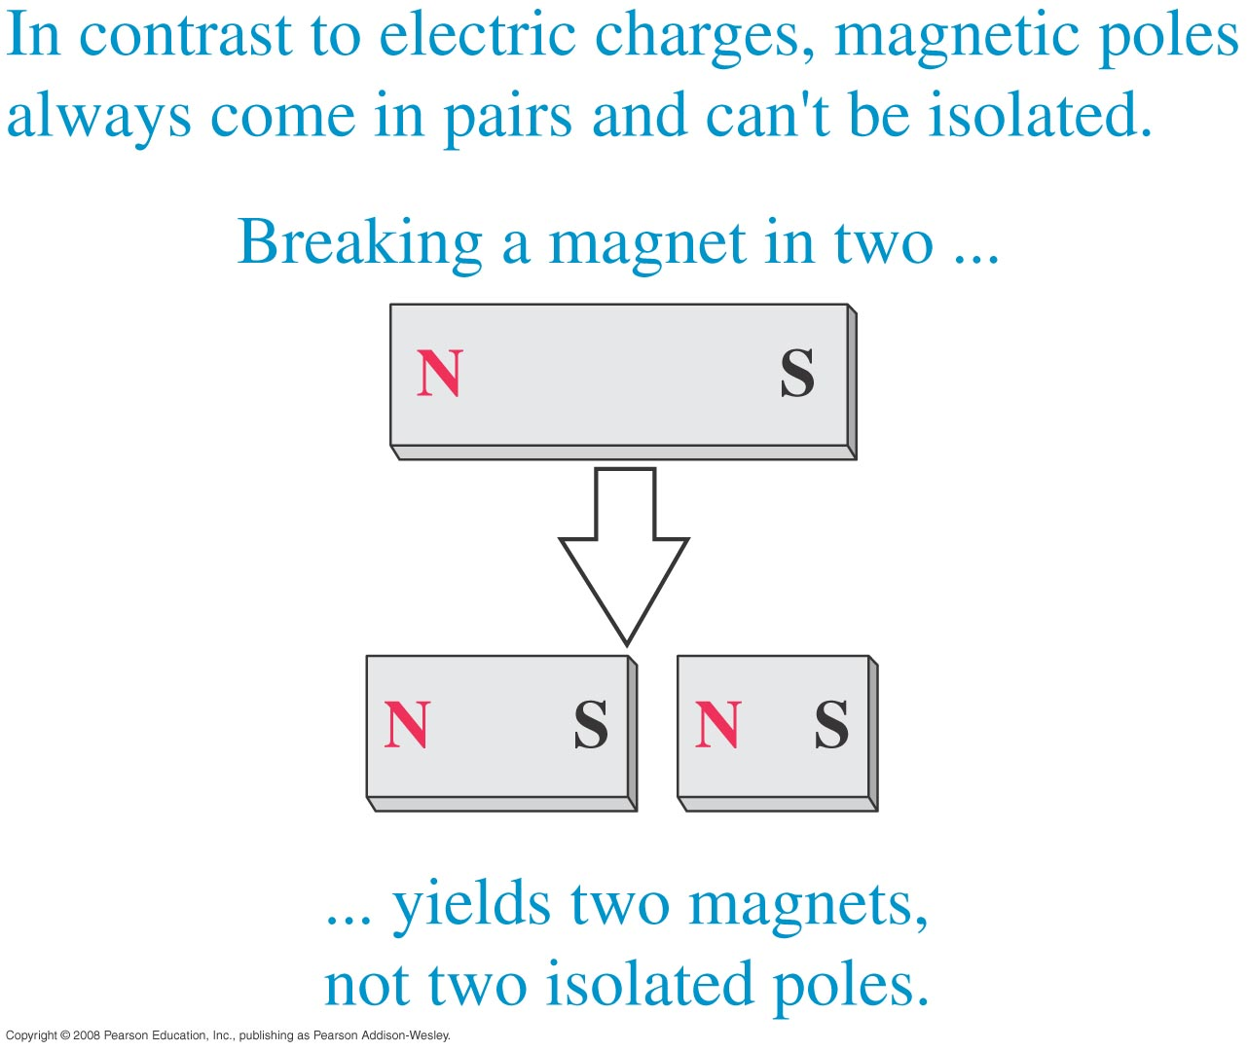
Magnetic monopoles
  Breaking a bar magnet does not separate its poles, as shown in the figure on the right.
  There is no experimental evidence for magnetic monopoles.

Slide 5
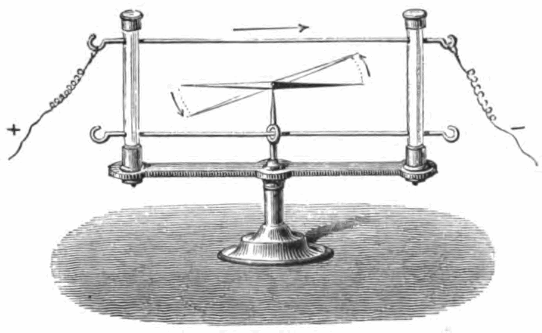
Electric current and magnets
  In 1820, Hans Oersted discovered that a current-carrying wire causes a compass to deflect.
  This discovery revealed a connection between moving charge and magnetism.

Slide 6
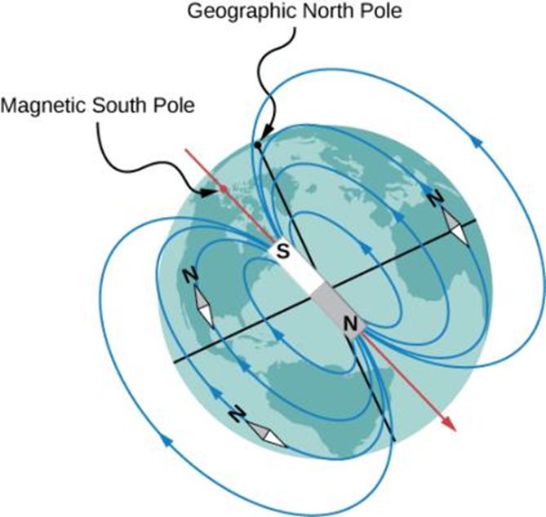
Magnetic field of the earth
  The north pole of a compass needle points toward the south pole of a magnet, which is how today’s magnetic field is oriented from inside Earth. It also points toward Earth’s geographic North Pole because the geographic North Pole is near the magnetic south pole.

Slide 7
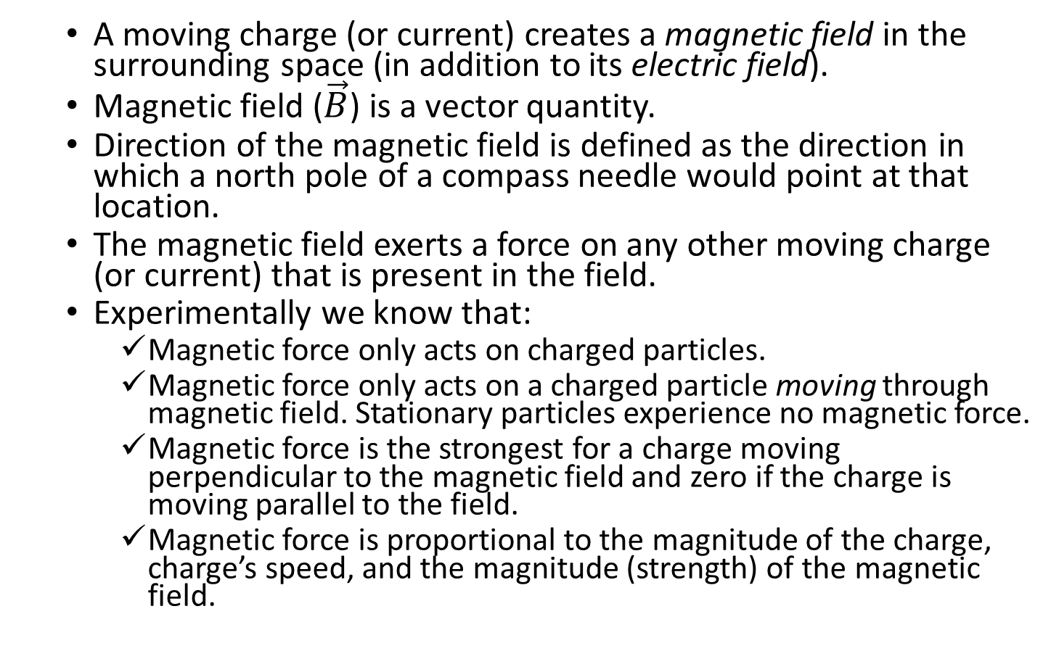
The magnetic field
  A moving charge (or current) creates a magnetic field in the surrounding space (in addition to its electric field).
  Magnetic field ($\vec{B}$) is a vector quantity.
  Direction of the magnetic field is defined as the direction in which a north pole of a compass needle would point at that location.
  The magnetic field exerts a force on any other moving charge (or current) that is present in the field.
  Experimentally we know that:
    Magnetic force only acts on charged particles.
    Magnetic force only acts on a charged particle moving through magnetic field. Stationary particles experience no magnetic force.
    Magnetic force is the strongest for a charge moving perpendicular to the magnetic field and zero if the charge is moving parallel to the field.
    Magnetic force is proportional to the magnitude of the charge, charge’s speed, and the magnitude (strength) of the magnetic field.

Slide 8
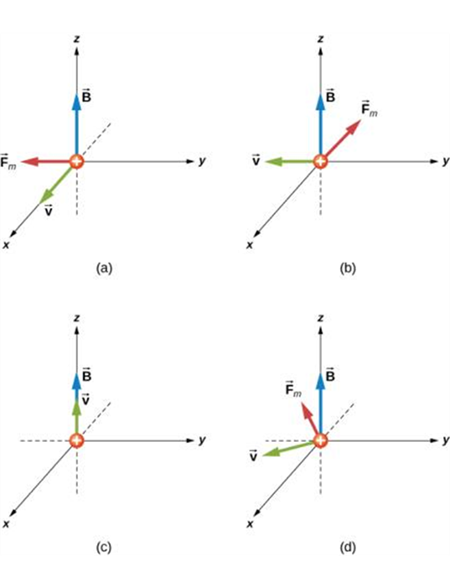
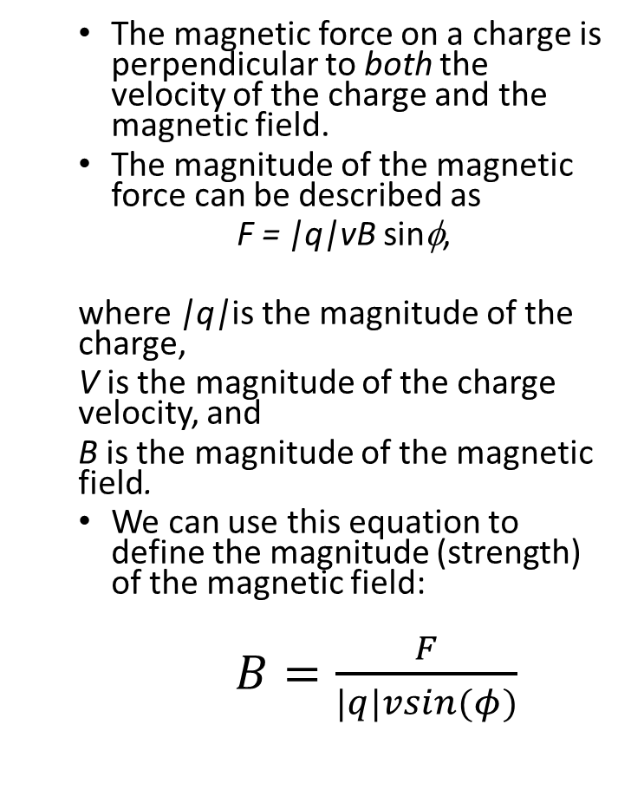
The magnetic force on a moving charge
  The magnetic force on a charge is perpendicular to both the velocity of the charge and the magnetic field.
  The magnitude of the magnetic force can be described as
  F = |q|vB sinφ,
  where |q|is the magnitude of the charge,
  V is the magnitude of the charge velocity, and
  B is the magnitude of the magnetic field.
  We can use this equation to define the magnitude (strength) of the magnetic field:
  $B=\frac{F}{|q|vsin(φ)}$
The magnetic forces on an alpha-particle moving in a uniform magnetic field. The field is the same in each drawing, but the velocity is different.

Slide 9
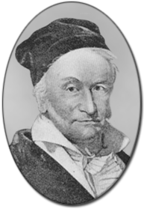
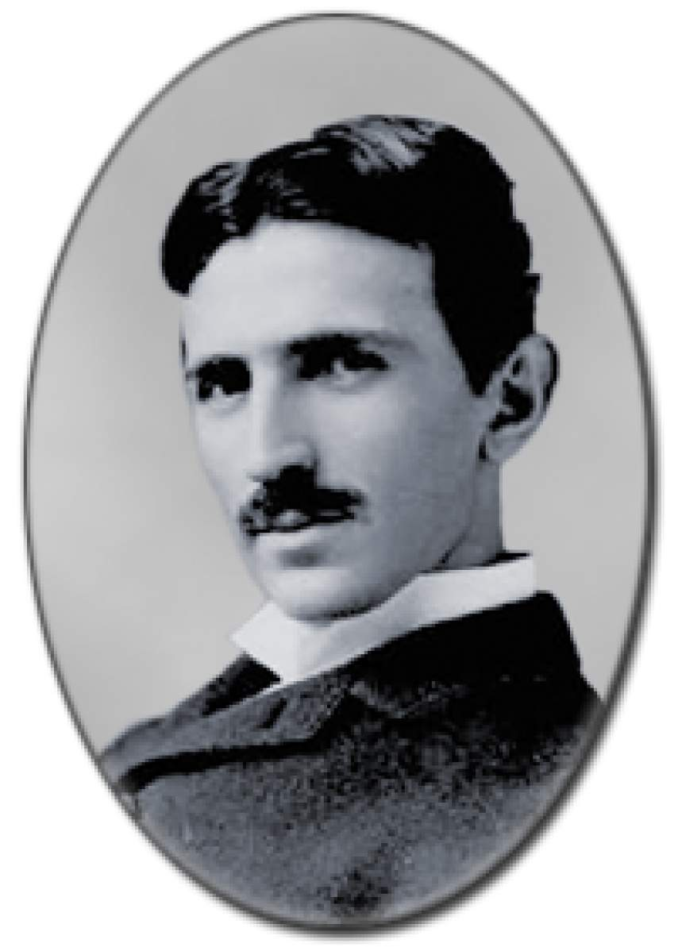
Magnetic field units
Note: the SI unit of magnetic field is
tesla (T)
1 T = 1 N/(A-m),
Often a non-SI unit, gauss (G) is used:
1 G = 10⁻⁴ T
Magnitude of the Earth’s magnetic
field near the surface is about 0.5 G.

Slide 10
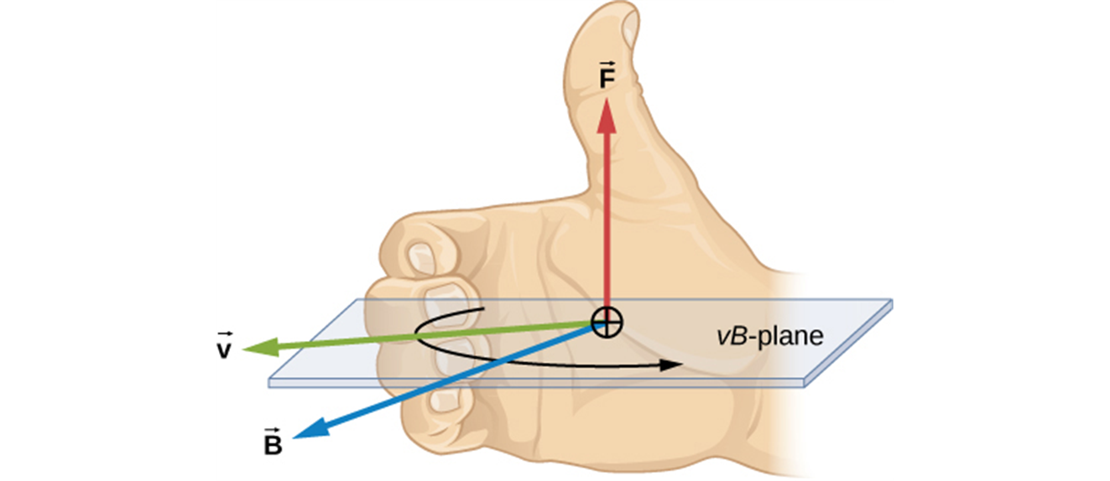
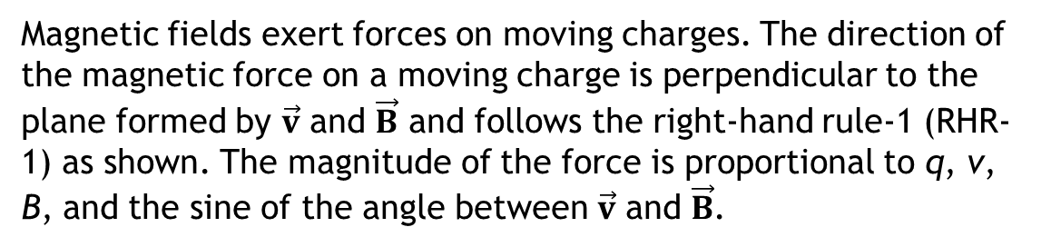
Magnetic force as a vector product
  We can write the magnetic force as a vector product.
  The right-hand rule gives the direction of the force on a positive charge.
  Two charges of equal magnitude but opposite signs moving in the same direction
  in the same field will experience magnetic forces in opposite directions.
Magnetic fields exert forces on moving charges. The direction of the magnetic force on a moving charge is perpendicular to the plane formed by $\vec{v}$ and $\vec{B}$ and follows the right-hand rule-1 (RHR-1) as shown. The magnitude of the force is proportional to q, v, B, and the sine of the angle between $\vec{v}$ and $\vec{B}$.

Slide 11
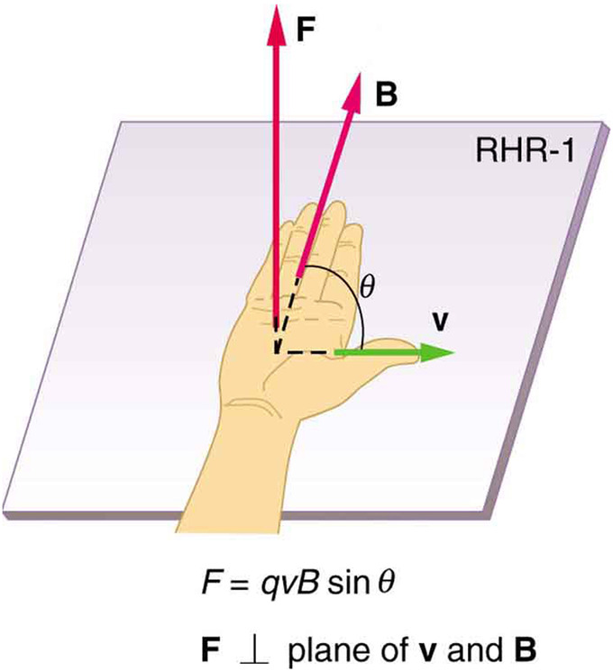
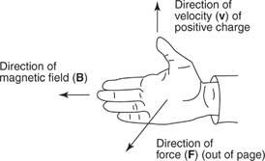
Right hand rule, another view

Slide 12
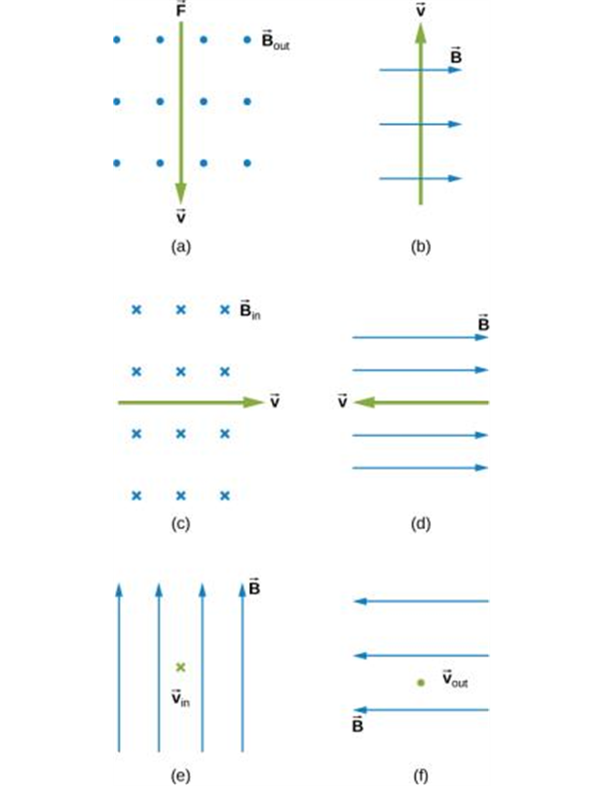
Right hand rule practice

Slide 13
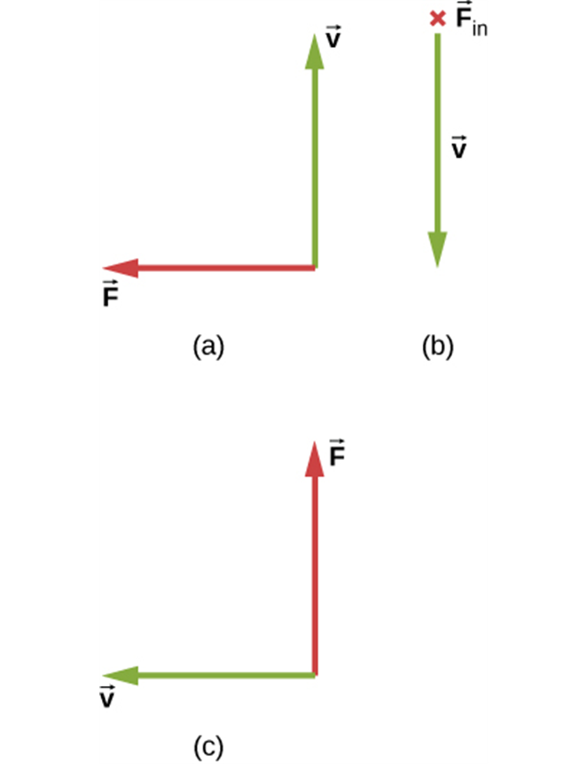
Right hand rule, more practice

Slide 14
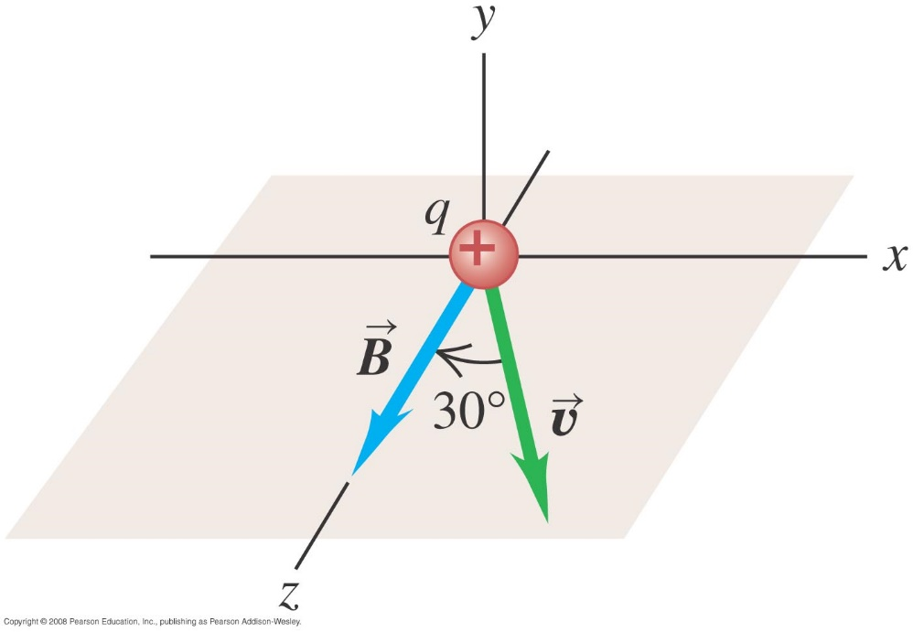



Magnetic force on a proton
  A beam of protons (q = 1.60 x 10⁻¹⁹ C) moves at 3.0 x 10⁵ m/s through a uniform magnetic field with a magnitude of 2.0 T that is directed along the positive z-axis. The velocity of each proton is in the xz-plane at an angle of 30º to the positive z axis. Find the force on a proton.
$\vec{B}=\left(2.0T\right)\hat{k}$
$\vec{v}=v⋅\cos\left({30}^{0}\right)\hat{k}+v⋅\sin\left({30}^{0}\right)\hat{i}$.
$$\vec{F}=q \vec{v }×\vec{B}=\left(−{4.8 ×10}^{−14}N\right)\hat{j}$$

Slide 15
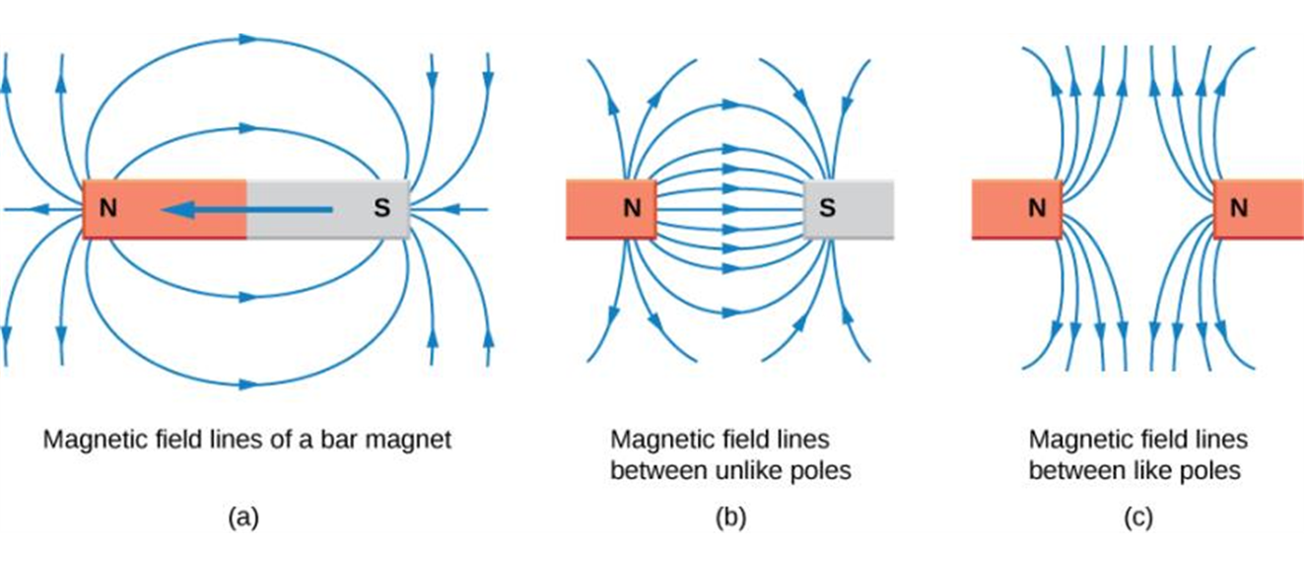
Magnetic field lines
  The idea of magnetic field lines is the same as for the electric field lines:
Magnetic field lines are defined to have the direction in which a small compass points when placed at a location in the field. The strength of the field is proportional to the closeness (or density) of the lines. If the interior of the magnet could be probed, the field lines would be found to form continuous, closed loops. To fit in a reasonable space, some of these drawings may not show the closing of the loops; however, if enough space were provided, the loops would be closed.

Slide 16
Magnetic field lines are not lines of force
  It is important to remember that magnetic field lines
  are not lines of magnetic force.

