Slide 1
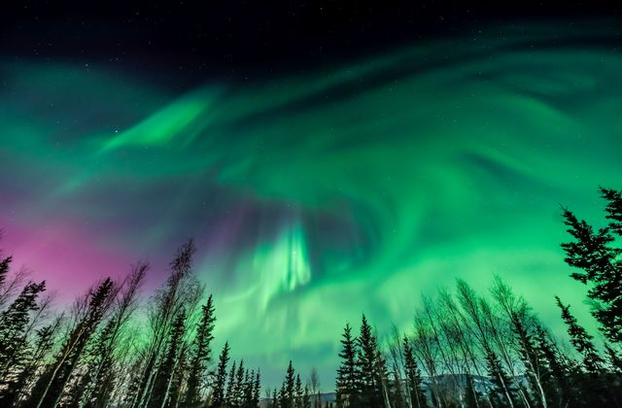


Motion of charged particles in a magnetic field

Slide 2
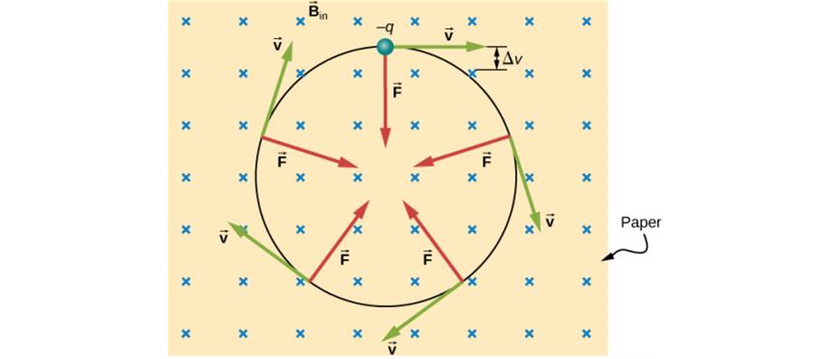
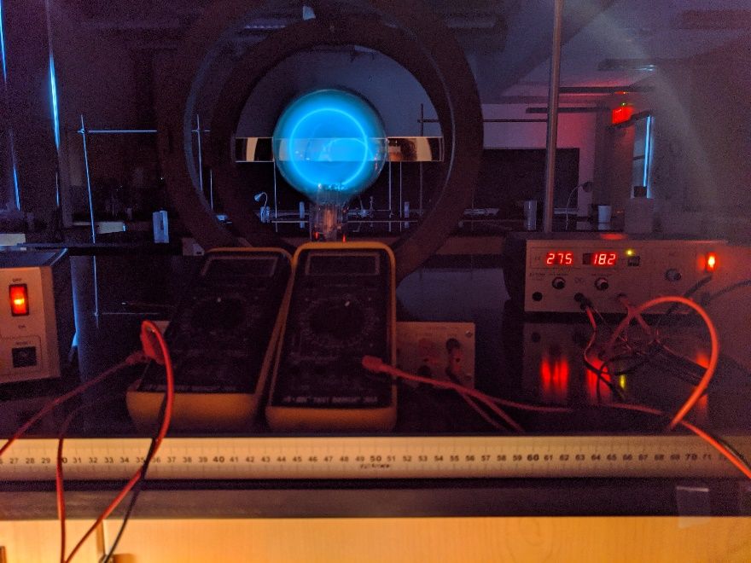
Motion of charged particles in a magnetic field
  A charged particle in a magnetic field always moves with constant speed.
  Figure at the right illustrates the forces and shows an experimental example.
  If the velocity of the particle is perpendicular to the magnetic field, the particle moves in a circle of radius R = mv/(|q|B).
  The number of revolutions of the particle per unit time is the cyclotron frequency.

Slide 3
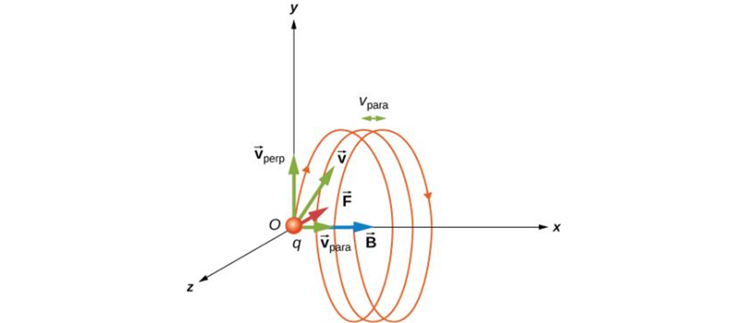
Helical motion
  If the particle has velocity components parallel to and perpendicular to the field, its path is a helix. (See at the right.)
  The speed and kinetic energy of the particle remain constant.

Slide 4
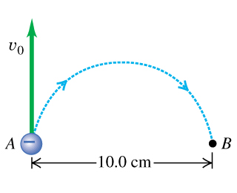
Example
Notes:
1.7 x 10-4 T , into T = 0.209 x 10-6 s, f = 4.78 x 10 6 Hz

Slide 5
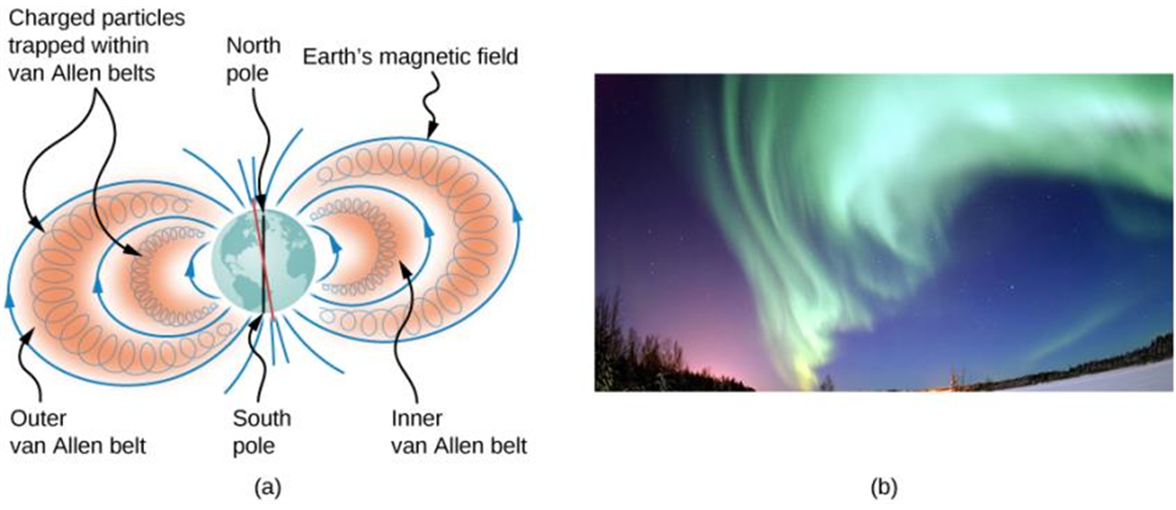
A nonuniform magnetic field
  Figures below show the Van Allen radiation belts and the resulting aurora. These belts are due to the earth’s nonuniform field.
The Van Allen radiation belts around Earth trap ions produced by cosmic rays striking Earth’s atmosphere.
The magnificent spectacle of the aurora borealis, or northern lights, glows in the northern sky above Bear Lake near Eielson Air Force Base, Alaska. Shaped by Earth’s magnetic field, this light is produced by glowing molecules and ions of oxygen and nitrogen. (credit b: modification of work by USAF Senior Airman Joshua Strang)

Slide 6
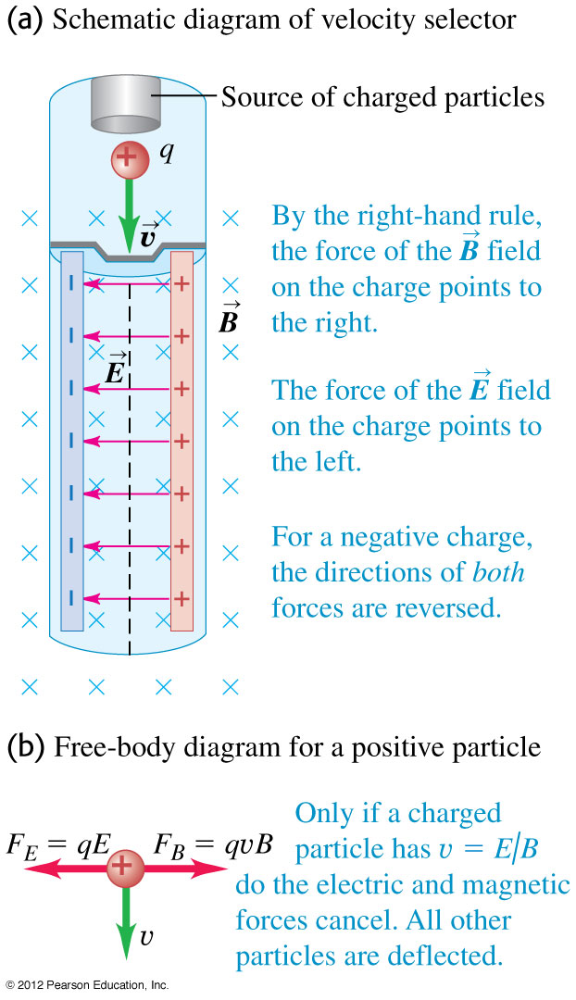
Velocity selector
  A velocity selector uses perpendicular electric and magnetic fields to select particles of a specific speed from a beam. (See Figure at the right.)
  Only particles having speed v = E/B pass through undeflected.

Slide 7
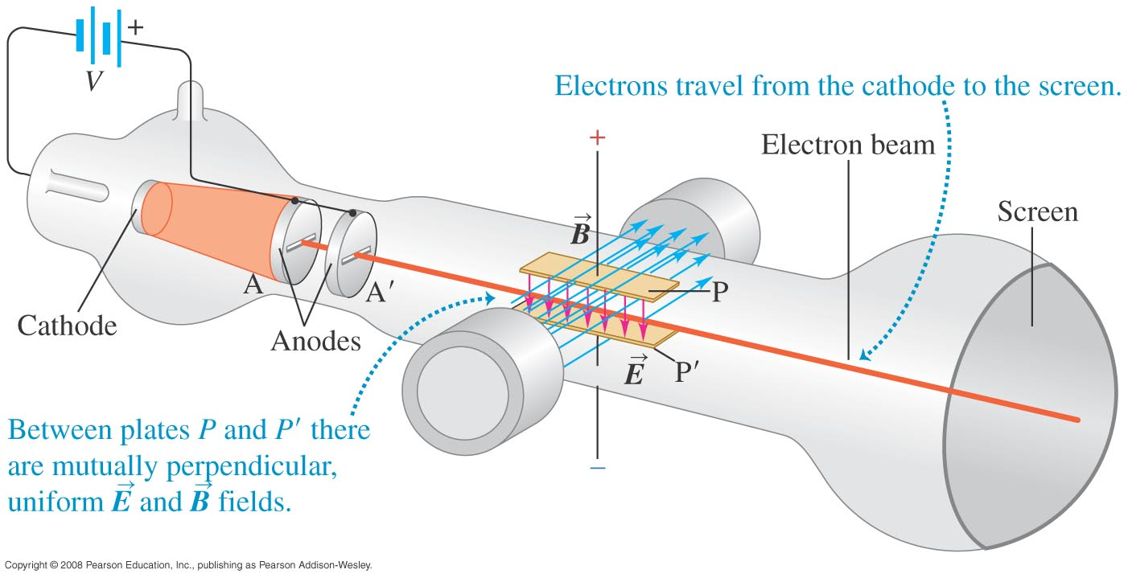
Thomson’s e/m experiment
  Thomson’s experiment measured the ratio e/m for the electron. His apparatus is shown below.

Slide 8
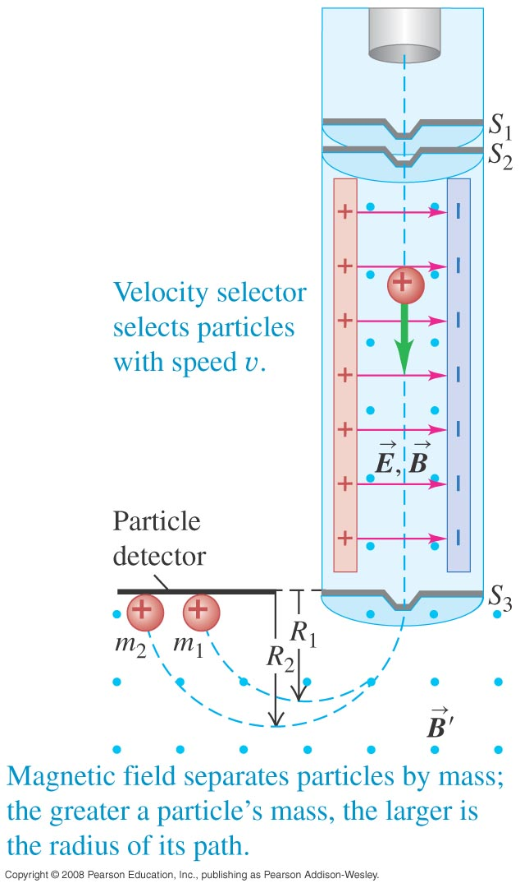
Mass spectrometer
  A mass spectrometer measures the masses of ions.
  The Bainbridge mass spectrometer (see Figure at the right) first uses a velocity selector. Then the magnetic field separates the particles by mass.

