Slide 1
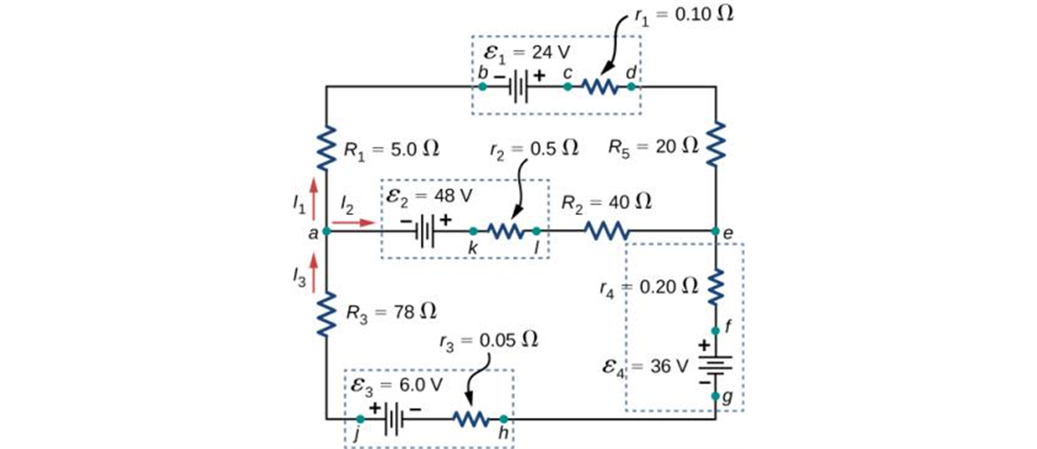


KIRCHHOFF’S RULES

Slide 2
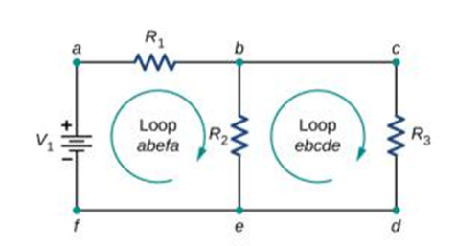
Let’s start with some lingo
  A junction is a point where three or more conductors meet.
  A branch is the path from one junction point to the other.
  A loop is any closed conducting path.
  Look at the circuit below, identify and count the junctions, branches, and loops.

Slide 3
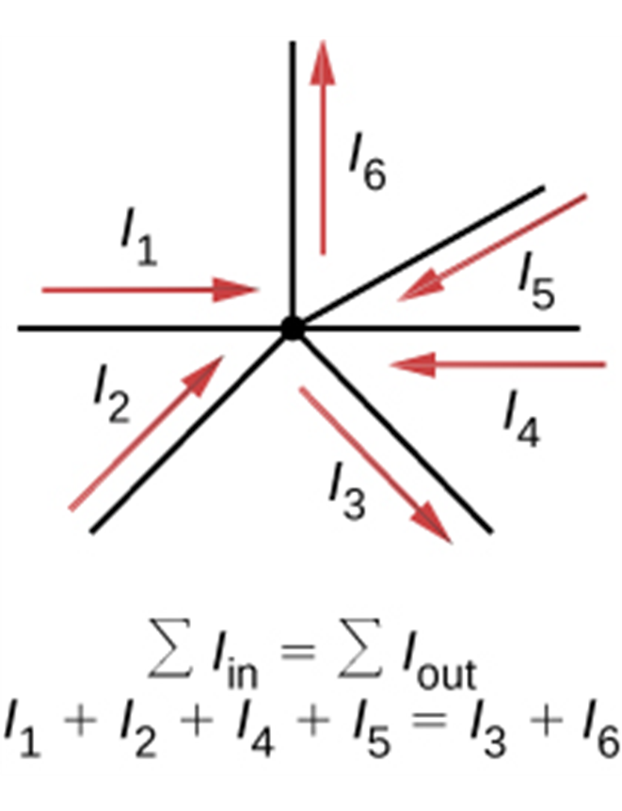
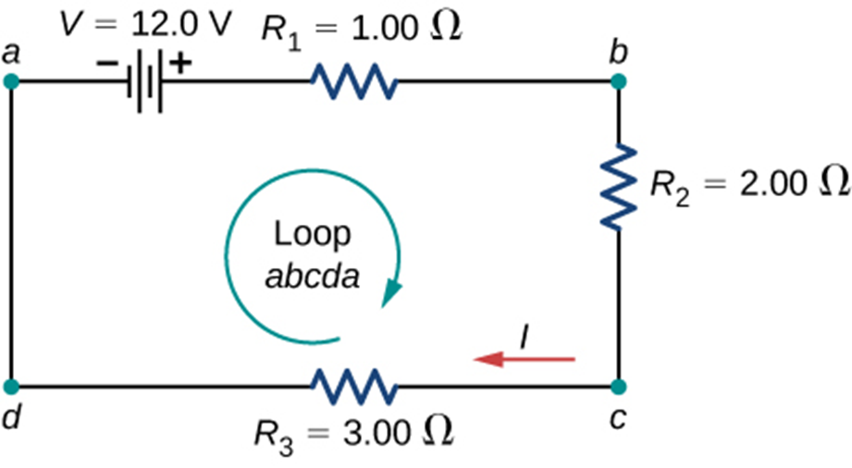
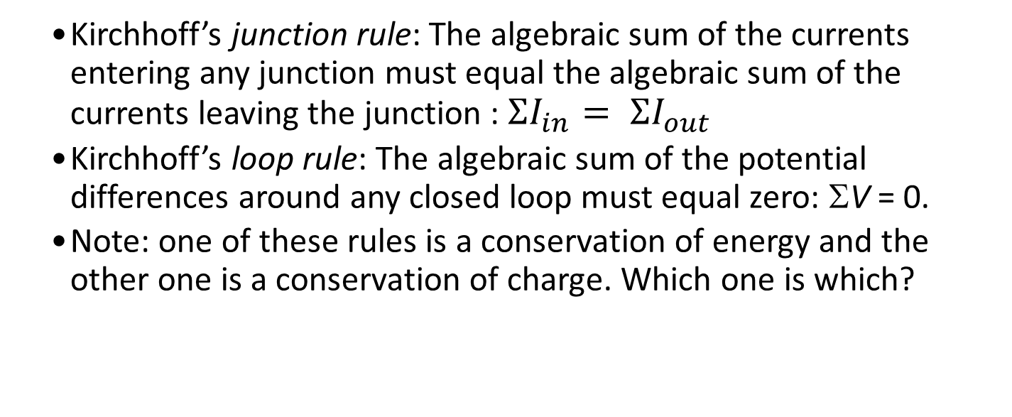
Kirchhoff’s rules
  Kirchhoff’s junction rule: The algebraic sum of the currents entering any junction must equal the algebraic sum of the currents leaving the junction : $ΣI_{in}= ΣI_{out}$
  Kirchhoff’s loop rule: The algebraic sum of the potential differences around any closed loop must equal zero: ΣV = 0.
  Note: one of these rules is a conservation of energy and the other one is a conservation of charge. Which one is which?

Slide 4
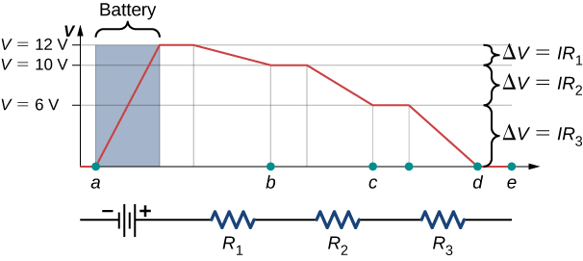
Loop rule, close look
A voltage graph as we travel around the circuit. The voltage increases as we cross the battery and decreases as we cross each resistor. Since the resistance of the wire is quite small, we assume that the voltage remains constant as we cross the wires connecting the components.

Slide 5
How to apply
Assign and label on a diagram a current for each branch of the circuit. Note:
  One brunch = one current.
  Do not worry about how you assign the directions of the currents!
Apply junction rule: sum up the currents entering a junction and set it equal to the sum of the currents leaving the junction.
The number of junction rule equations = number of junctions - 1

Slide 6
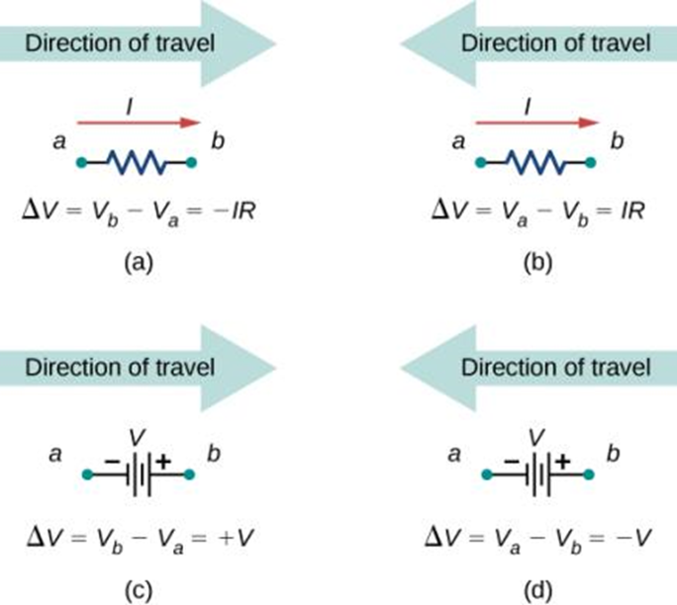
How to apply, continued
Chose and label a direction of travel along a loop (clockwise or counterclockwise). Assign the potential differences to each element of a loop. Here is how (figure below).
There is a logic behind these conventions – think about it as going to a higher or lower potential. That makes it easier to remember, but not necessary – you can simply memorize these.

Slide 7
How to apply, continued
Now is the time to apply that loop rule – sum up all potential differences as you are traveling along a loop and set it equal to zero.
How many loop equations do you need? In general, we need the total number of equations which equals to the number of unknown currents which, in turn, equals to the number of branches. So write down the number of equations that you need to get that total.
Rule of thumb – we only add a new loop equation if the loop contains an element you have not used before in other loop equations.

Slide 8
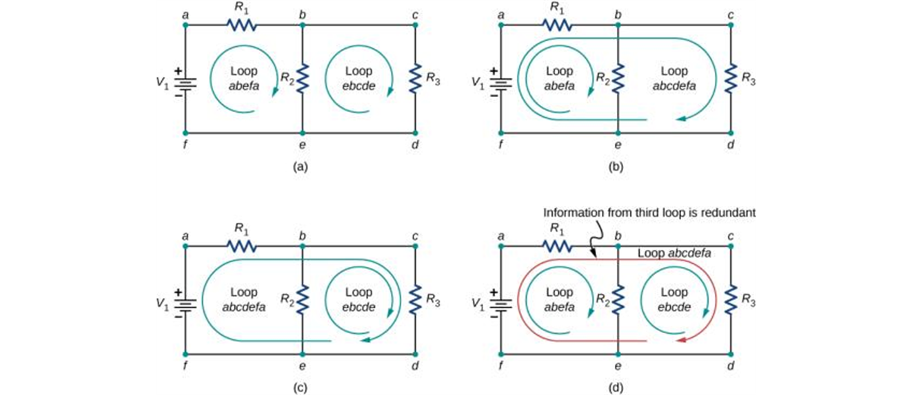
How to apply, continued
Panels (a)–(c) are sufficient for the analysis of the circuit. In each case, the two loops shown contain all the circuit elements necessary to solve the circuit completely. Panel (d) shows three loops used, which is more than necessary. Any two loops in the system will contain all information needed to solve the circuit. Adding the third loop provides redundant information.

Slide 9
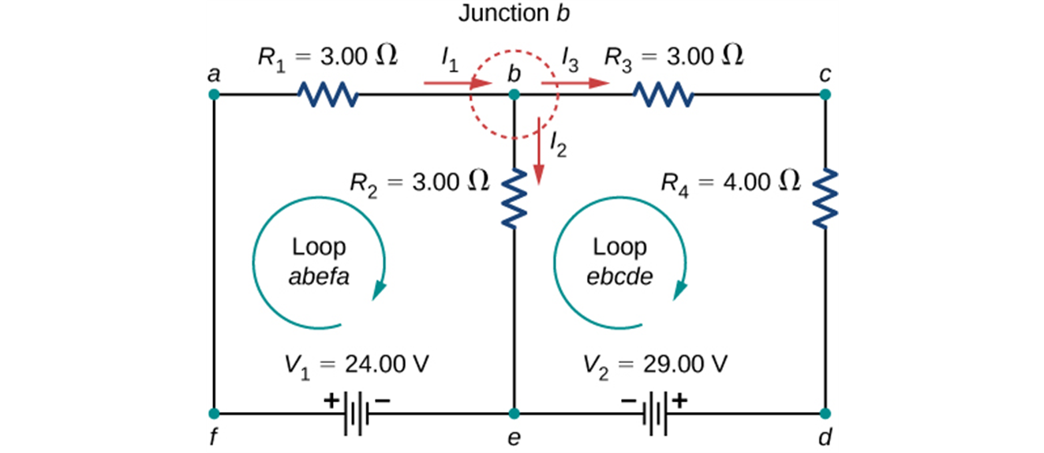

Let’s look at the following example
The circuit below has two junctions, three branches, and three loops. We need three equations in order to find three unknown currents.
The chosen directions of the currents are absolutely arbitrary – if you make an “incorrect” choice, the current will come out of the equations with a negative sign.
We are ready to apply a junction rule (there will be just one of these here, since the total number of junctions is 2. For the junction labeled b:
$$I_{1}=I_{2}+I_{3}.$$

Slide 10
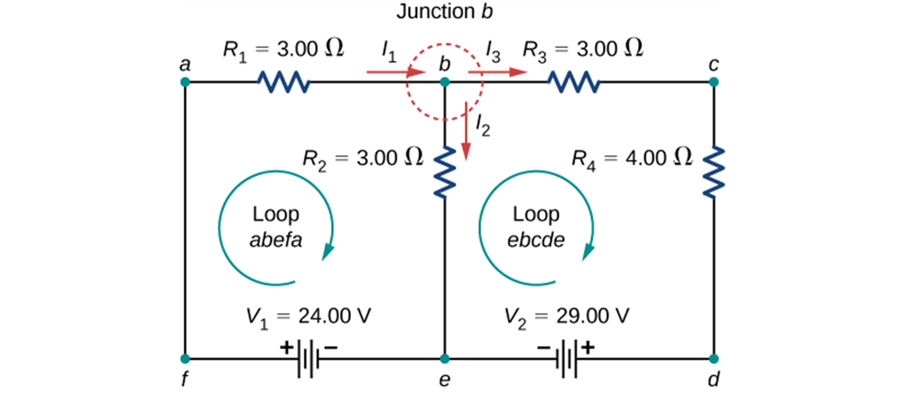
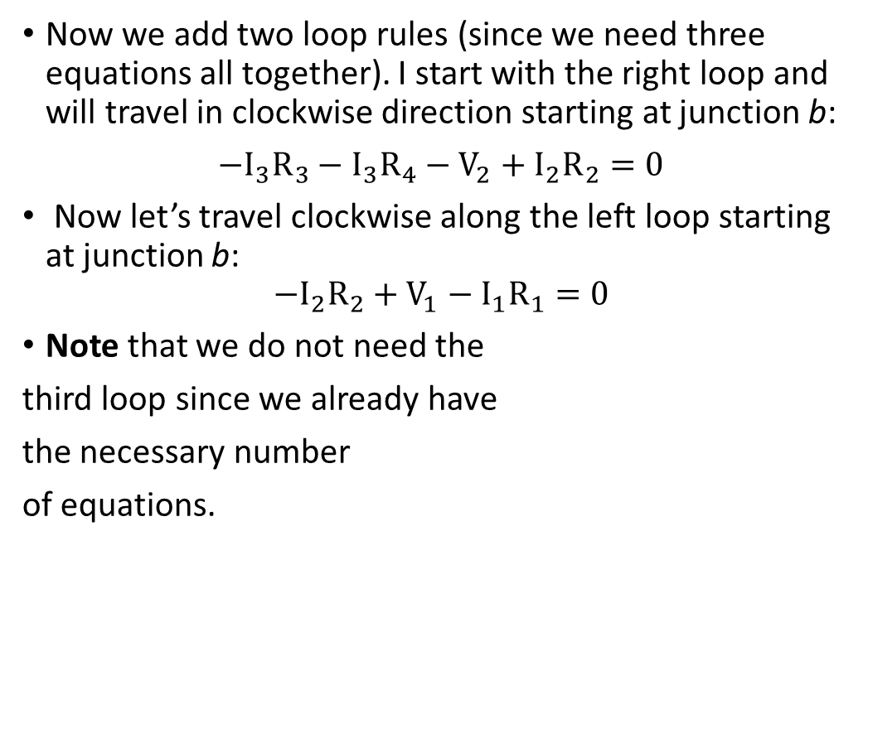
Example, continued
Now we add two loop rules (since we need three equations all together). I start with the right loop and will travel in clockwise direction starting at junction b:
$−I_{3}R_{3}−I_{3}R_{4}−V_{2}+I_{2}R_{2}=0$
Now let’s travel clockwise along the left loop starting at junction b:
$$−I_{2}R_{2}+V_{1}−I_{1}R_{1}=0$$
Note that we do not need the
third loop since we already have
the necessary number
of equations.

Slide 11
Example, continued
  At this point we have three equations for three unknown currents.
  Typically, the resistances and emf’s are given.
  You can use any of the tools you prefer to solve the system of linear equations to produce the solutions for the unknown currents.
  If the current is negative, the direction of the current is opposite to your original assumption.
  Once the currents are known, you can use Ohm’s Law to find the potential differences, electrical power, etc.

Slide 12
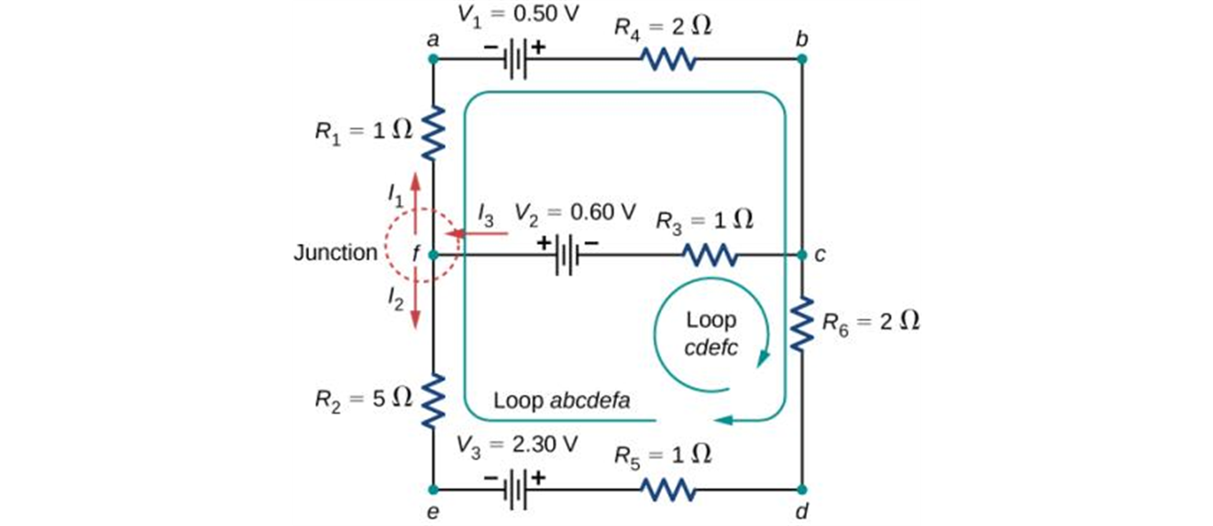
Try it yourself I
  Given the circuit below write the number of equations that would allow you to solve for the unknowns. You may go ahead and substitute the given numerical values to get the numerical solution.

Slide 13
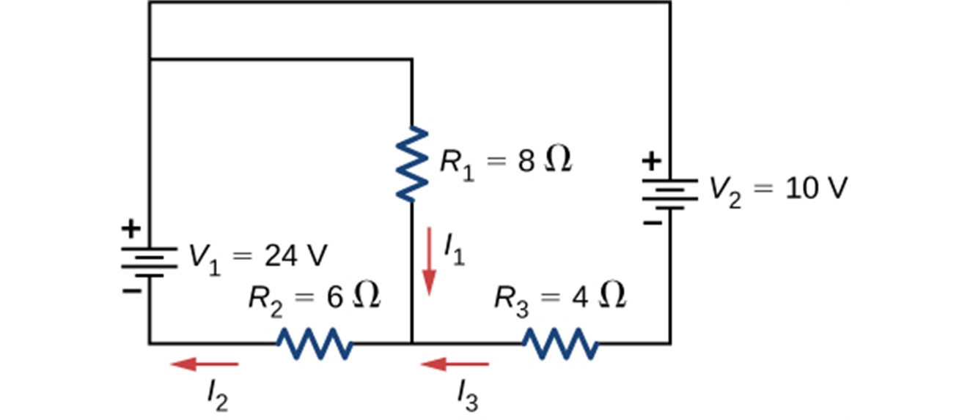
Try it yourself II
  Repeat with the circuit below.

