Slide 1
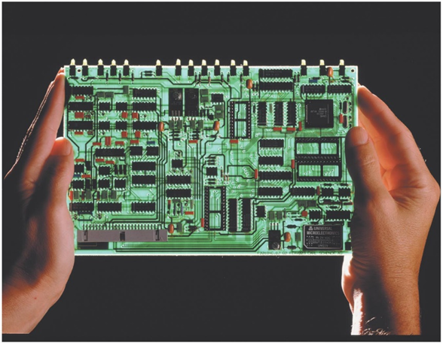


DC CIRCUITS - RESISTORS IN SERIES AND PARALLEL

Slide 2
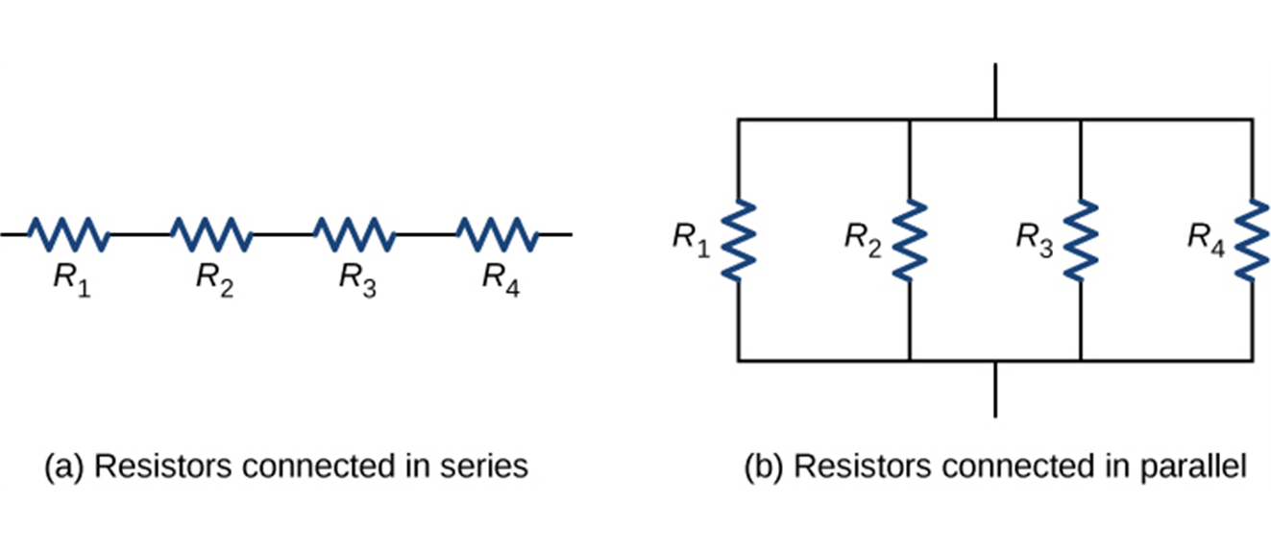
Resistors in series and parallel
  Resistors are in series if they are connected one after the other so the current is the same in all of them (see left figure below).
  Resistors are in parallel if they are connected so that the potential difference must be the same across all of them (see right figure below).

Slide 3
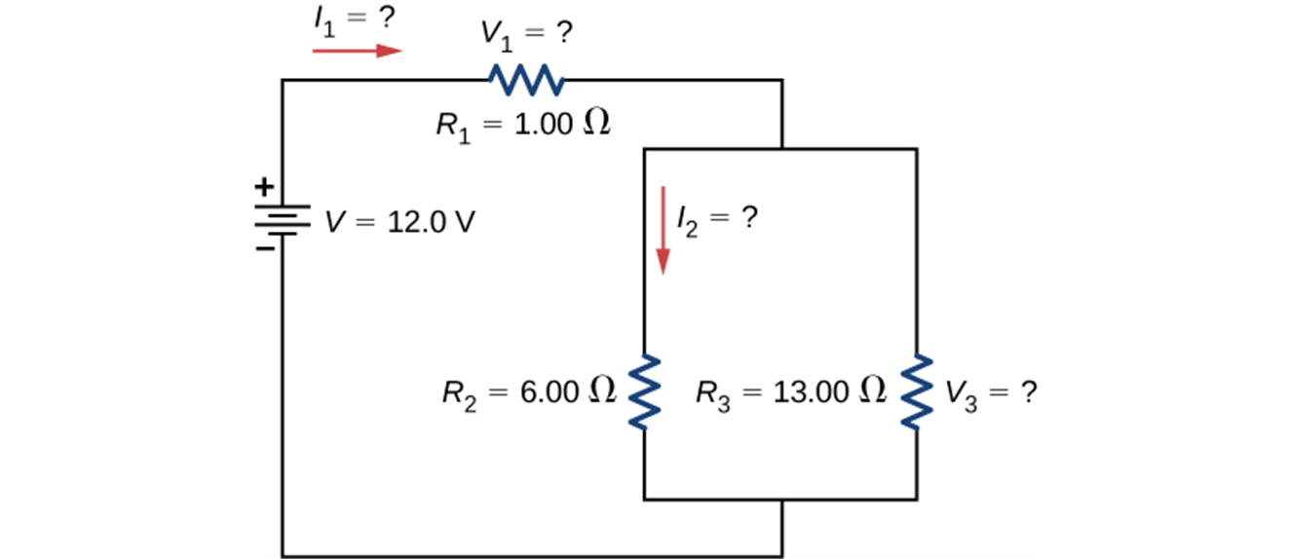
Resistors in series and parallel, continued
  Resistors can also be connected in combinations of series and parallel, as shown on the right.
  For any combination of resistors we can always find a single resistor that could replace the combination and result in the same total current and potential difference. The resistance of this single resistor is called equivalent resistance.

Slide 4
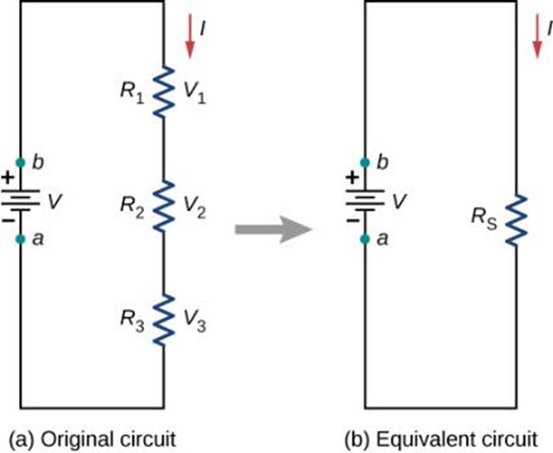
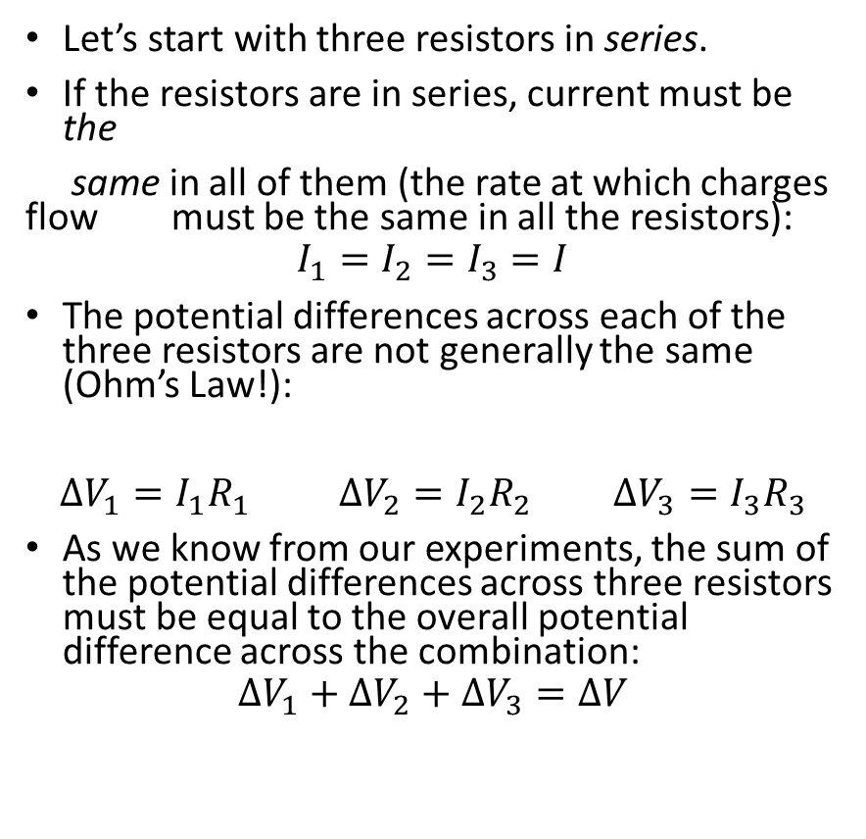
Resistors in series
Let’s start with three resistors in series.
If the resistors are in series, current must be the
same in all of them (the rate at which charges flow must be the same in all the resistors):
$$I_{1}=I_{2}=I_{3}=I$$
The potential differences across each of the three resistors are not generally the same (Ohm’s Law!):
$ΔV_{1}=I_{1}R_{1}$ $ΔV_{2}=I_{2}R_{2}$ $ΔV_{3}=I_{3}R_{3}$
As we know from our experiments, the sum of the potential differences across three resistors must be equal to the overall potential difference across the combination:
$$ΔV_{1}+ΔV_{2}+ΔV_{3}=ΔV$$

Slide 5
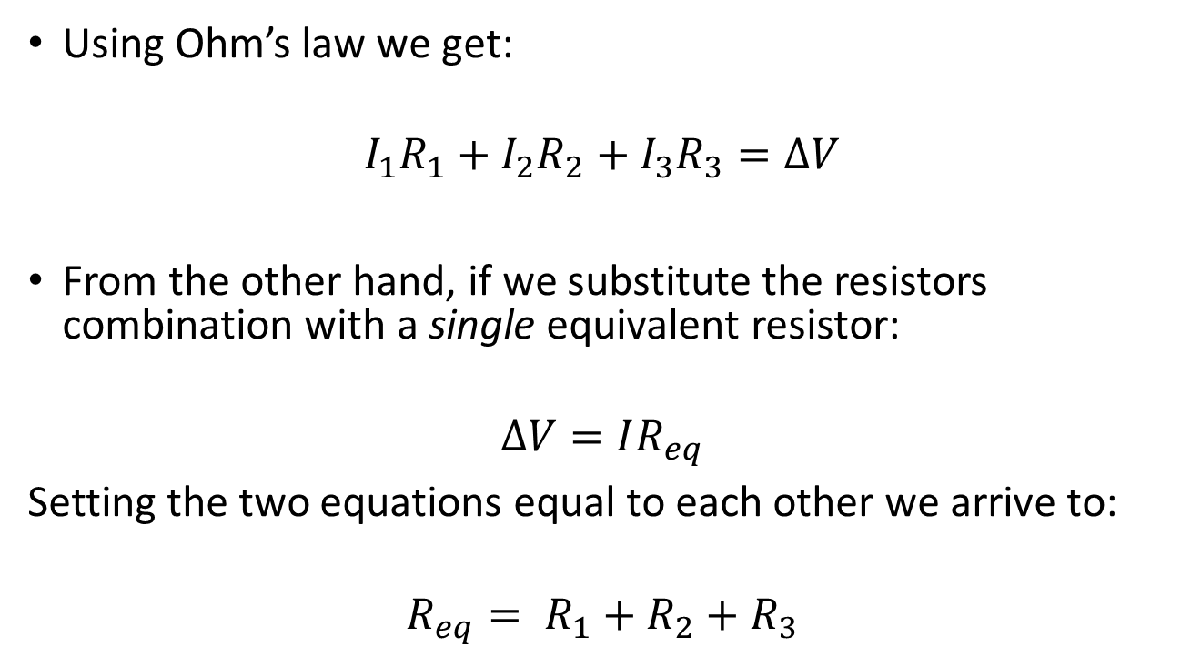
Resistors in series, continued
Using Ohm’s law we get:
$$I_{1}R_{1}+I_{2}R_{2}+I_{3}R_{3}=ΔV$$
From the other hand, if we substitute the resistors combination with a single equivalent resistor:
$$ΔV=IR_{eq}$$
Setting the two equations equal to each other we arrive to:
$${R_{eq}= R}_{1}+R_{2}+R_{3}$$

Slide 6
Resistors in series, summary
Currents in all resistors in series combination is the same.
Sum of potential differences across all resistors equals to the potential difference across the combination.
Equivalent resistance is the sum of the individual resistances (independent of how many resistors are in the combination).
Equivalent resistance of the combination is always greater than any one of the individual resistances.

Slide 7
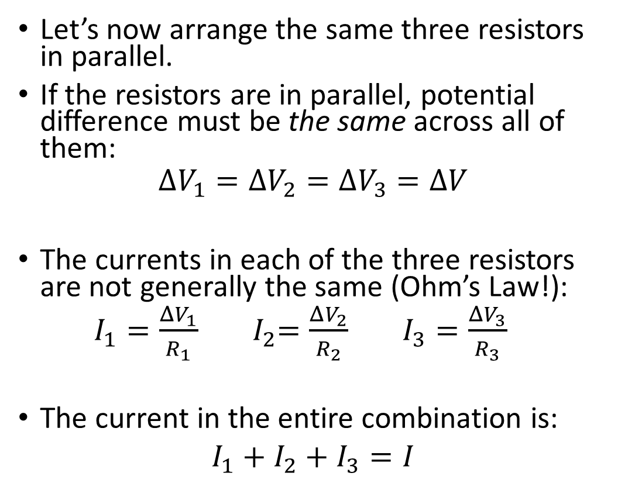
Resistors in parallel
Let’s now arrange the same three resistors in parallel.
If the resistors are in parallel, potential difference must be the same across all of them:
$$ΔV_{1}=ΔV_{2}=ΔV_{3}=ΔV$$
The currents in each of the three resistors are not generally the same (Ohm’s Law!):
$I_{1}{=\frac{ΔV_{1}}{R_{1}} }_{ }{ I}_{2}{=\frac{ΔV_{2}}{R_{2}} }_{ }$ $I_{3}{=\frac{ΔV_{3}}{R_{3}} }_{ }$
The current in the entire combination is:
$I_{1}+I_{2}+I_{3}=I$

Slide 8
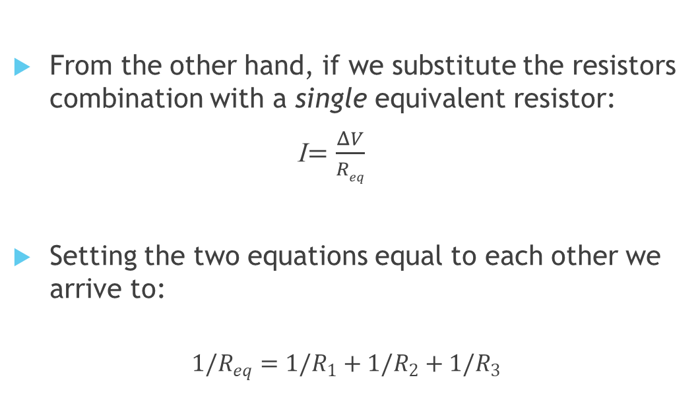
Resistors in parallel, continued
From the other hand, if we substitute the resistors combination with a single equivalent resistor:
I${=\frac{ΔV}{Req} }_{ }$
Setting the two equations equal to each other we arrive to:
$${{1/R}_{eq}=1/R}_{1}+1/R_{2}+1/R_{3}$$

Slide 9
Resistors in parallel, summary
Potential difference across all resistors in parallel combination is the same.
Sum of the currents in all resistors equals to the current in the combination.
The reciprocal of the equivalent resistance is the sum of the reciprocals of the individual resistances (independent of how many resistors are in the combination).
Equivalent resistance of the combination is always less than any one of the individual resistances.

Slide 10
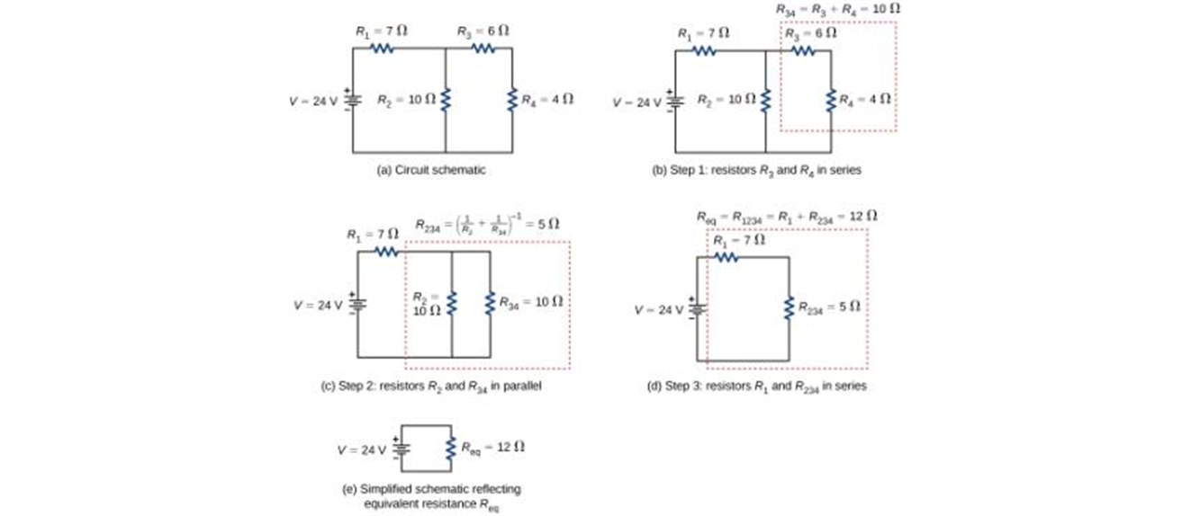
Parallel/series combination, example

Slide 11
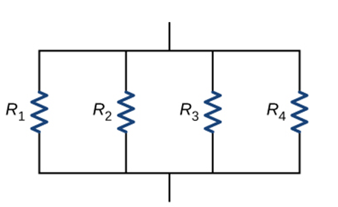

Let’s apply what we have learned
What things about the resistors in this circuit are the same for all three?
    A. Current I
    B. Potential difference
  C. Resistance R
  D. A and B
  E. B and C
Notes:
Answer: B

Slide 12
Let’s apply what we have learned
What things about the resistors in this circuit are the same for all three?
    A. Current I
    B. Potential difference
  C. Resistance R
  D. A and B
  E. B and C
Notes:
Answer: B

Slide 13
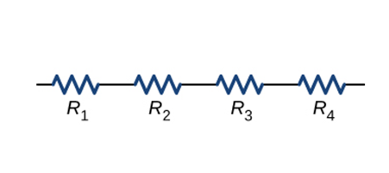
Let’s apply what we have learned
What things about the resistors in this circuit are the same for all three?
    A. Current I
    B. Potential difference
  C. Resistance R
  D. A and B
  E. B and C
Notes:
Answer: B

Slide 14
Let’s apply what we have learned
What things about the resistors in this circuit are the same for all three?
    A. Current I
    B. Potential difference
  C. Resistance R
  D. A and B
  E. B and C
Notes:
Answer: B

Slide 15
Let’s see how it works
Lets start with three resistors – 100 Ω, 200 Ω, and 300 Ω.
Connected in series, the equivalent resistance is 600 Ω.
Note that the equivalent resistance is greater than every one of the individual resistances!
Connected in parallel, the same three resistors produce an equivalent resistance of 600/11 Ω, or 54.4 Ω.
Note that the equivalent resistance is less than every one of the individual resistances!

