Slide 1
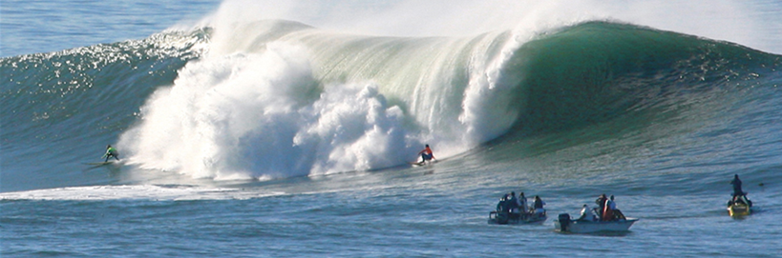

WAVES

Slide 2
Today’s objectives
By the end of this lesson, you will be able to:
Describe the basic characteristics of wave motion
Define the terms wavelength, amplitude, period, frequency, and wave speed
Explain the difference between longitudinal and transverse waves, and give examples of each type
List the different types of waves
Model a wave, moving with a constant wave velocity, with a mathematical expression
Calculate the velocity and acceleration of the medium
Show how the velocity of the medium differs from the wave velocity (propagation velocity)

Slide 3

What is a wave?
Wave is a disturbance that propagates or moves from the place it was created. The simplest waves repeat themselves for several cycles and are associated with simple harmonic motion.
There are three basic types of waves: mechanical waves, electromagnetic waves, and matter waves.
Mechanical waves exhibit characteristics common to all waves, such as amplitude, wavelength, period, frequency, and energy. All wave characteristics can be described by a small set of underlying principles.

Slide 4
Types of waves
There are three basic types of waves: mechanical waves, electromagnetic waves, and matter waves.
Mechanical waves exhibit characteristics common to all waves, such as amplitude, wavelength, period, frequency, and energy. All wave characteristics can be described by a small set of underlying principles.
For water waves, the disturbance is in the surface of the water.
For sound waves, the disturbance is a change in air pressure.
For earthquakes, there are several types of disturbances, including disturbance of Earth’s surface and pressure disturbances under the surface.
Visualizing water waves is useful because there is more to it than just a mental image. Water waves exhibit characteristics common to all waves, such as amplitude, period, frequency and energy. All wave characteristics can be described by a small set of underlying principles

Slide 5
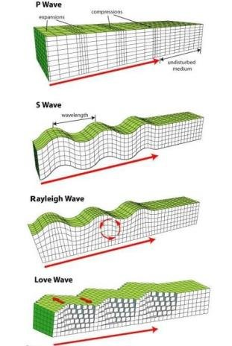
Mechanical waves
Mechanical waves are governed by Newton’s laws and require a medium.
A medium is the substance mechanical waves propagate through, and the medium produces an elastic restoring force when it is deformed.
Mechanical waves transfer energy and momentum, without transferring mass.
Some examples of mechanical waves are water waves, sound waves, and seismic waves.
The medium for water waves is water; for sound waves, the medium is usually air.
For surface water waves, the disturbance occurs on the surface of the water, perhaps created by a rock thrown into a pond or by a swimmer splashing the surface repeatedly.
For sound waves, the disturbance is a change in air pressure, perhaps created by the oscillating cone inside a speaker or a vibrating tuning fork. In both cases, the disturbance is the oscillation of the molecules of the fluid.
In mechanical waves, energy and momentum transfer with the motion of the wave, whereas the mass oscillates around an equilibrium point.
Types of seismic waves

Slide 6
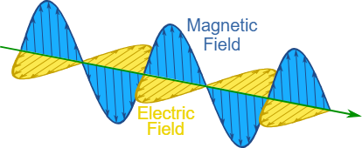
Electromagnetic waves
Electromagnetic waves are associated with oscillations in electric and magnetic fields and do not require a medium.
Examples include gamma rays, X-rays, ultraviolet waves, visible light, infrared waves, microwaves, and radio waves.
Electromagnetic waves can travel through a vacuum at the speed of light, c=2.99792458×10⁸m/s.

Slide 7
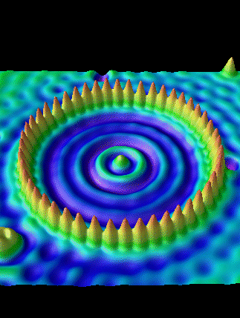
Matter waves
Matter waves are a central part of the branch of physics known as quantum mechanics. These waves are associated with protons, electrons, neutrons, and other fundamental particles found in nature. The theory that all types of matter have wave-like properties was first proposed by Louis de Broglie in 1924.
Electron waves of an electron trapped in a corral of iron atoms

Slide 8
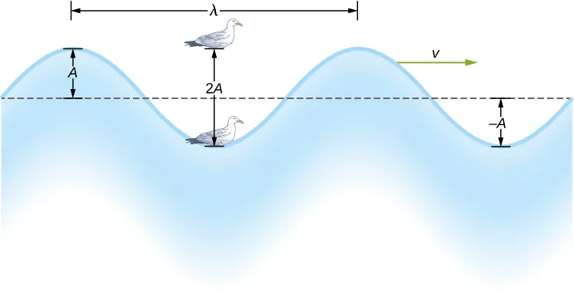

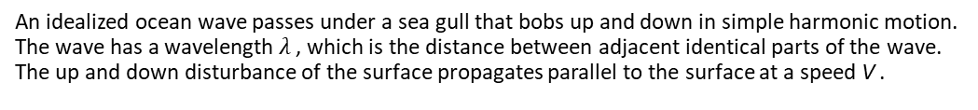
Characteristics of a wave: period, frequency, amplitude
The simplified wave in the figure on the right is an up and down disturbance of the water surface. It causes a sea gull to move up and down in simple harmonic motion as the wave crests and troughs (peaks and valleys) pass under the bird.
The time for one complete up and down motion is the wave’s period T.
The wave’s frequency is .
The amplitude of the wave (A) is a measure of the maximum displacement of the medium from its equilibrium position.
An idealized ocean wave passes under a sea gull that bobs up and down in simple harmonic motion. The wave has a wavelength $λ$ , which is the distance between adjacent identical parts of the wave. The up and down disturbance of the surface propagates parallel to the surface at a speed V .

Slide 9


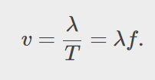
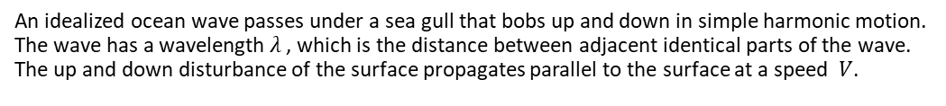
Characteristics of a wave, velocity and wavelength
The water wave moves through the medium with a propagation velocity .
The magnitude of the wave velocity is the distance the wave travels in a given time, which is one wavelength in the time of one period.
The water wave also has a length associated with it, called its wavelength λ, the distance between adjacent identical parts of a wave.
Note: This movement of the wave is the disturbance moving to the right, not the water itself (or the bird would move to the right).
An idealized ocean wave passes under a sea gull that bobs up and down in simple harmonic motion. The wave has a wavelength $λ$ , which is the distance between adjacent identical parts of the wave. The up and down disturbance of the surface propagates parallel to the surface at a speed $V$.

Slide 10
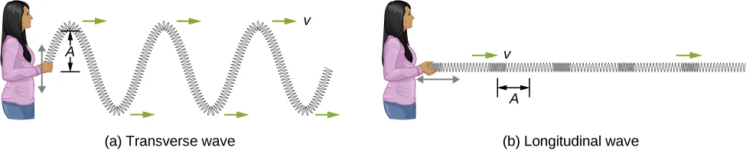
Transverse and longitudinal waves
A simple wave consists of a periodic disturbance that propagates from one place to another.
The wave that propagates in the horizontal direction while the surface is disturbed in the vertical direction is called a transverse wave or shear wave; in such a wave, the disturbance is perpendicular to the direction of propagation.
In contrast, in a longitudinal wave or compressional wave, the disturbance is parallel to the direction of propagation.
In this example of a transverse wave, the wave propagates horizontally, and the disturbance in the cord is in the vertical direction.
In this example of a longitudinal wave, the wave propagates horizontally, and the disturbance in the cord is also in the horizontal direction.

Slide 11
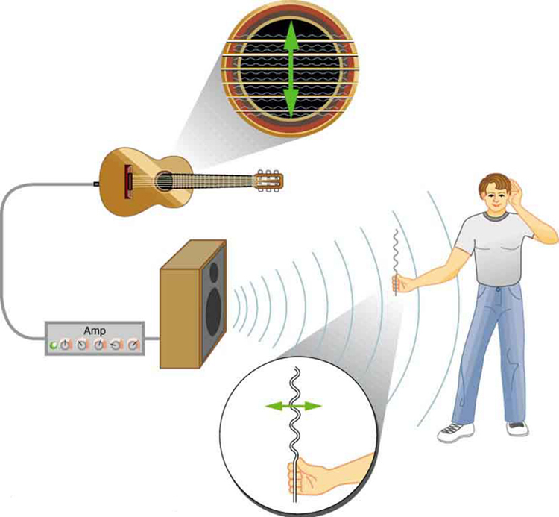
Transverse and longitudinal waves examples
Waves may be transverse, longitudinal, or a combination of the two.
The waves on the strings of musical instruments are transverse—so are electromagnetic waves, such as visible light.
Sound waves in air and water are longitudinal. Their disturbances are periodic variations in pressure that are transmitted in fluids. Fluids do not have appreciable shear strength, and thus the sound waves in them must be longitudinal or compressional.
Sound in solids can be both longitudinal and transverse.
The wave on a guitar string is transverse. The sound wave rattles a sheet of paper in a direction that shows the sound wave is longitudinal.

Slide 12
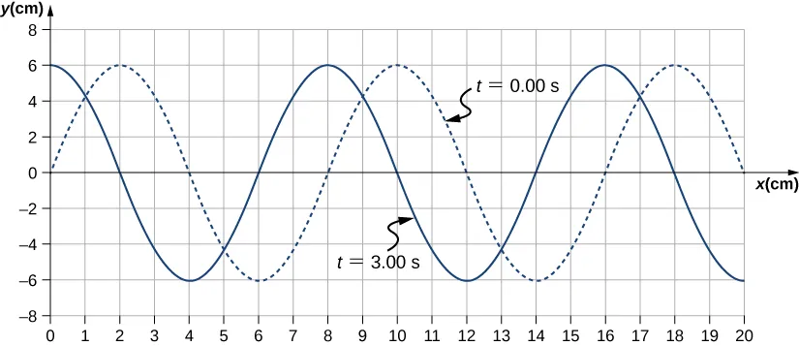
Characteristics of a wave, example
A transverse mechanical wave propagates in the positive x-direction through a spring with a constant wave speed, and the medium oscillates between +A and −A around an equilibrium position. The graph in Figure 16.6 shows the height of the spring (y) versus the position (x), where the x-axis points in the direction of propagation. The figure shows the height of the spring versus the x-position at t = 0.00s
as a dotted line and the wave at t = 3.00s as a solid line. Assume the wave has not traveled more than 1 wavelength in this time. (a) Determine the wavelength and amplitude of the wave. (b) Find the propagation velocity of the wave. (c) Calculate the period and frequency of the wave.

Slide 13
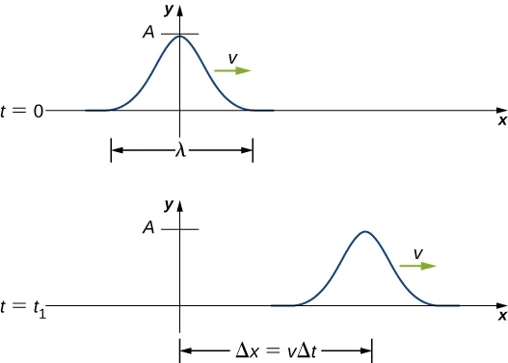
Mathematics of a wave
A pulse can be described as wave consisting of a single disturbance that moves through the medium with a constant amplitude. The pulse moves as a pattern that maintains its shape as it propagates with a constant wave speed. Because the wave speed is constant, the distance the pulse moves in a time Δt is equal to Δx = v Δt
The pulse at time t = 0 is centered on x = 0 with amplitude A. The pulse moves as a pattern with a constant shape, with a constant maximum value A. The distance traveled is measured with any convenient point on the pulse. In this figure, the crest is used.

Slide 14
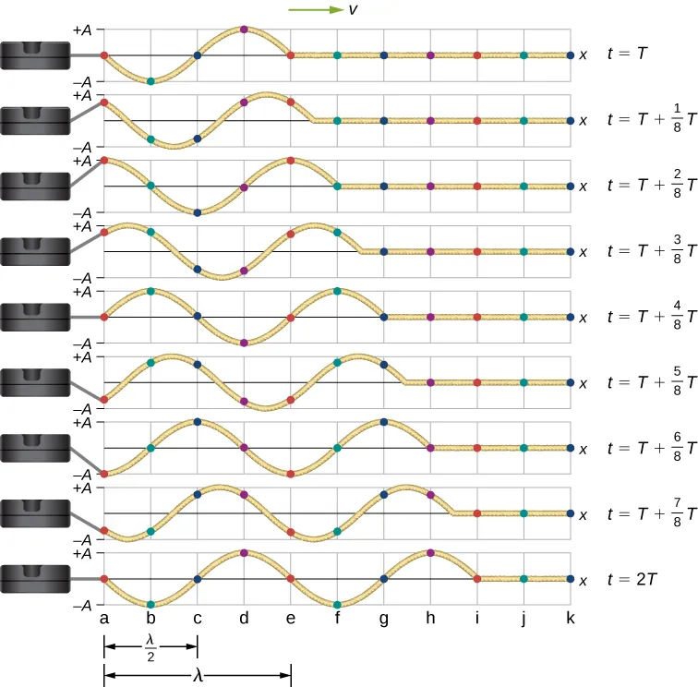
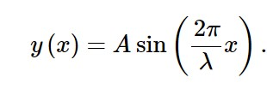

Modeling a one-dimensional sinusoidal wave using a wave function
Consider a string kept at a constant tension with one end is fixed and the free end is oscillated between y=+A and y=−A by a mechanical device at a constant frequency. Figure on the right shows snapshots of the wave at an interval of an eighth of a period, beginning after one period (t = T). We can model the y-position of the string as a function of the position x:
The wave on the string travels in the positive x-direction with a constant velocity v, and moves a distance vt in a time t. The wave function can now be defined by

Slide 15


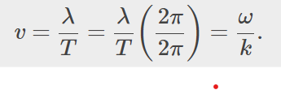

Wave function and wave number
We introduce the wave number:
The wave function can be written as
where A is the amplitude, k=2πλ is the wave number, ω=2πT is the angular frequency, the minus sign is for waves moving in the positive x-direction, and the plus sign is for waves moving in the negative x-direction.
The velocity of the wave is equal to
The wave function modeling a sinusoidal wave, allowing for an initial phase shift ϕ, is

Slide 16
Example
Write a wave function for a transverse wave on a taut string with an amplitude of 0.200 m, the period of 4.00 s and the wavelength of 1.00 m. What is the wave speed?

Slide 17
Velocity and acceleration of a medium
The particles of the medium oscillate around an equilibrium position as the wave propagates through the medium.
In the case of the transverse wave propagating in the x-direction, the particles oscillate up and down in the y-direction, perpendicular to the motion of the wave. The velocity of the medium, which is perpendicular to the wave velocity in a transverse wave, can be found by taking the partial derivative of the position equation with respect to time.
Acceleration of the medium can be found by taking the partial derivative of the velocity equation with respect to time.

Slide 18
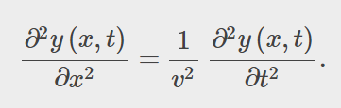
The linear wave equation
This relationship successfully describes any wave or pulse that has the form y(x,t)=f(x∓vt).
These waves result due to a linear restoring force of the medium—thus, the name linear wave equation. Any wave function that satisfies this equation is a linear wave function.

