Slide 1

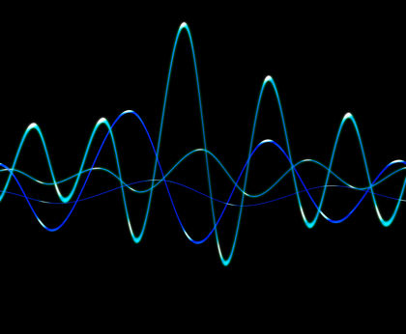
OSCILLATIONS

Slide 2
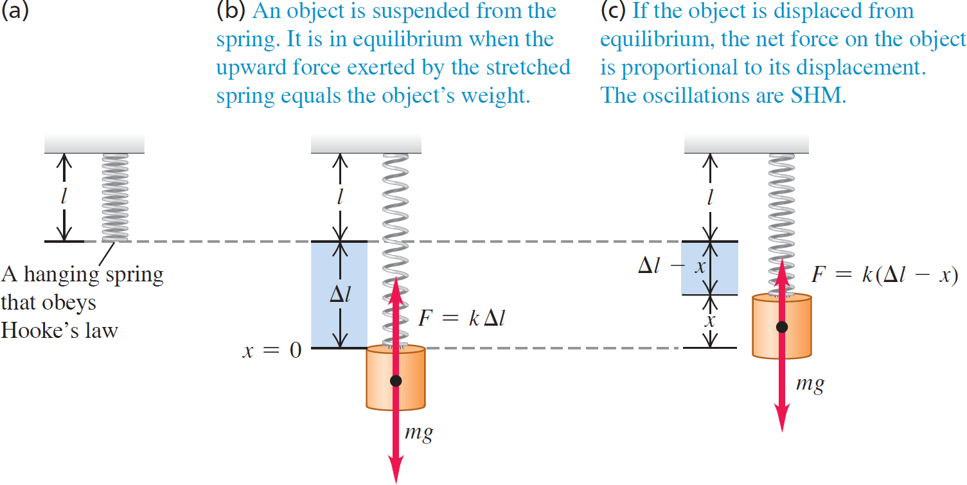
Vertical Simple Harmonic Motion

Slide 3
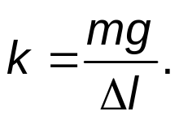
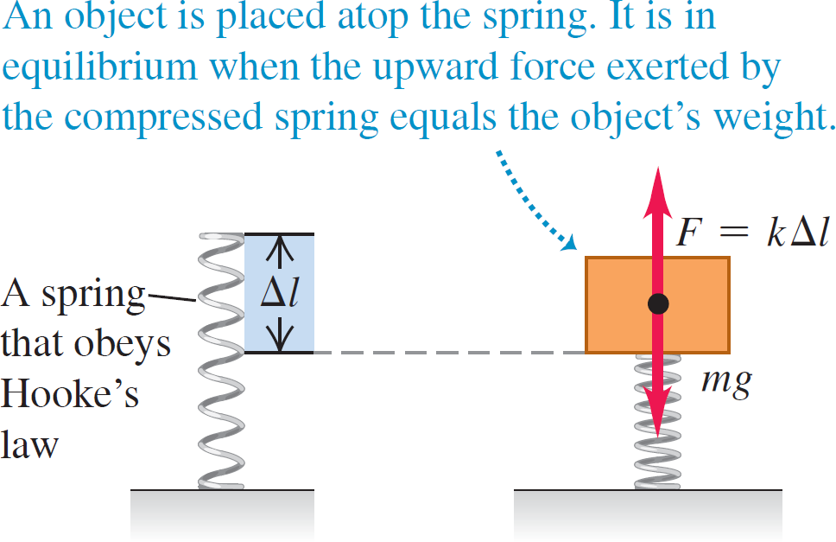
Vertical Simple Harmonic Motion
If the weight mg compresses the spring a distance Δl, the force constant is

Slide 4
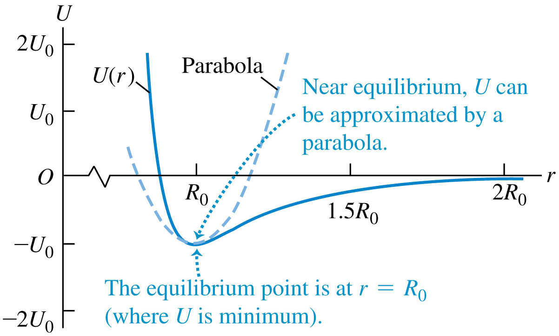
Potential Energy of a Two Atom System

Slide 5
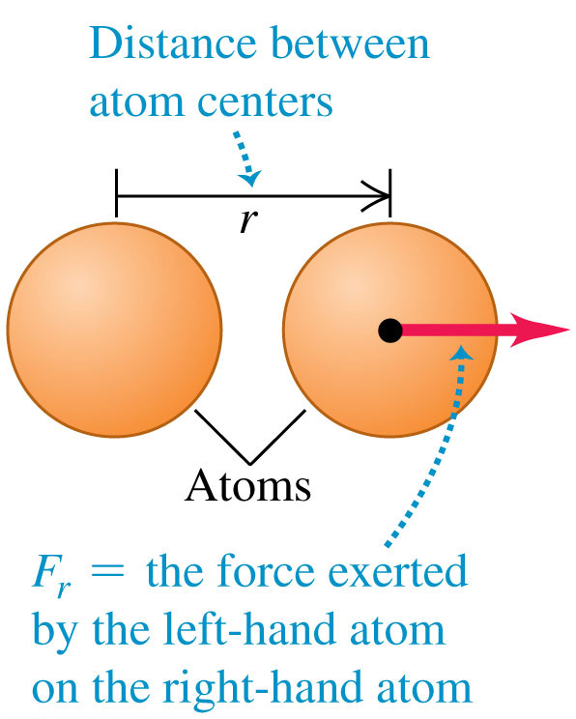
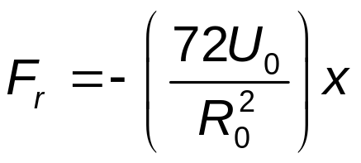
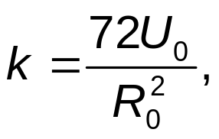
Vibrations of Molecules
Shown are two atoms having centers a distance r apart, with the equilibrium point at r = R₀.
If they are displaced a small distance x from equilibrium, the restoring force is approximately
So
and the motion is SHM.

Slide 6
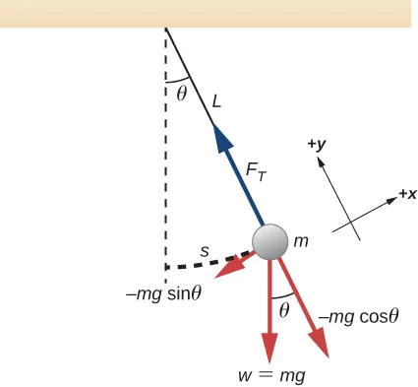
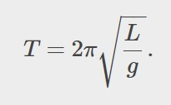
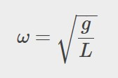
The Simple Pendulum
A simple pendulum consists of a point mass (the bob) suspended by a massless, unstretchable string.
If the pendulum swings with a small amplitude θ with the vertical, its motion is simple harmonic.

Slide 7
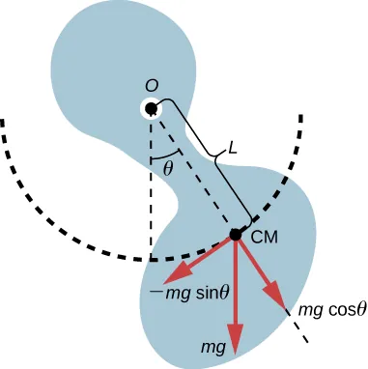
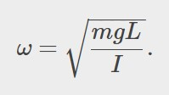
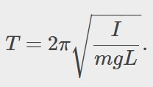
The Physical Pendulum
A physical pendulum is any real pendulum that uses an extended object instead of a point-mass bob.
The force of gravity acts on the center of mass (CM) and provides the restoring force that causes the object to oscillate.
For small amplitudes, its motion is simple harmonic.

Slide 8
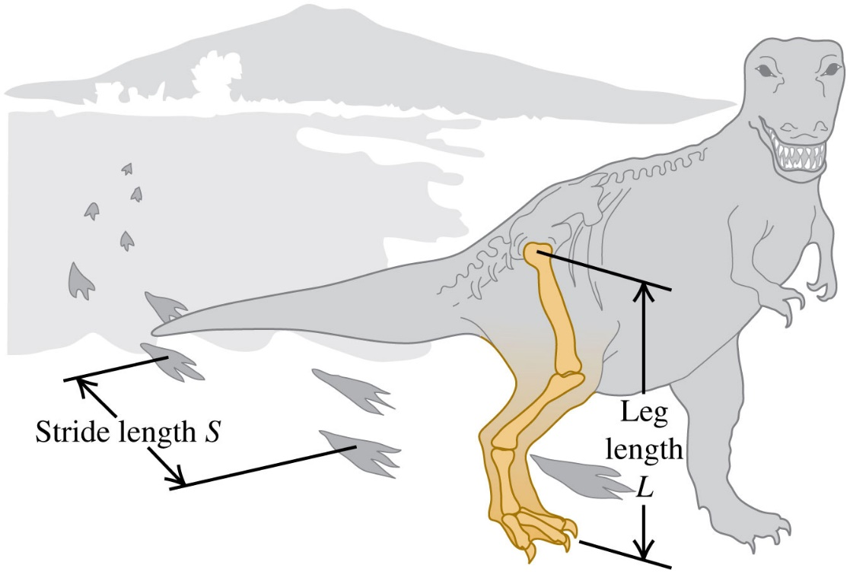
Tyrannosaurus Rex and the Physical Pendulum
All walking animals, including humans, have a natural walking pace, a number of steps per minute that is more comfortable than a faster or slower pace. Suppose this natural pace is equal to the period of the leg, viewed as a uniform rod pivoted at the hip joint. A) How does the natural walking pace depend on the length L of the leg, measured from hip to foot? B) Fossil evidence shows that Tyrannosaurus rex, a two-legged dinosaur that lived about 65 million years ago at the end of the Cretaceous period, had a leg length L = 3.1 m and a stride length (the distance from one foot-print to the next print of the same foot ) S = 4.0 m. Estimate the walking speed of Tyrannosaurus rex.

Slide 9
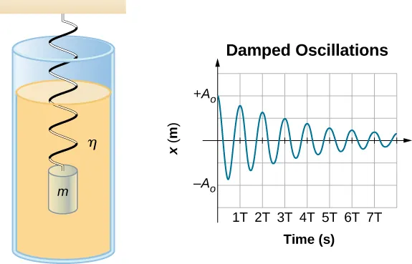
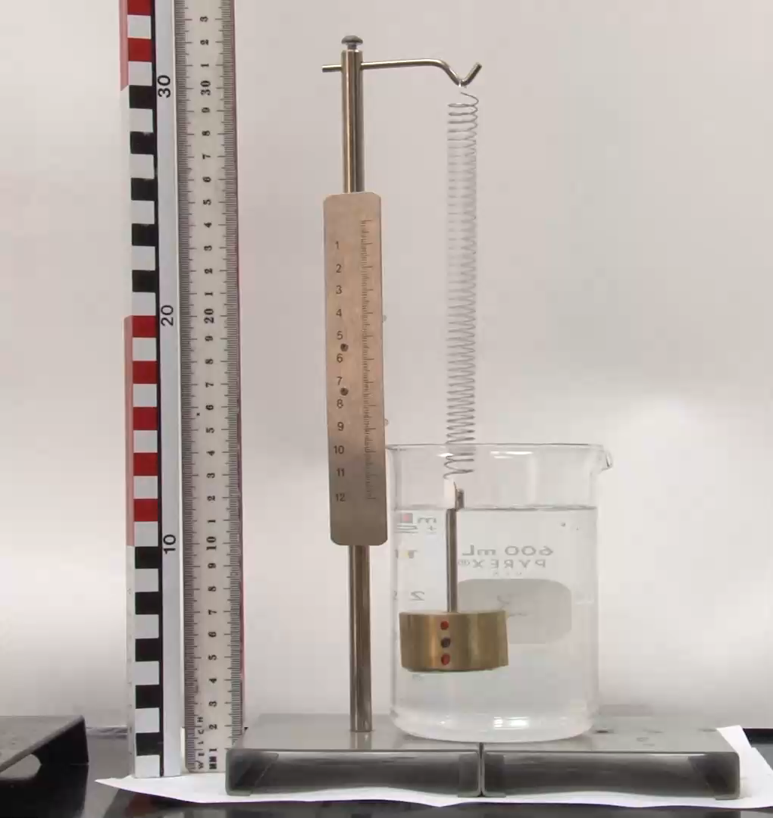
Damped Oscillations
Real-world systems have some dissipative forces that decrease the amplitude.
The decrease in amplitude is called damping and the motion is called damped oscillation.
For a mass on a spring oscillating in a viscous fluid, the period remains constant, but the amplitudes of the oscillations decrease due to the damping caused by the fluid.

Slide 10

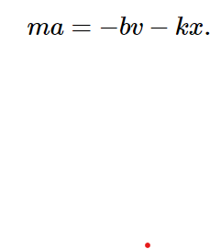


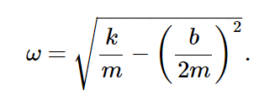
Mathematics of damped oscillations
If the magnitude of the velocity is small, meaning the mass oscillates slowly, the damping force is proportional to the velocity and acts against the direction of motion
Writing this as a differential equation in x, we obtain
with the solution:
where

Slide 11
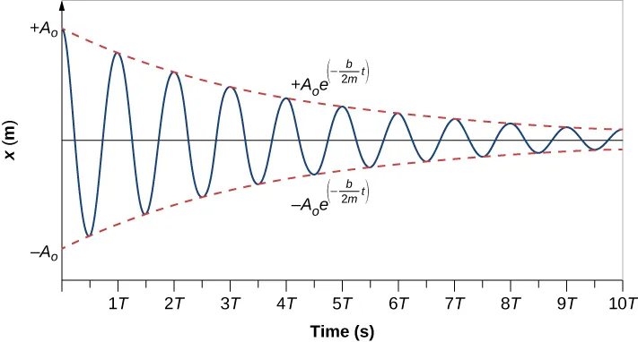
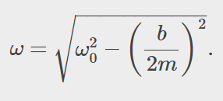
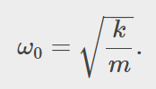
System with a Small Amount of Damping
In this graph of displacement versus time for a harmonic oscillator with a small amount of damping, the amplitude slowly decreases, but the period and frequency are nearly the same as if the system were completely undamped. This occurs because the non-conservative damping force removes energy from the system, usually in the form of thermal energy.
The angular frequency for damped harmonic motion becomes

Slide 12

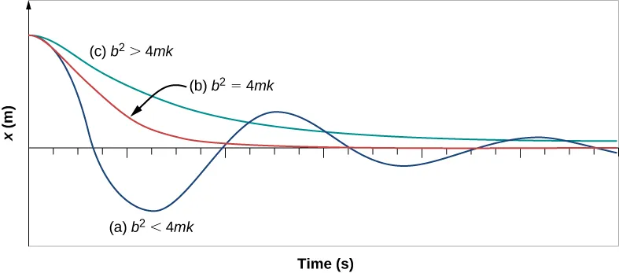

Critical Damping
Critical damping is defined as the condition in which the damping of an oscillator results in it returning as quickly as possible to its equilibrium position.
Critical damping happens at and is represented by Curve (b) .
Curve (c) represents an overdamped system for which
As with critical damping, it too may overshoot the equilibrium position, but will reach equilibrium over a longer period of time.
With less-than critical damping, the system will return to equilibrium faster but will overshoot and cross over one or more times. Such a system is underdamped (a).

Slide 13


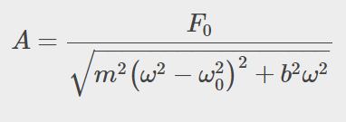
Mathematics of forced oscillations
We can analyze the motion of the mass by using second Newton’s law. The resulting equation is similar to the force equation for the damped harmonic oscillator, with the addition of the driving force:
After some time, the steady state solution to this differential equation is:
as long as the amplitude is equal to

Slide 14
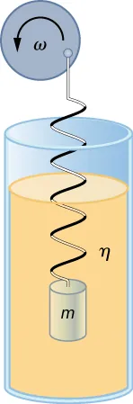

Forced Oscillations and Resonance
A damped oscillator left to itself will eventually stop moving.
But we can maintain a constant-amplitude oscillation by applying a force that varies with time in a periodic way.
We call this additional force a driving force.
Forced, damped harmonic motion produced by driving a spring and mass with a disk driven by a variable-speed motor.

Slide 15
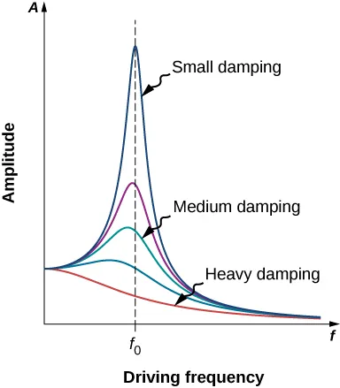
Resonance
Forced Oscillations and Resonance
The curves represent the same oscillator with the same natural frequency but with different amounts of damping.
Resonance occurs when the driving frequency equals the natural frequency, and the greatest response is for the least amount of damping.
The narrowest response is also for the least damping.
Amplitude of a harmonic oscillator as a function of the frequency of the driving force.

Slide 16
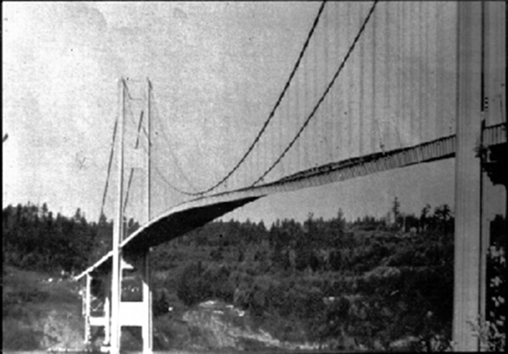
Unwanted Resonance
In 1940, the Tacoma Narrows Bridge in Washington state collapsed. Heavy cross winds drove the bridge into oscillations at its resonant frequency. Damping decreased when support cables broke loose and started to slip over the towers, allowing increasingly greater amplitudes until the structure failed (credit: PRI's Studio 360, via Flickr)

Slide 17

Forced Oscillations and Resonance
This lady beetle flies by means of a forced oscillation.
Unlike the wings of birds, this insect’s wings are extensions of its exoskeleton.
Muscles attached to the inside of the exoskeleton apply a periodic driving force that deforms the exoskeleton rhythmically, causing the attached wings to beat up and down.
The oscillation frequency of
the wings and exoskeleton is
the same as the frequency of
the driving force.

Slide 18
Example
(a) How much will a spring that has a force constant of 40.0 N/m be stretched by an object with a mass of 0.500 kg when hung motionless from the spring? (b) Calculate the decrease in gravitational potential energy of the 0.500-kg object when it descends this distance. (c) Part of this gravitational energy goes into the spring. Calculate the energy stored in the spring by this stretch and compare it with the gravitational potential energy. Explain where the rest of the energy might go.

