Slide 1


FLUID STATICS

Slide 2
Today’s objectives
By the end of this lesson, you will be able to:
  State the different phases of matter
  Describe the characteristics of the phases of matter at the molecular or atomic level
  Distinguish between compressible and incompressible materials
  Define density and its related SI units
  Compare and contrast the densities of various substances
  Define pressure and its related SI units
  Explain the relationship between pressure and force
  Calculate force given pressure and area

Slide 3
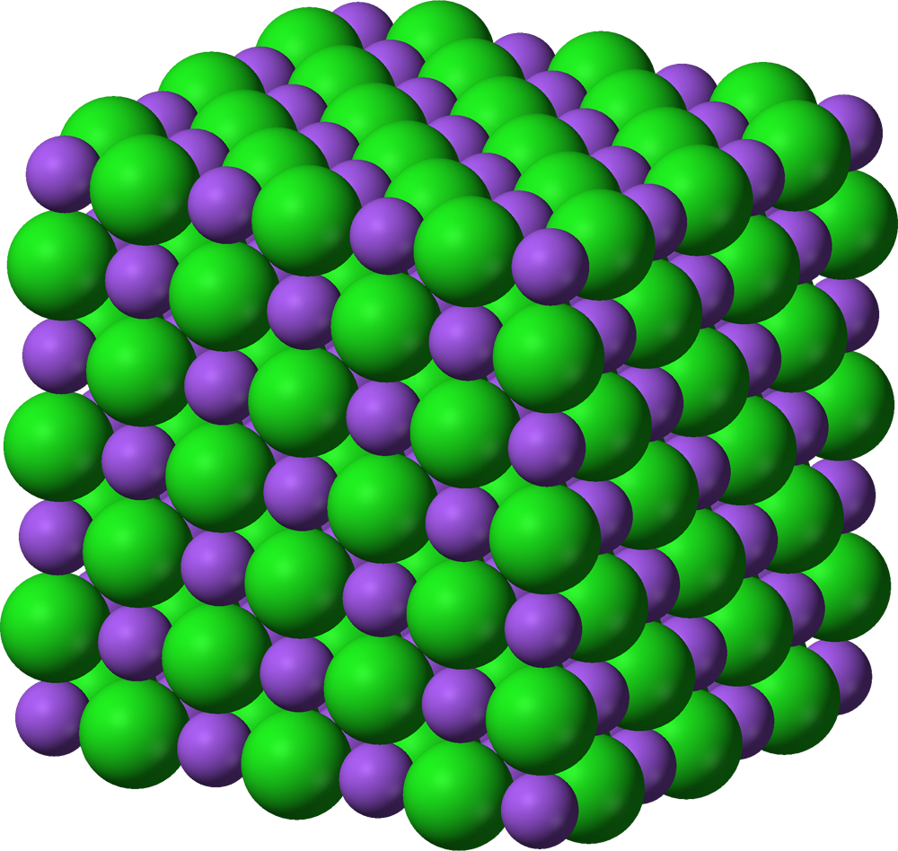
Characteristics of solids
The atoms or molecules in a solid are in close proximity to each other, and there is a significant force between these molecules.
Solids will take a form determined by the nature of these forces between the molecules. Although true solids are not incompressible, it nevertheless requires a large force to change the shape of a solid.
In some cases, the force between molecules can cause the molecules to organize into a lattice. The structure of this three-dimensional lattice is represented as molecules connected by rigid bonds (modeled as stiff springs), which allow limited freedom for movement. Even a large force produces only small displacements in the atoms or molecules of the lattice, and the solid maintains its shape.

Slide 4
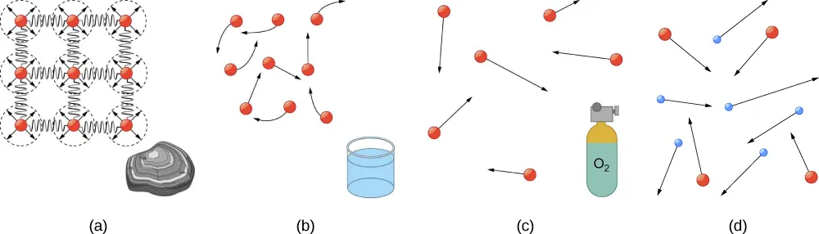
Characteristics of fluids
Like solids, the molecules in a liquid are bonded to neighboring molecules but possess many fewer of these bonds.
The molecules in a liquid are not locked in place and can move with respect to each other. The distance between molecules is similar to the distances in a solid, and so liquids have definite volumes, but the shape of a liquid changes, depending on the shape of its container.
Gases are not bonded to neighboring atoms and can have large separations between molecules. Gases have neither specific shapes nor definite volumes, since their molecules move to fill the container in which they are held
(a) Atoms in a solid always have the same neighbors, held near home by forces represented here by springs. These atoms are essentially in contact with one another. A rock is an example of a solid. This rock retains its shape because of the forces holding its atoms together. (b) Atoms in a liquid are also in close contact but can slide over one another. Forces between them strongly resist attempts to push them closer together and also hold them in close contact. Water is an example of a liquid. Water can flow, but it also remains in an open container because of the forces between its atoms. (c) Atoms in a gas are separated by distances that are considerably larger than the size of the atoms themselves, and they move about freely. A gas must be held in a closed container to prevent it from moving out freely. (d) A plasma is composed of electrons, protons, and ions that, like gases, are spaced far apart and move about freely.

Slide 5

Density
Average density is the mass per unit volume of a substance or object. In equation form, average density is defined as
where the Greek letter ρ is the symbol for density, m is the mass, and V is the volume occupied by the substance.
Note:
  the SI unit of density is kg/m³
  The metric system was originally devised so that water would have a density of 1g/cm³, equivalent to 10³ kg/m³
  The basic mass unit, the kilogram, was first devised to be the mass of 1000 mL of water, which has a volume of 1000 cm³.

Slide 6
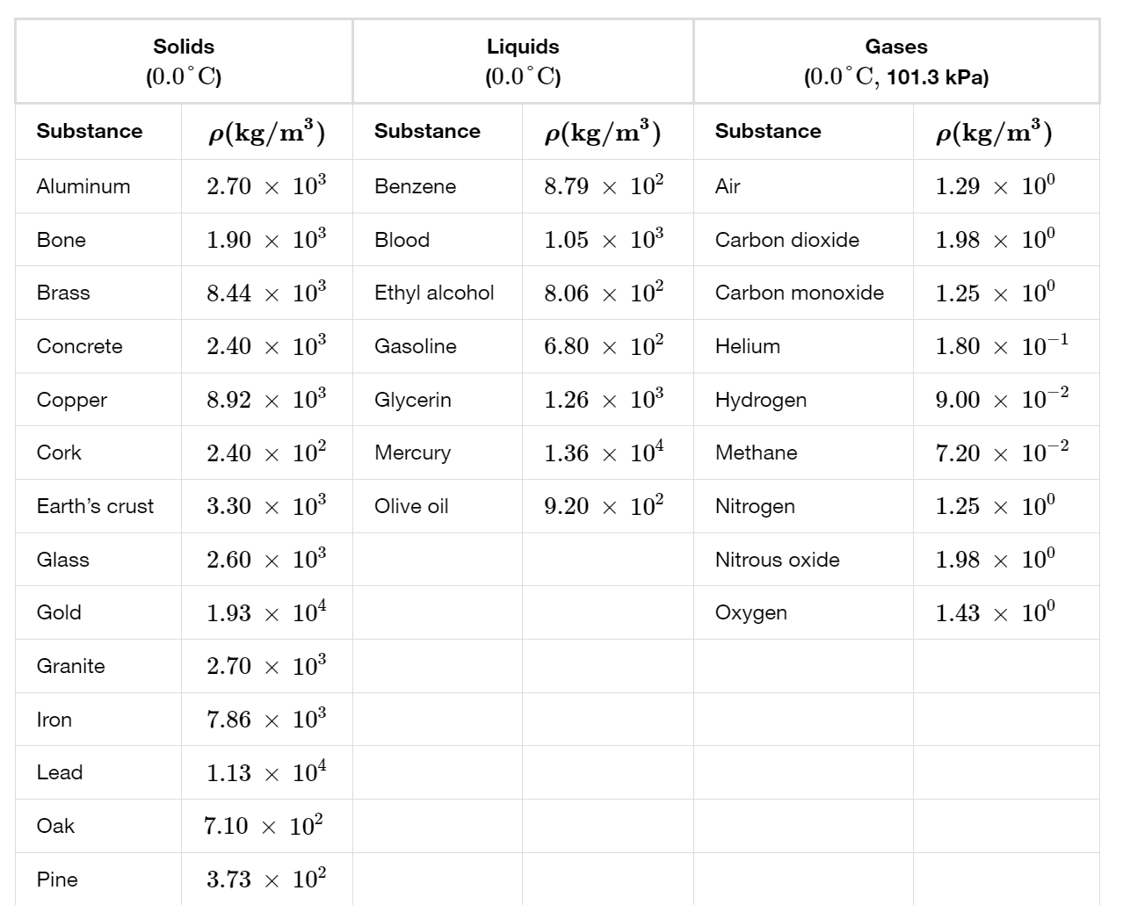
Densities of Some Common Substances

Slide 7
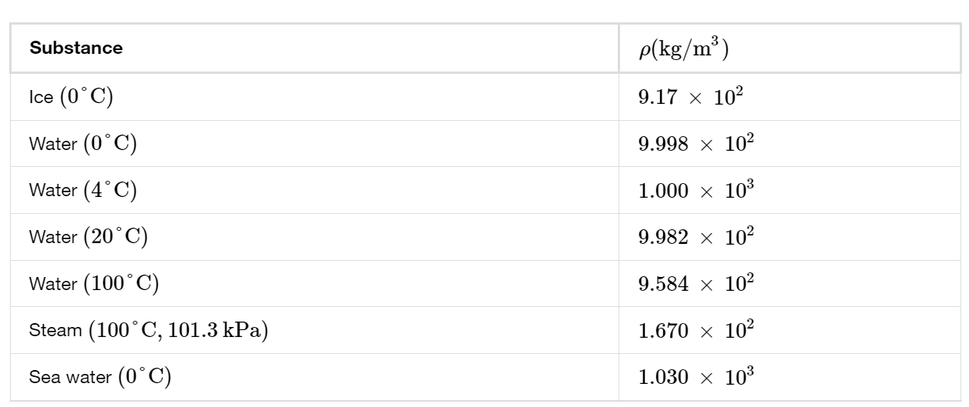
Densities of water

Slide 8

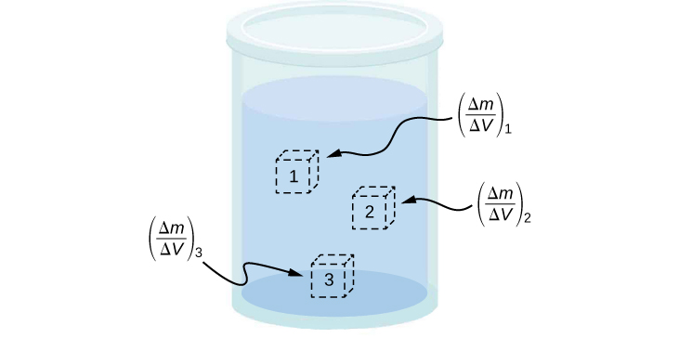
Homogeneous and heterogeneous materials
The density of a substance is not necessarily constant throughout the volume of a substance. If the density is constant throughout a substance, the substance is said to be a homogeneous substance.
If the density of a substance were not constant, the substance is said to be a heterogeneous substance. The density at a specific location within a heterogeneous material is called local density, and is given as a function of location, ρ=ρ(x,y,z)
where the Greek letter ρ is the symbol for density, m is the mass, and V is the volume occupied by the substance.
Density may vary throughout a heterogeneous mixture. Local density at a point is obtained from dividing mass by volume in a small volume around a given point.

Slide 9

Specific gravity
Dimensionless quantity called the specific gravity is often used to compare densities.
Specific gravity is defined as the ratio of the density of the material to the density of water at 4.0°C and one atmosphere of pressure, which is 1000 kg/m³:

Slide 10
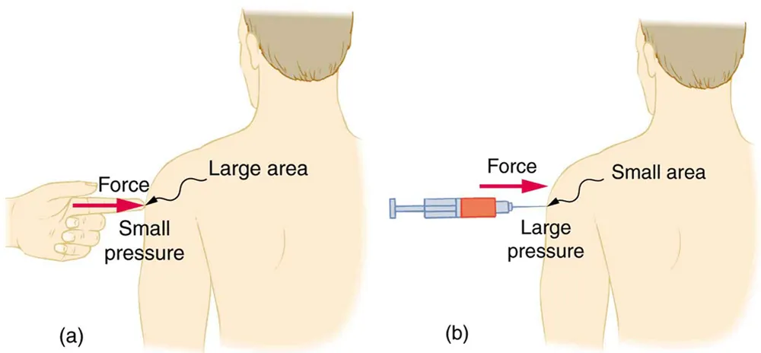


Pressure
In addition to the pascal, there are many other units for pressure that are in common use. In meteorology, atmospheric pressure is often described in units of millibar (mb), where 100 mb=1×10⁴ Pa. Pounds per square inch (lb/in²or psi) is still sometimes used as a measure of tire pressure, and millimeters of mercury (mm Hg) is still often used in the measurement of blood pressure.
Pressure P is defined as
where F is a normal force applied to an area A.
At a specific point we can define pressure as
A given force can have a significantly different effect depending on the area over which the force is exerted.
The SI unit for pressure is the pascal, where
1 Pa = 1 N/m².
(a) While the person being poked with the finger might be irritated, the force has little lasting effect. (b) In contrast, the same force applied to an area the size of the sharp end of a needle is great enough to break the skin.

Slide 11
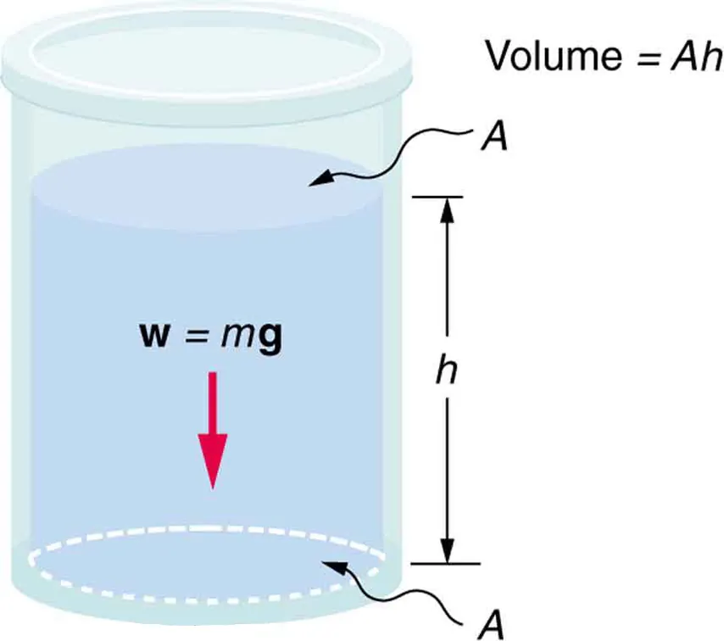



Variation of pressure with depth
Consider a fluid of constant density. The pressure at the bottom of the container is due to the pressure of the atmosphere (p₀) plus the pressure due to the weight of the fluid.
We can find the mass of the fluid from its volume and density:
or
Note that this equation is only good for pressure at a depth for a fluid of constant density.

Slide 12
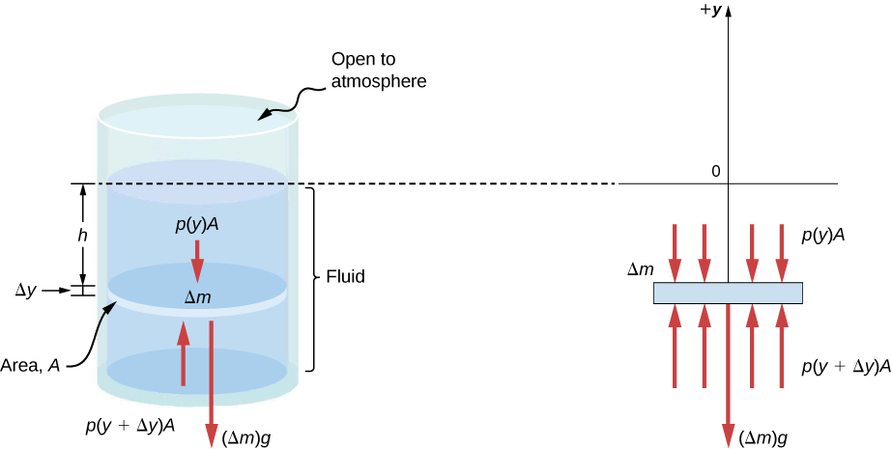

Pressure in a static fluid in a uniform gravitational field
A static fluid is a fluid that is not in motion. At any point within a static fluid, the pressure on all sides must be equal—otherwise, the fluid at that point would react to a net force and accelerate.
Forces on a mass element inside a fluid. The weight of the element itself is shown in the free-body diagram.

Slide 13
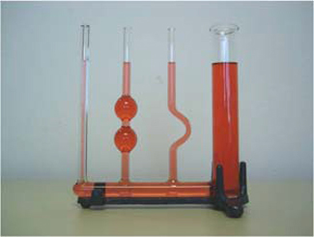
Pressure and the shape of the container
Note that the pressure in a fluid depends only on the depth from the surface and not on the shape of the container.
In a container where a fluid can freely move in various parts, the liquid stays at the same level in every part, regardless of the shape.
In the container pictured, the pressure at the bottom of each column is the same; if it were not the same, the fluid would flow until the pressures became equal.

Slide 14




Variation of atmospheric pressure with height
The change in atmospheric pressure with height is of particular interest. Assuming the temperature of air to be constant, and that the ideal gas law of thermodynamics describes the atmosphere to a good approximation, we can find the variation of atmospheric pressure with height, when the temperature is constant. The density ρ at y, the temperature T in the Kelvin scale (K), and the mass m of a molecule of air are related to the absolute pressure by the ideal gas law, in the form

Slide 15
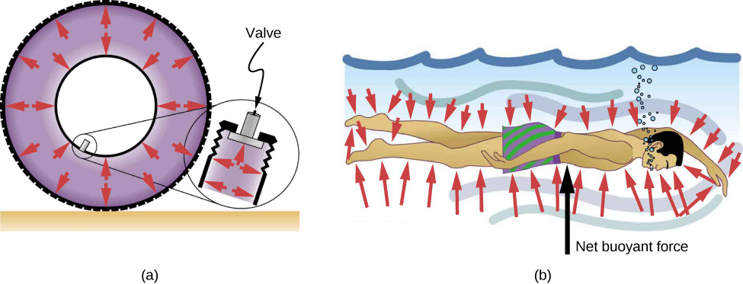
Direction of pressure in fluid
Fluid pressure has no direction, being a scalar quantity, whereas the forces due to pressure have well-defined directions: They are always exerted perpendicular to any surface.
In a static fluid enclosed in a tank, the force exerted on the walls of the tank is exerted perpendicular to the inside surface. Likewise, pressure is exerted perpendicular to the surfaces of any object within the fluid.
(a) Pressure inside this tire exerts forces perpendicular to all surfaces it contacts. The arrows represent directions and magnitudes of the forces exerted at various points. (b) Pressure is exerted perpendicular to all sides of this swimmer, since the water would flow into the space he occupies if he were not there. The arrows represent the directions and magnitudes of the forces exerted at various points on the swimmer. Note that the forces are larger underneath, due to greater depth, giving a net upward or buoyant force. The net vertical force on the swimmer is equal to the sum of the buoyant force and the weight of the swimmer.

Slide 16

Gauge and absolute pressure
Gauge pressure is defined as the pressure relative to atmospheric pressure. Gauge pressure is positive for pressures above atmospheric pressure, and negative for pressures below it.
In fact, atmospheric pressure does add to the pressure in any fluid not enclosed in a rigid container. This happens because of Pascal’s principle. The total pressure, or absolute pressure, is thus the sum of gauge pressure and atmospheric pressure:
where P_{abs} is absolute pressure, P_{g} is gauge pressure, and P_{atm} is atmospheric pressure.
For example, if your tire gauge reads 34 psi (pounds per square inch), then the absolute pressure is 34 psi plus 14.7 psi (P_{atm} in psi), or 48.7 psi (equivalent to 336 kPa).

Slide 17
Example
Calculate the average pressure exerted on the palm of a shot-putter’s hand by the shot if the area of contact is 50.0 cm² and he exerts a force of 800 N on it. Express the pressure in N/m² and compare it with the 1.00×10⁶ Pa pressures sometimes encountered in the skeletal system.

