Slide 1
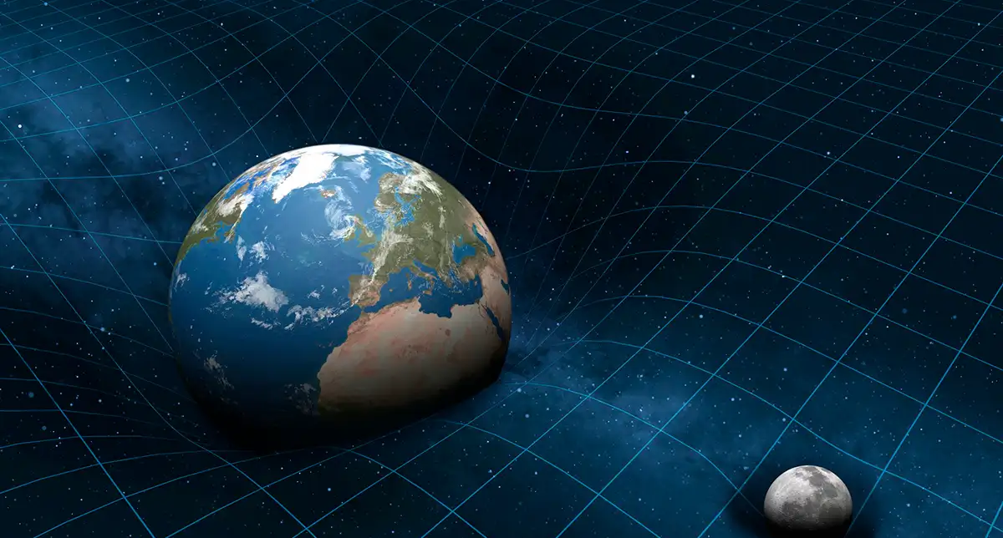

GRAVITATION

Slide 2
Today’s objectives
By the end of this lesson, you will be able to:
  List the significant milestones in the history of gravitation
  Calculate the gravitational force between two point masses
  Estimate the gravitational force between collections of mass
Describe the conic sections and how they relate to orbital motion
Describe how orbital velocity is related to conservation of angular momentum
Determine the period of an elliptical orbit from its major axis

Slide 3
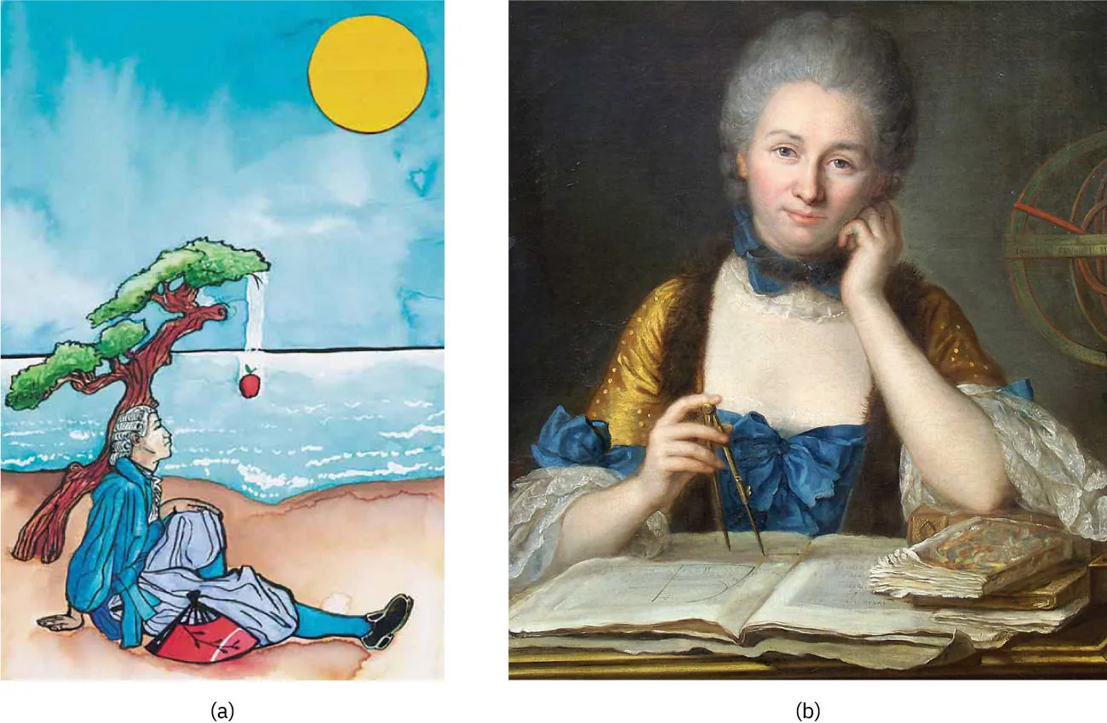
History of theory of gravitation
Aristotle (384–322 BCE) believed that it was the nature of rocks to seek Earth and the nature of fire to seek the Heavens. Brahmagupta (598~665 CE) postulated that Earth was a sphere and that objects possessed a natural affinity for it, falling toward the center from wherever they were located.
The motions of the Sun, our Moon, and the planets have been studied for thousands of years as well. These motions were described with amazing accuracy by Ptolemy (90–168 CE), whose method of epicycles described the paths of the planets as circles within circles. However, there is little evidence that anyone connected the motion of astronomical bodies with the motion of objects falling to Earth—until the seventeenth century.
Nicolaus Copernicus (1473–1543) is generally credited as being the first to challenge Ptolemy’s geocentric (Earth-centered) system and suggest a heliocentric system, in which the Sun is at the center of the solar system.
According to early accounts, Newton was inspired to make the connection between falling bodies and astronomical motions when he saw an apple fall from a tree and realized that if the gravitational force could extend above the ground to a tree, it might also reach the Sun. Like many revolutionary discoveries, it was not immediately accepted. Prominent French scientist and philosopher Émilie du Châtelet helped establish Newton's theory in France and mainland Europe.

Slide 4
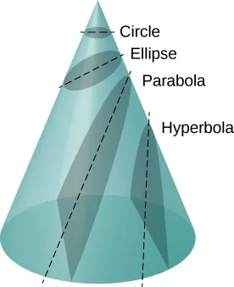
History of gravitation – Newton’s contribution
This idea was supported by the incredibly precise naked-eye measurements of planetary motions by Tycho Brahe and their analysis by Johannes Kepler and Galileo Galilei.
Kepler showed that the motion of each planet is an ellipse, and Robert Hooke (the s Hooke who formulated Hooke’s law for springs) intuitively suggested that these motions are due to the planets being attracted to the Sun.
But Newton was the first to propose an exact mathematical form and to use that form to show that the motion of heavenly bodies should be conic sections—circles, ellipses, parabolas, and hyperbolas. This theoretical prediction was a major triumph—it had been known for some time that moons, planets, and comets follow such paths, but no one had been able to propose a mechanism that caused them to follow these paths and not others.
All motion caused by an inverse square force is one of the four conic sections and is determined by the energy and direction of the moving body.

Slide 5
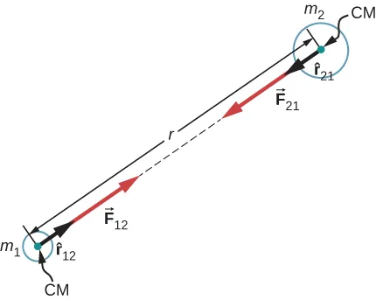

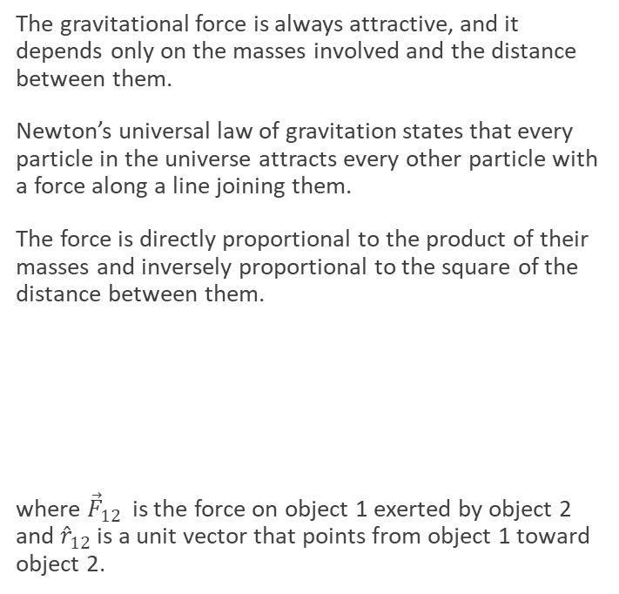
Gravitational force: details
The gravitational force is always attractive, and it depends only on the masses involved and the distance between them.
Newton’s universal law of gravitation states that every particle in the universe attracts every other particle with a force along a line joining them.
The force is directly proportional to the product of their masses and inversely proportional to the square of the distance between them.
where ${\vec{F}}_{12}$ is the force on object 1 exerted by object 2 and ${\hat{r}}_{12}$ is a unit vector that points from object 1 toward object 2.
Gravitational attraction is along a line joining the centers of mass of these two bodies. The magnitude of the force is the same on each, consistent with Newton’s third law.
Note that strictly speaking, Newton’s universal law of gravitation applies to point masses—all the mass is located at one point. But it applies equally to any spherically symmetric objects, where r is the distance between the centers of mass of those objects.

Slide 6
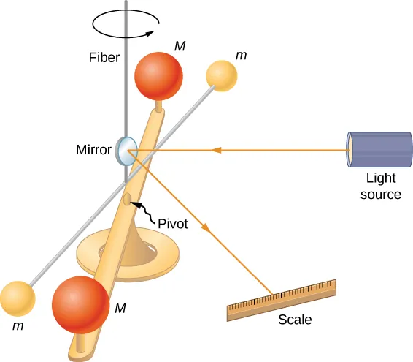
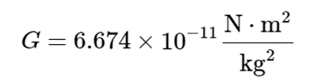
The Cavendish experiment
A century after Newton published his law of universal gravitation, Henry Cavendish determined the proportionality constant G by performing a painstaking experiment. He constructed a device similar to that shown on the left, in which small masses are suspended from a wire. Once in equilibrium, two fixed, larger masses are placed symmetrically near the smaller ones. The gravitational attraction creates a torsion (twisting) in the supporting wire that can be measured.
Cavendish used an apparatus similar to this to measure the gravitational attraction between two spheres (m) suspended from a wire and two stationary spheres (M).

Slide 7
Example: centripetal acceleration of the Moon
(a) Find the acceleration due to Earth’s gravity at the distance of the Moon.
(b) Calculate the centripetal acceleration needed to keep the Moon in its orbit (assuming a circular orbit about a fixed Earth), and compare it with the value of the acceleration due to Earth’s gravity that you have just found.

Slide 8
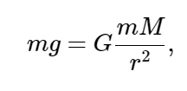
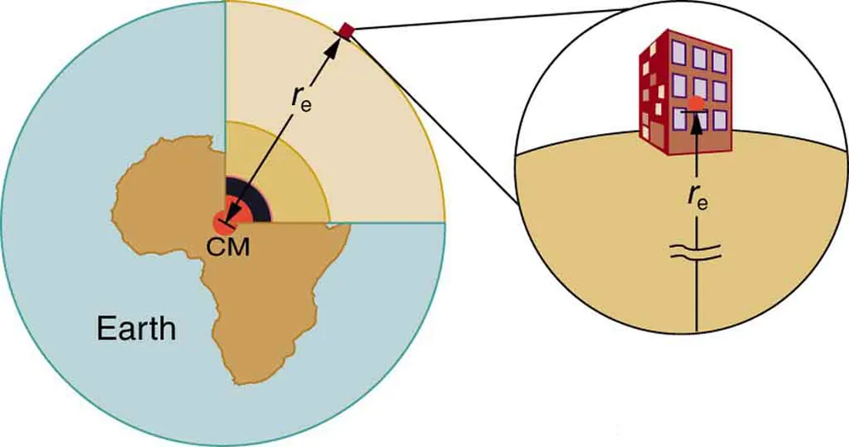
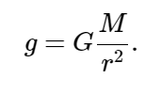
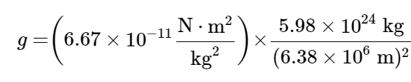

Weight
Recall that the acceleration due to gravity g is about 9.80 m/s² on Earth. We can now determine why this is so.
where m is the mass of the object, M is the mass of Earth, and r is the distance to the center of Earth (the distance between the centers of mass of the object and Earth). The mass m of the object cancels, leaving an equation for g:

Slide 9
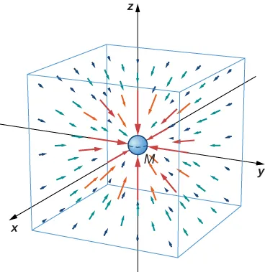

Gravitational field
We can introduce an idea of gravitational field caused by mass M as:
We can picture the field as shown on the left. The lines are directed radially inward and are symmetrically distributed about the mass.
A three-dimensional representation of the gravitational field created by mass M. Note that the lines are uniformly distributed in all directions. (The box has been added only to aid in visualization.)

Slide 10
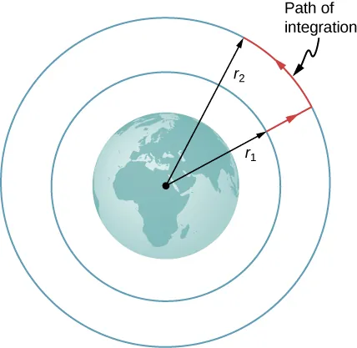
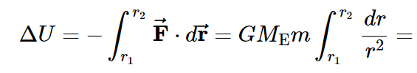
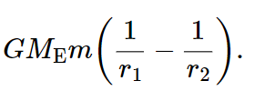


Gravitational potential energy beyond Earth
Starting from the definition of potential energy
Since we can introduce a simple expression for U:
The work integral, which determines the change in potential energy, can be evaluated along the path shown in red.

Slide 11
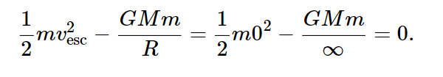
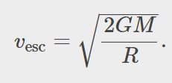
Escape velocity
Escape velocity is the minimum initial velocity of an object that is required to escape the surface of a planet (or any large body like a moon) and never return. As usual, we assume no energy lost to an atmosphere, should there be any.
Solving for the escape velocity,

Slide 12
Energy and gravitationally bound objects
Escape velocity can be defined as the initial velocity of an object that can escape the surface of a moon or planet. More generally, it is the speed at any position such that the total energy is zero.
If the total energy is zero or greater, the object escapes.
On the other hand, if the total energy is negative, then the kinetic energy must reach zero at some finite value of r, where U is negative and equal to the total energy. The object can never exceed this finite distance from M, since to do so would require the kinetic energy to become negative, which is not possible. We say m is gravitationally bound to M.

Slide 13
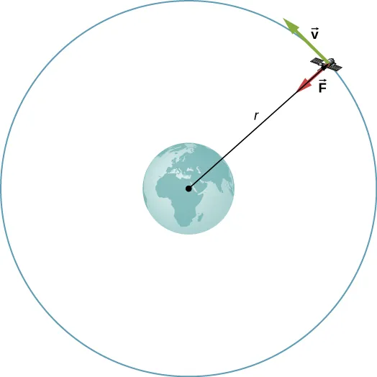
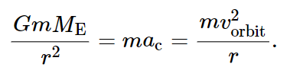
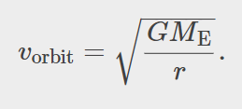
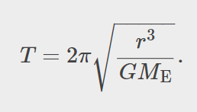
Planetary orbits
For a satellite of mass m in a circular orbit about Earth at distance r from the center of Earth
Solving for the speed of the orbit and orbital period:
A satellite of mass m orbiting at radius r from the center of Earth. The gravitational force supplies the centripetal acceleration.

Slide 14
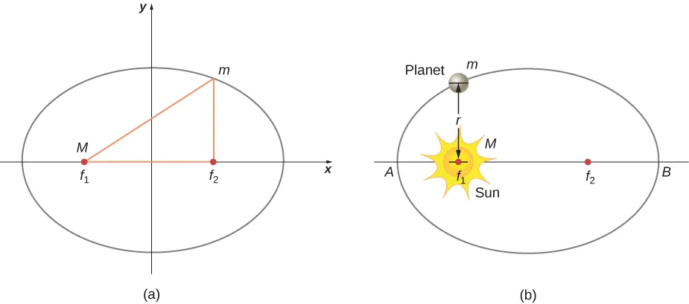
Kepler’s laws of planetary motion
Kepler’s First Law:
The orbit of each planet about the Sun is an ellipse with the Sun at one focus.
For elliptical orbits, the point of closest approach of a planet to the Sun is called the perihelion. It is labeled point A in the figure below. The farthest point is the aphelion and is labeled point B in the figure. For the Moon’s orbit about Earth, those points are called the perigee and apogee, respectively.
(a) An ellipse is a curve in which the sum of the distances from a point on the curve to two foci (f₁andf₂) is a constant. From this definition, you can see that an ellipse can be created in the following way. Place a pin at each focus, then place a loop of string around a pencil and the pins. Keeping the string taught, move the pencil around in a complete circuit. If the two foci occupy the same place, the result is a circle—a special case of an ellipse. (b) For an elliptical orbit, if m≪M, then m follows an elliptical path with M at one focus. More exactly, both m and M move in their own ellipse about the common center of mass.

Slide 15
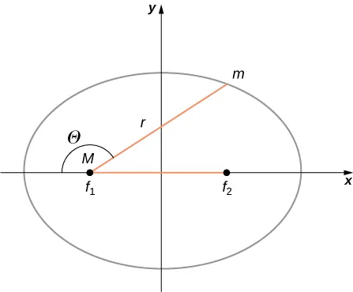
An ellipse has several mathematical forms, but all are a specific case of the more general equation for conic sections. There are four different conic sections, all given by the equation
The variables r and θ
are shown in Figure 13.17 in the case of an ellipse. The constants α
and e are determined by the total energy and angular momentum of the satellite at a given point. The constant e is called the eccentricity. The values of αand e determine which of the four conic sectionIf the total energy is negative, then 0≤e<1
, and Equation 13.10 represents a bound or closed orbit of either an ellipse or a circle, where e=0
. [You can see from Equation 13.10 that for e=0
, r=α
, and hence the radius is constant.] For ellipses, the eccentricity is related to how oblong the ellipse appears. A circle has zero eccentricity, whereas a very long, drawn-out ellipse has an eccentricity near one.
If the total energy is exactly zero, then e=1
and the path is a parabola. Recall that a satellite with zero total energy has exactly the escape velocity. (The parabola is formed only by slicing the cone parallel to the tangent line along the surface.) Finally, if the total energy is positive, then e>1
and the path is a hyperbola. These last two paths represent unbounded orbits, where m passes by M once and only once. This situation has been observed for several comets that approach the Sun and then travel away, never to return.s represents the path of the satellite.

Slide 16
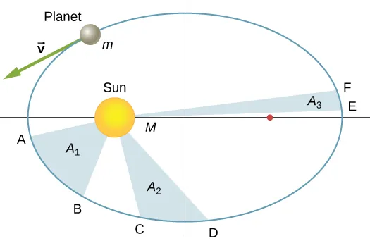
Kepler’s laws of planetary motion
Kepler’s Second Law:
Each planet moves so that an imaginary line drawn from the Sun to the planet sweeps out equal areas in equal times.
The shaded regions have equal areas. It takes equal times for m to go from A to B, from C to D, and from E to F. The mass m moves fastest when it is closest to M. Kepler’s second law was originally devised for planets orbiting the Sun, but it has broader validity.

Slide 17
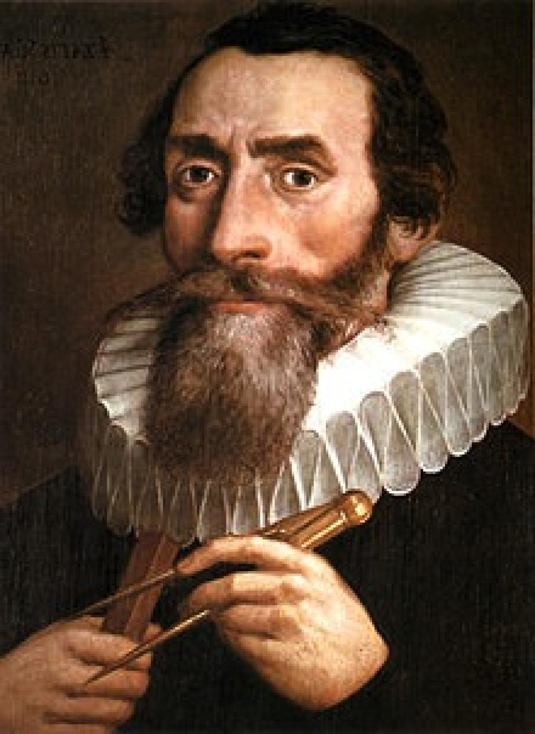
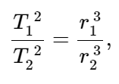
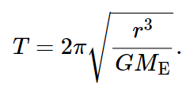
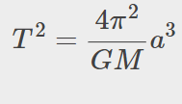
Kepler’s laws of planetary motion
Kepler’s Third Law
The ratio of the squares of the periods of any two planets about the Sun is equal to the ratio of the cubes of their average distances from the Sun. In equation form, this is
where T is the period (time for one orbit) and r is the average radius.
We derived Kepler’s third law for the special case of a circular orbit. The period of a circular orbit of radius r about Earth:

Slide 18
Derivation of Kepler’s third law for a circular orbit

Slide 19
Example: period of a satellite
Given that the Moon orbits Earth each 27.3 d and that it is an average distance of 3.84×10⁸m from the center of Earth, calculate the period of an artificial satellite orbiting at an average altitude of 1500 km above Earth’s surface.

Slide 20
Einstein’s theory of gravitation
In 1905, Albert Einstein published his theory of special relativity.
In this theory, no motion can exceed the speed of light—it is the speed limit of the Universe. This simple fact has been verified in countless experiments. However, it has incredible consequences—space and time are no longer absolute.
Two people moving relative to one another do not agree on the length of objects or the passage of time.
This speed limit on the Universe was also a challenge to the inherent assumption in Newton’s law of gravitation that gravity is an action-at-a-distance force.
That is, without physical contact, any change in the position of one mass is instantly communicated to all other masses. This assumption does not come from any first principle, as Newton’s theory simply does not address the question. (The same was believed of electromagnetic forces, as well. It is fair to say that most scientists were not completely comfortable with the action-at-a-distance concept.)

Slide 21
Einstein’s theory of gravity
A second assumption also appears in Newton’s law of gravitation.
The masses are assumed to be exactly the same as those used in Newton’s second law.
There is no underlying principle that this must be, but experimental results are consistent with this assumption.
In Einstein’s subsequent theory of general relativity (1916), both of these issues were addressed. His theory was a theory of space-time geometry and how mass (and acceleration) distort and interact with that space-time.

Slide 22
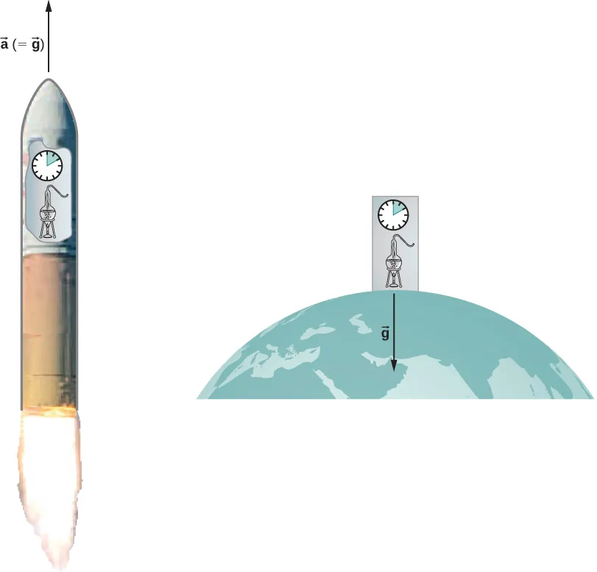
The principle of equivalence
Einstein came to his general theory in part by wondering why someone who was free falling did not feel their weight.
In Einstein’s general theory, there is no difference between free fall and being weightless.
Within a reasonably sized laboratory on Earth, the gravitational field g⃗ is essentially uniform. The principle of equivalence states that any physical experiments performed there have the identical results as those done in a laboratory accelerating at a⃗ =g⃗ in deep space, well away from all other masses.
Gravitation is not a force between two objects but is the result of each object responding to the effect that the other has on the space-time surrounding it. A uniform gravitational field and a uniform acceleration have exactly the same effect on space-time.

Slide 23
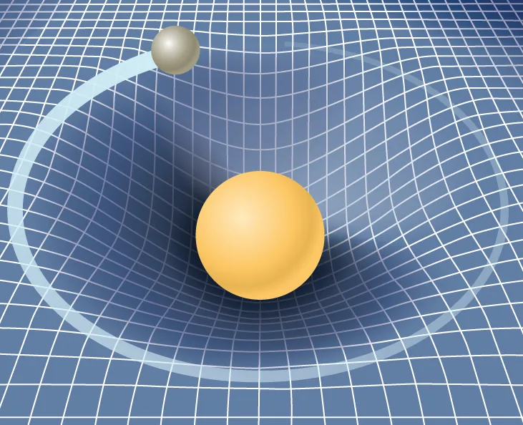
A geometric theory of gravity
Euclidian geometry assumes a “flat” space in which, among the most commonly known attributes, a straight line is the shortest distance between two points, the sum of the angles of all triangles must be 180 degrees, and parallel lines never intersect.
Non-Euclidean geometry was not seriously investigated until the nineteenth century, so it is not surprising that Euclidean space is inherently assumed in all of Newton’s laws.
The general theory of relativity challenges this long-held assumption. Only empty space is flat. The presence of mass—or energy, since relativity does not distinguish between the two—distorts or curves space and time, or space-time, around it. The motion of any other mass is simply a response to this curved space-time.
A smaller mass orbiting in the distorted space-time of a larger mass. In fact, all mass or energy distorts space-time.

Slide 24
Black holes
Einstein’s theory of gravitation is expressed in one deceptively simple-looking tensor equation (tensors are a generalization of scalars and vectors), which expresses how a mass determines the curvature of space-time around it. The solutions to that equation yield one of the most fascinating predictions: the black hole. The prediction is that if an object is sufficiently dense, it will collapse in upon itself and be surrounded by an event horizon from which nothing can escape. The name “black hole,” which was coined by astronomer John Wheeler in 1969, refers to the fact that light cannot escape such an object. Karl Schwarzschild was the first person to note this phenomenon in 1916, but at that time, it was considered mostly to be a mathematical curiosity.

