Slide 1
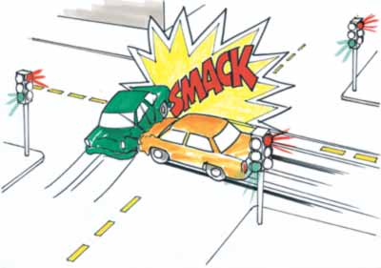


LINEAR momentum and impulse

Slide 2
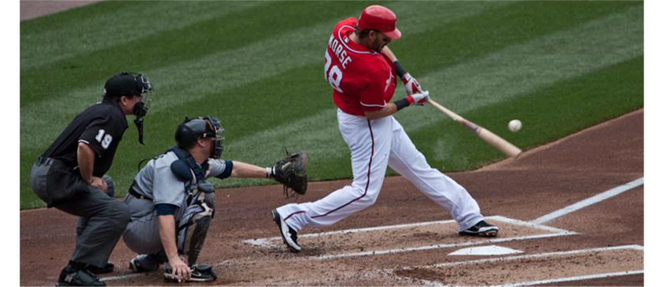
The need for linear momentum and impulse
In many situations, such as a bat hitting a ball, we cannot use Newton’s second law to solve problems because we know very little about the complicated forces involved.
Let’s introduce momentum and impulse, and the conservation of momentum, to solve such problems.
The law of conservation of momentum is valid even in
situations when Newton’s second law is not applicable,
such as bodies moving at high speeds or objects on a
very small scale

Slide 3

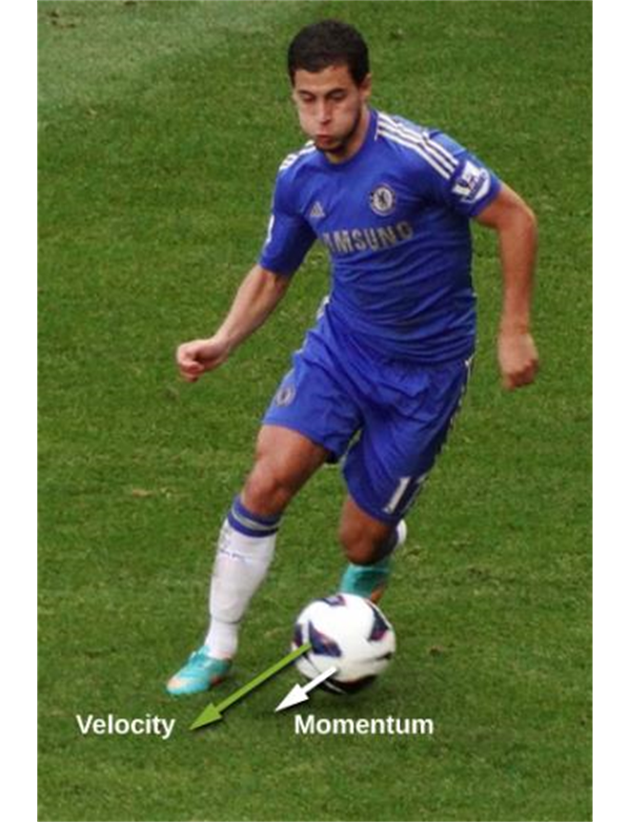
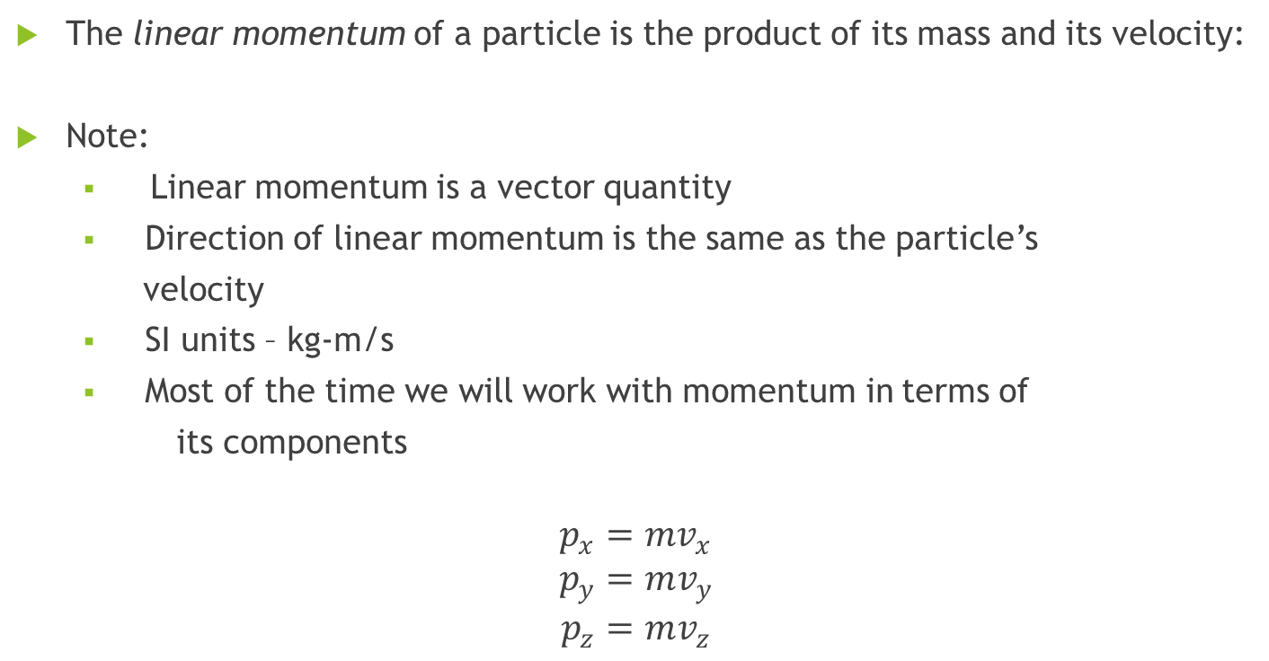
Linear momentum, definition
The linear momentum of a particle is the product of its mass and its velocity:
Note:
  Linear momentum is a vector quantity
  Direction of linear momentum is the same as the particle’s
  velocity
  SI units – kg-m/s
  Most of the time we will work with momentum in terms of
its components
$p_{x}=mv_{x}$
$$p_{y}=mv_{y}$$
$$p_{z}=mv_{z}$$

Slide 4
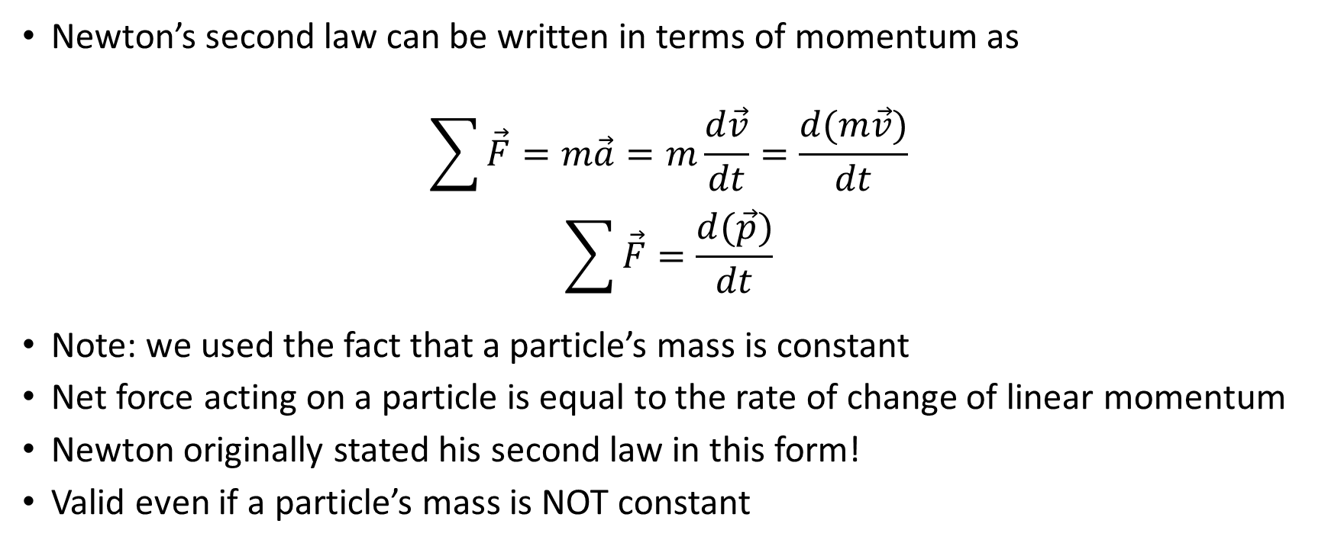
Newton’s second law and linear momentum
Newton’s second law can be written in terms of momentum as
$$\sum{\vec{F}}=m\vec{a}=m\frac{d\vec{v}}{dt}=\frac{d(m\vec{v})}{dt}$$
$$\sum{\vec{F}}=\frac{d(\vec{p})}{dt}$$
Note: we used the fact that a particle’s mass is constant
Net force acting on a particle is equal to the rate of change of linear momentum
Newton originally stated his second law in this form!
Valid even if a particle’s mass is NOT constant

Slide 5
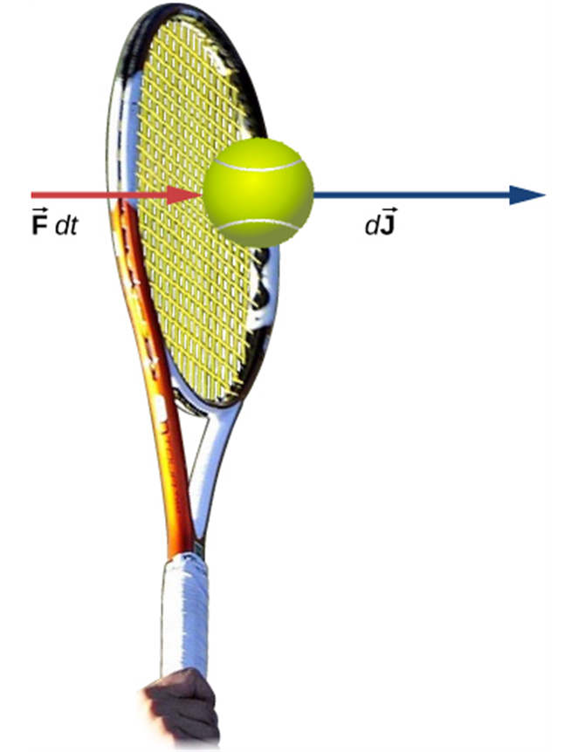
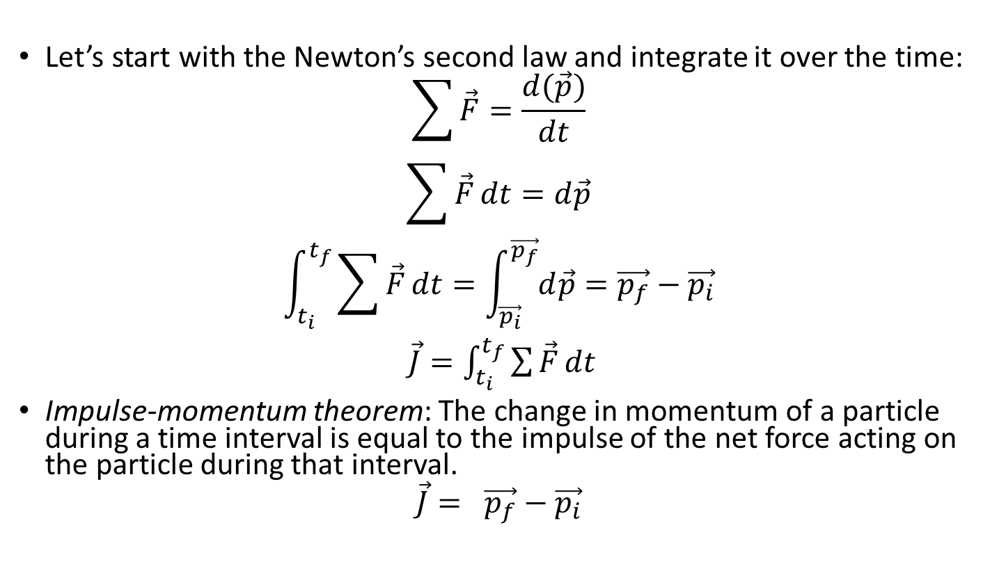
Impulse and impulse-momentum theorem
Let’s start with the Newton’s second law and integrate it over the time:
$$\sum{\vec{F}}=\frac{d(\vec{p})}{dt}$$
$$\sum{\vec{F}}dt=d\vec{p}$$
$$\int_{t_{i}}^{t_{f}}{\sum{\vec{F}}dt}=\int_{\vec{p_{i}}}^{\vec{p_{f}}}{d\vec{p}}=\vec{p_{f}}−\vec{p_{i}}$$
$\vec{J}=\int_{t_{i}}^{t_{f}}{\sum{\vec{F}}dt}$
Impulse-momentum theorem: The change in momentum of a particle during a time interval is equal to the impulse of the net force acting on the particle during that interval.
$$\vec{J}= \vec{p_{f}}−\vec{p_{i}}$$

Slide 6
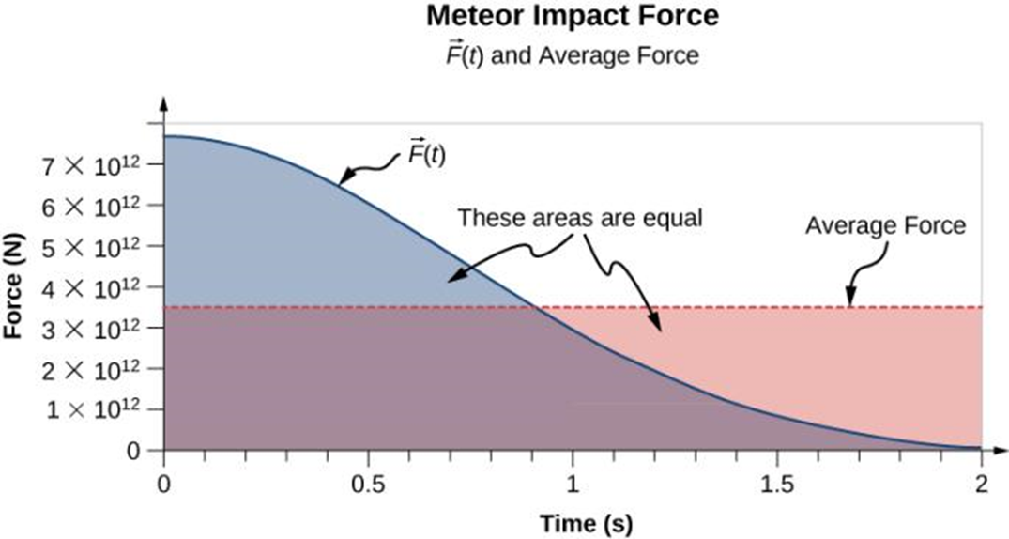
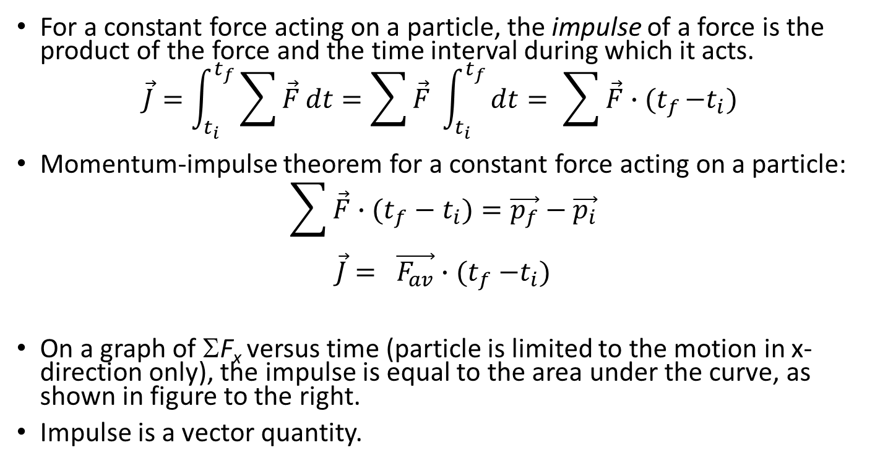
Impulse, details
For a constant force acting on a particle, the impulse of a force is the product of the force and the time interval during which it acts.
$$\vec{J}=\int_{t_{i}}^{t_{f}}{\sum{\vec{F}}dt}=\sum{\vec{F}} \int_{t_{i}}^{t_{f}}{dt={ \sum{\vec{F}}∙(t}_{f}−t_{i}) }$$
Momentum-impulse theorem for a constant force acting on a particle:
$${\sum{\vec{F}}∙(t}_{f}−t_{i})=\vec{p_{f}}−\vec{p_{i}}$$
$$\vec{J}= \vec{F_{av}}{∙(t}_{f}−t_{i})$$
On a graph of ΣF_{x} versus time (particle is limited to the motion in x-direction only), the impulse is equal to the area under the curve, as shown in figure to the right.
Impulse is a vector quantity.

Slide 7
Momentum and kinetic energy
Changes in momentum depend on time over which the net force acts, but changes in kinetic energy depend on the distance over which the net force acts.
Momentum is a vector while kinetic energy is a scalar.
What if you need to catch a 0.50 kg ball moving with a 4.0 m/s speed
or a 0.10 kg ball moving at 20.0 m/s?
Note that the momenta are the same while the kinetic energies are not.
Impulse required to stop a ball is the same in each case, but work is not!

Slide 8
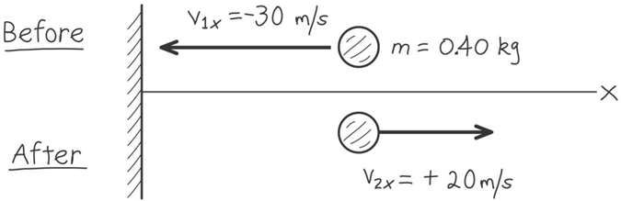
Let’s consider an example
Suppose you throw a ball with a mass of 0.40 kg against a brick wall. It hits the wall moving horizontally and to the left at 30 m/s and rebounds horizontally and to the right at 20 m/s. Find the impulse of the net force on the ball during the collision. If the ball is in contact with the wall for 0.010 s, find the average horizontal force that the wall exerts on the ball during the impact.

