Slide 1
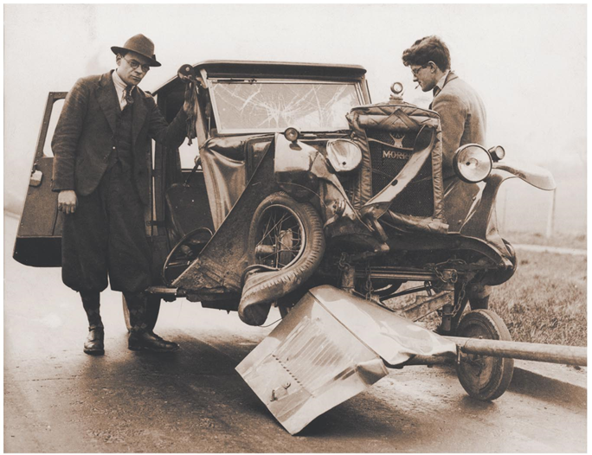


CONSERVATION OF LINEAR momentum

Slide 2
Concept of an isolated system
Isolated system - the one in which objects interact only
with each other but not with anything else.
Internal forces – the forces that particles of a system
exert on each other.
Note that the internal forces exist in Newton’s 3rd Law
pairs

Slide 3
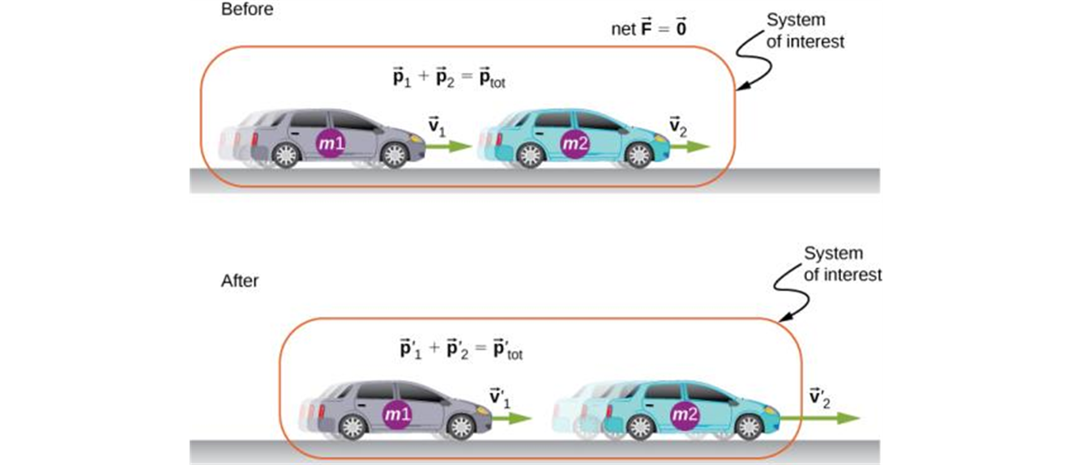
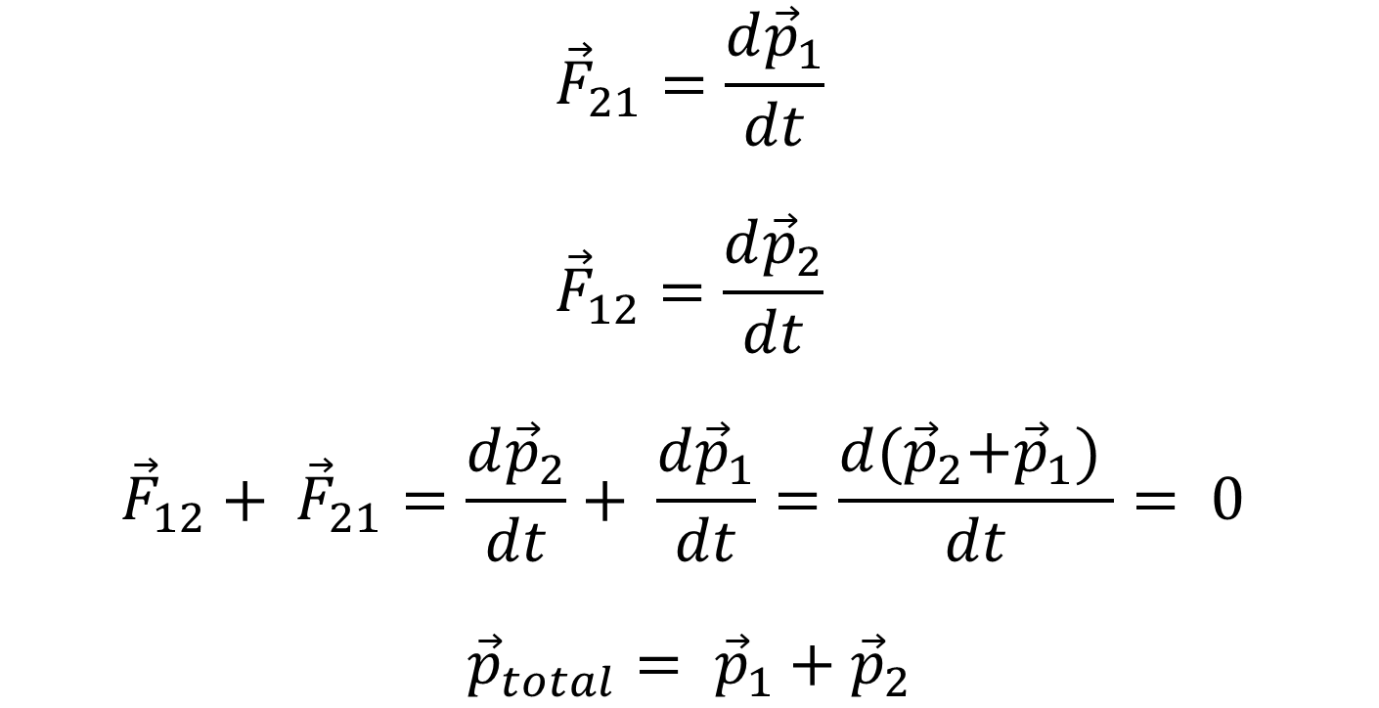
Principle of conservation of linear momentum
$${\vec{F}}_{21}=\frac{d{\vec{p}}_{1}}{dt}$$
$${\vec{F}}_{12}=\frac{d{\vec{p}}_{2}}{dt}$$
$${\vec{F}}_{12}+ {\vec{F}}_{21}=\frac{d{\vec{p}}_{2}}{dt}+ \frac{d{\vec{p}}_{1}}{dt}=\frac{d{(\vec{p}}_{2}+{\vec{p}}_{1}) }{dt}= 0$$
$${\vec{p}}_{total}= {\vec{p}}_{1}+{\vec{p}}_{2}$$
The two cars together form the system that is to be analyzed. It is important to remember that the contents (the mass) of the system do not change before, during, or after the objects in the system interact.

Slide 4
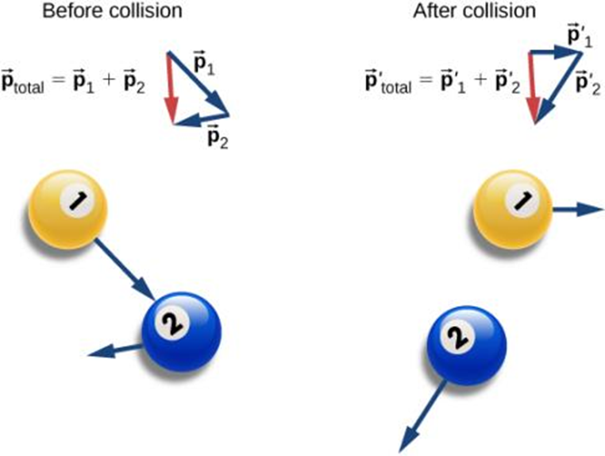
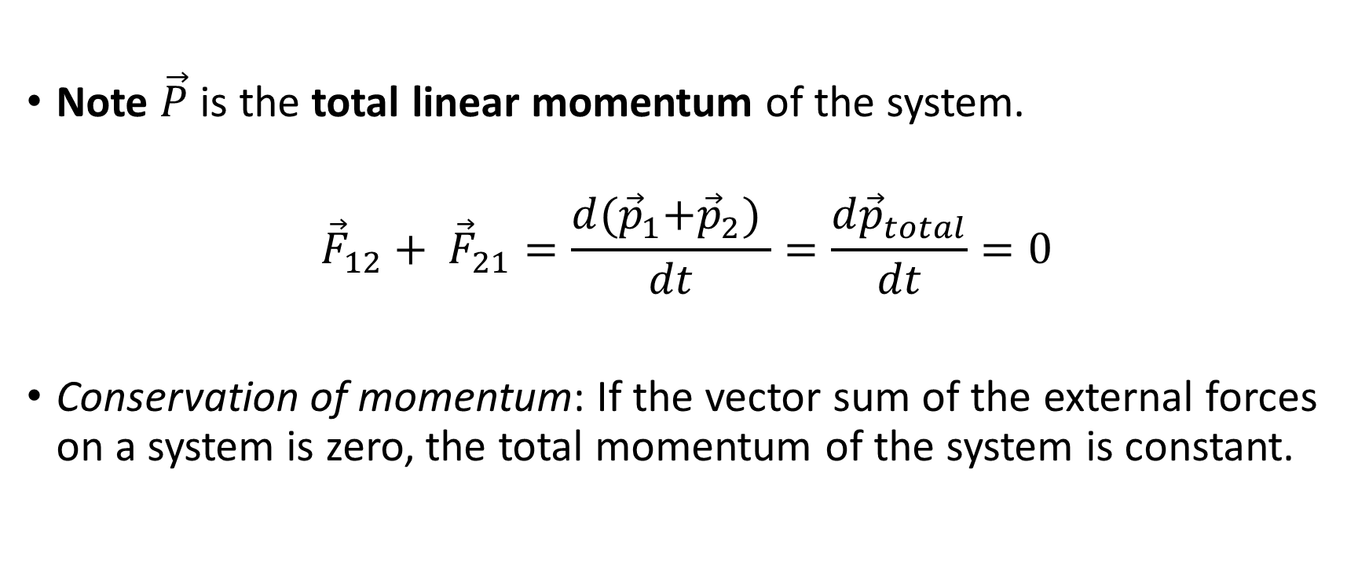
Principle of conservation of momentum, continued
Note $\vec{P}$ is the total linear momentum of the system.
$${\vec{F}}_{12}+ {\vec{F}}_{21}=\frac{d{(\vec{p}}_{1}+{\vec{p}}_{2}) }{dt}=\frac{d{\vec{p}}_{total}}{dt}=0$$
Conservation of momentum: If the vector sum of the external forces on a system is zero, the total momentum of the system is constant.

Slide 5
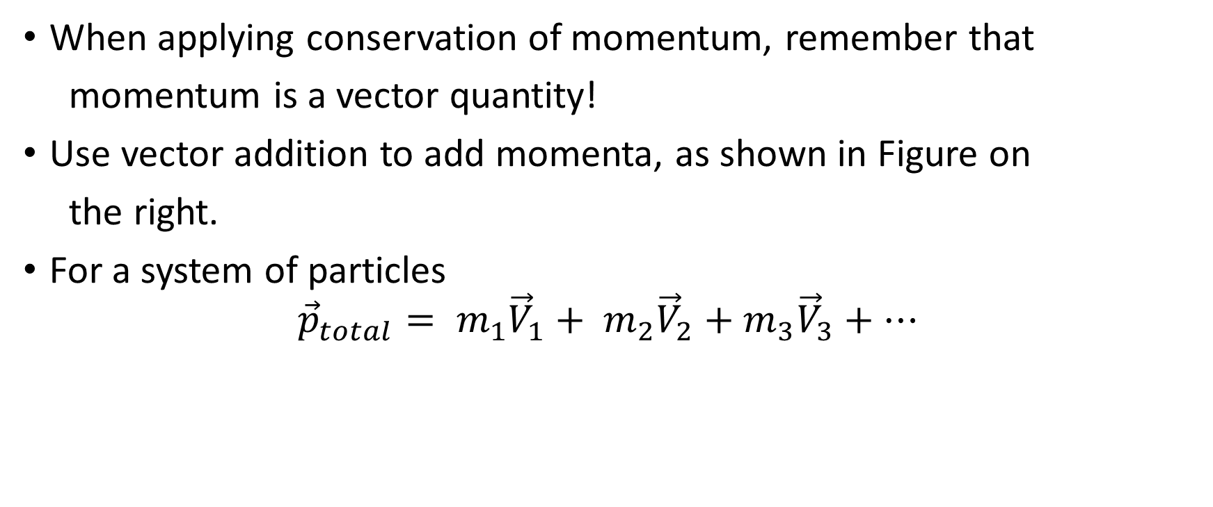
Notes on the Conservation of Momentum
When applying conservation of momentum, remember that
momentum is a vector quantity!
Use vector addition to add momenta, as shown in Figure on
the right.
For a system of particles
$${{\vec{p}}_{total}= m}_{1}{\vec{V}}_{1}+ m_{2}{\vec{V}}_{2}+m_{3}{\vec{V}}_{3}+…$$

Slide 6
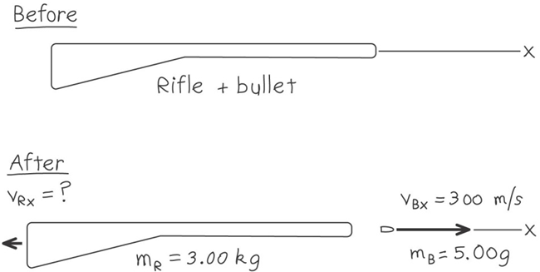
Recoil of a rifle, example
A marksman holds a rifle of mass m_{R} = 3.00 kg loosely in his hands, so as to let it recoil freely when fired. He fires a bullet of mass m_{B} = 5.00 g horizontally with a velocity relative to the ground of v_{B} = 300 m/s. What is the recoil velocity of a rifle? What are the final kinetic energy and momentum of the bullet? Of the rifle?

