Slide 1
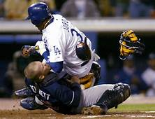


COLLISIONS

Slide 2
Collisions: major assumptions
Collision – any strong interaction between bodies that lasts relatively short time.
If the forces between the bodies are much stronger than any external forces, as is the case in most collisions, we can neglect the external forces entirely and treat the colliding bodies as an isolated system.
Total momentum of the system must be conserved in any collision.
If the forces between the bodies are also conservative, the total kinetic energy of the system Is conserved (elastic collisions).
A collision in which the kinetic energy is not conserved is called inelastic collision.
In any collision in which external forces can be neglected, total linear momentum is conserved, that is the total momentum before collision is equal to the total momentum after collision. Kinetic energy may or may not be conserved.

Slide 3
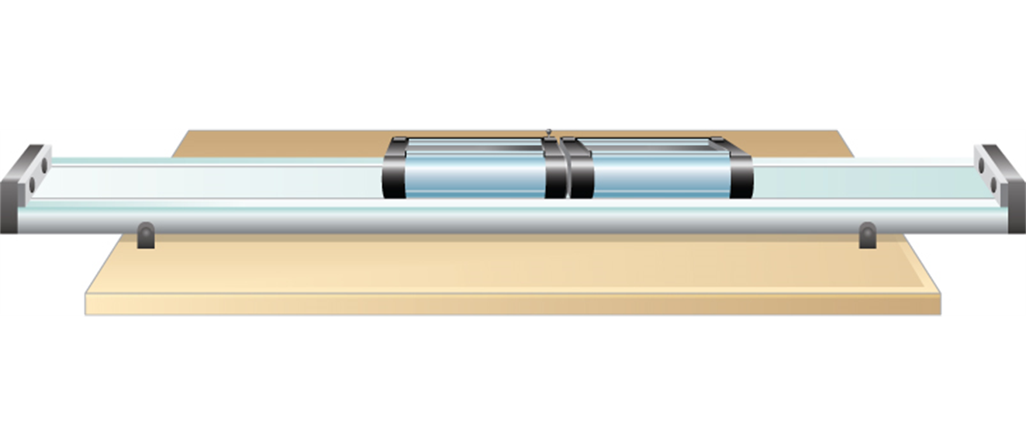
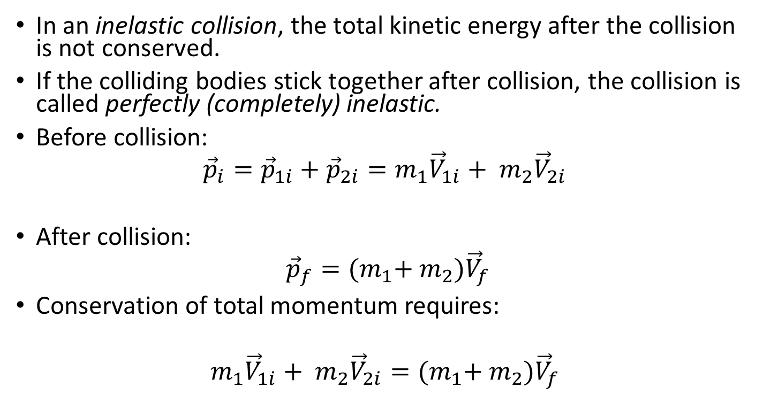
Inelastic collisions
In an inelastic collision, the total kinetic energy after the collision is not conserved.
If the colliding bodies stick together after collision, the collision is called perfectly (completely) inelastic.
Before collision:
$${\vec{p}}_{i}={\vec{p}}_{1i}+{\vec{p}}_{2i}=m_{1}{\vec{V}}_{1i}+ m_{2}{\vec{V}}_{2i}$$
After collision:
$${\vec{p}}_{f}={(m}_{1}+ m_{2}){\vec{V}}_{f}$$
Conservation of total momentum requires:
$$m_{1}{\vec{V}}_{1i}+ m_{2}{\vec{V}}_{2i}={(m}_{1}+ m_{2}){\vec{V}}_{f}$$
Two lab carts collide and stick together after the collision.

Slide 4
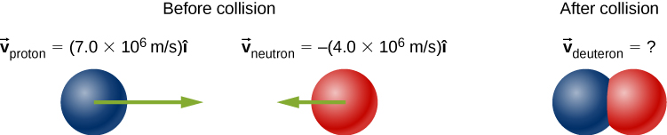
Perfectly inelastic collision, example

Slide 5
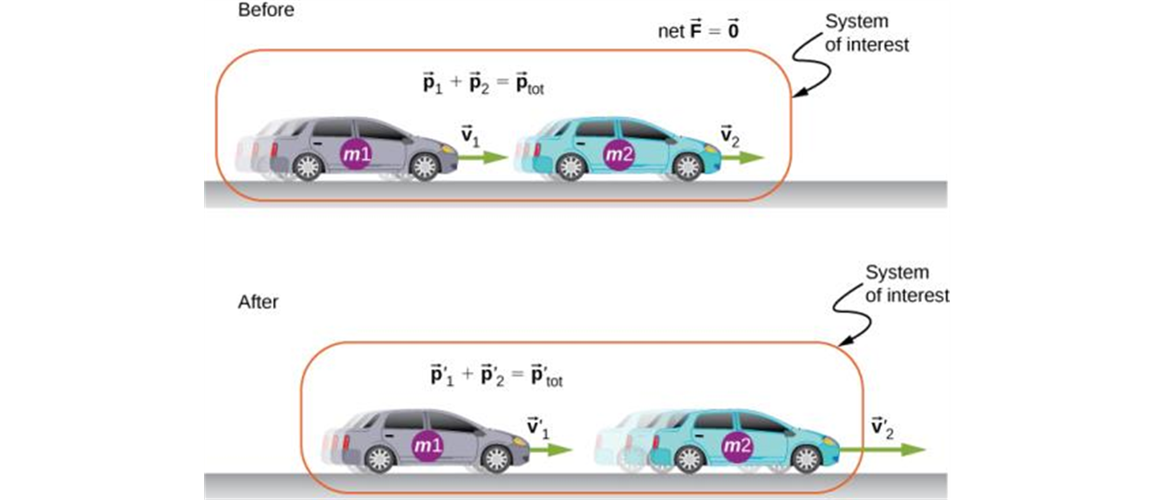
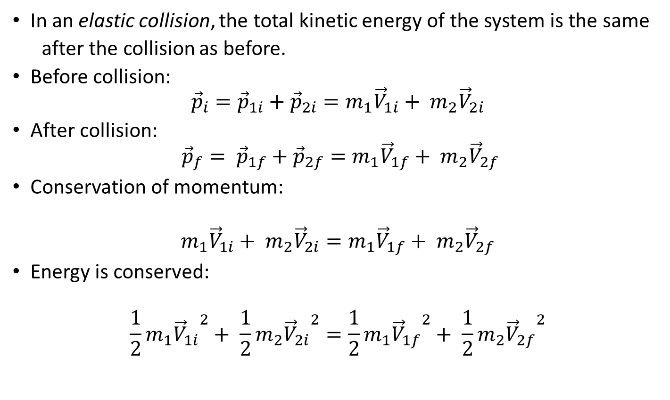
Elastic collisions
In an elastic collision, the total kinetic energy of the system is the same
after the collision as before.
Before collision:
$${\vec{p}}_{i}={\vec{p}}_{1i}+{\vec{p}}_{2i}=m_{1}{\vec{V}}_{1i}+ m_{2}{\vec{V}}_{2i}$$
After collision:
$${\vec{p}}_{f}= {\vec{p}}_{1f}+{\vec{p}}_{2f}=m_{1}{\vec{V}}_{1f}+ m_{2}{\vec{V}}_{2f}$$
Conservation of momentum:
$$m_{1}{\vec{V}}_{1i}+ m_{2}{\vec{V}}_{2i}=m_{1}{\vec{V}}_{1f}+ m_{2}{\vec{V}}_{2f}$$
Energy is conserved:
$${\frac{1}{2}m}_{1}{{\vec{V}}_{1i}}^{2}+ {\frac{1}{2}m}_{2}{{\vec{V}}_{2i}}^{2}={\frac{1}{2}m}_{1}{{\vec{V}}_{1f}}^{2}+ {\frac{1}{2}m}_{2}{{\vec{V}}_{2f}}^{2}$$

Slide 6
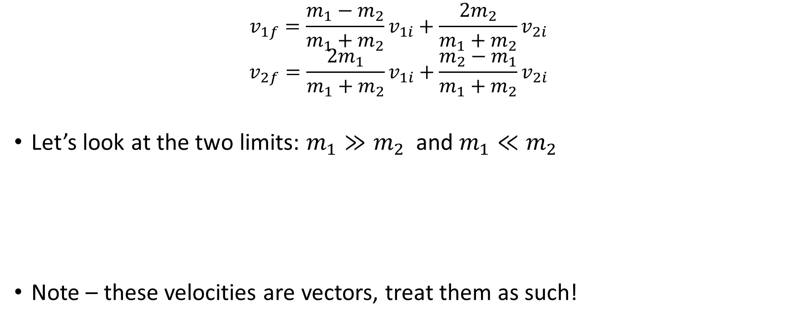
Head-on (1D) elastic collisions
$$v_{1f}=\frac{m_{1}−m_{2}}{m_{1}+m_{2}}v_{1i}+\frac{2m_{2}}{m_{1}+m_{2}}v_{2i}$$
$$v_{2f}=\frac{2m_{1}}{m_{1}+m_{2}}v_{1i}+\frac{m_{2}−m_{1}}{m_{1}+m_{2}}v_{2i}$$
Let’s look at the two limits: $m_{1}≫m_{2}$ and $m_{1}≪m_{2}$
Note – these velocities are vectors, treat them as such!

Slide 7
Head-on (1D) elastic collisions, another interesting case
What if the two masses are equal to each other and one of the objects is stationary before impact?

Slide 8
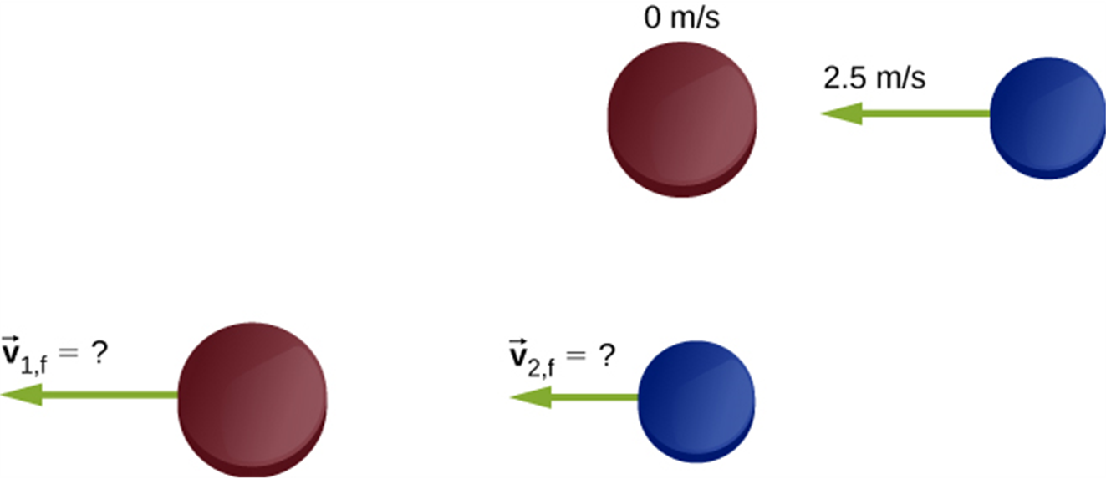
Elastic collisions, an example
Two different hockey pucks colliding. The top diagram shows the pucks the instant before the collision, and the bottom diagram show the pucks the instant after the collision. The net external force is zero.

