Slide 1
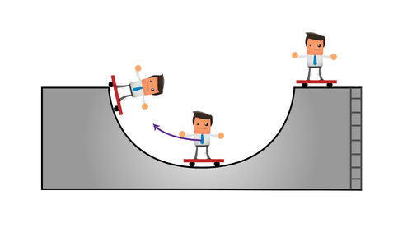


POTENTIAL ENERGY AND ENERGY CONSERVATION I

Slide 2
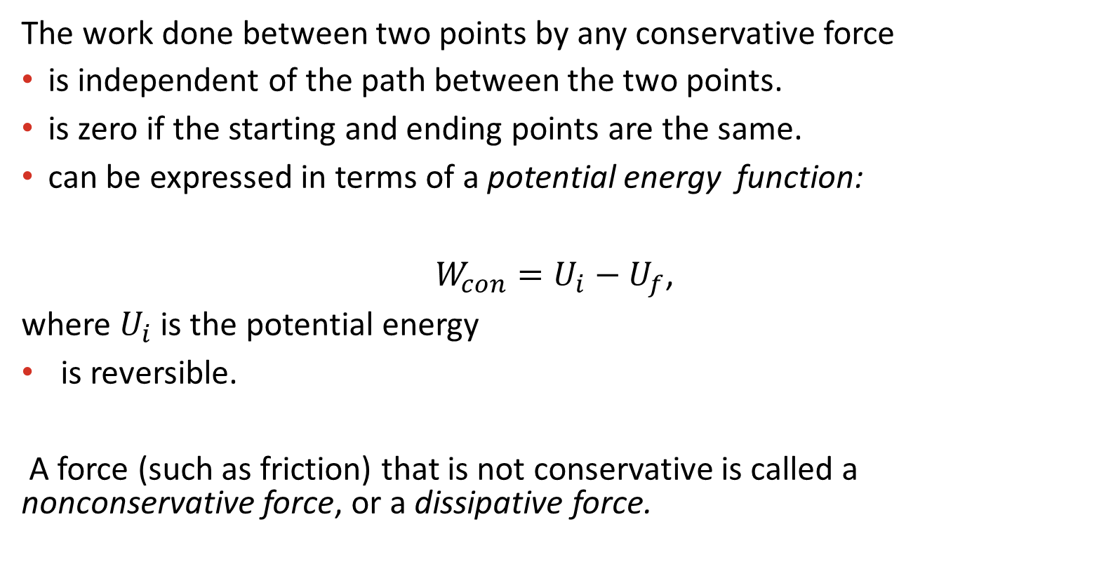
Conservative and nonconservative forces
The work done between two points by any conservative force
is independent of the path between the two points.
is zero if the starting and ending points are the same.
can be expressed in terms of a potential energy function:
$W_{con}=U_{i}−U_{f}$,
where $U_{i}$ is the potential energy
is reversible.
A force (such as friction) that is not conservative is called a nonconservative force, or a dissipative force.
Examples of conservative forces: gravitational and spring

Slide 3
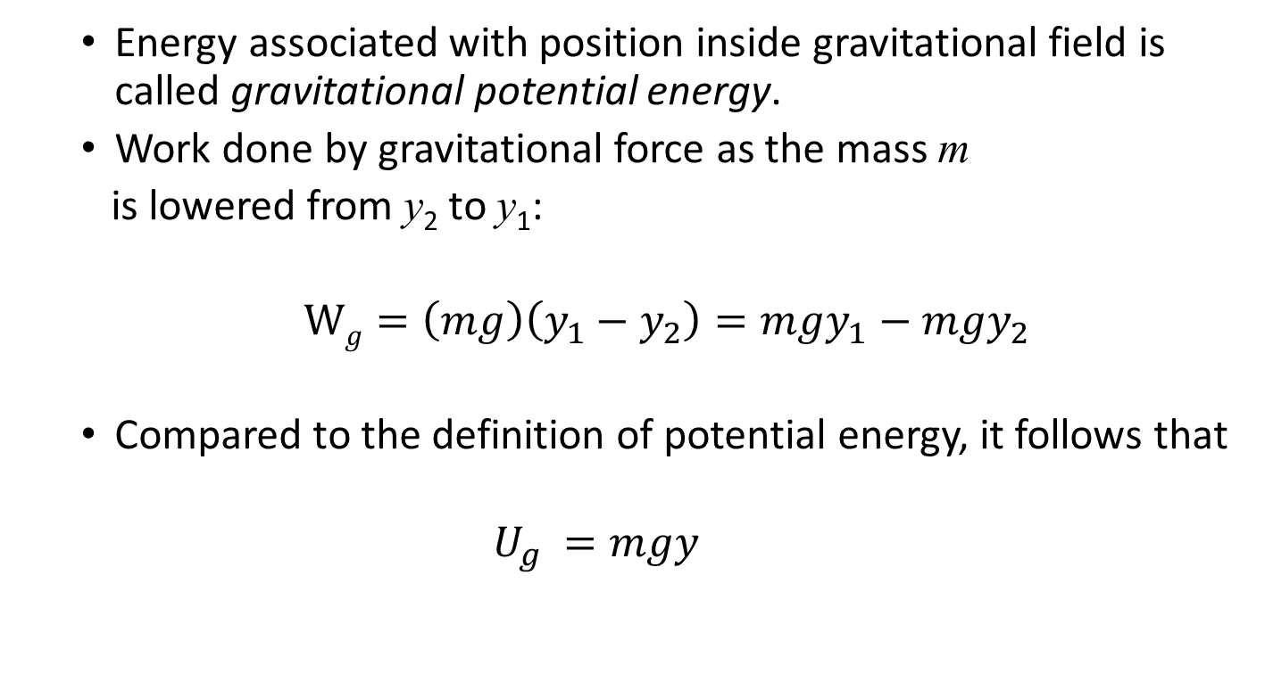
_{Gravitational potential energy}
  Energy associated with position inside gravitational field is called gravitational potential energy.
  Work done by gravitational force as the mass m
  is lowered from y₂ to y₁:
  $Wg=\left(mg\right)\left(y_{1}−y_{2}\right)=mgy_{1}−mgy_{2}$
  Compared to the definition of potential energy, it follows that
  $$U_{g }=mgy$$

Slide 4
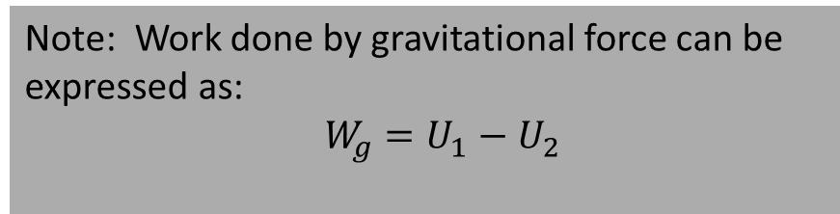
Gravitational potential energy, continued
Gravitational potential energy is a scalar.
SI units of gravitational potential energy are joules (see the definition)
Gravitational potential energy is shared between a body and the Earth.
Zero level of gravitational potential energy is arbitrary since only the change in potential energy has physical meaning.
Could be positive, negative, or zero.
We can use the same expression for gravitational potential energy whether the body’s path is curved or straight.
Note: Work done by gravitational force can be expressed as:
$$W_{g}=U_{1}−U_{2}$$

Slide 5
Concept of a system
A system is a portion of the universe that has been chosen for studying the changes that take place within it in response to varying conditions. A system may be complex, such as a planet, or relatively simple, as the liquid within a glass. – Encyclopedia Britannica
A region in space
A body
A collection of bodies
Has a boundary which clearly separates the system and its surroundings.
May exchange energy with its surroundings through:
  Work done on the system by its surroundings
  Heat transfer
  Radiant energy
  Electrical energy flow (current)
  Mass transfer
An isolated system is the one that does NOT exchange energy with its environment.

Slide 6
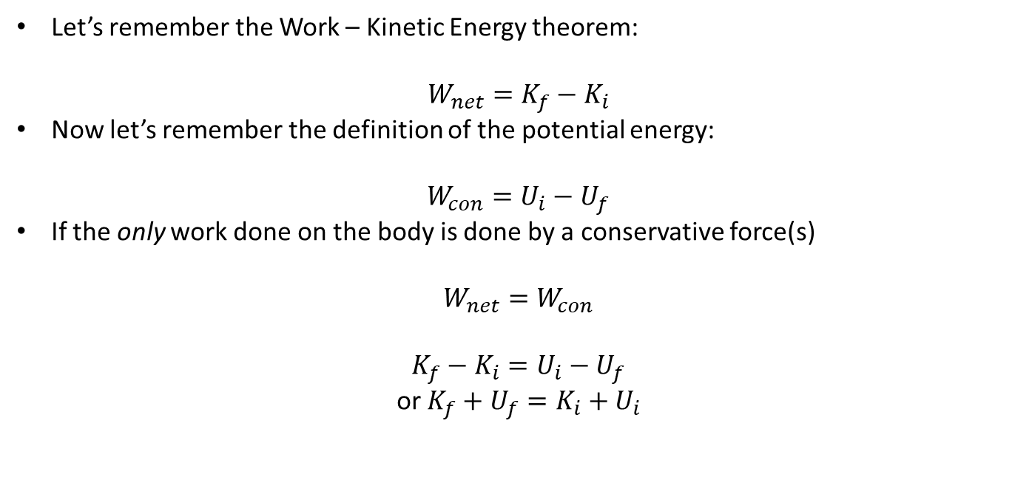
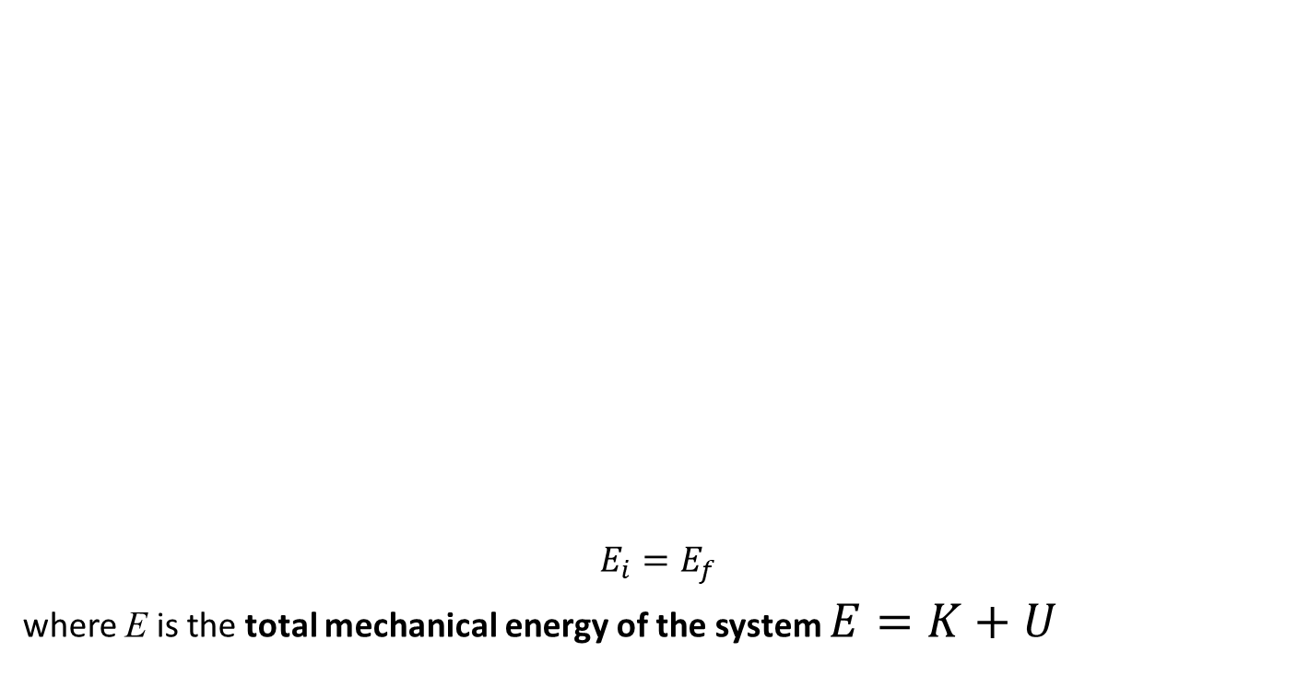
Conservation of mechanical energy
Let’s remember the Work – Kinetic Energy theorem:
$$W_{net}=K_{f}−K_{i}$$
Now let’s remember the definition of the potential energy:
$W_{con}=U_{i}−U_{f}$
If the only work done on the body is done by a conservative force(s)
$$W_{net}=W_{con}$$
$K_{f}−K_{i}=U_{i}−U_{f}$
or $K_{f}+U_{f}=K_{i}+U_{i}$
$E_{i}=E_{f}$
where E is the total mechanical energy of the system $E=K+U$
Total mechanical energy of an isolated system is conserved if the only forces acting within the system are conservative.

Slide 7
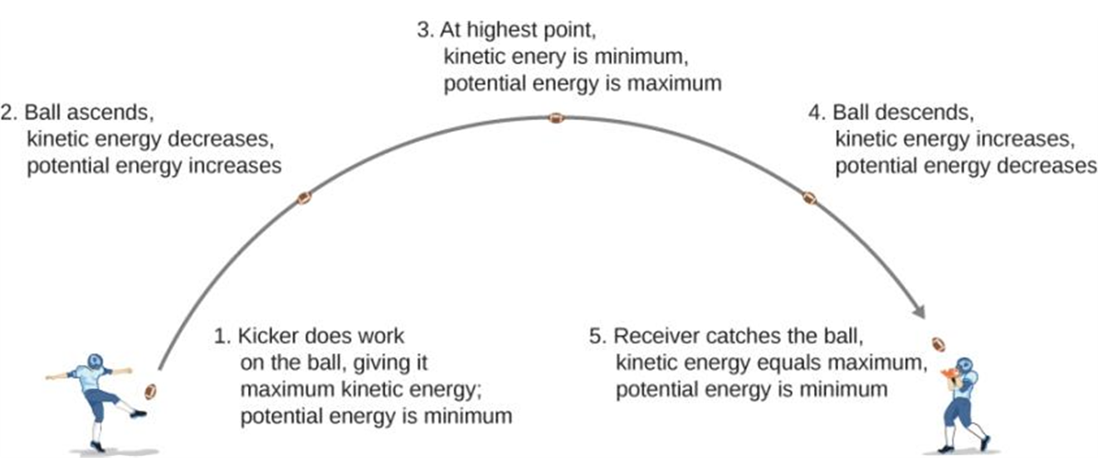
Example of energy conservation
As a football starts its descent toward the wide receiver, gravitational potential energy is converted back into kinetic energy.

