Slide 1



WORK DONE BY VARYING FORCE

Slide 2
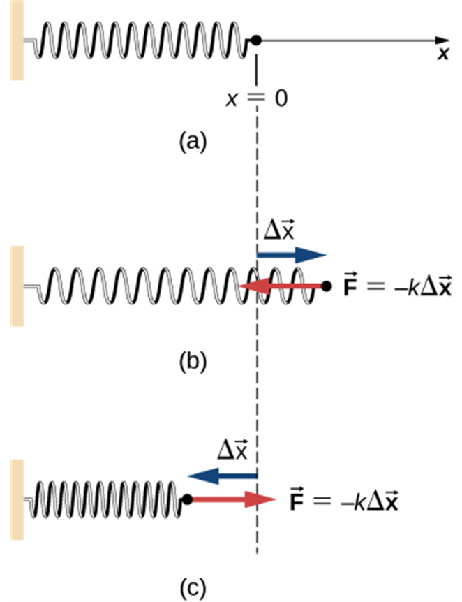
Work done by varying force
Many forces, such as the force to stretch
a spring, are not constant.
We approximate the work by dividing
the total displacement into many small
segments.
(a) The spring exerts no force at its equilibrium position. The spring exerts a force in the opposite direction to (b) an extension or stretch, and (c) a compression.

Slide 3
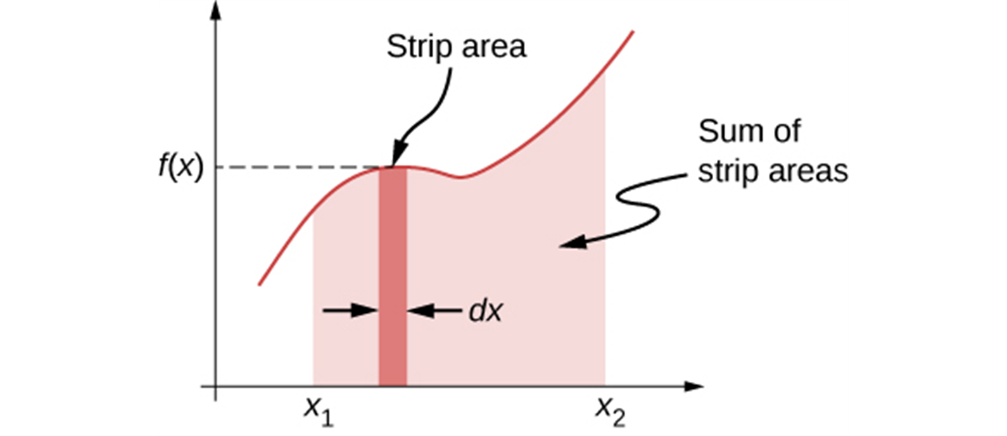
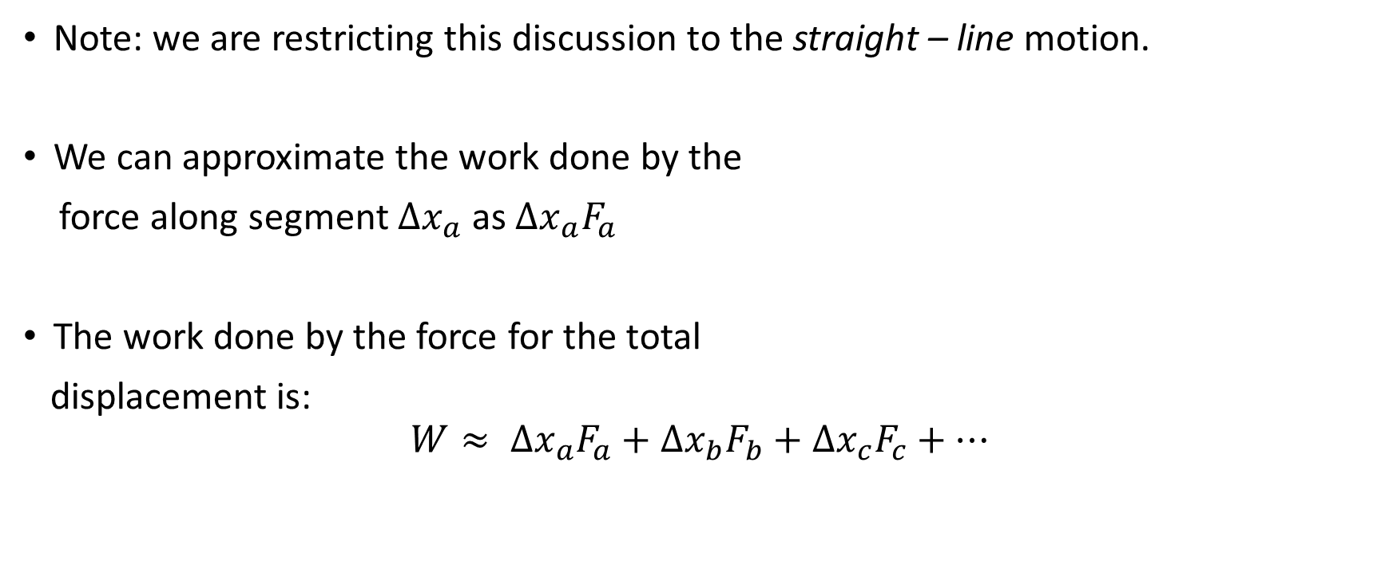
Work done by varying force, approximation
Note: we are restricting this discussion to the straight – line motion.
We can approximate the work done by the
force along segment $Δx_{a}$ as $Δx_{a}F_{a}$
The work done by the force for the total
displacement is:
$$W≈ Δx_{a}F_{a}+Δx_{b}F_{b}+Δx_{c}F_{c}+…$$

Slide 4
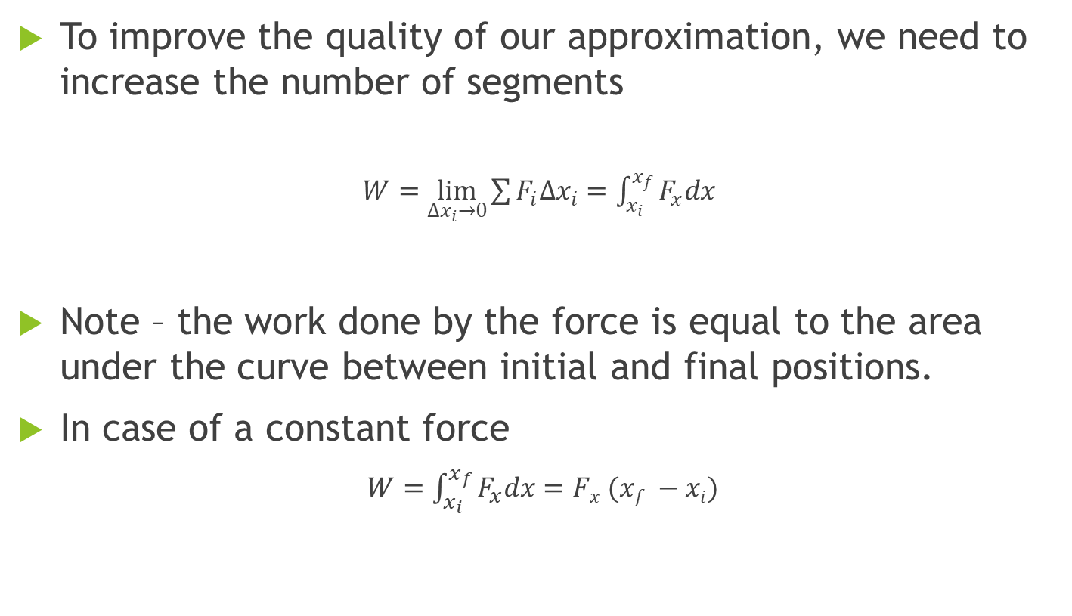
Work done by varying force, an integral
To improve the quality of our approximation, we need to increase the number of segments
$W=\lim_{∆x_{i}→0}{\sum{F_{i}∆x_{i}}}=\int_{x_{i}}^{x_{f}}{F_{x}dx}$
Note – the work done by the force is equal to the area under the curve between initial and final positions.
In case of a constant force
$W=\int_{x_{i}}^{x_{f}}{F_{x}dx=Fx (xf −xi)}$

Slide 5
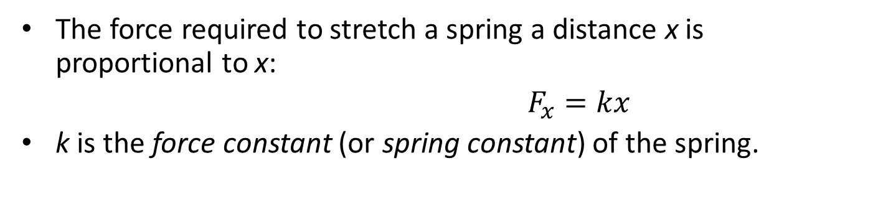
Work done by spring force
Note: the SI unit of spring constant is N/m
  The force required to stretch a spring a distance x is proportional to x:
  $F_{x}=kx$
  k is the force constant (or spring constant) of the spring.
(a) The spring exerts no force at its equilibrium position. The spring exerts a force in the opposite direction to (b) an extension or stretch, and (c) a compression.

Slide 6
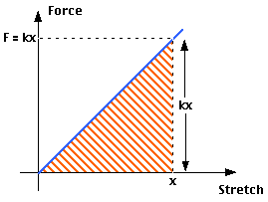
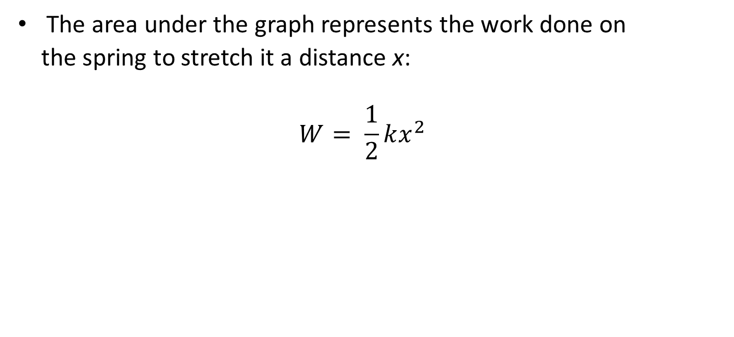
Work done by spring force, continued
  The area under the graph represents the work done on
  the spring to stretch it a distance x:
  $$W= \frac{1}{2}kx^{2}$$

Slide 7
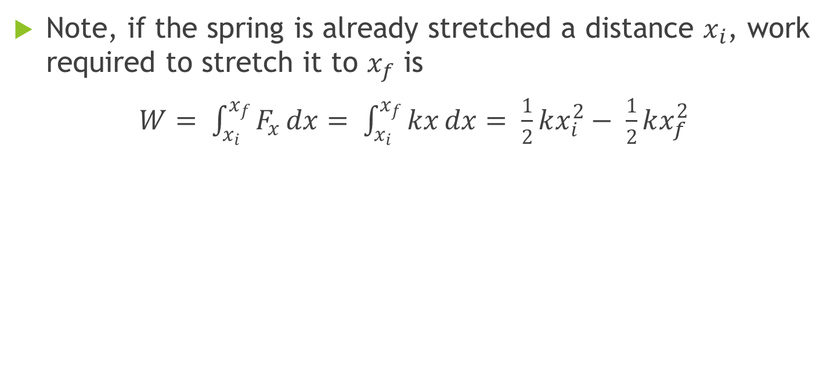
Work needed to stretch a spring
Note, if the spring is already stretched a distance $x_{i}$, work required to stretch it to $x_{f}$ is
$W= \int_{x_{i}}^{x_{f}}{F_{x}}dx= \int_{x_{i}}^{x_{f}}{kx}dx= \frac{1}{2}kx_{i}^{2}− \frac{1}{2}kx_{f}^{2}$

Slide 8
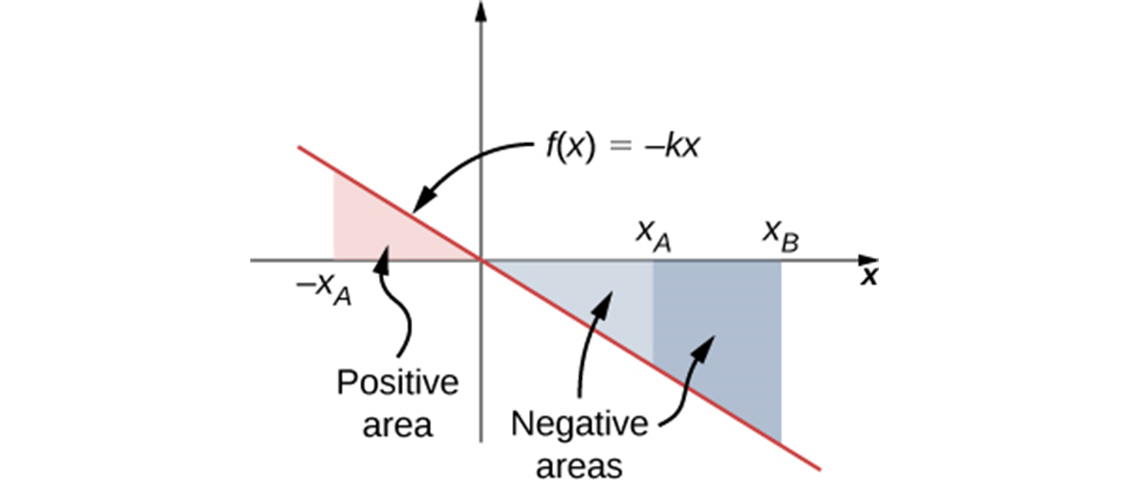
Graphical interpretation of work
Curve of the spring force f (x) = −kx versus x, showing areas under the line, between x_{A} and x_{B} , for both positive and negative values of x_{A} . When x_{A} is negative, the total area under the curve for the integral in is the sum of positive and negative triangular areas. When x_{A} is positive, the total area under the curve is the difference between two negative triangles.

