Slide 1
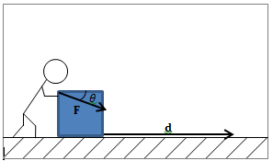

WORK AND KINETIC ENERGY THEOREM

Slide 2
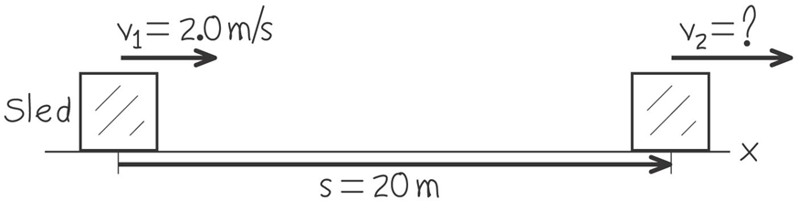
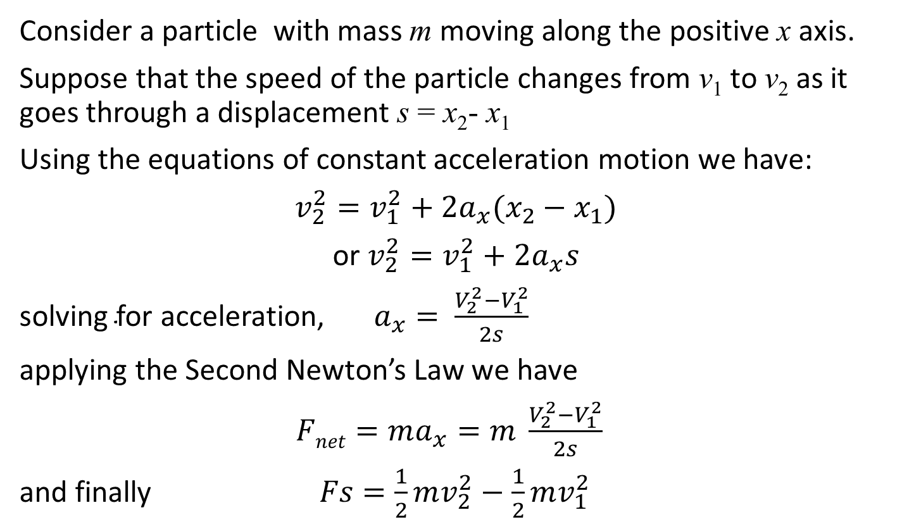
Let’s see how work done on a particle changes its speed
Consider a particle with mass m moving along the positive x axis.
Suppose that the speed of the particle changes from v₁ to v₂ as it goes through a displacement s = x₂- x₁
Using the equations of constant acceleration motion we have:
$v_{2}^{2}=v_{1}^{2}+2a_{x}(x_{2}−x_{1})$
or $v_{2}^{2}=v_{1}^{2}+2a_{x}s$
${\text{solving} \text{for} \text{acceleration}\text{,} a}_{x}= \frac{V_{2}^{2}−V_{1}^{2}}{2s}$
applying the Second Newton’s Law we have
$Fnet=ma_{x}=m \frac{V_{2}^{2}−V_{1}^{2}}{2s}$
and finally $Fs=\frac{1}{2}mv_{2}^{2}−\frac{1}{2}mv_{1}^{2}$

Slide 3
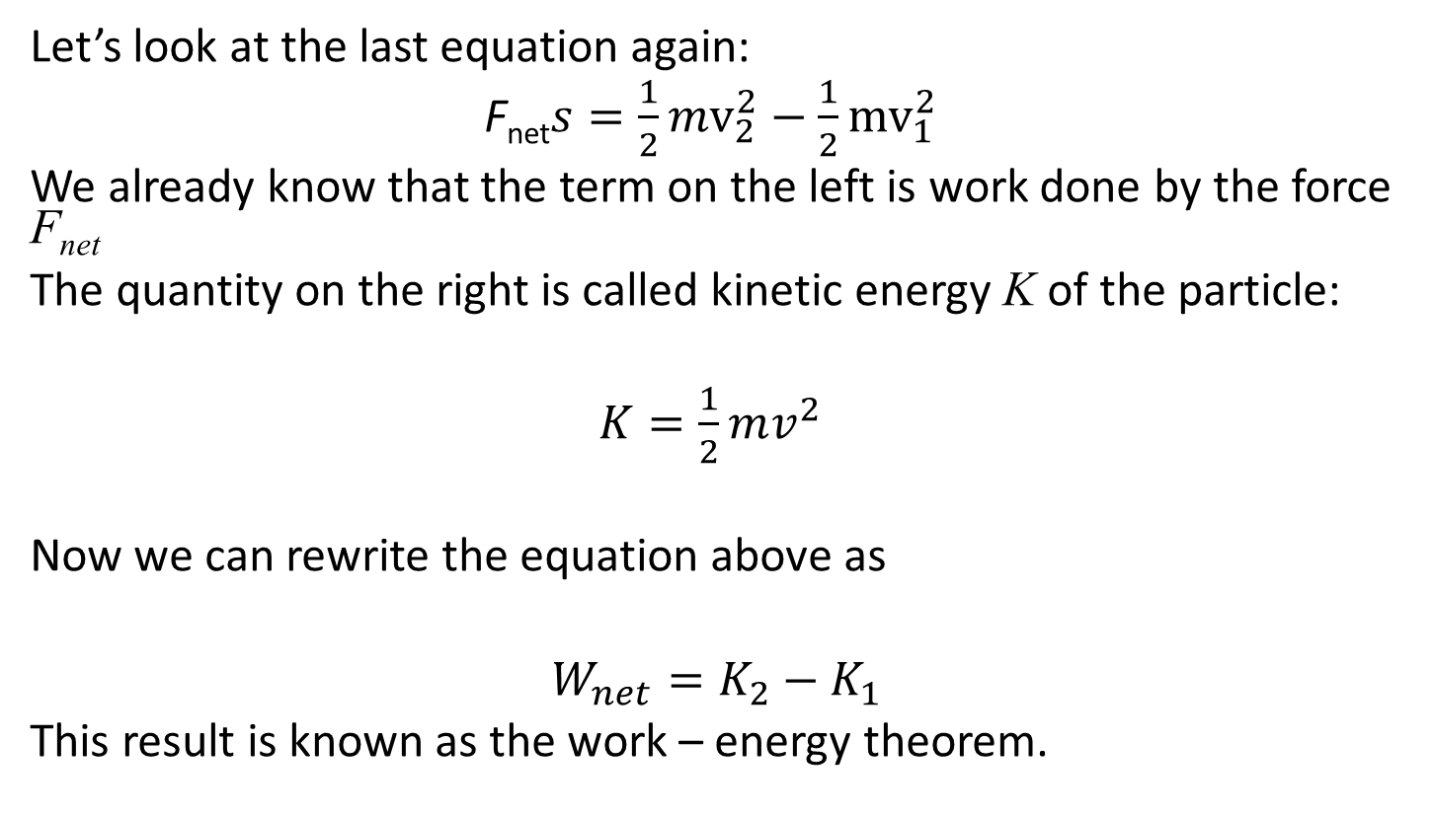
Kinetic energy
Let’s look at the last equation again:
F_{net}$s=\frac{1}{2}mv_{2}^{2}−\frac{1}{2}{mv}_{1}^{2}$
We already know that the term on the left is work done by the force F_{net}
The quantity on the right is called kinetic energy K of the particle:
$K=\frac{1}{2}mv^{2}$
Now we can rewrite the equation above as
$W_{net}=K_{2}−K_{1}$
This result is known as the work – energy theorem.

Slide 4
More on kinetic energy
Kinetic energy is a scalar
SI units are the same as of work – joules
Kinetic energy is always positive
Positive work done on a particle causes the particle’s kinetic energy (and speed) to increase
Negative work done on a particle causes the particle’s kinetic energy (and speed) to decrease
Kinetic energy can be thought of as the amount of work a particle can do as it comes to a complete stop (imagine slamming a chair into a wall) The kinetic energy abruptly goes to zero as the chair does work (and damage) to the wall

Slide 5
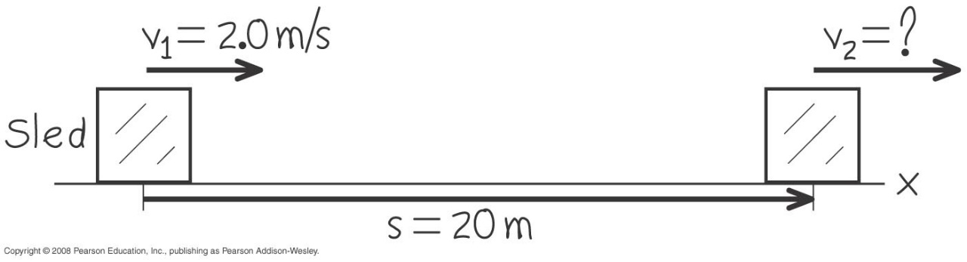
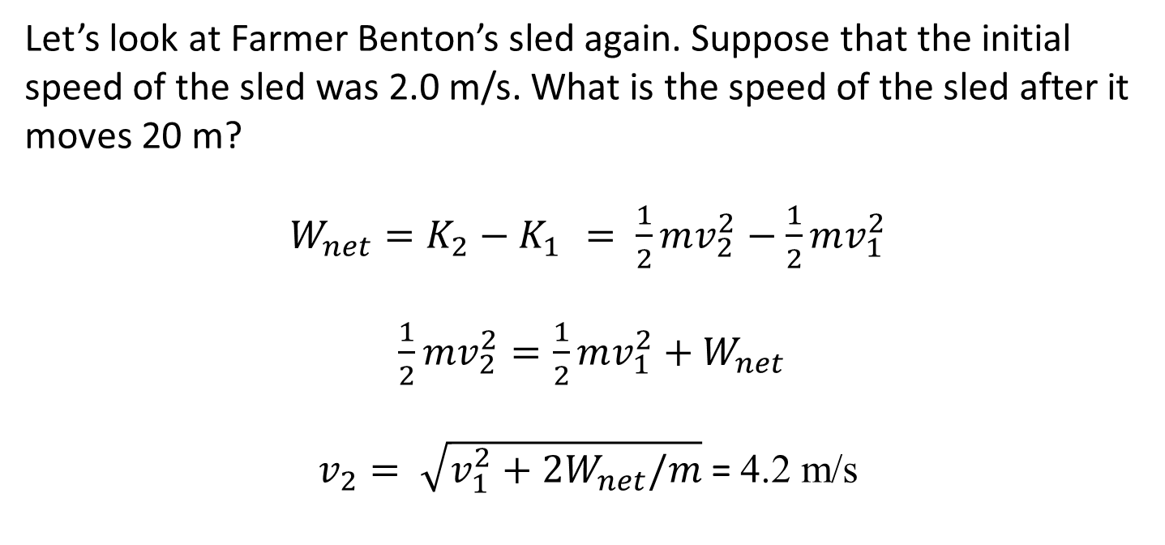
Using work – kinetic energy theorem
Let’s look at Farmer Benton’s sled again. Suppose that the initial speed of the sled was 2.0 m/s. What is the speed of the sled after it moves 20 m?
$W_{net}=K_{2}−K_{1 }= \frac{1}{2}mv_{2}^{2}−\frac{1}{2}mv_{1}^{2}$
$\frac{1}{2}mv_{2}^{2}=\frac{1}{2}mv_{1}^{2}+W_{net}$
$v_{2}= \sqrt{v_{1}^{2}+2W_{net}/m}$ = 4.2 m/s

