Slide 1
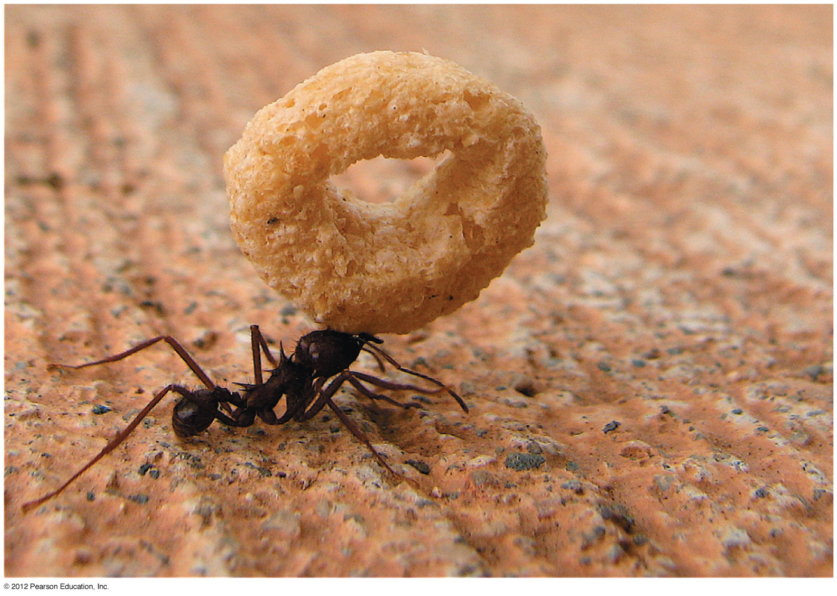


WORK DONE BY CONSTANT FORCE

Slide 2
The need for work
Free Body Diagram and the Newton’s Second Law are great tools, but things get very complicated if forces are NOT constant.
Alternative approach exists – one based on the concepts of work and energy.
Introducing these concepts allows us to formulate principle of conservation of energy – one of the most powerful tools in physics and beyond (chemistry, biology, etc.).
Work and energy are scalar quantities, easier to deal with in comparison with forces and accelerations that are vectors.
But there is a price to pay – we generally lose all information about direction of the motion.

Slide 3
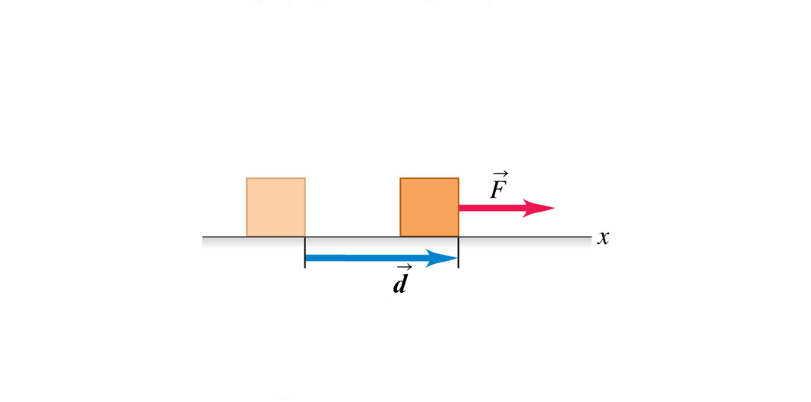
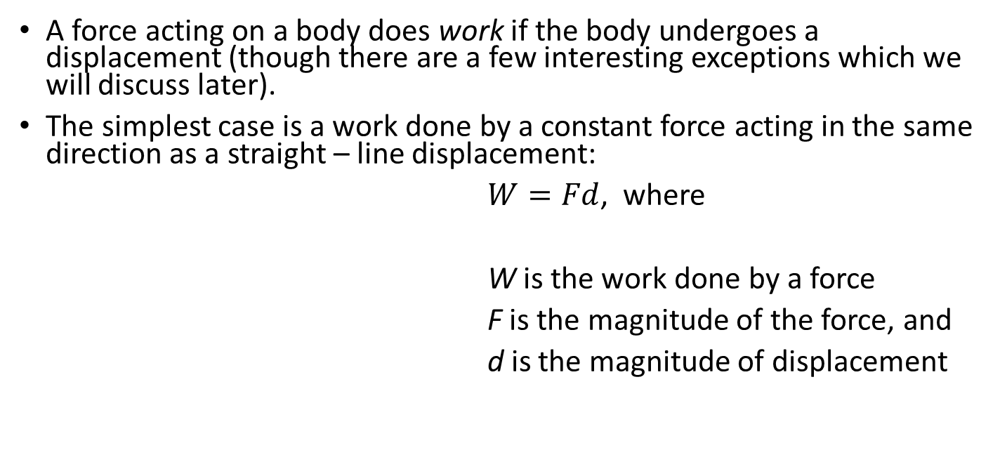
Work done by a constant force - definition
A force acting on a body does work if the body undergoes a displacement (though there are a few interesting exceptions which we will discuss later).
The simplest case is a work done by a constant force acting in the same direction as a straight – line displacement:
$W=Fd$, where
W is the work done by a force
F is the magnitude of the force, and
d is the magnitude of displacement
Note: Do not confuse W (work) with w (weight)!

Slide 4
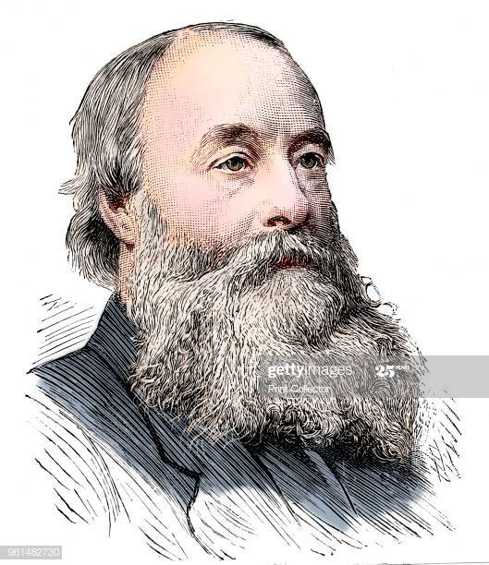
Details:
Work is a scalar quantity – does not have direction
SI Units are (looking at the definition) N-m (called Joule)
1 Joule = (1 Newton)(1meter)
Work can be positive, negative, or zero
James Prescott Joule, an English physicist who established that the various forms of energy—mechanical, electrical, and heat can be changed one into another.

Slide 5
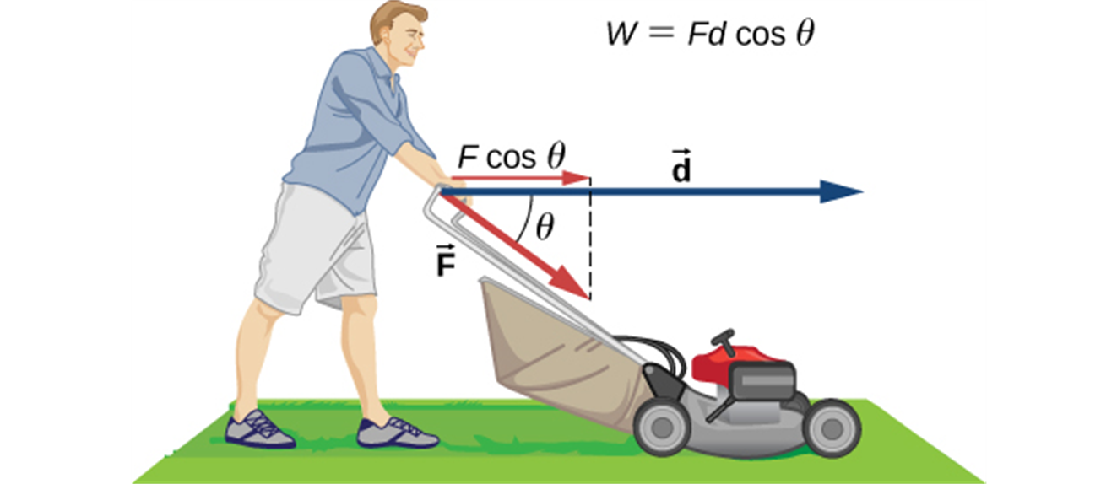
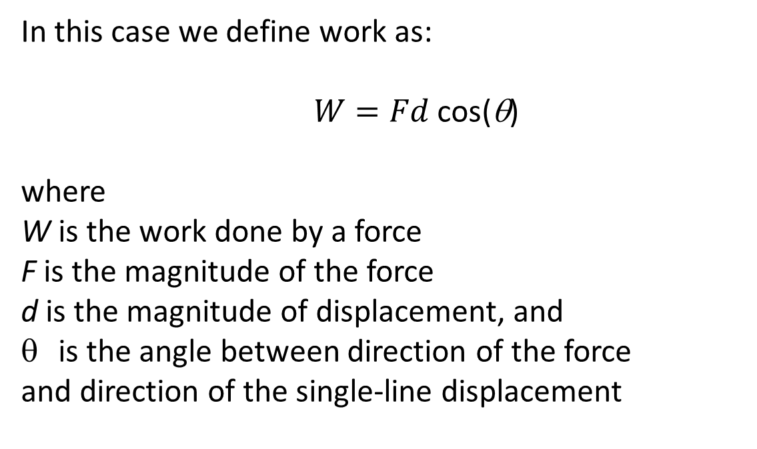
What if a constant force does NOT act along the direction of single – line displacement?
In this case we define work as:
$W=Fd$ cos(θ)
where
W is the work done by a force
F is the magnitude of the force
d is the magnitude of displacement, and
is the angle between direction of the force
and direction of the single-line displacement

Slide 6
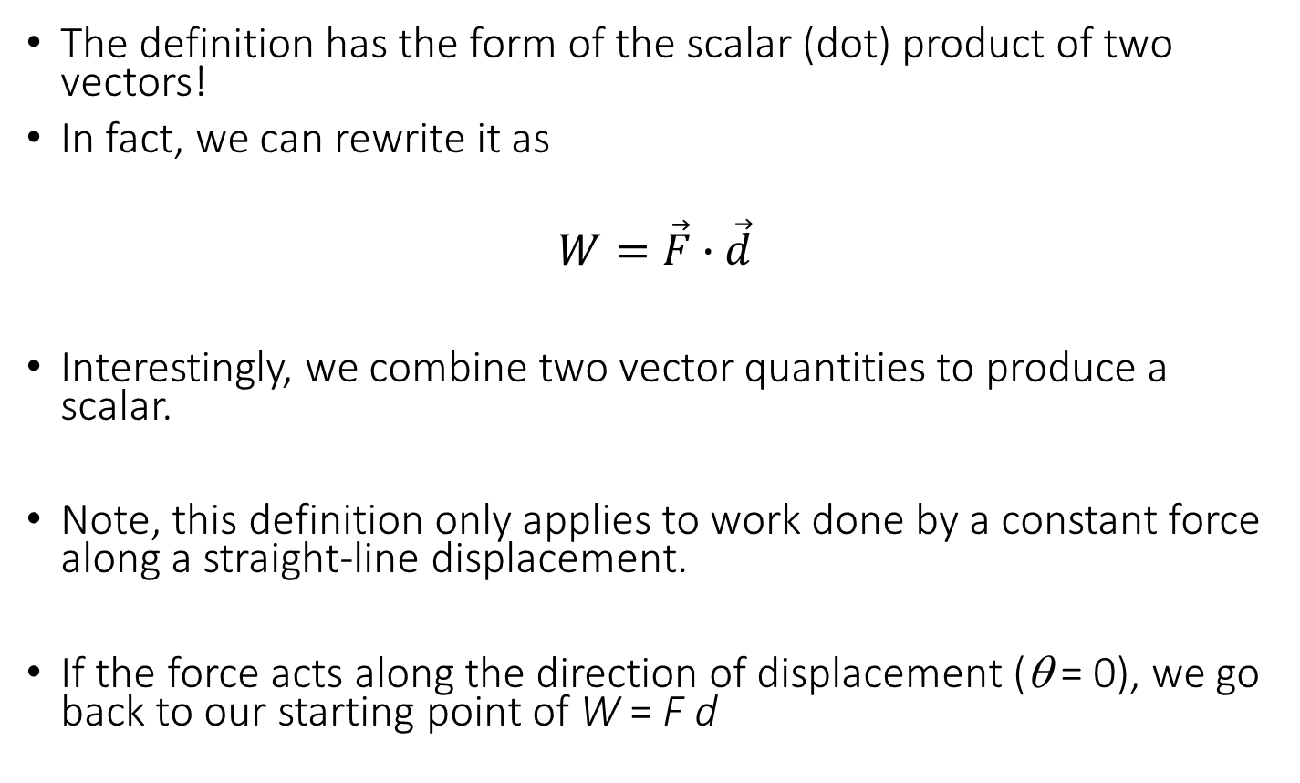
Did you notice something familiar?
The definition has the form of the scalar (dot) product of two vectors!
In fact, we can rewrite it as
$$W=\vec{F}∙\vec{d}$$
Interestingly, we combine two vector quantities to produce a scalar.
Note, this definition only applies to work done by a constant force along a straight-line displacement.
If the force acts along the direction of displacement (θ = 0), we go back to our starting point of W = F d

Slide 7
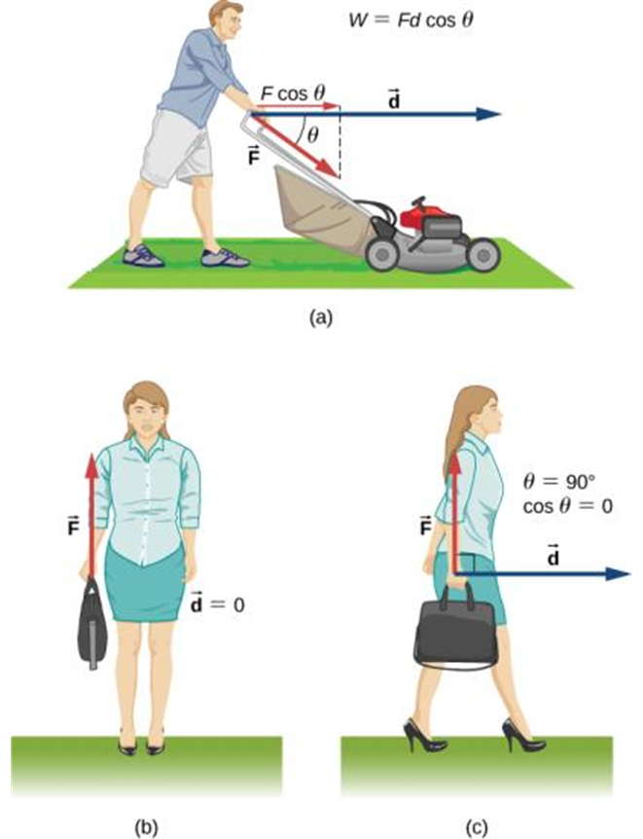
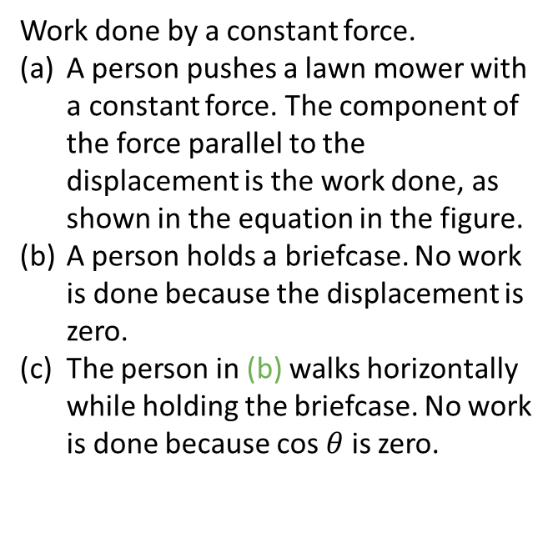
Positive, negative, and zero work
A force can do positive, negative, or zero work depending on the angle between the force and the displacement.
Work done by a constant force.
A person pushes a lawn mower with a constant force. The component of the force parallel to the displacement is the work done, as shown in the equation in the figure.
A person holds a briefcase. No work is done because the displacement is zero.
The person in (b) walks horizontally while holding the briefcase. No work is done because cos $θ$ is zero.

Slide 8
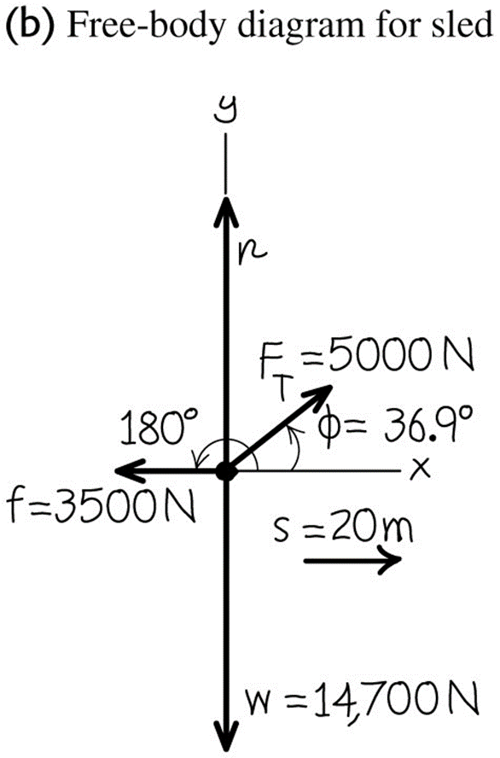
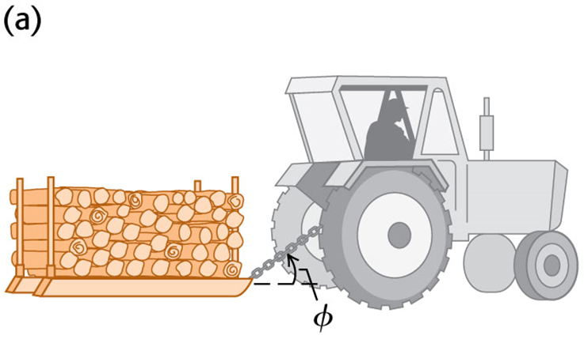
Work done by several forces, example
Farmer Benton hitches his tractor to a sled loaded with firewood and pulls it a distance of 20 m along level ground. The total weight of the sled and load is 14,700 N. The tractor exerts a constant 5,000 N force at an angle of 36.9º above the horizontal. There is a 3,500 N friction force opposing the sled’s motion. Find the work done by each force acting on the sled and the total work done by all forces.

Slide 9
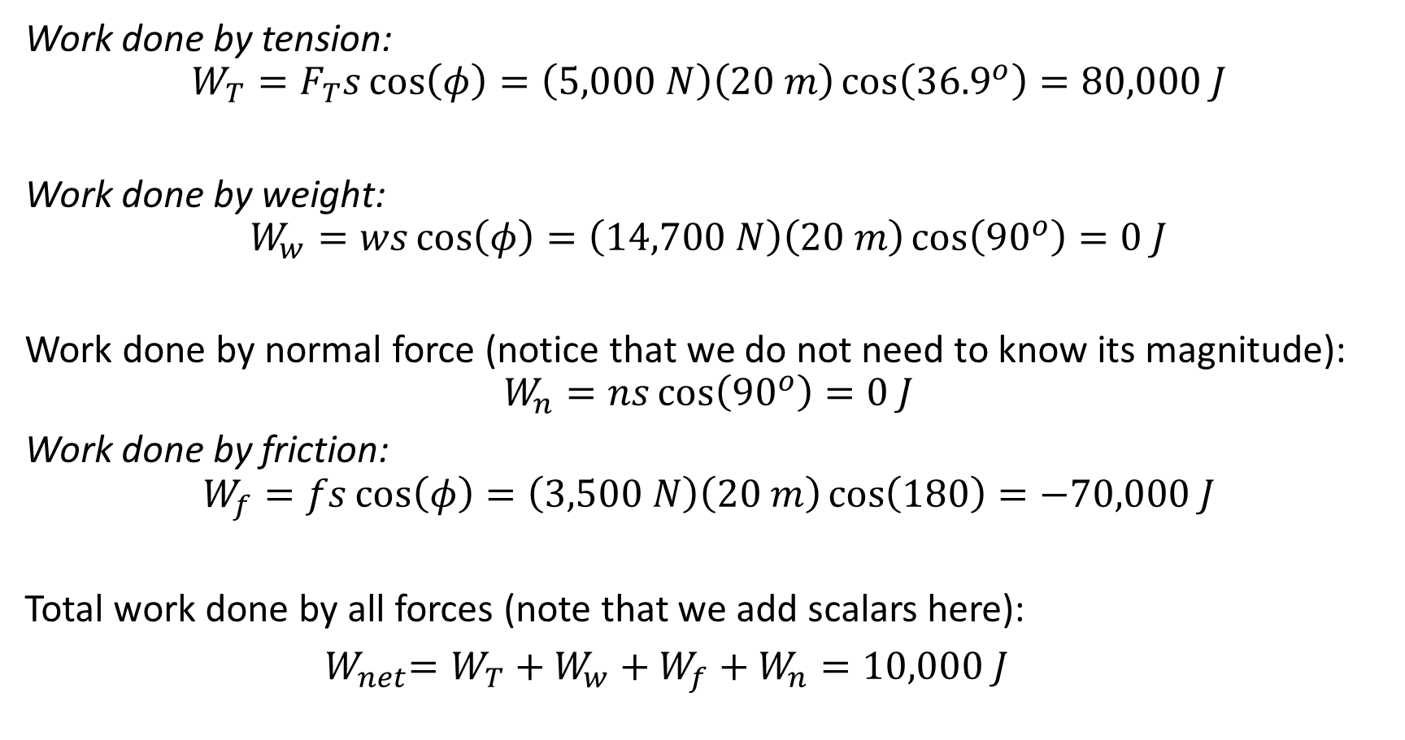
Solution
Work done by tension:
$$W_{T}=F_{T}s\cos\left(φ\right)=\left(5,000 N\right)\left(20 m\right)\cos\left({36.9}^{o}\right)=80,000 J$$
Work done by weight:
$$W_{w}=ws\cos\left(φ\right)=\left(14,700 N\right)\left(20 m\right)\cos\left({90}^{o}\right)=0 J$$
Work done by normal force (notice that we do not need to know its magnitude):
$$W_{n}=ns\cos\left({90}^{o}\right)=0 J$$
Work done by friction:
$$W_{f}=fs\cos\left(φ\right)=\left(3,500 N\right)\left(20 m\right)\cos\left(180\right)=−70,000 J$$
Total work done by all forces (note that we add scalars here):
${ W}_{net}=W_{T}+W_{w}+W_{f}+W_{n}=10,000 J$

