Slide 1
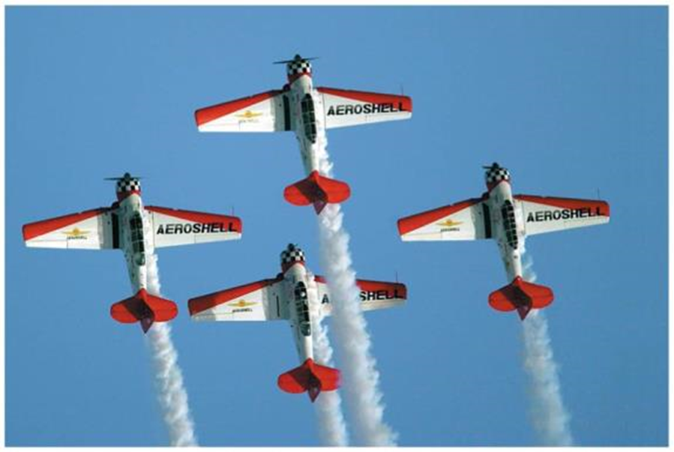


RELATIVE VELOCITY

Slide 2
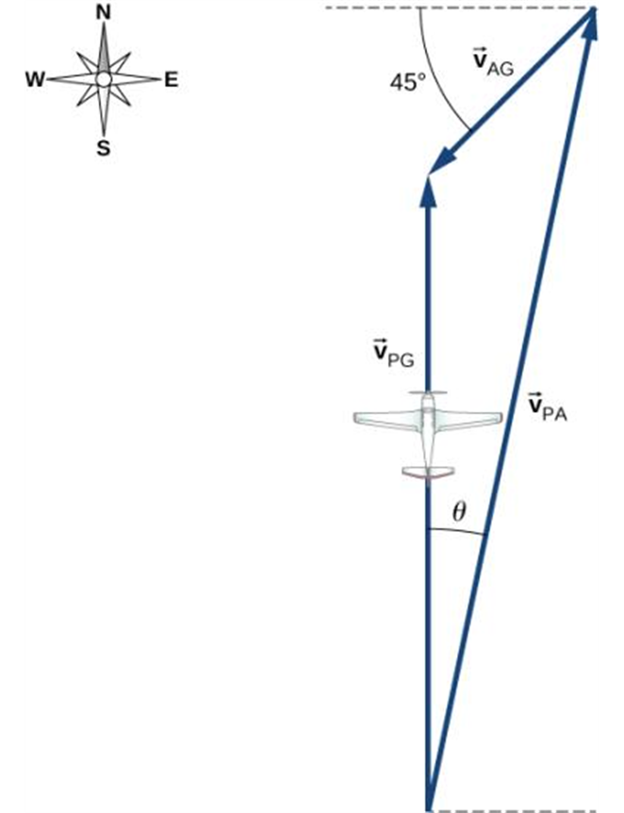
Relative Velocity
The velocity of a moving body seen by a particular observer is
called the velocity relative to that observer, or simply the relative velocity.
A frame of reference is a coordinate system plus a time scale.
In many situations relative velocity is extremely important.

Slide 3
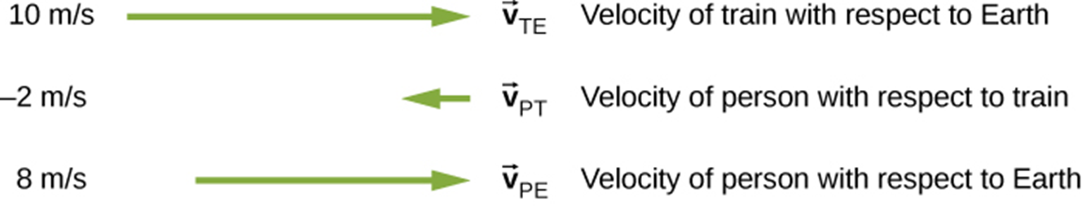
Relative Velocity in One Dimension
If point P is moving relative to reference frame A, we denote the velocity of P relative to frame A as v_{P/A}.
If P is moving relative to frame B and frame B is moving relative to frame A, then the x-velocity of P relative to frame A is v_{P/A-x} = v_{P/B-x} + v_{B/A-x}.

Slide 4
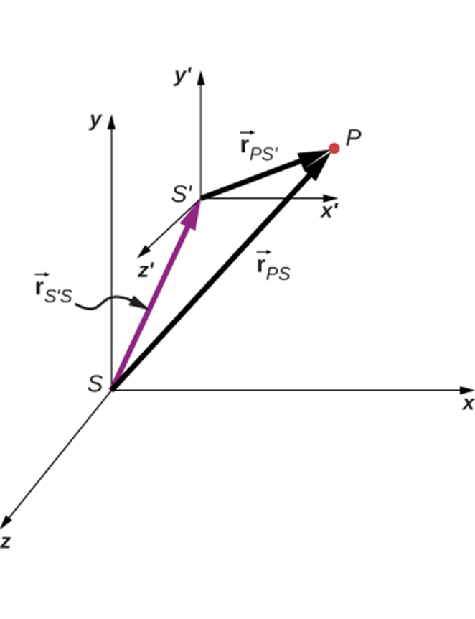
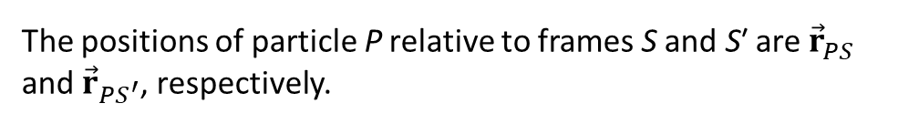
Relative Velocity in Two or Three Dimensions
We extend relative velocity to two or three dimensions by using vector addition to combine velocities.
The positions of particle P relative to frames S and S′ are ${\vec{r}}_{PS}$ and ${\vec{r}}_{{PS}^{′}}$, respectively.

Slide 5
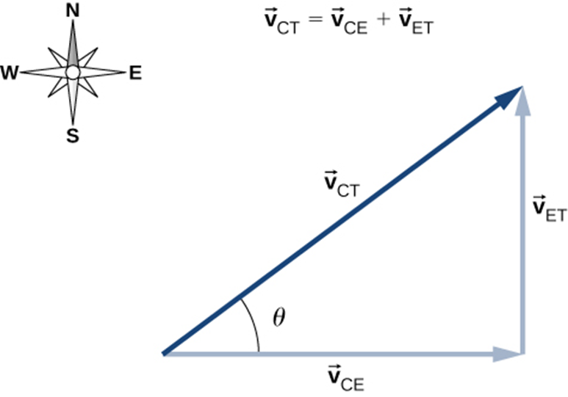
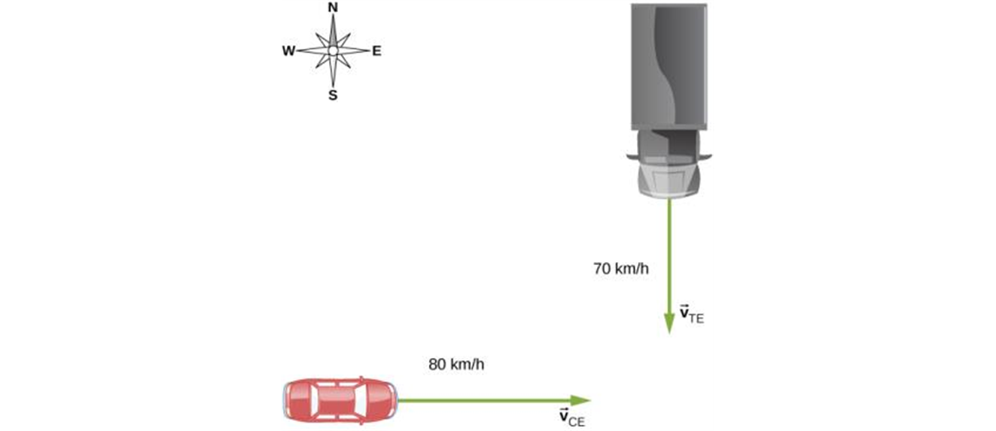
Relative Velocity in Two or Three Dimensions
A car travels east toward an intersection while a truck travels south toward the same intersection.
Vector diagram of the vector equation ${\vec{v}}_{CT} = {\vec{v}}_{CE} + {\vec{v}}_{ET}$.

