Slide 1
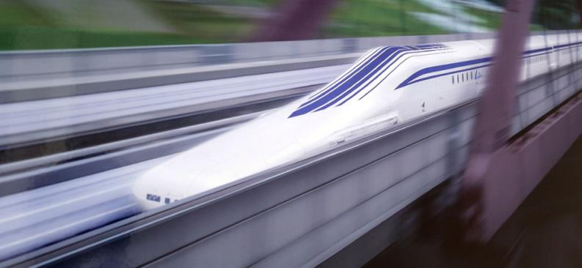


MOTION ALONG A STRAIGHT LINE
MOTION ALONG A STRAIGHT LINE

Slide 2
Introduction
Kinematics is the study of motion.
Velocity and acceleration are important physical quantities.
A typical runner gains speed gradually during the course of a sprinting foot race and then slows down after crossing the finish line.

Slide 3
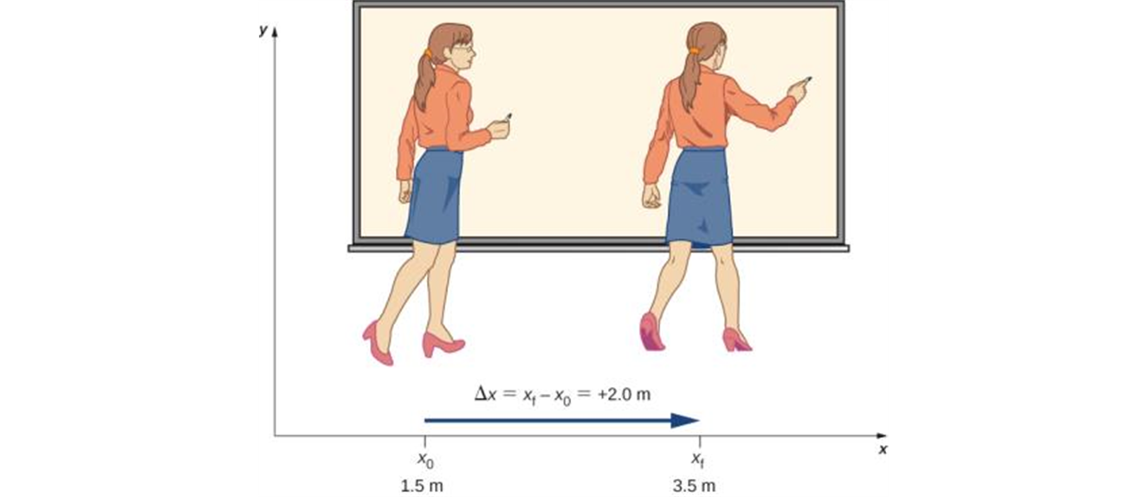


Displacement, time, and average velocity
A particle moving along the x-axis has a coordinate x.
The change in the particle’s coordinate is
The average x-velocity of the particle is
A professor paces left and right while lecturing. Her position relative to Earth is given by x. The +2.0-m displacement of the professor relative to Earth is represented by an arrow pointing to the right.
Note:
a. Both displacement and average velocities are vector quantities.
b. SI units of displacement are m.
c. SI units of average velocity are m/s.
$$v_{av, x}=\frac{∆x}{∆t}=\frac{x_{f}−x_{i}}{t_{f}−t_{i}}$$

Slide 4
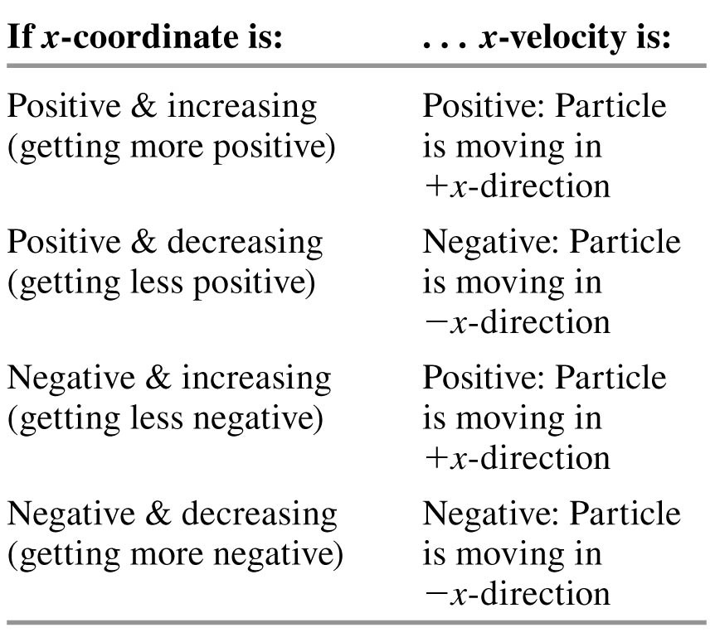
Rules for the sign of x-velocity

Slide 5
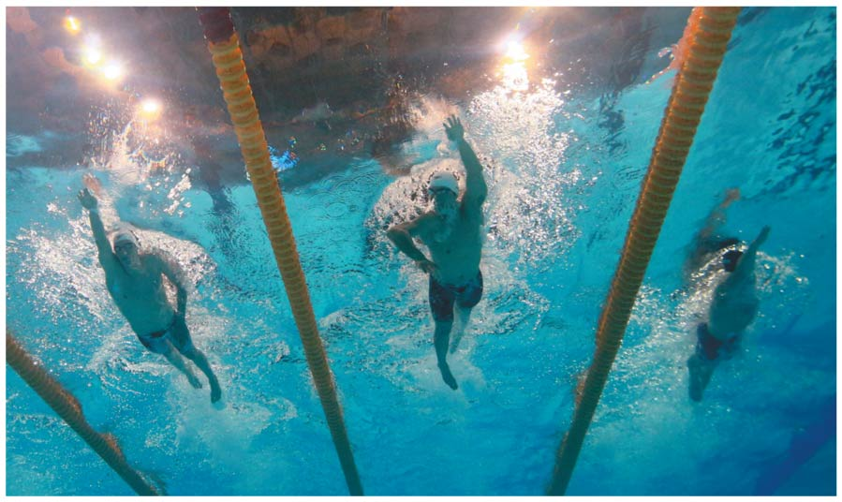
Average velocity
The winner of a 50-m swimming race is the swimmer whose average velocity has the greatest magnitude.
That is, the swimmer who traverses a displacement Δx of
50 m in the shortest elapsed time Δt.

Slide 6

Instantaneous velocity
The instantaneous velocity is the velocity at a specific instant of time or specific point along the path and is given by v_{x} = dx/dt.
The average speed (distance traveled/time it took) is not the magnitude of the average velocity!
$$v_{x}=\lim_{∆t→0}{\frac{∆x}{∆t}}$$

Slide 7
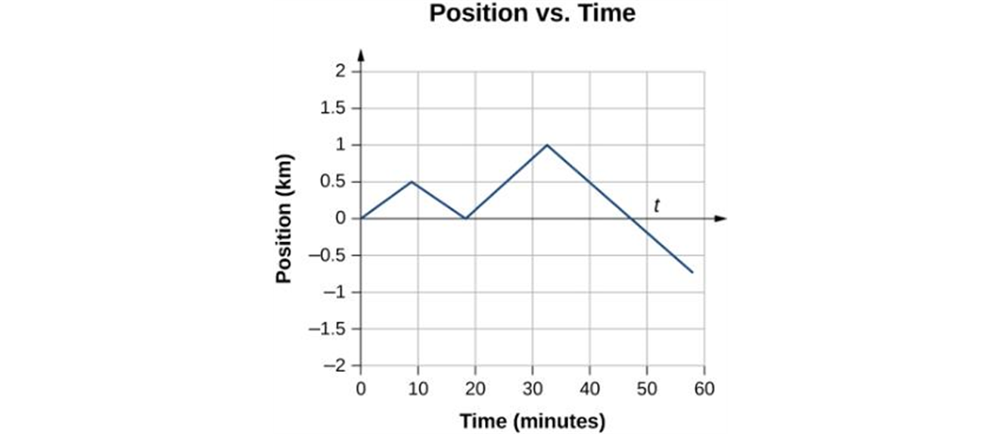
A position-time graph
This graph depicts object’s position versus time. The average velocity is the slope of a line connecting the initial and final points.

Slide 8
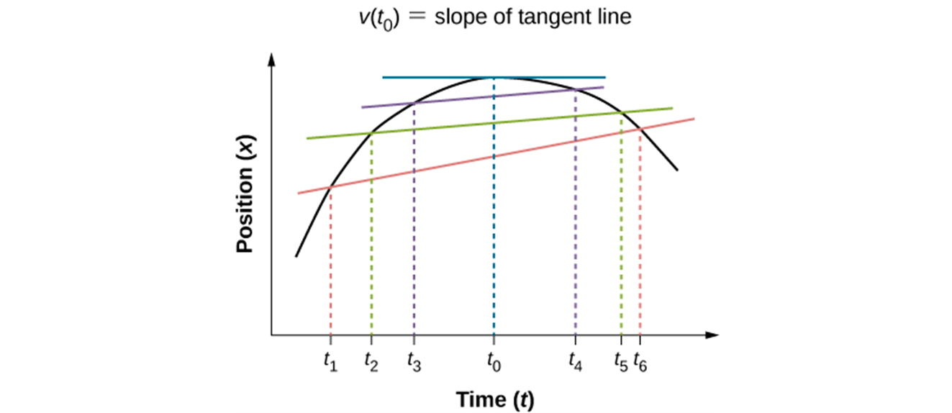
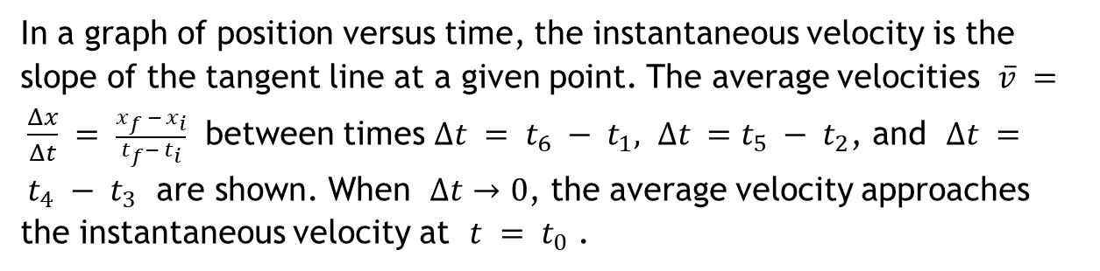
Finding velocity on an x-t graph
In a graph of position versus time, the instantaneous velocity is the slope of the tangent line at a given point. The average velocities $\overline{v} = \frac{Δx}{Δt} = \frac{x_{f }− x_{i}}{t_{f}−{ t}_{i}}$ between times $∆t = t_{6} − t_{1}, ∆t =t_{5} − t_{2}$, and $∆t = t_{4} −{ t}_{3}$ are shown. When $∆t$ → 0, the average velocity approaches the instantaneous velocity at $t = t_{0}$ .

Slide 9
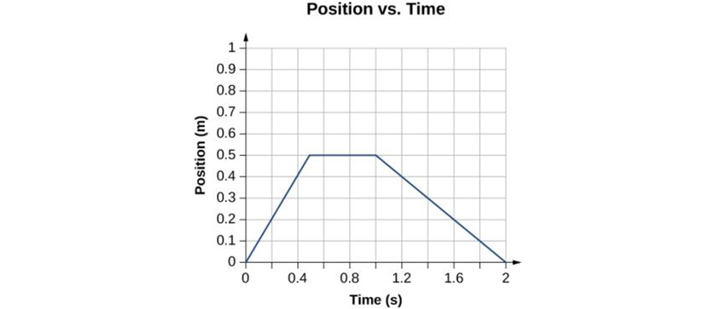
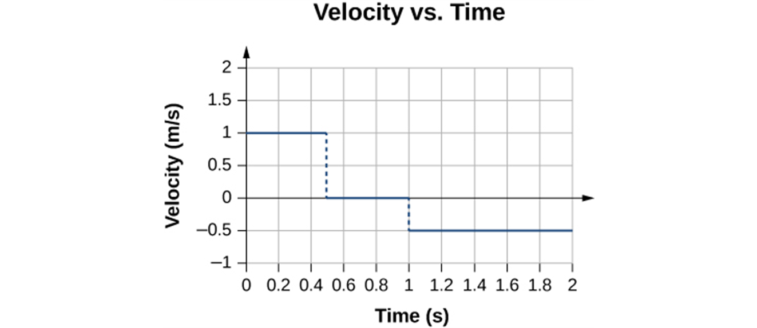
x-t and v–t graphs
The object starts out in the positive direction, stops for a short time, and then reverses direction, heading back toward the origin. Notice that the object comes to rest instantaneously, which would require an infinite force. Thus, the graph is an approximation of motion in the real world.
The velocity is positive for the first part of the trip, zero when the object is stopped, and negative when the object reverses direction.

Slide 10
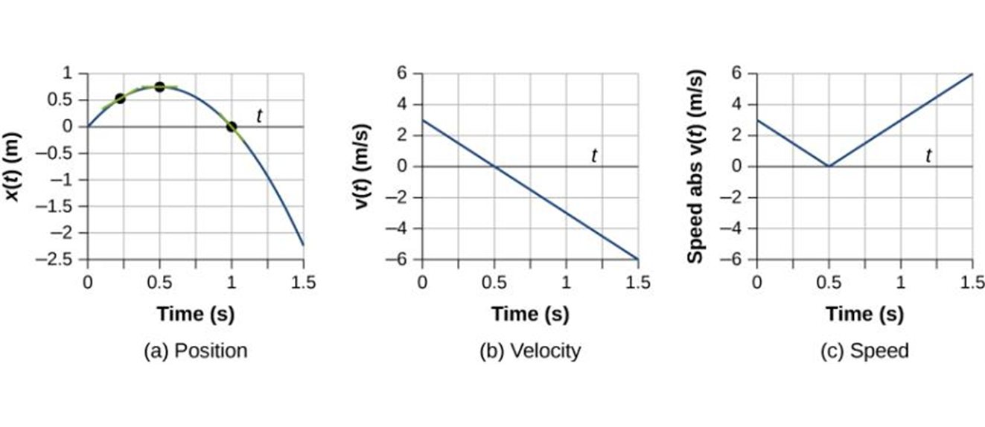
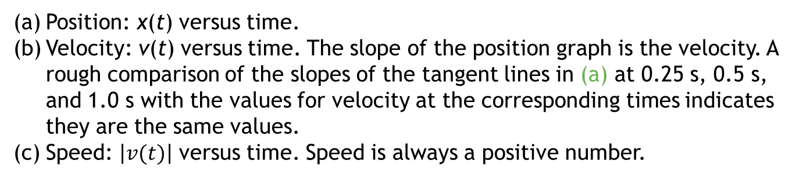
Another example
Position: x(t) versus time.
Velocity: v(t) versus time. The slope of the position graph is the velocity. A rough comparison of the slopes of the tangent lines in (a) at 0.25 s, 0.5 s, and 1.0 s with the values for velocity at the corresponding times indicates they are the same values.
Speed: $\left|v(t)\right|$ versus time. Speed is always a positive number.

Slide 11

Average acceleration
Acceleration describes the rate of change of velocity with time.
The average x-acceleration is
$$a_{av, x}=\frac{∆v_{x}}{∆t}=\frac{v_{xf}−v_{xi}}{t_{f}−t_{i}}$$

Slide 12
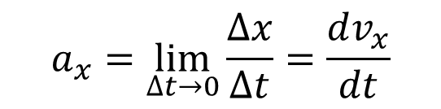
Instantaneous acceleration
The instantaneous acceleration is
$$a_{x}=\lim_{∆t→0}{\frac{∆x}{∆t}}=\frac{dv_{x}}{dt}$$
Note:
a. Both average and instantaneous accelerations are vector quantities.
b. SI units of acceleration are m/s² or m/s/s.

Slide 13
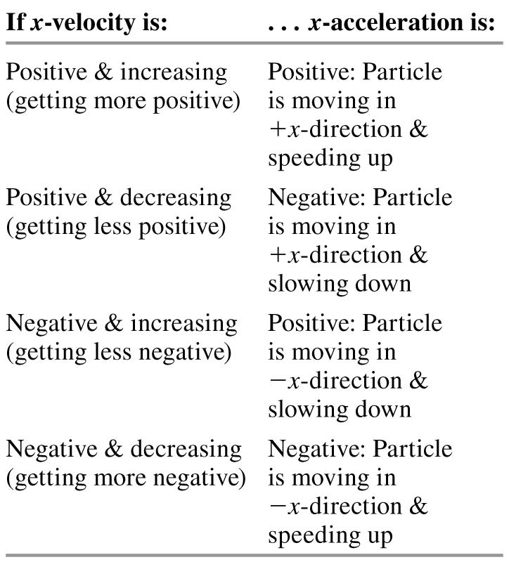
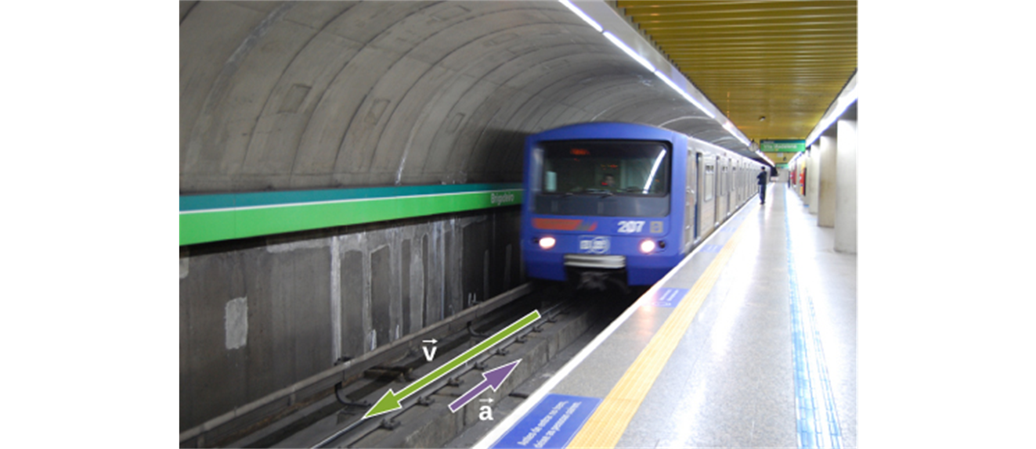
Rules for the sign of x-acceleration
A subway train in Sao Paulo, Brazil, decelerates as it comes into a station. It is accelerating in a direction opposite to its direction of motion. (credit: Yusuke Kawasaki)

Slide 14
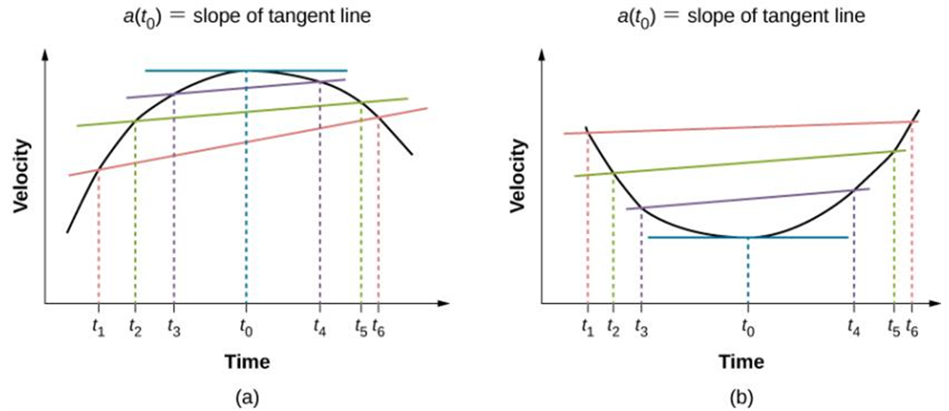
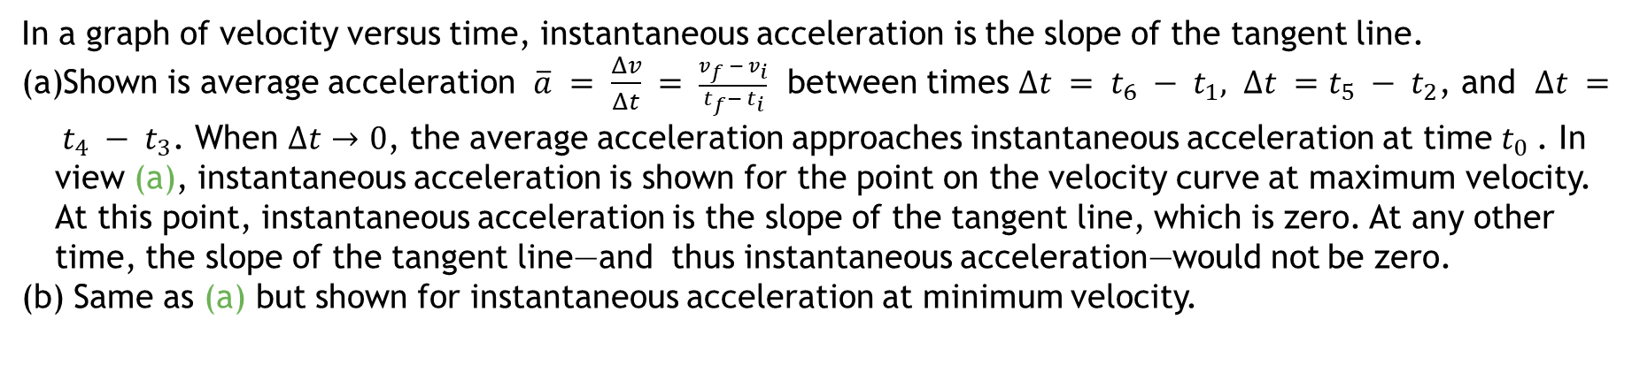
Finding acceleration on a v_{x}-t graph
In a graph of velocity versus time, instantaneous acceleration is the slope of the tangent line.
Shown is average acceleration $\overline{a} = \frac{Δv}{Δt} = \frac{v_{f }− v_{i}}{t_{f}−{ t}_{i}}$ between times $∆t = t_{6} − t_{1}, ∆t =t_{5} − t_{2}$, and $∆t = t_{4} −{ t}_{3}$. When $∆t$ → 0, the average acceleration approaches instantaneous acceleration at time $t_{0}$. In view (a), instantaneous acceleration is shown for the point on the velocity curve at maximum velocity. At this point, instantaneous acceleration is the slope of the tangent line, which is zero. At any other time, the slope of the tangent line—and thus instantaneous acceleration—would not be zero.
Same as (a) but shown for instantaneous acceleration at minimum velocity.

Slide 15
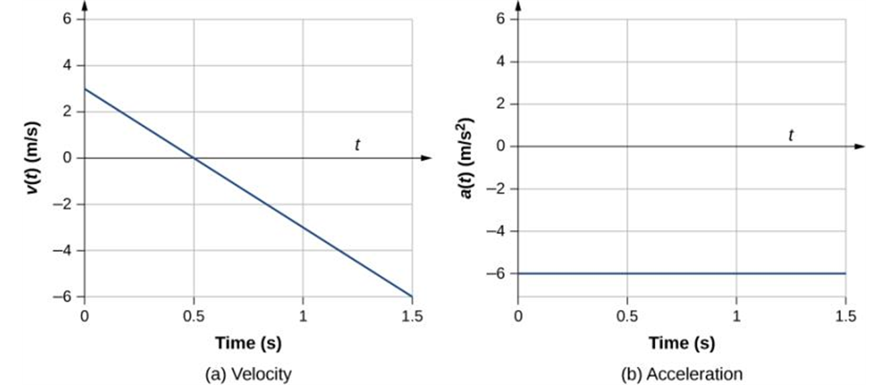
A v-t and a-t graphs
(a, b) The velocity-versus-time graph is linear and has a negative constant slope (a) that is equal to acceleration, shown in (b).

Slide 16
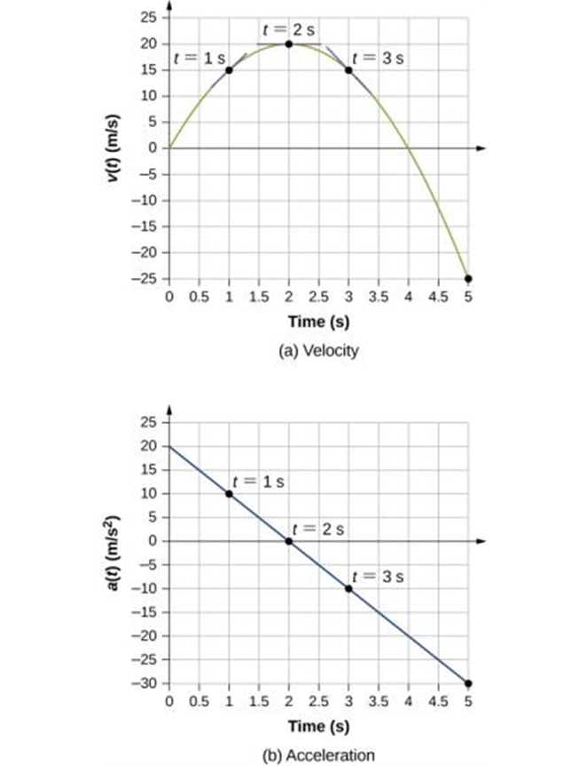
Another example
Velocity versus time. Tangent lines are indicated at times 1, 2, and 3 s. The slopes of the tangents lines are the accelerations. At t = 3 s, velocity is positive. At t = 5 s, velocity is negative, indicating the particle has reversed direction.
Acceleration versus time. Comparing the values of accelerations given by the black dots with the corresponding slopes of the tangent lines (slopes of lines through black dots) in (a), we see they are identical.

Slide 17
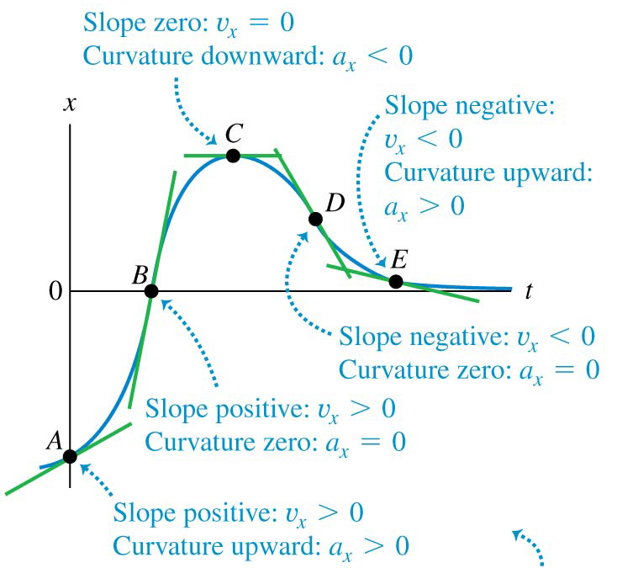
An x-t graph

Slide 18
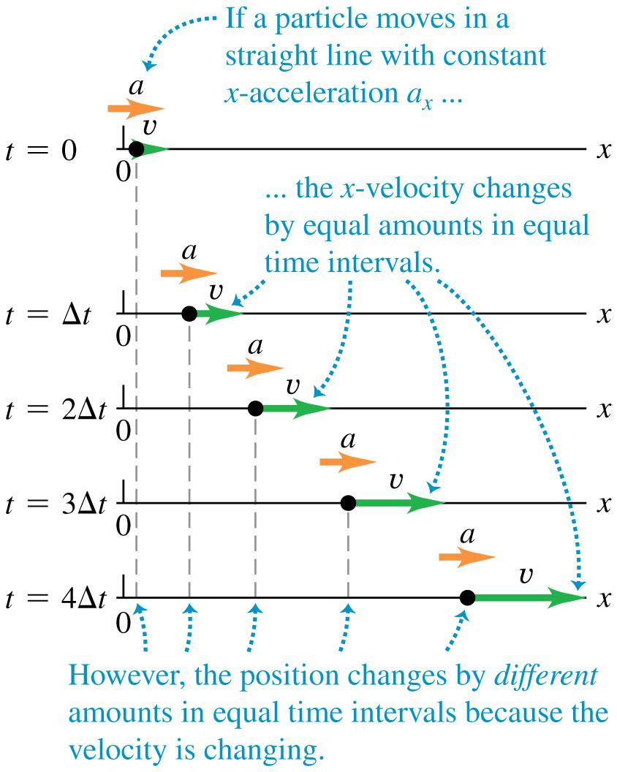
Motion with constant acceleration

Slide 19
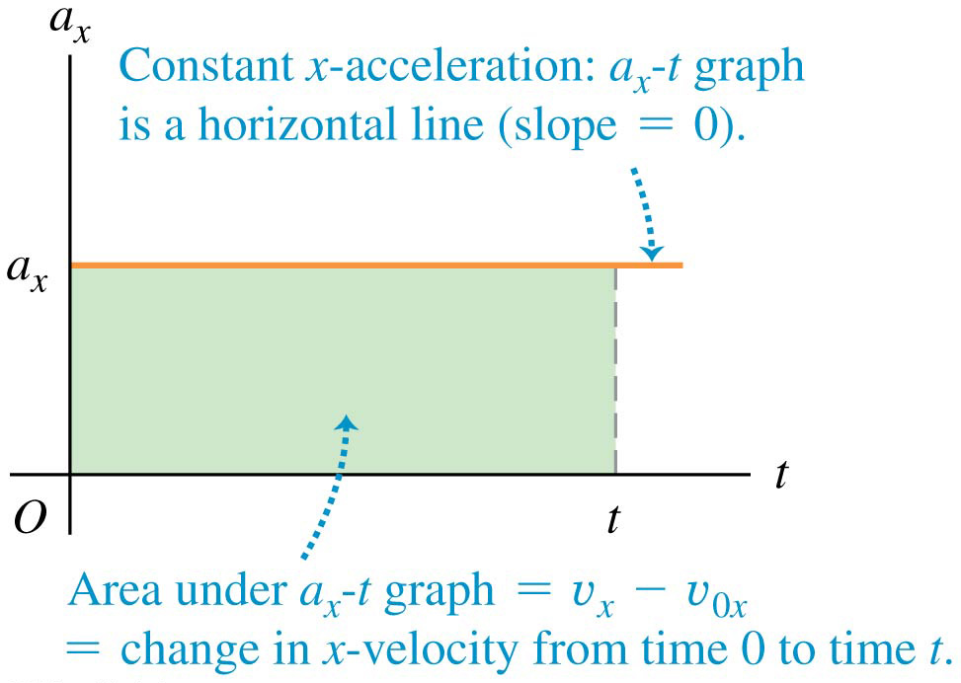
Motion with constant acceleration

Slide 20
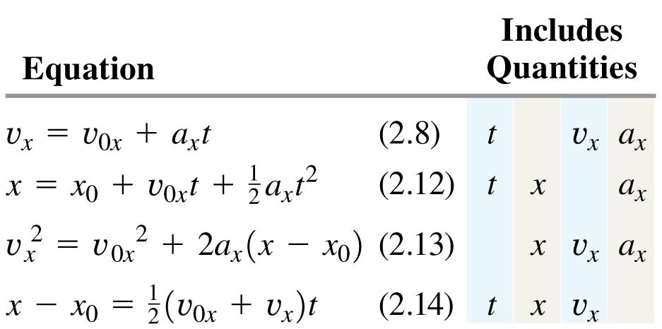
The equations of motion with constant acceleration
The four equations below apply to any straight-line motion with constant acceleration a_{x}.

Slide 21

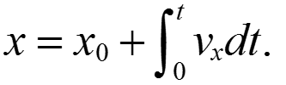
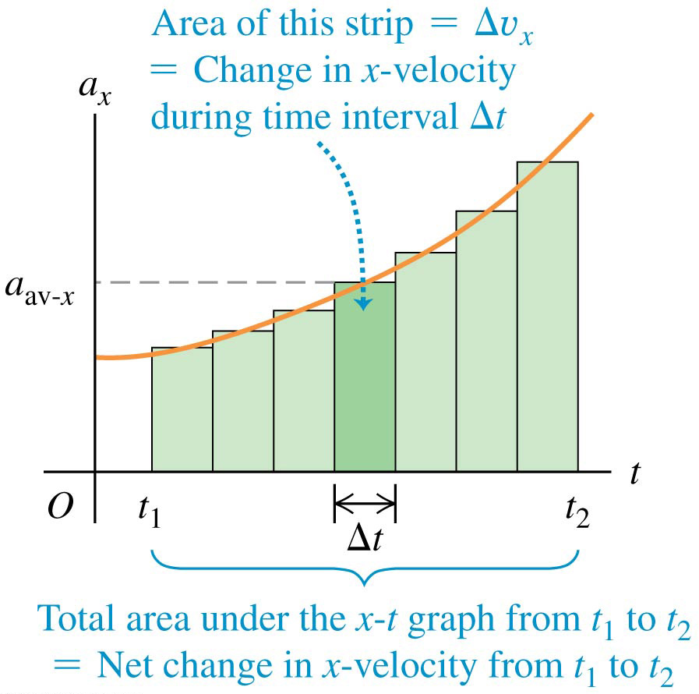
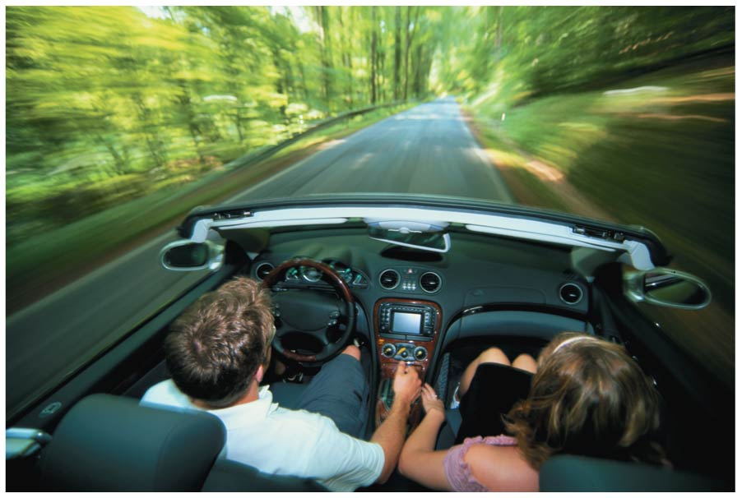
Velocity and position by integration
The acceleration of a car is not always constant.
The motion may be integrated over many small time intervals to give and

Slide 22

What are the next steps?
Practice the Try-It-Yourself Tutorials and Problems that deal with motion along straight line.
Move on to the discussion of a specific example of one-dimensional motion with constant acceleration: free fall

