Slide 1
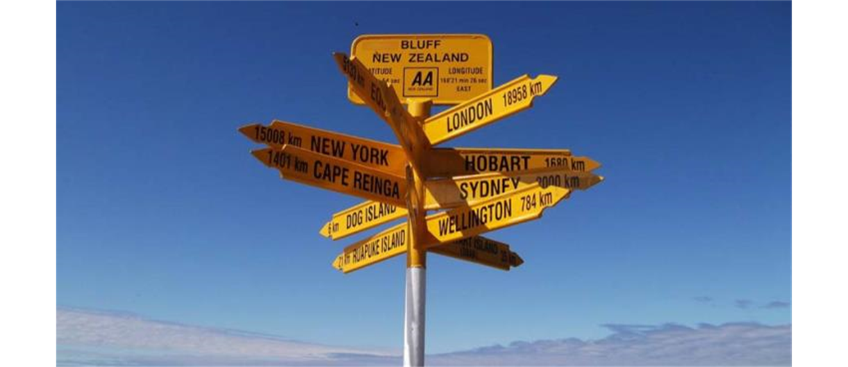


VECTORS

Slide 2



Vectors and Scalars
A scalar quantity can be described by a single number.
A vector quantity has both a magnitude and a direction in space.
Typically, a vector quantity is represented in boldface italic type with an arrow over it:
The magnitude of
is written as A or

Slide 3
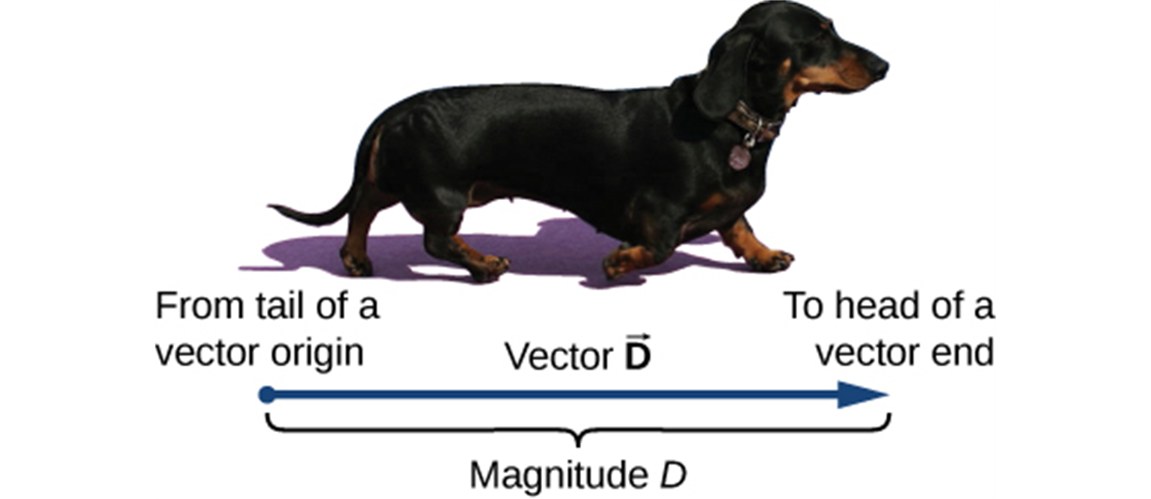
Drawing Vectors
We draw a vector from the initial point or origin (called the “tail” of a vector) to the end or terminal point (called the “head” of a vector), marked by an arrowhead. Magnitude is the length of a vector and is always a positive scalar quantity. (credit: modification of work by Cate Sevilla)

Slide 4
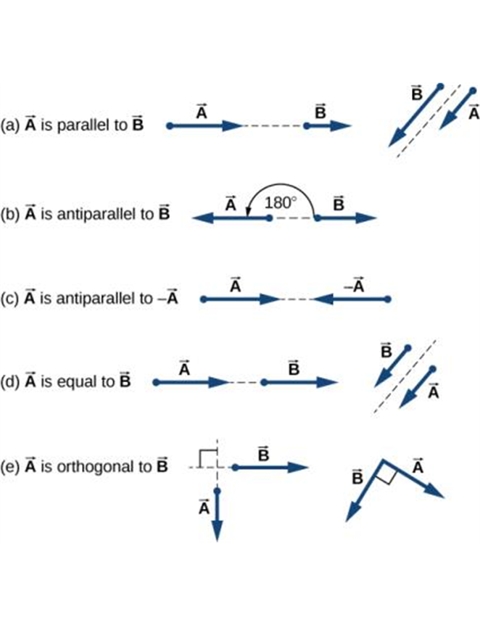
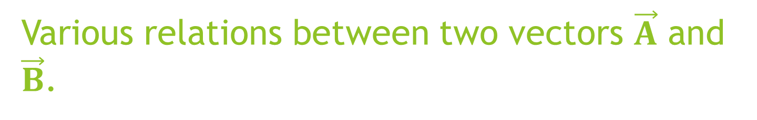
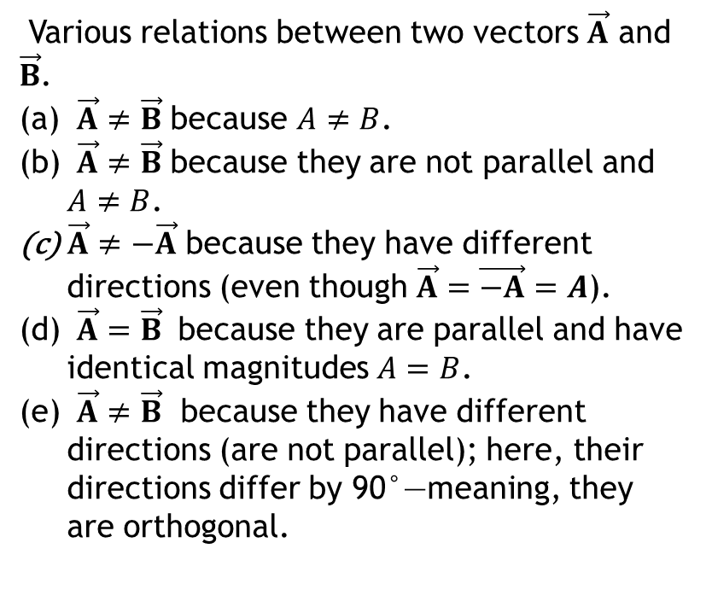
Various relations between two vectors $\vec{A}$ and $\vec{B}$.
Various relations between two vectors $\vec{A}$ and $\vec{B}$.
$\vec{A}≠\vec{B}$ because $A≠B$.
$\vec{A}≠\vec{B}$ because they are not parallel and $A≠B$.
$\vec{A}≠−\vec{A}$ because they have different directions (even though $\vec{A}=\vec{−A}=A$).
$\vec{A}=\vec{B}$ because they are parallel and have identical magnitudes $A=B$.
$\vec{A}≠\vec{B}$ because they have different directions (are not parallel); here, their directions differ by 90°—meaning, they are orthogonal.

Slide 5
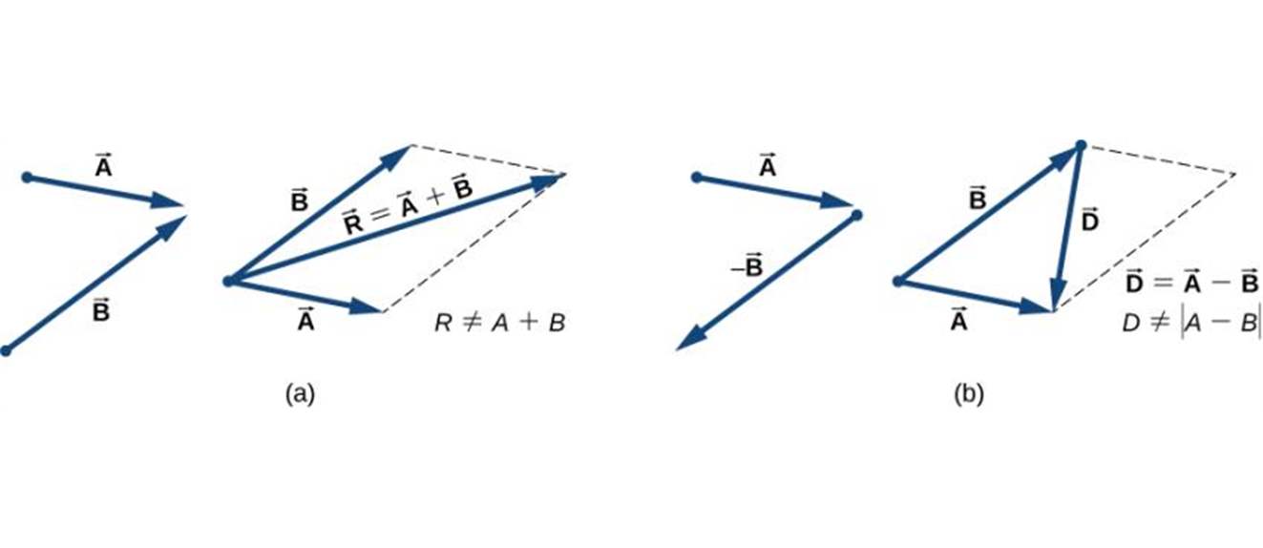
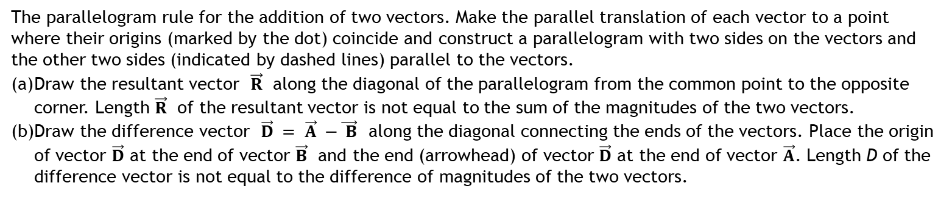
Adding/Subtracting Two Vectors Graphically (Parallelogram Method)
The parallelogram rule for the addition of two vectors. Make the parallel translation of each vector to a point where their origins (marked by the dot) coincide and construct a parallelogram with two sides on the vectors and the other two sides (indicated by dashed lines) parallel to the vectors.
Draw the resultant vector $\vec{R}$ along the diagonal of the parallelogram from the common point to the opposite corner. Length $\vec{R}$ of the resultant vector is not equal to the sum of the magnitudes of the two vectors.
Draw the difference vector $\vec{D} = \vec{A} −\vec{ B}$ along the diagonal connecting the ends of the vectors. Place the origin of vector $\vec{D}$ at the end of vector $\vec{B}$ and the end (arrowhead) of vector $\vec{D}$ at the end of vector $\vec{A}$. Length D of the difference vector is not equal to the difference of magnitudes of the two vectors.

Slide 6
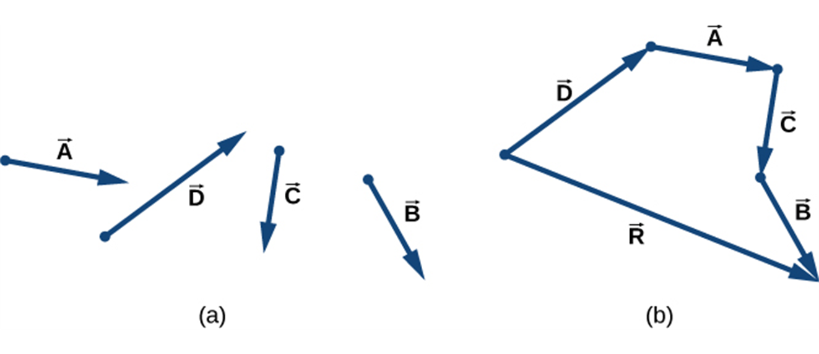
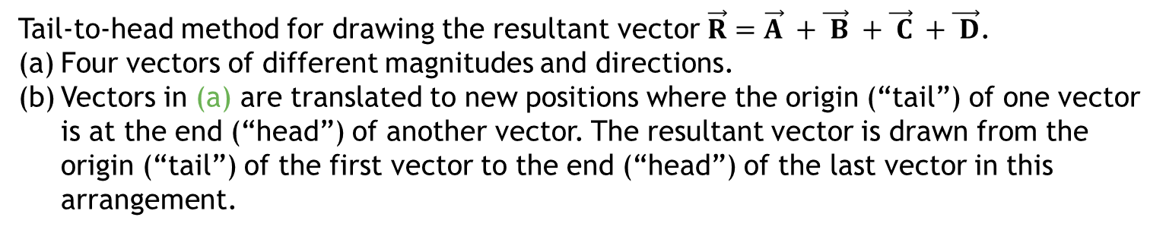
Adding Vectors (Tail to Head Method)
Tail-to-head method for drawing the resultant vector $\vec{R}=\vec{A} +\vec{ B} +\vec{ C} +\vec{ D}$.
Four vectors of different magnitudes and directions.
Vectors in (a) are translated to new positions where the origin (“tail”) of one vector is at the end (“head”) of another vector. The resultant vector is drawn from the origin (“tail”) of the first vector to the end (“head”) of the last vector in this arrangement.
Note: Multiple vectors can be added in any order.

Slide 7
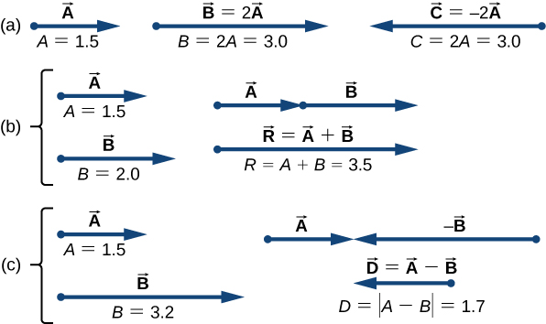
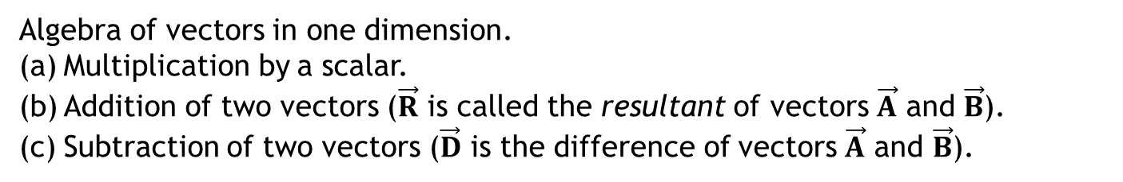
Vectors in One Dimension
Algebra of vectors in one dimension.
Multiplication by a scalar.
Addition of two vectors ($\vec{R}$ is called the resultant of vectors $\vec{A}$ and $\vec{B}$).
Subtraction of two vectors ($\vec{D}$ is the difference of vectors $\vec{A}$ and $\vec{B}$).

Slide 8
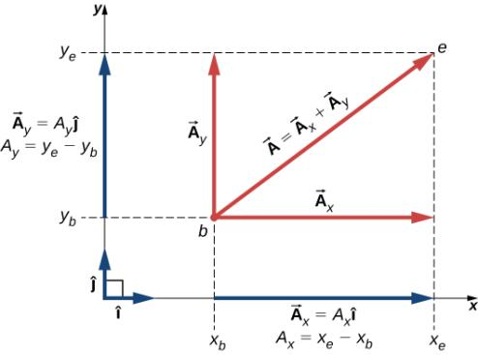
Components of a Vector
Adding vectors graphically provides limited accuracy. Vector components provide a general method for adding vectors.
Any vector can be represented by an x-component A_{x} and a y-component A_{y}.

Slide 9
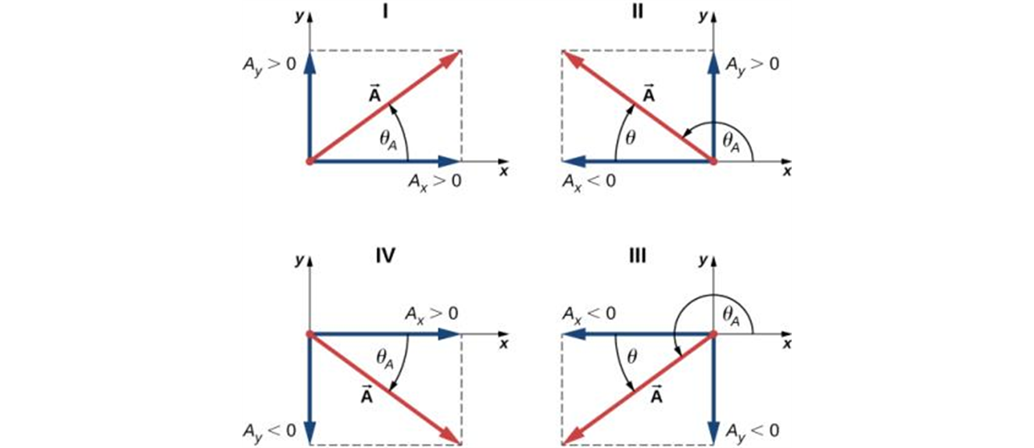
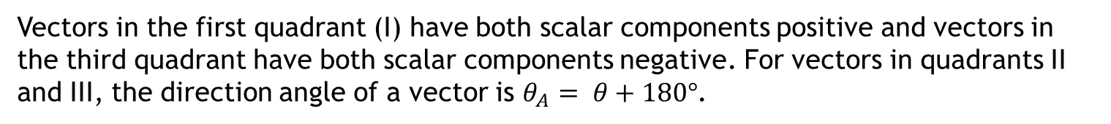
Positive and Negative Components
The components of a vector may be positive or negative numbers, as shown below.
Vectors in the first quadrant (I) have both scalar components positive and vectors in the third quadrant have both scalar components negative. For vectors in quadrants II and III, the direction angle of a vector is $θ_{A}= θ+180°$.

Slide 10
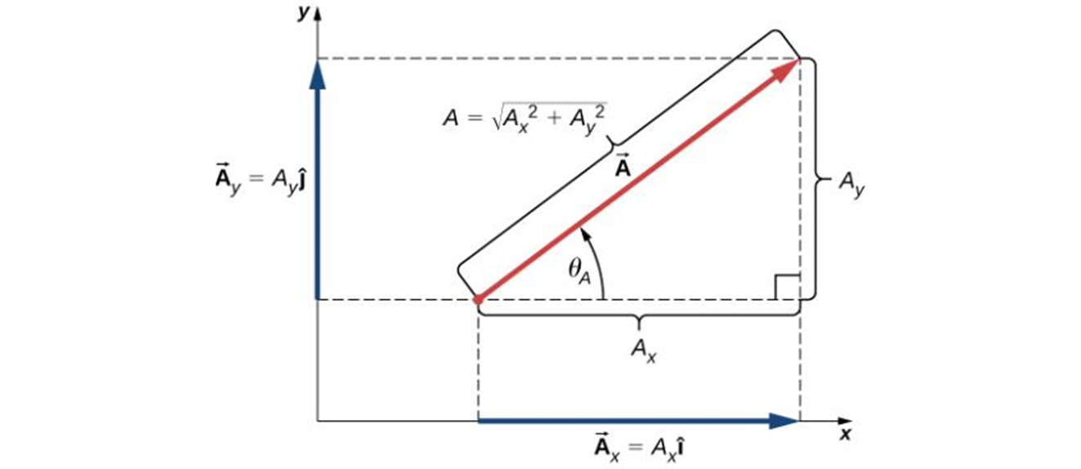
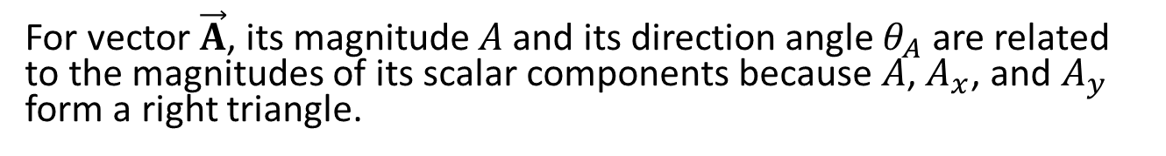

Finding Components
We can calculate the components of a vector from its magnitude and direction.
$$A_{x}=Acos(θ_{A})$$
$$A_{y}=Asin(θ_{A})$$
For vector $\vec{A}$, its magnitude $A$ and its direction angle $θ_{A}$ are related to the magnitudes of its scalar components because $A$, $A_{x}$, and $A_{y}$ form a right triangle.

Slide 11

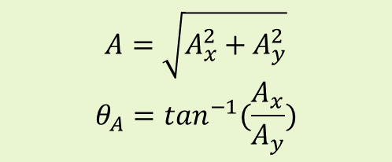
Calculations Using Components
We can use the components of a vector to find its magnitude and direction:
$$A=\sqrt{A_{x}^{2}+A_{y}^{2}}$$
$$θ_{A}=\tan^{−1}(\frac{A_{x}}{A_{y}})$$
We can use the components of a set of vectors to find the components of their sum:

Slide 12


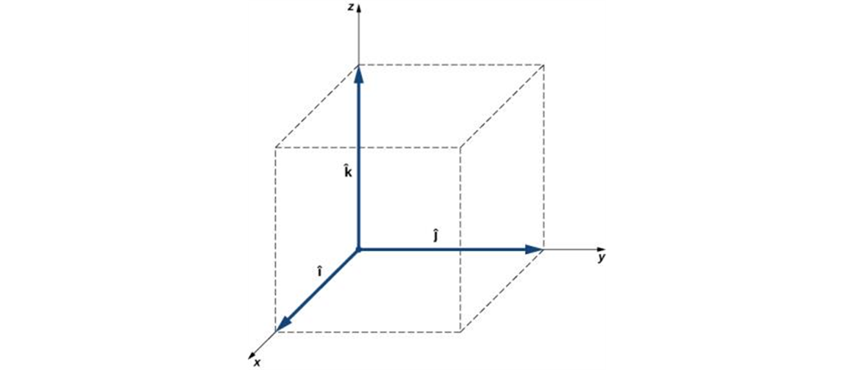

Unit Vectors
A unit vector has a magnitude of 1 with no units.
The unit vector
points in the +x-direction,
points in the +y-direction, and
points in the +z-direction.
Three unit vectors define a Cartesian system in three-dimensional space. The order in which these unit vectors appear defines the orientation of the coordinate system. The order shown here defines the right-handed orientation.

Slide 13
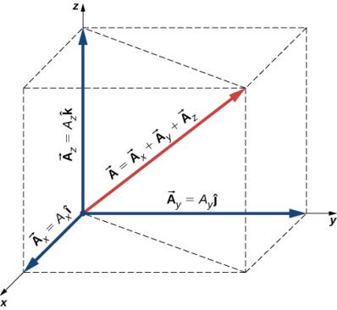
Vector as a Sum of Vector Components
A vector in three-dimensional space is the vector sum of its three vector components.

Slide 14
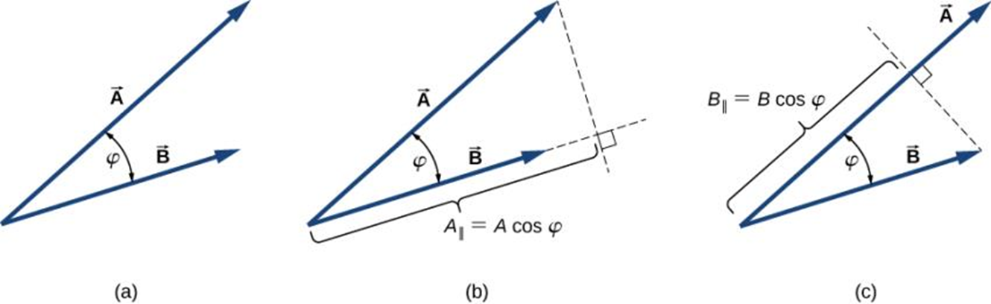
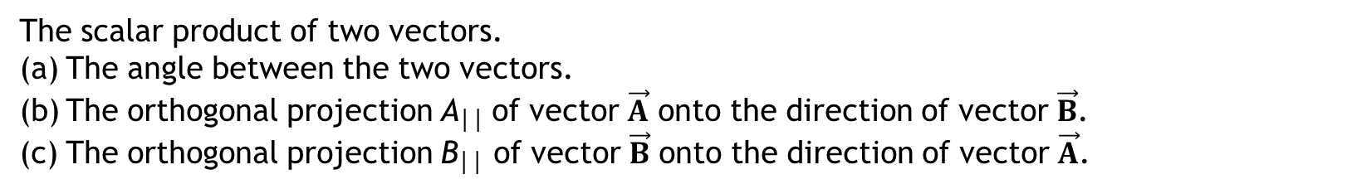
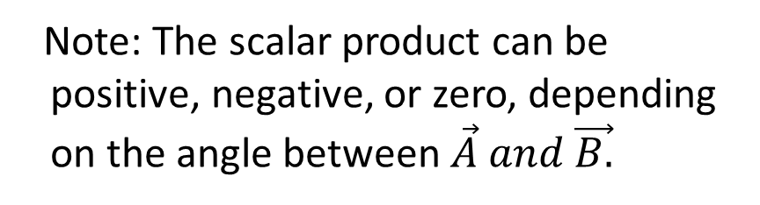

The Scalar Product: Definition
Note: The scalar product can be positive, negative, or zero, depending on the angle between $\vec{A} and \vec{B.}$
$$\overset{⃑}{A}∙\overset{⃑}{B}=ABcosφ$$
The scalar product of two vectors.
The angle between the two vectors.
The orthogonal projection A││ of vector $\vec{A}$ onto the direction of vector $\vec{B}$.
The orthogonal projection B││ of vector $\vec{B}$ onto the direction of vector $\vec{A}$.

Slide 15
Calculating a Scalar Product Using Components
In terms of components:
$$\vec{A}∙\vec{B}=A_{x}B_{x}+A_{y}B_{y}+A_{z}B_{z}$$
The scalar product of two vectors is the sum of the products of their respective components.

Slide 16
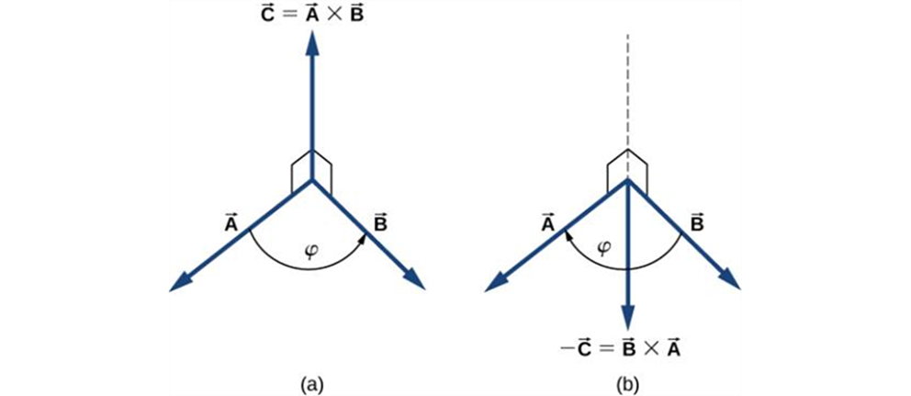
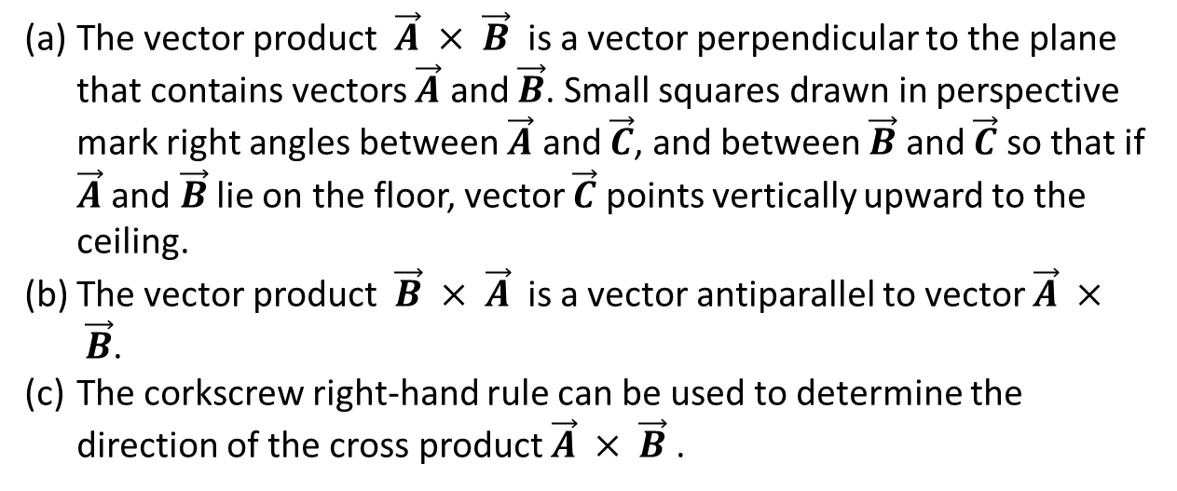
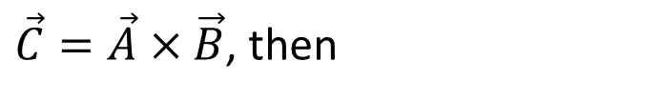
The Vector Product
If the vector product (“cross product”) of two vectors is
$\vec{C}=\vec{A}×\vec{B}$, then
The vector product $\vec{A} × \vec{B}$ is a vector perpendicular to the plane that contains vectors $\vec{A}$ and $\vec{B}$. Small squares drawn in perspective mark right angles between $\vec{A}$ and $\vec{C}$, and between $\vec{B}$ and $\vec{C}$ so that if $\vec{A}$ and $\vec{B}$ lie on the floor, vector $\vec{C}$ points vertically upward to the ceiling.
The vector product $\vec{B} × \vec{A}$ is a vector antiparallel to vector $\vec{A} × \vec{B}$.
The corkscrew right-hand rule can be used to determine the direction of the cross product $\vec{A} × \vec{B}$ .

Slide 17
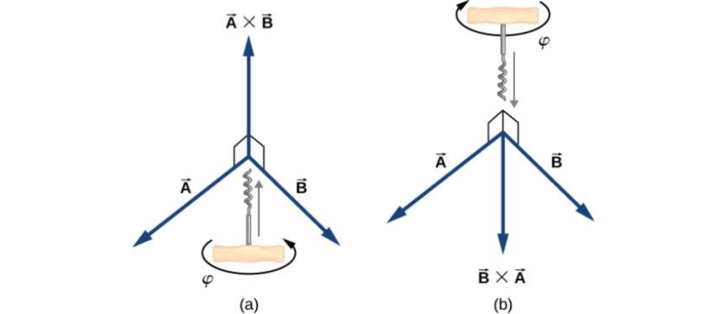
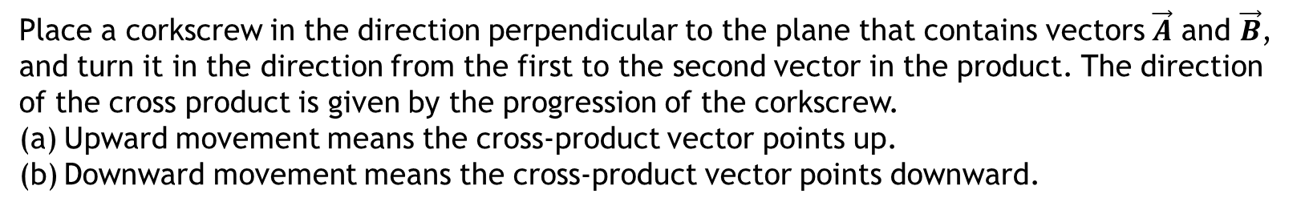
Right Hand Rule
Place a corkscrew in the direction perpendicular to the plane that contains vectors $\vec{A}$ and $\vec{B}$, and turn it in the direction from the first to the second vector in the product. The direction of the cross product is given by the progression of the corkscrew.
Upward movement means the cross-product vector points up.
Downward movement means the cross-product vector points downward.

Slide 18
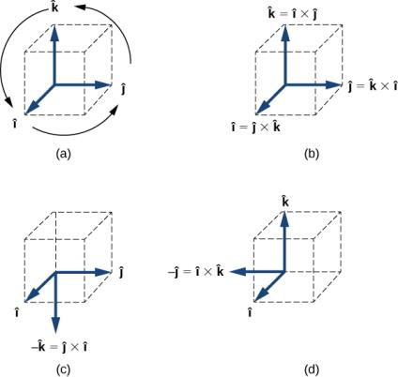
Cross Product of Unit Vectors
The diagram of the cyclic order of the unit vectors of the axes.
The only cross products where the unit vectors appear in the cyclic order. These products have the positive sign.
(d) Two examples of cross products where the unit vectors do not appear in the cyclic order. These products have the negative sign.

