Slide 1
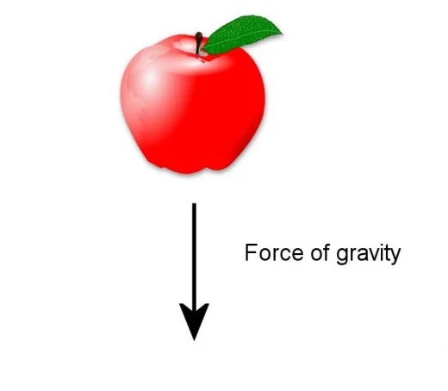


FREE FALL MOTION

Slide 2
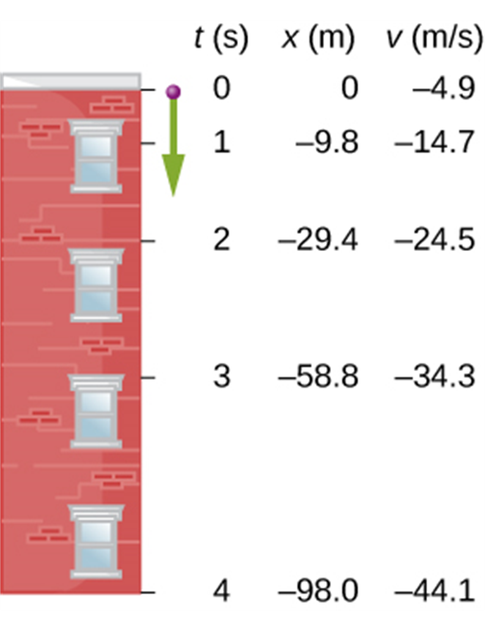
Freely falling bodies
Free fall is the motion of an object under the influence of only gravity.
In the figure, a strobe light flashes with equal time intervals between flashes.
The velocity change is the same in each time interval, so the acceleration is constant.
The positions and velocities at 1-s intervals of a ball thrown downward from a tall building at 4.9 m/s.

Slide 3
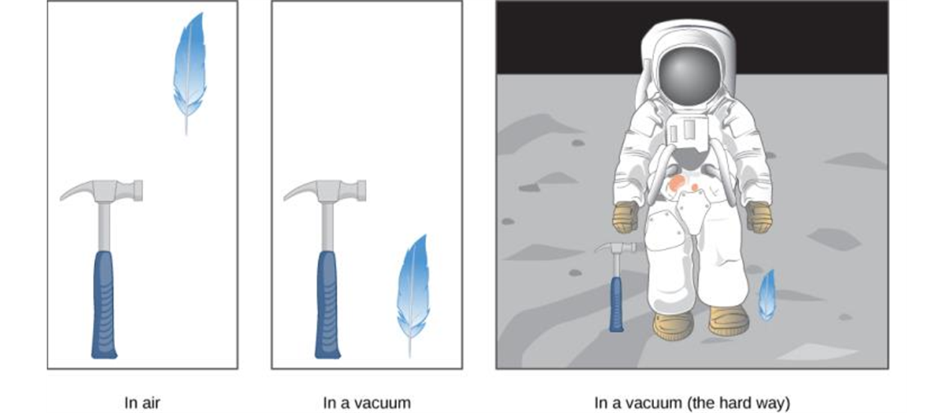
A free fall acceleration
If there is no air resistance, the downward
acceleration of any freely falling object is
g = 9.80 m/s² = 32 ft/s².
A hammer and a feather fall with the same constant acceleration if air resistance is negligible. This is a general characteristic of gravity not unique to Earth, as astronaut David R. Scott demonstrated in 1971 on the Moon, where the acceleration from gravity is only 1.67 m/s² and there is no atmosphere.

Slide 4
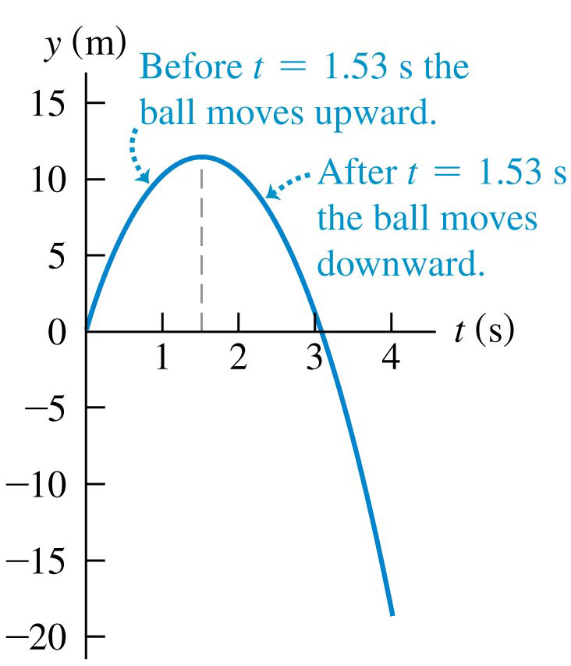
Up-and-down motion in free fall
Position as a function of time for a ball
thrown upward with an initial speed of
15.0 m/s.

Slide 5
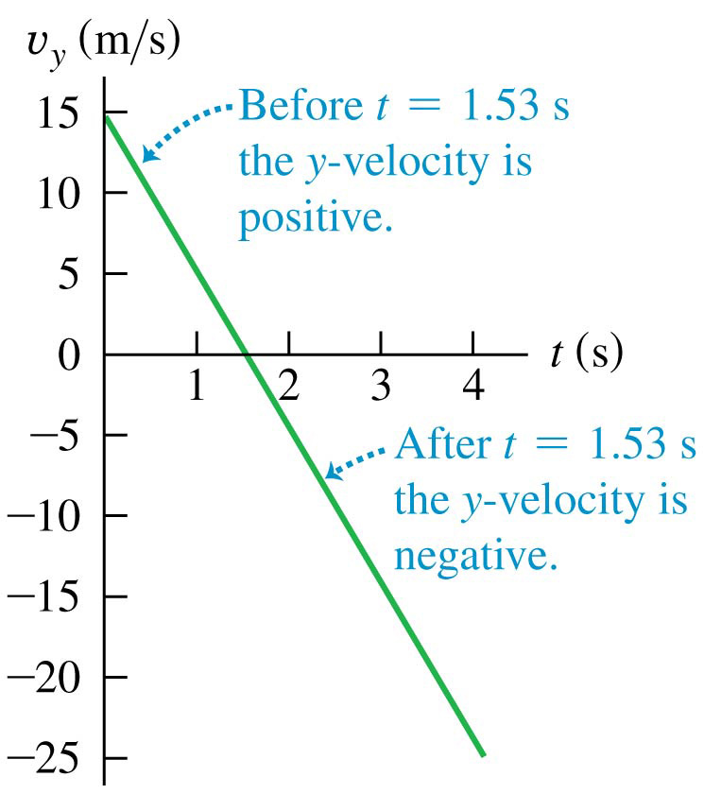
Up-and-down motion in free fall
Velocity as a function of time for a ball thrown upward with an initial speed of 15.0 m/s.
The vertical velocity, but not the acceleration, is zero at the highest point.

Slide 6
Free fall example
A watermelon is dropped from the edge of the roof of a building and falls to the ground. You noticed that it takes 2.5 s for the watermelon to reach the ground.
What is the height of the building?
How fast does the watermelon move just before it hits the ground?
How fast does the watermelon move as it passes through the midpoint of its journey?
Notes:
Y0=30.6 m, V=24.5 m/s V =
17.3 m/s

