Slide 1
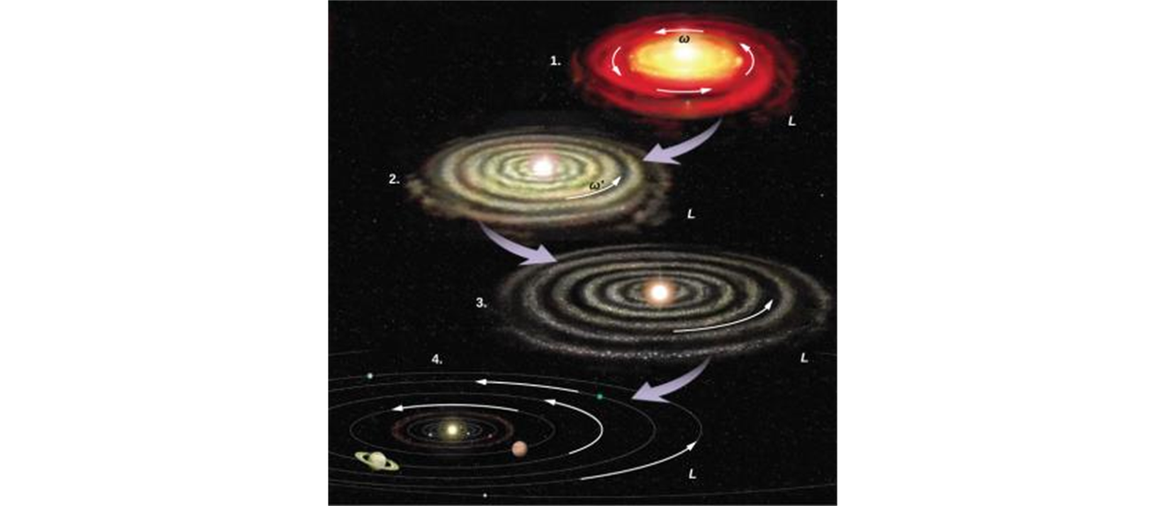

ANGULAR MOMENTUM

Slide 2
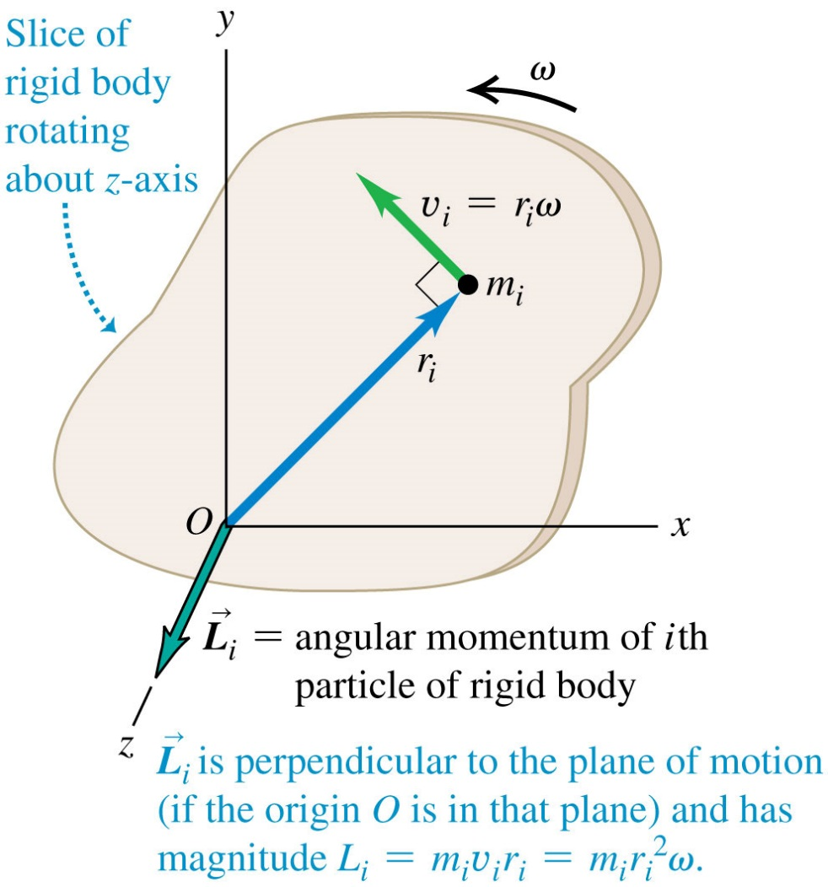

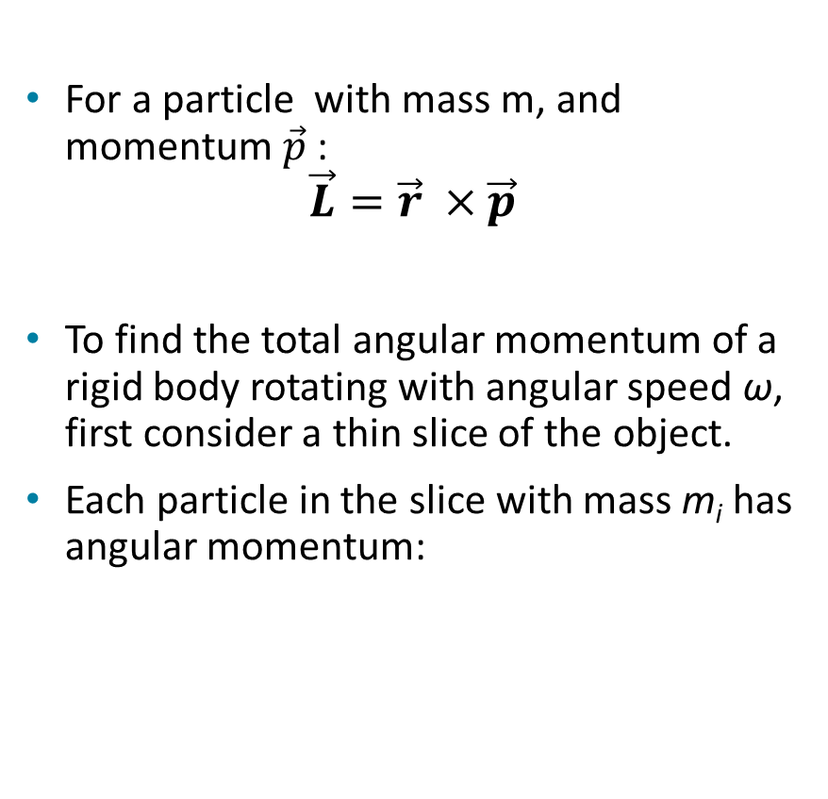
Angular momentum definition
For a particle with mass m, and momentum $\vec{p}$ :
$$\vec{L}=\vec{r} ×\vec{p}$$
To find the total angular momentum of a rigid body rotating with angular speed ω, first consider a thin slice of the object.
Each particle in the slice with mass m_{i} has angular momentum:

Slide 3
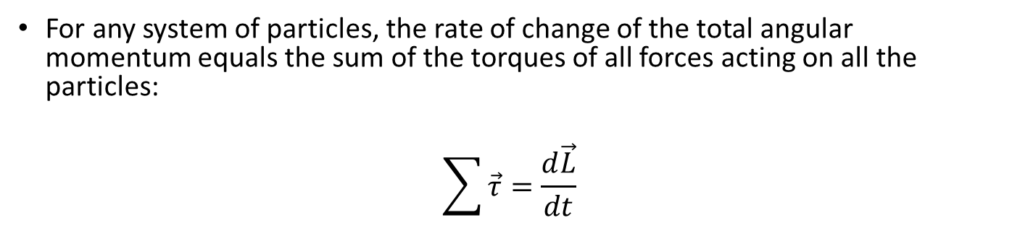
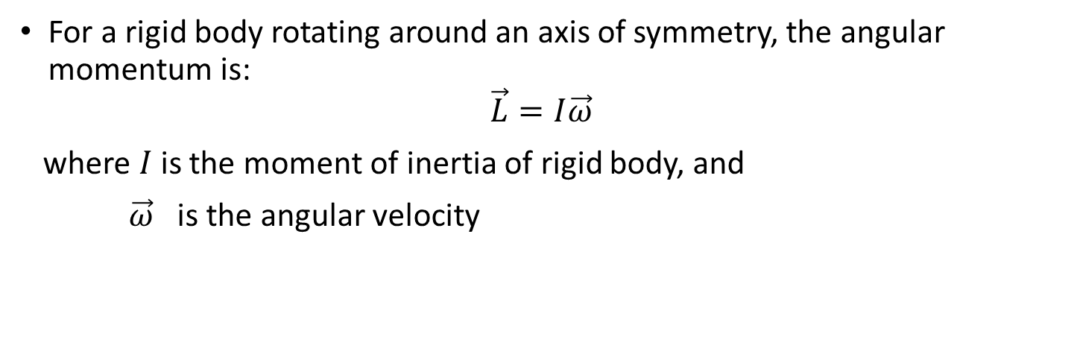
Angular Momentum, Continued
For a rigid body rotating around an axis of symmetry, the angular momentum is:
$$\vec{L}=I\vec{ω}$$
where $I$is the moment of inertia of rigid body, and
$\vec{ω}$ is the angular velocity
For any system of particles, the rate of change of the total angular momentum equals the sum of the torques of all forces acting on all the particles:
$$\sum{\vec{τ}}=\frac{d\vec{L}}{dt}$$
Note:
Value of angular momentum depends on the choice of origin
2. SI units - kg-m ²/s

Slide 4
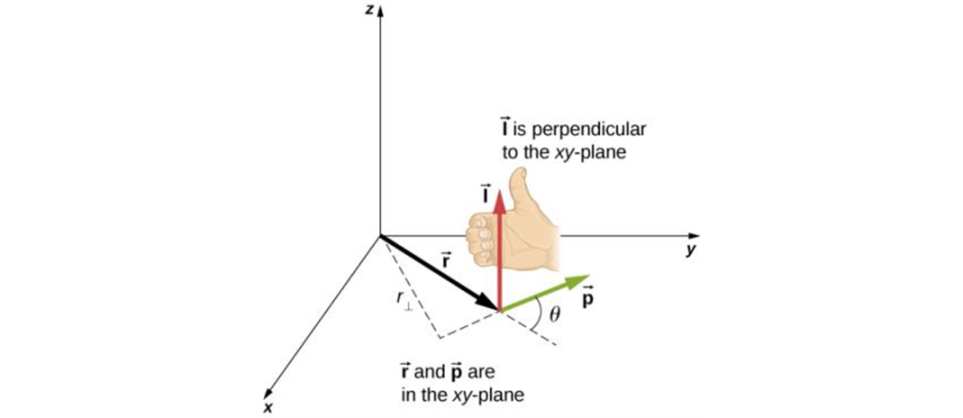
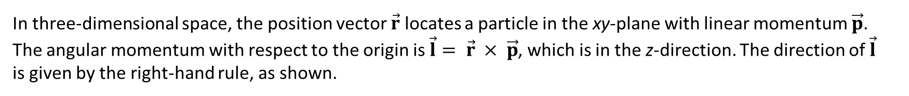
Angular momentum: direction
In three-dimensional space, the position vector $\vec{r}$ locates a particle in the xy-plane with linear momentum $\vec{p}$. The angular momentum with respect to the origin is $\vec{l}= \vec{r} × \vec{p}$, which is in the z-direction. The direction of $\vec{l}$ is given by the right-hand rule, as shown.

Slide 5
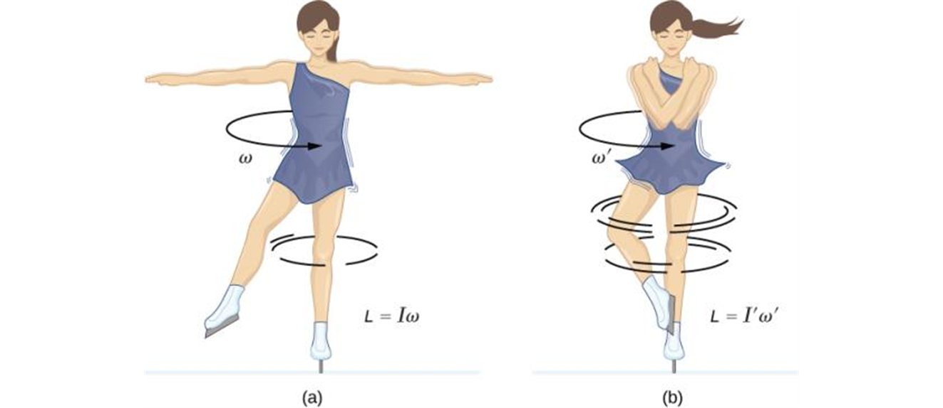
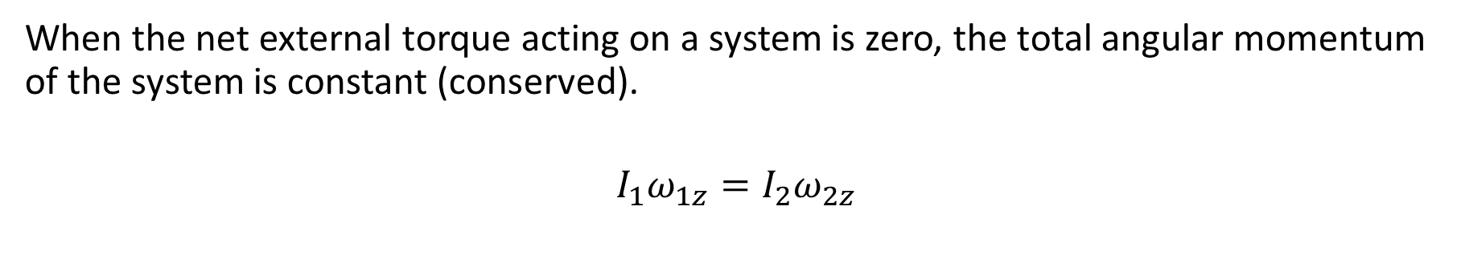
Conservation of angular momentum
When the net external torque acting on a system is zero, the total angular momentum of the system is constant (conserved).
$$I_{1}ω_{1z}=I_{2}ω_{2z}$$
An ice skater is spinning on the tip of her skate with her arms extended. Her angular momentum is conserved because the net torque on her is negligibly small.
Her rate of spin increases greatly when she pulls in her arms, decreasing her moment of inertia. The work she does to pull in her arms results in an increase in rotational kinetic energy.

