Slide 1



ROTATION OF RIGID BODIES

Slide 2
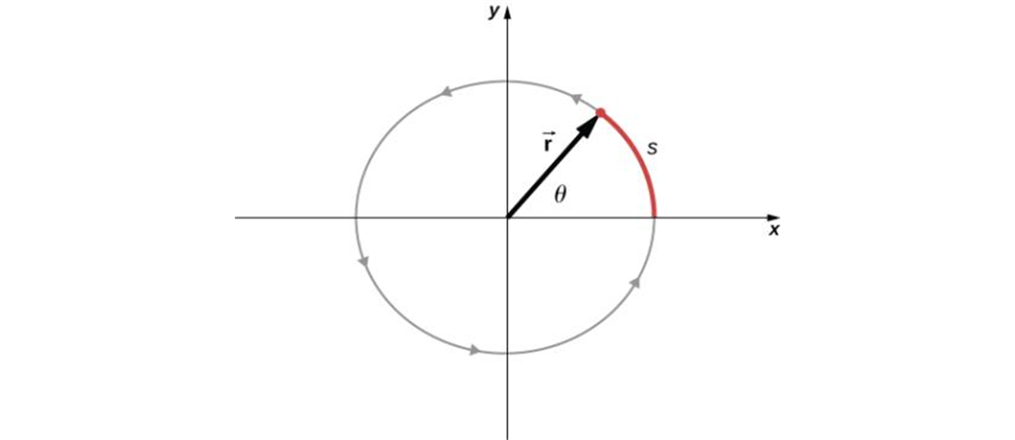
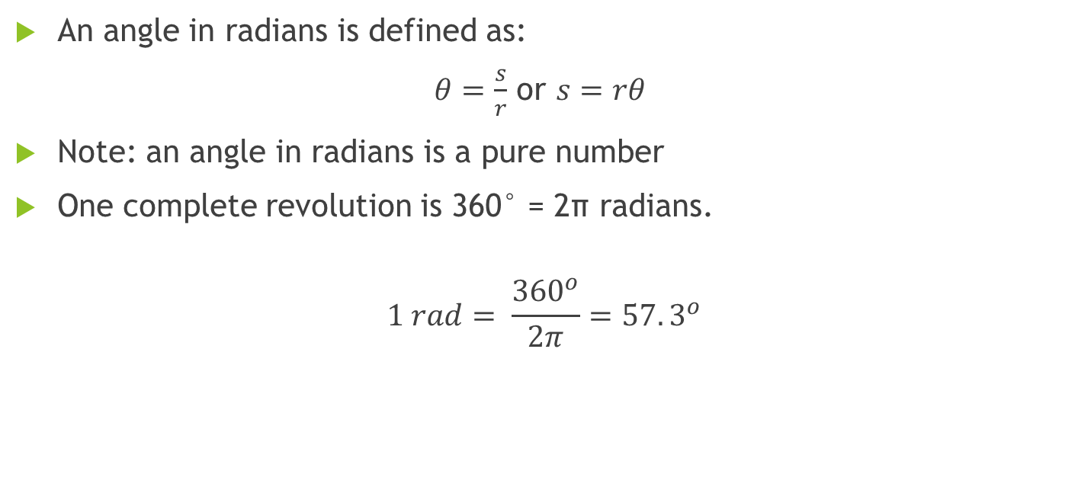
Angle in radians
An angle in radians is defined as:
$θ=\frac{s}{r}$ or $s=rθ$
Note: an angle in radians is a pure number
One complete revolution is 360° = 2π radians.
$$1 rad= \frac{{360}^{o}}{2π}=57.3^{o}$$

Slide 3
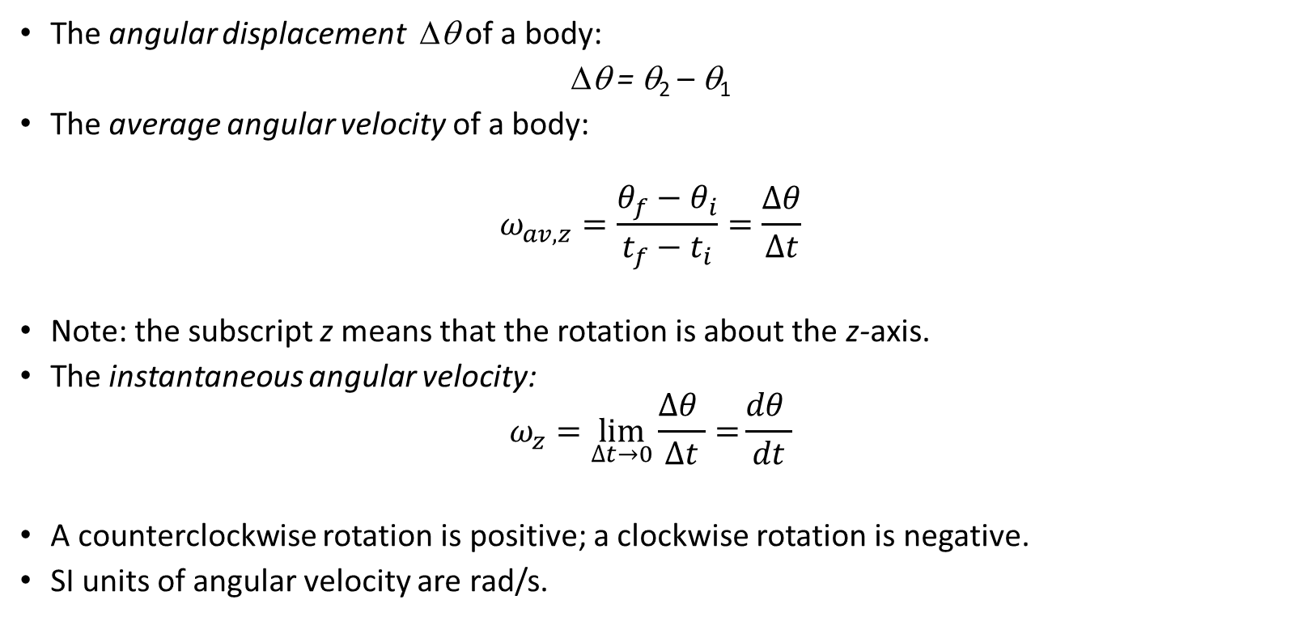
Angular displacement and velocity
The angular displacement Δθ of a body:
Δθ = θ₂ – θ₁
The average angular velocity of a body:
$$ω_{av,z}=\frac{θ_{f}−θ_{i}}{t_{f}−t_{i}}=\frac{∆θ}{∆t}$$
Note: the subscript z means that the rotation is about the z-axis.
The instantaneous angular velocity:
$$ω_{z}=\lim_{∆t→0}{\frac{∆θ }{∆t}=}\frac{dθ }{dt}$$
A counterclockwise rotation is positive; a clockwise rotation is negative.
SI units of angular velocity are rad/s.

Slide 4
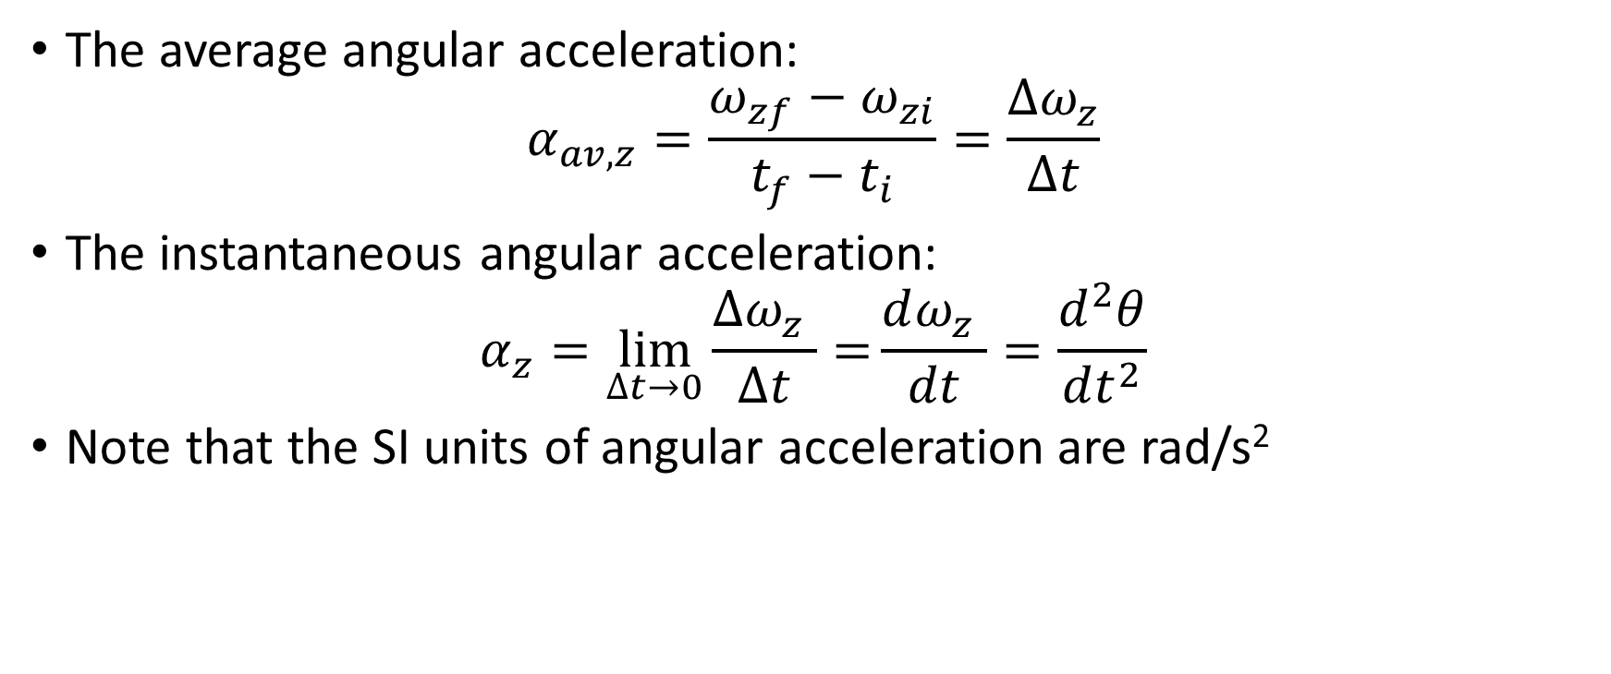
Angular acceleration
The average angular acceleration:
$$α_{av,z}=\frac{ω_{zf}−ω_{zi}}{t_{f}−t_{i}}=\frac{∆ω_{z}}{∆t}$$
The instantaneous angular acceleration:
$$α_{z}=\lim_{∆t→0}{\frac{∆ω_{z} }{∆t}=}\frac{dω_{z} }{dt}=\frac{d^{2}θ}{dt^{2}}$$
Note that the SI units of angular acceleration are rad/s²

Slide 5
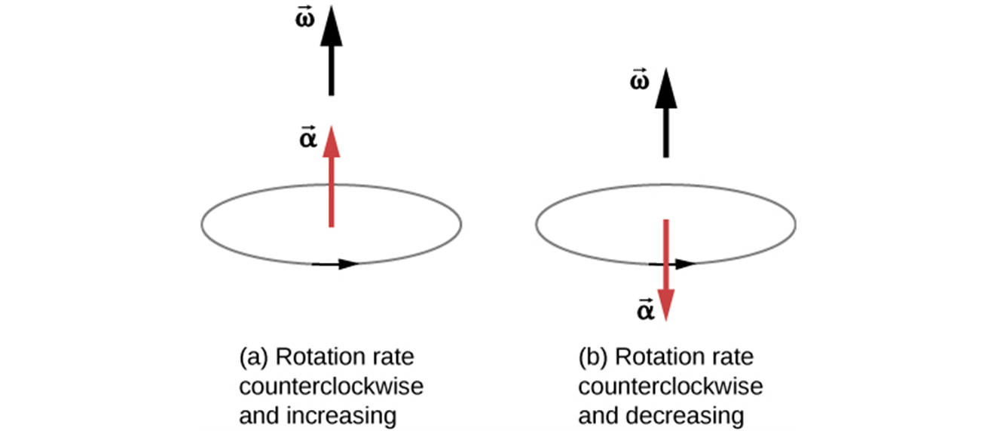
Angular acceleration is a vector
For a fixed rotation axis, the angular acceleration and angular velocity vectors both lie along that axis.
The angular acceleration is in the same direction as the angular velocity, which increases the rotation rate.
The angular acceleration is in the opposite direction to the angular velocity, which decreases the rotation rate.

Slide 6
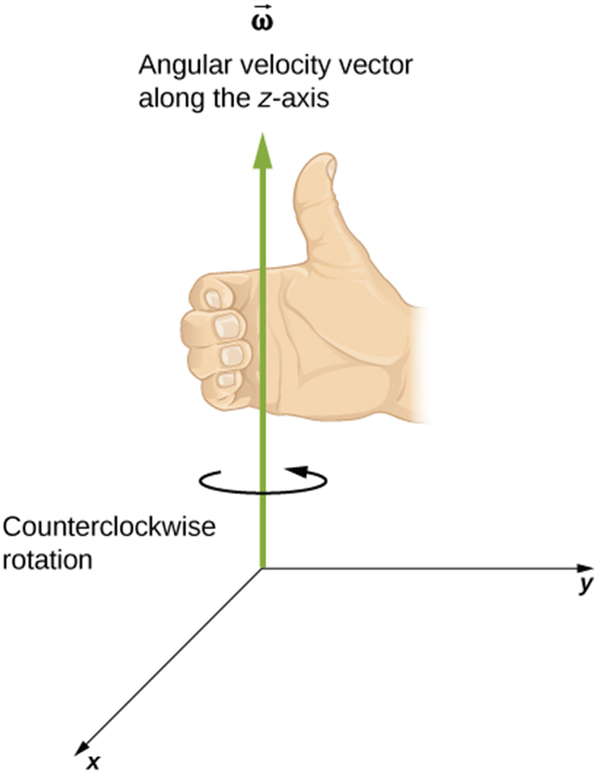
Angular velocity is a vector
Angular velocity is a vector whose direction is given by the right-hand rule as shown in the Figure.

Slide 7
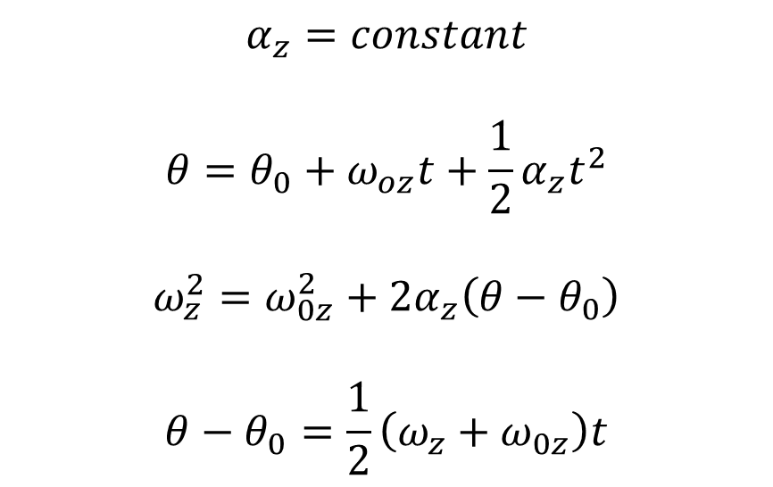
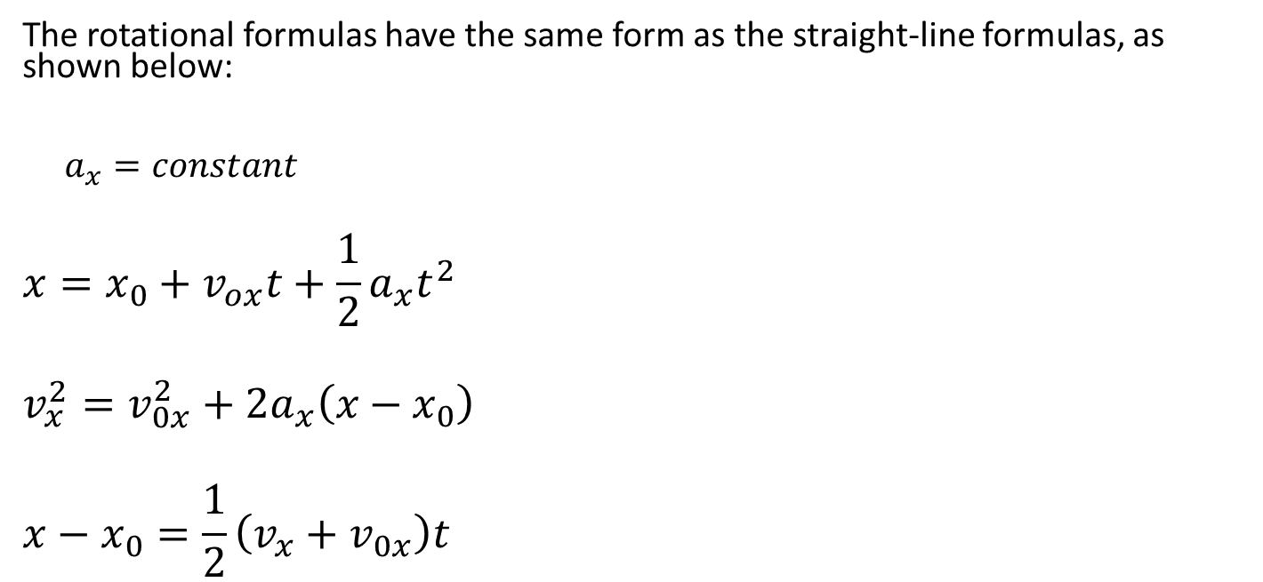
Comparison of linear and angular motion with constant acceleration
The rotational formulas have the same form as the straight-line formulas, as shown below:
$a_{x}=constant$
$$x=x_{0}+v_{ox}t+\frac{1}{2}a_{x}t^{2}$$
$$v_{x}^{2}=v_{0x}^{2}+2a_{x}\left(x−x_{0}\right)$$
$$x−x_{0}=\frac{1}{2}\left(v_{x}+v_{0x}\right)t$$
$$α_{z}=constant$$
$$θ=θ_{0}+ω_{oz}t+\frac{1}{2}α_{z}t^{2}$$
$$ω_{z}^{2}=ω_{0z}^{2}+2α_{z}\left(θ−θ_{0}\right)$$
$$θ−θ_{0}=\frac{1}{2}\left(ω_{z}+ω_{0z}\right)t$$

Slide 8
Rotation of a disc, example
You have just finished watching a movie on DVD and the disc is slowing to a stop. The angular velocity of the disc at t = 0 is 27.5 rad/s and its angular acceleration is -10.0 rad/s². What is the disc’s angular velocity at t = 0.300 s? What angle does the disc rotate through during this time?

Slide 9
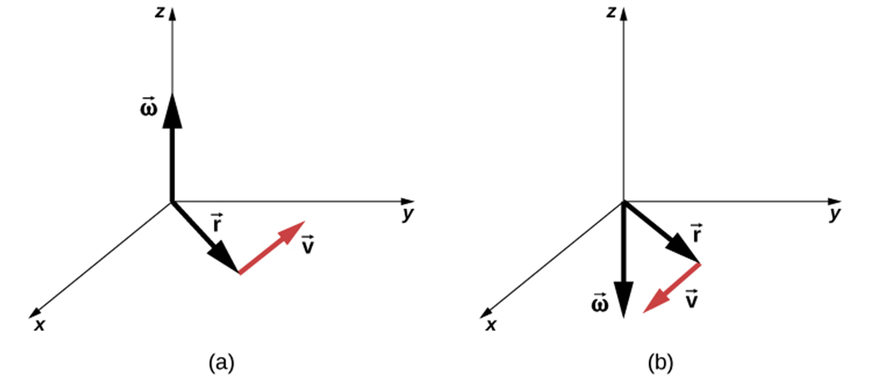
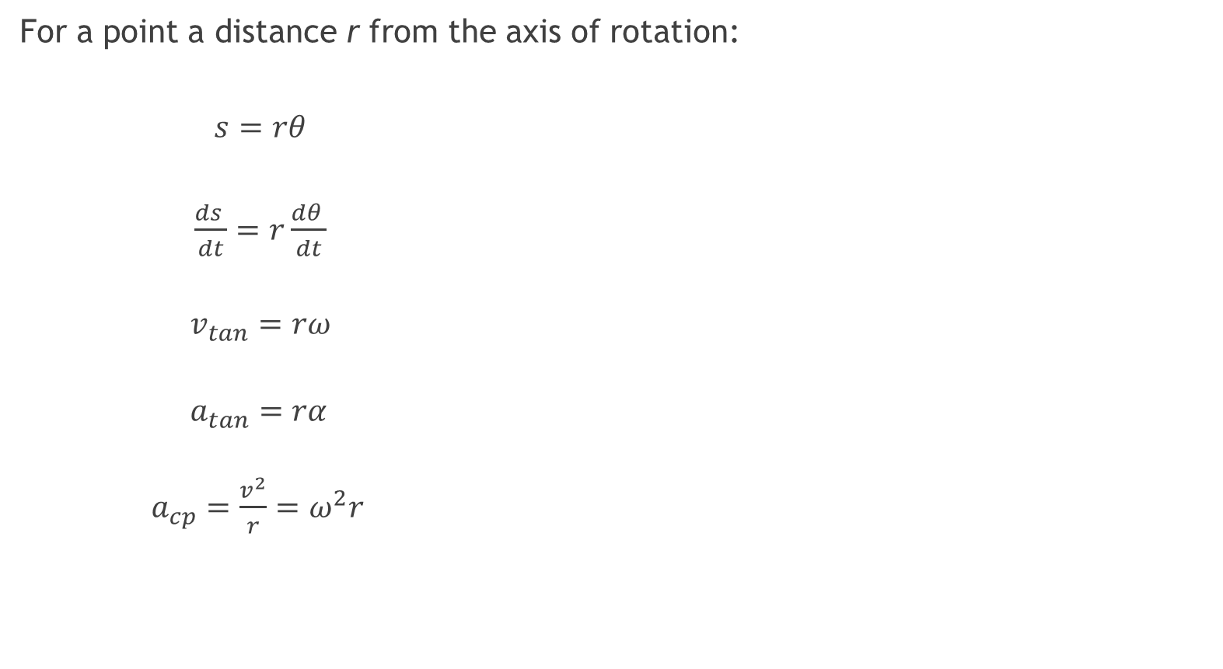
Relating linear and angular kinematics
For a point a distance r from the axis of rotation:
$s=rθ$
$\frac{ds }{dt}=r\frac{dθ }{dt}$
  $v_{tan}=rω$
  $a_{tan}=rα$
  $a_{cp}={\frac{v^{2}}{r}=ω}^{2}r$
The vectors shown are the angular velocity, position, and tangential velocity.
The angular velocity points in the positive z-direction, giving a counterclockwise rotation in the xy-plane.
The angular velocity points in the negative z-direction, giving a clockwise rotation.

Slide 10
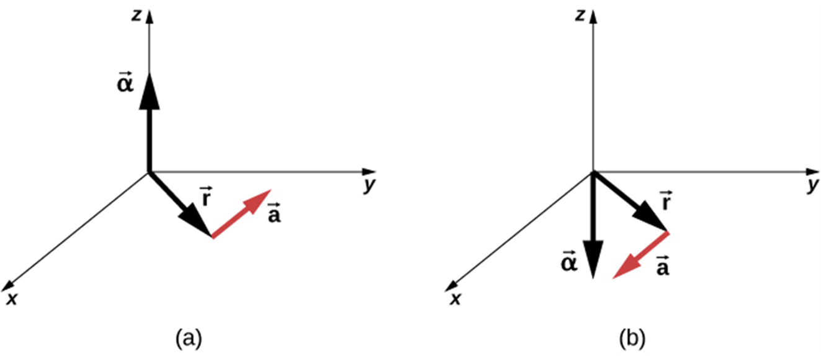
Relating linear and angular kinematics, continued
The angular acceleration is the positive z-direction and produces a tangential acceleration in a counterclockwise sense.
The angular acceleration is in the negative z-direction and produces a tangential acceleration in the clockwise sense.
Note: Remember to use angles in radians as you relate angular and linear quantities!

Slide 11
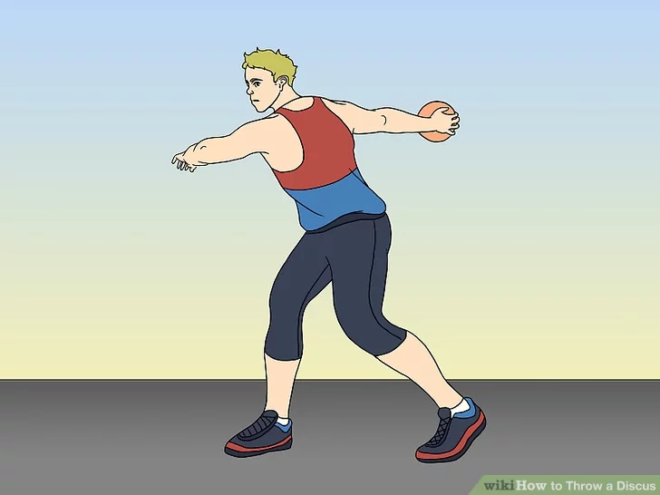
An athlete throwing a discus
A discus thrower moves a discus in a circle with radius 80.0 cm. At a certain instant, the thrower is spinning at an angular speed of 10.0 rad/s and the angular speed is increasing at 50.0 rad/s². At this instant, find the tangential and centripetal components of the acceleration and its magnitude.
Notes:
At = 40 m/s2, acp = 80 m/s2, a = 89.4 m/s2

