Slide 1



KINETIC ENERGY OF ROTATION

Slide 2
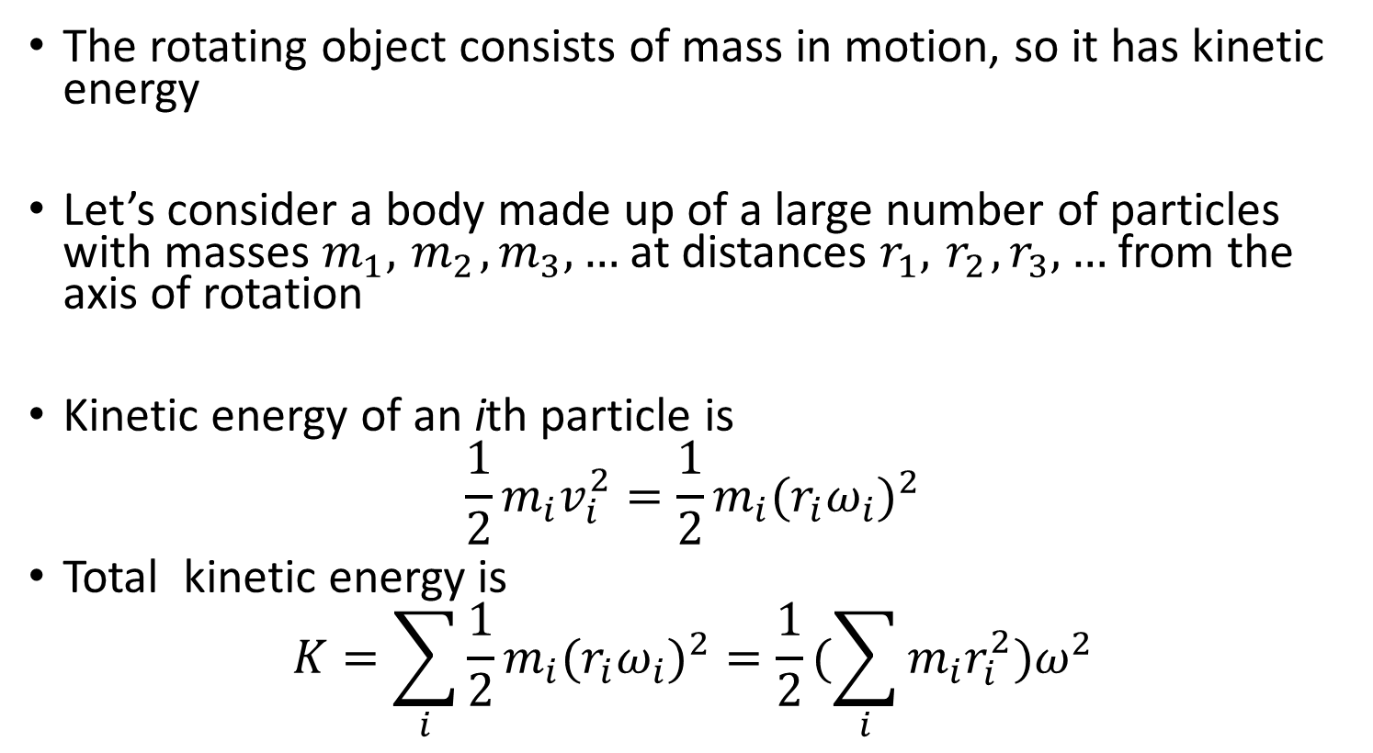
Rotational Kinetic Energy
The rotating object consists of mass in motion, so it has kinetic energy
Let’s consider a body made up of a large number of particles with masses $m_{1},{ m}_{2}, m_{3},…$at distances $r_{1},{ r}_{2}, r_{3},…$from the axis of rotation
Kinetic energy of an ith particle is
$$\frac{1}{2}m_{i}v_{i}^{2}=\frac{1}{2}m_{i}(r_{i}ω_{i})^{2}$$
Total kinetic energy is
$$K=\sum_{i}{\frac{1}{2}m_{i}(r_{i}ω_{i})^{2}}=\frac{1}{2}(\sum_{i}{m_{i}r_{i}^{2})ω^{2}}$$

Slide 3


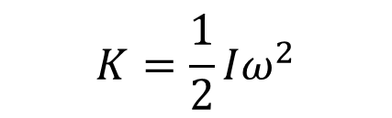
Rotational kinetic energy and moment of inertia
The rotational kinetic energy of a rigid body is:
The moment of inertia, I, is obtained by multiplying the mass of each particle by the square of its distance from the axis of rotation and adding these products:
The SI unit of I is the
$$K=\frac{1}{2}Iω^{2}$$
$$I=m_{1}r_{1}^{2}+m_{2}r_{2}^{2}+ m_{3}r_{3}^{2}+⋯=\sum_{i}{m_{i}r_{i}^{2}}$$

Slide 4
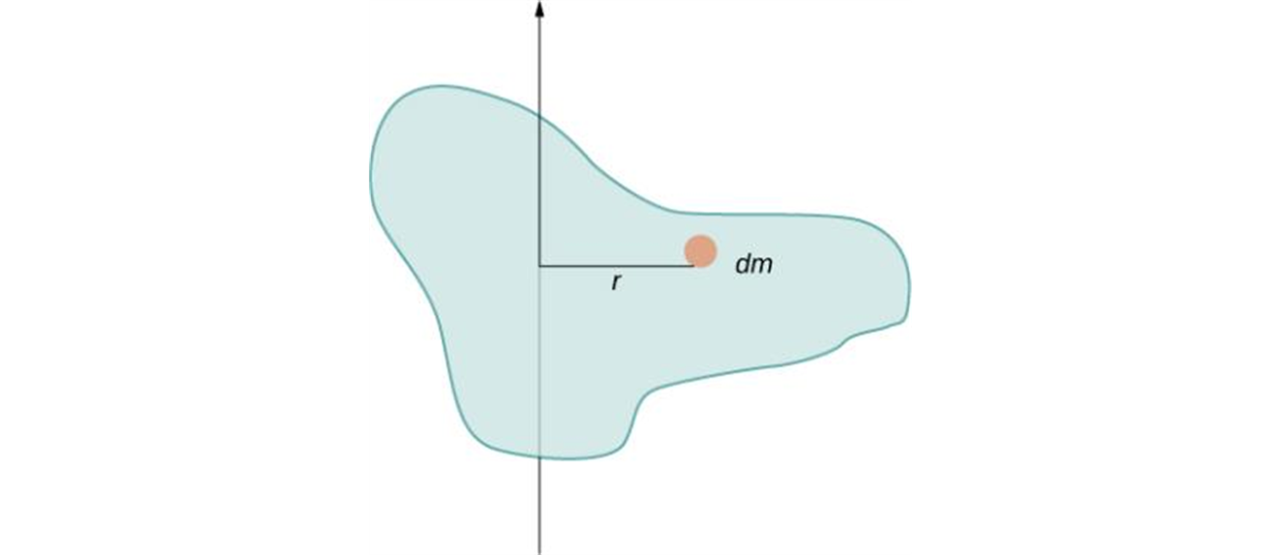
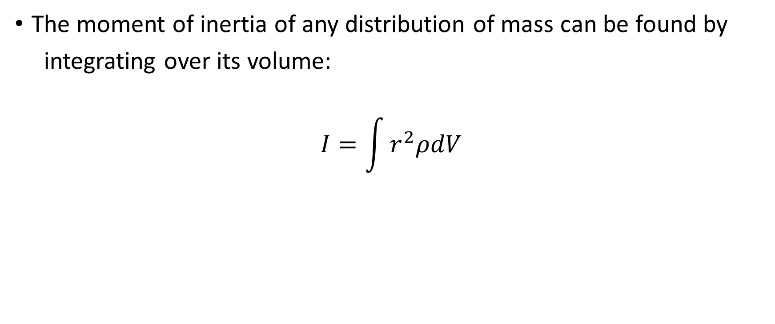
Moment of inertia of continuous distribution of mass
The moment of inertia of any distribution of mass can be found by
integrating over its volume:
$$I=\int{r^{2}ρdV}$$
Using an infinitesimally small piece of mass to calculate the contribution to the total moment of inertia.

Slide 5
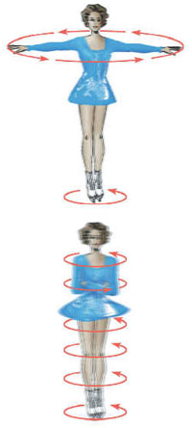
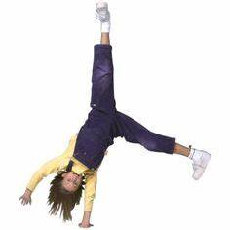
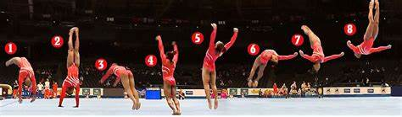
Moment of inertia, continued
Moment of inertia depends on
Mass of an object
Size and shape of the object
How the mass is distributed
Axis of rotation

Slide 6
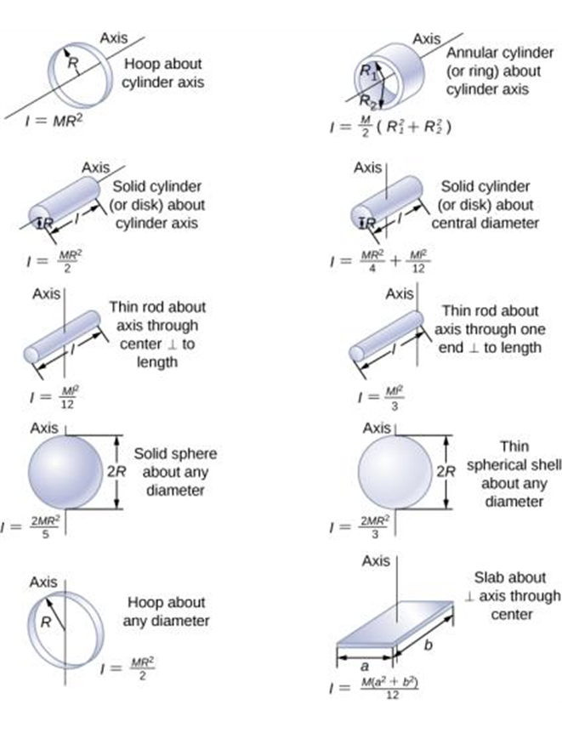
Moments of inertia of some common objects

Slide 7
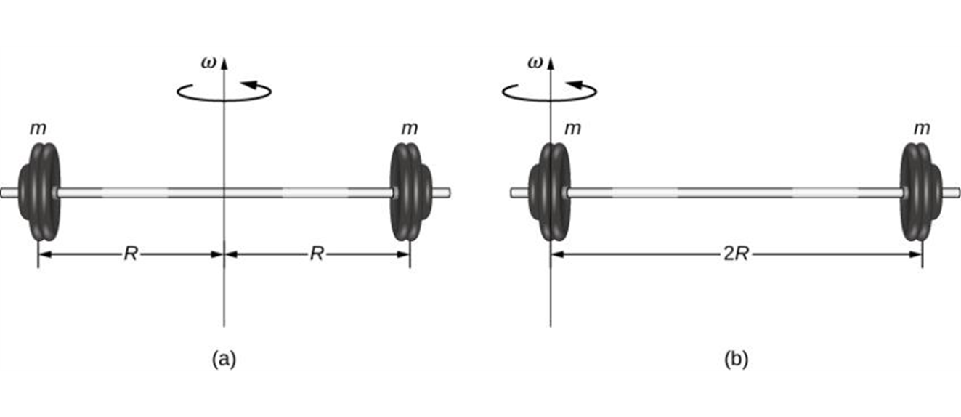
The parallel-axis theorem
There is a simple relationship, called the parallel-axis theorem, between the moment of inertia of an object about an axis through its center of mass and the moment of inertia about any other axis parallel to the original axis.
$$I_{p}=I_{cm}+Md^{2}$$
(a) A barbell with an axis of rotation through its center; (b) a barbell with an axis of rotation through one end.

