Slide 1
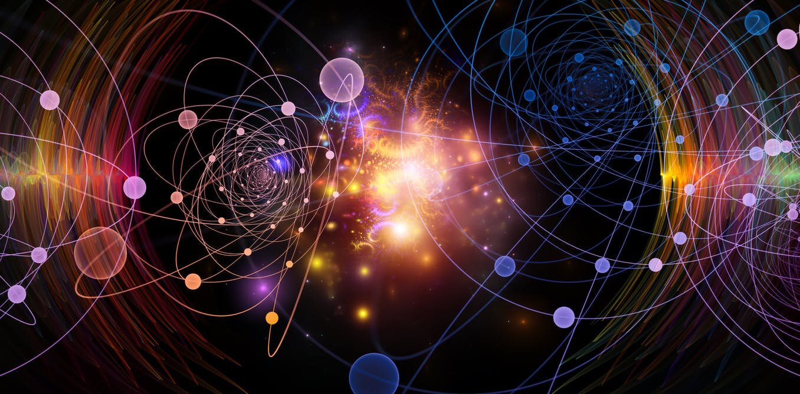


PHYSICS: THE SCIENCE OF THE UNIVERSE AND EVERYTHING IN IT

Slide 2
The Nature of Physics
Physics is an experimental science in which physicists seek patterns that relate the phenomena of nature.
The patterns are called physical theories.
A very well established or widely used theory is called a physical law or principle.
Usually expressed in mathematical terms.

Slide 3

Solving Problems in Physics
Typically, we will follow these steps:
Identify the relevant concepts, target variables,
and known quantities, as stated or implied in the problem.
Set Up the problem: Choose the equations that you’ll use to solve the problem, and draw a sketch of the situation.
Execute the solution: This is where you “do the math.”
Evaluate your answer: Compare your answer with your estimates, and reconsider things if there’s a discrepancy.

Slide 4
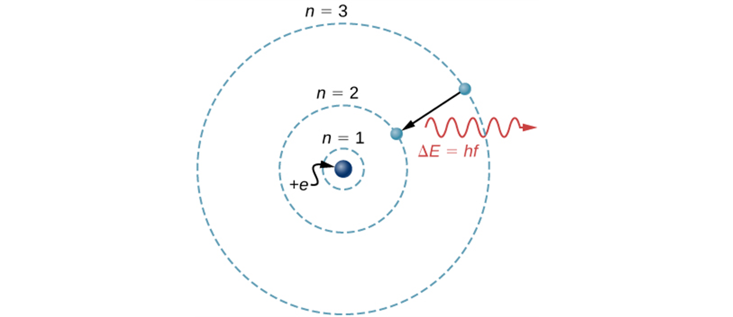
Idealized Models
Model: simplified version of a physical system which is otherwise too complicated to analyze in full detail.
For example, the Bohr model of a single-electron atom shows the electron orbiting the nucleus in one of several possible circular orbits. Like all models, it captures some, but not all, aspects of the physical system.

Slide 5
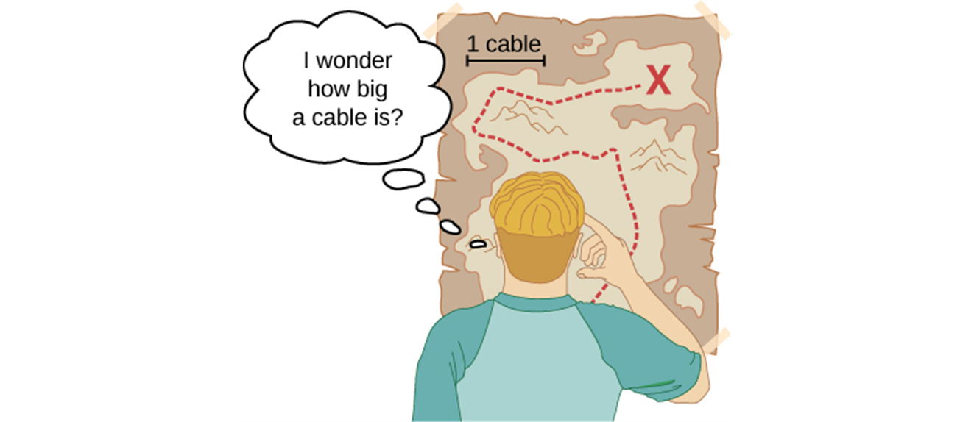
Standards and Units
Experiments require measurements.
Physical quantity - any number that describes physical phenomenon quantitatively.
Generally, we separate fundamental and derived physical quantities.
Length, time, and mass are three fundamental quantities of physics.
The International System (SI for Système International) is the most widely used system of units.
In SI units, length is measured in meters, time in seconds, and mass in kilograms.

Slide 6
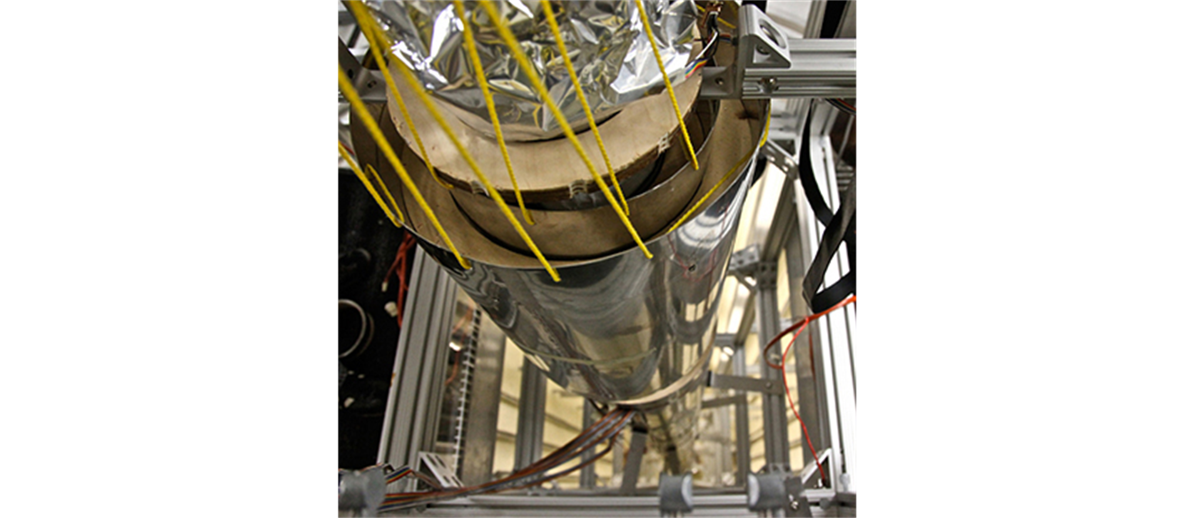
Time
1 second is defined as time required for 9,192,631,770 cycles of the radiation from cesium atom.
An atomic clock such as this one uses the vibrations of cesium atoms to keep time to a precision of better than a microsecond per year. The fundamental unit of time, the second, is based on such clocks. This image looks down from the top of an atomic fountain nearly 30 feet tall. (credit: Steve Jurvetson)

Slide 7
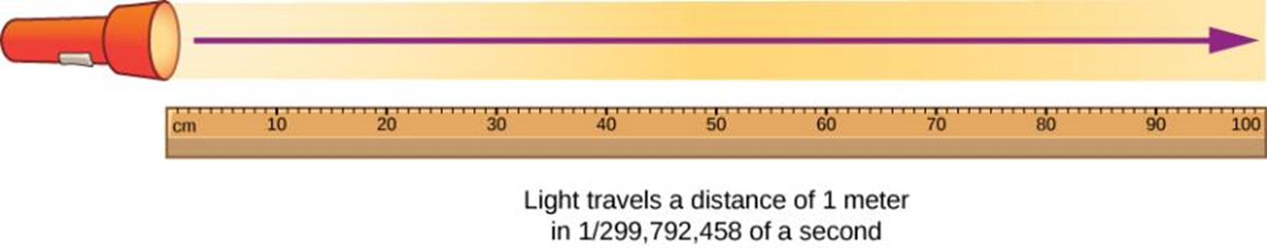
Length
1 meter = the distance light travels in a vacuum in 1/299,792,458 second.

Slide 8
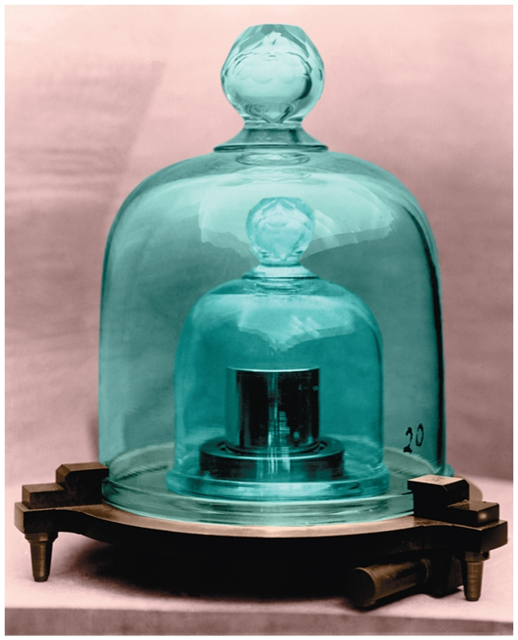
Mass
1 kilogram (old definition) = mass of a particular cylinder of platinum-iridium allow kept at the International Bureau of Weights and Measures at Sevres (France).
The kilogram is now defined in terms of the Planck constant, h. Its agreed value will be set as 6.626,070,15 × 10⁻³⁴ kg m² s^{–1}
Note: the gram is not a fundamental unit!

Slide 9
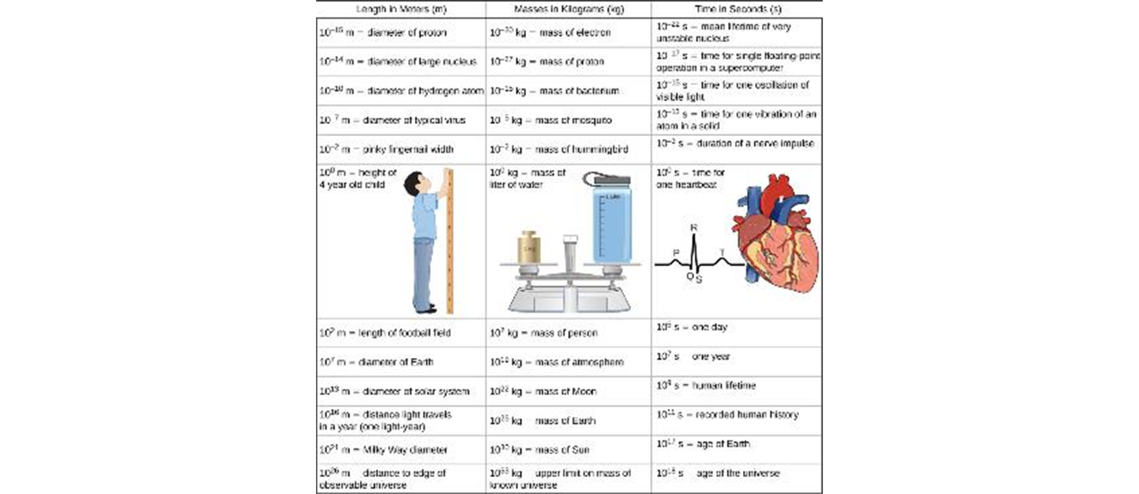
Length. Mass, and Time, Order of Magnitude
This table shows the orders of magnitude of length, mass, and time.

Slide 10
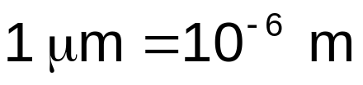




Unit Prefixes
Prefixes can be used to create larger and smaller units for the fundamental quantities. Some examples are:
(size of some bacteria and living cells)
(a 10-minute walk)
(mass of a grain of salt)
(mass of a paper clip)
(time for light to travel 0.3 m)

Slide 11
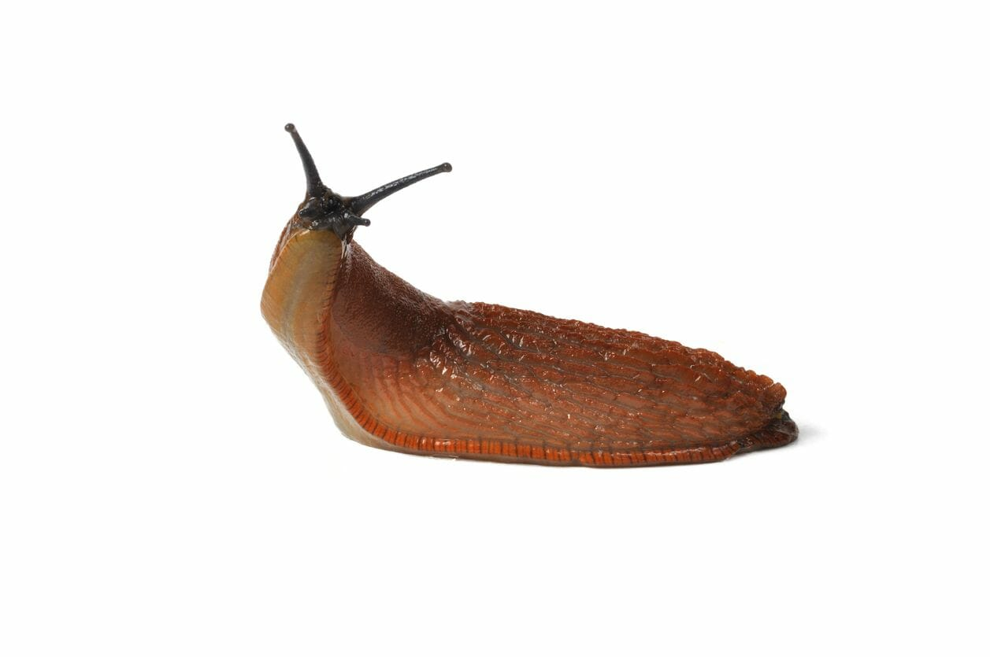
The British Engineering System
Length: foot (1 foot = 0. 3048 m)
Time: second
Mass: slug (1 slug = 14.59 kg)
Note: the pound is a unit of a force (1 pound = 4.448 N)

Slide 12
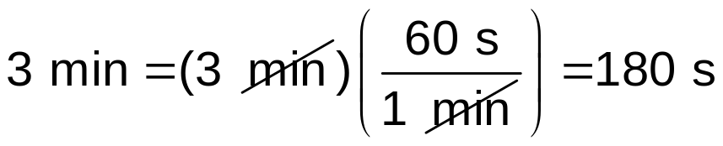
Unit Consistency and Conversions
An equation must be dimensionally consistent. Terms to be added or equated must always have the same units. (Be sure you’re adding “apples to apples.”)
Always carry units through calculations.
Convert to standard units as necessary, by forming a ratio of the same physical quantity in two different units, and using it as a multiplier.
For example, to find the number of seconds in 3 min, we write:

Slide 13
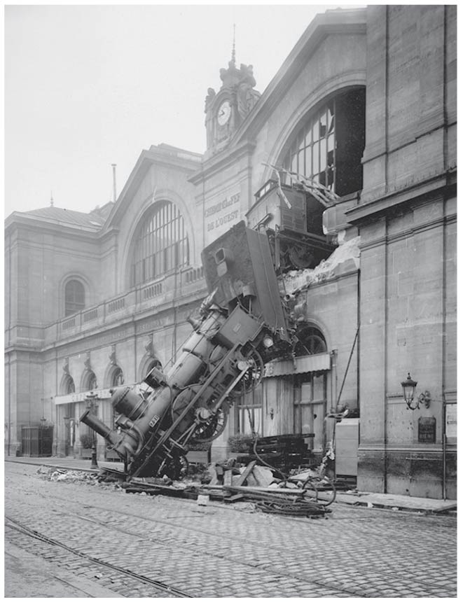
Uncertainty and Significant Figures
The uncertainty of a measured quantity is indicated by its number of significant figures.
For multiplication and division, the answer can have no more significant figures than the smallest number of significant figures in the factors.
For addition and subtraction, the number of significant figures is determined by the term having the fewest digits to the right of the decimal point.
As this train mishap illustrates, even a small percent error can have spectacular results!

