Slide 1


SOURCES OF MAGNETIC FIELD

Slide 2
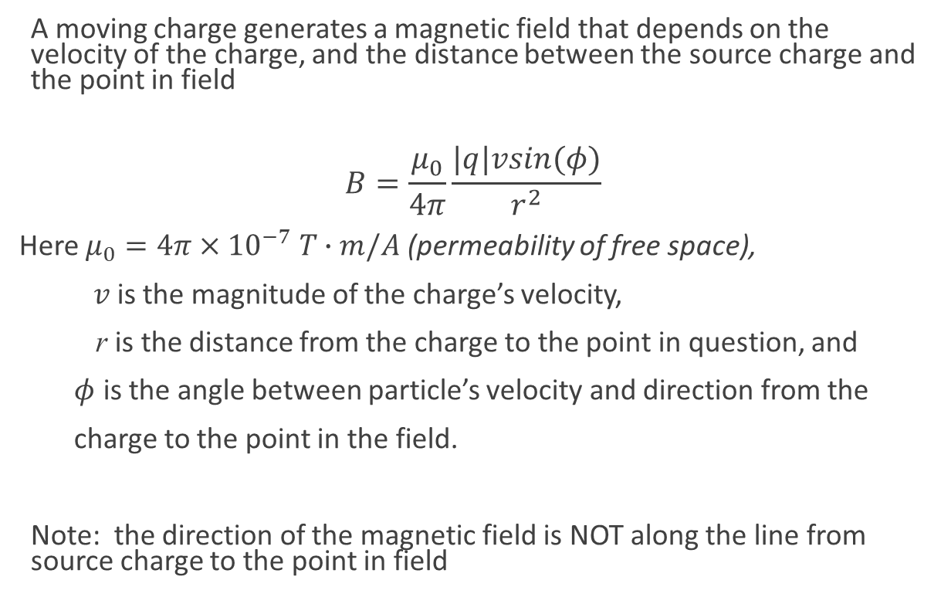
Magnetic Field of a moving charge, MAGNITUDE
A moving charge generates a magnetic field that depends on the velocity of the charge, and the distance between the source charge and the point in field
$$B=\frac{μ_{0}}{4π}\frac{|q|vsin(φ)}{r^{2}}$$
Here $μ_{0}=4π×{10}^{−7} T∙m/A$ (permeability of free space),
$v$ is the magnitude of the charge’s velocity,
r is the distance from the charge to the point in question, and
$φ$ is the angle between particle’s velocity and direction from the
charge to the point in the field.
Note: the direction of the magnetic field is NOT along the line from source charge to the point in field

Slide 3
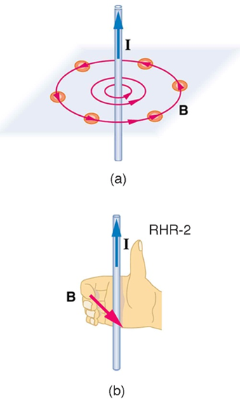
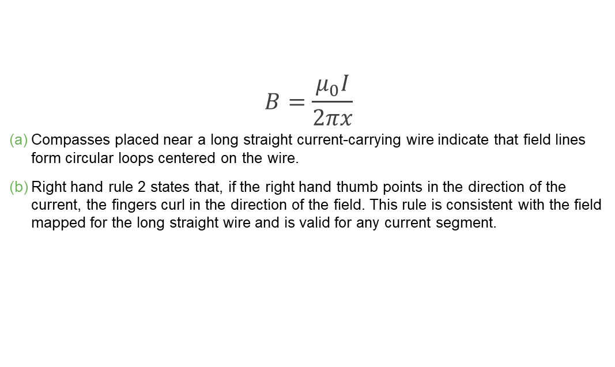
Magnetic field of a straight current-carrying conductor
$$B=\frac{μ_{0}I}{2πx}$$
Compasses placed near a long straight current-carrying wire indicate that field lines form circular loops centered on the wire.
Right hand rule 2 states that, if the right hand thumb points in the direction of the current, the fingers curl in the direction of the field. This rule is consistent with the field mapped for the long straight wire and is valid for any current segment.

Slide 4
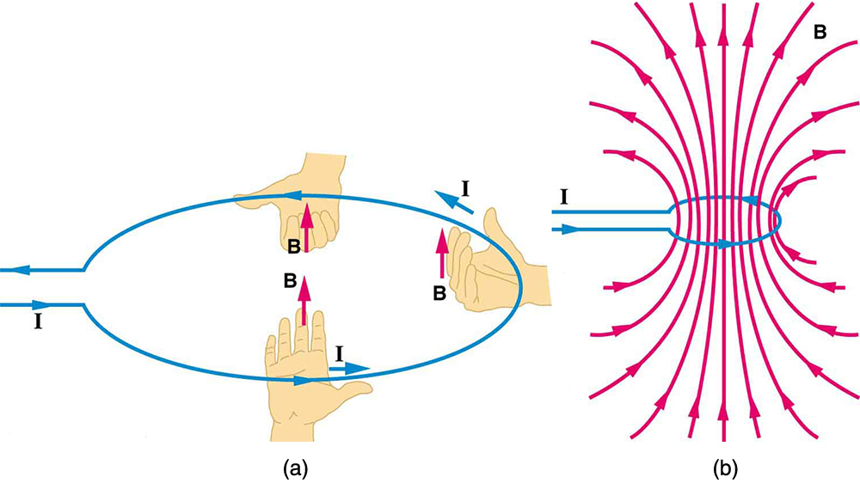
Magnetic field of a current-carrying loop
RHR-2 gives the direction of the magnetic field inside and outside a current-carrying loop.
More detailed mapping with compasses or with a Hall probe completes the picture. The field is similar to that of a bar magnet.

Slide 5
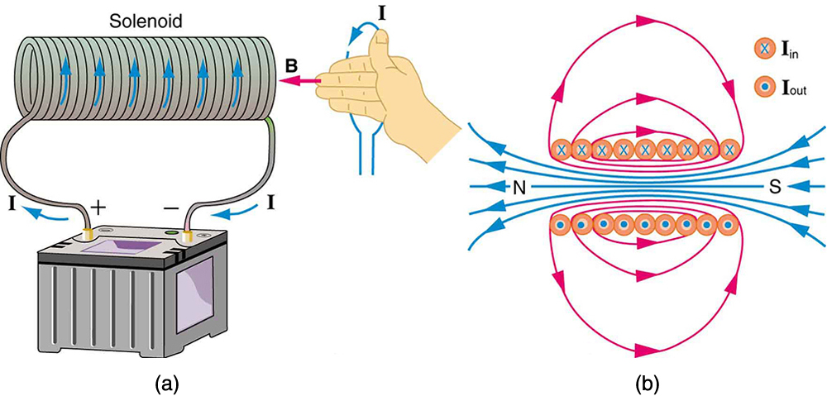
Figure 22.40
Because of its shape, the field inside a solenoid of length l is remarkably uniform in magnitude and direction, as indicated by the straight and uniformly spaced field lines. The field outside the coils is nearly zero.
This cutaway shows the magnetic field generated by the current in the solenoid.

Slide 6
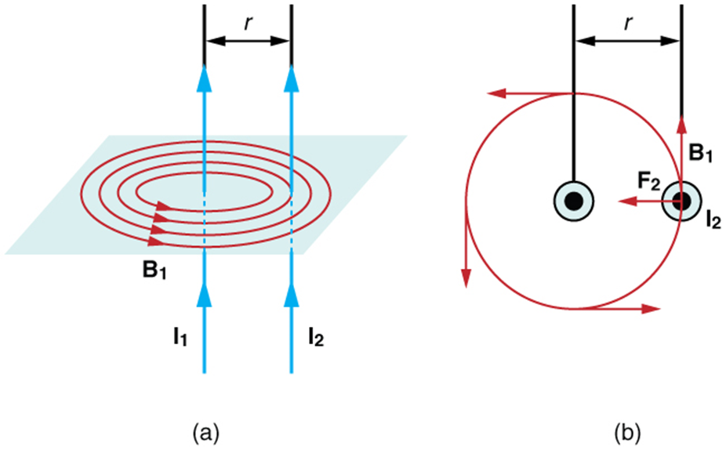
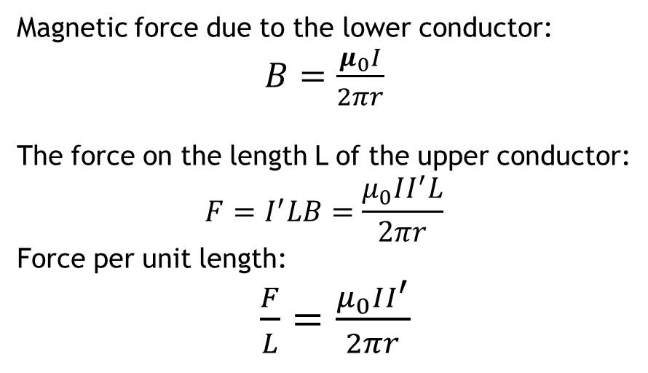
Forces between parallel conductors
Magnetic force due to the lower conductor:
$B=\frac{μ_{0}I}{2πr}$
The force on the length L of the upper conductor:
$$F=I^{′}LB=\frac{μ_{0}II^{′}L}{2πr}$$
Force per unit length:
$\frac{F}{L}=\frac{μ_{0}II^{′}}{2πr}$
The magnetic field produced by a long straight conductor is perpendicular to a parallel conductor, as indicated by RHR-2.
A view from above of the two wires shown in (a), with one magnetic field line shown for each wire. RHR-1 shows that the force between the parallel conductors is attractive when the currents are in the same direction. A similar analysis shows that the force is repulsive between currents in opposite directions.
The conductors attract each other if the currents are in the same direction and repel if they are in opposite directions.

Slide 7
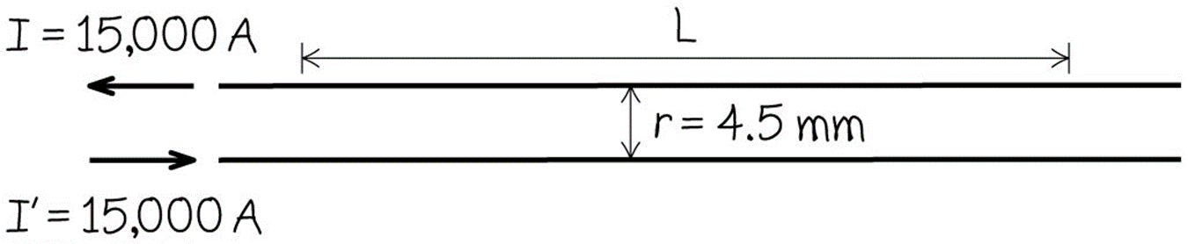
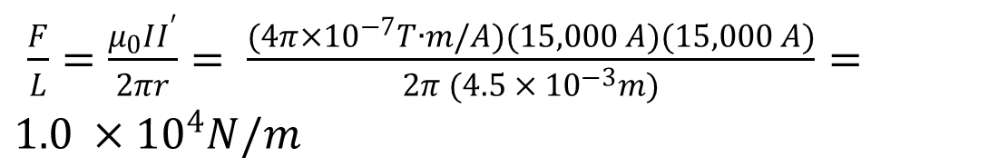
Forces between parallel wires, example
$\frac{F}{L}=\frac{μ_{0}II^{′}}{2πr}= \frac{(4π×{10}^{−7}T∙m/A)(15,000 A)(15,000 A)}{2π (4.5 × {10}^{−3}m)}=1.0 ×{10}^{4}N/m$
One ampere is that current that if present in each of two parallel conductors of infinite length and one meter apart in empty space, causes each conductor to experience a force of exactly 2 x 10⁻⁷ newtons per meter of length

Slide 8

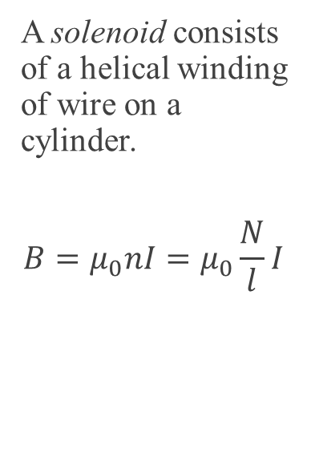
MAGNETIC FIELD OF A SOLENOID
A solenoid consists of a helical winding of wire on a cylinder.
$$B=μ_{0}nI=μ_{0}\frac{N}{l}I$$
Because of its shape, the field inside a solenoid of length l is remarkably uniform in magnitude and direction, as indicated by the straight and uniformly spaced field lines. The field outside the coils is nearly zero.
This cutaway shows the magnetic field generated by the current in the solenoid.

