Slide 1

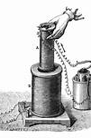
ELECTROMAGNETIC INDUCTION

Slide 2
Today’s objectives
By the end of this lesson, you will be able to:
Calculate the flux of a uniform magnetic field through a loop of arbitrary orientation.
Describe methods to produce an electromotive force (emf) with a magnetic field or magnet and a loop of wire.
Calculate emf, current, and magnetic fields using Faraday’s Law.
Explain the physical results of Lenz’s Law
Calculate emf, force, magnetic field, and work due to the motion of an object in a magnetic field.
Explain the magnitude and direction of an induced eddy current, and the effect this will have on the object it is induced in.

Slide 3
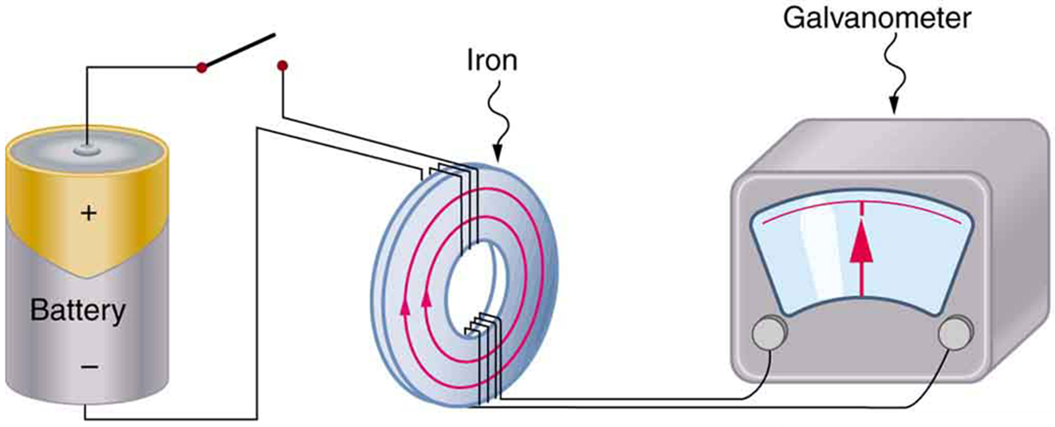
Emf and current induced in a loop
Faraday’s apparatus for demonstrating that a magnetic field can produce a current. A change in the field produced by the top coil induces an emf and, hence, a current in the bottom coil. When the switch is opened and closed, the galvanometer registers currents in opposite directions. No current flows through the galvanometer when the switch remains closed or open.

Slide 4
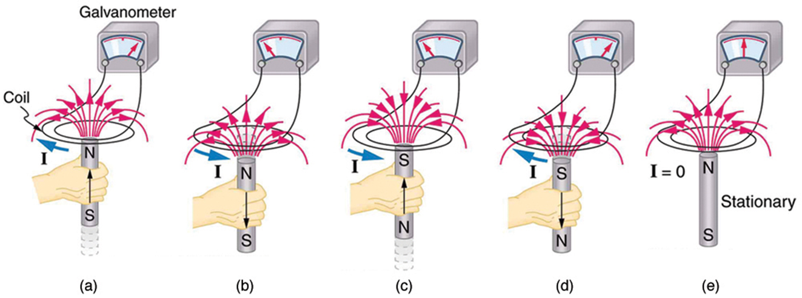
Induced current
Movement of a magnet relative to a coil produces emfs as shown. The same emfs are produced if the coil is moved relative to the magnet. The greater the speed, the greater the magnitude of the emf, and the emf is zero when there is no motion.

Slide 5
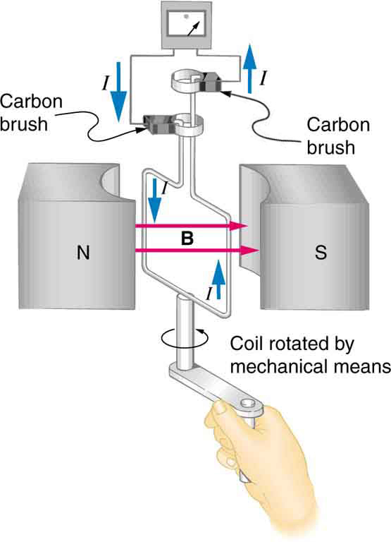
Rotating a coil
Rotation of a coil in a magnetic field produces an emf. This is the basic construction of a generator, where work done to turn the coil is converted to electric energy.
Note the generator is very similar in construction to a motor.

Slide 6
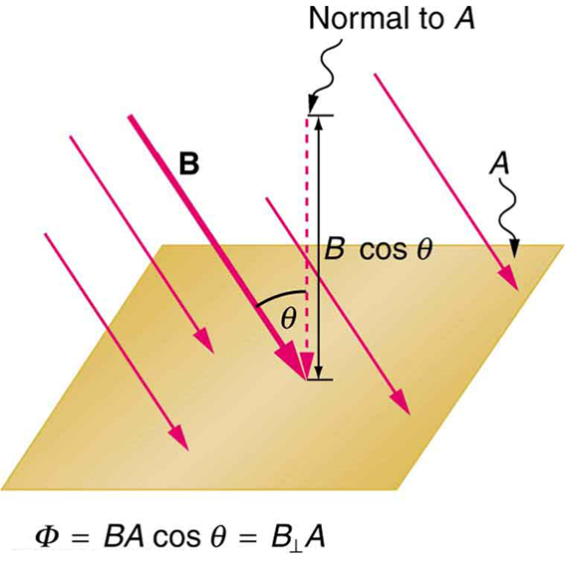

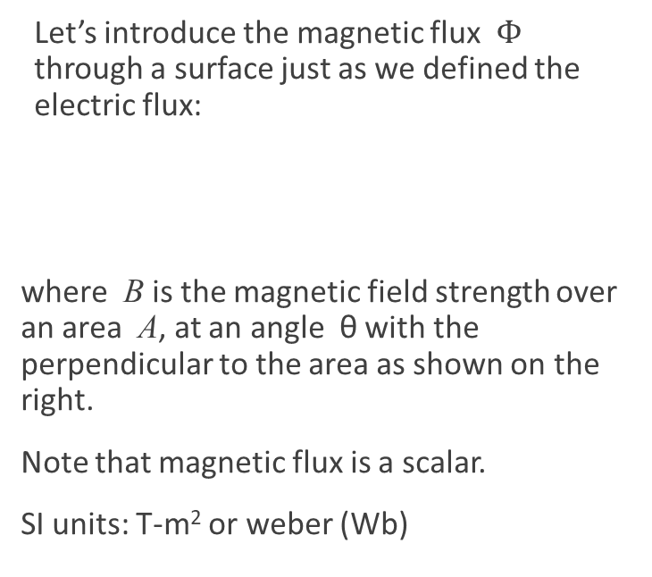
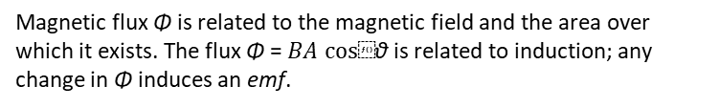
Magnetic flux
Let’s introduce the magnetic flux $Φ_{}$ through a surface just as we defined the electric flux:
where B is the magnetic field strength over an area A, at an angle θ with the perpendicular to the area as shown on the right.
Note that magnetic flux is a scalar.
SI units: T-m² or weber (Wb)
Magnetic flux Φ is related to the magnetic field and the area over which it exists. The flux Φ = $BA cos⁡$θ is related to induction; any change in Φ induces an emf.

Slide 7
More on magnetic flux
Magnetic flux is proportional to the total number of magnetic field lines that cross the area.

Slide 8
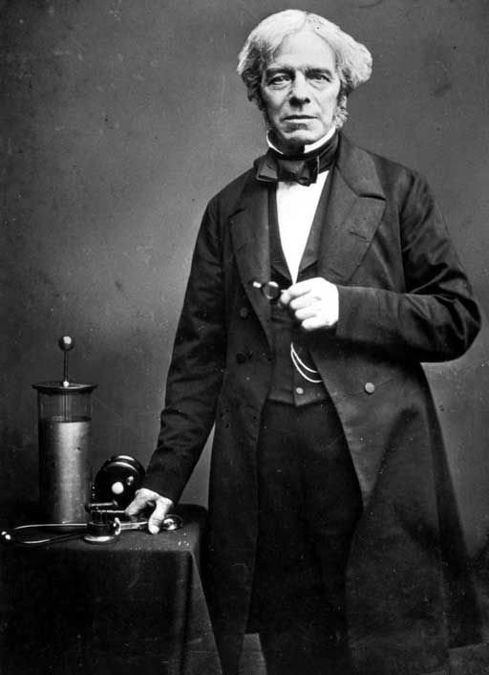
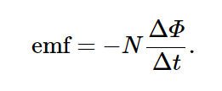
Faraday’s law
The induced emf in a closed loop equals to the negative of the time rate of change of magnetic flux through the loop.

Slide 9
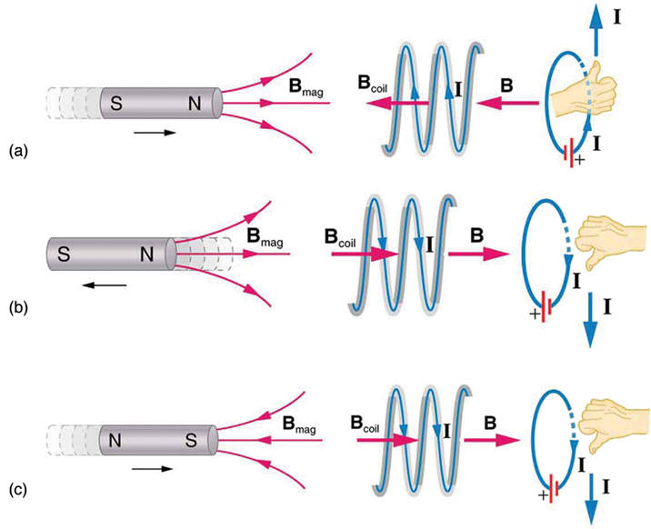
Lenz’s law
Lenz’s law is a convenient method for determining the direction of an induced current or emf:
Direction of the induces emf is such as to produce a current whose magnetic field will minimize the changes in the magnetic flux through the loop.
(a) When this bar magnet is thrust into the coil, the strength of the magnetic field increases in the coil. The current induced in the coil creates another field, in the opposite direction of the bar magnet’s to oppose the increase. This is one aspect of Lenz’s law—induction opposes any change in flux. (b) and (c) are two other situations. Verify for yourself that the direction of the induced B_{coil} shown indeed opposes the change in flux and that the current direction shown is consistent with RHR-2.

Slide 10
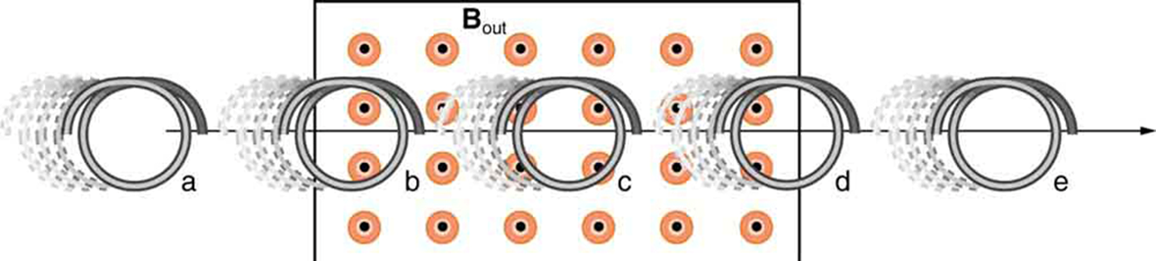
Lenz’s law example
Let’s practice:
A coil is moved into and out of a region of uniform magnetic field. What is the direction of the induced current?

Slide 11
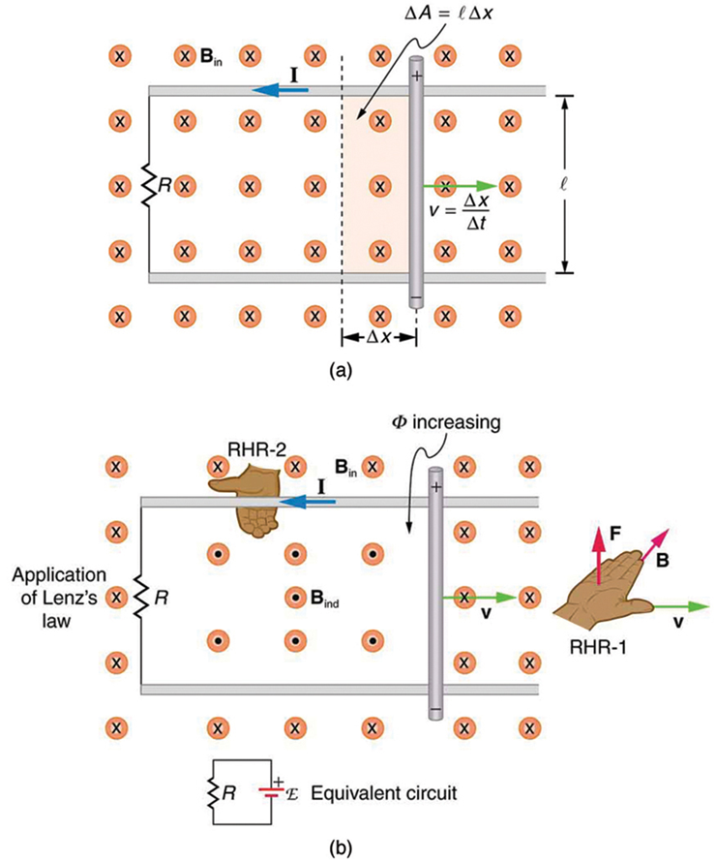
Motional emf
a) A motional emf = Bℓv is induced between the rails when this rod moves to the right in the uniform magnetic field. The magnetic field B is into the page, perpendicular to the moving rod and rails and, hence, to the area enclosed by them. (b) Lenz’s law gives the directions of the induced field and current, and the polarity of the induced emf. Since the flux is increasing, the induced field is in the opposite direction, or out of the page. RHR-2 gives the current direction shown, and the polarity of the rod will drive such a current. RHR-1 also indicates the same polarity for the rod. (Note that the script E symbol used in the equivalent circuit at the bottom of part (b) represents emf.)

Slide 12
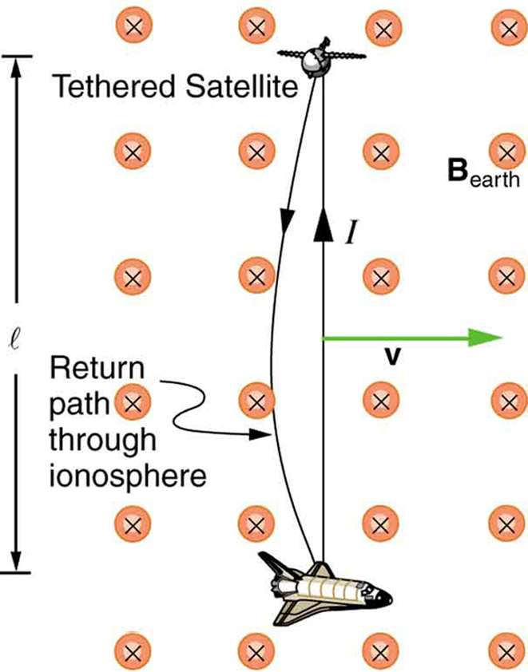
Motional emf
Motional emf as electrical power conversion for the space shuttle is the motivation for the Tethered Satellite experiment. A 5 kV emf was predicted to be induced in the 20 km long tether while moving at orbital speed in the Earth’s magnetic field. The circuit is completed by a return path through the stationary ionosphere.

Slide 13
Motional emf, example
A jet airplane with a 75.0 m wingspan is flying at 280 m/s. What emf is induced between wing tips if the vertical component of the Earth’s field is 3.00×10⁻⁵T? Is an emf of this magnitude likely to have any consequences?

Slide 14
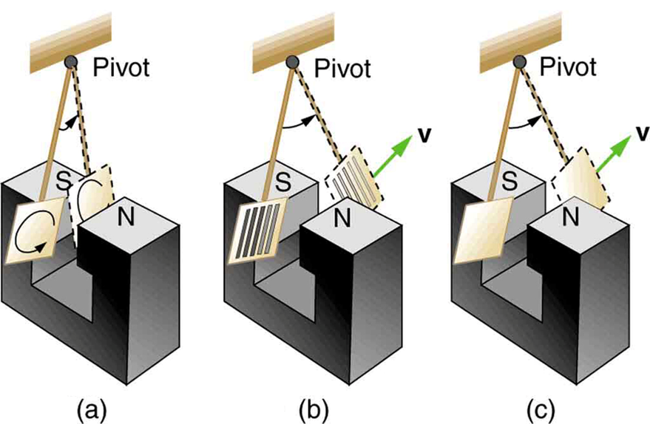
Eddy currents
When a piece of metal moves through a magnetic field or is located in a changing magnetic field, eddy currents of electric current are induced.
The metal detectors used at airport security checkpoints operate by detecting eddy currents induced in metallic objects.
A common physics demonstration device for exploring eddy currents and magnetic damping.
The motion of a metal pendulum bob swinging between the poles of a magnet is quickly damped by the action of eddy currents.
There is little effect on the motion of a slotted metal bob, implying that eddy currents are made less effective.
There is also no magnetic damping on a nonconducting bob, since the eddy currents are extremely small.

Slide 15
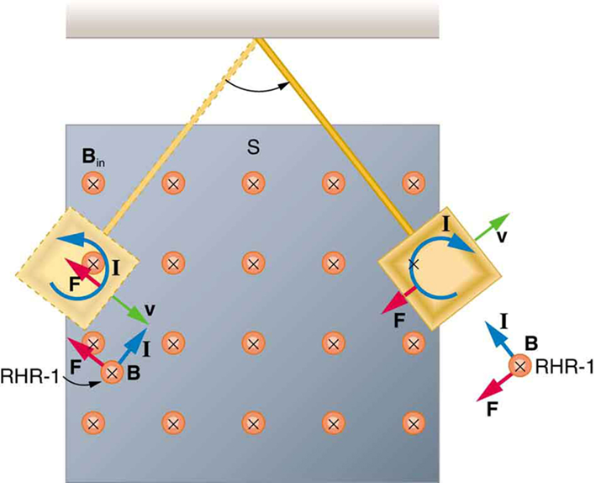
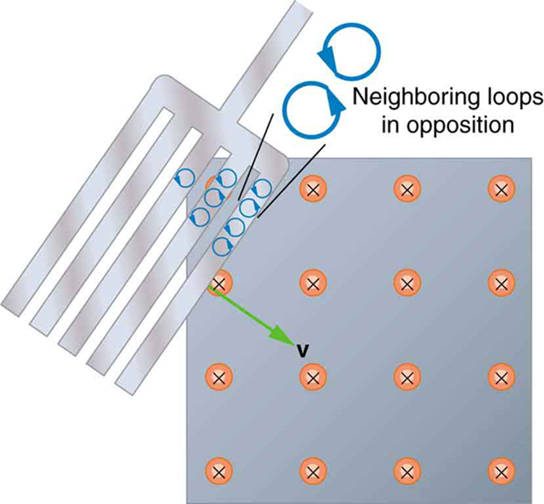
Eddy currents, closer look
A more detailed look at the conducting plate passing between the poles of a magnet. As it enters and leaves the field, the change in flux produces an eddy current. Magnetic force on the current loop opposes the motion. There is no current and no magnetic drag when the plate is completely inside the uniform field.
Eddy currents induced in a slotted metal plate entering a magnetic field form small loops, and the forces on them tend to cancel, thereby making magnetic drag almost zero.

