Slide 1
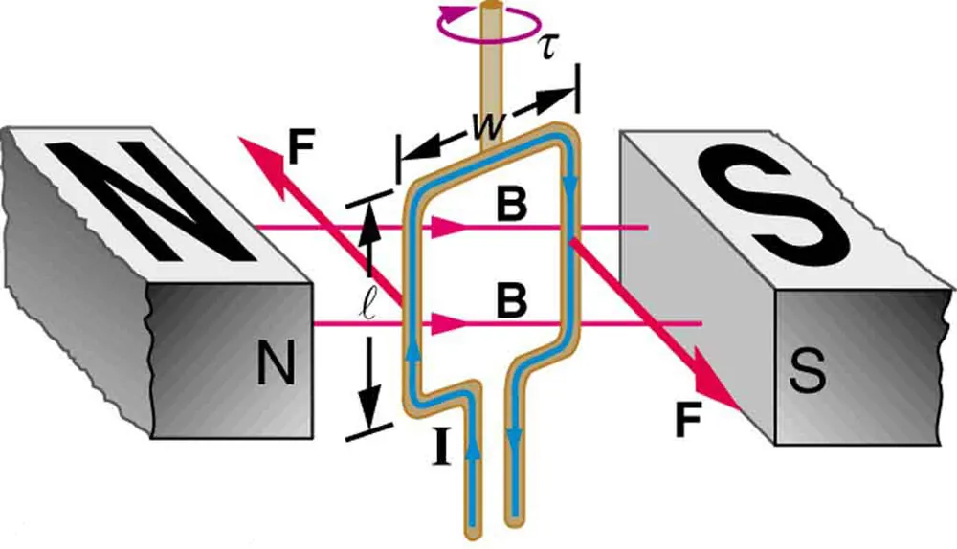

FORCE AND TORQUE ON A CURRENT LOOP

Slide 2
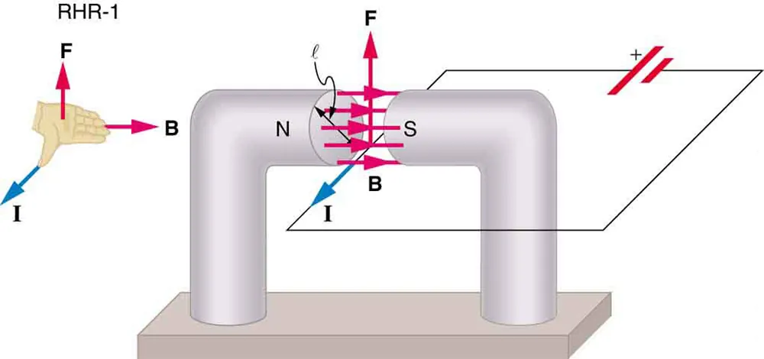
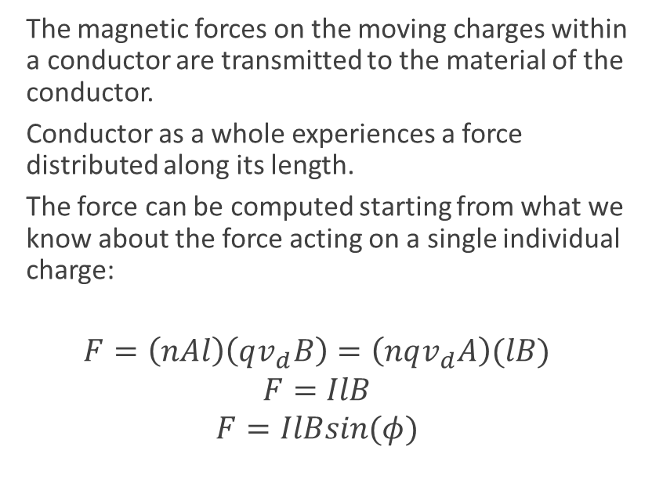
The magnetic force on a current-carrying conductor
  The magnetic forces on the moving charges within a conductor are transmitted to the material of the conductor.
  Conductor as a whole experiences a force distributed along its length.
  The force can be computed starting from what we know about the force acting on a single individual charge:
$$F=\left(nAl\right)\left(qv_{d}B\right)=\left(nqv_{d}A\right)(lB)$$
$$F=IlB$$
$$F=IlBsin(φ)$$
The magnetic field exerts a force on a current-carrying wire in a direction given by the right hand rule 1 (the same direction as that on the individual moving charges). This force can easily be large enough to move the wire, since typical currents consist of very large numbers of moving charges.

Slide 3
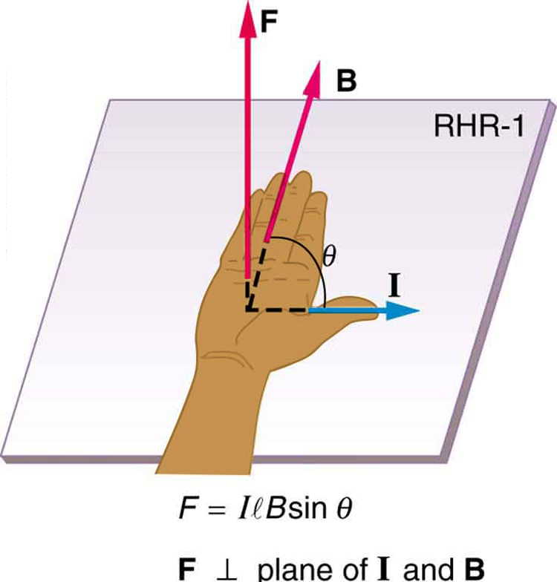
Direction of the magnetic force
Direction of the force on a current-carrying wire in a magnetic field is given by RHR-1.

Slide 4
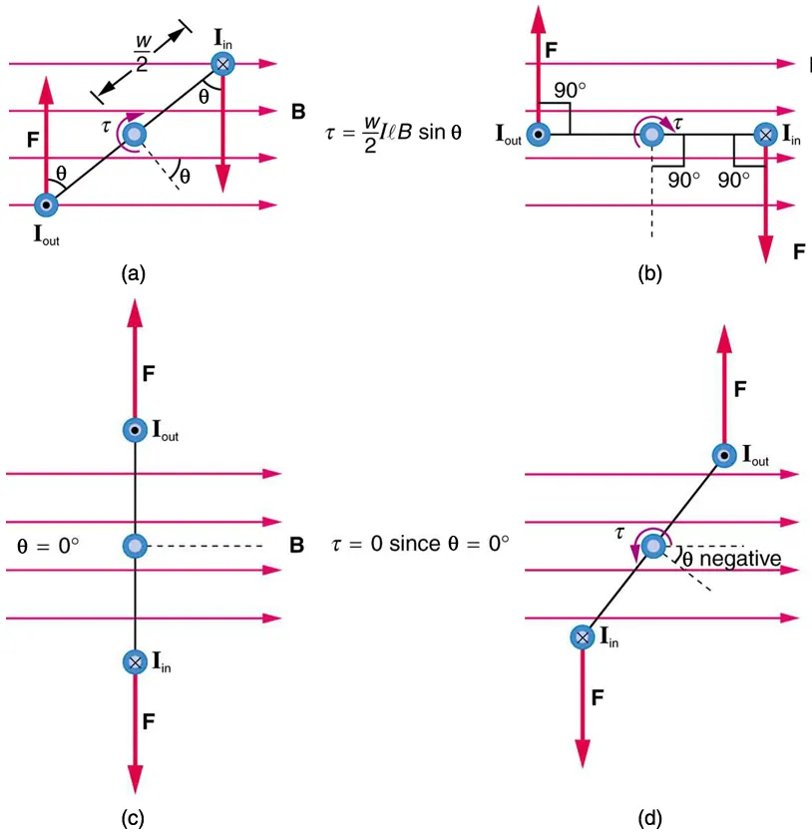
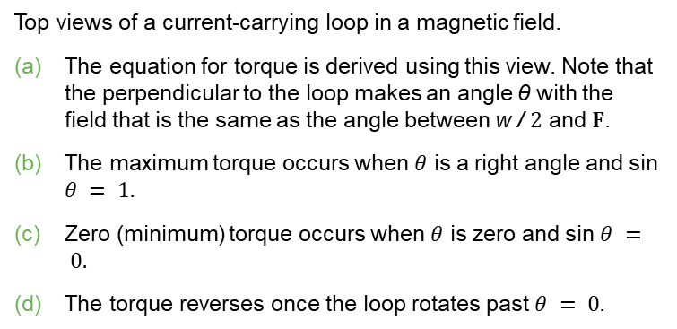
Force and torque on a current loop
  The net force on a current loop in a uniform magnetic field is zero. But the net torque is not, in general, equal to zero.
Top views of a current-carrying loop in a magnetic field.
The equation for torque is derived using this view. Note that the perpendicular to the loop makes an angle θ with the field that is the same as the angle between w / $2$ and $F$.
The maximum torque occurs when $θ$ is a right angle and sin $θ = 1$.
Zero (minimum) torque occurs when $θ$ is zero and sin $θ = 0.$
The torque reverses once the loop rotates past $θ = 0$.

Slide 5
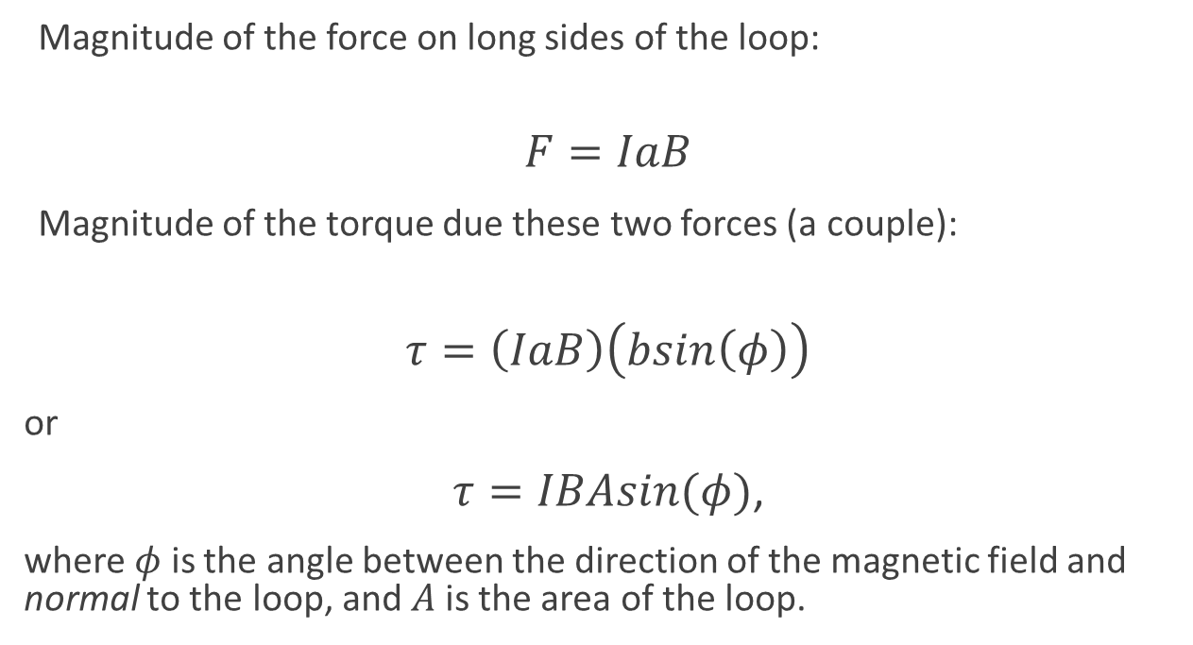
Force and torque on a current loop, continued
Magnitude of the force on long sides of the loop:
$$F=IaB$$
Magnitude of the torque due these two forces (a couple):
$$τ=\left(IaB\right)\left(bsin\left(φ\right)\right)$$
or
$τ=IBAsin(φ)$,
where $φ$ is the angle between the direction of the magnetic field and normal to the loop, and $A$is the area of the loop.

Slide 6
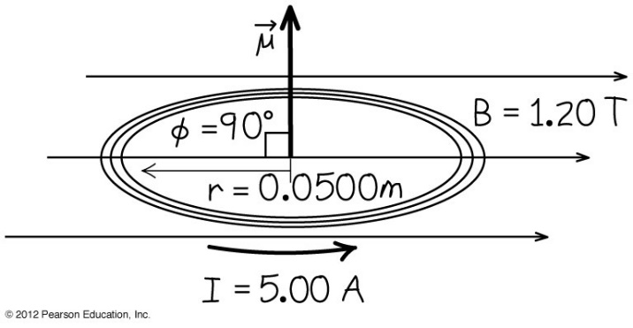
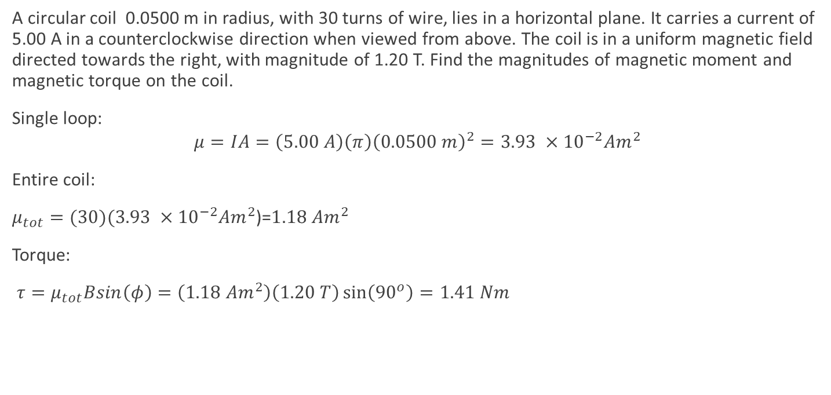
Example: magnetic torque on a circular coil
A circular coil 0.0500 m in radius, with 30 turns of wire, lies in a horizontal plane. It carries a current of 5.00 A in a counterclockwise direction when viewed from above. The coil is in a uniform magnetic field directed towards the right, with magnitude of 1.20 T. Find the magnitudes of magnetic moment and magnetic torque on the coil.
Single loop:
$$μ=IA=\left(5.00 A\right)\left(π\right){\left(0.0500 m\right)}^{2}=3.93 ×{10}^{−2}Am^{2}$$
Entire coil:
$μ_{tot}=(30)(3.93 ×{10}^{−2}Am^{2}$)=$1.18 Am^{2}$
Torque:
$τ=μ_{tot}Bsin\left(φ\right)=\left(1.18 Am^{2}\right)\left(1.20 T\right)\sin\left(90^{o}\right)=1.41 Nm$

