Slide 1


Motion of charged particles in a magnetic field

Slide 2
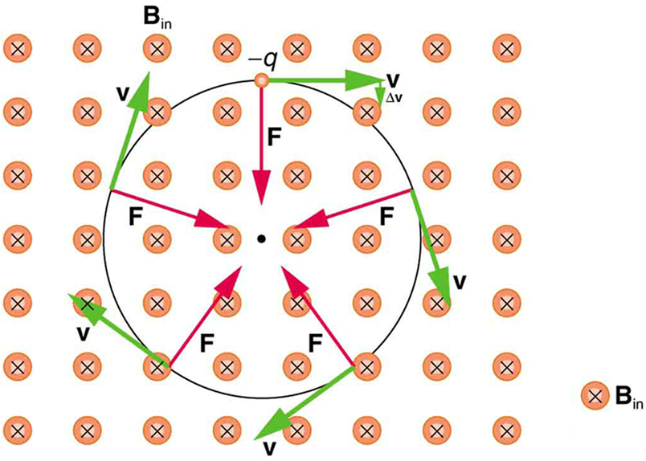
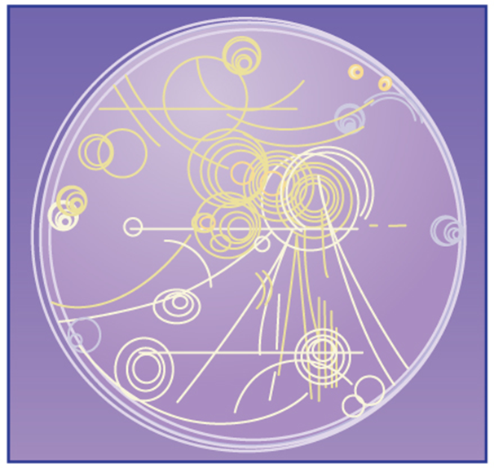
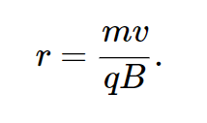
Motion of charged particles in a magnetic field
  A charged particle in a magnetic field always moves with constant speed.
  Figure at the right illustrates the forces and shows an experimental example.
  If the velocity of the particle is perpendicular to the magnetic field, the particle moves in a circle of radius
  The number of revolutions of the particle per unit time is the cyclotron frequency.

Slide 3
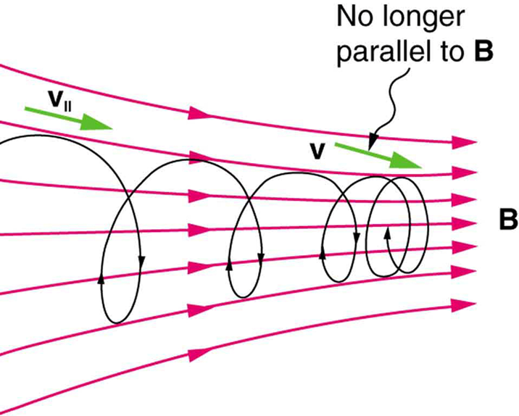
Helical motion
  If the particle has velocity components parallel to and perpendicular to the field, its path is a helix. (See at the right.)
  The speed and kinetic energy of the particle remain constant.
When a charged particle moves along a magnetic field line into a region where the field becomes stronger, the particle experiences a force that reduces the component of velocity parallel to the field. This force slows the motion along the field line and here reverses it, forming a “magnetic mirror.”

Slide 4
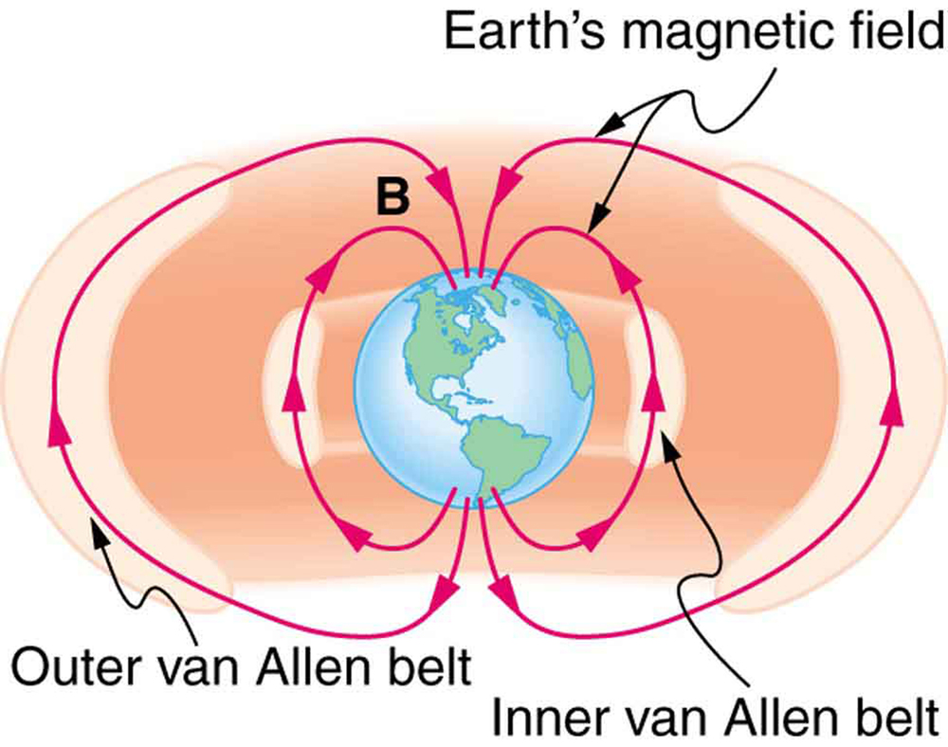
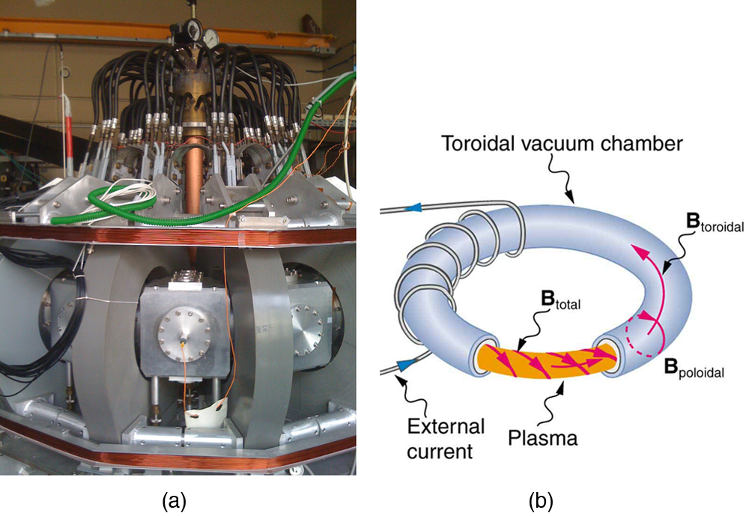
A non-uniform magnetic field
  Figure below shows the Van Allen radiation belts. These belts are due to the earth’s non-uniform field.
Tokamaks such as the one shown in the figure are being studied with the goal of economical production of energy by nuclear fusion. Magnetic fields in the doughnut-shaped device contain and direct the reactive charged particles. (credit: David Mellis, Flickr)

Slide 5
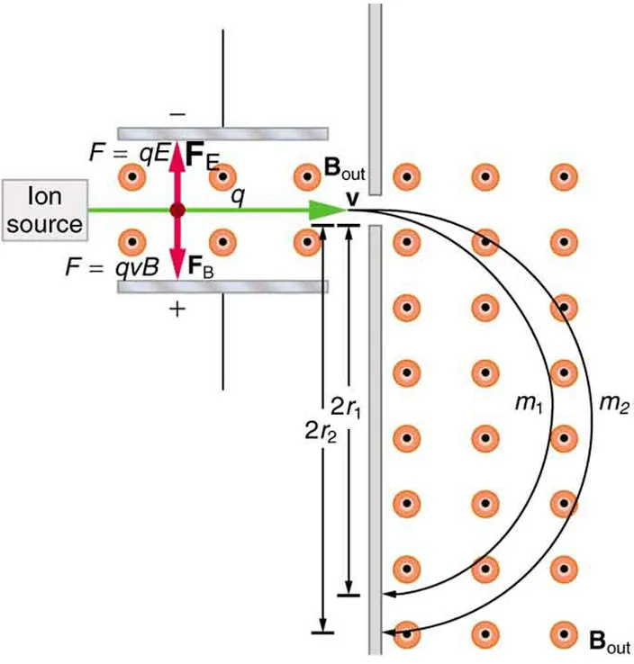
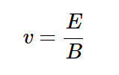
Velocity selector
  A velocity selector uses perpendicular electric and magnetic fields to select particles of a specific speed from a beam. (See Figure at the right.)
  Only particles having speed
  pass through undeflected.

Slide 6
Mass spectrometer
  A mass spectrometer measures the masses of ions.
  The curvature of a charged particle’s path in the field is related to its mass and is measured to obtain mass information.
  Historically, such techniques were employed in the first direct observations of electron charge and mass.
  Today, mass spectrometers (sometimes coupled with gas chromatographs) are used to determine the make-up and sequencing of large biological molecules.

Slide 7
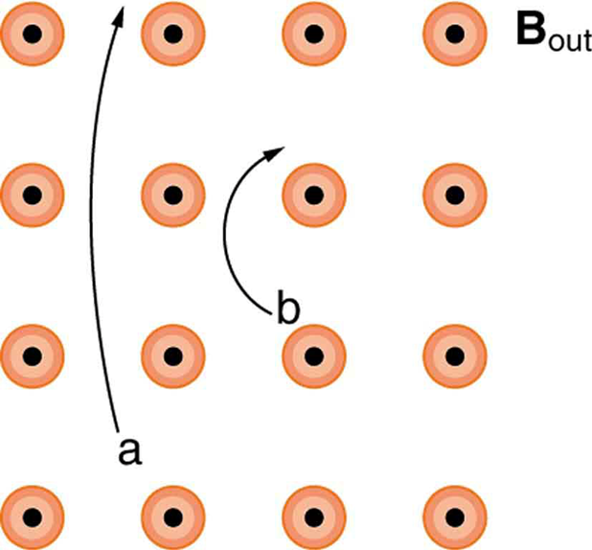
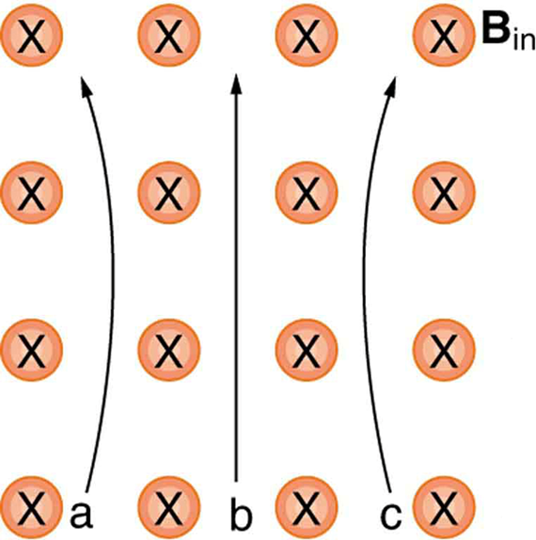
Attention quiz
What are the signs of the charges on the particles pictured below?
Which of the particles below has the greatest velocity, assuming they have identical charges and masses?

