Slide 1

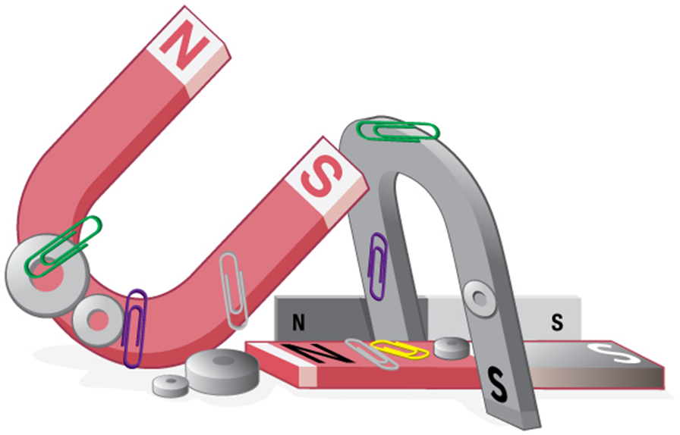
MAGNETIC FORCES AND FIELDS

Slide 2
Today’s objectives
By the end of this lesson, you will be able to:
Describe the difference between the north and south poles of a magnet.
Describe how magnetic poles interact with each other.
Define magnetic field and describe the magnetic field lines of various magnetic fields.
Describe the effects of magnetic fields on moving charges.
Use the right-hand rule 1 to determine the velocity of a charge, the direction of the magnetic field, and the direction of the magnetic force on a moving charge.
Calculate the magnetic force on a moving charge.

Slide 3
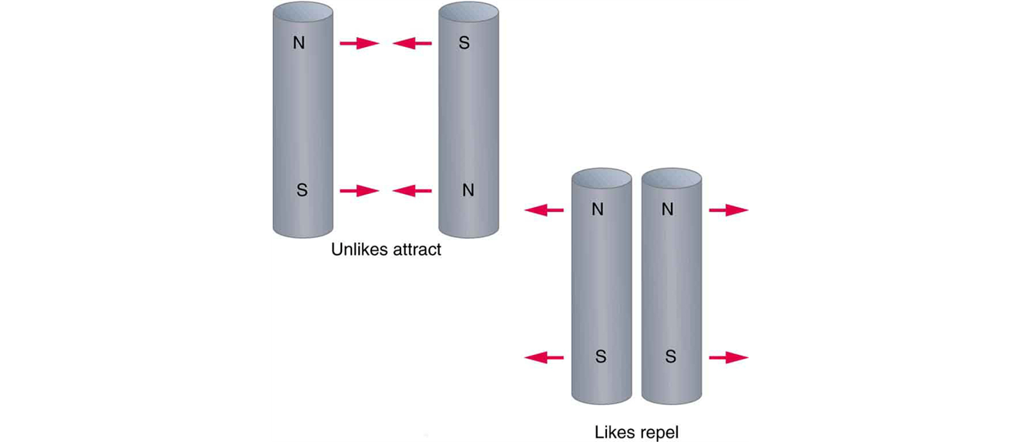
Properties of magnets
  Permanent magnets exert forces on each other.
  Magnets have two poles: north and south.
  Opposite poles attract while like poles repel.

Slide 4
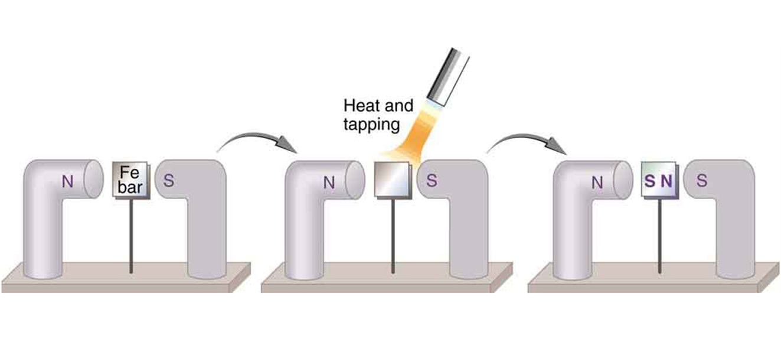
Magnetism and certain metals
  Either pole of a permanent magnet will attract a metal like iron.
An unmagnetized piece of iron is placed between two magnets, heated, and then cooled, or simply tapped when cold. The iron becomes a permanent magnet with the poles aligned as shown: its south pole is adjacent to the north pole of the original magnet, and its north pole is adjacent to the south pole of the original magnet. Note that there are attractive forces between the magnets.

Slide 5
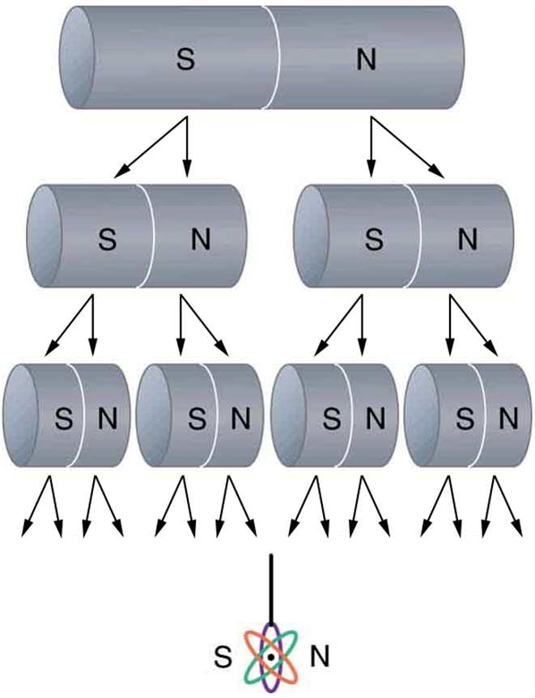
Magnetic monopoles
  Breaking a bar magnet does not separate its poles, as shown in the figure on the right.
  There is no experimental evidence for magnetic monopoles.

Slide 6
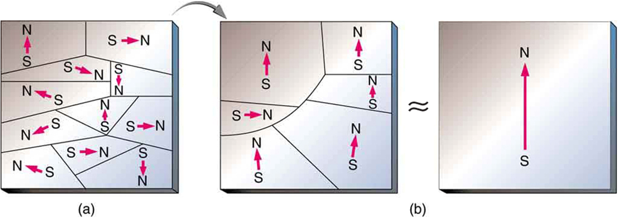
Magnetism: a micro view
An unmagnetized piece of iron (or other ferromagnetic material) has randomly oriented domains.
When magnetized by an external field, the domains show greater alignment, and some grow at the expense of others. Individual atoms are aligned within domains; each atom acts like a tiny bar magnet.

Slide 7
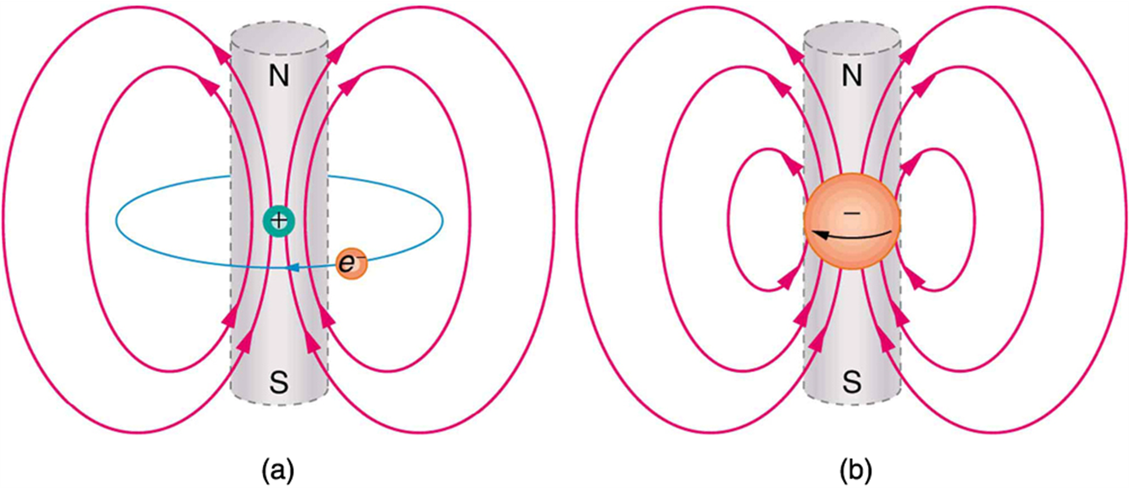
Electrons and magnetic field
In the planetary model of the atom, an electron orbits a nucleus, forming a closed-current loop and producing a magnetic field with a north pole and a south pole.
Electrons have spin and can be crudely pictured as rotating charge, forming a current that produces a magnetic field with a north pole and a south pole. Neither the planetary model nor the image of a spinning electron is completely consistent with modern physics. However, they do provide a useful way of understanding phenomena.

Slide 8
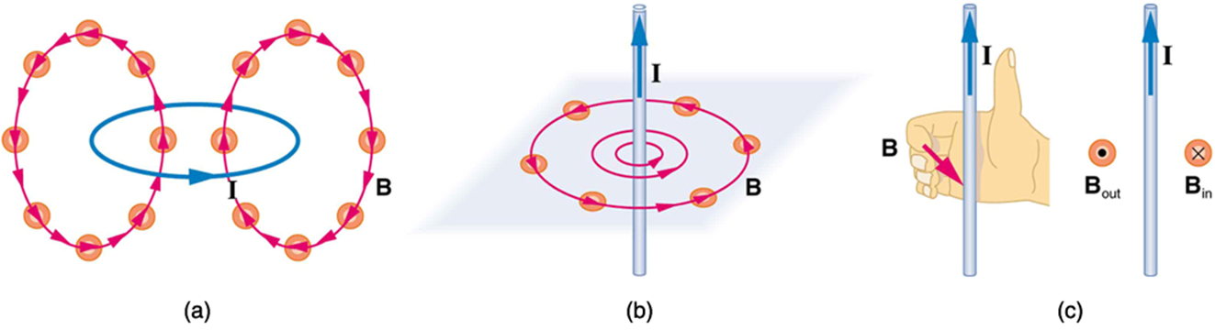
Electric current and magnets
  In 1820, Hans Oersted discovered that a current-carrying wire causes a compass to deflect.
  This discovery revealed a connection between moving charge and magnetism.
Small compasses could be used to map the fields shown here.
The magnetic field of a circular current loop is similar to that of a bar magnet.
A long and straight wire creates a field with magnetic field lines forming circular loops.
When the wire is in the plane of the paper, the field is perpendicular to the paper. Note that the symbols used for the field pointing inward (like the tail of an arrow) and the field pointing outward (like the tip of an arrow).

Slide 9
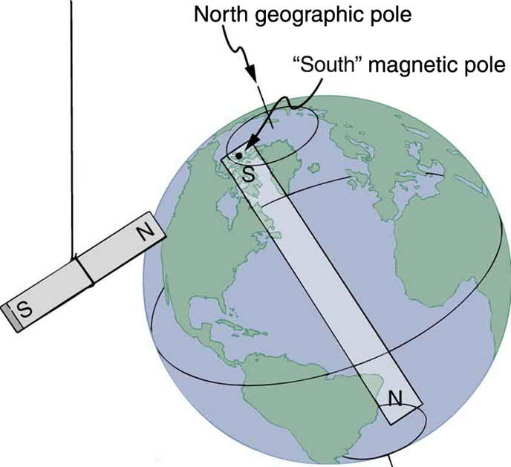
Magnetic field of the Earth
  The Earth is a magnet.
  Magnetic south pole is close to the geographic North pole and the magnetic south pole is close to the geographic South pole.
One end of a bar magnet is suspended from a thread that points toward north. The magnet’s two poles are labeled N and S for north-seeking and south-seeking poles, respectively.

Slide 10
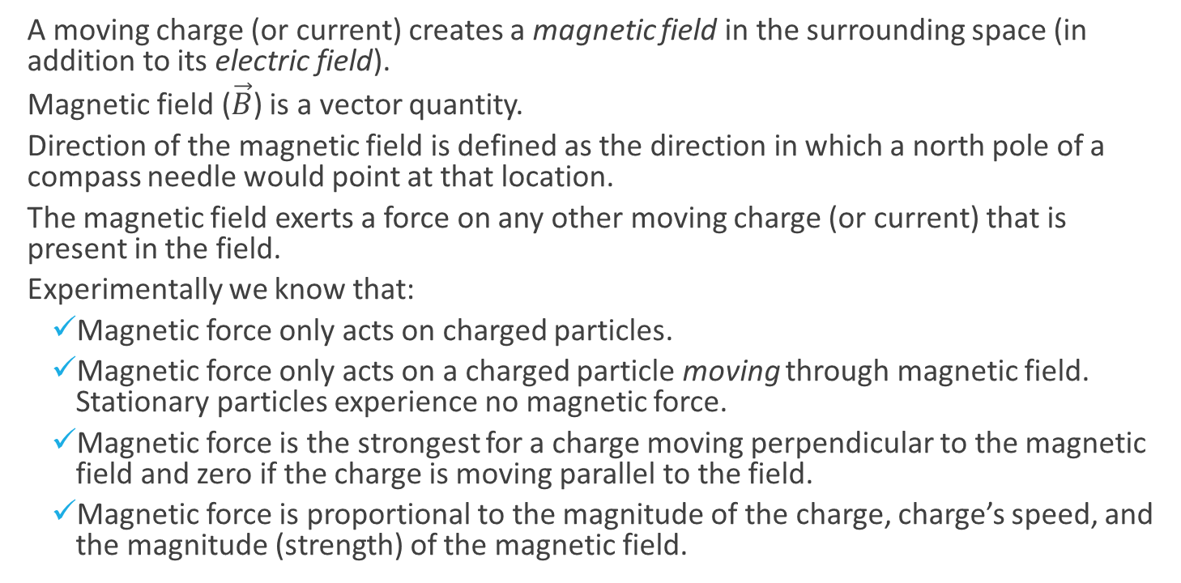
The magnetic field
  A moving charge (or current) creates a magnetic field in the surrounding space (in addition to its electric field).
  Magnetic field ($\vec{B}$) is a vector quantity.
  Direction of the magnetic field is defined as the direction in which a north pole of a compass needle would point at that location.
  The magnetic field exerts a force on any other moving charge (or current) that is present in the field.
  Experimentally we know that:
    Magnetic force only acts on charged particles.
    Magnetic force only acts on a charged particle moving through magnetic field. Stationary particles experience no magnetic force.
    Magnetic force is the strongest for a charge moving perpendicular to the magnetic field and zero if the charge is moving parallel to the field.
    Magnetic force is proportional to the magnitude of the charge, charge’s speed, and the magnitude (strength) of the magnetic field.

Slide 11

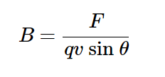
The magnetic force on a moving charge
The magnetic force on a charge is perpendicular to both the velocity of the charge and the magnetic field.
The magnitude of the magnetic force can be described as
where q is the magnitude of the charge,
v is the magnitude of the charge velocity, and
B is the magnitude of the magnetic field.
We can use this equation to define the magnitude (strength) of the magnetic field:

Slide 12
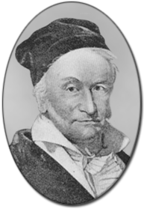
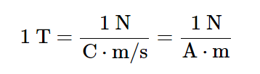
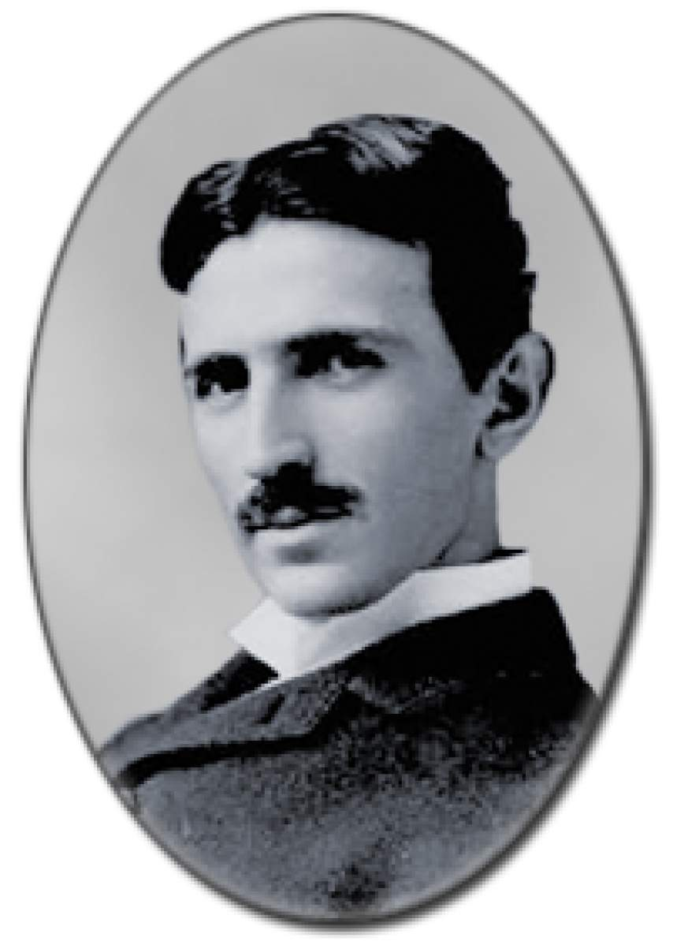
Magnetic field: units
Note: the SI unit of magnetic field is
tesla (T)
Often a non-SI unit, gauss (G) is used:
1 G = 10⁻⁴ T
Magnitude of the Earth’s magnetic field
near the surface is about 0.5 G.

Slide 13
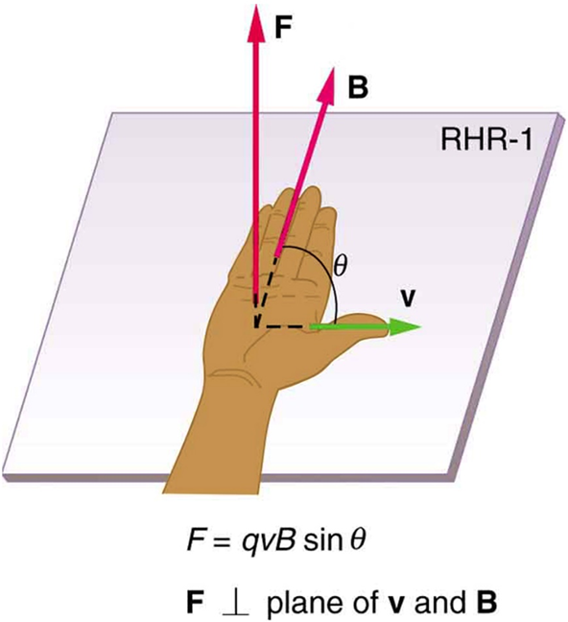
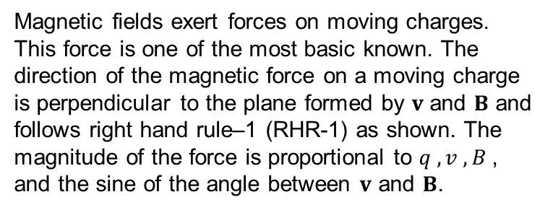
Magnetic force as a vector (cross) product
  We can write the magnetic force as a vector product.
  The right-hand rule gives the direction of the force on a positive charge.
Magnetic fields exert forces on moving charges. This force is one of the most basic known. The direction of the magnetic force on a moving charge is perpendicular to the plane formed by $v$ and $B$ and follows right hand rule–1 (RHR-1) as shown. The magnitude of the force is proportional to $q , v , B$, and the sine of the angle between $v$ and $B$.

Slide 14
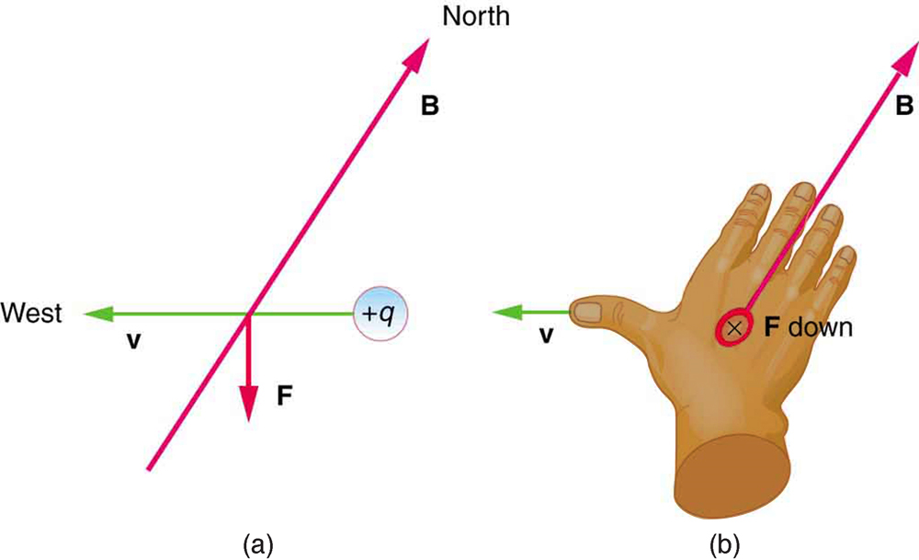
Using the RHR-1 example
A positively charged object moving due west in a region where the Earth’s magnetic field is due north experiences a force that is straight down as shown. A negative charge moving in the same direction would feel a force straight up.

Slide 15
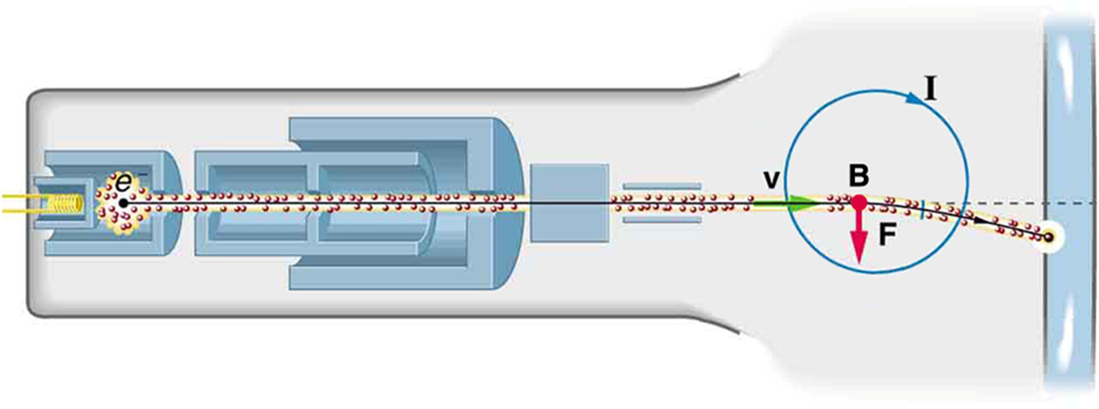
Determining the direction of a magnetic field
  A cathode-ray tube can be used to determine the direction of a magnetic field, as shown below.
The cathode ray tube (CRT) is so named because rays of electrons originate at the cathode in the electron gun. Magnetic coils are used to steer the beam in many CRTs. In this case, the beam is moved down. Another pair of horizontal coils would steer the beam horizontally.

Slide 16



Example: magnetic force on a proton
  A beam of protons (q = 1.60 x 10⁻¹⁹ C) moves at 3.0 x 10⁵ m/s through a uniform magnetic field with a magnitude of 2.0 T that is directed along the positive z-axis. The velocity of each proton is in the xz-plane at an angle of 30º to the positive z axis. Find the force on a proton.
$\vec{B}=\left(2.0T\right)\hat{k}$
$\vec{v}=v⋅\cos\left({30}^{0}\right)\hat{k}+v⋅\sin\left({30}^{0}\right)\hat{i}$.
$$\vec{F}=q \vec{v }×\vec{B}=\left(−{4.8 ×10}^{−14}N\right)\hat{j}$$

Slide 17
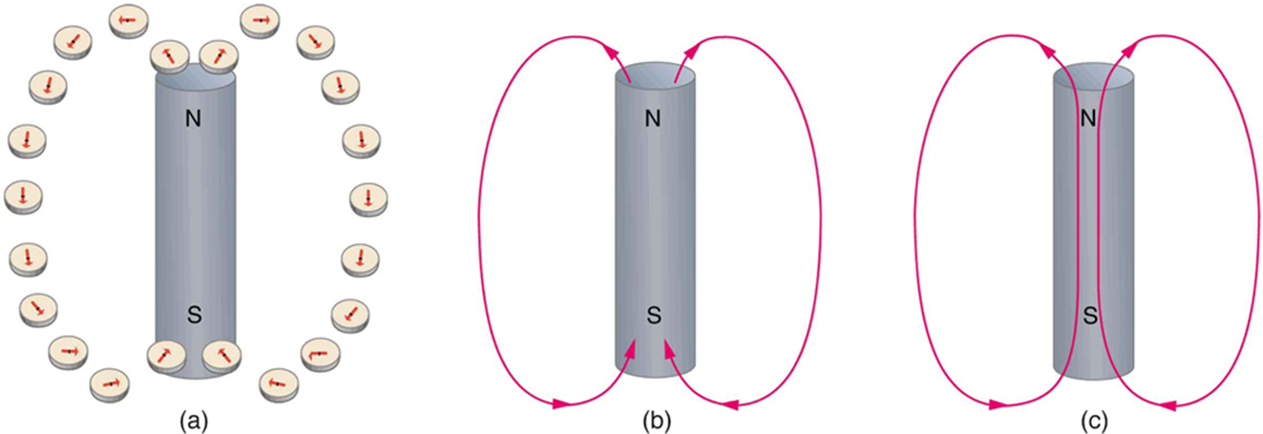
Magnetic field lines
  The idea of magnetic field lines is the same as for the electric field lines:
Magnetic field lines are defined to have the direction that a small compass points when placed at a location.
If small compasses are used to map the magnetic field around a bar magnet, they will point in the directions shown: away from the north pole of the magnet, toward the south pole of the magnet. (Recall that the Earth’s north magnetic pole is really a south pole in terms of definitions of poles on a bar magnet.)
Connecting the arrows gives continuous magnetic field lines. The strength of the field is proportional to the closeness (or density) of the lines.
If the interior of the magnet could be probed, the field lines would be found to form continuous closed loops.

Slide 18
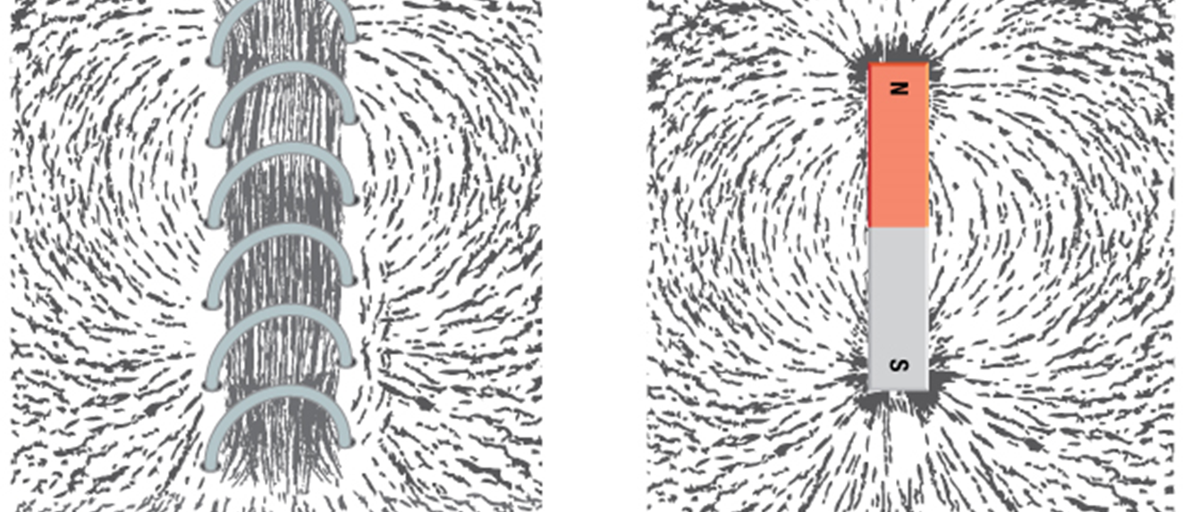
Magnetic field lines: examples
Iron filings near
a current-carrying coil and
a magnet act like tiny compass needles, showing the shape of their fields. Their response to a current-carrying coil and a permanent magnet is seen to be very similar, especially near the ends of the coil and the magnet.

