Slide 1
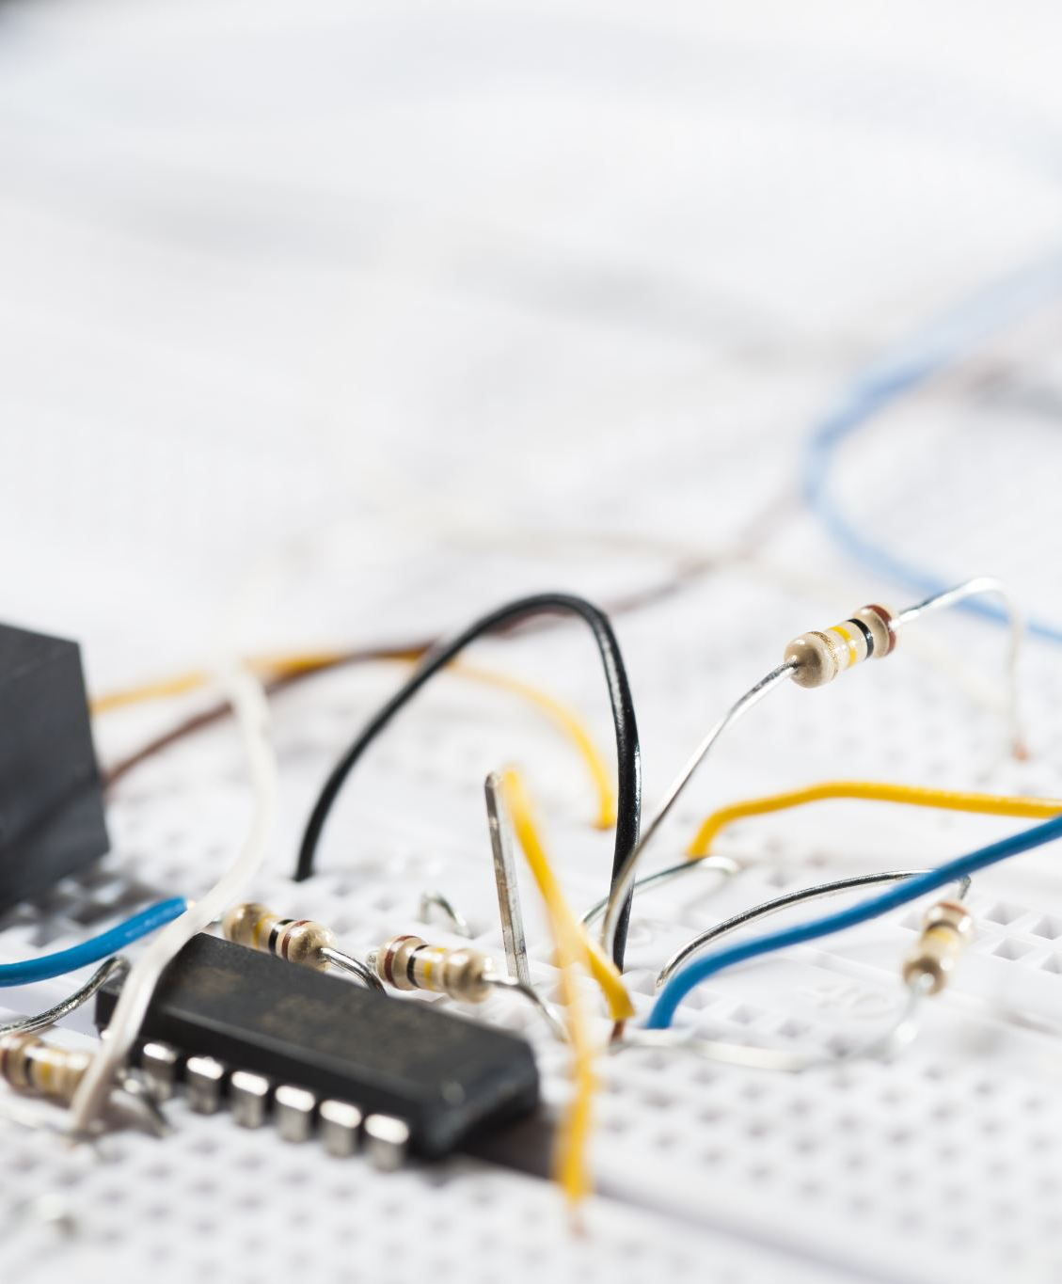

DC CIRCUITS: RESISTORS IN SERIES AND PARALLEL

Slide 2
Today’s objectives
By the end of this lesson, you will be able to:
Draw a circuit with resistors in parallel and in series.
Calculate the voltage drop of a current across a resistor using Ohm’s law.
Contrast the way total resistance is calculated for resistors in series and in parallel.
Explain why total resistance of a parallel circuit is less than the smallest resistance of any of the resistors in that circuit.
Calculate total resistance of a circuit that contains a mixture of resistors connected in series and in parallel.

Slide 3
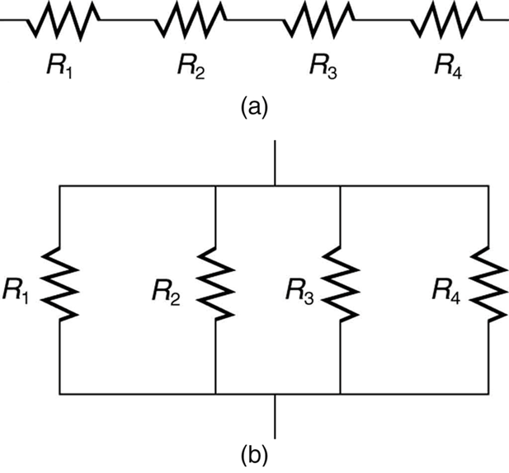
Resistors in series and parallel
  Resistors are in series (a) if they are connected one after the other so the current is the same in all of them (see left figure below).
  Resistors are in parallel (b)if they are connected so that the potential difference must be the same across all of them (see right figure below).

Slide 4
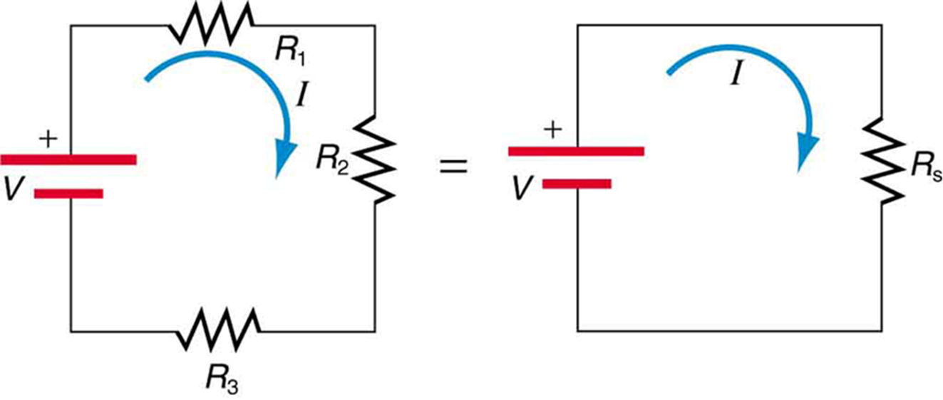
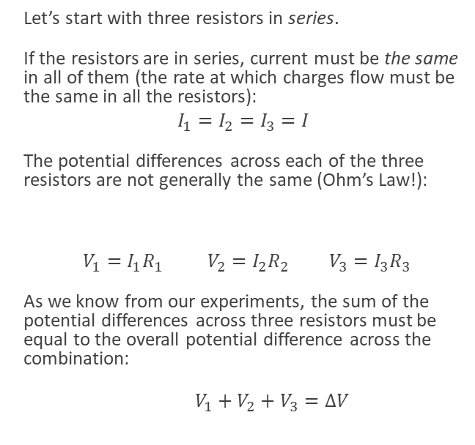
Resistors in series
Let’s start with three resistors in series.
If the resistors are in series, current must be the same in all of them (the rate at which charges flow must be the same in all the resistors):
$$I_{1}=I_{2}=I_{3}=I$$
The potential differences across each of the three resistors are not generally the same (Ohm’s Law!):
$V_{1}=I_{1}R_{1}$ $V_{2}=I_{2}R_{2}$ $V_{3}=I_{3}R_{3}$
As we know from our experiments, the sum of the potential differences across three resistors must be equal to the overall potential difference across the combination:
$V_{1}+V_{2}+V_{3}=ΔV$
Three resistors connected in series to a battery (left) and the equivalent single or series resistance (right).

Slide 5
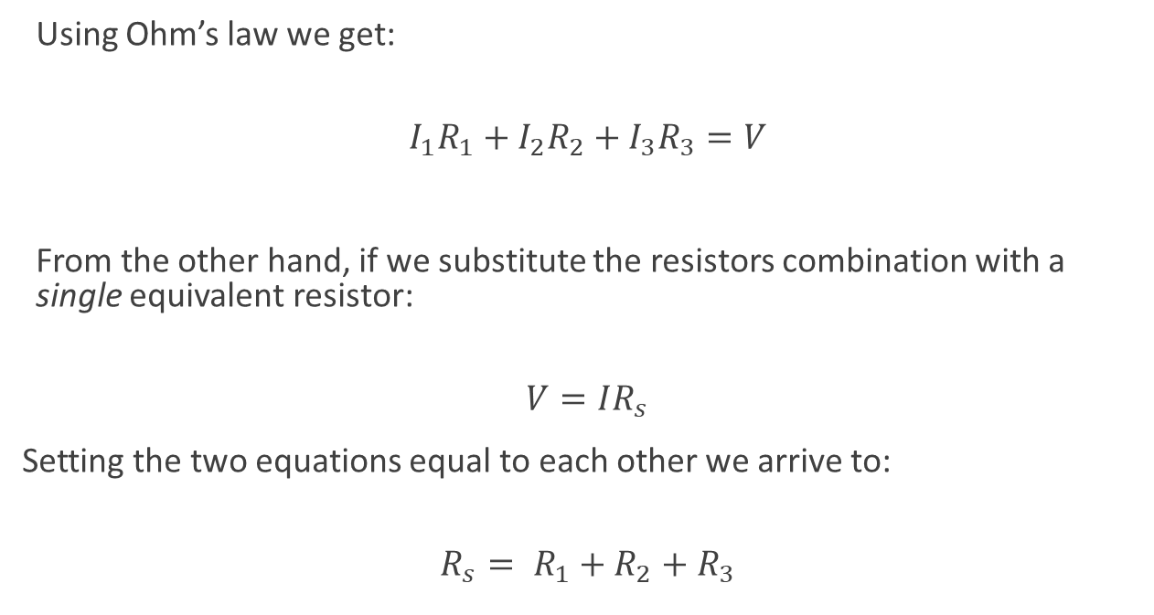
Resistors in series, continued
Using Ohm’s law we get:
$$I_{1}R_{1}+I_{2}R_{2}+I_{3}R_{3}=V$$
From the other hand, if we substitute the resistors combination with a single equivalent resistor:
$$V=IR_{s}$$
Setting the two equations equal to each other we arrive to:
$${R_{s}= R}_{1}+R_{2}+R_{3}$$

Slide 6

Resistors in series, summary
Currents in all resistors in series combination is the same.
Sum of potential differences across all resistors equals to the potential difference across the combination.
Equivalent resistance is the sum of the individual resistances (independent of how many resistors are in the combination).
Equivalent resistance of the combination is always greater than any one of the individual resistances.

Slide 7
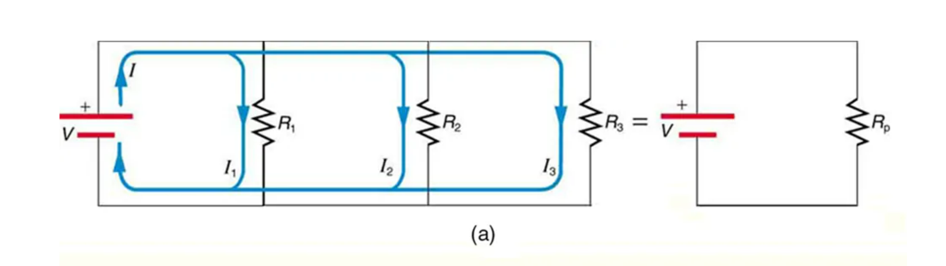
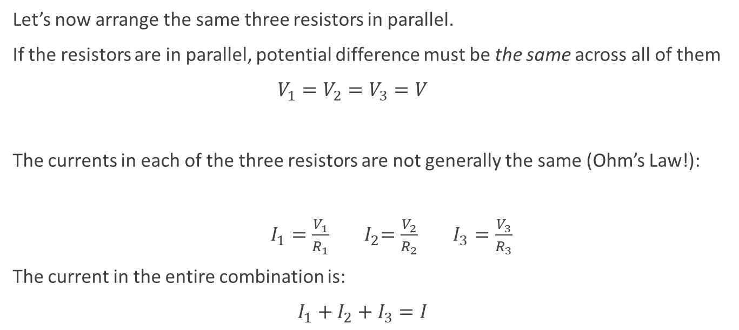
Resistors in parallel
Let’s now arrange the same three resistors in parallel.
If the resistors are in parallel, potential difference must be the same across all of them
$V_{1}=V_{2}=V_{3}=V$
The currents in each of the three resistors are not generally the same (Ohm’s Law!):
$I_{1}{=\frac{V_{1}}{R_{1}} }_{ }{ I}_{2}{=\frac{V_{2}}{R_{2}} }_{ }$ $I_{3}{=\frac{V_{3}}{R_{3}} }_{ }$
The current in the entire combination is:
$I_{1}+I_{2}+I_{3}=I$
Three resistors connected in parallel to a battery and the equivalent single or parallel resistance.

Slide 8
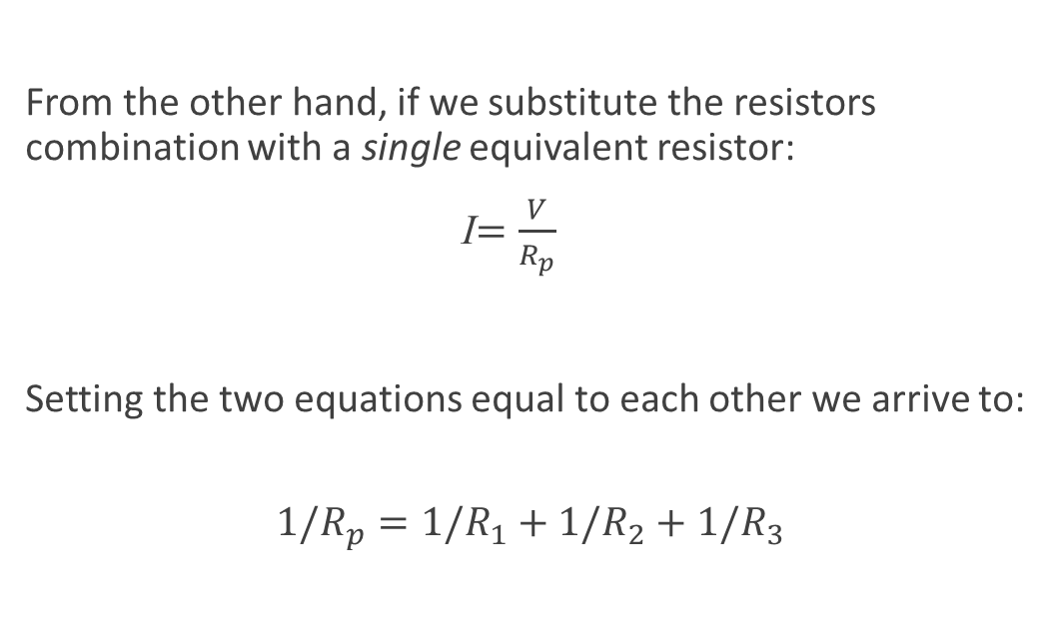
Resistors in parallel, continued
From the other hand, if we substitute the resistors combination with a single equivalent resistor:
I${=\frac{V}{R_{p}} }_{ }$
Setting the two equations equal to each other we arrive to:
$${{1/R}_{p}=1/R}_{1}+1/R_{2}+1/R_{3}$$

Slide 9
Let’s see how it works
Let’s start with three resistors – 100 Ω, 200 Ω, and 300 Ω.
Connected in series, the equivalent resistance is 600 Ω.
Note that the equivalent resistance is greater than every one of the individual resistances!
Connected in parallel, the same three resistors produce an equivalent resistance of 600/11 Ω, or 54.4 Ω.
Note that the equivalent resistance is less than every one of the individual resistances!

