Slide 1
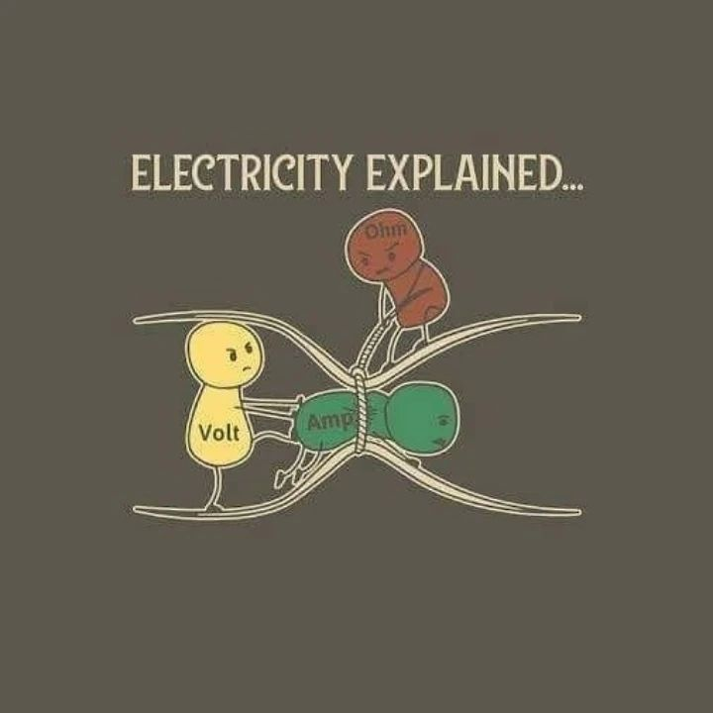

ELECTRIC CURRENT, RESISTANCE, AND OHM’S LAW

Slide 2
Today’s objectives
By the end of this class, you will be able to:
Define electric current, ampere, and drift velocity
Describe the direction of charge flow in conventional current.
Use drift velocity to calculate current and vice versa.

Slide 3
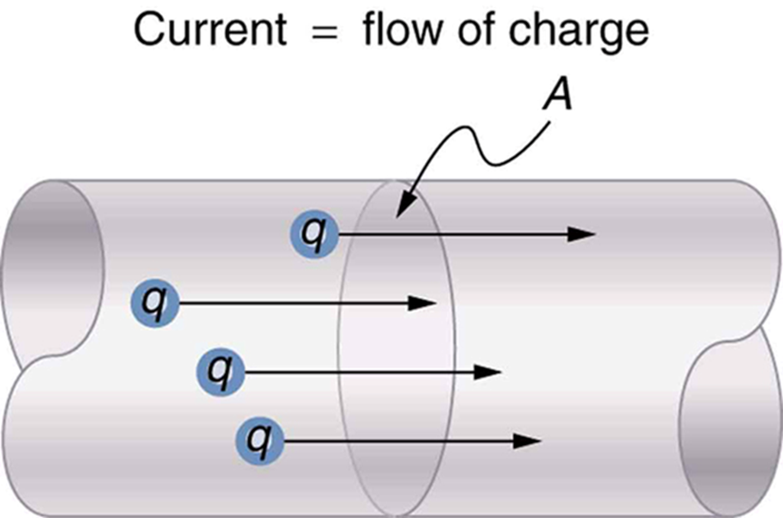
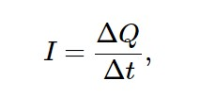
Current, the definition
A current is any motion of charge from one region to another.
where ΔQ is the amount of charge passing through a given area in time Δt.

Slide 4
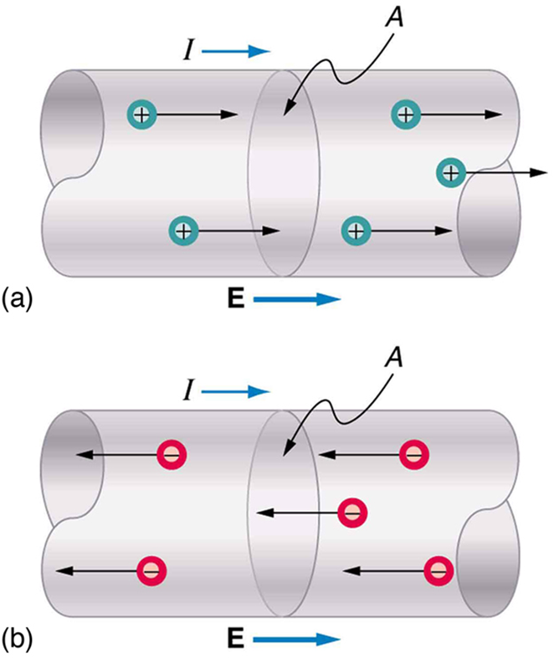
Direction of current
A current can be produced by positive or negative charge flow.
Conventional current is treated as a flow of positive charges.
In a metallic conductor, the moving charges are electrons — but the current still points in the direction positive charges would flow. In ionic solutions, such as salt water, both positive and negative charges move. This is also true in nerve cells.
Positive charges move in the direction of the electric field and the same direction as conventional current.
Negative charges move in the direction opposite to the electric field. Conventional current is in the direction opposite to the movement of negative charge. The flow of electrons is sometimes referred to as electronic flow.

Slide 5

Current, more details
The current direction in a wire is from higher potential to lower potential, or in the direction of the electric field.
Current is measured in coulombs/second, which we define as an ampere A.

Slide 6
Example
What is the current when a typical static charge of 0.250μC moves from your finger to a metal doorknob in 1.00μs?

Slide 7
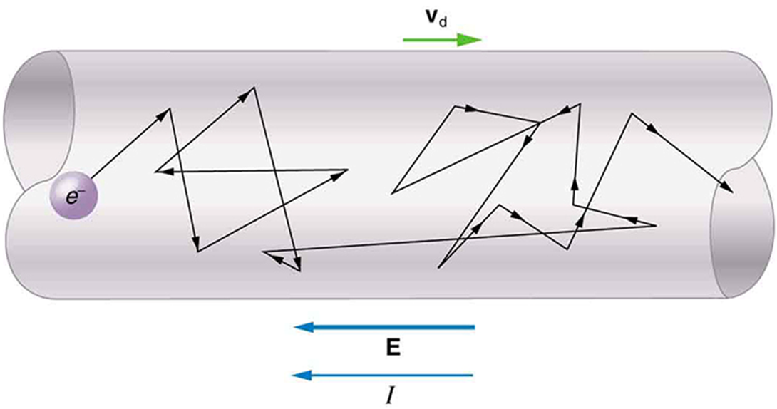
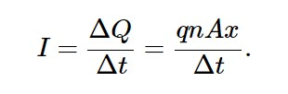

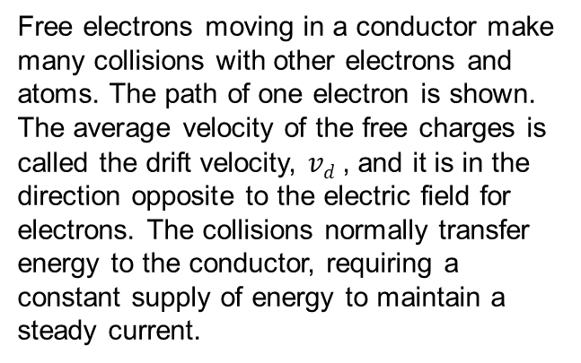
Current and drift velocity
Free electrons moving in a conductor make many collisions with other electrons and atoms. The path of one electron is shown. The average velocity of the free charges is called the drift velocity, $vd$, and it is in the direction opposite to the electric field for electrons. The collisions normally transfer energy to the conductor, requiring a constant supply of energy to maintain a steady current.
where I is the current through a wire of cross-sectional area A made of a material with a free charge density n. The carriers of the current each have charge q and move with a drift velocity of magnitude v_{d}.

Slide 8
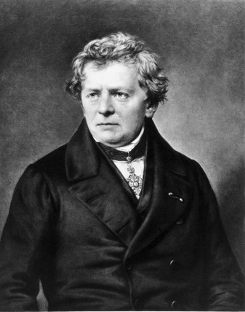

Resistance and Ohm’s law
The current that flows through most substances is directly proportional to the voltage V applied to it. The German physicist Georg Simon Ohm (1787–1854) was the first to demonstrate experimentally that the current in a metal wire is directly proportional to the voltage applied:
This important relationship is known as Ohm’s law. This is an empirical law like that for friction—an experimentally observed phenomenon. Such a linear relationship doesn’t always occur.

Slide 9

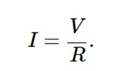
Resistance
If voltage drives current, what impedes it? The electric property that impedes current (crudely similar to friction and air resistance) is called resistance R.
Collisions of moving charges with atoms and molecules in a substance transfer energy to the substance and limit current. Resistance is defined as inversely proportional to current, or
Combining the relationships of current to voltage and current to resistance gives

Slide 10
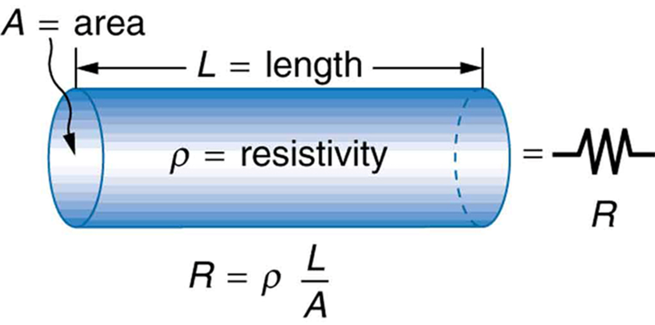
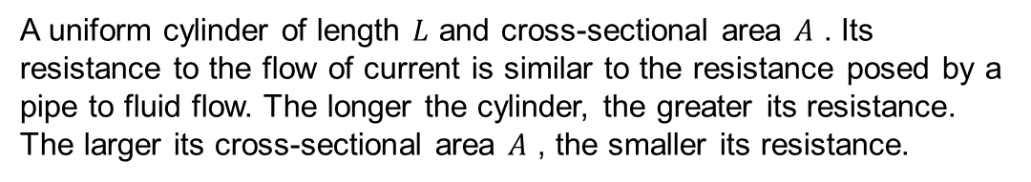
Resistivity
A uniform cylinder of length $L$ and cross-sectional area $A$ . Its resistance to the flow of current is similar to the resistance posed by a pipe to fluid flow. The longer the cylinder, the greater its resistance. The larger its cross-sectional area $A$ , the smaller its resistance.

Slide 11
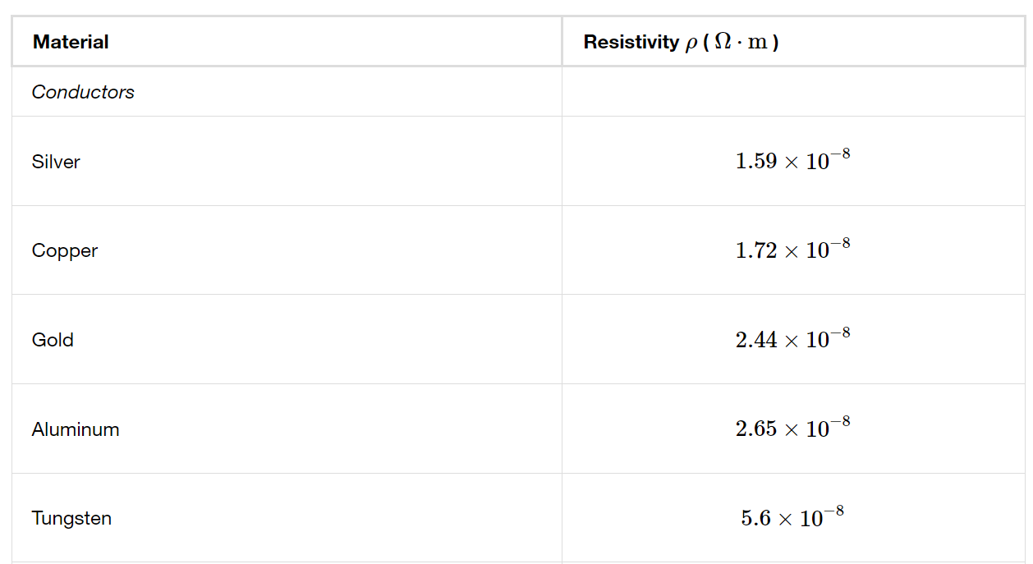
Resistivity at room temperature, conductors at 20º C

Slide 12
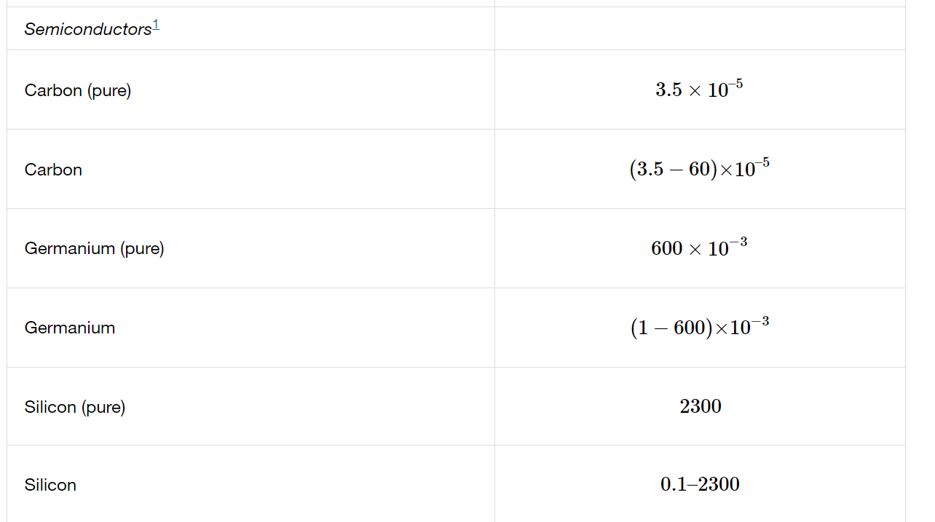
Resistivity at room temperature, semiconductors at 20º C

Slide 13
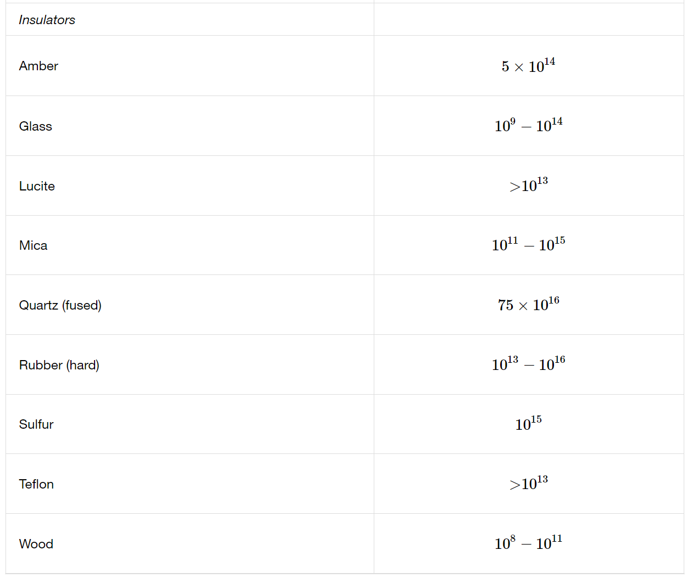
Resistivity at room temperature, insulators at 20º C

Slide 14
Attention quiz
The charge carriers in metals are
  A. Electrons.
  B. Positrons.
  C. Protons.
  D. A mix of protons and electrons.
A wire carries a current. If both the wire diameter and the electron drift speed are doubled, the electron current increases by a factor of
  A. 2
  B. 4
  C. 6
  D. 8
  E. Some other value

Slide 15
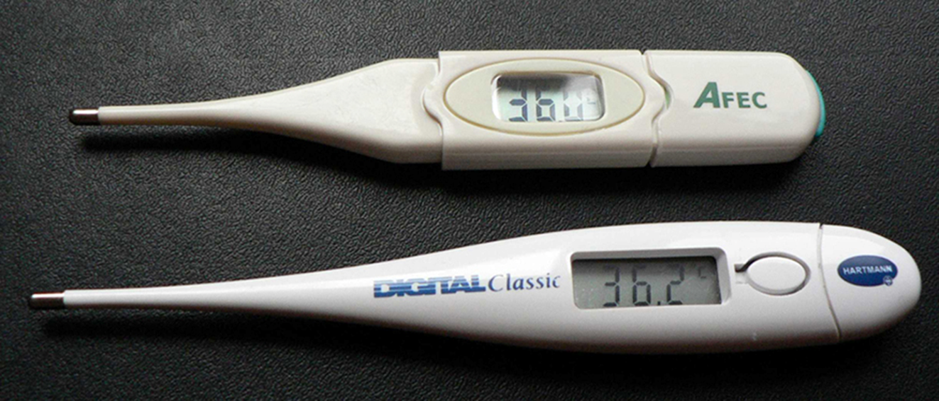


Resistivity and temperature
The resistivity of a metallic conductor nearly always increases with increasing temperature.
Over a small temperature range, the resistivity of a metal can be represented approximately:
These familiar thermometers are based on the automated measurement of a thermistor’s temperature-dependent resistance. (credit: Biol, Wikimedia Commons)
where ρ₀ is the original resistivity and
α is the temperature coefficient of resistivity.
The resistance of an object also depends on temperature as

Slide 16
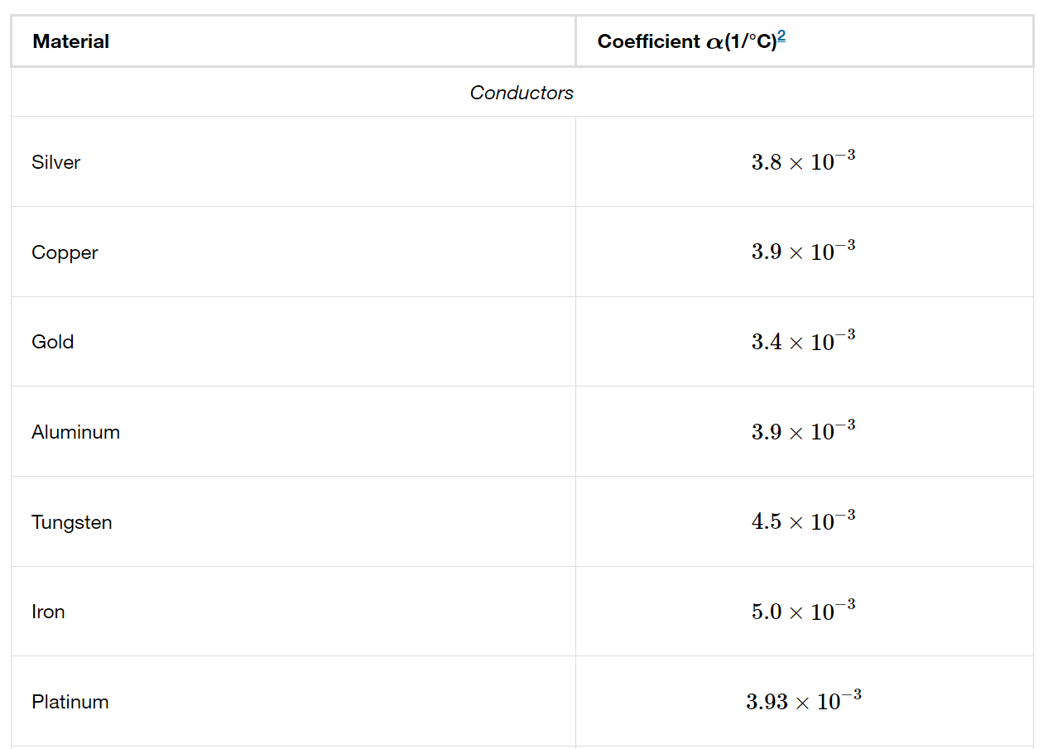
Temperature coefficients of resistivity, conductors

Slide 17
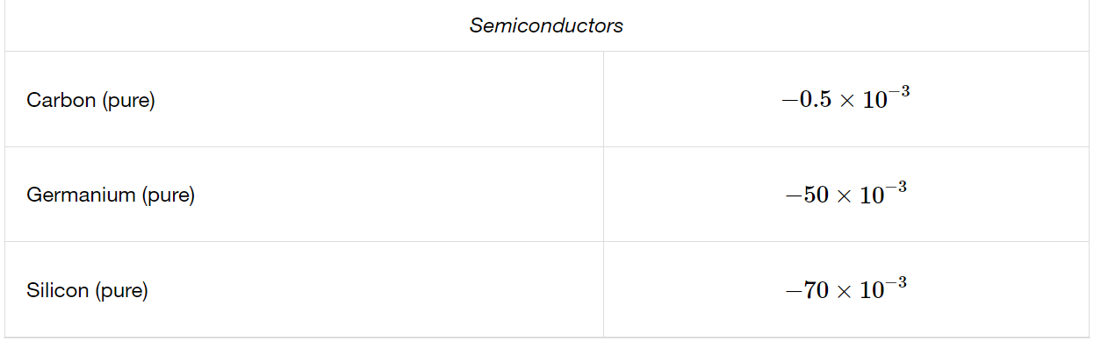
Temperature coefficients of resistivity, semiconductors

Slide 18
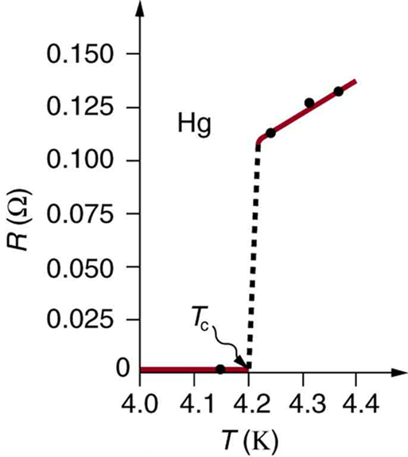
Superconductivity
Some materials show a phenomenon called superconductivity.
As the temperature decreases, the resistivity at first decreases smoothly, like that of any metal. Below a certain critical temperature T_{c} a phase transition occurs and the resistivity suddenly drops to zero.
Once a current has been established in a superconducting ring, it continues indefinitely without the presence of any driving field.
The resistance of a sample of mercury is zero at very low temperatures—it is a superconductor up to about 4.2 K. Above that critical temperature, its resistance makes a sudden jump and then increases nearly linearly with temperature.

Slide 19
Example, Ohm’s law
(a) Find the voltage drop in an extension cord having a 0.0600-Ω
resistance and through which 5.00 A is flowing.
(b) A cheaper cord utilizes thinner wire and has a resistance of 0.300Ω. What is the voltage drop in it when 5.00 A flows?
(c) Why is the voltage to whatever appliance is being used reduced by this amount? What is the effect on the appliance?

Slide 20
Example, resistance and resistivity
(a) Of what material is a wire made, if it is 25.0 m long with a 0.100 mm diameter and has a resistance of 77.7Ω at 20.0ºC?
(b) What is its resistance at 150ºC?

Slide 21
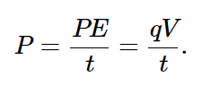

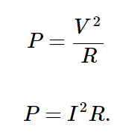
Power in electric circuit
Power is the rate at which energy is moved, and so electric power is
Recognizing that current is I=q/t, the expression for power becomes
Using Ohm’s law, we can rewrite it as

