Slide 1
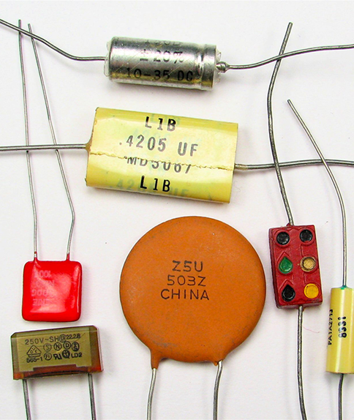

CAPACITANCE AND
DIELECTRICS

Slide 2
Today’s objectives:
By the end of this class, you will be able to:
Describe the action of a capacitor and define capacitance.
Explain parallel plate capacitors and their capacitances.
Discuss the process of increasing the capacitance of a dielectric.
Determine capacitance given charge and voltage.
Derive expressions for total capacitance in series and in parallel.
Identify series and parallel parts in the combination of connection of capacitors.
Calculate the effective capacitance in series and parallel given individual capacitances.
List some uses of capacitors.
Express in equation form the energy stored in a capacitor.
Explain the function of a defibrillator.

Slide 3
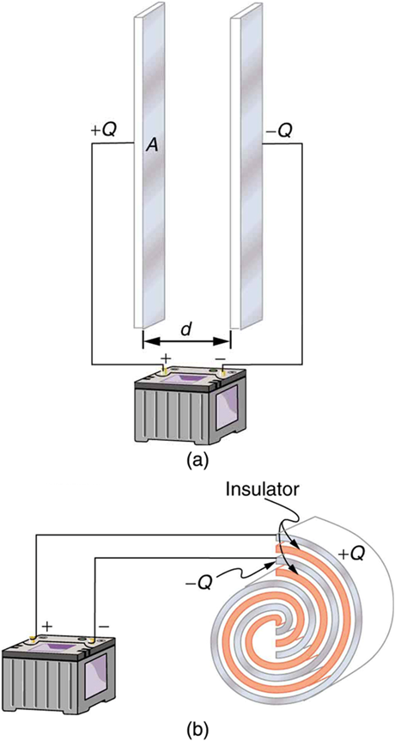
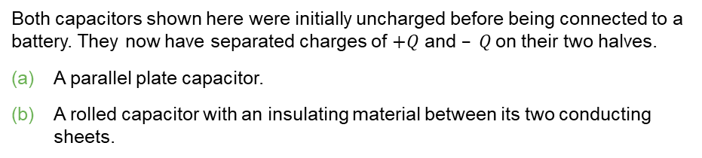
Capacitors
Any two conductors separated by an insulator (or a vacuum) form a capacitor.
When the capacitor is charged, it means the two conductors have charges with equal magnitude and opposite sign, and the net charge on the capacitor as a whole is zero.
The two conductors are called plates (or electrodes).
Both capacitors shown here were initially uncharged before being connected to a battery. They now have separated charges of $+Q$ and $– Q$on their two halves.
A parallel plate capacitor.
A rolled capacitor with an insulating material between its two conducting sheets.

Slide 4
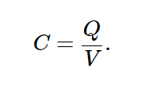
Capacitors and capacitance
If we change the magnitude of charge on each conductor, the potential difference between conductors changes; however, the ratio of charge to potential difference does not change.
This ratio is called the capacitance C of the capacitor:

Slide 5
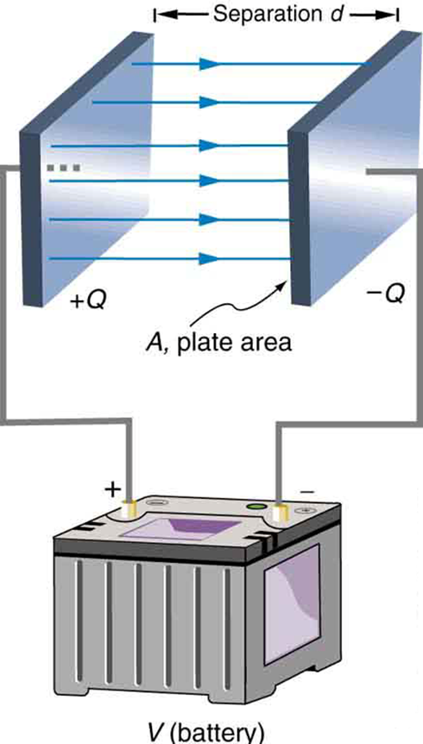
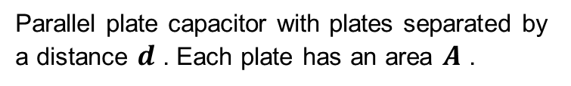
Parallel-plate capacitor
A parallel-plate capacitor consists of two parallel conducting plates separated by a distance that is small compared to their dimensions.
A parallel-plate capacitor creates a uniform electric field between its flat plates.
Parallel plate capacitor with plates separated by a distance $d$ . Each plate has an area $A$ .

Slide 6
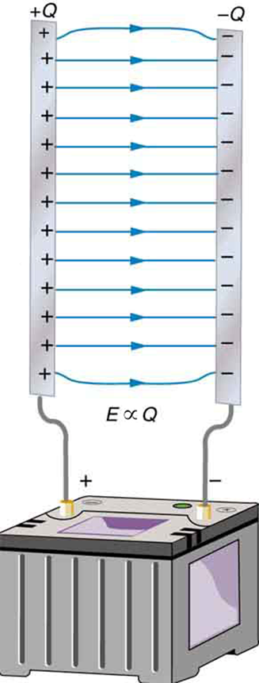
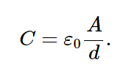
The parallel-plate capacitor, continued
The field between the plates of a parallel-plate capacitor is essentially uniform, and the charges on the plates are uniformly distributed over their opposing surfaces.
When the region between the plates is empty, the capacitance is:
The capacitance depends on the geometry of the capacitor only.
The quantities A and d are constants for a given capacitor, and ϵ₀ is a universal constant.
Electric field lines in this parallel plate capacitor, as always, start on positive charges and end on negative charges. Since the electric field strength is proportional to the density of field lines, it is also proportional to the amount of charge on the capacitor.

Slide 7
Parallel plate capacitor, example
A parallel-plate capacitor is constructed of two square plates, 1 m on each side, separated by a 1.0 mm gap. What is the capacitance of this capacitor? If it were charged to 100 V, how much charge would be on the capacitor?
Notes:
Answer: Equation 21.20 gives the capacitance: C = eps_0*A/d where A = 1 m^2, d = 1E-3 m, and eps_0 = 8.85E-12 (SI units). C = 8.85E-9 Farads. With 100V applied, it will accumulate a charge Q = CV = 8.85E-7 Coulombs.

Slide 8
Parallel-plate capacitor, another example
The capacitance of practical parallel-plate capacitors is quite small, in the pF range. Suppose you want to make a 1.0 μF capacitor using square plates separated by 1.0 mm. How large do the plates need to be?

Slide 9
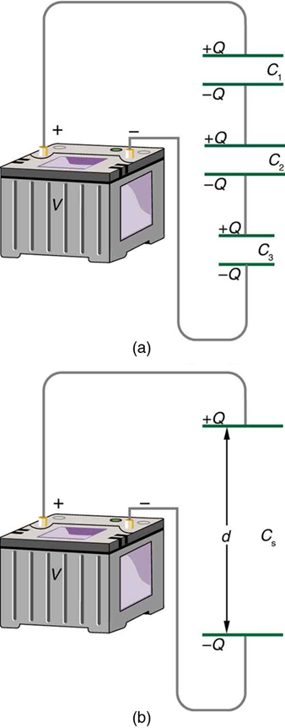
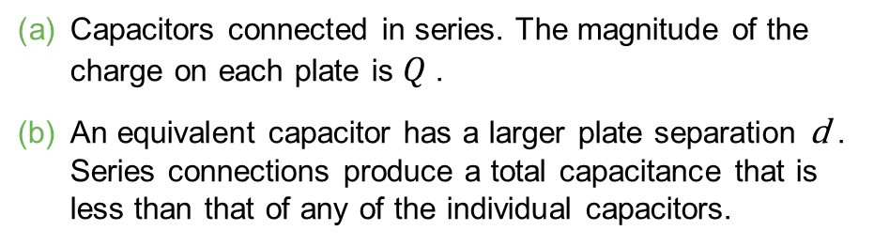
Capacitors in series
Capacitors are in series if they are connected one after the other, as illustrated.
The equivalent single capacitor is also shown.
Capacitors connected in series. The magnitude of the charge on each plate is $Q$.
An equivalent capacitor has a larger plate separation d . Series connections produce a total capacitance that is less than that of any of the individual capacitors.

Slide 10
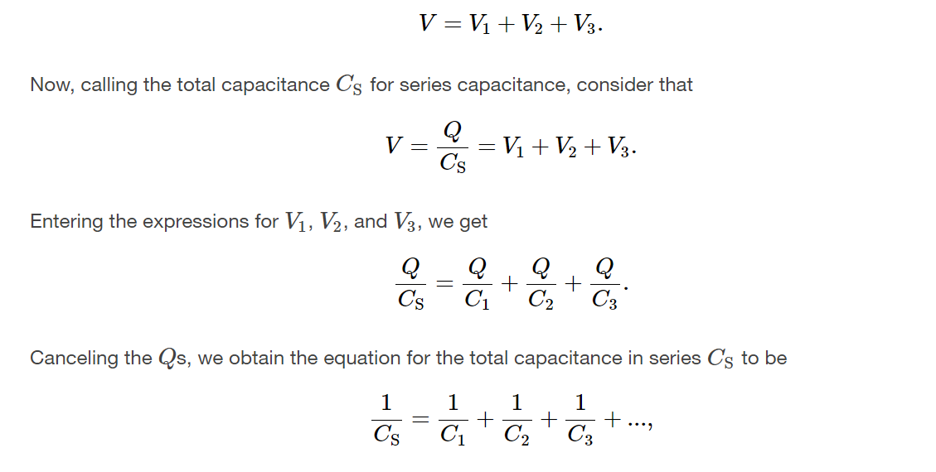
Capacitors in series, details

Slide 11

Capacitors in series, summary
When several capacitors are connected in series, the magnitude of charge is the same on all plates of all the capacitors.
The potential differences of the individual capacitors add to give the total potential difference across the series combination.
The equivalent capacitance of the series combination
is given by:

Slide 12
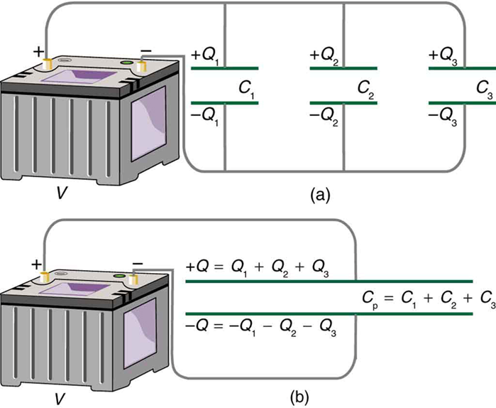
Capacitors in parallel
Capacitors are connected in parallel between a and b if the potential difference V_{ab} is the same for all the capacitors.
Capacitors in parallel. Each is connected directly to the voltage source just as if it were all alone, and so the total capacitance in parallel is just the sum of the individual capacitances.
The equivalent capacitor has a larger plate area and can therefore hold more charge than the individual capacitors.

Slide 13
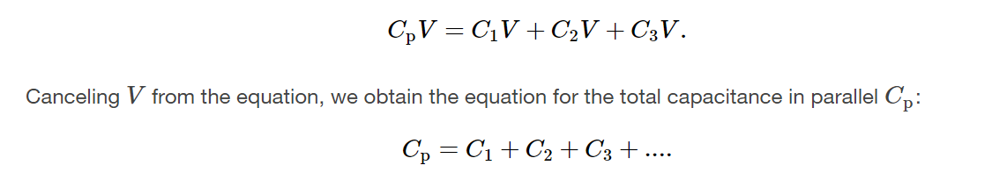
Capacitors in parallel, details

Slide 14

Capacitors in parallel, summary
When several capacitors are connected in parallel, the potential differences are the same for all the capacitors.
The charges on the individual capacitors add to give the total charge on the parallel combination.
The equivalent capacitance of the parallel combination is given by:

Slide 15
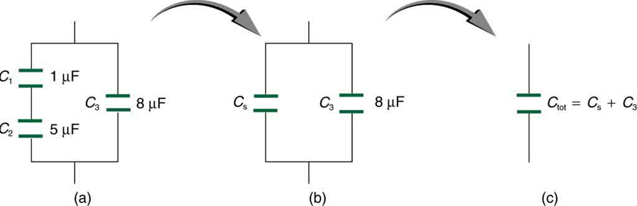
Combination of capacitors, example
This circuit contains both series and parallel connections of capacitors.
C₁ and C₂ are in series; their equivalent capacitance C_{S} is less than either of them.
Note that C_{S} is in parallel with C₃ . The total capacitance is, thus, the sum of C_{S} and C₃ .

Slide 16

Dielectrics
Most capacitors have a nonconducting material, or dielectric, between their conducting plates.
A common type of capacitor uses long strips of metal foil for the plates, separated by strips of plastic sheet such as Mylar.

Slide 17
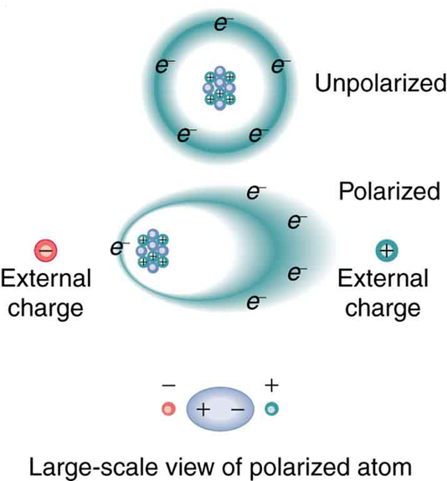
Dielectrics and polarization
When a dielectric is inserted between the plates of a capacitor, the electric field decreases.
This is due to polarization of the charge within the dielectric, which results in induced surface charges, as shown.
Artist’s conception of a polarized atom. The orbits of electrons around the nucleus are shifted slightly by the external charges (shown exaggerated). The resulting separation of charge within the atom means that it is polarized. Note that the unlike charge is now closer to the external charges, causing the polarization.

Slide 18
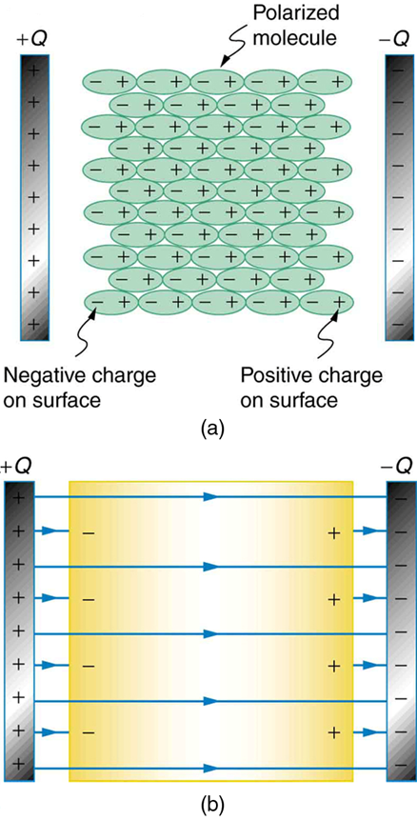
Molecular model of induced charge
The polarization of molecules within a dielectric leads to the formation of a layer of charge on each surface of the dielectric material.
The molecules in the insulating material between the plates of a capacitor are polarized by the charged plates. This produces a layer of opposite charge on the surface of the dielectric that attracts more charge onto the plate, increasing its capacitance.
The dielectric reduces the electric field strength inside the capacitor, resulting in a smaller voltage between the plates for the same charge. The capacitor stores the same charge for a smaller voltage, implying that it has a larger capacitance because of the dielectric.

Slide 19
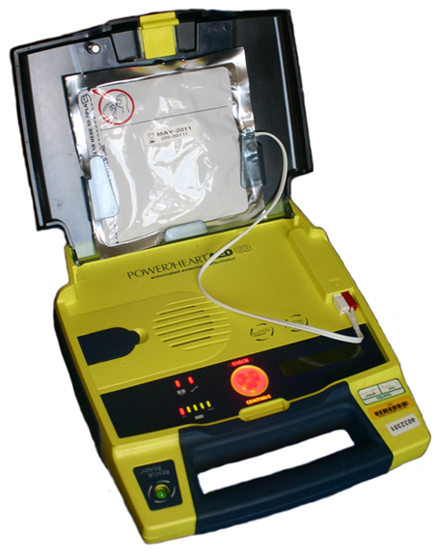
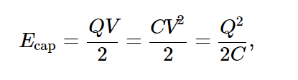
Energy stored in a capacitor
The potential energy stored in a capacitor is:
Automated external defibrillators are found in many public places. These portable units provide verbal instructions for use in the important first few minutes for a person suffering a cardiac attack. (credit: Owain Davies, Wikimedia Commons)
The capacitor energy is stored in the electric field between the plates.

