Slide 1


COULOMB’S LAW

Slide 2
Today’s objectives
By the end of this class, you will be able to:
State Coulomb’s law in terms of how the electrostatic force changes with the distance between two objects.
Calculate the electrostatic force between two charged point forces, such as electrons or protons.
Compare the electrostatic force to the gravitational attraction for a proton and an electron; for a human and the Earth.

Slide 3
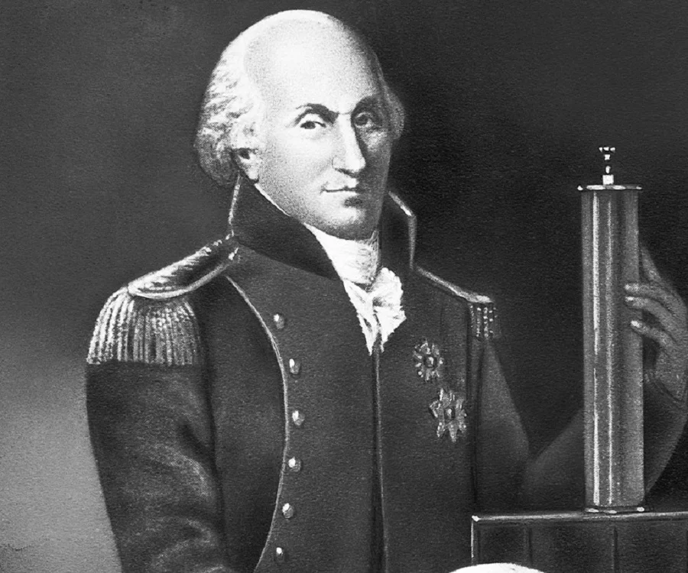
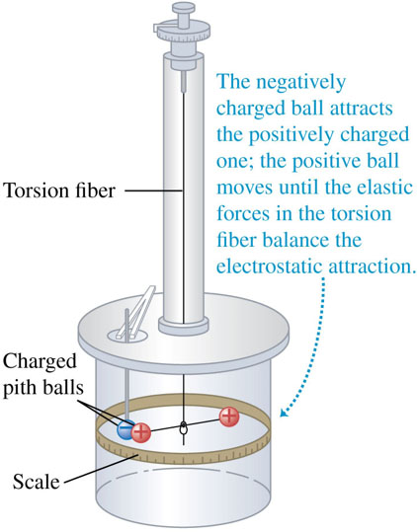
Force between point charges
Coulomb studied the interaction forces of charged particles in detail in 1784.
He used a torsion balance similar to the one used 13 years later by Cavendish to study the much weaker gravitational interaction.
For point charges, Coulomb found that the magnitude of the electric force between two point charges is directly proportional to the product of their charges and inversely proportional to the square of the distance between them.

Slide 4
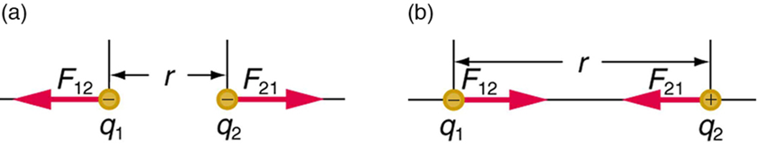
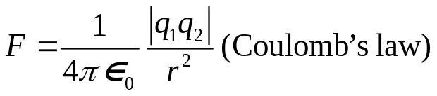
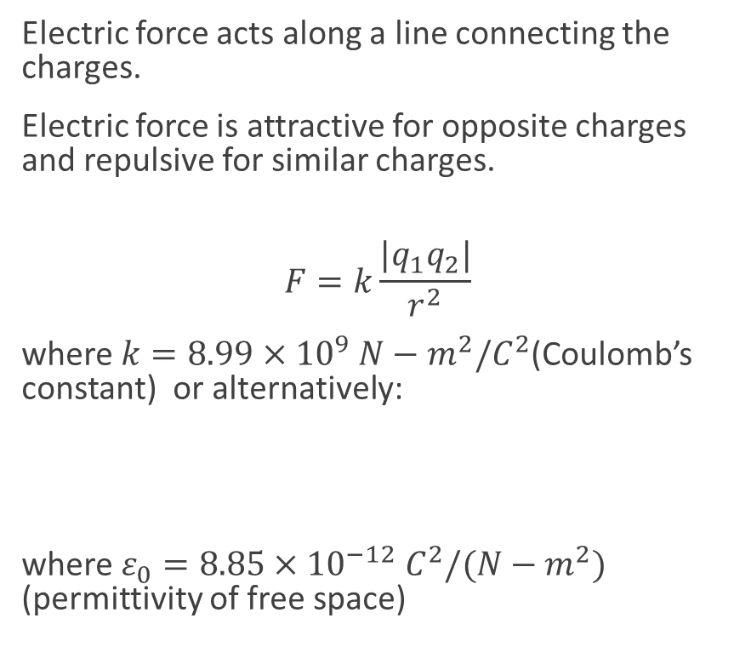
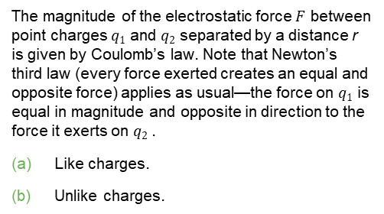
Force between point charges, continued
Electric force acts along a line connecting the charges.
Electric force is attractive for opposite charges and repulsive for similar charges.
$$F=k\frac{|q_{1}q_{2}|}{r^{2}}$$
where $k=8.99×{10}^{9} N−m^{2}/C^{2}$(Coulomb’s constant) or alternatively:
where $ε_{0}=8.85×{10}^{−12} C^{2}/(N−m^{2})$ (permittivity of free space)
The magnitude of the electrostatic force $F$ between point charges $q1$ and $q2$ separated by a distance r is given by Coulomb’s law. Note that Newton’s third law (every force exerted creates an equal and opposite force) applies as usual—the force on $q1$ is equal in magnitude and opposite in direction to the force it exerts on $q2$.
Like charges.
Unlike charges.

Slide 5
Coulomb’s law, details
Coulomb’s law describes the force between two charged particles.
Coulomb’s law applies only to point charges and spherically symmetric charge distributions.
Objects can be considered point charges if they are much smaller than the distance between them.
Coulomb’s law looks much like Newton’s gravity except the charge q can be positive or negative, so the force can be attractive or repulsive.

Slide 6

Superposition principle and other important details
Electric forces, like other forces, can be superimposed.
The net electric force on charge j due to all other charges is the sum of the individuals forces due to each charge:
Each force is given by Coulomb’s law.

Slide 7
Superposition principle, example
Two +10 nC charged particles are 2.0 cm apart on the x-axis. What is the net force on a +1.0 nC charge midway between them? What is the net force if the charged particle on the right is replaced by a -10 nC charge?

