Slide 1


CHARGES AND ELECTRIC FORCES

Slide 2
Today’s objectives
By the end of this class, you will be able to:
Define electric charge, and describe how the two types of charge interact.
Describe three common situations that generate static electricity.
State the law of conservation of charge.

Slide 3
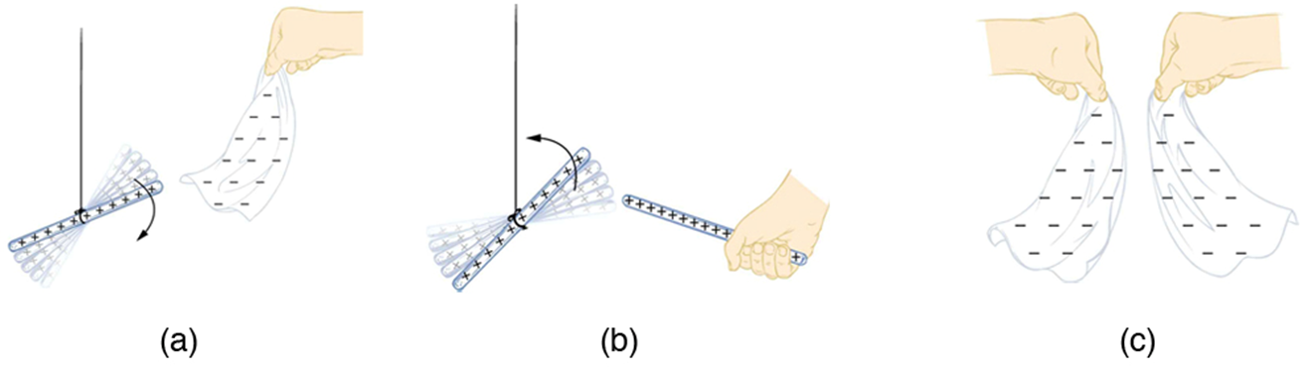
Electric charge
Plastic rods and fur (real or fake) are particularly good for demonstrating electrostatics, the interactions between electric charges that are at rest (or nearly so).
After we charge both plastic rods by rubbing them with the piece of fur, we find that the rods repel each other.
A glass rod becomes positively charged when rubbed with silk, while the silk becomes negatively charged.
The glass rod is attracted to the silk because their charges are opposite.
Two similarly charged glass rods repel.
Two similarly charged silk cloths repel.

Slide 4
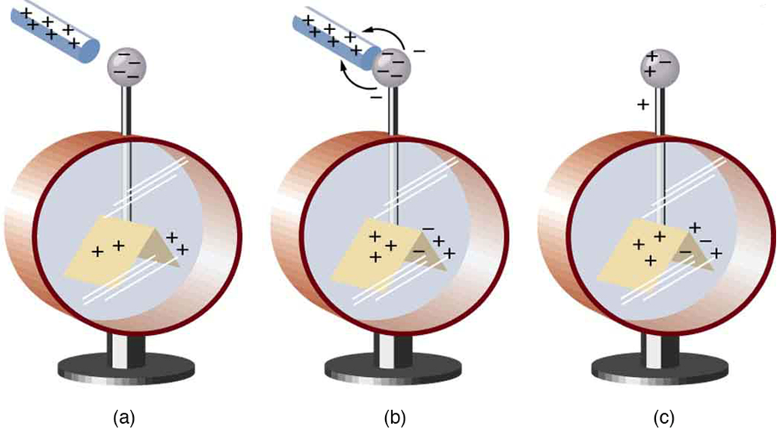
Electric charge, continued
A charged plastic rod attracts a charged glass rod; furthermore, the plastic rod and the fur attract each other, and the glass rod and the silk attract each other.
These experiments and many others like them have shown that there are exactly two kinds of electric charge: The kind on the plastic rod rubbed with fur (negative) and the kind on the glass rod rubbed with silk (positive).
Similar charges repel, opposite charges attract
An electroscope is a favorite instrument in physics demonstrations and student laboratories. It is typically made with gold foil leaves hung from a (conducting) metal stem and is insulated from the room air in a glass-walled container. (a) A positively charged glass rod is brought near the tip of the electroscope, attracting electrons to the top and leaving a net positive charge on the leaves. Like charges in the light flexible gold leaves repel, separating them. (b) When the rod is touched against the ball, electrons are attracted and transferred, reducing the net charge on the glass rod but leaving the electroscope positively charged. (c) The excess charges are evenly distributed in the stem and leaves of the electroscope once the glass rod is removed.

Slide 5
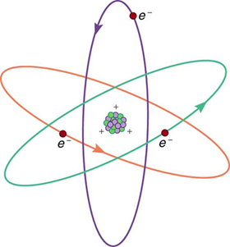
Electric charge and the structure of matter
An atom has a dense, positively charged nucleus, containing positively charged protons and neutral neutrons.
The nucleus is surrounded by the much-less-massive negatively charged electrons that form an electron cloud.
A neutral atom has the same number of protons as electrons.
Charge, like mass, is an inherent property of electrons and protons.
This simplified (and not to scale) view of an atom is called the planetary model of the atom. Negative electrons orbit a much heavier positive nucleus, as the planets orbit the much heavier sun. There the similarity ends, because forces in the atom are electromagnetic, whereas those in the planetary system are gravitational. Normal macroscopic amounts of matter contain immense numbers of atoms and molecules and, hence, even greater numbers of individual negative and positive charges.

Slide 6
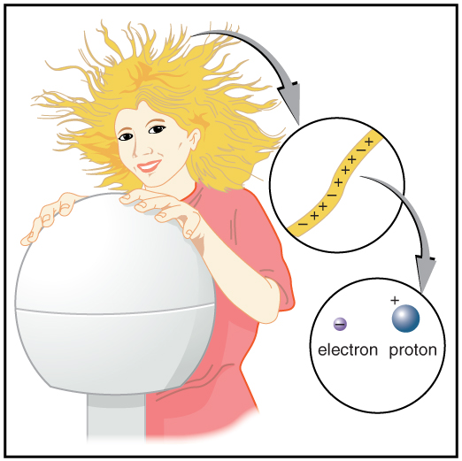
Matter – charged vs neutral
Electrons and protons are the basic charges in ordinary matter.
There are no other sources of charge.
An object is charged if it has an unequal number of protons and electrons.
Most macroscopic objects have an equal number of protons and electrons. Such objects are electrically neutral.
When this person touches a Van de Graaff generator, some electrons are attracted to the generator, resulting in an excess of positive charge, causing her hair to stand on end. The charges in one hair are shown. An artist’s conception of an electron and a proton illustrate the particles carrying the negative and positive charges. We cannot really see these particles with visible light because they are so small (the electron seems to be an infinitesimal point), but we know a great deal about their measurable properties, such as the charges they carry.

Slide 7
ATOMS AND IONS
Ionization is the process of removing an electron from the electron cloud of an atom.
A positive ion is an atom with one or more electrons removed.
Objects gain a positive charge not by gaining protons, but by losing electrons.
Protons are extremely tightly bound within the nucleus, but electrons are bound much more loosely.
Atoms that can accommodate an extra electron become negative ions.

Slide 8
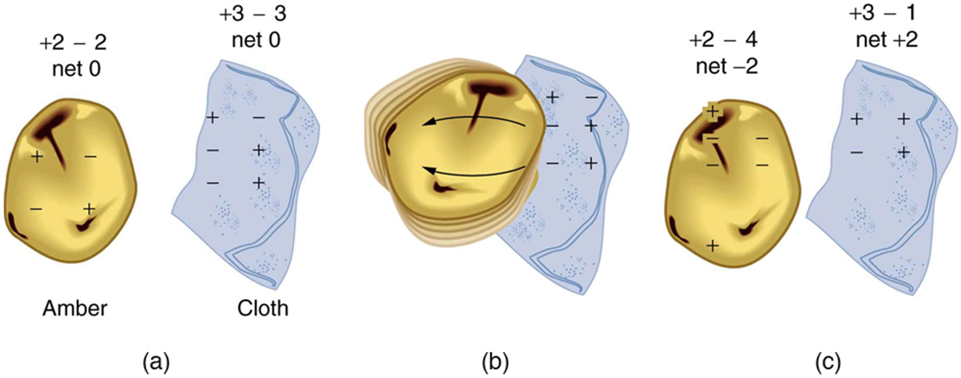
Charging, an atomic view
Molecular ions can be created when one of the bonds in a large molecule is broken.
Rubbing and friction often cause molecular bonds at the surface to break.
Charging occurs when negative ions transfer to one material leaving positive ions on the other.
When materials are rubbed together, charges can be separated, particularly if one material has a greater affinity for electrons than another.
Both the amber and cloth are originally neutral, with equal positive and negative charges. Only a tiny fraction of the charges are involved, and only a few of them are shown here.
When rubbed together, some negative charge is transferred to the amber, leaving the cloth with a net positive charge.
When separated, the amber and cloth now have net charges, but the absolute value of the net positive and negative charges will be equal.

Slide 9
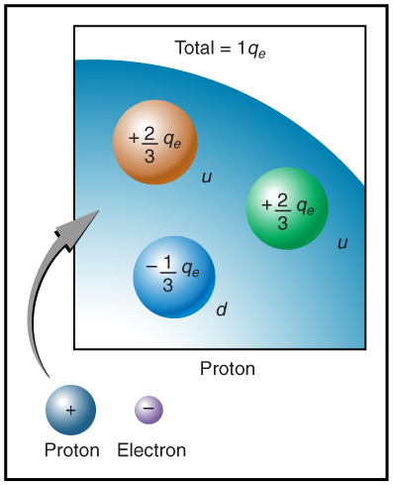
Electric charge is conserved and quantized
The proton and electron have the charge of the same magnitude.
The magnitude of charge of the electron or proton is a natural unit of charge. All observable charge is quantized in this unit.
The universal principle of charge conservation states that the algebraic sum of all the electric charges in any closed system is constant.
Artist’s conception of fractional quark charges inside a proton. A group of three quark charges add up to the single positive charge on the proton.

Slide 10






The fundamental charge
Charge is represented by the symbol q. The S I unit is a coulomb (C).
The fundamental charge (e) is the magnitude of the charge of an electron or proton:
Particle | Mass (kg) | Charge (C)
Proton | 1.67 times 10 to the negative twenty seventh power. | Positive e = 1.60 times 10 to the negative nineteenth power.
Electron | 9.11 times 10 to the negative thirty first power. | Negative e = negative 1.60 times 10 to the negative nineteenth power.

Slide 11
Insulators and conductors
Charge can be transferred from one object to another only when the objects touch.
Discharging is removing a charge from an object, which you can do by touching it.
Conductors are those materials through or along which charge easily moves.
Insulators are materials in which charge is immobile.
Glass and plastics are insulators, metal is a conductor.

Slide 12

Charging by conduction
Consider an electroscope being charged by touching it with a positively charged glass rod.
Since only electrons move in metals, we see that they are attracted to the top of the electroscope. There, some are transferred to the positive rod by touch, leaving the electroscope with a net positive charge.
Electrostatic repulsion in the leaves of the charged electroscope separates them.
Similarly, the electroscope can be negatively charged by contact with a negatively charged object.
Note: the physical contact is required.
The charge on the metal ball is of the same sign as the charge on the rod.
An electroscope is a favorite instrument in physics demonstrations and student laboratories. It is typically made with gold foil leaves hung from a (conducting) metal stem and is insulated from the room air in a glass-walled container. (a) A positively charged glass rod is brought near the tip of the electroscope, attracting electrons to the top and leaving a net positive charge on the leaves. Like charges in the light flexible gold leaves repel, separating them. (b) When the rod is touched against the ball, electrons are attracted and transferred, reducing the net charge on the glass rod but leaving the electroscope positively charged. (c) The excess charges are evenly distributed in the stem and leaves of the electroscope once the glass rod is removed.

Slide 13
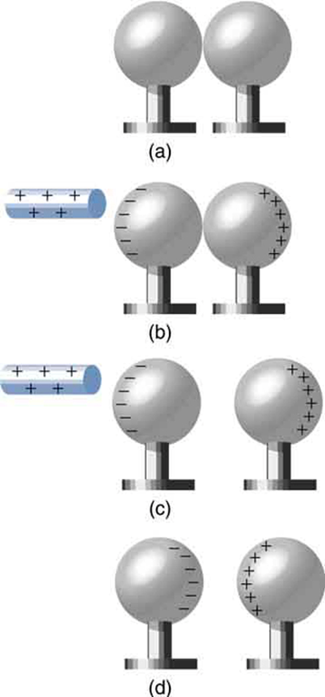
Charging by induction
Two uncharged or neutral metal spheres are in contact with each other but insulated from the rest of the world.
A positively charged glass rod is brought near the sphere on the left, attracting negative charge and leaving the other sphere positively charged.
The spheres are separated before the rod is removed, thus separating negative and positive charge.
The spheres retain net charges after the inducing rod is removed—without ever having been touched by a charged object.

Slide 14
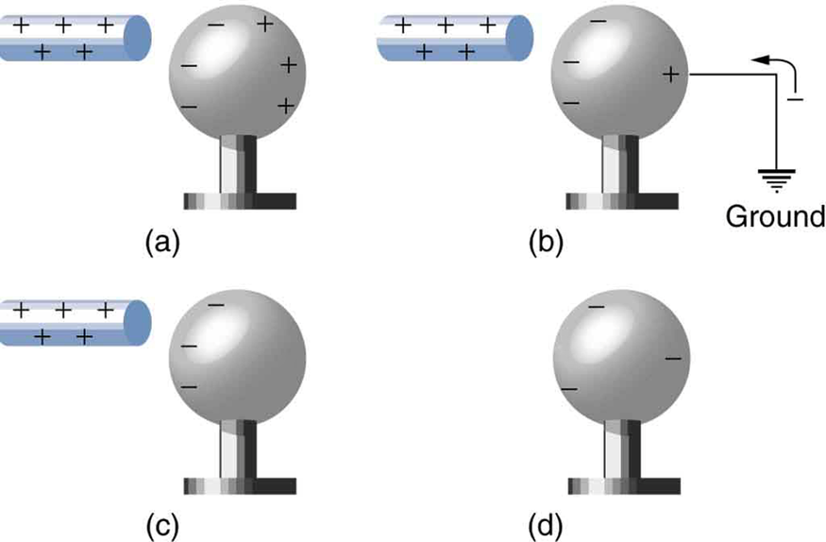
Charging by induction, another case
A positively charged rod is brought near a neutral metal sphere, polarizing it.
The sphere is grounded, allowing electrons to be attracted from the earth’s ample supply.
The ground connection is broken.
The positive rod is removed, leaving the sphere with an induced negative charge.
Note:
There is NO physical contact between the ball and the rod.
The charge on the ball is of the opposite sign compared to the one on the rod.

Slide 15
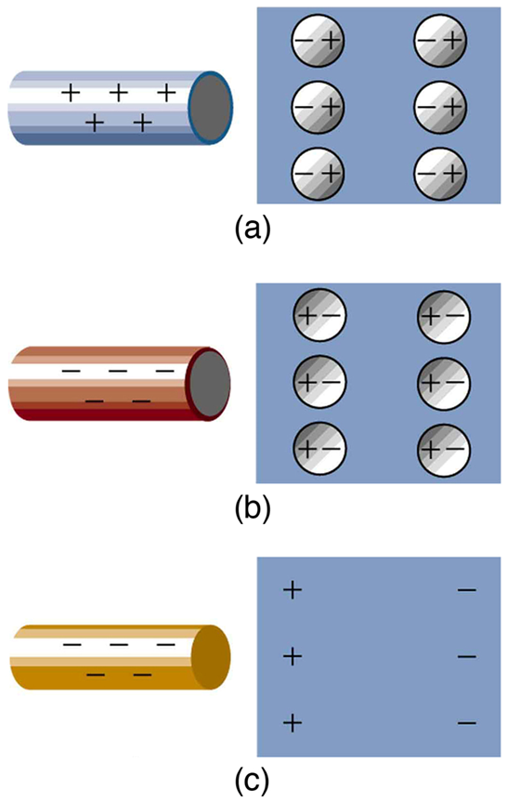
Electric forces on uncharged objects
A positive object brought near a neutral insulator polarizes its molecules. There is a slight shift in the distribution of the electrons orbiting the molecule, with unlike charges being brought nearer and like charges moved away. Since the electrostatic force decreases with distance, there is a net attraction.
A negative object produces the opposite polarization, but again attracts the neutral object.
The same effect occurs for a conductor; since the unlike charges are closer, there is a net attraction.

Slide 16
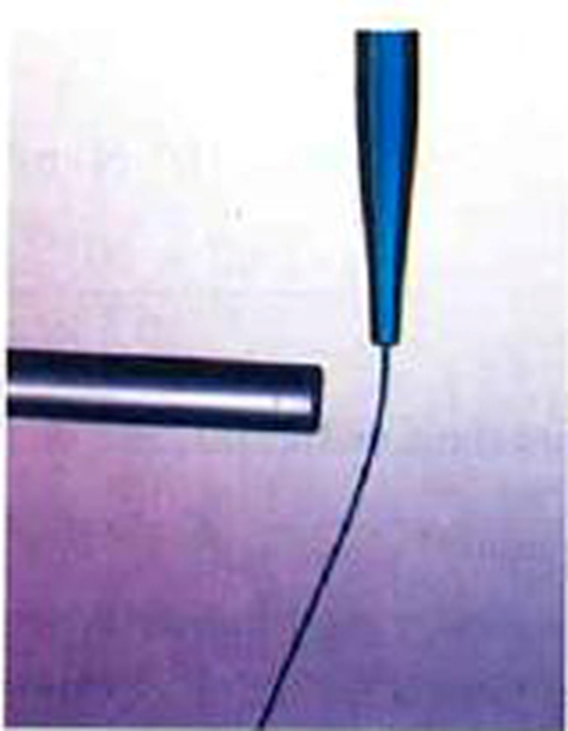
Polarization
The negatively charged plastic rod causes a slight shifting of charge within the molecules of the neutral insulator, an effect called polarization.

Slide 17
Attention quiz
1. A negatively charged rod is brought near a neutral metal sphere. Which of the following is true?
  A. There is an attractive force between the rod and sphere.
  B. There is a repulsive force between the rod and sphere.
  C. There is no electric force between the rod and sphere.
2. A neutral object
  A. Is identical to an insulator.
  B. Has no charge of either sign.
  C. Has no net charge.
  D. Is not attracted to a charged rod.
Notes:
Answers:
1 A
2 C

