Slide 1
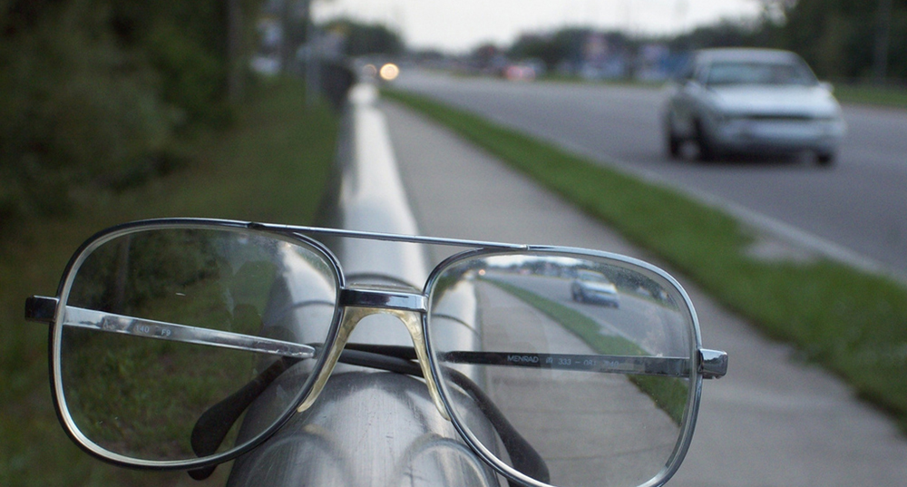
IMAGE FORMATION BY LENSES AND MIRRORS

Slide 2
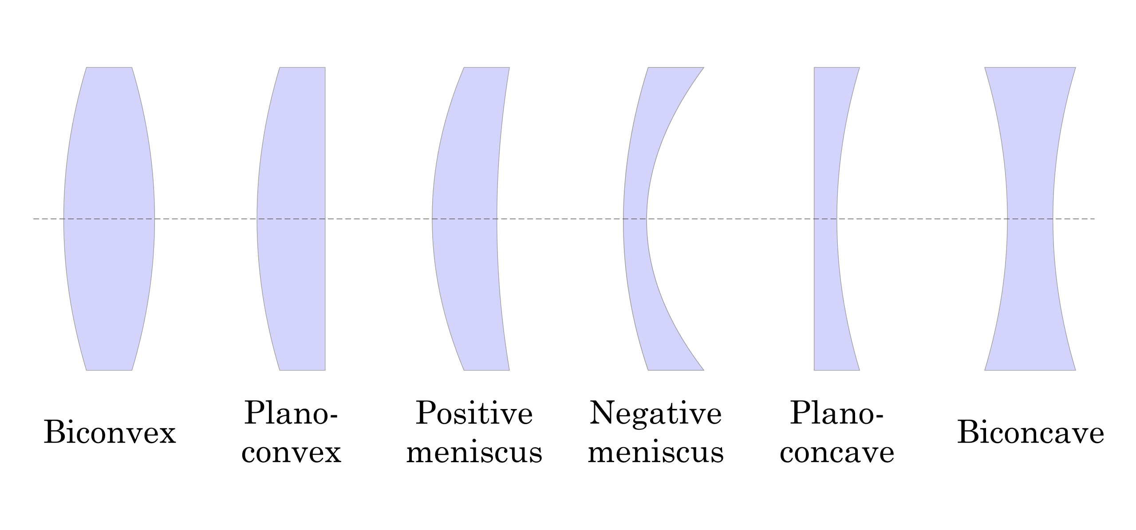
Types of Lenses
Shown below are various types of lenses, both converging and diverging.
Any lens that is thicker at its center than at its edges is a converging lens with positive f ; and any lens that is thicker at its edges than at its center is a diverging lens with negative f.

Slide 3
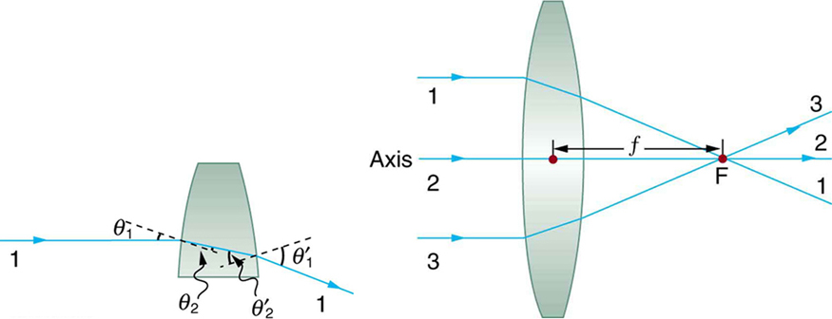
Image formation by a converging lens
Rays of light entering a converging lens parallel to its axis converge at its focal point F. (Ray 2 lies on the axis of the lens.) The distance from the center of the lens to the focal point is the lens’s focal length f. An expanded view of the path taken by ray 1 shows the perpendiculars and the angles of incidence and refraction at both surfaces.

Slide 4
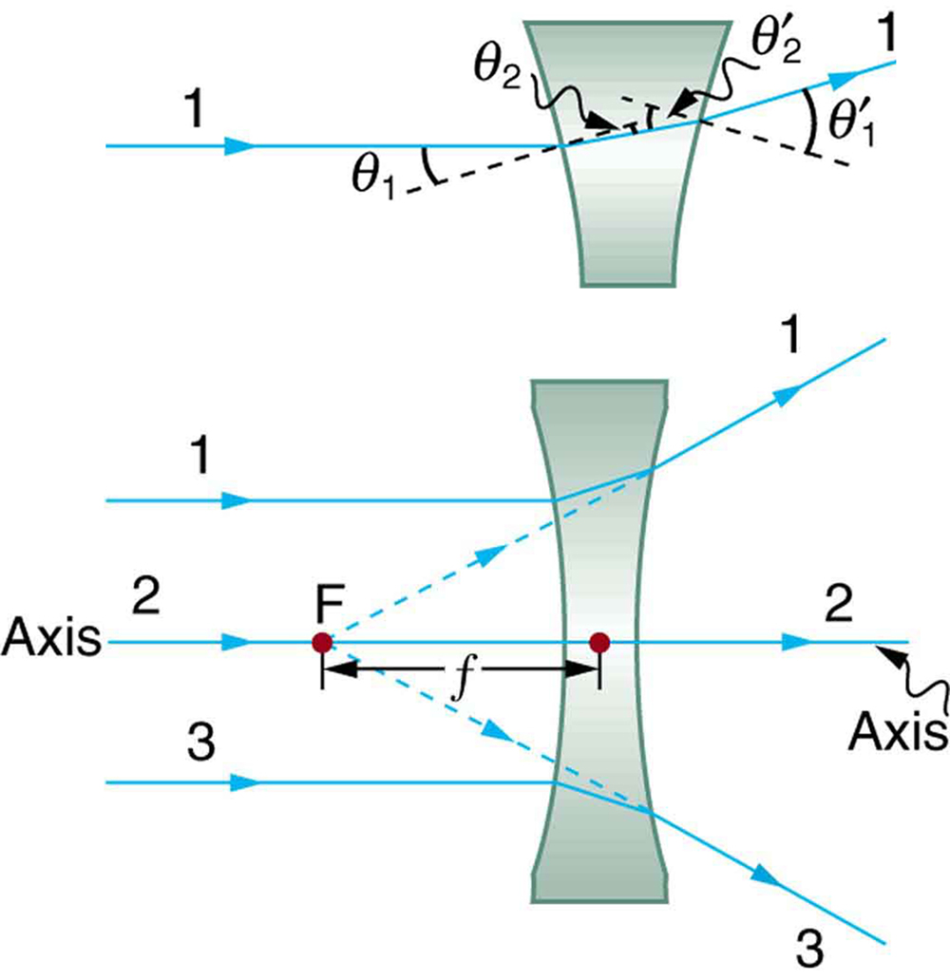
Image formation by a diverging lens
Rays of light entering a diverging lens parallel to its axis are diverged, and all appear to originate at its focal point F. The dashed lines are not rays—they indicate the directions from which the rays appear to come. The focal length f of a diverging lens is negative. An expanded view of the path taken by ray 1 shows the perpendiculars and the angles of incidence and refraction at both surfaces.

Slide 5

Power of a lens
The greater effect a lens has on light rays, the more powerful it is said to be. For example, a powerful converging lens will focus parallel light rays closer to itself and will have a smaller focal length than a weak lens. The light will also focus into a smaller and more intense spot for a more powerful lens.
The power P of a lens is defined to be the inverse of its focal length. In equation form, this is

Slide 6
Ray diagrams for lenses
The rules for ray tracing for thin lenses are as follows:
A ray entering a converging lens parallel to its axis passes through the focal point F of the lens on the other side.
A ray entering a diverging lens parallel to its axis seems to come from the focal point F.
A ray passing through the center of either a converging or a diverging lens does not change direction.
A ray entering a converging lens through its focal point exits parallel to its axis.
A ray that enters a diverging lens by heading toward the focal point on the opposite side exits parallel to the axis.

Slide 7
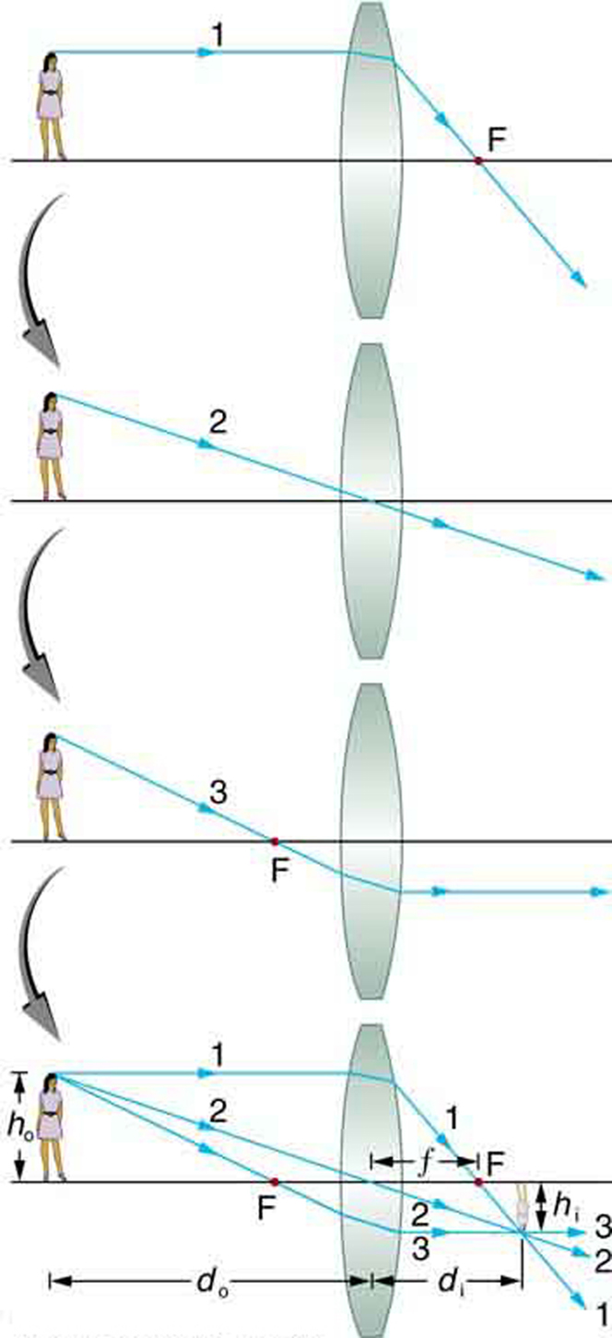
Example of a ray diagram
Ray tracing is used to locate the image formed by a lens. Rays originating from the same point on the object are traced—the three chosen rays each follow one of the rules for ray tracing, so that their paths are easy to determine. The image is located at the point where the rays cross. In this case, a real image—one that can be projected on a screen—is formed.

Slide 8
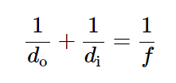
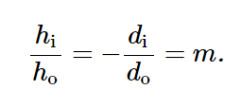
Thin lens equations
We define d_{o} to be the object distance, the distance of an object from the center of a lens.
Image distance d_{i} is defined to be the distance of the image from the center of a lens.
The height of the object and height of the image are given the symbols h_{o} and h_{i}, respectively.
Images that appear upright relative to the object have heights that are positive and those that are inverted have negative heights.
Here m is the magnification.

Slide 9
Example
A clear glass light bulb is placed 0.750 m from a convex lens having a 0.500 m focal length. Use ray tracing to get an approximate location for the image. Then use the thin lens equations to calculate (a) the location of the image and (b) its magnification. Verify that ray tracing and the thin lens equations produce consistent results.

Slide 10
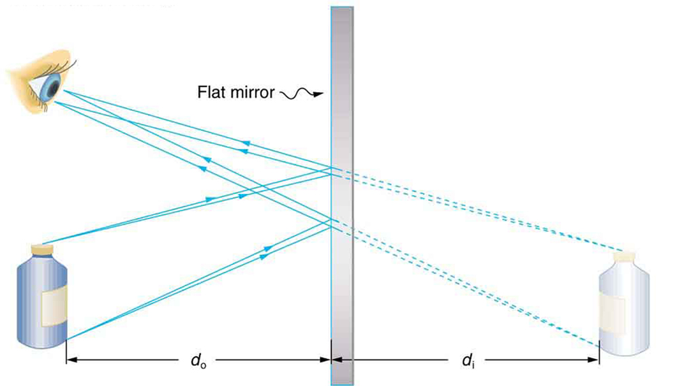
Reflection from a flat surface
Two rays are shown emerging from the same point, striking the mirror, and being reflected into the observer’s eye.
The rays can diverge slightly, and both still get into the eye. If the rays are extrapolated backward, they seem to originate from a common point behind the mirror, locating the image.
Using the law of reflection, we can see that the image and object are the same distance from the mirror.
This is a virtual image, since the rays only appear to originate from a common point behind the mirror.
In front of the mirror, the rays behave exactly as if they had come from behind the mirror, so that is where the image is situated.
Two sets of rays from common points on an object are reflected by a flat mirror into the eye of an observer. The reflected rays seem to originate from behind the mirror, locating the virtual image.

Slide 11
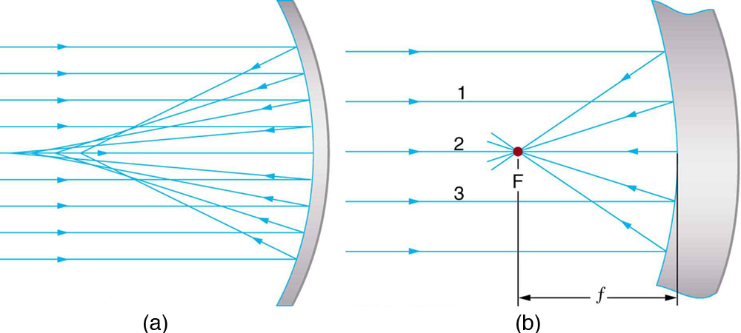


Spherical mirrors
Just as for lenses, the shorter the focal length, the more powerful the mirror; thus,
for a mirror, too.
A more strongly curved mirror has a shorter focal length and a greater power. Using the law of reflection and some simple trigonometry, it can be shown that the focal length is half the radius of curvature, or
(a) Parallel rays reflected from a large spherical mirror do not all cross at a common point. (b) If a spherical mirror is small compared with its radius of curvature, parallel rays are focused to a common point. The distance of the focal point from the center of the mirror is its focal length f. Since this mirror is converging, it has a positive focal length.

Slide 12
Ray diagrams for mirrors
Ray tracing is as useful for mirrors as for lenses. The rules for ray tracing for mirrors are as follows:
A ray approaching a concave converging mirror parallel to its axis is reflected through the focal point F of the mirror on the same side.
A ray approaching a convex diverging mirror parallel to its axis is reflected so that it seems to come from the focal point F behind the mirror.
Any ray striking the center of a mirror is followed by applying the law of reflection; it makes the same angle with the axis when leaving as when approaching.
A ray approaching a concave converging mirror through its focal point is reflected parallel to its axis.
A ray approaching a convex diverging mirror by heading toward its focal point on the opposite side is reflected parallel to the axis.

Slide 13
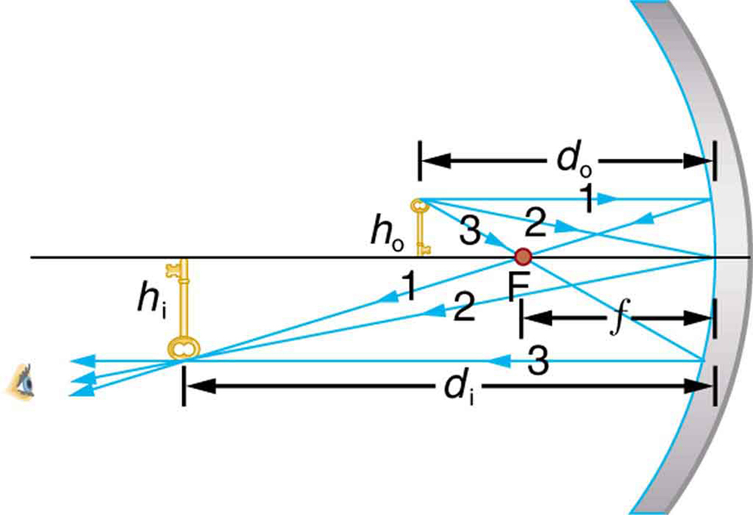
Example 1: concave mirror
A case 1 image for a mirror. An object is farther from the converging mirror than its focal length. Rays from a common point on the object are traced using the rules in the text. Ray 1 approaches parallel to the axis, ray 2 strikes the center of the mirror, and ray 3 goes through the focal point on the way toward the mirror. All three rays cross at the same point after being reflected, locating the inverted real image. Although three rays are shown, only two of the three are needed to locate the image and determine its height.

Slide 14
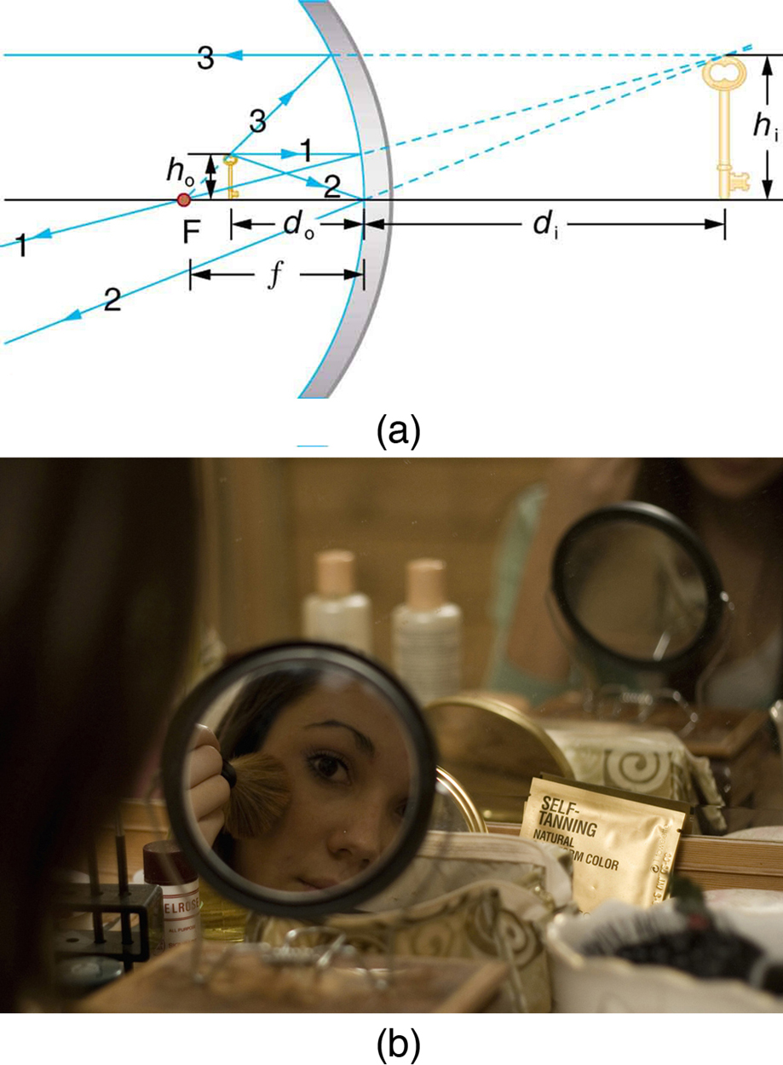
Example 2: concave mirror
(a) Case 2 images for mirrors are formed when a converging mirror has an object closer to it than its focal length. Ray 1 approaches parallel to the axis, ray 2 strikes the center of the mirror, and ray 3 approaches the mirror as if it came from the focal point. (b) A magnifying mirror showing the reflection. (credit: Mike Melrose, Flickr)

Slide 15
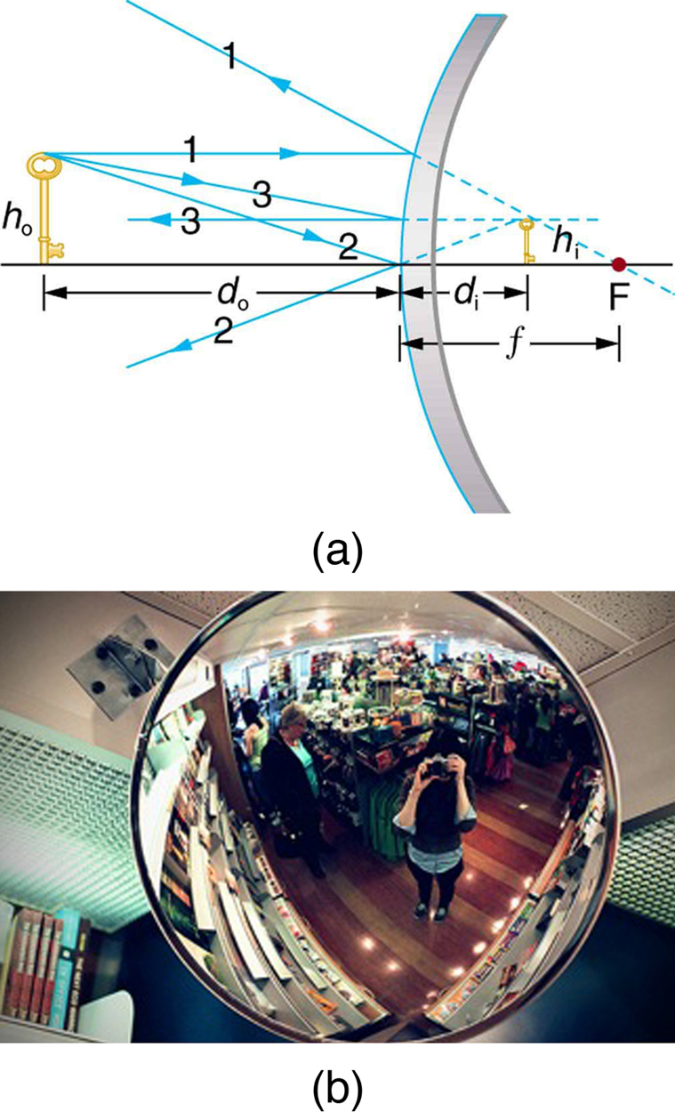
Example 3: convex mirror
Case 3 images for mirrors are formed by any convex mirror. Ray 1 approaches parallel to the axis, ray 2 strikes the center of the mirror, and ray 3 approaches toward the focal point. All three rays appear to originate from the same point after being reflected, locating the upright virtual image behind the mirror and showing it to be smaller than the object. (b) Security mirrors are convex, producing a smaller, upright image. Because the image is smaller, a larger area is imaged compared to what would be observed for a flat mirror (and hence security is improved). (credit: Laura D’Alessandro, Flickr)

