Slide 1
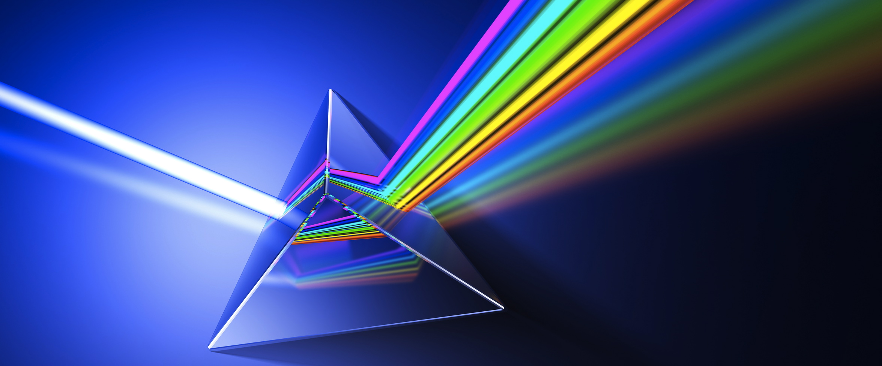

GEOMETRIC OPTICS

Slide 2
Today’s objectives
By the end of this lesson, you will be able to:
Explain reflection of light from polished and rough surfaces.
Explain the phenomenon of total internal reflection.
Describe the workings and uses of fiber optics.
Determine the index of refraction, given the speed of light in a medium.
Explain the phenomenon of dispersion and discuss its advantages and disadvantages.

Slide 3
The ray aspect of light
We will model light as traveling in straight lines called rays.
Light may change direction when it encounters objects (such as a mirror) or in passing from one material to another (such as in passing from air to glass), but it then continues in a straight line or as a ray.
The word ray comes from mathematics and here means a straight line that originates at some point. It is acceptable to visualize light rays as laser rays (or even science fiction depictions of ray guns).
Since light moves in straight lines, changing directions when it interacts with materials, it is described by geometry and simple trigonometry. This part of optics, where the ray aspect of light dominates, is therefore called geometric optics.

Slide 4
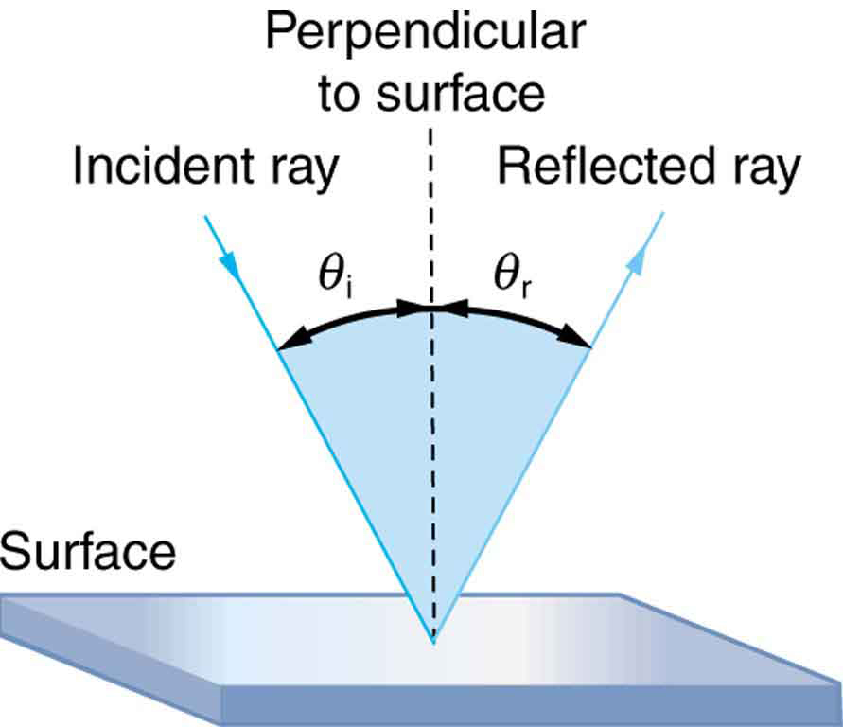
Reflection and Refraction
When a light wave strikes a smooth interface separating two transparent materials (such as air and glass or water and glass), the wave is in general partly reflected and partly refracted (transmitted) into the second material.
The segments of plane waves can be represented by bundles of rays forming beams of light.
For simplicity we often draw only one ray in each beam.

Slide 5
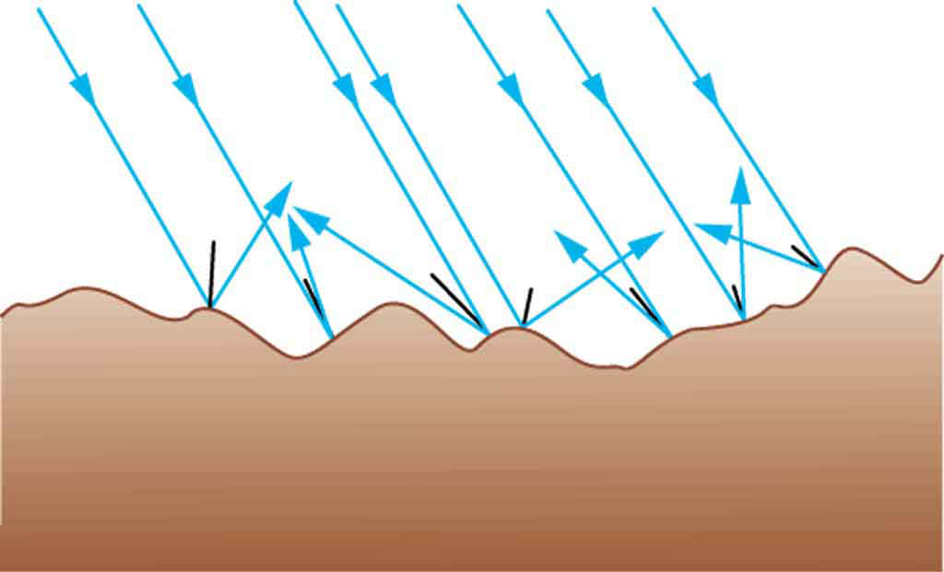
Diffuse and Specular Reflection
Our primary concern will be with specular reflection from a very smooth surface such as highly polished glass or metal.
Scattered reflection from a rough surface is called diffuse reflection.
The vast majority of objects in your environment are visible to you because they reflect light in a diffuse manner.
Light is diffused when it reflects from a rough surface. Here many parallel rays are incident, but they are reflected at many different angles since the surface is rough.

Slide 6

The Law of Reflection
The angle of reflection is equal to the angle of incidence for all wavelengths and for any pair of materials.
Note that all angles are measured from the normal.

Slide 7

The Law of Refraction
The changing of a light ray’s direction (loosely called bending) when it passes through variations in matter is called refraction.
This result is also called Snell’s law, after the Dutch scientist Willebrord Snell (1591–1626).

Slide 8


Index of Refraction
The index of refraction of an optical material (also called the refractive index), denoted by n, is defined as:
where v is the observed speed of light in the material and c is the speed of light in vacuum.
Note that the index of refraction is always greater than or equal to one.

Slide 9
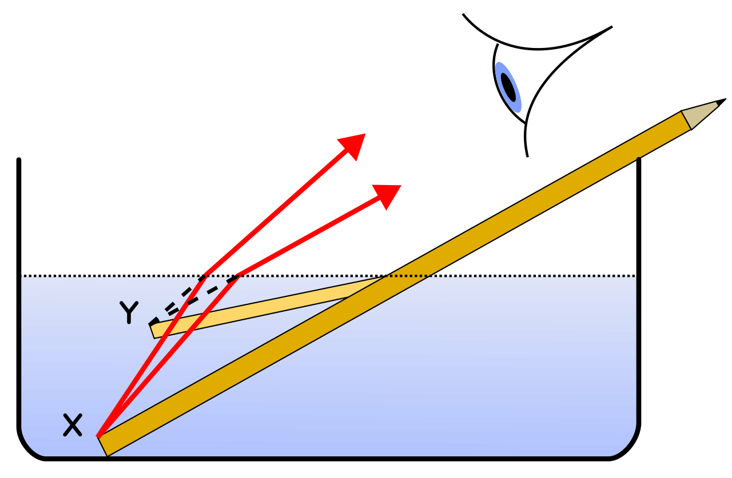
Why Does the pencil Appear to Be Bent?
The law of refraction explains why a partially submerged straight pencil appears bent.
Light rays coming from below the surface change in direction at the air–water interface, so the rays appear to be coming from a position above their actual point of origin.

Slide 10
Index of Refraction for Yellow Light (λ₀ = 589nm)
Substance | Index of Refraction, n
Ice (H₂O) | 1.309
Water (H₂O) at 20 degrees Celsius | 1.333
Glycerine at 20 degrees Celsius | 1.473
Crown glass (typical value) | 1.52
Rock salt (NaCl) | 1.544
Quartz (SiO₂) | 1.544
Diamond (C) | 2.417

Slide 11
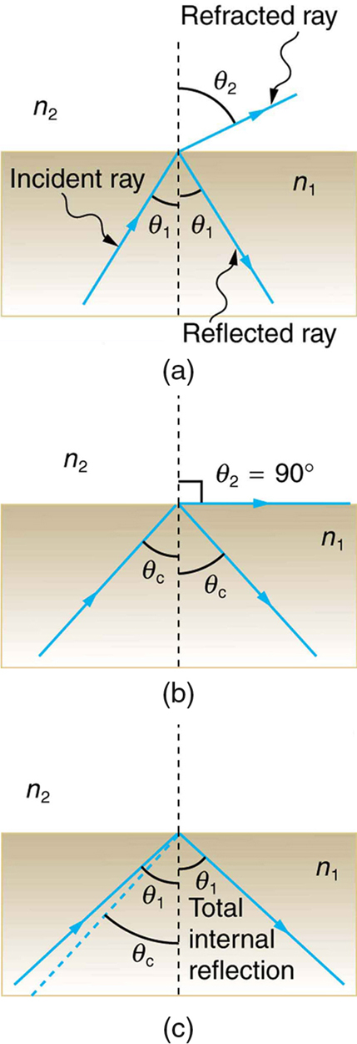

Total Internal Reflection
Under certain circumstances, all of the light can be reflected back from an interface, even though the second material is transparent.
(a) A ray of light crosses a boundary where the speed of light increases and the index of refraction decreases. That is, n₂<n₁ . The ray bends away from the perpendicular. (b) The critical angle θ_{c} is the one for which the angle of refraction is 90º. (c) Total internal reflection occurs when the incident angle is greater than the critical angle.

Slide 12
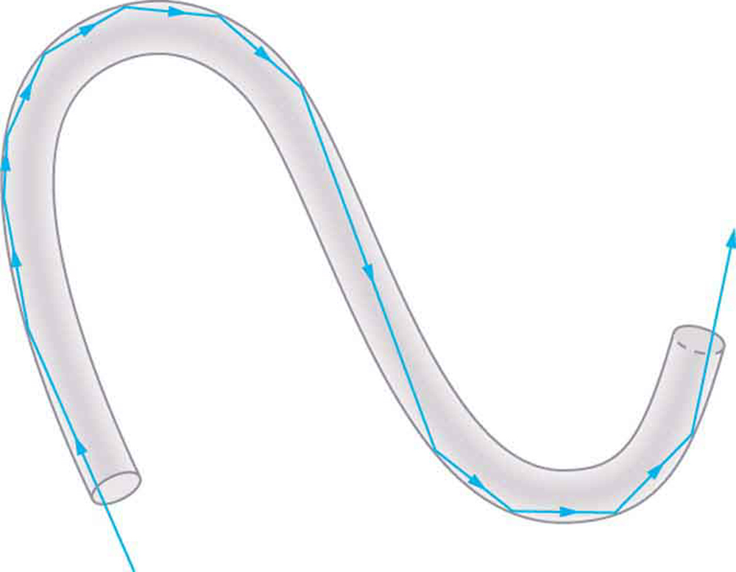
Fiber Optics
When a beam of light enters at one end of a transparent rod, the light can be totally reflected internally if the index of refraction of the rod is greater than that of the surrounding material.
The light is “trapped” within even a curved rod, provided that the curvature is not too great.

Slide 13
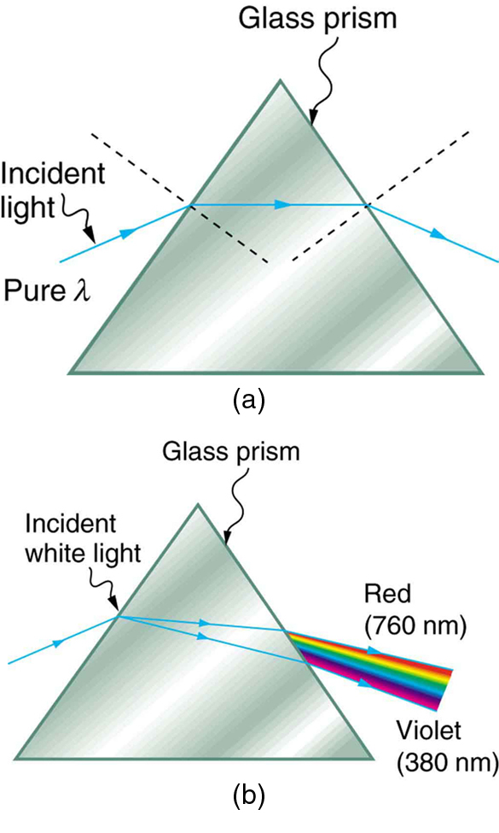
Dispersion
The speed of light in vacuum is the same for all wavelengths, but the speed in a material substance is different for different wavelengths.
The dependence of wave speed and index of refraction on wavelength is called dispersion.
In most materials the value of n decreases with increasing wavelength and decreasing frequency.
(a) A pure wavelength of light falls onto a prism and is refracted at both surfaces. (b) White light is dispersed by the prism (shown exaggerated). Since the index of refraction varies with wavelength, the angles of refraction vary with wavelength. A sequence of red to violet is produced, because the index of refraction increases steadily with decreasing wavelength.

Slide 14
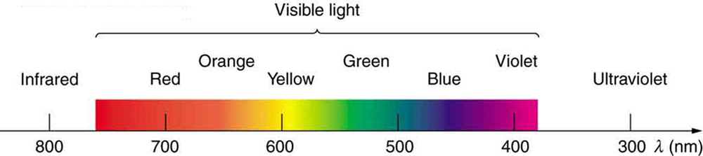
Spectrum
Ordinary white light is a superposition of waves with all visible wavelengths.
The band of dispersed colors is called a spectrum.

Slide 15
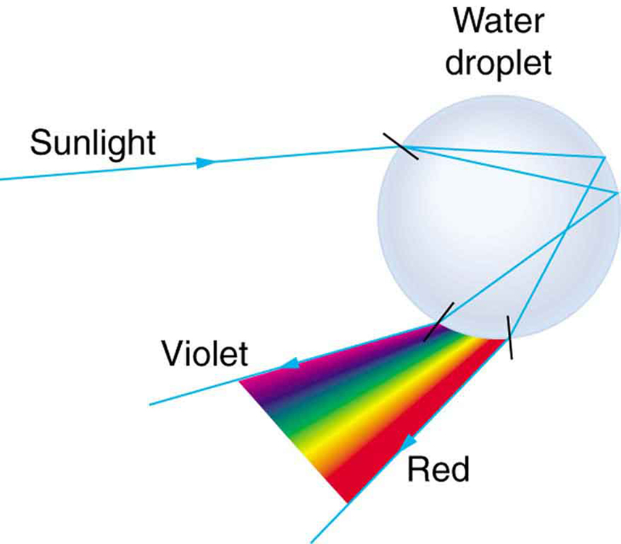
How Rainbows Form
When sunlight enters a spherical water droplet suspended in the air, it is (partially) reflected from the back surface of the droplet, and is refracted again upon exiting the droplet.
A light ray that enters the middle of the raindrop is reflected straight back.
All other rays exit the raindrop within an angle Δ of that middle ray, with many rays “piling up” at the angle Δ.

Slide 16
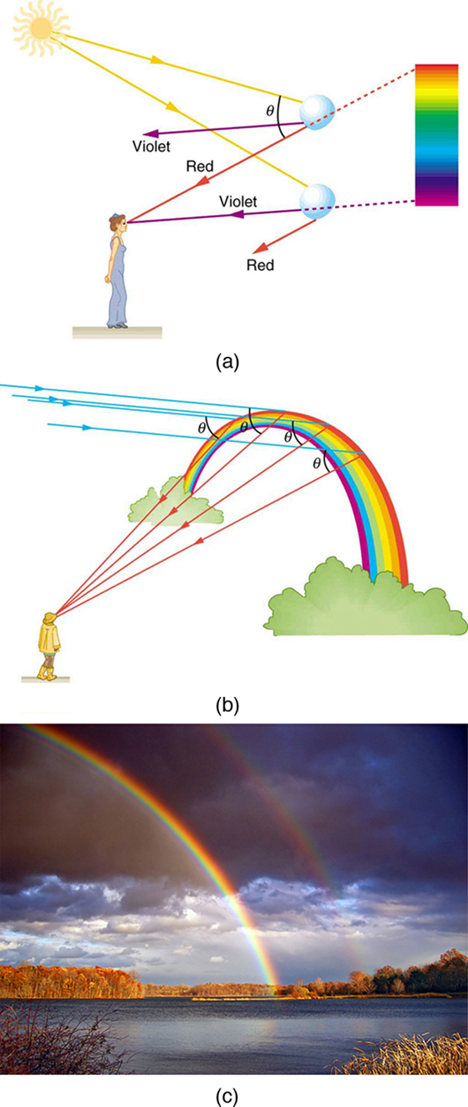
How Rainbows Form, continued
(a) Different colors emerge in different directions, and so you must look at different locations to see the various colors of a rainbow. (b) The arc of a rainbow results from the fact that a line between the observer and any point on the arc must make the correct angle with the parallel rays of sunlight to receive the refracted rays. (c) Double rainbow. (credit: Nicholas, Wikimedia Commons)

