Slide 1
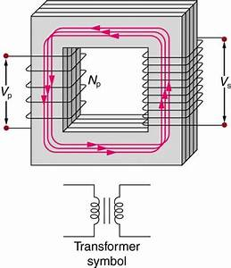

INDUCTANCE

Slide 2
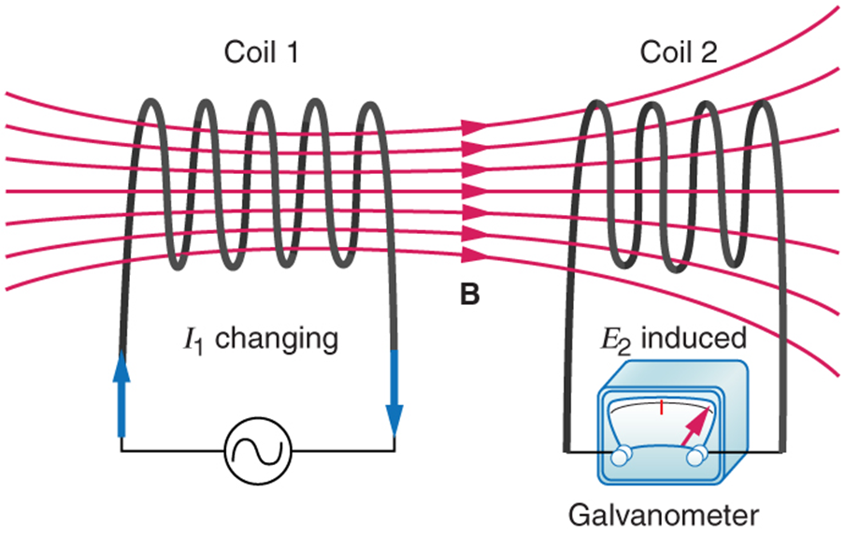
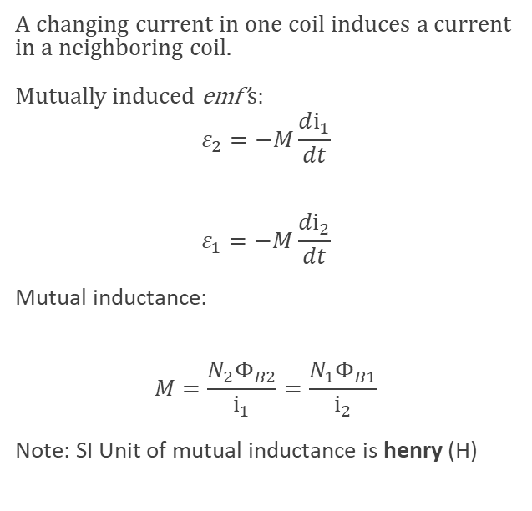
Mutual inductance
A changing current in one coil induces a current in a neighboring coil.
Mutually induced emf’s:
$$ε_{2}=−M\frac{di_{1}}{dt}$$
$$ε_{1}=−M\frac{di_{2}}{dt}$$
Mutual inductance:
$$M=\frac{N_{2}Φ_{B2}}{i_{1}}=\frac{N_{1}Φ_{B1}}{i_{2}}$$
Note: SI Unit of mutual inductance is henry (H)
These coils can induce emfs in one another like an inefficient transformer. Their mutual inductance M indicates the effectiveness of the coupling between them. Here a change in current in coil 1 is seen to induce an emf in coil 2. (Note that " E₂ induced" represents the induced emf in coil 2.)

Slide 3
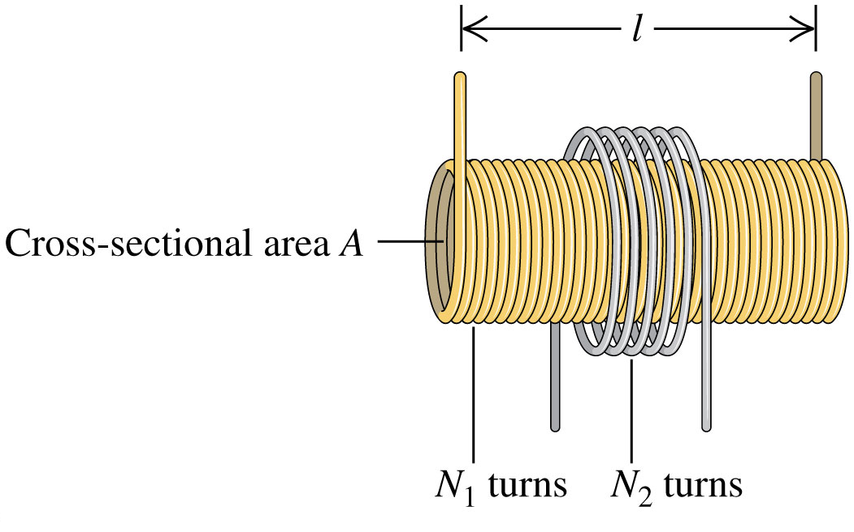
Example: calculating mutual inductance
In one form of Tesla coil (a high-voltage generator), a long solenoid with length l and cross-sectional area A is closely wound with N₁ turns of wire. A coil with N₂ turns surrounds it at its center. Find the mutual inductance.

Slide 4
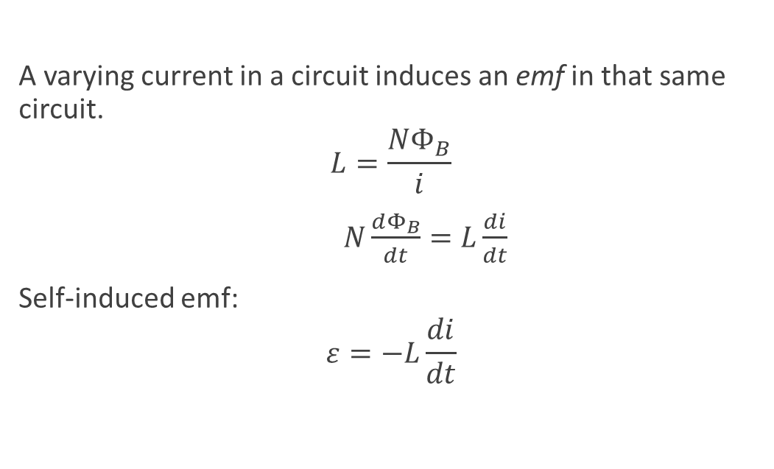
Self-inductance and inductors
A varying current in a circuit induces an emf in that same circuit.
$$L=\frac{NΦ_{B}}{i}$$
$N\frac{dΦ_{B}}{dt}=L\frac{di}{dt}$
Self-induced emf:
$$ε=−L\frac{di}{dt}$$

