Slide 1
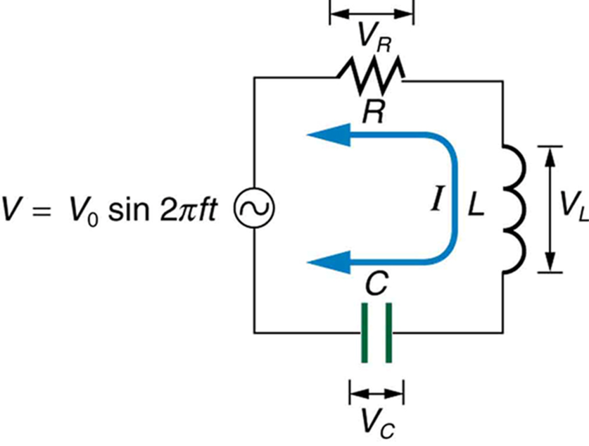

ALTERNATING CURRENTS

Slide 2
Today’s objectives
By the end of this lesson, you will be able to:
Calculate the impedance, phase angle, resonant frequency, power, power factor, voltage, and/or current in a RLC series circuit.
Draw the circuit diagram for an RLC series circuit.
Explain the significance of the resonant frequency.

Slide 3
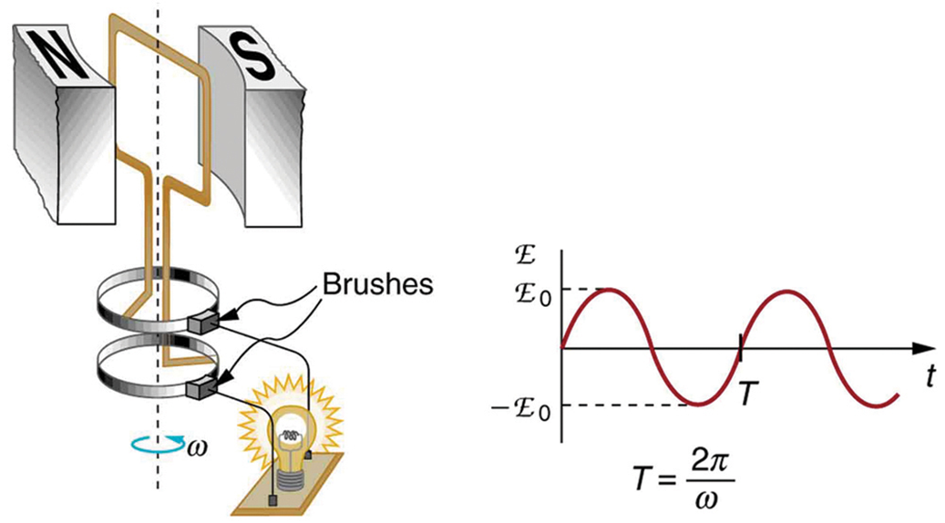
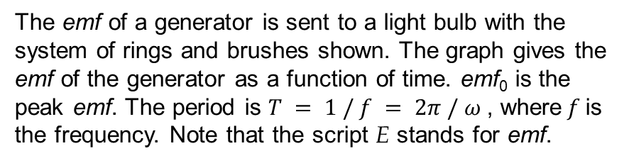
ac generator
The emf of a generator is sent to a light bulb with the system of rings and brushes shown. The graph gives the emf of the generator as a function of time. emf₀ is the peak emf. The period is $T = 1 / f = 2π / ω$, where$f$is the frequency. Note that the script E stands for emf.

Slide 4
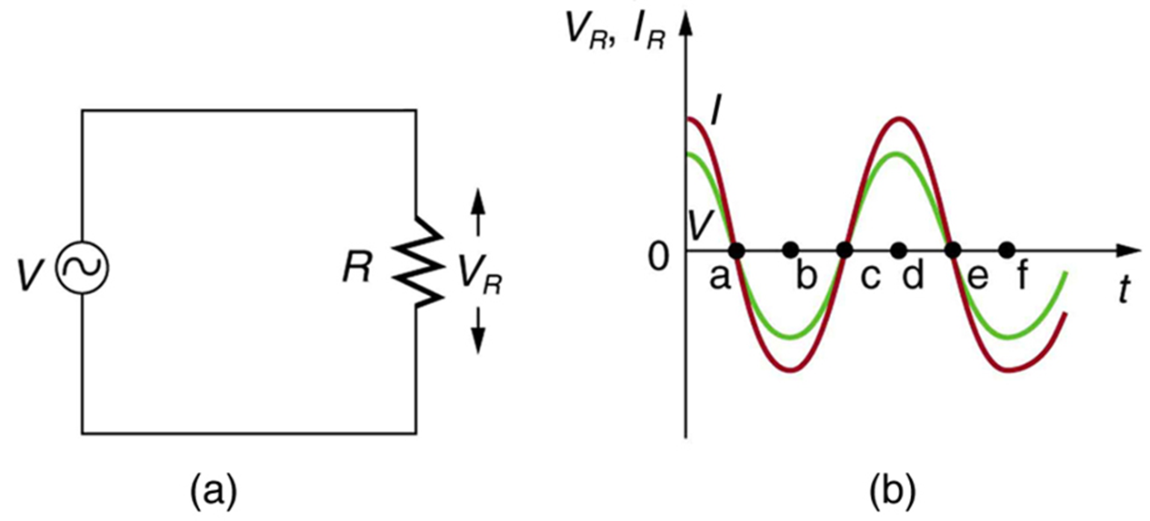
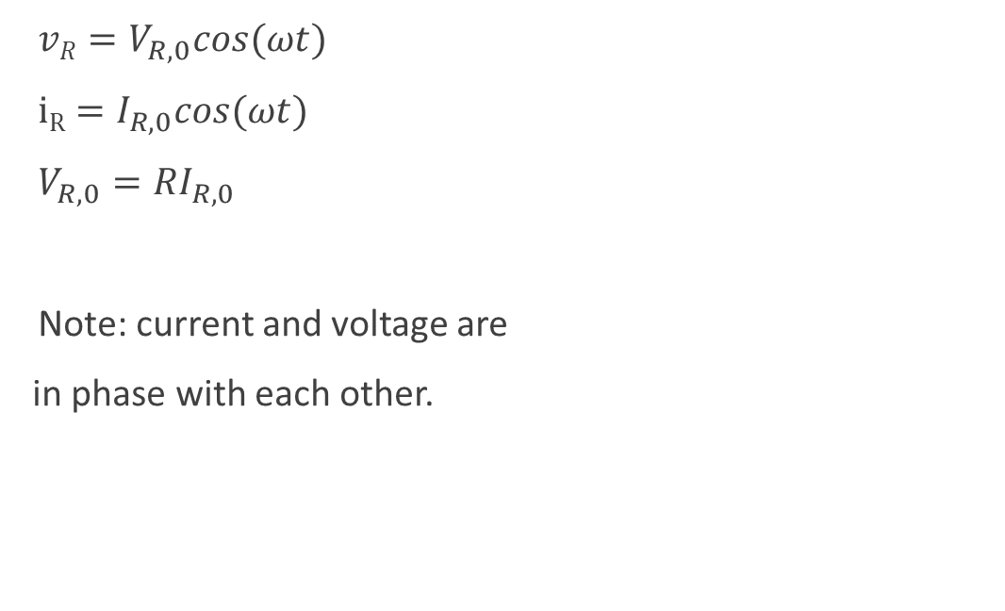
Resistor in an ac circuit
$vR=V_{R,0}cos(ωt)$
$iR=I_{R,0}cos(ωt)$
$V_{R, 0}=RI_{R, 0}$
Note: current and voltage are
in phase with each other.
An AC voltage source in series with a resistor.
Graph of current and voltage across the resistor as functions of time, showing them to be exactly in phase.

Slide 5
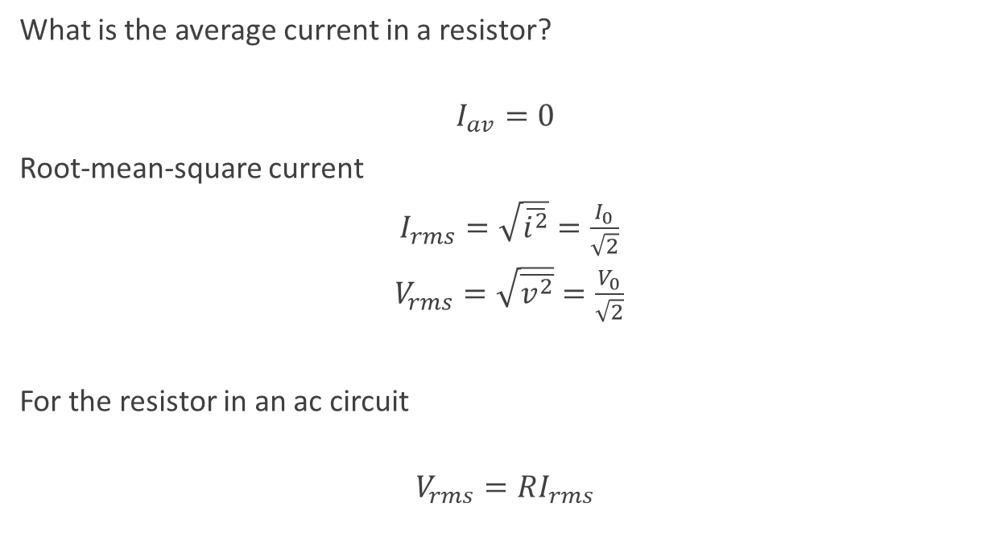
rms current
rms current is a dc current that would produce the same power output as the actual ac circuit!
What is the average current in a resistor?
$$I_{av}=0$$
Root-mean-square current
$I_{rms}=\sqrt{\overline{i^{2}}}=\frac{I_{0}}{\sqrt{2}}$
$V_{rms}=\sqrt{\overline{v^{2}}}=\frac{V_{0}}{\sqrt{2}}$
For the resistor in an ac circuit
$$V_{rms}=RI_{rms}$$
“120-V ac” means the rms voltage, not the maximum, which is 170 V!

Slide 6
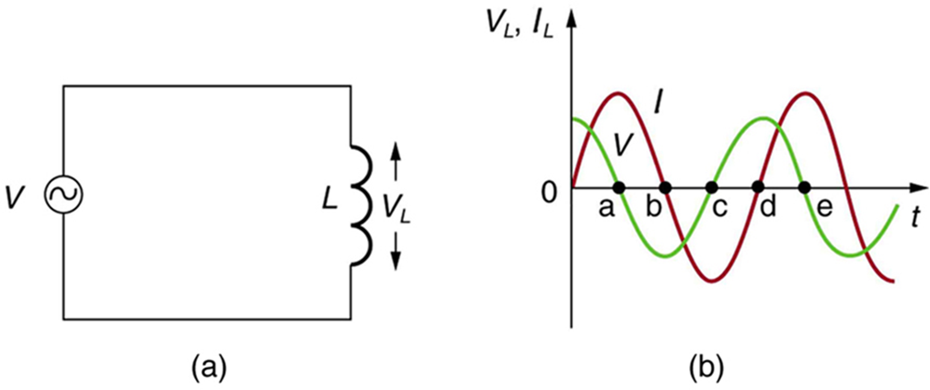
Inductor in an ac circuit
An AC voltage source in series with an inductor having negligible resistance.
Graph of current and voltage across the inductor as functions of time.

Slide 7
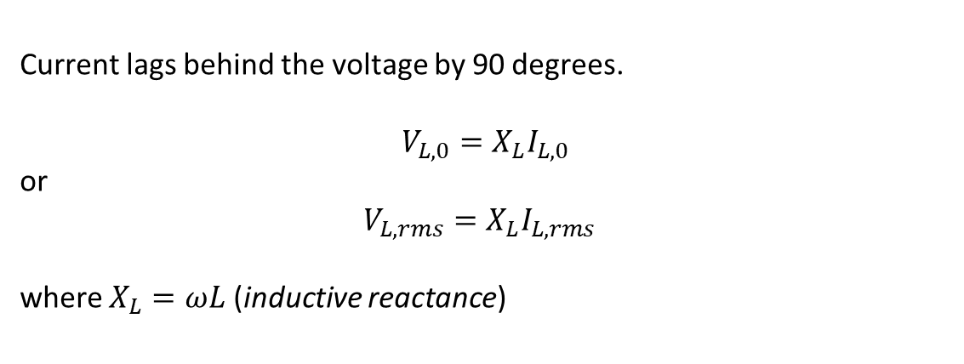
Inductor in an ac circuit, continued
Current lags behind the voltage by 90 degrees.
$V_{L,0}=X_{L}I_{L,0}$
or
$V_{L,rms}=X_{L}I_{L,rms}$
where $X_{L}=ωL$ (inductive reactance)
Note: units of the inductive reactance are Ohms!

Slide 8
An inductor in an ac circuit example
Suppose you want the current amplitude in a pure inductor in a radio receiver to be 250 μA when the voltage amplitude is 3.60 V at a frequency of 1.60 MHz (corresponding to the upper end of the AM broadcast band). What inductive reactance is needed? What inductance? If the voltage amplitude is kept constant, what will be the current amplitude through the inductor at 16.0 Mhz?

Slide 9
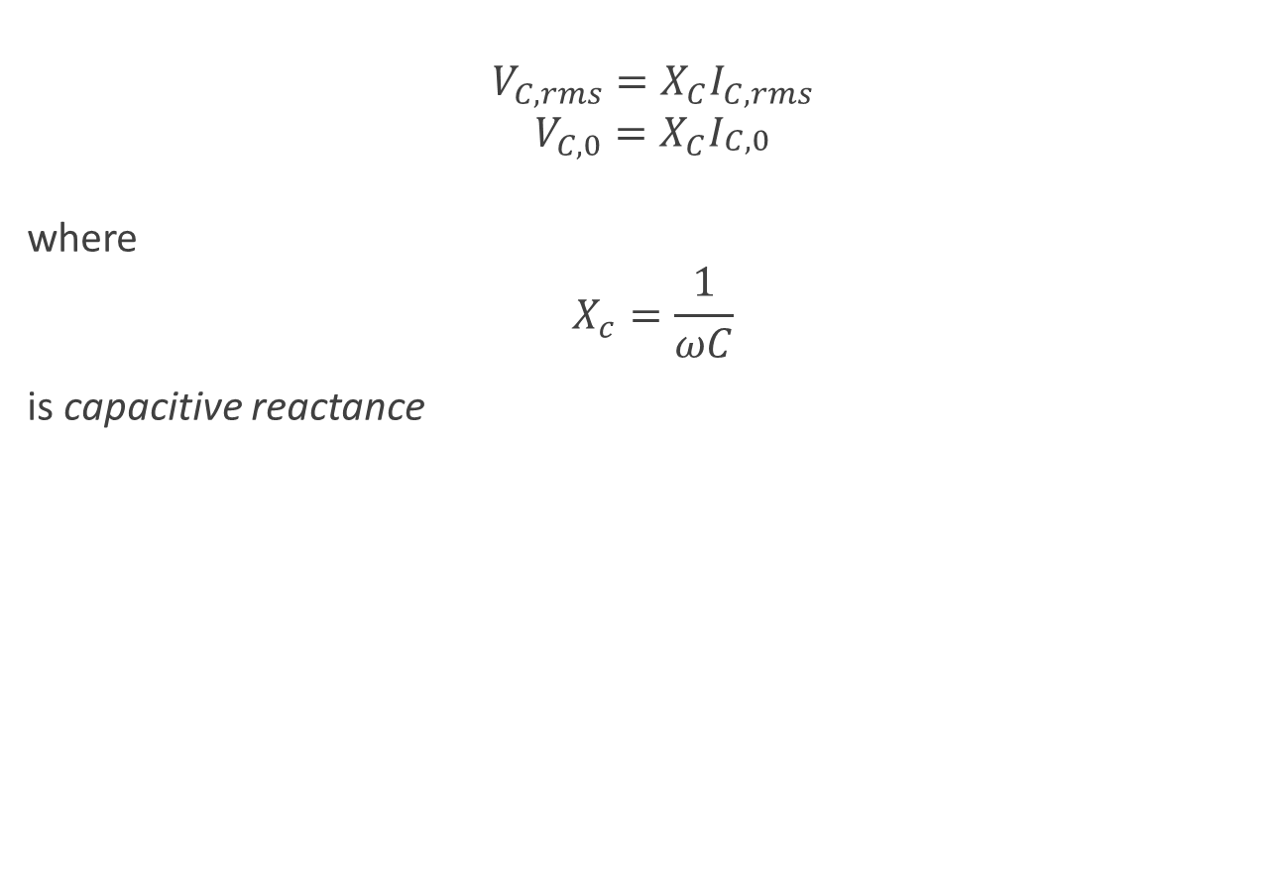
Capacitor in an ac circuit
$$V_{C,rms}=X_{C}I_{C,rms}$$
$$V_{C,0}=X_{C}I_{\begin{aligned}C,0 \\ \end{aligned}}$$
where
$$X_{c}=\frac{1}{ωC}$$
is capacitive reactance

Slide 10
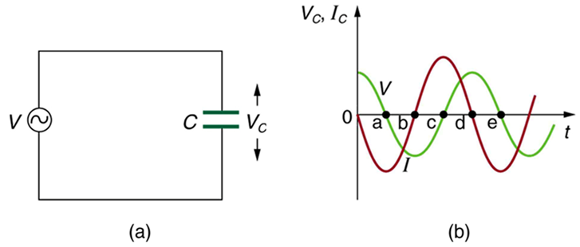
Capacitance in an ac circuit, continued
Current leads the voltage by 90 degrees
Remember ELI the ICE man mnemonics!

Slide 11
Phasors
Phasor is a vector rotating around the origin of a coordinate system
Length of the phasor corresponds to a maximum value of a current (or voltage)
Projection of a phasor onto horizontal axis at a moment t equals the instantaneous value of a current (voltage).
You can play with phasor simulation here:
https://www.geogebra.org/m/hgyqrt8j

Slide 12

The L-R-C series circuit
Many ac circuits used in practical applications involve resistance, capacitance, and inductance
Can be analyzed with phasor diagram

Slide 13
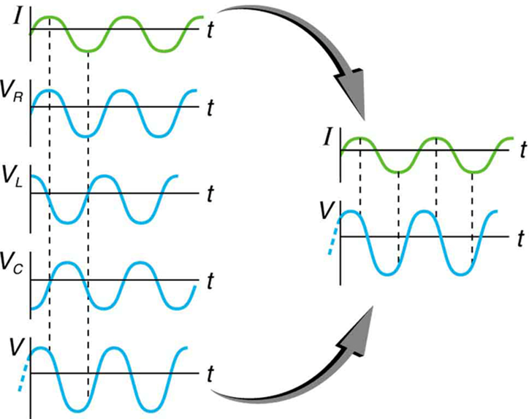
The L-R-C series circuit, continued
This graph shows the relationships of the voltages in an RLC circuit to the current. The voltages across the circuit elements add to equal the voltage of the source, which is seen to be out of phase with the current.

Slide 14


Impedance
The combined effect of resistance R, inductive reactance X_{L}, and capacitive reactance X_{C} is defined to be impedance, an AC analogue to resistance in a DC circuit.
with current, voltage, and impedance related by an AC version of Ohm’s law:

Slide 15
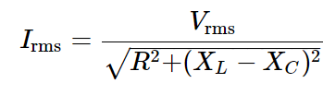


Resonance in an ac circuit
How does an RLC circuit behave as a function of the frequency of the driving voltage source? The root-mean-square current
will peak at a particular frequency at which
Solving for the resonant frequency gives:

Slide 16
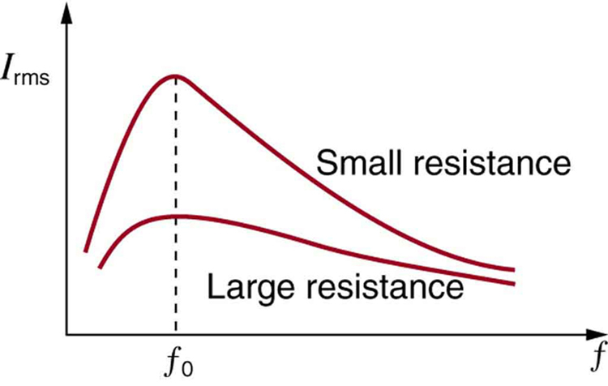
Resonance and the circuits’ resistance
A graph of current versus frequency for two RLC series circuits differing only in the amount of resistance. Both have a resonance at f₀, but that for the higher resistance is lower and broader. The driving AC voltage source has a fixed amplitude V₀.

