Slide 1

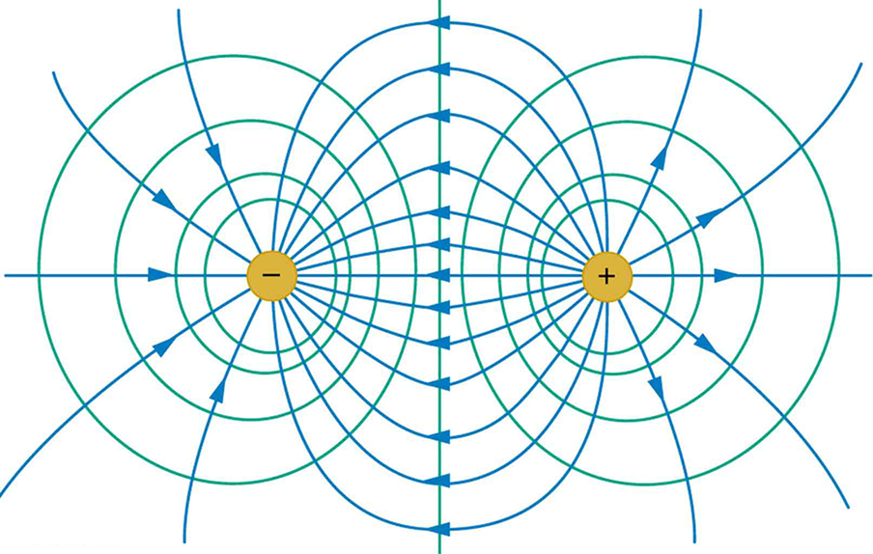
EQUIPOTENTIAL LINES

Slide 2
Today’s objectives
Explain equipotential lines and equipotential surfaces.
Describe the action of grounding an electrical appliance.
Compare electric field and equipotential lines.

Slide 3
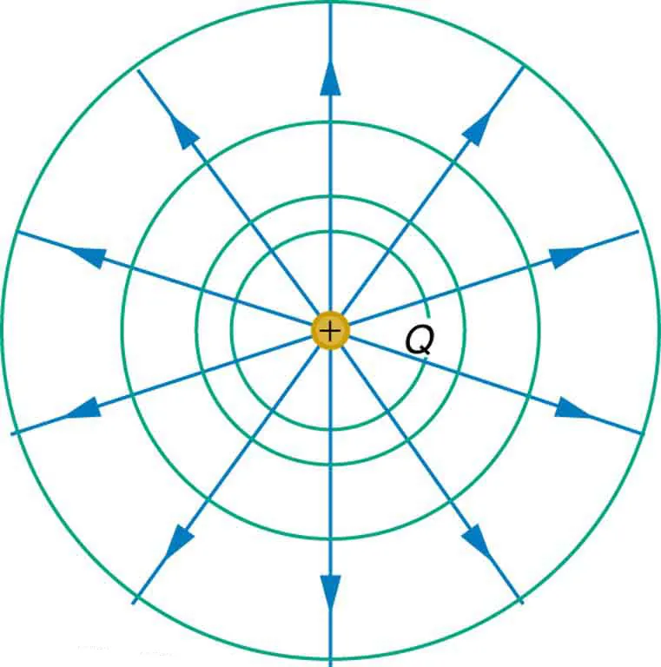
Equipotential lines
We can represent electric potentials (voltages) pictorially, just as we drew pictures to illustrate electric fields. Picture on the left shows an isolated positive point charge and its electric field lines. Electric field lines radiate out from a positive charge and terminate on negative charges. While we use blue arrows to represent the magnitude and direction of the electric field, we use green lines to represent places where the electric potential is constant. These are called equipotential lines in two dimensions, or equipotential surfaces in three dimensions.

Slide 4
Notes on equipotential lines
It is important to note that
Equipotential lines are always perpendicular to electric field lines.
No work is required to move a charge along an equipotential.
A conductor is an equipotential surface in static situations.

Slide 5
Equipotential lines, two equal but opposite charges
The electric field lines and equipotential lines for two equal but opposite charges. The equipotential lines can be drawn by making them perpendicular to the electric field lines, if those are known. Note that the potential is greatest (most positive) near the positive charge and least (most negative) near the negative charge.

Slide 6
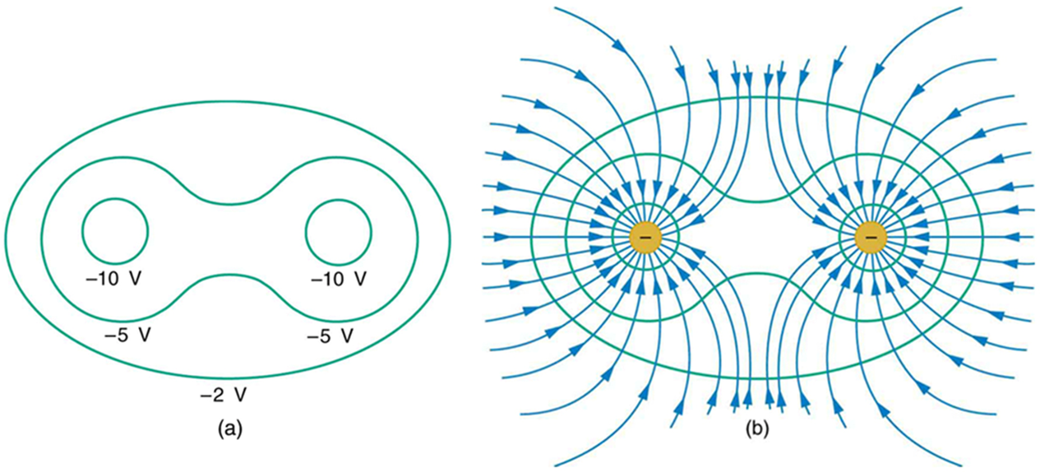
Equipotential lines, two equal negative charges
These equipotential lines might be measured with a voltmeter in a laboratory experiment.
The corresponding electric field lines are found by drawing them perpendicular to the equipotentials. Note that these fields are consistent with two equal negative charges.

