Slide 1


ELECTRIC POTENTIAL ENERGY

Slide 2

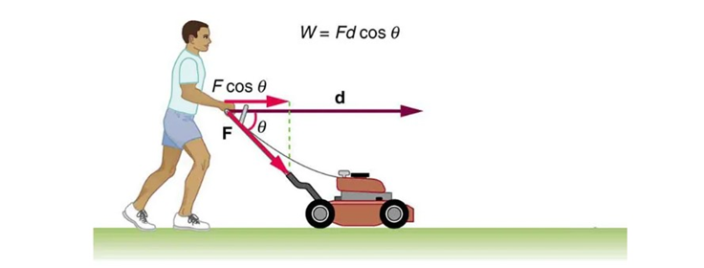
Refresher: work done by a constant force
A force acting on a body does work if the body undergoes a displacement (though there are a few interesting exceptions which we will discuss later).
The simplest case is a work done by a constant force acting in the same direction as a straight – line displacement:
where
W is the work done by a force
F is the magnitude of the force, and
d is the magnitude of displacement, and
φ is the angle between direction of the force and direction of the single-line displacement

Slide 3
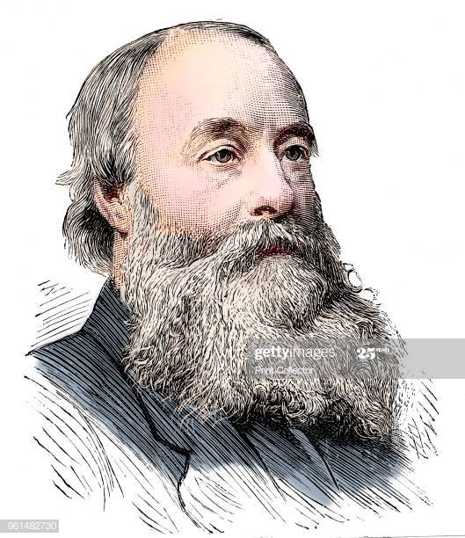
Refresher: work
Work is a scalar quantity – does not have direction
SI Units are (looking at the definition) N-m (called Joule)
1 Joule = (1 Newton)(1meter)
Work can be positive, negative,
or zero
James Prescott Joule, an English physicist who established that the various forms of energy—mechanical, electrical, and heat can be changed one into another.

Slide 4
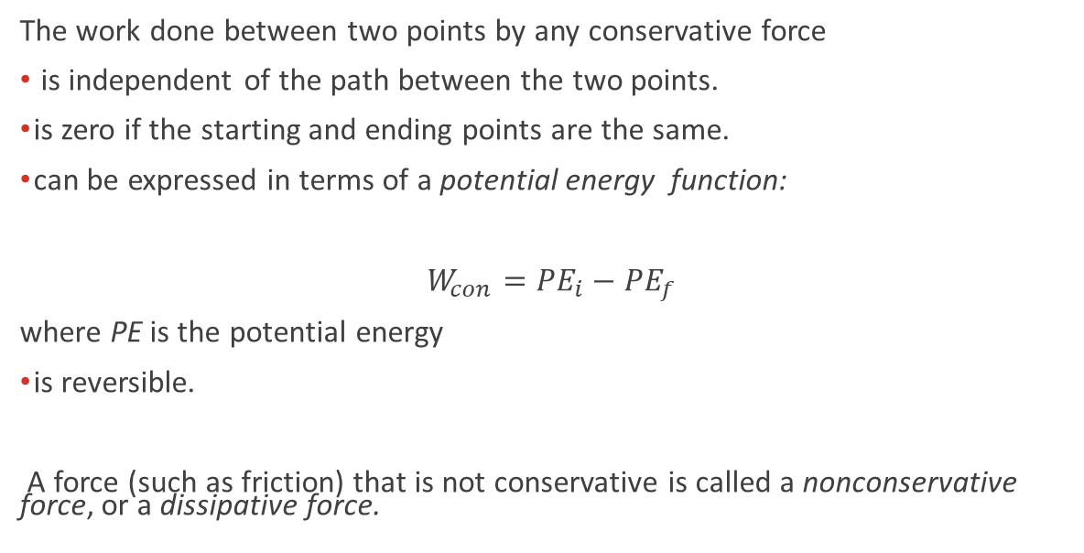
Refresher: conservative and nonconservative forces
The work done between two points by any conservative force
is independent of the path between the two points.
is zero if the starting and ending points are the same.
can be expressed in terms of a potential energy function:
$W_{con}={PE}_{i}−{PE}_{f}$
where PE is the potential energy
is reversible.
A force (such as friction) that is not conservative is called a nonconservative force, or a dissipative force.
Examples of conservative forces: gravitational and spring

Slide 5
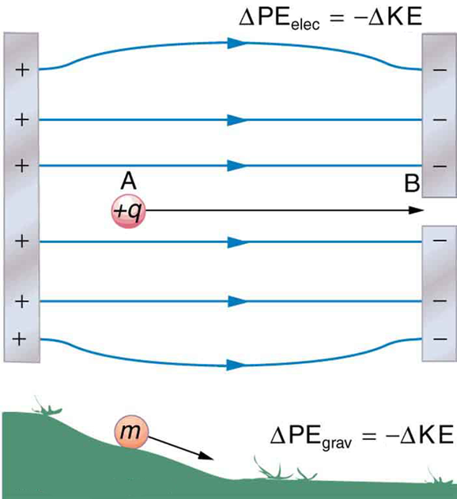
Electric potential energy in a uniform field
In the figure, a pair of charged parallel metal plates sets up a uniform electric field.
The field exerts a force on a positive test charge.
As the charge moves from point A to point B, the work done by the field is independent of the path the particle takes.

Slide 6
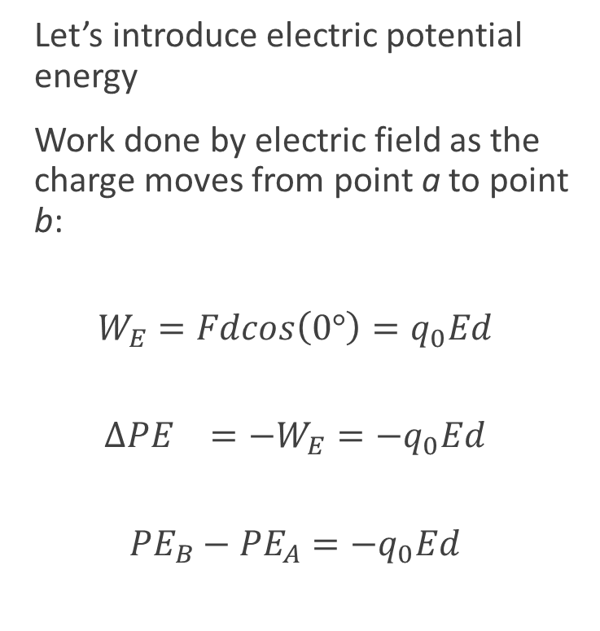
Electric potential energy in a uniform field, continued
Let’s introduce electric potential energy
Work done by electric field as the charge moves from point a to point b:
$$W_{E}=Fdcos\left(0°\right)=q_{0}Ed$$
$$∆{PE}_{}=−W_{E}=−q_{0}Ed$$
$${PE}_{B}−{PE}_{A}=−q_{0}Ed$$

Slide 7
Electric potential energy of two point charges
We can introduce the idea of electric potential energy for any field.
The work done by the electric field of one point charge on another does not depend on the path taken.
Therefore, the electric potential energy only depends on the distance between the charges.
This equation is valid no matter what the signs of the charges are.
Potential energy is defined to be zero when the charges are infinitely far apart.

Slide 8

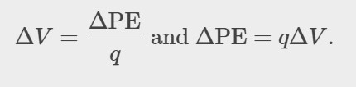
Electric potential
Electric potential V (or simply potential, since electric is understood) is defined as the potential energy per unit charge:
The potential difference between points A and B, V_{B}–V_{A} is thus defined to be the change in potential energy of a charge q moved from A to B, divided by the charge.
Note: Units of potential difference are joules per coulomb, given the name volt (V) after Alessandro Volta.

Slide 9
Electric potential, details
Note that
term voltage is the common name for potential difference. Keep in mind that whenever a voltage is quoted, it is understood to be the potential difference between two points.
voltage is not the same as energy. Voltage is the energy per unit charge.

Slide 10
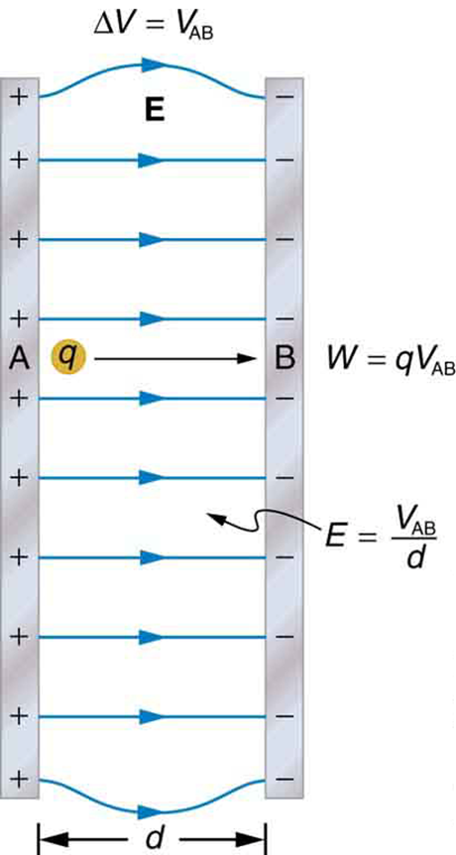
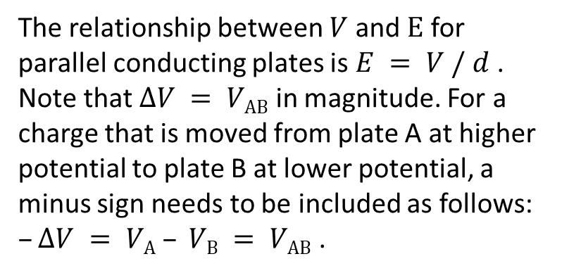
Electric potential, constant electric field
The relationship between $V$ and $E$ for parallel conducting plates is $E = V / d$. Note that $ΔV = VAB$in magnitude. For a charge that is moved from plate A at higher potential to plate B at lower potential, a minus sign needs to be included as follows: $–ΔV = VA – VB = VAB$ .

Slide 11

Electric potential due to a point charge
Electric potential at distance r from a point charge Q can be calculated as:
Note that superposition principle applies to the potential due to a combination of point charges.

Slide 12
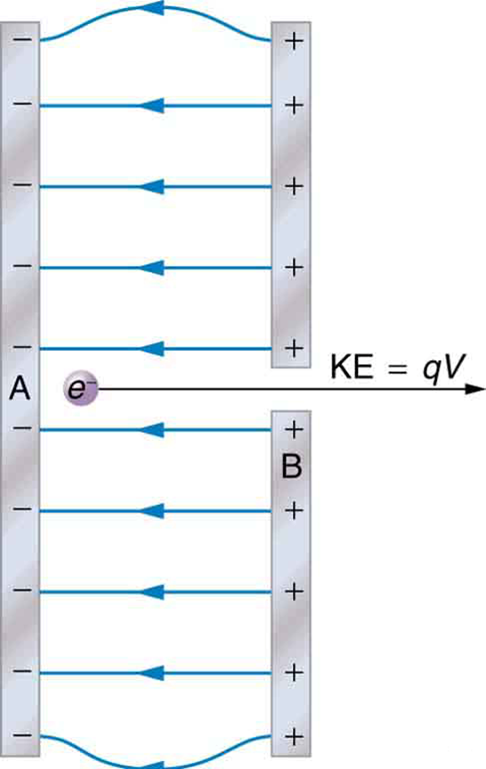
Electron volt
A typical electron gun accelerates electrons using a potential difference between two metal plates. The energy of the electron in electron volts is numerically the same as the voltage between the plates. For example, a 5000 V potential difference produces 5000 eV electrons.

Slide 13


Conservation of energy
The total energy of a system is conserved if there is no net addition (or subtraction) of work or heat transfer. For conservative forces, such as the electrostatic force, conservation of energy states that mechanical energy is a constant.
where i and f stand for initial and final conditions.

